Slide 1
ENGI 301 Split Flap Display Proposal
2022/02/10
Jefferson Xia

Slide 2
Intentions
I am fascinated with mechanical displays. From the established split flap displays to newer displays such a flip dots and mechanical 7 segment displays, I have always found watching these displays in the transition phase to be mesmersing (video links at the bottom).
Apart from the visual aesthetic, I also enjoy the auditory feedback these displays give. The clacking of parts and switches are very pleasing to listen to.
I think that a split flap display would be both interesting and practical but also be a great project for me to take on as an introduction to both the hardware and software sides of mechanical systems.
There is also a lot of documentation of DIY split flap displays on the internet for me to reference.
Flip Dot Display in Oil: https://www.youtube.com/watch?v=NCQzJsVtL0Y
Vesta Board (Commercial Split Flap Company): https://www.youtube.com/watch?v=8ARBlCdq94k
Mechanical 7 Segment Display: https://www.youtube.com/watch?v=yFQS_TQ4948

Slide 3
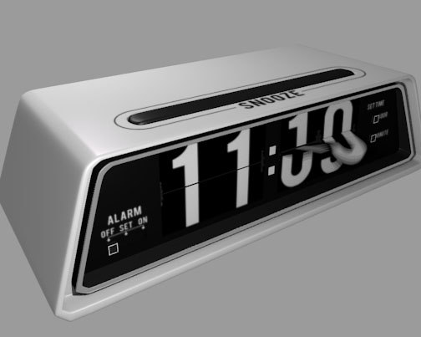
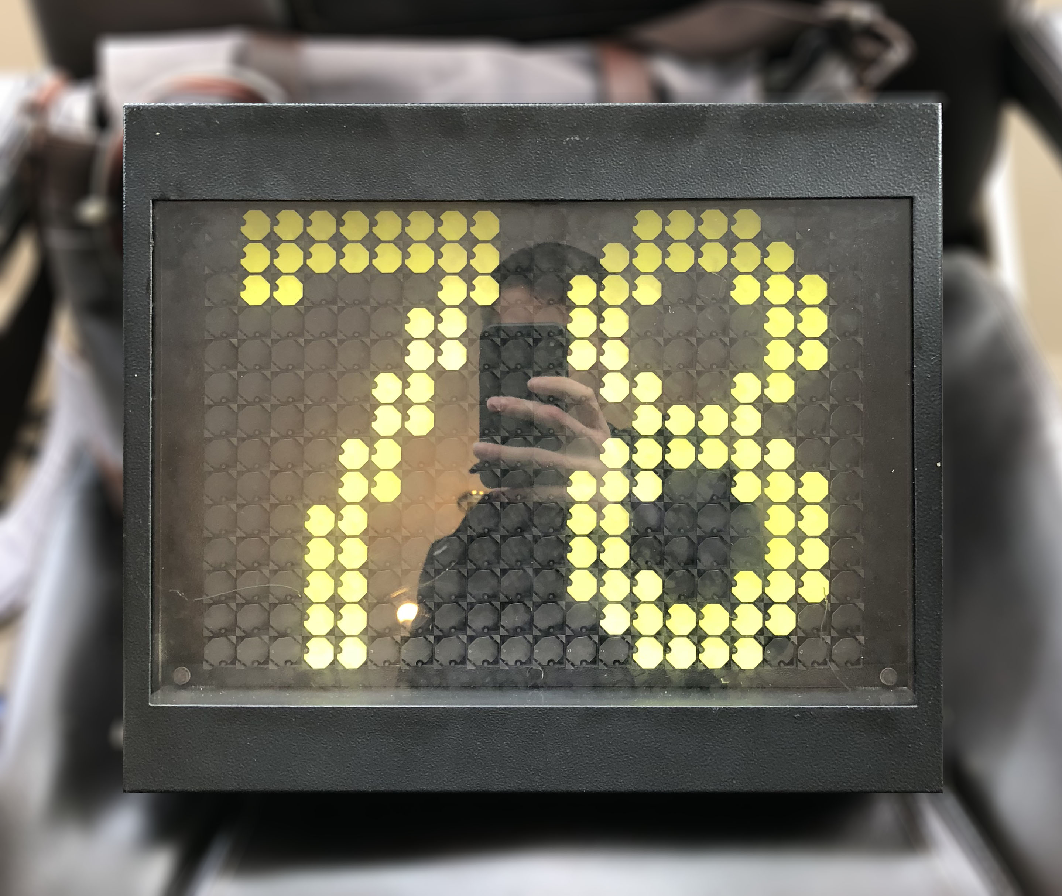
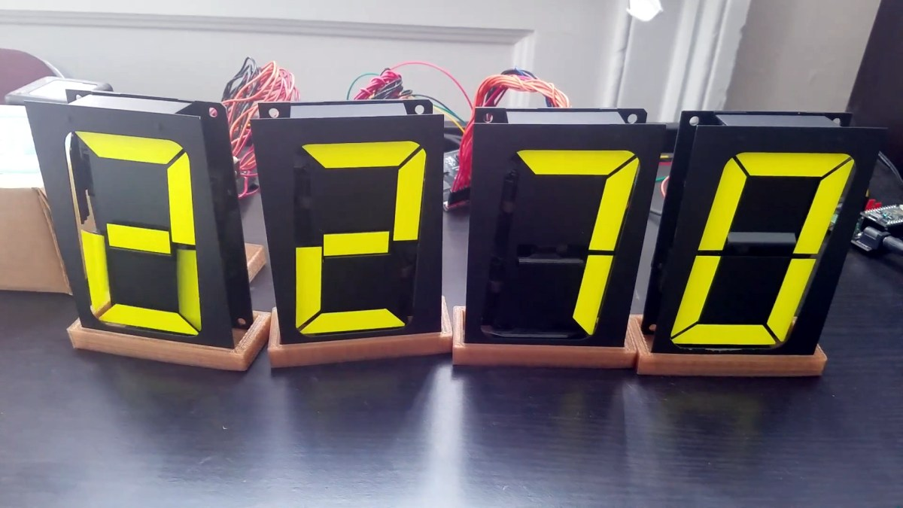
Split Flap Clock
Flip Dot Display
Mechanical 7 Segment Display

Slide 4
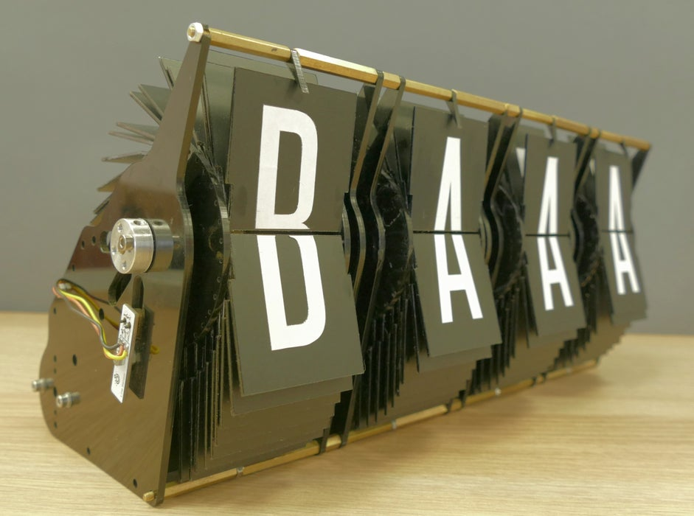
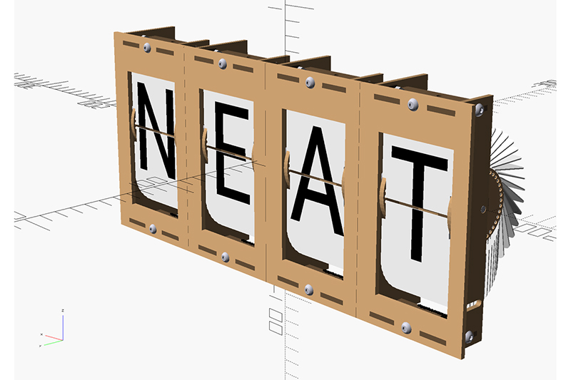
Proposal
What is being proposed?
4 segment Flip Stack Display that displays weather and takes user inputs from a keypad
https://www.instructables.com/IoT-Split-flap-Weather-Forecast-Powered-by-XOD/s
https://github.com/scottbez1/splitflap

Slide 5
Addition Details
Using PocketBeagle as main controller
As the PocketBeagle has a small size and many GPIO ports, I thought it would work well in a Flip Stack display.
I think it is also sophisticated enough to be able to handle tasks such as getting weather information and receiving custom information to translate to the display.
Connecting a keypad as a physical input controller
In the two main examples that I looked at, the information to display was conveyed through a computer. I would like to use a keypad as the user input device.
Using the keypad, the user can display custom text and numbers.
Make it a “Count-up” Timer (to track work time)

Slide 6
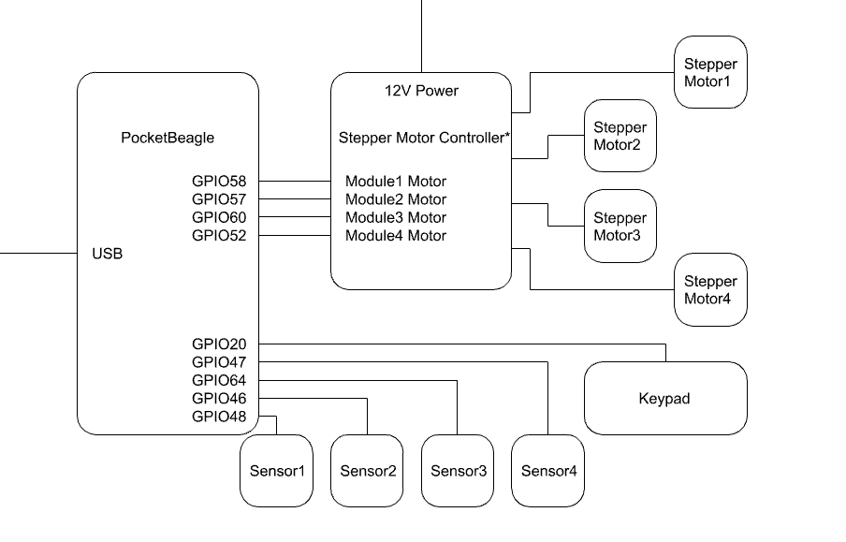
System Block Diagram
*I am currently not sure what the controller would be, or if it’s even needed while using a PocketBeagle

Slide 7
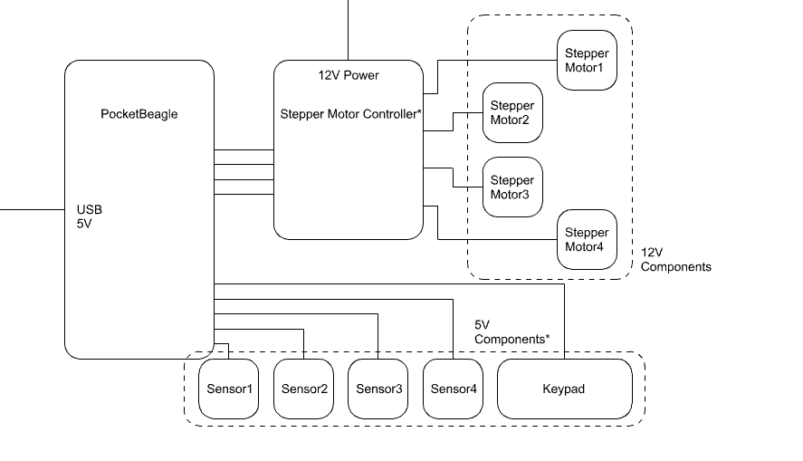
Power Block Diagram
*Do the GPIOs provide power? Or would these need to be connected to the Vout?

Slide 8
Components / Budget
Component | Need to Buy | Cost
Step Motors | Yes | $17.00
Hall Effect Sensor (AH3391Q?) | Yes | $8.00
4mm Magnets | Yes | $9.00
Stepper Motor Driver | Yes | $10.00
Step Down Buck Converter (12V-5V) | Yes | $9.00
Sensor PCB | Maybe? | $3.00
Acrylic Sheets | No
Nuts and Bolts | No
Keypad | No

