Slide 1
Kotlin的小美好
Domain focused approach
Kotlin in airwallex
Jeff Fang, Airwallex

Slide 2
Kotlin的小美好
萧超杰
Airwallex

Slide 3
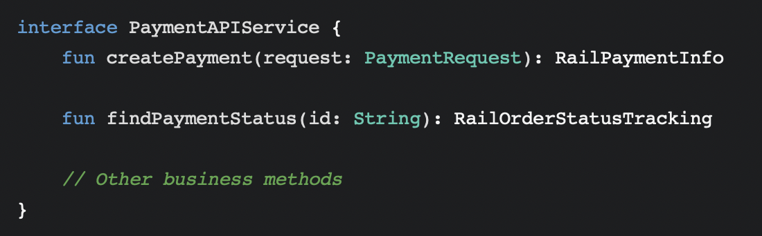
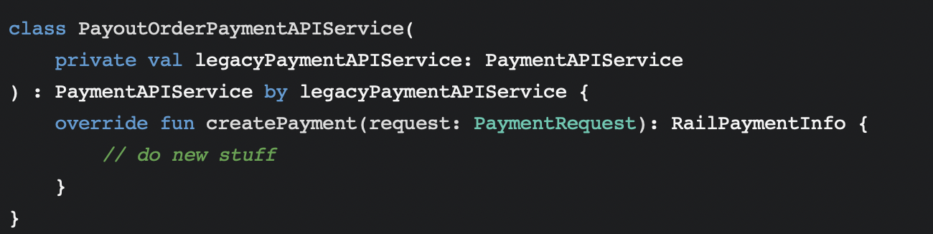
Delegate
Split legacy application into microservices gradually.

Slide 4
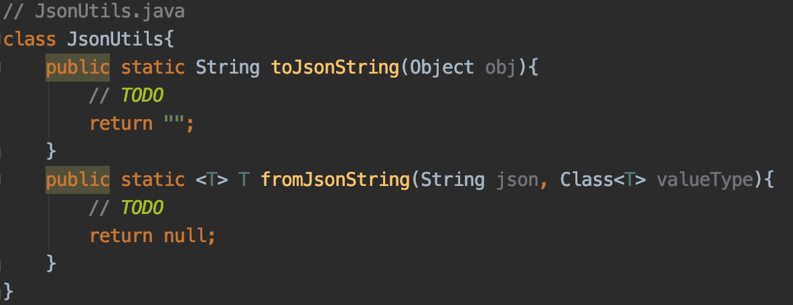
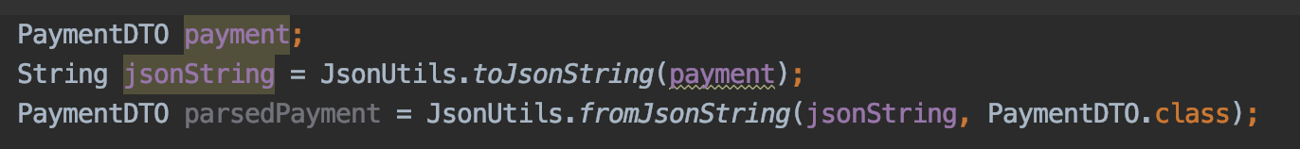
Extensions
Json serialization and deserialization
But how to maintain these utils？

Slide 5
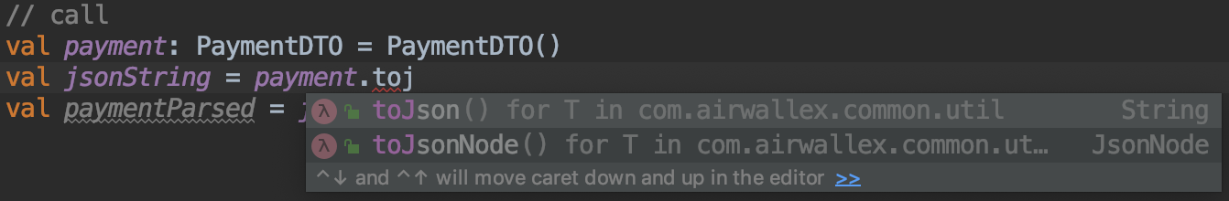
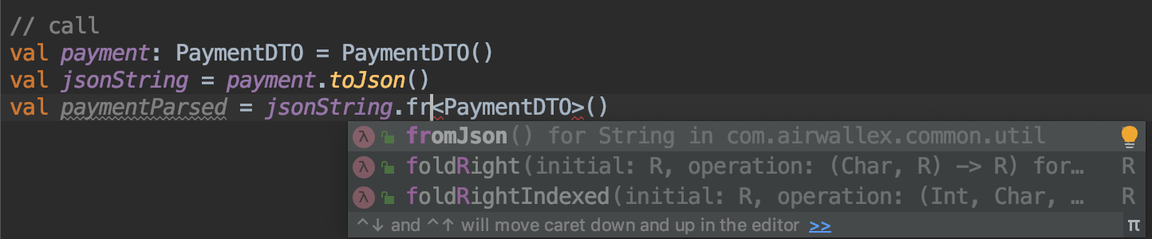
Extensions
kotlin extensions
Extension is IDEA friendly.

Slide 6
Operator overloading
Currency calculation
USD(5) + USD(5) = USD(10)
USD(5) + AUD(7) = USD(10) // 7 AUD = 5 USD
More readable! Much similar to natural language.

Slide 7
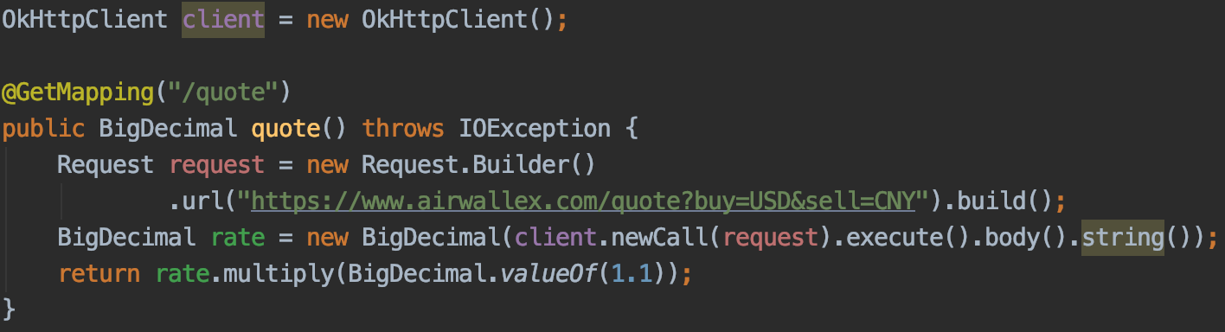
Coroutines
Provide quotation query api to our clients
// blocking I/O
Notes:
123sdfsf

Slide 8
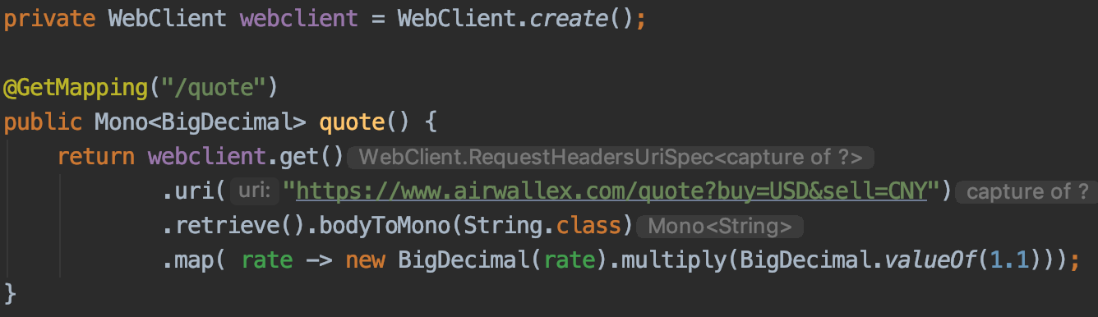
Coroutines
// blocking I/O → reactive I/O with webflux

Slide 9
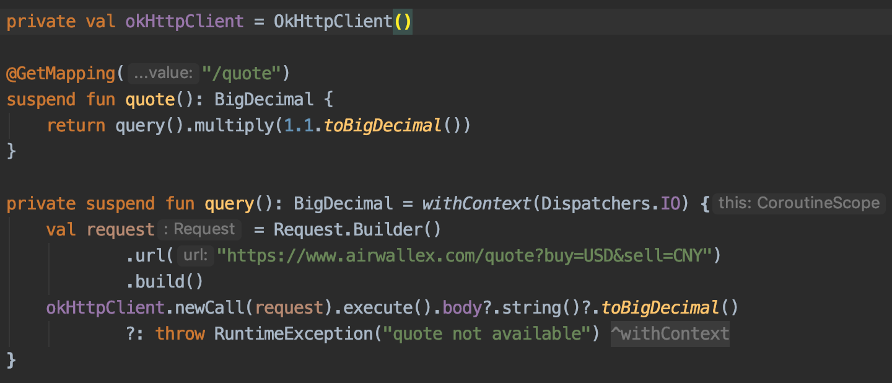
Coroutines
// suspend
Notes:
Ktor,fuel等客户端支持suspend httpclient，这样可以不用withcontext切换到io dispatchers

Slide 10
Coroutines - Suspend
write asynchronously executed code by writing synchronous code
Notes:
用同步的方法写异步代码

Slide 11
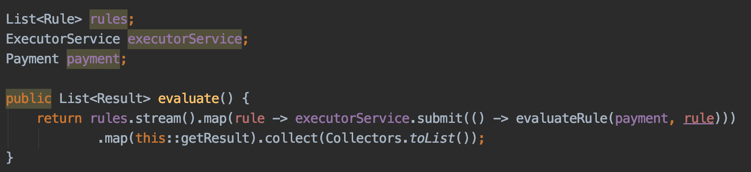
Coroutines concurrency
Evaluate multiple payment rules parallelly.
Each rule evaluated in one thread.
One evaluation already failed, but other evaluations continue.
Notes:
Future cancel() API

Slide 12
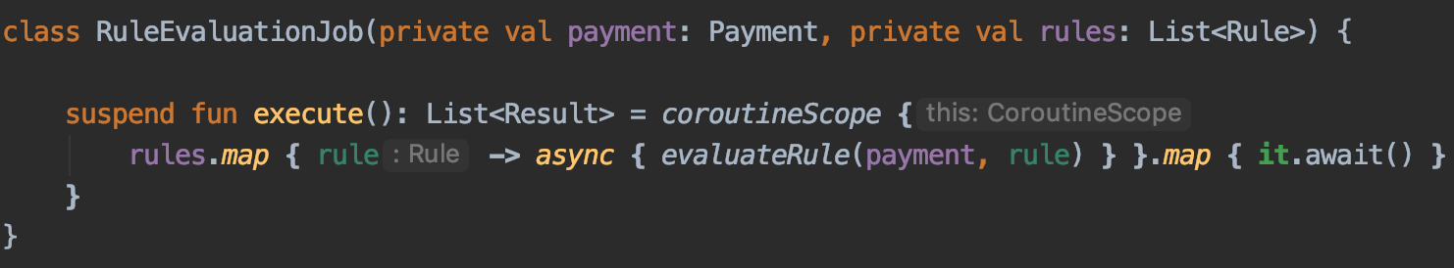
Coroutines concurrency
If we use coroutines
Each rule evaluated in one coroutine. Cost is much lower than thread.
If one evaluation failed, other evaluation can be cancelled automatically.
Notes:
Coroutines更加轻
父子coroutines 异常处理方便

Slide 13
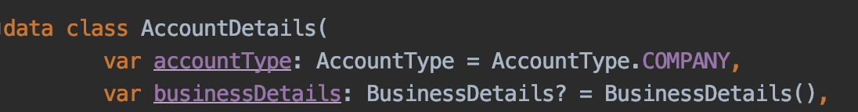
Not-Null Assertion
Should think about Nullable and Non-Null Types when design model
Should avoid use !!
Since business Details cannot be null, it is better to change it to Non-Null type.

Slide 14
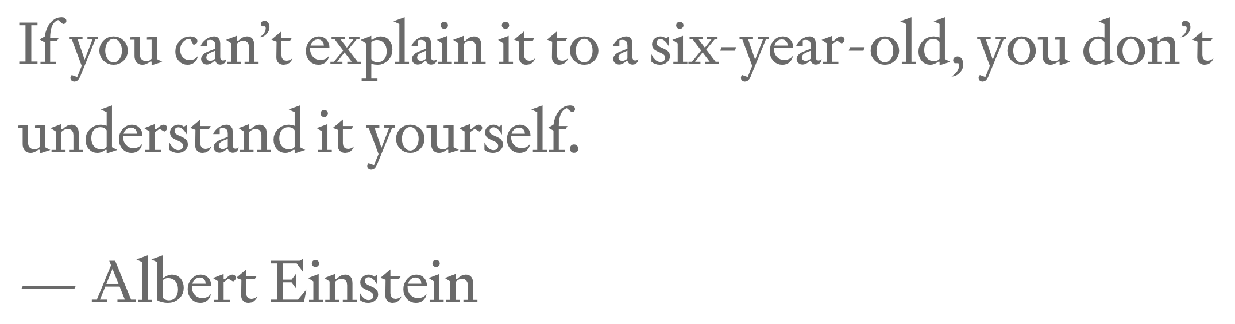
Kotlin DSL

Slide 15
Kotlin DSL
If your business logic in code is not understandable by BA/Product, the code is not maintainable

Slide 16
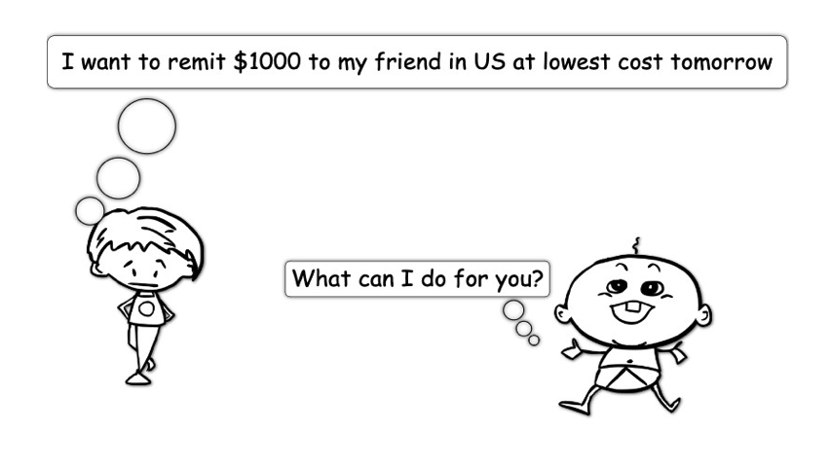
DSL Case Study: Global payment
Notes:
Customer needs
Introduce the concept of money house
Airwallex point of view

Slide 17
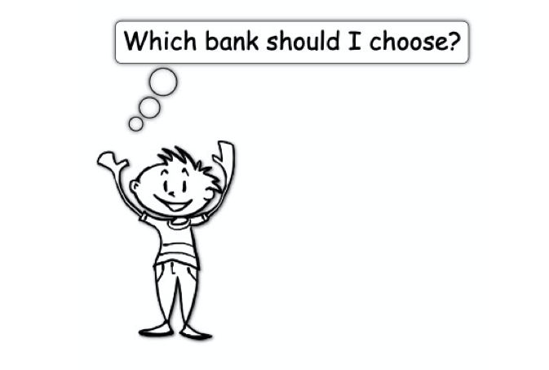
DSL Case Study: Global payment
Notes:
Time to deliver
Cost

Slide 18
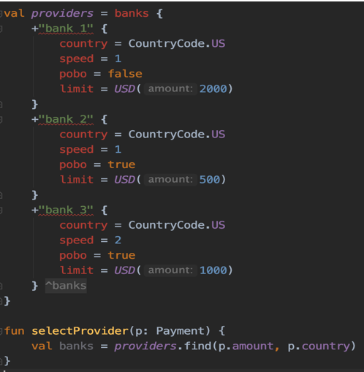
DSL Case Study: Global payment
Notes:
Similar to API driven design
Ask your non-dev college to see if they can understand
Prefer natural language
Declare what to you instead of how to do

Slide 19
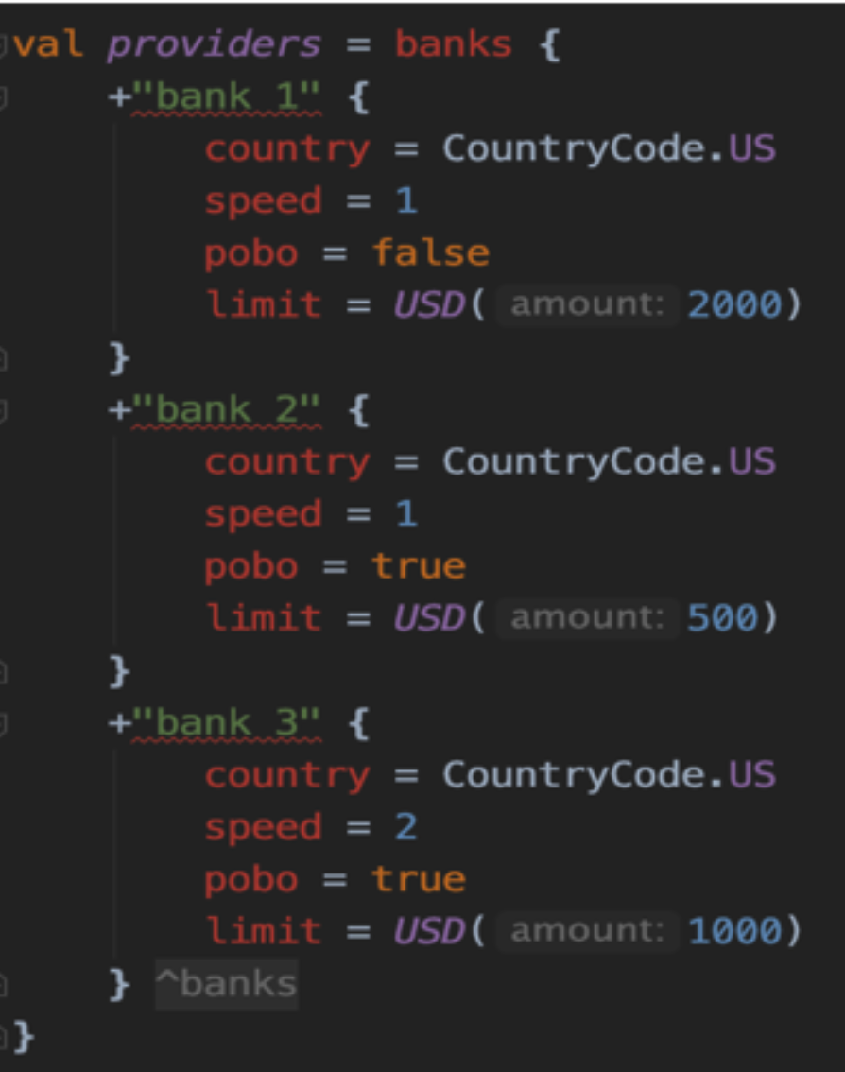
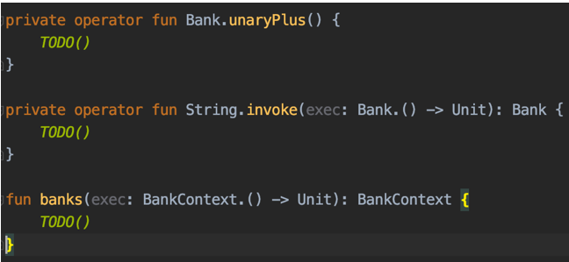
DSL Case Study: Global payment
Notes:
Intellij helps generate the stub
Extension function
Operator overloading
Lambda with receiver
Infix function

Slide 20
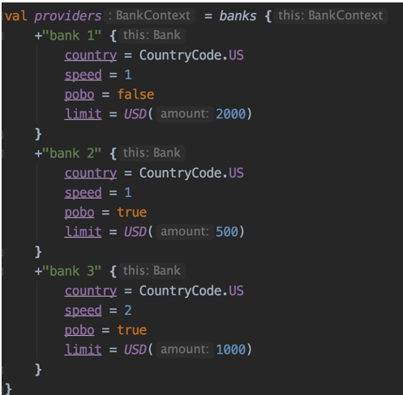
DSL Case Study: Global payment

Slide 21
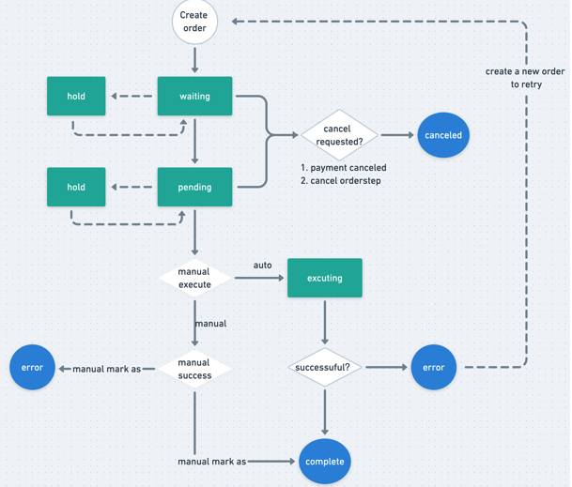
DSL Case Study: payment order
Notes:
State machine -> Which framework to use? -> framework details
Too early

Slide 22
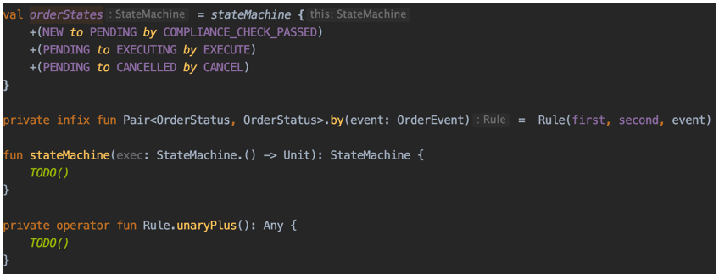
DSL Case Study: payment order
Notes:
Framework agnostic

Slide 23
DSL: other use case
Gradle 5 DSL
Spring 5 router DSL
Spring Fu (incubator)
Jetbrains/Exposed

Slide 24
Kotlin DSL
Moving to microservice
Domain Driven Design
Ubiquitous Language
Notes:
Moving to microservice
Domain Driven Design
Ubiquitous Language
Don’t get requirement then jump right into the framework or database layer. Design your domain properly.

Slide 25
Kotlin in Airwallex
Why kotlin
Interoperability with Java
Microservice approach, easy to adopt
Learning curve
Developer interest

Slide 26

Thank you!

