Slide 1
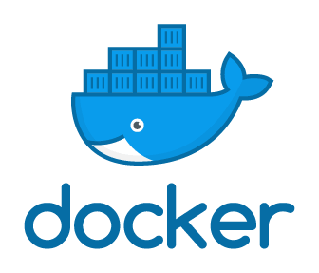

Slide 2

Why docker?
The code doesn’t work on the other system due to the difference in the computer environments.
Effectively create development environments.
Notes:
virtualization simulate an environment, so that the program can run on different hardware

Slide 3
Outline
What is container?
Basic usage of docker
Development with docker
Deployment with docker
https://www.youtube.com/watch?v=3c-iBn73dDE&t=5970s

Slide 4
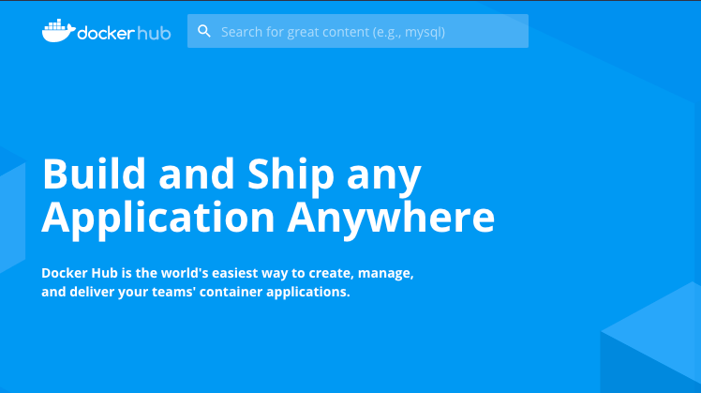
Docker repository

Slide 5
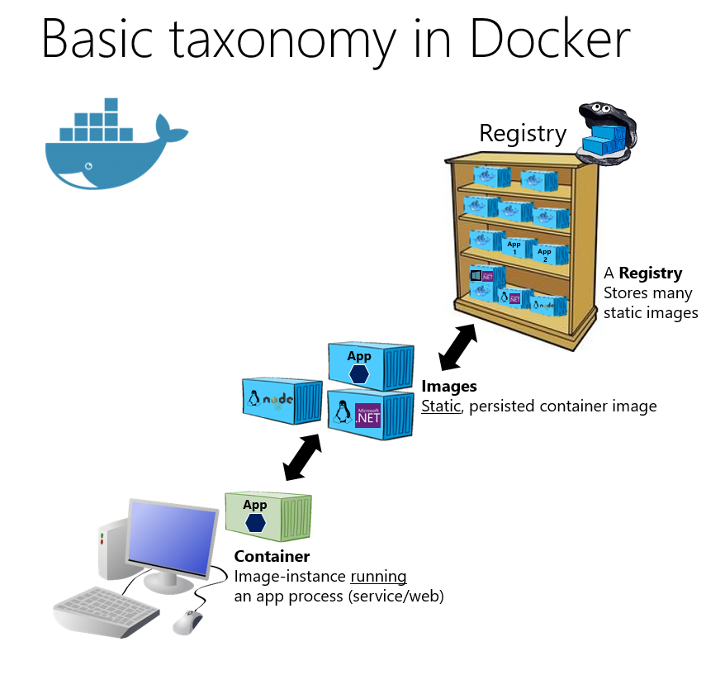
Docker Image, Container and Repository
Registry:
A Registry is a place to store image files
Docker hub
Image:
Image file is a template used to generate container instance
Container:
A container is an execution instance created from an image file

Slide 6
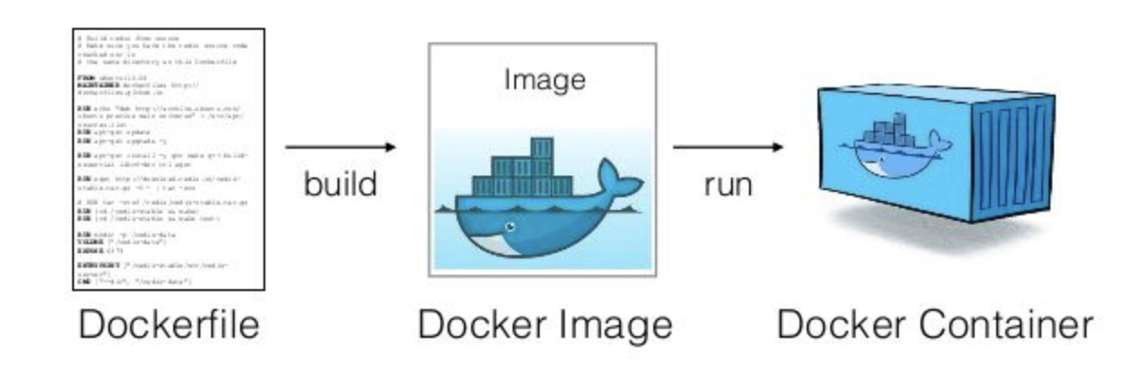
DockerFile

Slide 7
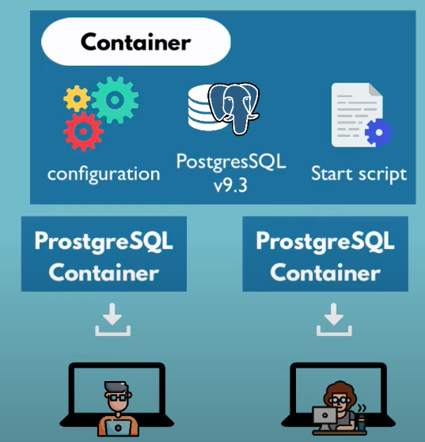
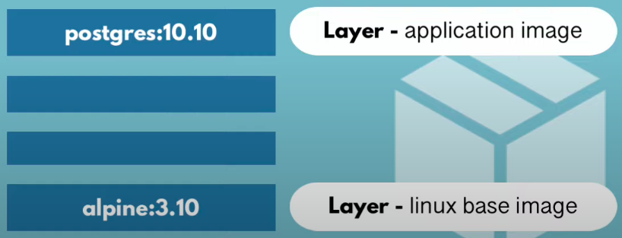
What is container?
Development & Deployment
A way to package app with all dependencies and configurations
Layer of images
Linux base image

Slide 8
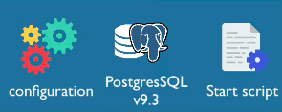
Docker Image
Docker Container
the actual package
actually start the application
container env is created
Running
artifact, that can be moved around
Not running

Slide 9
Docker vs Virtual Machine
They are different level abstractions.
Why linux based docker container don’t run on Windows?
Docker
VM
Application
Application
OS Kernel
OS Kernel
Hardware
Hardware
Size vs Speed vs Compatibility

Slide 10
Docker Installation
Mac & Windows: https://www.docker.com/products/docker-desktop
Linux: https://docs.docker.com/engine/install/

Slide 11
Overview - Docker Basic Command
Image vs Container
Version and Tag
Docker command
docker ps
docker pull
docker run
docker start
docker stop
docker exec -it
docker logs

Slide 12
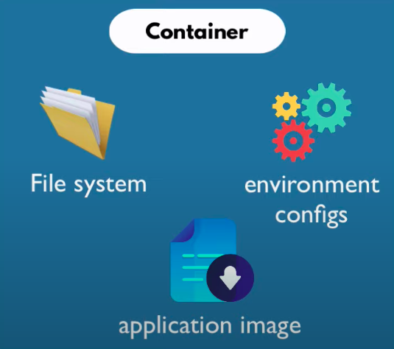
Difference Image and Container
Container is running environment for Image
Container
Virtual file system
Port binded: talk to the application running inside of container

Slide 13
Docker Command - Practical Example
docker run = start new container
pull images and run container
docker run -d -p 8080:80 --name container-name image-name
docker stop = stops the container
docker start = start stopped container
docker ps = list running container
container port?

Slide 14
Container Port vs Host Port
Multiple containers run on your host machine
Host machine has certain ports available
Conflict when same port on host machine
some-app://localhost:3307
Port 5000
Port 3306
Port 3307
Host
Port 5000
Port 3306
Port 3306
Container
Container
mysql 8.0
Container
mysql 5.7

Slide 15
Optional: GPU Server
$docker run -it -d -v {local}:{container} --port 32001:8888 32002:6666 \
--shm 10G pytorch-20.08:iir

Slide 16
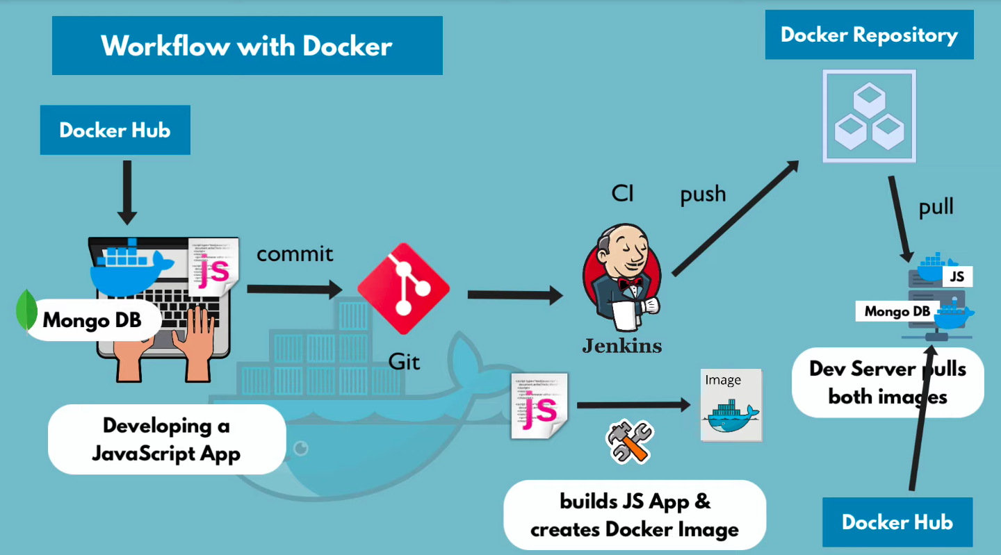

Slide 17



Demo Project

Slide 18
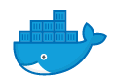
Docker Network
Host
Isolated docker network
localhost:8000
localhost:3306
Django
without port number

Slide 19
Docker Network
Host
Isolated docker network
localhost:8000
Django
without port number

Slide 20
Docker Network
$ docker network ls
$ docker network create {network-name}
RUN MySQL
$docker run -d \
-p 3306:3306 \
-e MYSQL_ROOT_PASSWORD=root \
--name mysql \
--net mysql-network \
mysql:8.0
RUN phpMyAdmin $docker run -d \
-p 8080:80 \
-e PMA_HOST="mysql" \
--name phpmyadmin \
--net mysql-network \
phpmyadmin/phpmyadmin
Notes:
python manage.py migrate
python manage.py createsuperuser

Slide 21
Docker Compose
mysql.yaml version: '3'
services:
mysql:
image: mysql:8.0
restart: always
ports:
- 3306:3306
environment:
- MYSQL_ROOT_PASSWORD=root
…
phpmyadmin:
image: phpmyadmin/phpmyadmin
RUN MySQL
$docker run -d \
-p 3306:3306 \
-e MYSQL_ROOT_PASSWORD=root \
--name mysql \
--net mysql-network \
mysql:8.0

Slide 22
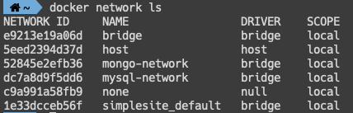
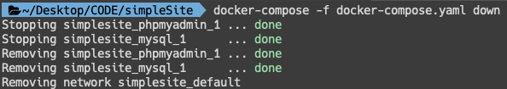
Docker Compose
$ docker-compose -f mysql.yaml up -d
$ docker-compose -f mysql.yaml down -d
$ docker network ls // network is created by docker compose

Slide 23
Build Your Own Docker Image
$ docker build -t {name}:{tag} .
DockerFile
FROM python:3.8
WORKDIR /app
COPY requirements.txt /app/requirements.txt
RUN pip install -r requirements.txt
COPY . /app
RUN python manage.py migrate
CMD python manage.py runserver 0.0.0.0:8000

Slide 24
Push to Repository
Name your local images using one of these methods:
When you build them, using docker build -t <hub-user>/<repo-name>[:<tag>]
By re-tagging an existing local image docker tag <existing-image> <hub-user>/<repo-name>[:<tag>]
By using docker commit <existing-container> <hub-user>/<repo-name>[:<tag>] to commit changes
Push to repository
$ docker push <hub-user>/<repo-name>:<tag>

Slide 25
Recap
What is container?
Basic docker usage
port bind
Development with docker
docker network
docker compose
Deployment with docker
Dockerfile

Slide 26
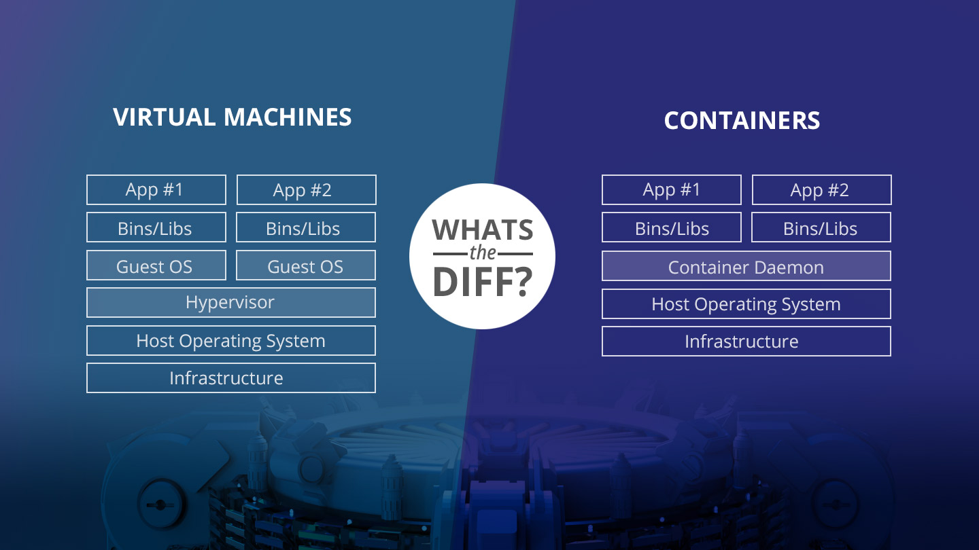
containers
Docker Engine
Notes:
Type of containers that can be installed on the host should work with the kernel of the host. Hence, you cannot install a Windows container on a Linux host or vice-versa.

Slide 27
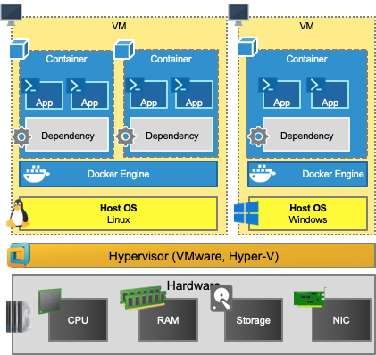
VM can use with Docker together

Slide 28
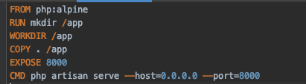
Example
FROM
WORKDIR
COPY
EXPOSE
RUN
CMD
docker build . -t “name”:”tag”

Slide 29
follow
“one services per container”
as rule of thumb

Slide 30
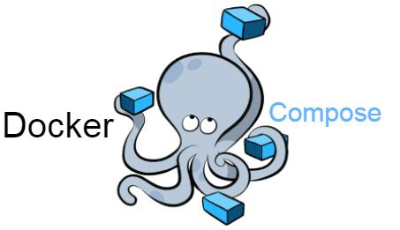

Slide 31
