Slide 1
Cancer-miRNA Search System
Final Project for the Biomedical Information Retrieval
組員：方郁文、吳政達

Slide 2
Problem
Find evidence of the relation for given Cancer and mi-RNA.
Our team focuses on the correlation of bone and soft tissue sarcoma with certain mi-RNA

Slide 3
Methods
Scrap the articles which mentions the target Cancer and mi-RNA
Find the expression (evidence) describing the relation of target Cancer and mi-RNA
Rank the evidence sentences using impact factor of the source journal
Calculate the Evidence Score for the Cancer and mi-RNA

Slide 4
Target Cancers and mi-RNA
Cancer type:
Osteosarcoma 骨肉瘤
Ewing sarcoma 尤文式骨肉瘤
Chondrosarcoma 軟骨骨肉瘤
Multiple myeloma 多發性骨髓瘤
Rhabdomyosarcom 橫紋肌肉瘤
Synovial sarcoma 關節滑囊肉瘤
Neuroblastoma 神經母細胞瘤
Cholangiocarcinoma 膽管惡性腫瘤
Retinoblastoma 視網膜神經母細胞瘤
Squamous cell carcinoma 扁平細胞癌
miRNA:
miR-34a
miR-143
miR-22
miR-106a
miR-181a
miR-141
miR-15a
miR-25
miR-206
miR-1
miR-183
miR-17
miR-124
LIN28b
miR-26a
miR-21
let-17
miR-17-92
miR-184
miR-31

Slide 5
Expression keywords
promoted/promotion/promoter
Higher expression/expressing/overexpression/overexpressed
lower/poor expression
regulates/regulation/up-regulated/upregulated/upregulation/up-regulation
enhances/enhancing
down-regulated/downregulation/down-regulation/ underexpression
suppresses/suppression/suppressed/suppressor
repression/ repressing
increased
decreased
carcinogenesis
inhibited/inhibition/inhibitory
interacted/interaction
axis
mediator/mediated
metastasis
target/target gene
oncomir
oncogenes
markers/biomarkers
p53/ tumor suppressor

Slide 6
Scrap Pubmed
Search Keyword
cancer
mirna
Get
title
abstract
journal
Results in total of 373 articles from Pubmed

Slide 7
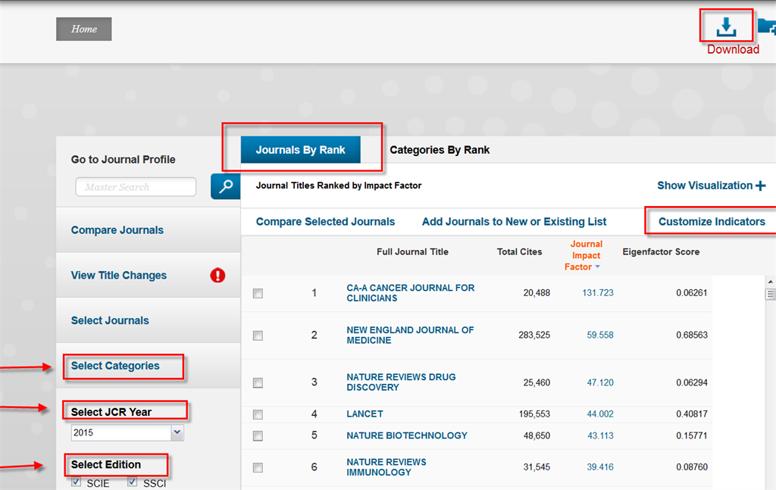
Ranking of the searching results
Mainly based on the latest impact factor of the journal
Higher “IF” implying higher level of evidence

Slide 8
Evidence Score for the Cancer and mi-RNA
key sentences x num of articles x ( avg(impact factor + 1 ) )
Some journals have no “IF” or were dropped by JCI, e.g. Oncotarget

Slide 9
Limitations
keyword matched: up-regulation
Despite a strong “up-regulations” mark of miR-21 in injury-associated hepatocellular carcinoma and in cholangiocarcinoma, miR-21 deletion or antisense inhibition did not reduce the development of liver tumors.
Wide range of evidence score
Notes:
我們用keywords去抓取關鍵句子, 但是有時候抓出來句子的本意, 不見得是跟關鍵字一樣; 另外我們設計的evidence score產生的分數級距差距極大, 未來應該可以設計更好的正規畫評分方式來呈現證據等級

Slide 10
Conclusions
To search context, not only abstract. E.g. miDatabase
To design a better function to rank searching results, e.g. addition of number of citations of the articles
To design a better evidence score
Notes:
未來可以更精進的: 增加內文搜索(例如 miDtabase), 設計更好的排序公式 (例如除了impact factor, 加入citation次數的加權), 設一更好的evidence score

