Slide 1
Address Book Demo
Jeff Flater

Slide 2
Agenda
Overview
Database
Domain Model
Design Patterns
MVC4 Project
Unit Testing
Code Demo
Address Book Demo
Summarize
Questions / Comments

Slide 3
Overview
Quick overview of what this meeting is all about
Demo Address Book Project
Base Requirements
ASP.NET MVC4
SQL Server / ADO.NET
OOP Design Patterns (at least two)
Various People
Customer, Manager, Employee & Sales Person
Each Person is Related to Each other

Slide 4
Database Overview
Database Tables
Customer
Manager
Employee
Sales Person
RelationshipTree
Database Views
Created associated views to only show records that have not been marked deleted

Slide 5
Domain Model
Concrete Classes
Customer
Employee
Manager
Sales Person
Tree
Leaf
Abstract Classes
Entity
Person
Personnel

Slide 6
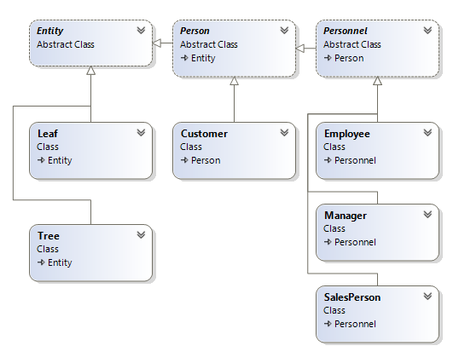
Domain Model

Slide 7
Design Patterns
Repository Pattern
Data Transfer Objects (DTO) Pattern

Slide 8
MVC4 Project
Model
View
Controller
REST API
Javascript
jQuery
jQuery Datatables
Twitter Bootstrap 3
HTML5

Slide 9
Unit Testing
Visual Studio Unit Test
Jasmine Unit Test

Slide 10
Code Demo
Database
Model
Repositories
Library
DTOs
MVC4 Controllers / Views / Javascript
Visual Studio Unit Test
Jasmine Unit Test

Slide 11
Address Book Demo
Search People
Add New Person / Relationship
View Person
Edit Person / Relationship
Delete Person

Slide 12
Summarize
Database Design
Domain Model
Design Patterns
MVC4 Project
Unit Testing

Slide 13
Questions / Comments
Thank you for your time.
Questions / Comments?

