Slide 1
Address Book Demo
Jeff Flater

Slide 2
Agenda
Overview
Mocks
Database
Domain Model
Data Access Layer
Business Logic Layer
Design Patterns
MVC4 Project
Unit Testing
Code Demo
Address Book Demo
Summary
Questions / Comments

Slide 3
Overview
Quick overview of what this meeting is all about
Demo Address Book Project
Base Requirements
ASP.NET MVC4
SQL Server / ADO.NET
OOP Design Patterns (at least two)
Various People
Customer, Manager, Employee & Sales Person
Each Person is Related to Each other

Slide 4
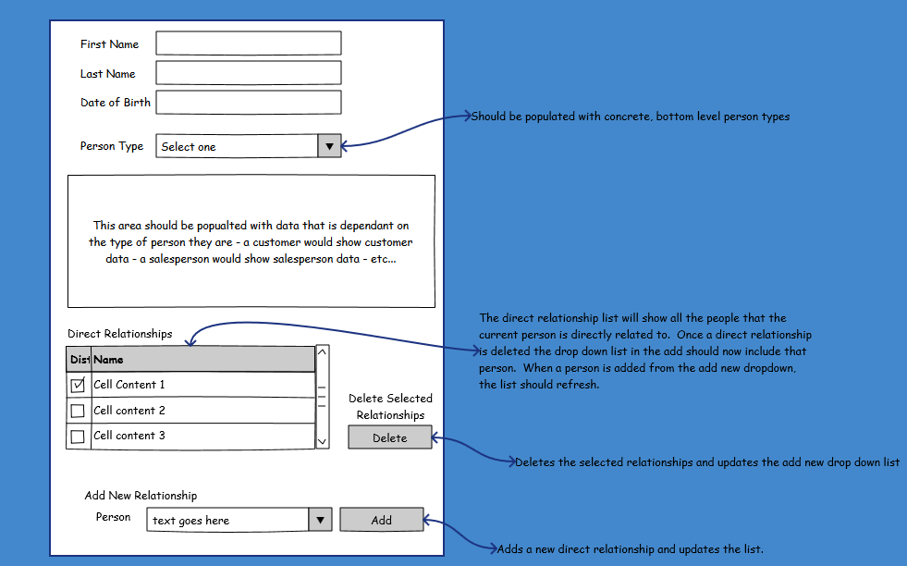
Mock – Landing Page

Slide 5
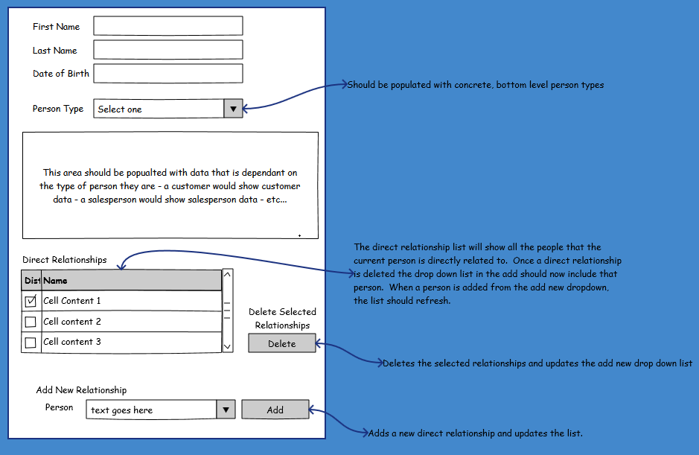
Mock – Add/Edit Popup

Slide 6
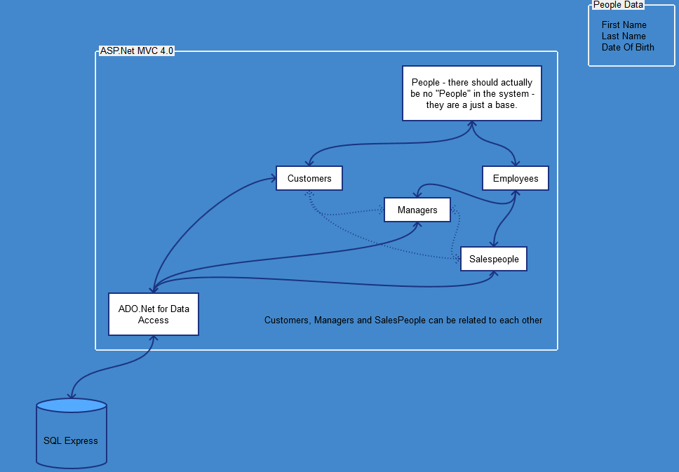
Mock – Architecture

Slide 7
Database Overview
Database Tables
Customer
Manager
Employee
Sales Person
RelationshipTree
Database Views
Created associated views to only show records that have not been marked deleted

Slide 8
Domain Model
Concrete Classes
Customer
Employee
Manager
Sales Person
Tree
Leaf
Abstract Classes
Entity
Person
Personnel

Slide 9
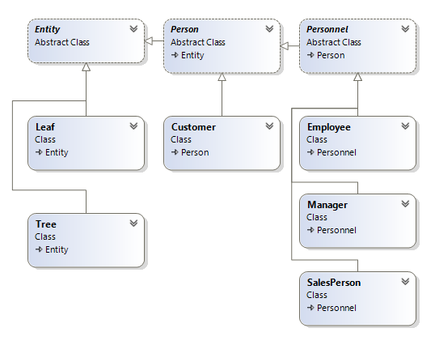
Domain Model

Slide 10
Data Access Layer
AddressBook.Lib
ADO.NET
SQL
AutoMapper

Slide 11
Business Logic Layer
AddressBook.Lib.BLL
Customer
Employee
Manager
Relationship
SalesPerson

Slide 12
Design Patterns
Repository Pattern
Data Transfer Objects (DTO) Pattern

Slide 13
MVC4 Project
Model
View
Controller
REST API
Javascript
jQuery
jQuery Datatables
Twitter Bootstrap 3
HTML5

Slide 14
Unit Testing
Visual Studio Unit Test
Jasmine Unit Test

Slide 15
Code Demo
Database
Model
Repositories
Library
DTOs
MVC4 Controllers / Views / Javascript
Visual Studio Unit Test
Jasmine Unit Test

Slide 16
Address Book Demo
Search People
Add New Person / Relationship
View Person
Edit Person / Relationship
Delete Person

Slide 17
Summary
Database Design
Domain Model
Design Patterns
MVC4 Project
Unit Testing

Slide 18
Questions / Comments
Thank you for your time.
Questions / Comments?

