Slide 1
Address Book Demo
Jeff Flater

Slide 2
Agenda
Overview
Database Design
Domain Model
Design Patterns
Web Project
Unit Testing
Summarize

Slide 3
Overview
Quick overview of what this meeting is all about
Demonstrate Address Book Project
Base Requirements
ASP.NET MVC4
SQL Server / ADO.NET
OOP Design Patterns (at least two)
Various People
Customer, Manager, Employee & Sales Person
Each Person is Related to Each other

Slide 4
Database Overview
Database Tables
Customer
Manager
Employee
Sales Person
RelationshipTree
Database Views
Created associated views to only show records that have not been marked deleted

Slide 5
Domain Model
Concrete Classes
Customer
Employee
Manager
Sales Person
Tree
Leaf
Abstract Classes
Entity
Person
Personnel

Slide 6
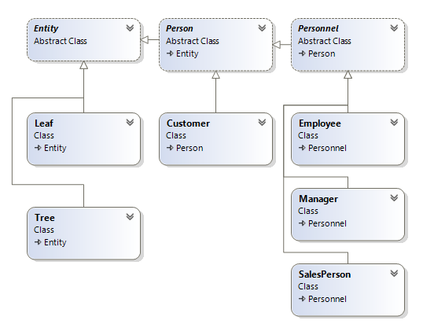
Domain Model

Slide 7
Design Patterns
Repository Pattern
Data Transfer Objects (DTO) Pattern

Slide 8
Web Project
MVC4
Model
View
Contoller
REST API
Javascript
jQuery
jQuery Datatables
Twitter Bootstrap 3
HTML5

Slide 9
Web Project
MVC4
Model
View
Contoller
REST API
Javascript
jQuery
jQuery Datatables
Twitter Bootstrap 3
HTML5

Slide 10
Summarize
Database Design
Domain Model
Design Patterns
Web Project
Unit Testing

