Slide 1
Welcome to the Dark Arts:
Computer Security Examined
Professor: Oberta A. Slotterbeck (Obie)
Computer Science Department
Hiram College
obie@hiram.edu
These slides are posted at cs.hiram.edu/~obie/3.18.09.ppt

Slide 2
First, a Disclaimer
The meaning of the word “hacker” has changed over the years.
Originally - it was used for someone who had a deep understanding of programming and operating systems because they could “hack” at the bits and accomplish something useful.
Later - it was used to refer to a person who did malicious damage with a computer.
Some people prefer to keep the original meaning for “hacker” and call a person a “cracker” if they do malicious damage intentionally.
For no other reason other than I am used to the term, I will use the word “hacker” to mean a person who does malicious damage intentionally.

Slide 3
Questions to Start Things Rolling
With respect to your computer:
  Are you running a firewall?
  Are you running anti-spyware software?
  Are you running anti-virus software?
  Are you running anti-phishing software?
  Have you backed up your computer recently?
  Do you keep back up data physically separated from the location of your computer?
  Are you very careful about where you go on the web to download files – music, images, software?
  Are you familiar with and practice using “hardening” techniques for your computer?
  Do you use a different password on each system you access?
  Do you protect your password by not divulging it in any way – post-it notes on monitor, a slip of paper on your desk?
  Do you use different passwords at different web sites?
  Do you safeguard individual files by placing passwords on them?
Even if you answered “YES” to each of these questions, your computer can still be compromised.

Slide 4
What We Will Consider Today
You have all heard of worms, Trojans, and viruses in the context of computer security.
Although we could touch upon that type of malware, this talk will look at the really dark side of computer security - i.e. that which is really hidden from the casual user and not controlled by firewalls, anti-spyware, anti-virus software etc.
Yet, it is precisely the dark side that threatens us the most today.
Moreover, there does not appear to be an easy solution to the threats that are posed.

Slide 5
Software Security: Why Care?
Software is ubiquitous.
We rely on software to handle the sensitive and high-value data on which our livelihoods, privacy, and very lives depend.
Many critical business functions in government and industry depend completely on software.
Software is increasingly exposed to the Internet.
  – Increased exposure makes software (and the data it handles) visible to people who never even knew it existed before.
  – Not all of those people are well intentioned
(to say the least!).

Slide 6
Properties of Secure Software
Secure software is software that can’t be intentionally forced to perform any unintended function.
Secure software continues to operate correctly even under attack.
Secure software can recognize attack patterns and avoid or withstand recognized attacks.
At the whole-system level, after an attack, secure software recovers rapidly and sustains only minimal damage without revealing compromising information.
After an attack, secure software lets the system adminstrator(s) know what happened.

Slide 7
Software Is The Main Problem
“We wouldn’t have to spend so much time and effort on network security if we didn’t have such bad software security.”
Bruce Schneider - author of
“Applied Cryptography”
“Secrets & Lies: Digital Security in a Networked World”

Slide 8
Hackers
“Malicious hacker’s don’t create security holes; they simply exploit them. Security holes and vulnerabilities – the real root cause of the problem – are the result of bad software design and implementation.”
John Viega & Gary McGraw - well known security experts and authors of several security books

Slide 9
Developers Aren’t Ready
“64% of developers are not confident in their ability to write secure applications
Bill Gates, RSA Conference 2005
“ Have you ever written a program section with a security hole? How did you know?”
Mark G. Graff & Kenneth R. van Wyk - both security experts

Slide 10
One Problem: Exploitable Defects in Software Lead to Vulnerabilities
Some defects cannot be remedied by traditional security mechanisms (e.g., firewalls, server hardening, etc.)
Inherent deficiencies in the software’s processing model (e.g., Web, Email) and the model’s associated protocols/technologies
  – Example: Trust establishment in web applications is usually only one-way (the client authenticates the server, not vice versa)

Slide 11
Exploitable Defects cont’d
Shortcomings in the software’s security architecture
  – Example: Exclusive reliance on infrastructure components to filter/block dangerous input, malicious code, etc.
Defects in execution environment components (middleware, frameworks, operating system, etc.)
  Example: Known vulnerabilities in J2EE, Windows XP, Windows Vista, Linux, etc.

Slide 12
Exploitable Defects cont’d
Defects in the design or implementation of software’s interfaces with environment- and application-level components
  – Example: Reliance on known-to-be-insecure API, RPC, or communications protocol implementations
Defects in the design or implementation of the software’s interfaces with its users (human or software process)
  – Example: Web application fails to establish user trustworthiness before accepting user input.

Slide 13
Exploitable Defects cont’d
Defects in the design or implementation of the software’s processing of input
  – Example: C++ and C applications do not automatically do bounds checking on user-submitted input data before writing that data to a memory buffer.
  Java is a safer language, but it is not as popular as C and C++ combined.
    C and C++ are widely used for programming both applications and libraries.
    Why?

Slide 14
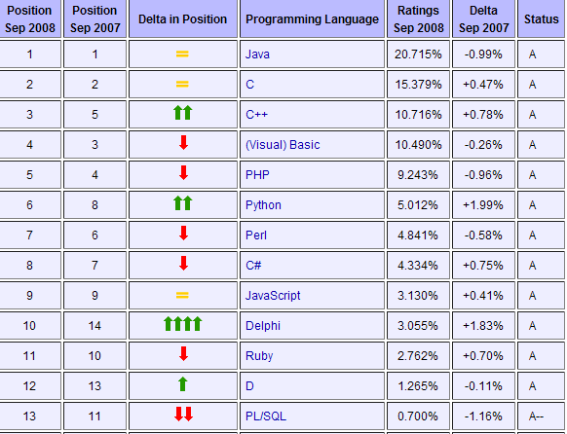
Language Usage Statistics
Source: http://www.tiobe.com/index.php/content/paperinfo/tpci/index.html

Slide 15
So What Can Be Done With An Exploitable Defect?
Buffer Overflows – A hacker will overflow a memory buffer or the stack, causing the system to crash or to load and execute malicious code, thereby taking over the machine
Denial of Service – A hacker will deny individual users or the entire system the ability to operate.
Session hijacking – A hacker will claim the identity of another user in the system
Command Injection (e.g. SQL Injection) – A hacker will modify input causing a database to return other users’ data, drop tables, shutdown the database.

Slide 16
So What Can Be Done With These Exploitable
Defects?
Cross Site Scripting (XSS) – A hacker will reflect malicious scripts (e.g. Javascript) off a web server to be executed in another user’s browser to steal their session, redirect them to a malicious site, steal sensitive user data, or deface the webpage.
Cross-site scripting flaws are increasingly becoming one of the favored vectors for hackers.
In 2006, the Web Application Security Consortium (WASC) surveyed 31,373 sites
  More than 85% were vulnerable to cross-site scripting attacks!

Slide 17
The Web Hacking Incidents Database (WHID)
The web hacking incident database (WHID) is a Web Application Security Consortium project dedicated to maintaining a list of web applications related security incidents.
This is just one of many such databases – for example, most of the security services maintain databases.
Scanning some recent incidents ---- chosen because many people use the software that was hacked

Slide 18
WHID 2009-33: eBay Fraud
10 March 2009
Attack Method: Content Spoofing and Cross Site Scripting (XSS)
Outcome: Monetary Loss
A zero day XSS vector enables hackers to include in an eBay offer an arbitrary code which is executed by both FireFox and IE.
As a result they were able to spoof the content of the offer, so that the user saw different information than the details known to eBay.

Slide 19
WHID 2009-32: 750 Twitter Accounts Hacked
10 March 2009
Attack Method: Brute Force
Outcome: Defacement and link to spam
Twitter reported in a blog entry that 750 accounts were hacked.
The hacker posted messages linking to a porn webcam.
While Twitter did not disclose how the attack was carried out, the suggested remediation hints that the account passwords were guessed, probably using a brute force attack.

Slide 20
WHID 2008-59: Spotify Streaming Music Service Hacked and Millions of Records Leaked
Reported: 8 March 2009 Attack Method: Unknown
Spotify is a new music streaming radio like service from Sweden.
A weakness in Spotify streaming protocols enables hackers to gain access to users' encrypted passwords, email address, birth date, gender, postal code and billing receipt.
An interesting aspect of this incident is that while the vulnerability had been discovered and fixed on December 19th, the fact that it was actually exploited was discovered only in March 2009.

Slide 21
2008 CSI Computer Crime & Security
Survey – How Bad Is It?
This year’s survey results are based on the responses of 522 computer security practitioners in U.S. corporations, government agencies, financial institutions, medical institutions and universities.
For the 13th year, CSI has asked its community how they were affected by network and computer crime in the prior year and what steps they’ve taken to secure their organizations.
Get the complete survey here and a brief summary on the next slide.

Slide 22
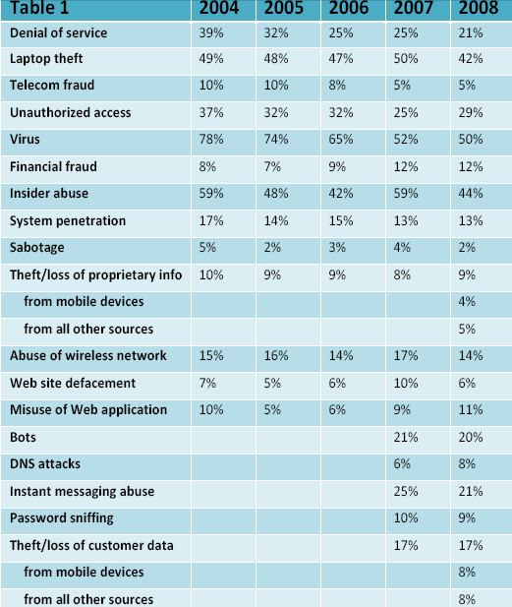
Percentages of Key Incidents

Slide 23
Cost of Software Security Vulnerabilities
NIST estimates costs of $60 Billion+ a year due to software vulnerabilities
Fixes during post product release cost at least 6x more than in the development phase
What to Do About These Vulnerabilities?
Integrate software security into the software lifecycle
At every step of the software lifecycle, consider security concerns.
Learn how to program more securely – something that often is not taught (or if taught, ignored!)

Slide 24
Why Are Secure Programming Practices Often Ignored?
Writing secure code has been estimated to increase:
  The cost of producing the software by at least 1/3
  The time needed to produce the software by at least 1/3.
The goal of most programming projects is to deliver the product on time and within budget.
If security issues are not dealt with up front, and considered right at the beginning of a project, managers are usually not willing to add these costs into the budget later.

Slide 25
Where Are Some of the Security Problems That Are Not Obvious to Many Users
The entire password concept
The user
Unsafe downloads
Security patches
Lack of liability in the software industry
The complexity of software today
Insecure code which allows such holes as
  Buffer overflows
  Smashing the stack attacks
These are only a few, but let's examine these

Slide 26
A Security Problem: The Entire Password Concept
Password guessing and cracking is an important vulnerability in many systems because passwords are still the most commonly used form of authentication
Users have too many passwords!!!
Many times, they must choose their own
    Consequently, they choose easy to guess passwords – dog’s or children’s name or friend’s name
    They use the same password on many accounts

Slide 27
Password attacks require little skill
  Guess passwords
  Attain access through social engineering
  Use freely available tools, databases of easy words, default passwords (for specific software or hardware, for example).
    One of them is from CIRT.net
  http://www.cirt.net/cgi-bin/passwd.pl

Slide 28
Bad Passwords
Not surprisingly, many users choose weak passwords
  Usually one related to themselves in some way
Repeated research over some 30 years has demonstrated that around 40% of user-chosen passwords are readily guessable by cracking programs

Slide 29
Forming Many Good Passwords -Password Phrase Method
Choose a phrase and an algorithm for turning that phrase into individual letters (lower and upper case) as well as numbers and special characters.
If you use a book in your office for the phrase and follow some fixed procedure, you can generate many different passwords.
This has been shown to be better than randomly generated passwords as randomly generated passwords are hard to remember.

Slide 30
Cracking Passwords
Passwords work as follows: …
    Log in to your system, provide plaintext password
    System encrypts it with a password algorithm which is often published on the Web.
    Compare results, if match, you are in, if not, login denied
Dictionary attacks use brute force to try words stored in a dictionary
There are many web sites explaining how to create password dictionaries:
http://geodsoft.com/howto/password/cracking_dictionaries.htm#crackerdict

Slide 31
Password Cracking Times Via Brute Force
Length
26 Lower case 36 letters and digits 52 mixed case
3 0.02 seconds .04 seconds 0.14 seconds
4 0.46 seconds 1.68 seconds 7.31 seconds
5 11.9 seconds 1.01 minutes 6.34 minutes
6 5.15 minutes 36.3 minutes 5.59 hours
7 2.23 hours 21.8 hours 11.9 days
8 2.42 days 1.07 months 1.70 years
9 2.07 months 3.22 years 88.20 years
10 4.48 years 1.16 centuries 4.58 millennia
11 1.16 centuries 4.17 millennia 238.00 millennia
12 3.03 millennia 150.00 millennia 12,395.00 millennia
13 78.70 millennia 5,410.00 millennia 644,521.00 millennia
14 2,046.00 mill. 194,728.00 millennia 33,515,076.00 millennia
The table is calculated by assuming 1,000,000 encryption operations per second; this is a plausible number for a desktop PC in early 2007 when this table was generated.

Slide 32
A Security Problem: The User
Social engineering is the art of manipulating people into performing actions or divulging confidential information.
While similar to a confidence trick or simple fraud, the term typically applies to trickery for information gathering or computer system access and in many cases the attacker never comes face-to-face with the victim.
Surprisingly, few security textbooks speak to this technique, but hackers claim it is one of the most effective.

Slide 33
Social Engineering Technique
Pretexting is the act of creating and using an invented scenario (the pretext) to persuade a target to release information or perform an action.
It is often done over the telephone.
It's more than a simple lie as it most often involves some prior research or set up and the use of pieces of known information (e.g. for impersonation: date of birth, Social Security Number, last bill amount) to establish legitimacy in the mind of the target.

Slide 34
Phishing/pharming
Typically, the phisher sends an email that appears to come from a legitimate business — a bank, or credit card company — requesting "verification" of information and warning of some dire consequence if it is not done.
The email usually contains a link to a fraudulent web page that looks legitimate — with company logos and content — and has a form requesting private information.

Slide 35
Road Apple
In a road apple attack, the attacker leaves a malware infected floppy disc, CD ROM or USB flash drive in a location sure to be found (bathroom, elevator, sidewalk, parking lot), gives it a legitimate looking and curiosity-piquing label, and simply waits.
For example, an attacker might create a disk featuring a corporate logo, readily available off the target's web site, and write "Executive Salary Summary Q1 2008" on the front.
The attacker would then leave the disk on the floor of an elevator or somewhere in the lobby of the target company.

Slide 36
An unknowing employee might find it and subsequently insert the disk into a computer to satisfy their curiosity, or a good samaritan might find it and turn it in to the company.
In either case as a consequence of merely inserting the disk to see the contents, the user would unknowingly install malware on their computer, likely giving an attacker unfettered access to the victim's PC and perhaps the target company's internal computer network.
Unless other controls block the infection, PCs set to "autorun" inserted media may be compromised as soon as a rogue disk is inserted.

Slide 37
Kevin Mitnick
Reformed computer criminal and security consultant Kevin Mitnick popularized the term social engineering, pointing out that it's much easier to trick someone into giving you a password for a system than to spend the effort to hack in.
He has written two delightful books that show blow-by-blow how social engineering works:
  The Art of Deception (2002) (Co-authors William L. Simon and Steve Wozniak), which focuses on social engineering, and
  The Art of Intrusion (2005) (Co-author William L. Simon), focusing on real stories of security exploits many of which use social engineering.

Slide 38
How Bad is It?
At one company that was tested, a security penetration team managed to persuade 17 out of 30 employees to give their passwords over the phone.
A British survey has found that 70% of people would reveal their computer password in exchange for a bar of chocolate
The survey also showed that 34% of respondents volunteered their password when asked without even needing to be bribed.
A second survey found that 79% of people unwittingly gave away information that could be used to steal their identity when questioned.

Slide 39
How Bad is It?
A survey was undertaken by the organizers of Infosecurity Europe 2003 in a quest to find out how security conscious workers are with company information stored on computers.
Workers were asked a series of questions which included: What is your password? Three in four (75 per cent) of people immediately gave their password.
If they initially refused they were asked which category their password fell into and then asked a further question to find out the password.

Slide 40
The most common password was "password" (12 per cent) and the most popular category was their own name (16 per cent) followed by their football team (11 per cent) and date of birth (8 per cent).
Two thirds of workers had given their password to a colleague and three quarters knew their co-workers passwords.
In addition to using their password to gain access to their company information two thirds of workers use the same password for everything, including their personal banking, website access, etc.
Using the same password makes them more vulnerable to financial fraud, personal data loss or even identity theft

Slide 41
One More Example
A group of strangers walked into a large shipping firm and walked out with access to the firm’s entire corporate network.
How did they do it?
By obtaining small amounts of access, bit by bit, from a number of different employees in that firm.
First, they did research about the company for two days before even attempting to set foot on the premises.
They learned key employees’ names by calling HR.
Next, they pretended to lose their key to the front door, and an employer let them in.

Slide 42
Then they "lost" their identity badges when entering the third floor secured area, smiled, and a friendly employee opened the door for them.
The strangers were able to enter the CFO office and obtain financial data off his unlocked computer.
They dug through the corporate trash, finding all kinds of useful documents.
They asked a janitor for a garbage pail in which to place their contents and carried all of this data out of the building in their hands.
The strangers had studied the CFO's voice, so they were able to phone, pretending to be the CFO, in a rush, desperately in need of his network password

Slide 43
From there, they used regular technical hacking tools to gain super-user access into the system.
In this case, the strangers were network consultants performing a security audit for the CFO without any other employees' knowledge.
They were never given any privileged information from the CFO but were able to obtain all the access they wanted through social engineering.
This story was recounted by Kapil Raina, a security expert at Verisign and co-author of mCommerce Security: A Beginner's Guide, based on an actual workplace experience with a previous employer.
http://www.securityfocus.com/infocus/1527

Slide 44
Social Engineering Works Simply Because It Exploits Our Human Vulnerabilities
  Desire to help
  Hope for a reward
  Fear of making a mistake
  Fear of getting in trouble
  Fear of getting someone else in trouble
  Feeling sorry for someone who has a problem
  Wanting to not be rude to others

Slide 45
And Then There Was Hiram!
I knew from past experience that most people don’t believe that they could be tricked easily.
In August, I proposed to Mr. Frank Ventura and Mr. Bryan Drennen an experiment I wanted to run in the Computer Security class.
Breaking the class into six teams of three, each team was to try and obtain passwords from people at Hiram by trickery or obtain permission to put a memory stick or CD in a computer to which someone was logged in.

Slide 46
There Were Some Rules ---
Mr. Frank Ventura insisted that at the beginning of the semester he would remind everyone by email that under no circumstances should a password be shared, written down, or compromised in any way.
If you read the article in The Advance and my follow up letter-to-the editor, you know what happened ….

Slide 47
And Then There Was Hiram!
Students were given instructions and they had a week to do the experiment.
I warned them that once the experiment was revealed, they might not be able to obtain any data.
Chris Kerr, Kent Vasko, and Andrew Winfield the following Monday launched a pharming attack on the entire campus.

Slide 48
In their words,
  “Mass email reached the entire campus
  Email addresses were easily copied and pasted from a campus directory
  A scare tactic involving a fictional virus was used to induce minor panic and stall critical thinking
  The team posed as a fictional computer help center to gain trust
  There were clues in the email that this was bogus!”

Slide 49
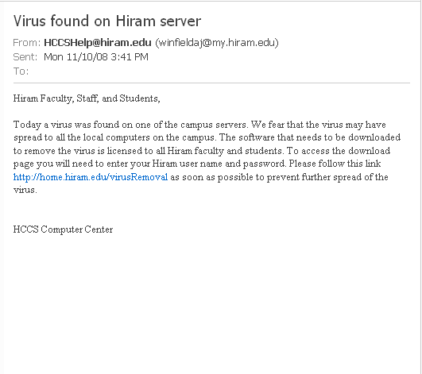


The Bait

Slide 50
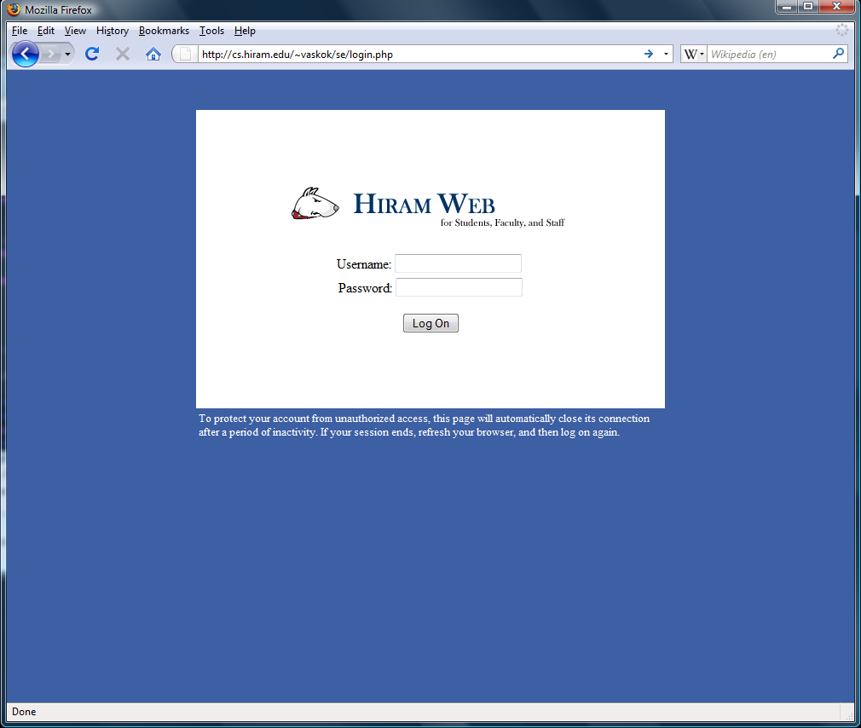
The Trap

Slide 51
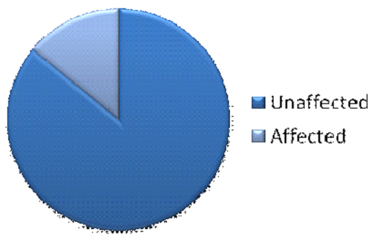
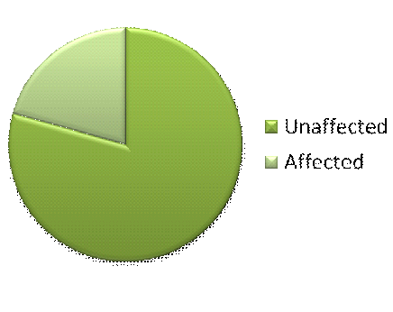
The Results
14.07%
20.67%

Slide 52
The Results – Only Ran For 1 Hour 10 Minutes
Students – 1237 total
Faculty and Staff – 208 total
14.07%
20.67%

Slide 53
After the Pharming Attack Code Was Disabled and an Alert Was Sent Out Across the Campus:
Several people wrote Andrew Winfield telling him the link was broken and would he reinstate it!
There were other attacks - Most were done after a warning from the helpdesk went out.
Teams wandered in the dorms, KC lab, library, staff offices, KC Welcome desk, KC Common Room and various offices.
Most who agreed to supply passwords or access to their computers were students, and many were strangers to the attacker in these tests.

Slide 54
51 Additional People Were Compromised:
1) Asked friends to insert a CD or memory stick
2) Claimed to have forgotten a password and needed to print pictures
3) Claimed to be doing a frequency count on types of passwords
4) Kit-Kats offered for password
5) Claimed to have a survey on a memory stick they needed to answer for a class
6) Claimed flash drive was broken and needed data on memory stick
7) Described a virus in a (real) notice from Norton and offered to allow a CD from Norton to be used to eradicate the virus
8) Claimed they had to obtain data on a USB drive and didn’t have a working one
9) Claimed to need a computer quickly to print something for a class

Slide 55
PLEASE - If You Get Nothing Else of This Talk, Learn These Rules
Never give your password to anyone!
Don't write your password somewhere.
Don't enter sites that request personal information unless you are absolutely sure of the site.
Never click on anything while you are in a panic!
Choose multiple safe passwords.

Slide 56
A Security Problem: Unsafe Downloads
Matthew Young for an IRC in the Computer Security class, investigated how likely it was to download malware when downloading what appeared to be something else – an image, a song, software, etc.
He worked with the Gnutella Network using LimeWire since LimeWire is the most popular peer-to-peer and file-sharing program with over 160 million downloads.
Matthew chose this project because, in his words, “Peer-to-Peer (P2P) file sharing is a rapidly growing area where new users often do not completely understand the risks they are taking.”

Slide 57
Why LimeWire and the Gnutella Network?
LimeWire is a Peer-to-Peer client that uses the Gnutella network to find and share files.
Keywords were used in an automated search to locate various files.

Slide 58
Analyzing the Data
The results were chilling and somewhat surprising:
Of the 750 files that were downloaded, 434 or 58% contained an infection of some type.
There were a total of 30 different threats.
Of these, 396 (91%) of the infections were from Zipped files, with the remaining 38 (9%) of infections being found in Audio/Video files.
The “Others” file type contained no malware.

Slide 59
Analyzing the Data - By Query Type
255 or 59% of infected files came from the Software and OS’s queries.
100 or 23% of infected files came from Movie queries.
72 or 16% of infected files came from Video Game queries.
7 or 2% of infected files came from Music queries.

Slide 60
Infections Found
Trojan-Downloader.WMA.GetCodec.b
Trojan-Downloader.Win32.VB.bsa
Trojan.Win32.Buzus.adbl
P2P-Worm.Win32.VB.dw
Virus.Win32.Sality.v
AdWare.Win32.Agent.dva
Trojan.Win32.Agent.uvi
Trojan-Dropper.Win32.VB.gtf
Backdoor.Win32.IRCBot.dd
Trojan.Win32.VB.eme
Virus.Win32.Fontra.c
P2P-Worm.Win32.Agent.bm
Trojan.Win32.Obfuscated.gen
Trojan-Downloader.Win32.VB.dck
Trojan-Downloader.Win32.VB.dck was by far the most common infection found, making up over 50% of the total.

Slide 61
Conclusions
Zipped files are the most likely to contain malware, with 396 of the 430 files downloaded being infected (92%).
While no queries were completely safe, Music searches resulted in the least amount of malware with only 7 of the 150 downloaded files being infected (5%).
Audio and Video files are not immune to infection, 38 of the 254 Audio/Video files downloaded were infected (15%).

Slide 62
Conclusions Continued
Of the 66 “Other” file types downloaded, there were no infections found in any.
Queries for Software or OS’s were the most likely to return an infected file, with 255 of the 300 files downloaded being infected (85%).
Do not download 113KB Zip files. 223 of the 224 files this size contained the Trojan-Downloader.Win32.VB.dck (99.5%).

Slide 63
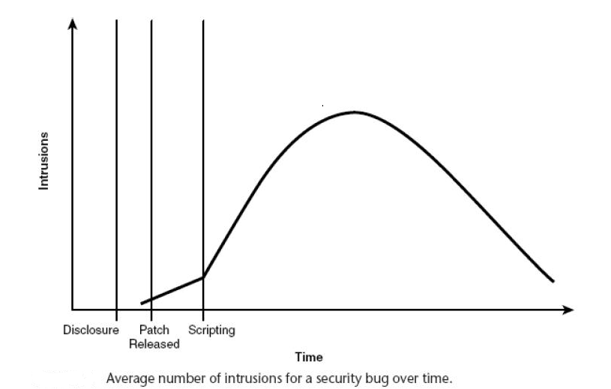
A Security Problem: Security Patches
Security patches should fix problems - right?
In truth they point out to hackers where the vulnerabilities are.
In addition, many users never install the patches.
This tells the story

Slide 64
A Security Problem: Lack of Liability in the Software Industry
There is no software liability – no incentive for secure software.
Most developers never learned to produce secure code.
Secure code often takes performance and development cost hits.
Consequently, the longer development times and the longer running times discourage developers from writing secure code.

Slide 65
A Security Problem: The Complexity of Software Today
Software products are growing in size.
Windows XP has 40 million lines of source code –
  A page is typically 52 lines of code.
  So, we are talking about ~1539 reams of standard one-sided xerox paper!
Typically there are 5-50 bugs per KLOC (a thousand lines of code) -it has been estimated that 50% of the bugs are coding errors and 50% are design errors
10% of the bugs result in security faults.
40,000 KLOC*5*10% = 25,000 security bugs (lower bound)

Slide 66
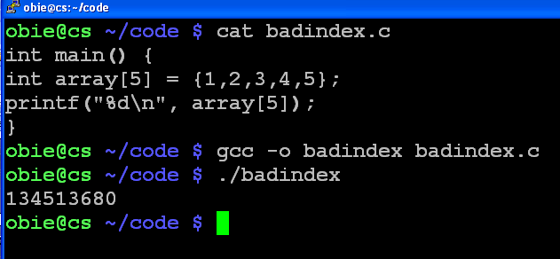
A Security Problem: Insecure Code
Insecure code which allows such holes as
  Buffer overflows
  Smashing the stack attacks

Slide 67
What Happened To The Last Program?
The information leakage exists because C does not check array bounds - C++ doesn't either!
Thus, whatever was in the position where array[5] should be will be output.
Do array out of bounds errors always produce access to a memory location?
  No, the system might crash (DoS).
  This example just leaks information.
  There are worst consequences as we will see.

Slide 68
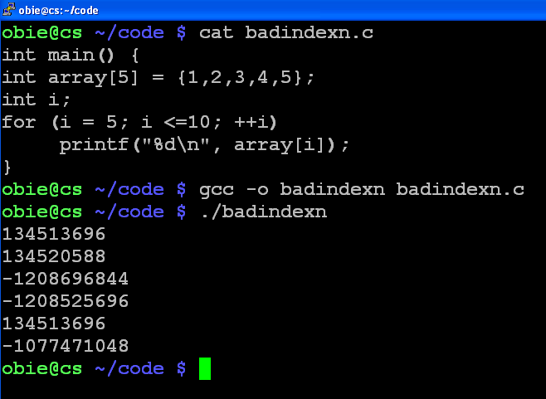
Can We Leak More Information?

Slide 69
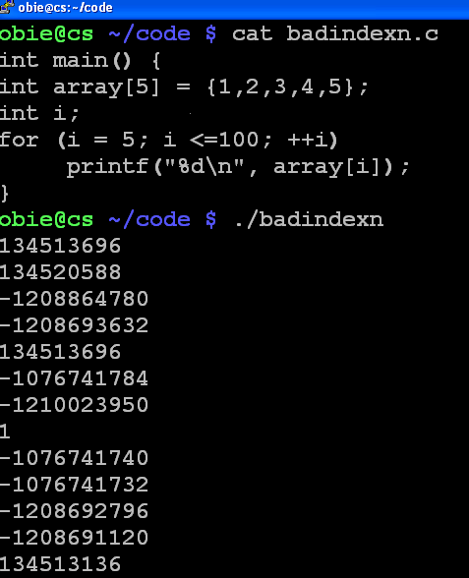
Or Even More?

Slide 70
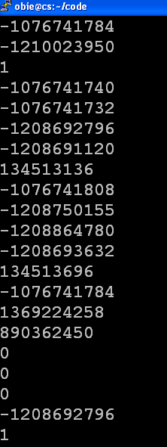
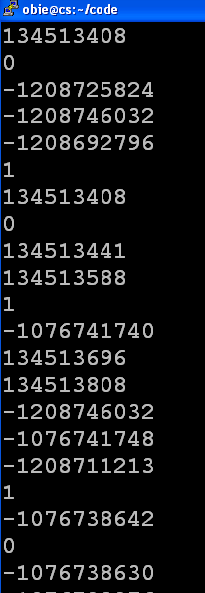
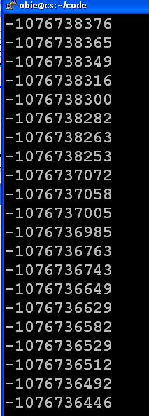
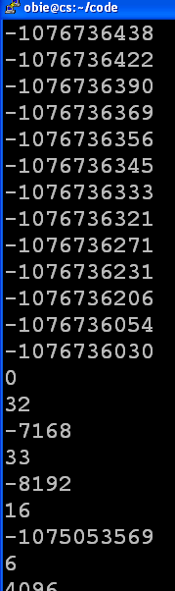
And More Leakage!

Slide 71
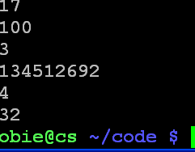
And, At Last It Terminates!
Observe that to use this information you do need to know how to read the machine code that is output!
But, that's no big deal for a hacker who has patience to check out the code.
Note: Some people call this a buffer overflow problem, but some prefer to think of it as an information leakage problem.

Slide 72
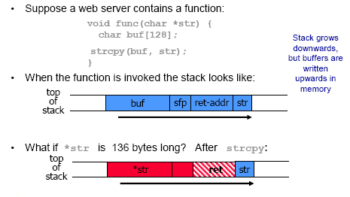
Simplified Example of Smashing the Stack

Slide 73
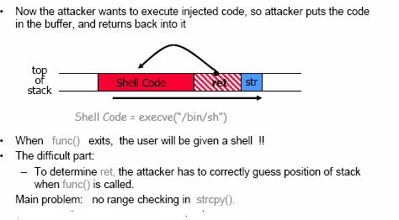
Example Continued
Source: David Lie ECE1776

Slide 74
Simplified Stack Example
low →
void func(int a, int b){
char buffer[10];
}
void main(){
func(1, 2);
}
:
:
SP
buffer
SP
ret
return
address
a
SP
high →
b
SP

Slide 75
Smashing the Stack
low →
What happens if buffer overflows?
???
:
:
Program “returns” to wrong location
buffer
SP
overflow
SP
A crash is likely
ret
ret…
NOT!
overflow
a
SP
high →
b
SP

Slide 76
Smashing the Stack
low →
With code injection, attacker can run any code on an affected system
:
:
SP
mal. code
ret
ret
SP
a
SP
high →
b
SP

Slide 77
There Are Many More Known Problems
CODING BUGS – 50%
Information leakage
Control hijacking
Buffer overflow
Smashing the stack
Command injection
Cross-site scripting
Integer overflow
Race conditions
Formatted strings
Segment overwrite
Heap overflows
Incomplete mediation
SQL injection
PHP include
Non-trusted input
Realize these problems are not mutually exclusive!

Slide 78
Some Other Security Problems With Programs
DESIGN FLAWS – 50%
Cryptography misuse
Lack of compartmentalization
More privilege used than necessary
Relying on secret algorithms
Sharing resources
Usability problems

Slide 79
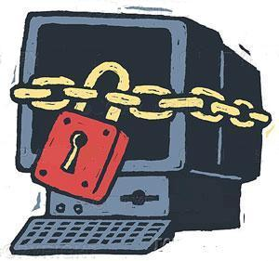
Can We Fix These Problems?
Some- but it will cost a lot to implement the changes.
But we must fix them in the future or we'll make the use of interconnected computers too dangerous to use.
Perhaps one of our current
students will solve some of these
problems in a cost-efficient way!
I doubt this is what we want:

Slide 80
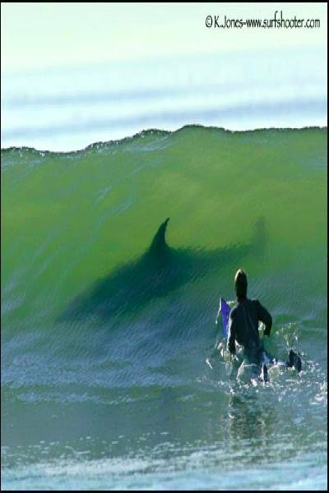
Or This ---

Slide 81
Thank you for your time for coming to this my last public lecture at Hiram College!
Any questions?

