Slide 1
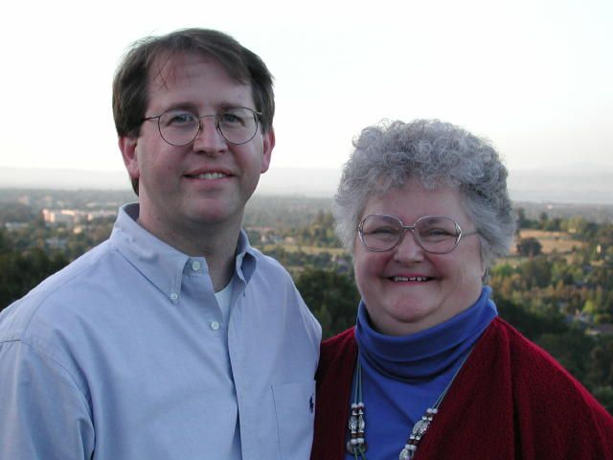
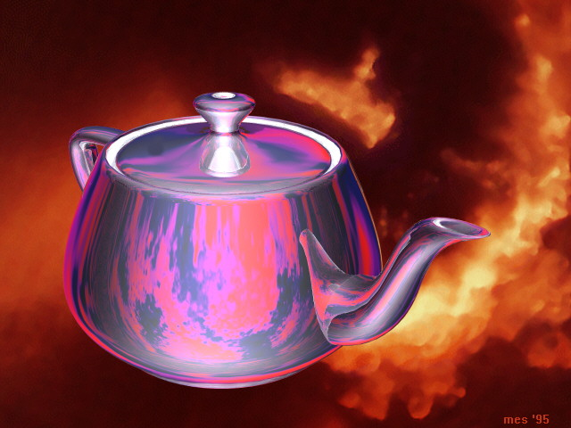
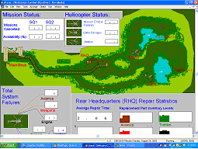
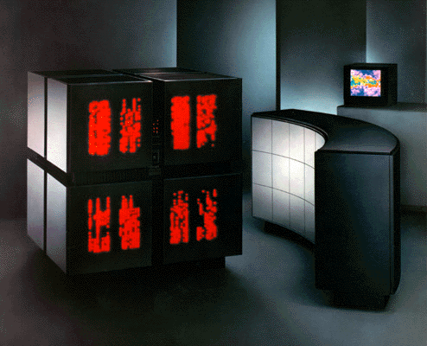


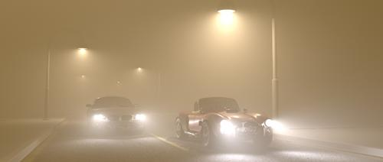
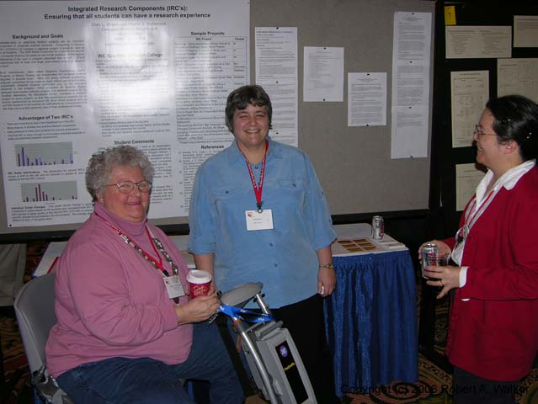
Oberta (Obie) Slotterbeck
Professor of Computer Science
Obie visiting with Hiram graduate,
James Washura '83 in Silicon Valley
where he and his brother Thomas '83
founded SyntheSys Research, Inc.
What scientific questions get you excited?
My discipline is evolving so rapidly there is no end to exciting avenues to explore. In my early career, I was concerned predominately with designing mathematical algorithms for computer algebra systems (MACSYMA, VAXIMA) and functional analysis calculations (Tsirelson Space norms). Recently my publications have been in the area of computer science education. However, I still am turned on by questions in the areas of Graphics, Computer Simulations, and Parallel Computing.
How do you involve students in your research?
My department requires each student to do two Integrated Research Components (IRCs). These are attached to specific courses. The students start with a formal proposal and complete their work in the semester by providing a public talk to peers, by demonstrating a working program prototyping their research, and by submitting a journal style paper of their work. I typically direct IRCs in Graphics, Computer Simulations, Parallel Computing, and Algorithm Design. Several students have continued their IRC work with related projects in graduate school.
What exciting findings have you
and your students made recently?
In the Computer Simulation IRC last Spring, a student was able to show how to improve the operation of a family run store in Japan. Another student simulated the genetic mutations in Agrobacterium tumefaciens in order to provide a teaching tool. One student modeled Miller dining hall and was able to show how their serving policy affected their service at that time.
Students currently doing an IRC in Graphics this term are working on improving various algorithms for generating smoke, water turbulence, hair, fire and other phenomena you see in the movies and in video games.
Interesting recent publication or presentation?
Poster presenting our IRC model:
Integrated Research Components: Ensuring that all Students Can Have a Research Experience by Ellen L. Walker and Oberta A. Slotterbeck, presented at the SIGCSE 2006 Symposium.
Paper presenting our IRC model:
Integrated Research Components: A Practical and Effective Alternative to Senior Projects by Ellen L. Walker and Oberta A. Slotterbeck, presented at the 2006 CCSC Midwest Conference.

