Slide 1
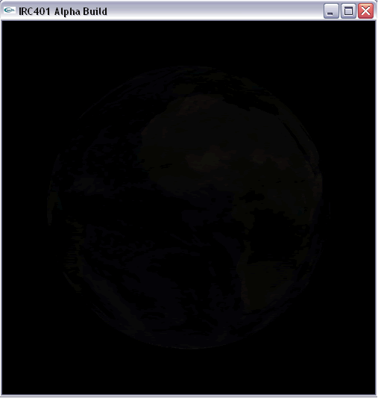
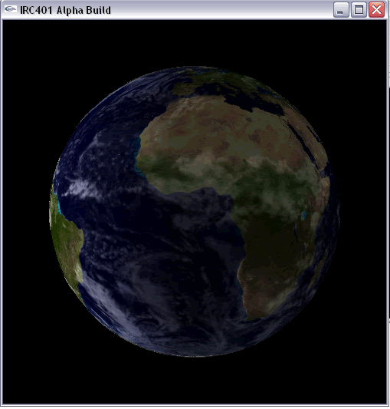
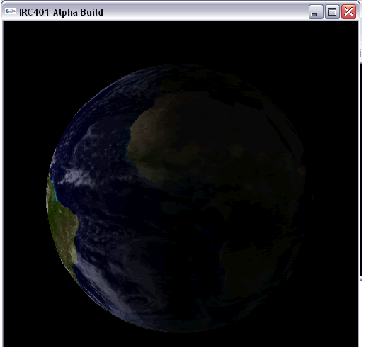
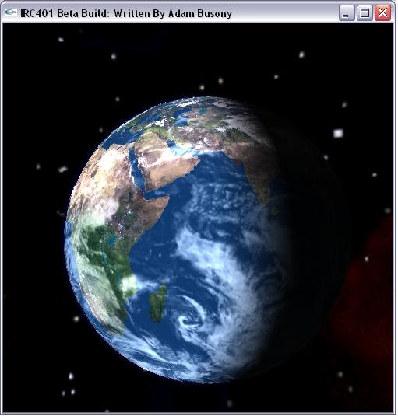
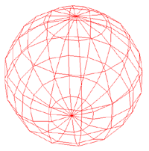
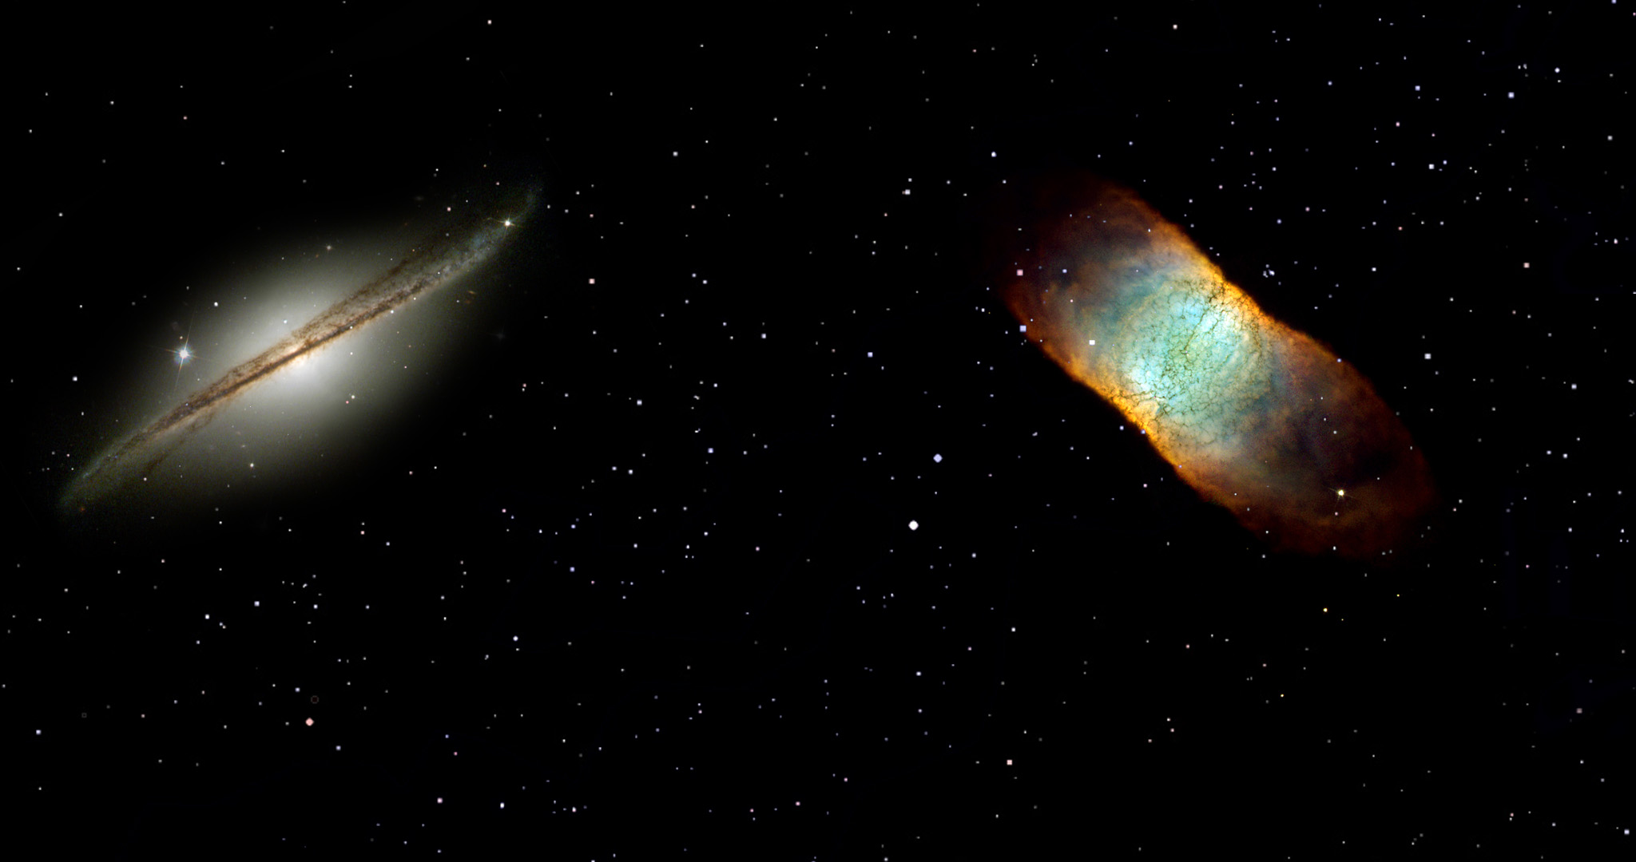
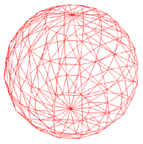
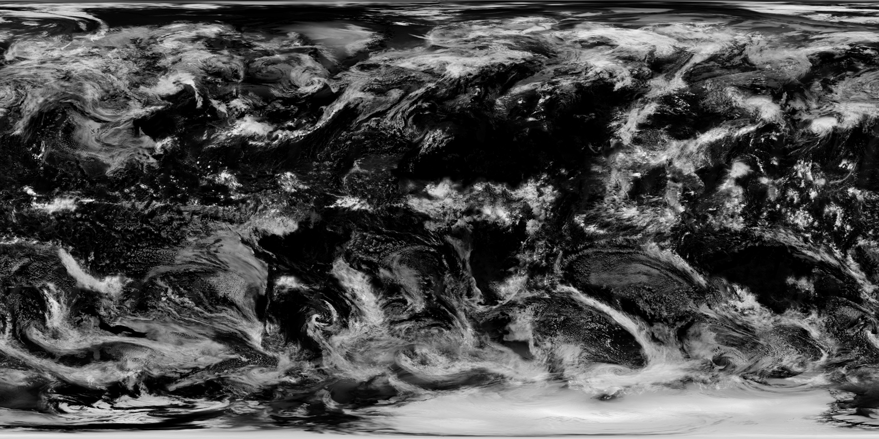
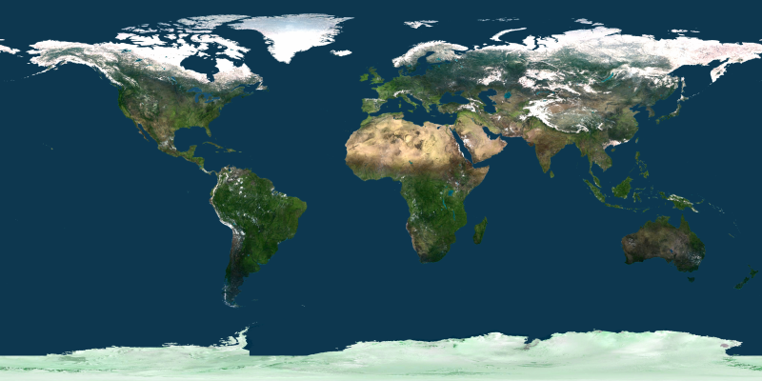
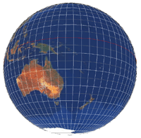
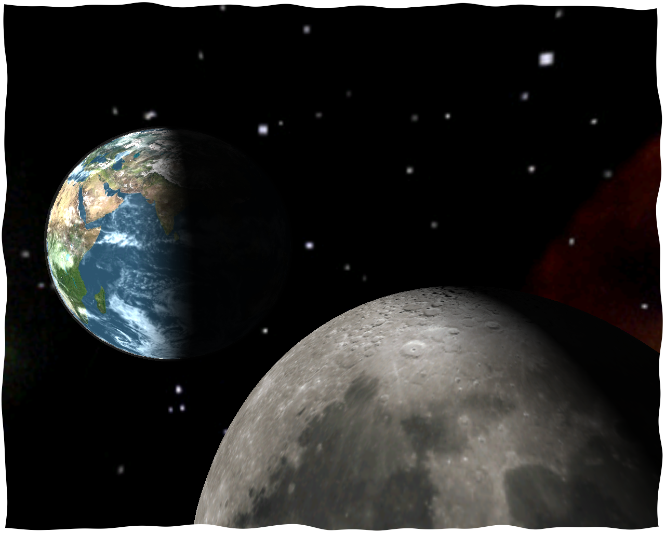
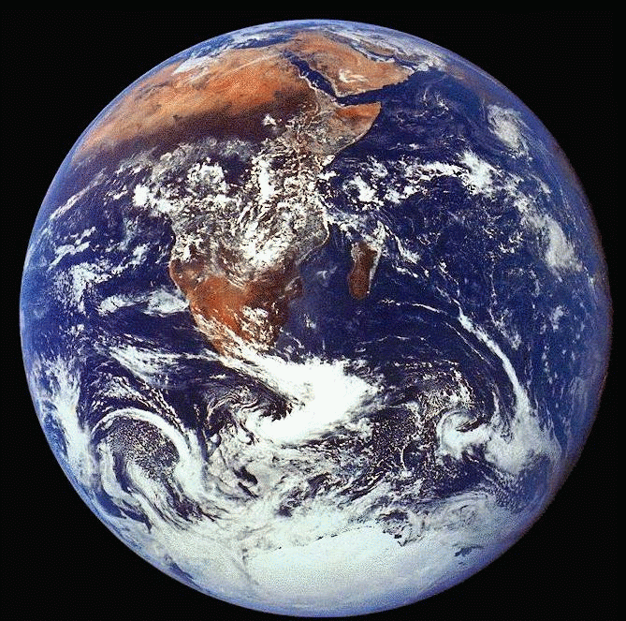
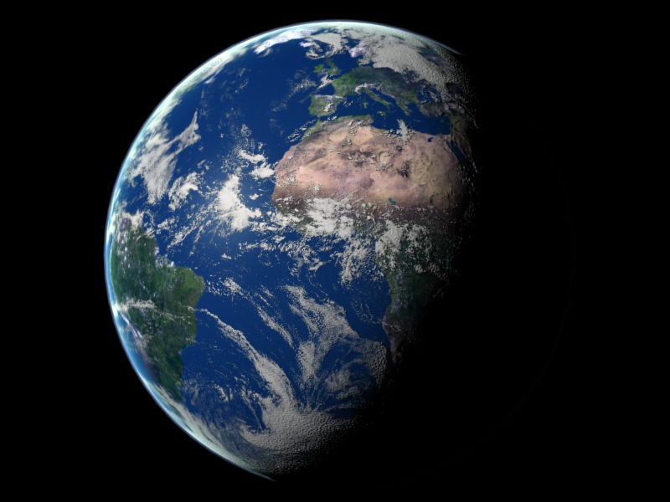
Modeling of Planetary Bodies from an Orbital Perspective
Integrated Research Component
By: Adam Busony
Right:
Implementation of lighting was accomplished in various stages. In the first picture lighting was enabled. In the second picture, lighting was applied evenly. The third shot shows lighting being distributed. In the final picture an “atmosphere” was added and lighting values were further tweaked.
Abstract:
The real-time graphical modeling of planetary bodies is a very difficult task given the current state of computer hardware. The complexity of such objects if often so large, that the only way to represent them as convincingly real entities is to pre-render them in ray-tracing software. Real-time representations of such objects must often sacrifice detail in order to be able to display the objects at acceptable frame rates, and in doing so, sacrifice the realistic qualities of the representation.
This project will delve into the issues present in performing a real-time representation of a planetary body. Advancements in current computer processing power and 3-D acceleration have allowed for unprecedented levels of complexity. The goal at hand is to create a visual representation of a habitable planet (Earth) that is visually convincing to the viewer. Techniques used include scalable texture mapped spheres, skyboxes, lighting, blending, alpha-transparency, and advanced camera manipulation techniques.
Above:
A variety of textures were used in the implementation of this project. The bottom two textures represent the Earth’s terrain and sky. The top texture was used to represent the starscape that is viewed while navigating around space.
Above:
The standard GLUsphere object in addition to a robust algorithm allowed for the quick generation of spheres in the program. Because of the chosen implementation for the spheres, they can be easily scaled at further distances thus preserving the frame rate with multiple planets in the system. Texture coordinates were also generated for the appropriate objects.
Right: A real-time representation of Earth and the Moon rendered by the IRC program.
Above: A Pre-rendered Model of the Earth
Employing Ray-tracing
(Courtesy http://www.noirextreme.com/earth)
Above: An Actual View of Earth from Space
(Courtesy NASA)

