Slide 1
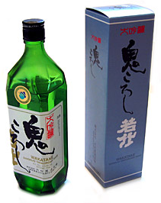
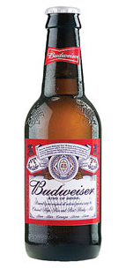
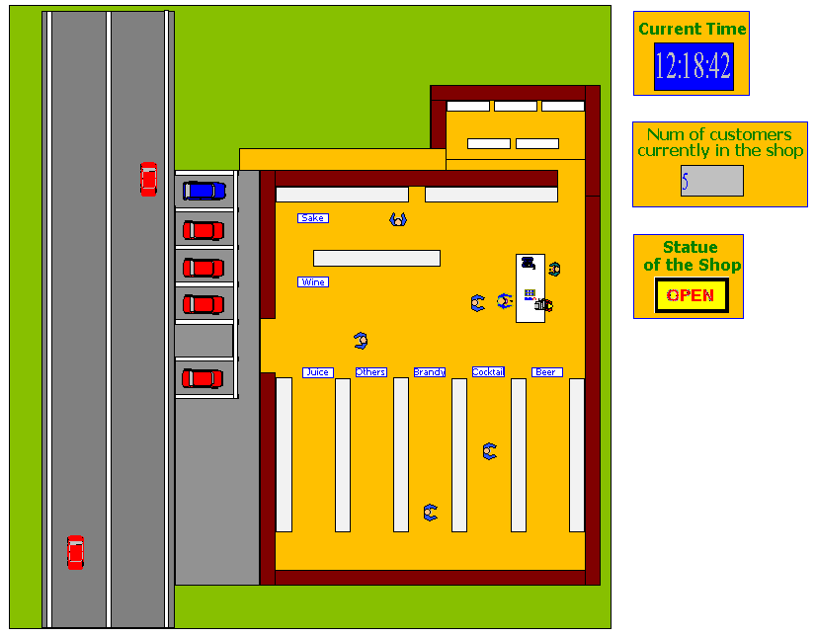


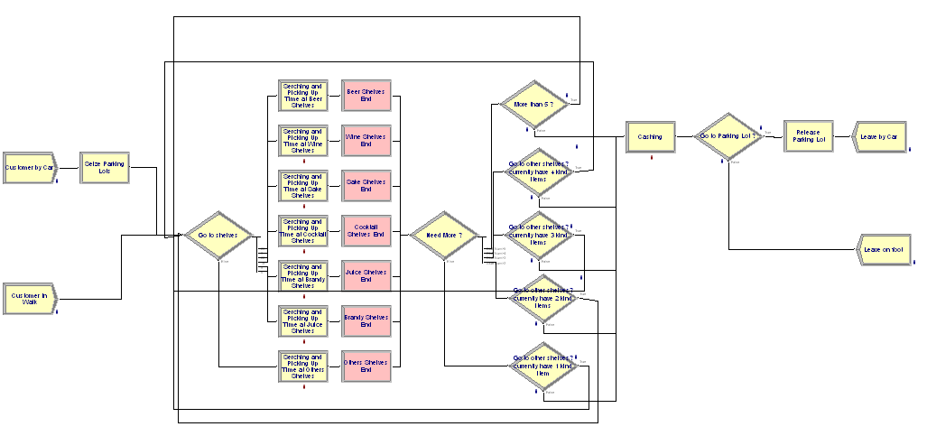
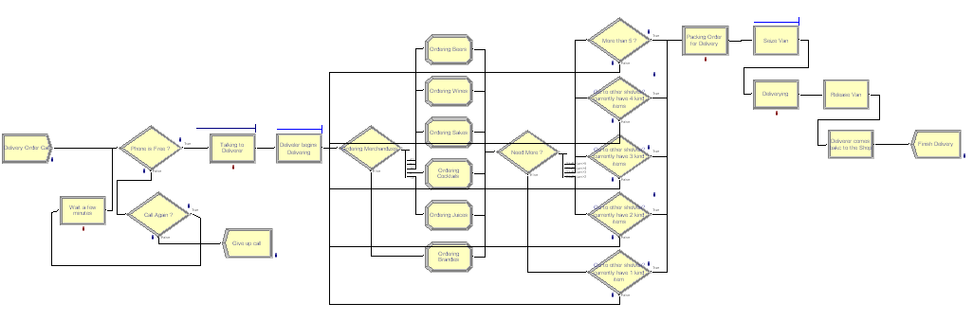


A Simulation to Study the Operations of a Family-run Liquor Shop
Spring 2007: Integrated Research Component in Simulation
By: Hiroki Morimoto
Abstract:
Simulation is a good tool for measuring the performance of a model, improving its operation, and predicting its result and its effect under a variety of situations. Therefore, simulation is used by various companies and applied in across many fields to decide the best way of running system as well as understanding the flow of system among various scenarios. As simulation software becomes more powerful and cheaper, the tendency of applying simulation to their company increases more and more despite the fact that it is still time-consuming and hard work.
The presenting project discusses and constructs the liquor shop model which our family runs in our hometown via software Arena version 11.0. Arena helps us to construct a simple small model to a big complex model. Using the constructed model, we try to finds the best way that maintains the customers’ satisfactions as well as maximize profits under several scenarios to consider focusing on a typical weekend work that tend to congest with customers. The data and distribution is based on the observation in the shop, customers’ questionnaires, and our experiences.
Considerable Scenarios
    No deliver service
    Increase casher(s)
    Increase deliverer(s) and stuff(s)
    Increase parking lot(s)
    Combined these scenarios
Focus Measurements
Maximize
    Total Profit in a day
Minimize
    Average waiting time and number at cashing desk
    Average waiting time and number in parking lot
    Total cost in a day
    Number of rejected delivery service calls
Above:
The screenshot taken during the simulation. Also, this screenshot represents the layout of the liquor shop and how customers and workers behave.
Above:
The simplest logic that represents the typical flow of delivery service.
Above:
The simplest logic that represents the typical behavior and flow of both walk in customers and customer who drive up. This logic is built followed the process-oriented modeling method

