Slide 1
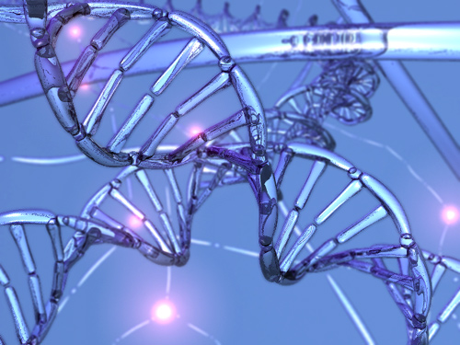
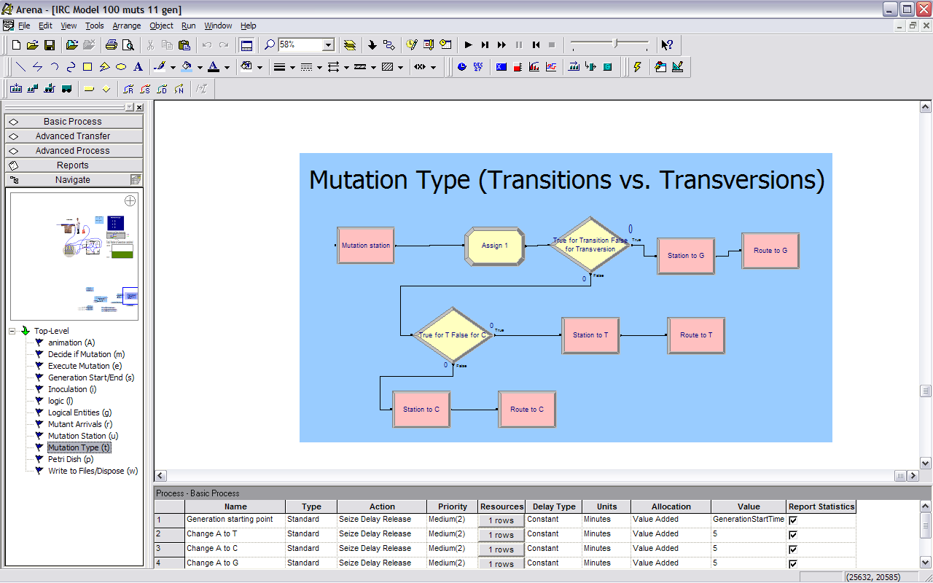
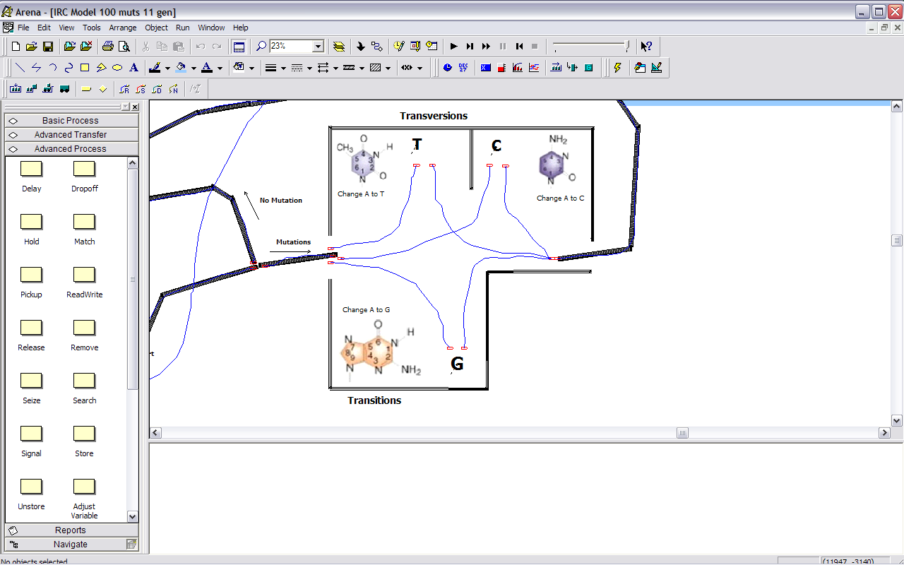
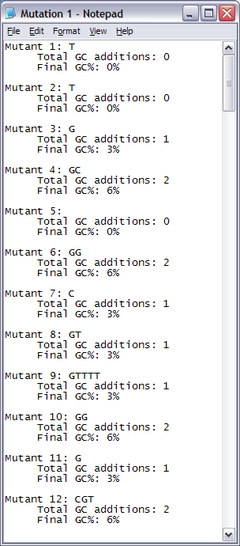
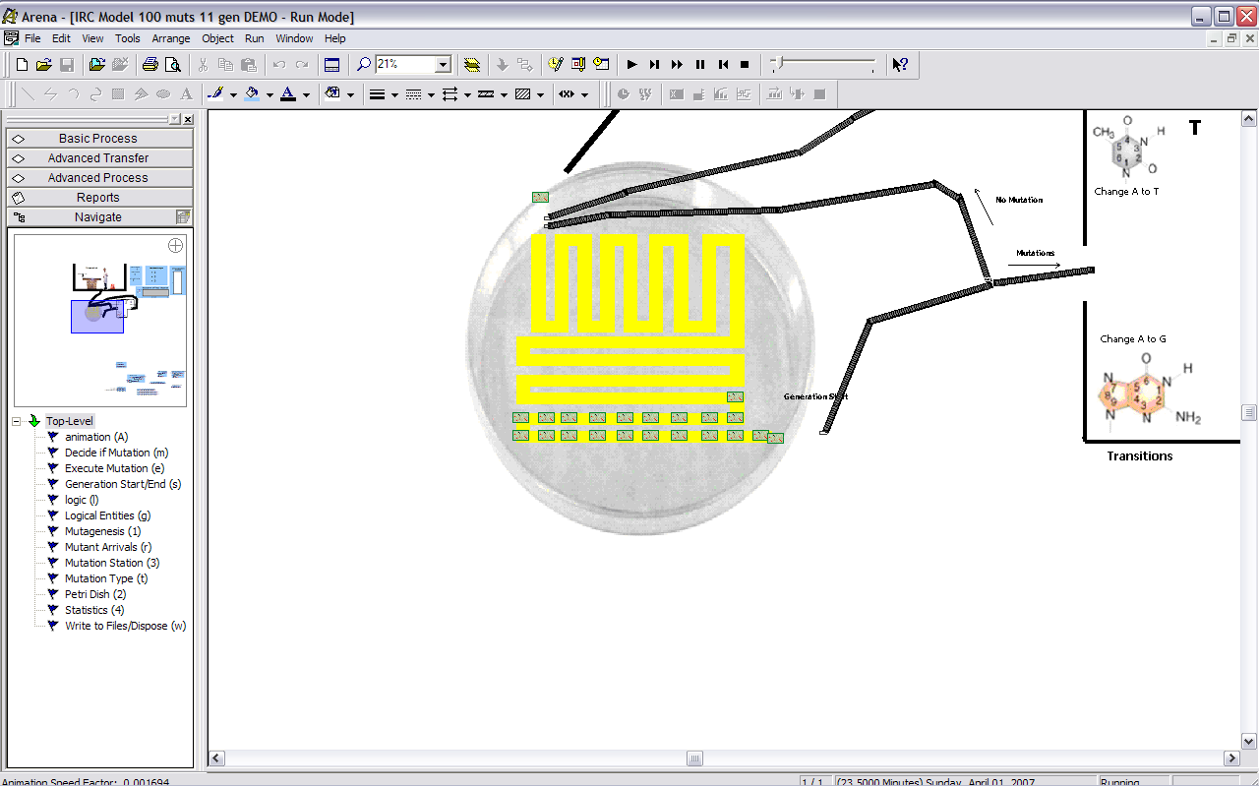
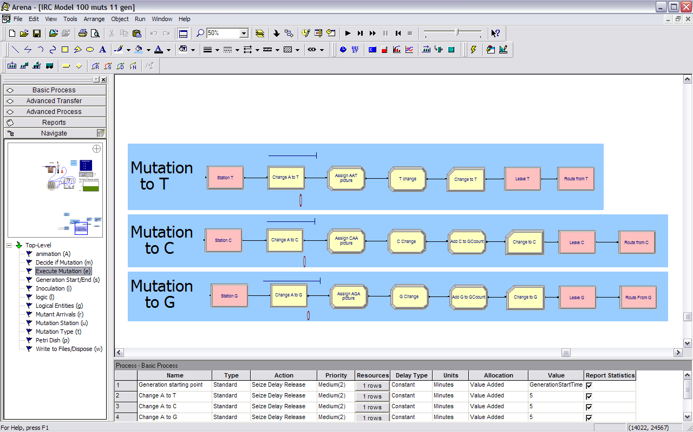
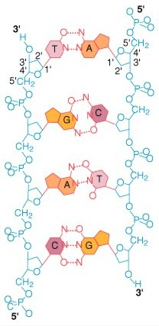
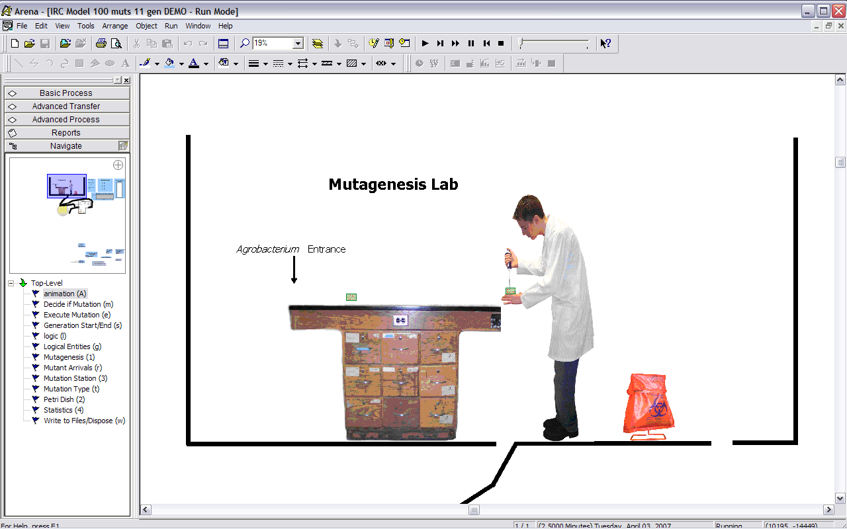
Simulation of Genetic Mutations in Agrobacterium tumefaciens
Spring 2007: Integrated Research Component
By: Joseph Moeller
Abstract:
Genetic mutations are a result of mistakes that occur during replication of organismal DNA. Because they are random with respect to time and location in the genome, mutations are very unpredictable. This simulation explored mutations at varying rates and types to figure out how long it would take a section of foreign DNA to become more similar to the host organism’s DNA in terms of Guanine + Cytosine percentage. Data from this simulation were recorded in string format before being outputted to a file, allowing users to clearly visualize and understand what type of nucleotide additions took place. Biological processes such as this are often misunderstood and difficult to visualize. In addition to collecting data from the simulation, this project helps explain the process of mutations via simple animation for a clearer understanding.
Above:
Decide modules used to change parameters for different simulation scenarios of the program. Changing the rate of transition vs. transversion mutations altered the final output of each mutant.
Above:
Mutation Center where mutants received base-substitution mutations within their inserted foreign DNA.
Below & Above:
Agrobacterium cells receiving a section of foreign, Adenine rich DNA (Below). After each cell is mutagenized, they move to the FIFO queue on the Petri dish (Above). Here, they wait their turn to move one-by-one through the system with a chance to obtain a mutation.
Above:
The logic for the different possible mutations. Assign modules make changes to variables, including the 1-dimmensional arrays. Record modules report tally statistics of overall types of mutations that occurred during the simulation.
Above:
Data was held in multiple 1-dimmensional arrays. At the end of the simulations, the string data from the arrays were outputted into this format, allowing the user to quickly and easily see the types of mutations each mutant received. GC% was calculated for the 30 base-pairs of foreign inserted DNA.
Right:
DNA molecule showing between-class bonding of nucleotides: Adenine bonding with Thymine, and Guanine bonding with Cytosine.
Background picture from http://nanopedia.case.edu/image/dna.jpg

