Slide 1
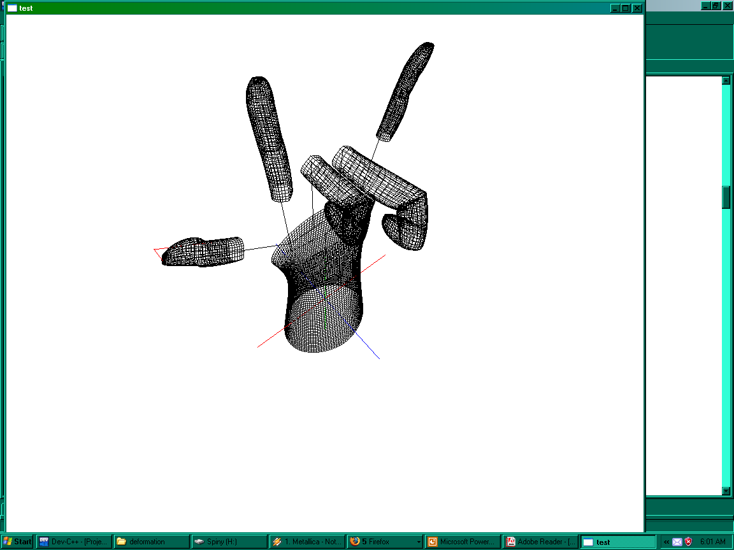
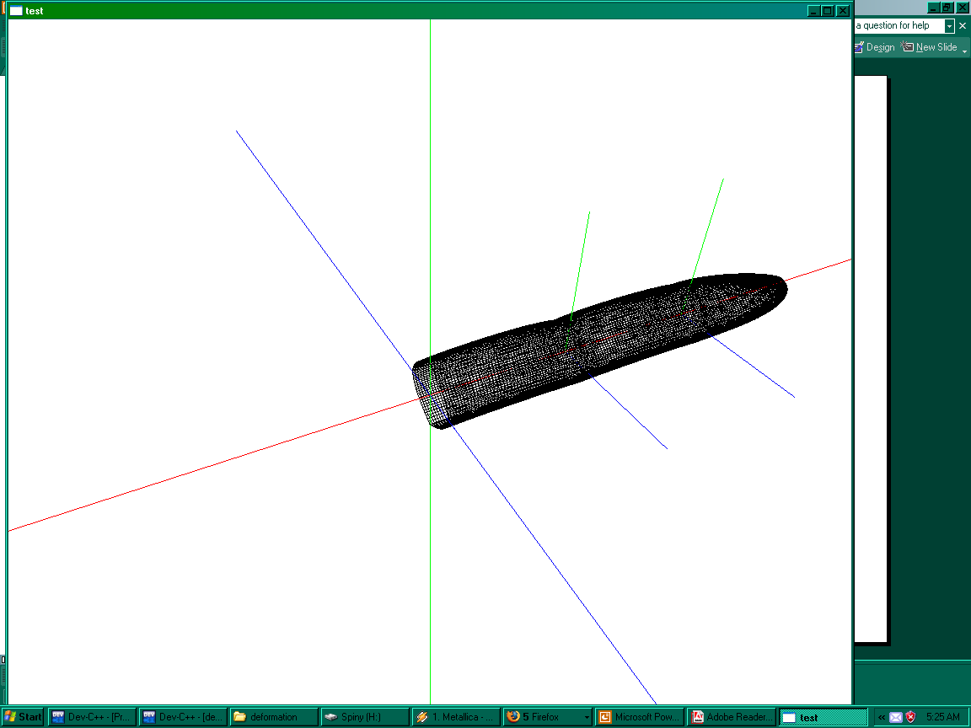
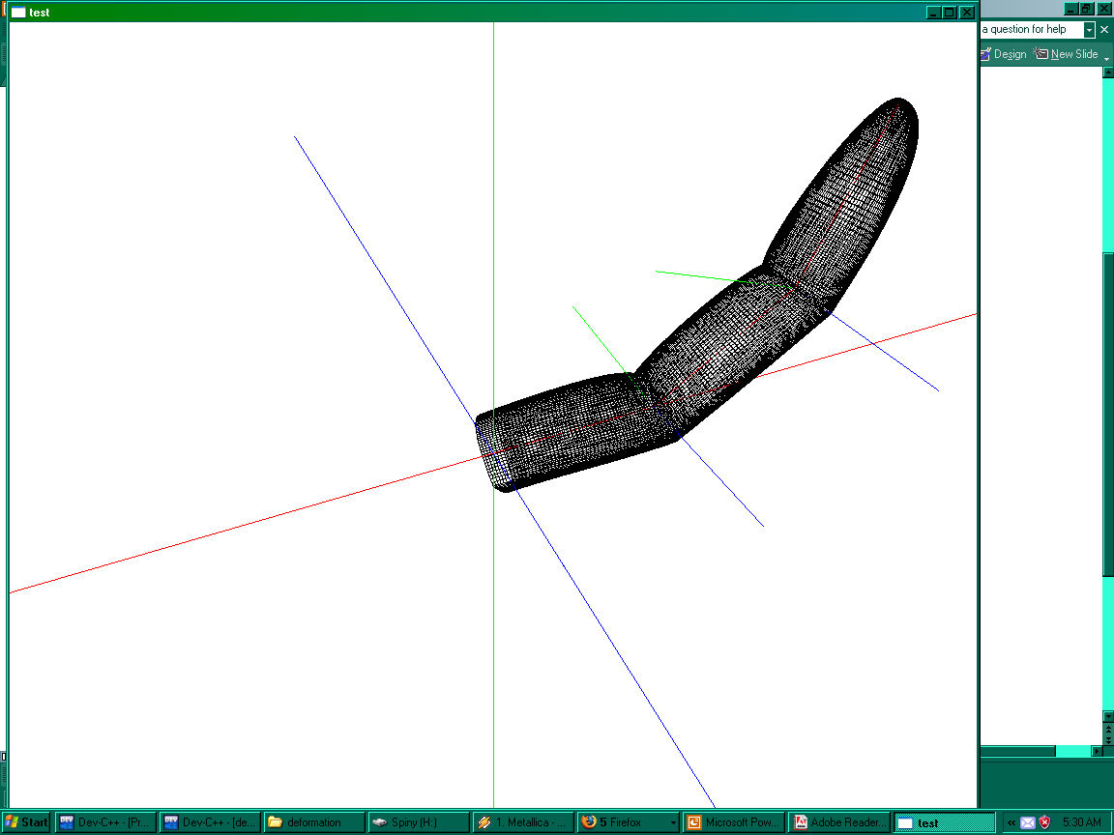
Real-time Modeling of a Deformable Human Hand Using Bezier Surfaces
Jason Wray
Abstract
Real time, realistic rendering of human subjects is among the supreme goals of computer graphics. The financial incentives for improvements in this domain are great, as applications as diverse as Medical Research, military training, and, of course, video games require it. Nonetheless, realistically rendering the human body at a speed to allow for real-time animation has proven to be a difficult task. One of the outstanding causes of this difficulty is the fact that the human body is not a rigid object; as it moves, skin and muscles bend, twist and stretch in complicated ways. While this fact makes offline rendering of human subjects difficult as well, techniques which can be used to solve the problem in settings where calculation time is not vital, such as physical modeling, can not be used to solve this problem in real-time systems.
Instead, deformation of human models in real-time is typically accomplished by creating a skeleton consisting of rigid bones and joints that allow for restricted movement, and placing polygon mesh skin on said skeleton. As the underlying skeleton moves in a rigid manner, the vertices of the polygon mesh above it are altered, simulating, the effect of skin and muscle moving in the human body.
The Skeletal Subspace Deformation (SSD) algorithm is a widely used implementation of this general tactic. In SSD, the vertices of the polygon mesh are associated with one or more of the bones of the skeleton, with each associated bone being given a weight [167 Lewis00]. The transformation matrices for each of the bones associated with the vertex in question are then applied to the vertex proportionally to these weights, effectively, as the name suggests, deforming the space around the bones in order to produce the appearance of correctly deforming tissue.
I have modeled a human hand using a variation of the SSD algorithm, altered in order to overcome the systematic failure Lewis calls “the collapsing joint defect” [ibid.]. The mesh which the skeleton’s transformations deform is not, however, manually generated, but are the result of OpenGL’s Bezier surface approximation: this means that the deformation matrices are applied to the control points of the surfaces rather than individual vertices.
An example of a pose made using the model, with the palm removed to allow the underlying skeleton to be clearly seen.
Examples of deformation being applied to a wireframe finger. Note the use of non-continuity to simulate the creases on the insides of joints.

