Slide 1

3D Graphics and Animation Using Bryce 5

Slide 2
Multimedia Art
Formerly, most artists drew everything by hand. Some still do.
But many of the animated images and special effects you see today in the movies, TV ads, and games are computer-generated.
That means there’s a whole new breed of artist -- and a whole new career path to consider.
With creativity and imagination, multimedia artists bring dazzling images and new sophistication to everything from cartoons to commercials

Slide 3
Multimedia Art
The government's Bureau of Labor Statistics expect jobs for multimedia artists and animators to grow as fast as the average for all careers through 2014.
While competition is always tough in this field, growth in the movie and video industries should provide many new, exciting opportunities.
Animators will also be needed to work on Internet sites and other forms of electronic media.
According to Cartoon News, the last three years have seen record-breaking revenues for computer animated films.

Slide 4
Computer-generated movies
Since 2000, the feature-length digital animation film genre has produced each year at least one film animation grossing over $100 million:
• Shrek (2001), $267,783,866 (Academy Award Winner)
• Ice Age (2002), $175,676,09
• Finding Nemo (2003) $339,703,580
• Shrek 2 (2004) $436,471,036
• Madagascar (2005) $193,187,569
• Cars (2006) $243,786,632

Slide 5
Why Study the Software Bryce?
Many computer artists use Maya or Studio Max for creating various images.
Bryce is not as complicated, but it acts somewhat like Maya so you can see how computer artists in the entertainment field work.
Why would anyone take CPSC 387: Graphics if you can create neat graphics with program such as Maya, Studio Max, Bryce and other similar programs created by various special effects studios?

Slide 6
When the Software Isn't Sufficient to Create the Inspiration of the Artist
Example: In the "Time Machine", consider the scene where the ivy entwines the glass dome of the lab as the scientist moves forward in time.
Originally it looked like green, plastic snakes when drawn using existing software.
Maya is written in C and OpenGL which computer scientists in graphics usually know.
They had to go into Maya and add additional features so the artists could render the scene in a realistic matter.

Slide 7
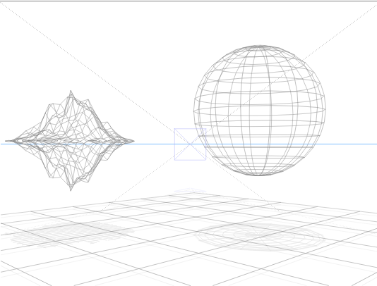
Recall we Looked at the Role of Wireframes
Most initial modeling is done in wireframes and Bryce uses this approach.

Slide 8
Why Wireframes?
Rendering a solid screen image with lighting and texturing enabled is a time consuming and expensive task.
Rendering a wire frame is not costly.
Every movement of a point in 3D space requires the multiplication of a 4 X 4 matrix by a 4 X 1 vector.
Trust me that this is computationally expensive if you had to move every point in, say, a sphere.
In animated sequences, a point can be moved 60 times per second!
Important fact: With a wireframe, only the vertices must be moved, not every point in the figure!!!

Slide 9
Fractals are Used in Bryce
Fractals ypically are used to model objects with the following properties:
Irregular
Randomly jagged, but constrained
Non-fluid
On zooming in, the shape becomes more irregular
On zooming out, the shape becomes less irregular

Slide 10
Fractals (for students with calculus basis)
Were introduced mathematically to capture the notion that you can have a continuous curve that is nowhere differentiable---i.e. there is no point at which a derivative exists.
Intuitively, this means the curve is unbroken---i.e. smooth---but it is incredibly jagged.
Of course, when we draw a fractal we are drawing it at only one point in its generation, as many of these are defined as the limit of an iterative process.

Slide 11
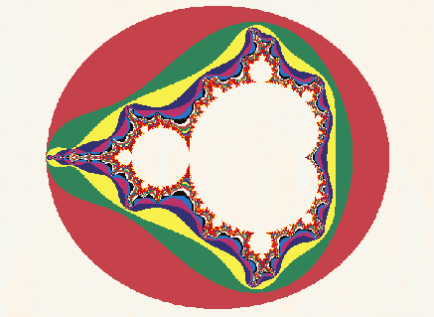
Fractals
The Mandelbrot set designed by Mandelbrot.

Slide 12

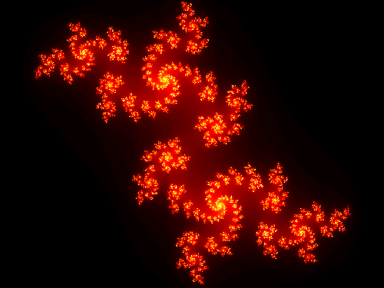

dragon curves are some other fractals

Slide 13
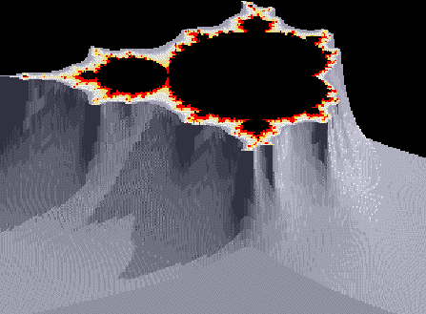
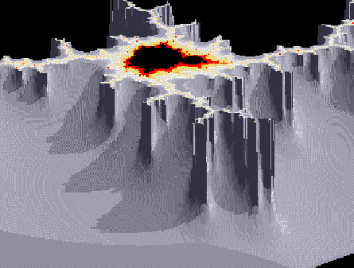
The Start of an Idea for Generating Mountains
These are close to the Mandelbrot set, but one of the values generated in the iteration is used to produce a height, and, consequently a rugged terrain.

Slide 14
Fractal Like Methods
Shorelines, trees, mountains, etc. aren't really fractals, but we can use fractal like methods to model them.
Mandelbrot first used them in graphics to generate mountainous terrain, but Fournier, Fussell, and Carpenter in 1982 found a faster way to generate terrain.
Since then, the methods have been modified to produce trees and ferns as well is mountains...

Slide 15
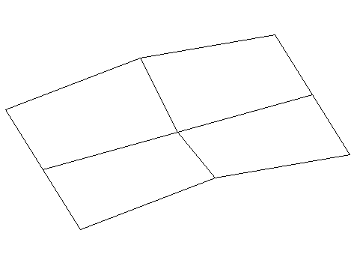
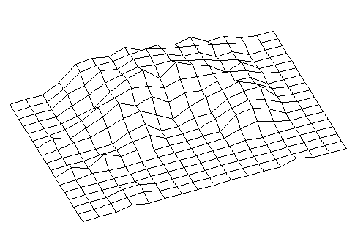
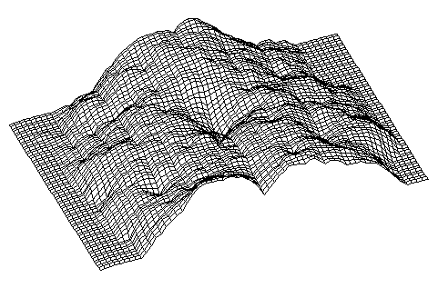
Basic Idea for Generating Fractal Mountains
(Fournier, Fussell, and Carpenter Algorithm Used by Bryce)

Slide 16


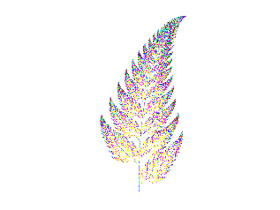
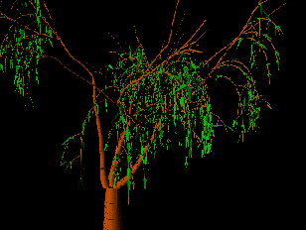
A similar idea produces ferns and trees.
.

Slide 17
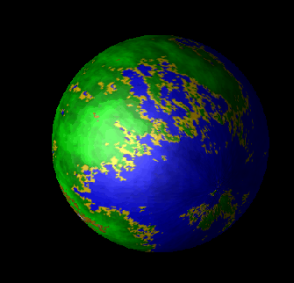
A Fractal Texture Mapped onto a Sphere to Make it Look Like a Planet

Slide 18
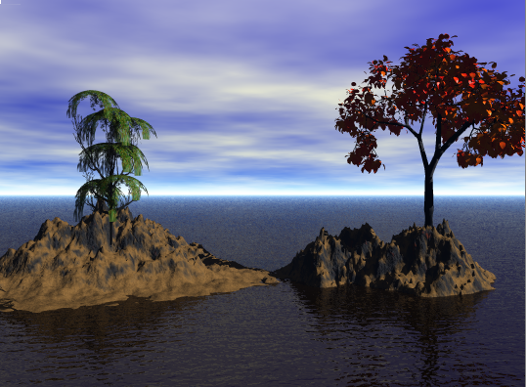
Bryce Generated Fractal Rocks and Fractal Trees

Slide 19
Bryce's Spaces
There are 3 types of spaces in Bryce. Each has its own axis space designated by x, y, and z coordinates.
  World Space- analogous to the layout on a map, but a 3 dimensional one rather than a 2 dimensional one.
  Object Space- uses an axis system embedded in the object. You can oriented objects by rotating them around their own axis.
  Camera Space- uses an axis system at the center of the camera as it views the scene. The positive x-axis is always to the right; the positive y-axis is always up; and the positive z-axis is into the screen.

Slide 20
Orienting Yourself in Bryce's 3D World Space
We need 3-axis in a 3D world: x, y, and z.
A point is located by giving its x, y, and z coordinates.
Example (50, -10, 100 )
Bryce's World Space center
+Z
50
+X

Slide 21
Orienting Yourself in Bryce's 3D Camera Space
We need 3-axis in a 3D world: x, y, and z.
The default orientation on the screen (which is typically used in graphics work) is:
+Y
(i.e. up)
Bryce's World Space center
+Z (i.e. into the screen)
+X
(i.e. right)

Slide 22
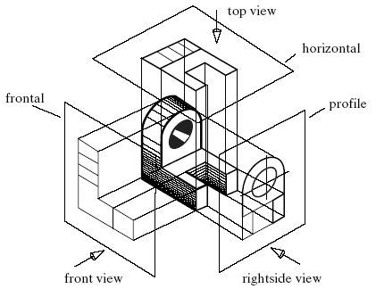
Bryce Provides Multiview Orthographic Projections of the 6 Sides of a Scene

Slide 23
Director and Camera
Both are two different positions relative to the scene.
They can be separated just as the two functions can be separated when shooting a movie.

Slide 24
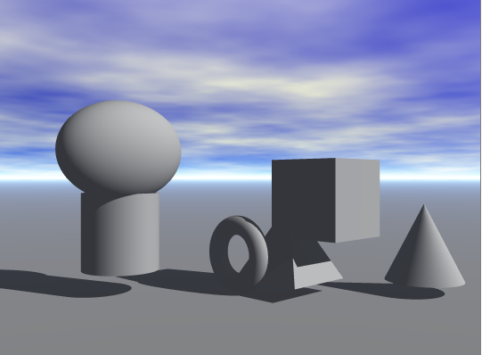
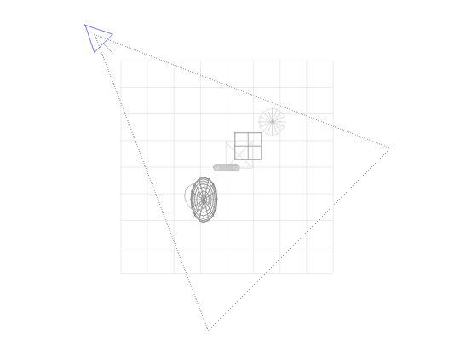
Top View
camera
Top View
X = Director’s position
X

Slide 25
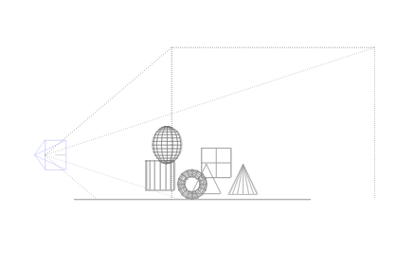
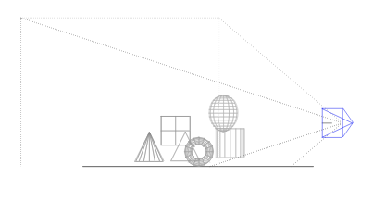
Front and Back View
Front View
Back View

Slide 26
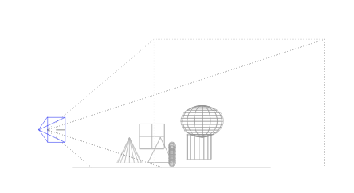
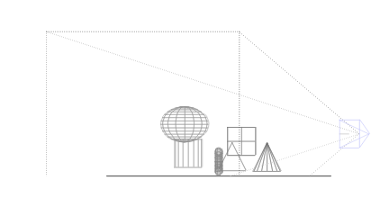
Left and Right View
Left View
Right View

