Slide 1
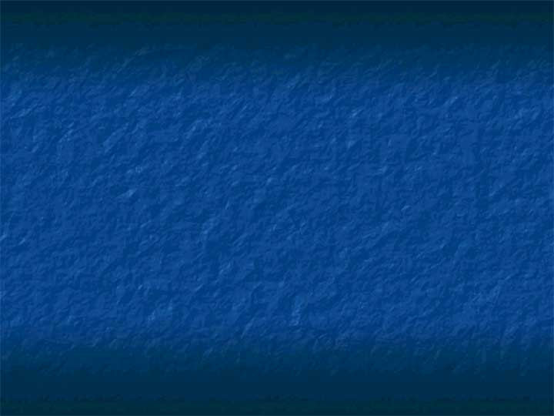
2D and 3D Animation and Video
Chapter 10

Slide 2
First Computer Graphics Animation Perceived to Have Motion and Be of Quality of Animators’ Work
“Luxo Jr.”, an animated short produced by John Lasseter of Pixar in 1987
Followed the usual method of animating by keyframing as witnessed by the title of the paper at SIGGRAPH ’87
  “Principles of traditional animation applied to 3D computer animation”

Slide 3
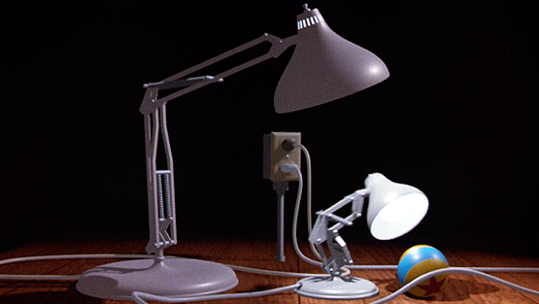
Run the film at source: http://www.pixar.com/shorts/ljr/

Slide 4
The Illusion of Motion
All animation, computer animation, video, films, depend on a sequence of slowly changing still images to create the illusion of motion.
The illusion works because of two physiological phenomena:
  1) Persistence of vision
    Images seen by the eye remain in the brain for a fraction of a second after the actual image stimulus is gone.
    Sequences shown at an appropriate rate appear to depict motion.
  2) Visual closure
    The mind-eye phenomenon fills the spaces between visual stimuli.

Slide 5
Keyframes
Traditional cartoonists draw keyframes that depict the extremes of an object’s motions.
Then assistants and “inbetweeners” draw the inbetween frames.
All of this is extremely time consuming due to the volume of frames that must be produced:
EXAMPLE: 5-minute animation clip
  5 minutes X 60 seconds/minute X 24 frames/second = 7200 frames!
A feature length film of 2 hours contains 158,400 frames!
Pencil tests (outlines with color to be filled in later) help, but script changes are still very costly.

Slide 6
Inbetweening
The computer can dramatically help by producing the inbetween frames automatically.
This technique works well for moving objects (as in ads)
But, inbetweening on characters at a rate higher than every other frame, causes a mechanical look.
The simplest technique is linear interpolation.
  Creates inbetween frames at equal intervals along straight lines.
  Can be used for any change in appearance such as rotation, scaling, shearing, color, transparency, and shape.
  Morphing uses interpolation.

Slide 7
Example – Linear Interpolation
First : Calculate the midpoint of x and y values
Second: Calculate at 1/3 and 2/3 points of the x and y values
Keyframe values
Interpolated values

Slide 8
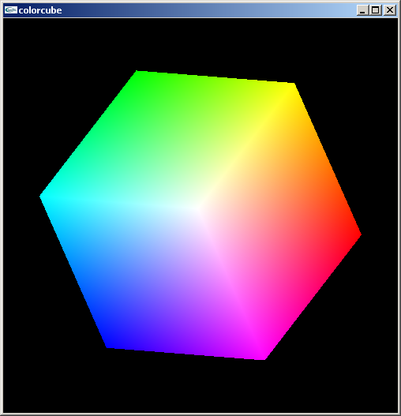
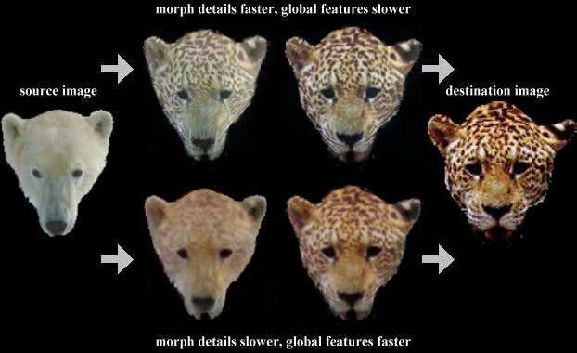
Interpolation Examples
Of color, on the color cube
(linear)
Sometimes linear interpolation is not satisfactory.
Morphing (not necessarily linear) creates equal spacing along curved paths.

Slide 9
Origin of Morphing - Supposedly
A caricaturist and magician, George Méliès became fascinated by the Lumière brothers' demonstration of their short films in 1895.
After building a camera based on an English projector, Méliès began filming unstaged street scenes and moments of passing daily life.
One day, the story goes, he was filming at the Place de l'Opéra and his camera jammed as a bus was passing. After some tinkering, he was able to resume filming, but by this time the bus had gone and a hearse was passing in front of his lens.
When Méliès screened the film, he discovered something unexpected: a moving bus seemed to transform itself instantly into a hearse.

Slide 10
Morphing
Seen in a lot of TV ads and movies to create interesting characters:
  Shapechanger in Star Trek
  Form changer in Terminator 2
Some artists are beginning to use morphing to dramatize transitional themes in their works. Two mentioned in the text are:
  Joseph Santarromana
  Cynthia Beth Rubin

Slide 11
Easing vs Interpolation
Interpolation assumes an object covers equal distances in equal units of time.
Easing drops this assumption and lets the object accelerate or decelerate as it moves between keyframes.
  Acceleration is handled by increasing the distance between the interpolated values
  Deceleration concentrates more values close to the keyframes.
Most 3d animation packages (including Bryce 5) allow the user to set motion paths that an object will follow and set the location of the keyframes.

Slide 12
Motion Blur
Motion blur occurs in film because the camera shutter is open long enough during each frame to register the impression of objects in motion.
This results in an individual frame being slightly out of focus.
But, when played back at 24 frames per second, the effect is to produce a vivid and sharp image.
Extremely fast moving objects still exhibit motion blur and emphasize the extreme speeds.
Simulating motion blur helps add realism to a computer animation.

Slide 13
Motion Blur
Motion blur, when used in film or animation sequences, has nice qualities such as capturing the perceptual effect of high speed motion more accurately.
The introduction of motion blur to a computer-generated image sequence typically involves some form of temporal supersampling - that is, a higher density of samples is taken in the time dimension than the final frame rate of the image sequence.
Early attempts at motion blur were designed as a solution to temporal aliasing as well as mimicking a camera shutter.

Slide 14
Flicks
24 frames per second are displayed in films.
But, actually run at 48 or 72 frames per second with the same frame being double or triple flashed.
Computer images on a screen typically are refreshed at the rate of 60 images per second.
Without these speeds, there appears to be a flicker with the film or the monitor!
Older films weren’t shown at these rates and this earned them the designation of flicks.

Slide 15
Real-time Recording
When inbetweening is used, the animator must determine where to create a keyframe, usually using a timeline shown on the screen.
This can be automated by taking a snapshot of the scene during the creation process and storing these as keyframes.
This is still rarely used although it can be demonstrated at Scott Sona Snibbe’s website on “The Motion Phone”
  http://www.snibbe.com/scott/mphone/msketch.html
  and http://www.snibbe.com/scott/mphone/

Slide 16
Animation (or Video Compositing) Programs
Two main interfaces:
  Provide cels – a series of frame-based drawing areas
  Provide a timeline – provides a clock-based line where the user can mark keyframes.
Some of the programs:
  Macromedia Director http://www.macromedia.com/software/director/
  Adobe After Effects
  http://www.adobe.com/products/aftereffects/main.html
  Bryce 5
  Maya

Slide 17
The Illusion of Space
Animation can create the illusion of space by using
  Compositing – blue screen shooting
  Changing the point of view
    Move an object and keep the camera stationary
    Move the camera
  Creating transitions – which work subconsciously. Some examples are:
    Dissolves
    Fades
    Wipes
    Page turning
Not all animation programs support all of these.

Slide 18
Features That are Desirable to Have
Collision detection
Effects of gravity
Hierarchical structure modeling
Behavorial modeling using artificial intelligence techniques which simulate real world motion
  Example: Particle systems
The use of dynamics- rules of motion based on the laws of physics.
  Dynamically calculated positions based on previous calculations and additional features such as wind affecting the motion of an object.

Slide 19
Features That are Desirable to Have
Motion tracking and capture
  Has become popular recently
Automated motion using kinematics, rules for motion based on the geometry of rigid objects
  Forward kinematics
    End position and rotations are not known, only its motion
  Inverse kinematics
    A desired final position and rotation are achieved by creating movement with given constraints.
    This is harder than forward kinematics since there are infinitely many movements that can arrive at the same position.

Slide 20
Faking vs Algorithms
Motion capture, faked dynamics, texture mapping, and bump mapping bother some computer graphics professionals.
They do not lead to a development of a reusable expertise.
Solutions that “look right” are developed for particular contexts, but cannot be applied to other settings,
Faking animation produces animation that has already “been seen” by a programmer, so unconstrained and unpredictable behaviors cannot be generated.
Consequently, the search for algorithms continues at the research level to produce some of the effects we handle now by faking.

Slide 21
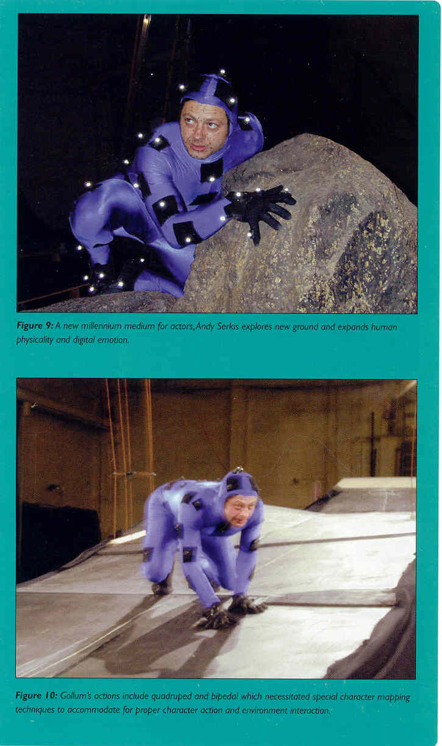
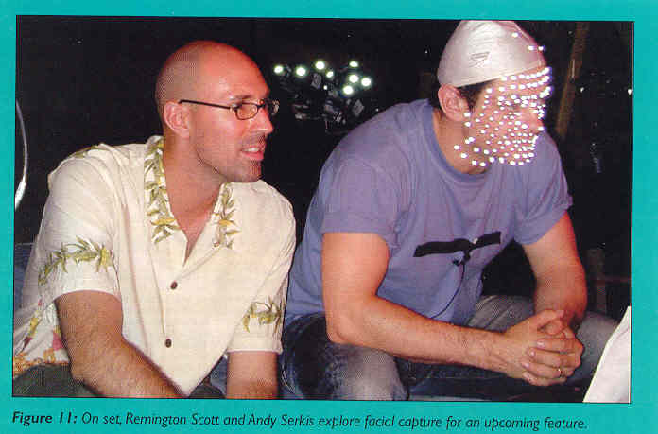
Motion Tracking and Capture – Lord of the Rings
Source: Computer Graphics, Vol 37, Number 4, Nov 2003, pages 20-21.
Remington Scott supervised all the motion capture work. Andy Serkis was Gollum.

Slide 22
User Input and Interactive Graphics
Good user interaction in computer graphics is best achieved when there is a tight coupling between user input and system response.
The delayed reaction by the computer graphics systems is known as latency.
Latency is a serious deterrent to achieving seamless user interaction.
This is particularly noticeable in Virtual Environments systems using a Head Mounted Display interface.
If the scene does not change as soon as the user's head moves, the goal of simulating the real world is thwarted.
It is also very noticeable in games for the same reason.

Slide 23
What Topics are Graphics Research Topics In Recent Yesrs
For the SIGGRAPH 2005 listing of papers see:
http://www.cs.brown.edu/~tor/sig2005.html
and for the SIGGRAPH 2006 listing of papers see: http://www.cs.brown.edu/~tor/sig2006.html
In May, the SIGGRAPH 2007 listing of papers will be posted online.

Slide 24
Animation and Game Development
Highlights from an article in “ACM Queue”, Game Development: Harder Than You Think, by Jonathan Blow, game development consultant
There is a tension between the animation needed for the big screen, artists, and gamers.
Maya and 3D Studio Max were designed originally for non-realtime applications.
Graphics in games MUST run in realtime.
Thus, plugins, post-processing tools, and domain specific editors are usually written by gamers to augment the more standard packages.

Slide 25
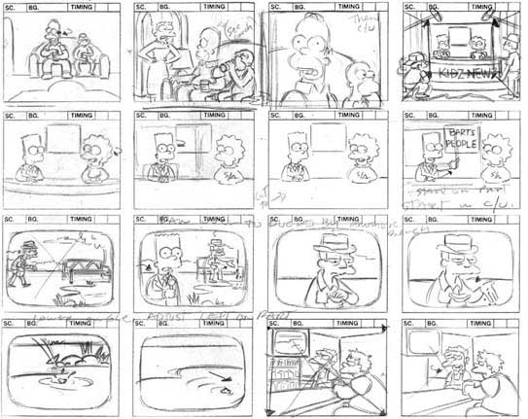
The Overall Workflow of Creating an Animation
1) The spark or inspiration for an animated sequence
2) Pre-planning: Planning the movie, usually with a storyboard:
3) Constructing
the scene
4) Animate the
scene
5) Preview and
tweak
6) Render the
sequence
7) Post-production
Source: http://www.artlex.com/ArtLex/Sq.html

Slide 26
Time in Bryce
Bryce measures time in two ways:
  By counting frames
  And by simultaneously showing frames and time using the SMPTE (Society of Motion Picture and Television Engineers) standard.
    SMPTE is pronounced "simptee"
    The SMPTE code is 00:00:00.00 which gives hours, minutes, seconds, and frames.
  For short animations, counting frames is adequate.

Slide 27
SMPTE fps
If you were producing a movie for film or TV, you need to know the SMPTE frames per second (fps) rates:
  24 fps for motion picture film
  25 fps for European-standard video including the former Soviet Republic and Middle East
  30 fps for US standard video.
The default setting in Bryce is 15 fps, but it can be changed.
Time in SMPTE format is given as 00:00:00.00 (hours, minutes, seconds, and frames.)
  Note this says you could go up to over 99 hours, but don't even try!

Slide 28
Bryce Animation
Time is often called a 4th dimension.
In Bryce, you arrange scene and then record your movements or transformations of objects over time.
Bryce creates a motion path from your recorded movements and then generates an animation.
While only a few records are specify by you, the computer generates the inbetweens needed to move from one record to the next – i.e. it does the work that traditionally was done by animator helpers.
You can have Bryce record automatically as you move objects or you can handle manually and have more control.

Slide 29
Bryce Animation
You can animate almost anything in your scene although we will demonstrate only a few of these so you can see how these work.
  objects
  camera
  object size
  object shape
  object orientation
  object materials
  terrain objects
  sky properties
  lights

Slide 30
Bryce Animation
By using the Advanced Motion Lab, you can adjust the speed at which an object moves along the motion path. (We won't look at this.)
More than one object can be animated in a scene.
With linked objects, you can record different motions of the children (say the arms of a creature) from the parent (say the torso of a creature.)
You will design and work mainly in wireframe mode because rendering potentially can take a lot of time.
However, when you render you can create a movie in .mov (Windows format) or .avi (Quicktime format) which can be played independently of Bryce with the installation of the appropriate player
  An animated sequence is a nice addition to a personal web page!

