Slide 1
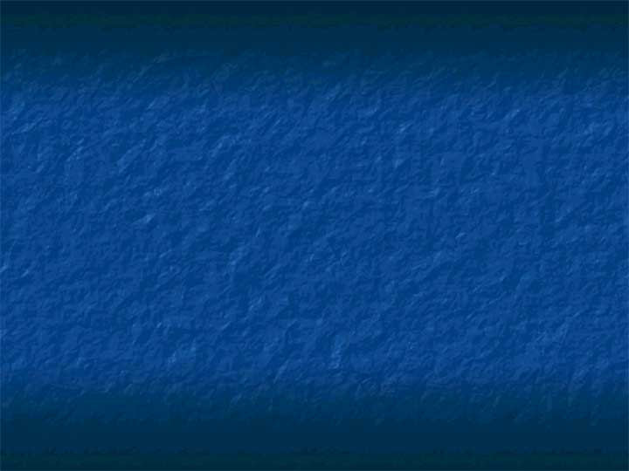
Digital Design and Layout-
2D Geometric Graphics
Chapter 4

Slide 2
Digital Design and Layout Programs
Also called
  vector-based (since they are similar to the earlier vector graphics),
  geometry-based (since they are built from abstract geometric forms), or
  object-oriented (because the forms are often called objects) programs.
Evolved chiefly to serve design professionals and illustrators, not fine artists.
End product is almost always the print media.
In fact, have historically been ignored by fine artists.
Good to know as they provide extraordinary control over line, form, placement, and typography.

Slide 3
Examples of 2D Geometry-based Programs
Adobe Illustrator
Macromedia Freehand
CorelDRAW
Claris MacDraw
and CAD (computer-assisted design or computer-assisted drafting) programs such as
  AutoCAD
  Microstation
  SolidWorks
  IntelliCAD
  In fact, many of these today are 3D-based.

Slide 4
Basic Concepts Supported
Parts of image are made up of
  Linear elements – lines and curves
  Colors applied to the linear elements and the spaces they enclose
  Geometric shapes that are manipulated, not pixels.
But, to display these on a monitor, the image must be rasterized, converted to raster graphics.
This process, as we have seen before, requires sampling that may cause the image on the screen to look differently when it is printed.

Slide 5
Adobe Postscript
What is it?
  A geometric page description language.
  Describes the appearance of text and graphics on printed, or displayed, pages.
Why is it useful?
  It is widely used on all computer platforms as a language for printing documents:
    A word processing application, for example, will translate its proprietary format into a PostScript program which is then interpreted by the laser printer and output as a graphical mage.
  A PostScript drawing looks much better when printed on a 600-dpi printer than on a 300-dpi printer.
  A bit-mapped image looks the same on both printers.

Slide 6
Postscript
Characteristics
  Device independent
  Can print on any printer with a Postscript interpreter
  Inspired the entire field of desktop publishing.
PostScript is the standard for desktop publishing because it is supported by imagesetters, the very high-resolution printers used by service bureaus to produce camera-ready copy.

Slide 7
Disadvantages of Postscript
Viewing PostScript files on-screen requires a viewer such as GhostView.
To print correctly, the client computer must have access to the fonts specified in the PostScript file.
  Unfortunately these fonts tend to be copyrighted, which means that developers wishing to distribute files to a wide audience are constricted to using standard PostScript fonts in order to avoid possible copyright infringements.
PostScript's main weakness is its tendency to generate large files unsuitable for document interchange over the Web.

Slide 8
We Have Already Seen Many of the Features of 2D Geometric-Based Graphics:
Vertices – point on linear elements such as straight or curved lines
Paths – A linear element that runs through a sequence of vertices
  Must be stroked (assigned a color) to be seen.
Spline curves – mathematically-constructed curves that fit the curve to a set of defined points called control points.
  Bezier curves are one example of a spline.
  Graphics programmers often use NURBs
  (nonuniform rational B-splines).

Slide 9
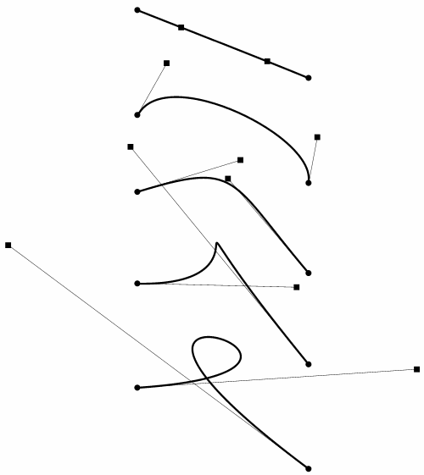
Bezier Curves – What You Used in Photoshop Doing Vector Graphics

Slide 10
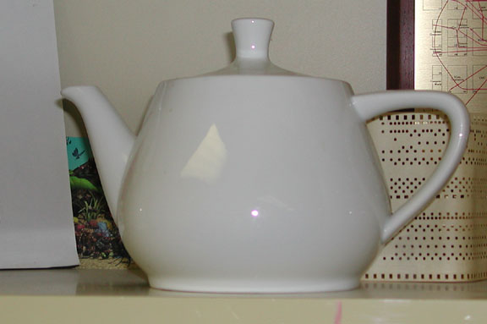
The Utah Teapot
Bezier curves were first used in computer graphics by Martin Newell at U of Utah to define what graphics computer scientists fondly think of as the Utah teapot.
The original teapot was donated to the Boston Computer Museum but now resides in the Ephemera collection of the Computer History Museum where it's catalogued as "Teapot used for Computer Graphics rendering" catalogue number X00398.1984.

Slide 11
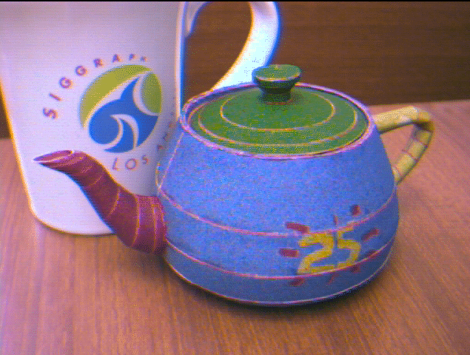
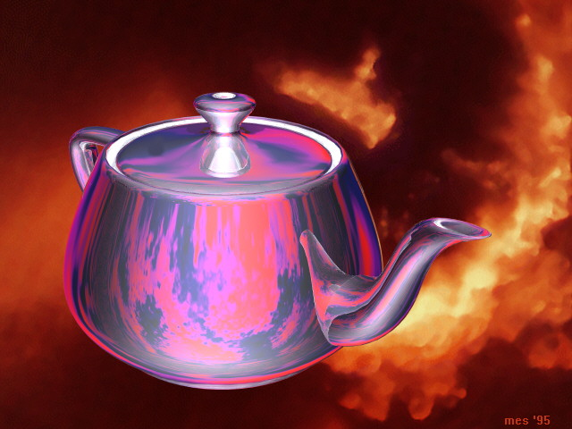
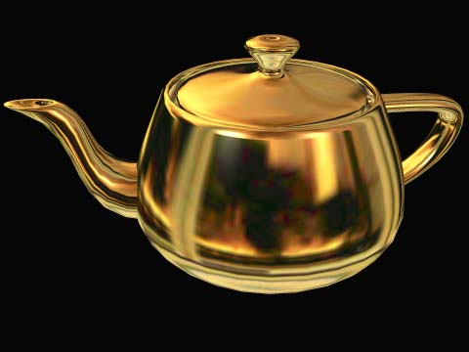
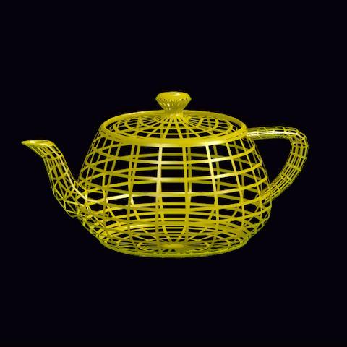
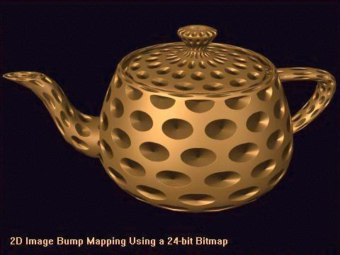
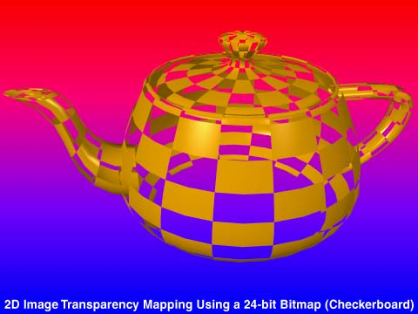
Many Versions of the Teapot Have Been Made
From Steve Baker’s History of the Teapot site: http://www.sjbaker.org/teapot/index.html

Slide 12
Utah Teapot in Movie “Toy Story”
In the movie Toy Story, you can spot the teapot in the scene after Buzz loses his arm and has tea with the headless dolls.
It is widely believed that the graphics folks inserted that scene just so that a gratuitous Utah Teapot could be seen.

Slide 13
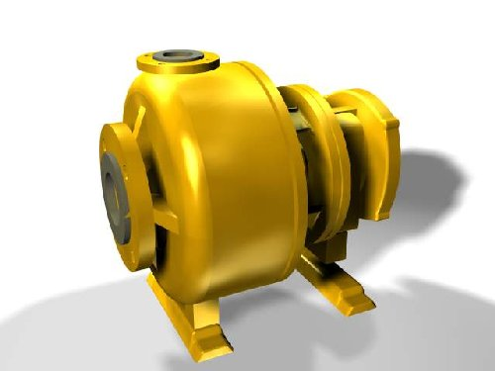
NURBS Exist in 2D, But Are Used More in 3D Modeling
This is an example from a CAD/CAM (Computer Aided Design/Computer Aided Manufacturing) program.

Slide 14
Typography
Obviously essential for the designer of an ad, a brochure, a newsletter, or digital design.
Type can be placed anywhere on a page, rotated, scaled, and deformed like any other layout object.
Desktop publishing requires the merging of images and type and the ability to handle multiple pages.
One desktop publishing program you will use to build the final pages of your visual journal is Adobe InDesign.

Slide 15
Typography
Choosing the best type style for a a page being designed, is more than just pulling down a particular font randomly.
A wonderful book emphasizing this is Typographic Design: Form and Communication by Rob Carter, Ben Day, and Philip B. Meggs.
Good typography depends on the visual contrast between one font and another and between text blocks, headlines, and the surrounding space.
We’ll look at this a bit more when we look at a desktop publishing program.

Slide 16
Simple Examples – See How the Following Convey Information and Mood
ALL CAPITALS TEND TO BE HARD TO READ AS WE DISTINQUISH MANY WORDS BY THEIR SHAPE

Slide 17
Other Features of a Digital Design and Layout Program – Local Touch Tools
Path drawing
Numeric input to define and alter objects
  For example: location, size, relationships
Editing of objects
  Rearranging paths
  Tweaking linear objects positions
Stroking

Slide 18
Other Features of a Digital Design and Layout Program – Global Touch Tools
Fill closed paths with color.
Use of gradient tools to blend colors.
Incremental blending and interpolation
  i.e. morphing (not same as animated morphing)
Algorithmic touch
Adding and subtracting shapes with boolean operations – AND, OR, NOT

Slide 19
Other Tools in a Digital Design and Layout Program (some of which you have seen as they are in Photoshop)
Placement tools
Selection tools
Layers
Grouping of objects, layers, and other items
Ability to combine raster and vector graphics.
Note: Many of these concepts are expanded into what we now use in 3D graphics and animation.

