Slide 1

Rendering 3D Worlds-
3D Geometric Graphics II
Chapter 8

Slide 2
Rendering
An Overview

Slide 3
Rendering the Model
Definition: The mapping of the 3D world to the 2D screen.
The mapping is done by an algorithm, basically a recipe of instructions that the computer follows.

Slide 4
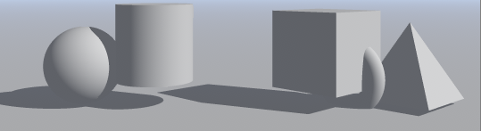
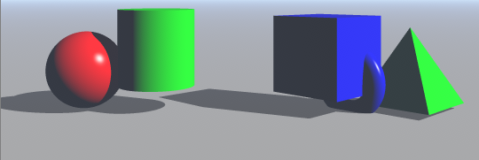
Materials
In your first Bryce lab, we had you work with no material settings, other than the dull gray which looks somewhat like dull plastic, although there were shadows that provided some depth cues.
Until about 8-15 years ago, in was not uncommon for most 3D graphics objects to look like plastic – either dull plastic or shiny plastic, depending upon the lighting that was used.
Note your textbook mentions this and it was written in 1999!

Slide 5
Now We Can Produce Very Realistic 3D Images
The following were student produced images from
http://www.depaul.edu/~rwolfe/539/hmwk1gallery/gallery.html
http://www.depaul.edu/~rwolfe/469/w99demos/index.html
but they are no longer available on the web.

Slide 6


Slide 7
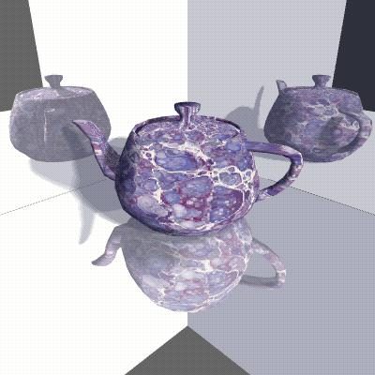

Slide 8
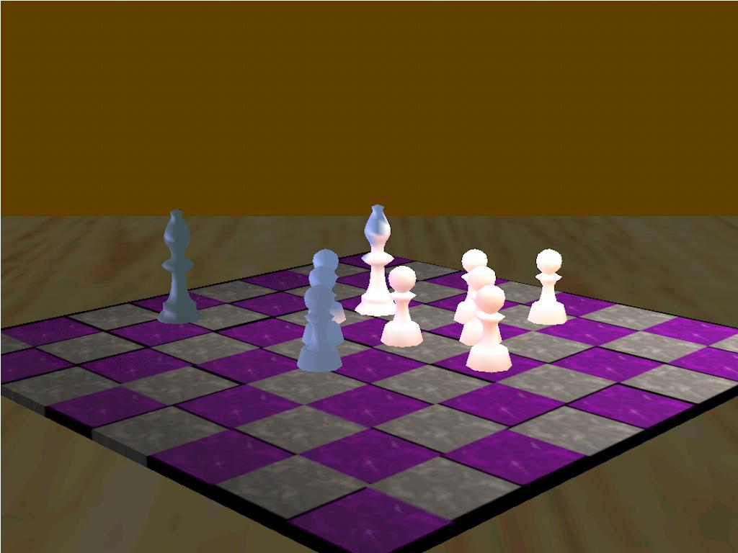

Slide 9
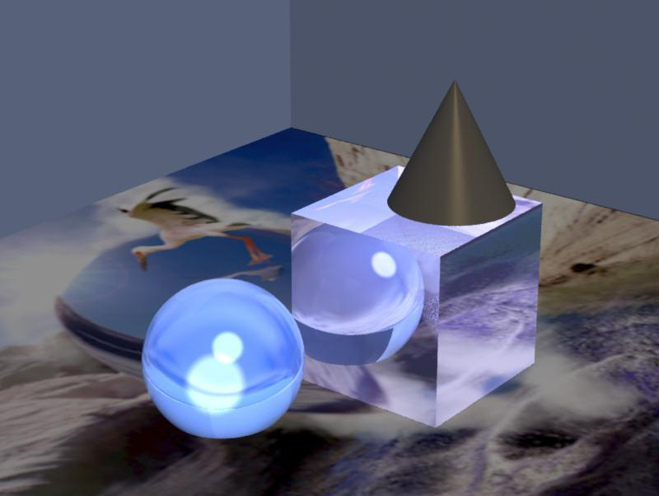

Slide 10
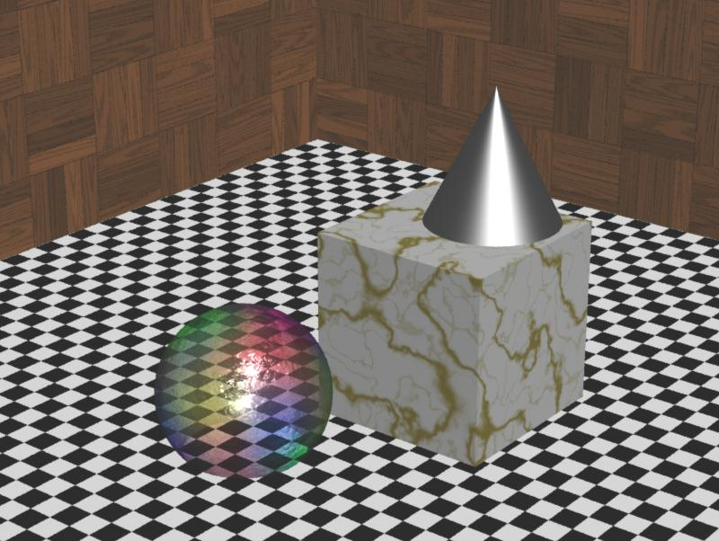
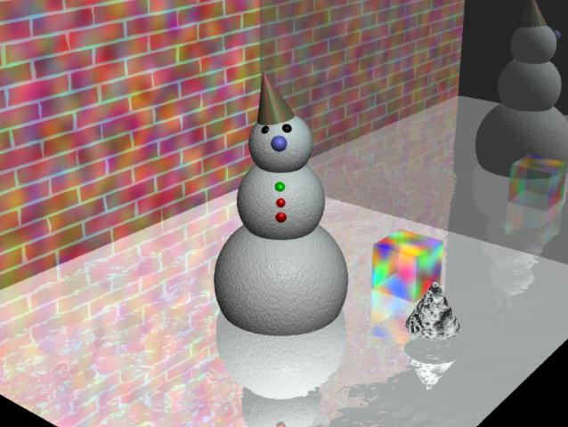

Slide 11
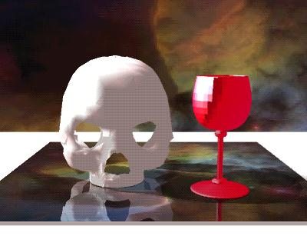

Slide 12
3d Modeling- Depth Cues
Definition: Processes used to create an object that appears to be 3 dimensional in a computer application
These processes provide an illusion that the image is 3 dimensional.The processes have been known for years to artists.
Examples include the use of :
  reflections shading
  lighting highlights
  fogging effects size
  various projections shadows
  refraction effects hidden lines and surfaces

Slide 13
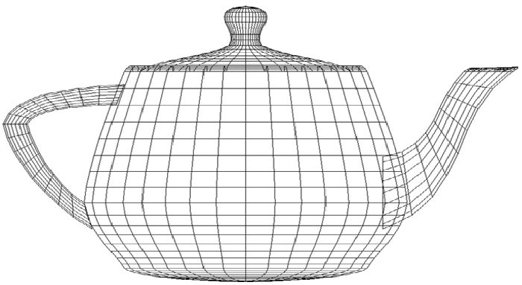
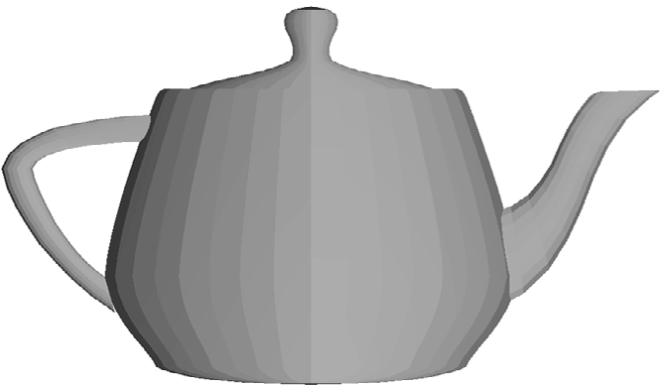
VISIBILITY
As we know, most objects are modeled as wireframes as they are easier to generate with a computer than curves. Recall the teapot.
Obtaining depth cues via visibility requires hidden surface algorithms that eliminate lines and surfaces.
A wireframe teapot
shows limited depth.
A filled in image provides
better depth cues.

Slide 14
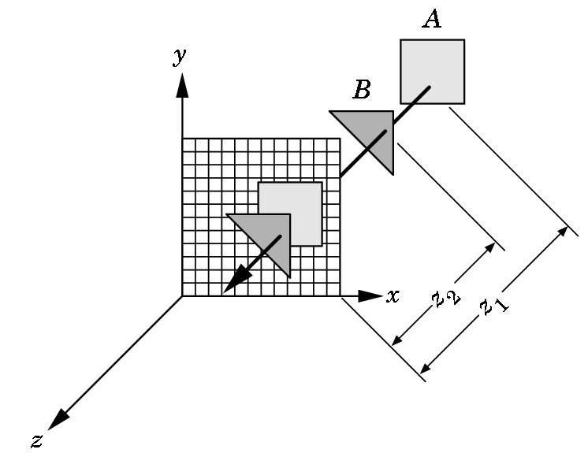
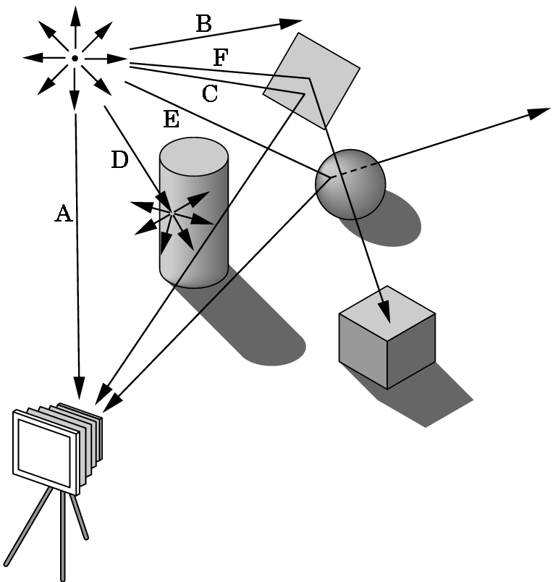
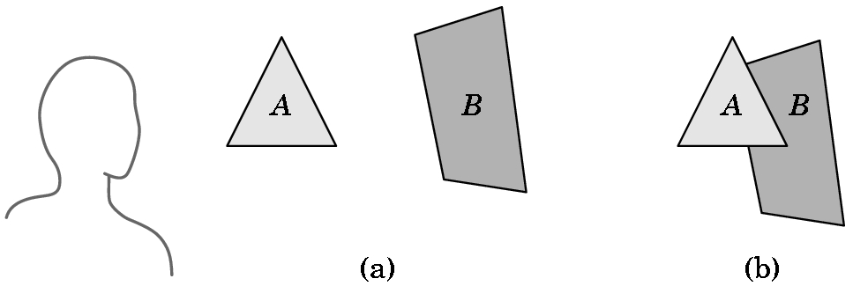
Which Objects Are Visible is a Function of the Rendering Algorithm Used
z-buffer painter's ray-tracing
3 COMMONLY USED ALGORITHMS

Slide 15
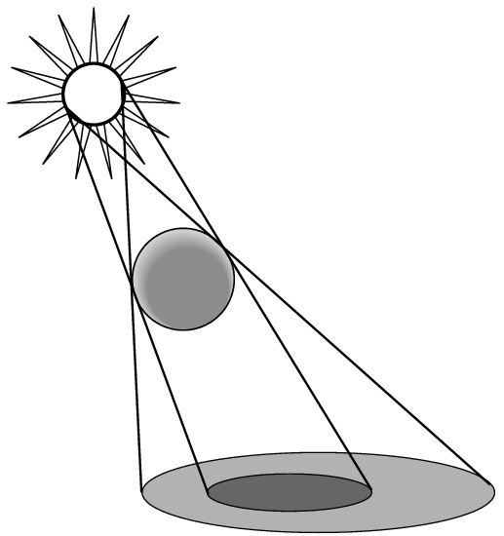
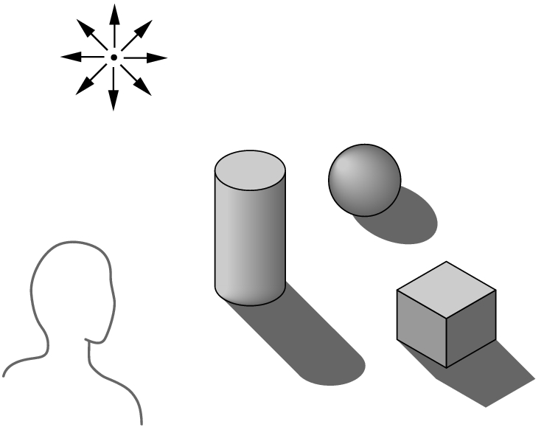
An Example
The algorithm used determines how easy it is to do realistic modeling and how costly the rendering process is. For example, consider shadows.
Without shadows, objects seem to float above their supporting surface.
Shadows add realism to an image as well as depth cues.
The difficulty (or ease) of providing shadows depends upon which algorithms are used to render the scene.

Slide 16
Bryce Uses Ray Tracing as a Rendering Algorithm
The basic idea is that we trace light rays as they bounce around in a scene until we finally determine the color of a pixel.
Theoretically, each light source would generate the light rays to be traced.
If something isn’t hit by a light ray, then it is in shadow if it is part of an object
  or
  it is the background if it is not part of an object.

Slide 17
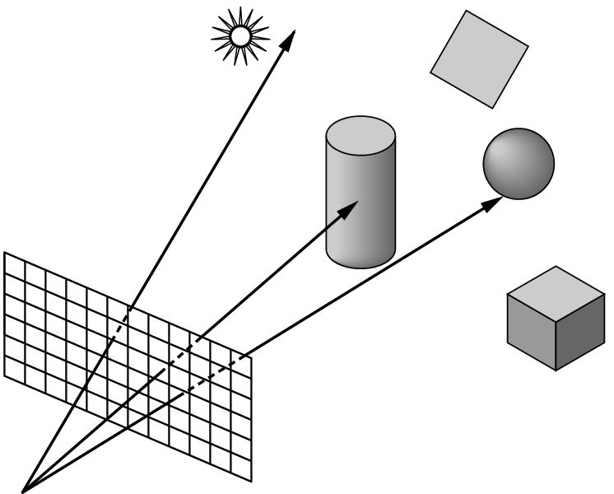
Ray Tracing Can Easily Produce Shadows
But, casting rays from a light source can be a waste of computing power.
Most rays don't ever reach the eye.
Instead, from the eye, we cast one ray for each pixel. Each ray either intersects an object, hits the light source, or goes to infinity.

Slide 18
RAY TRACING- Basic idea of the algorithm
If the ray goes to infinity, it should receive a background color.
If the ray intersects an object
then we must calculate a shade for the point of intersection.
But what is seen, depends upon the relationship between the object and the light source so we use shadow rays...

Slide 19
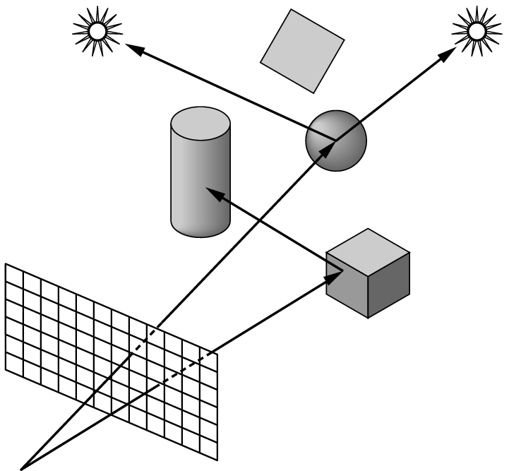
Shadow Rays
If a shadow ray intersects an object before it hits a light source, then the light is blocked and the point is in shadow from that source.
If the surface is opaque and doesn't scatter light, we have our shadow areas identified.
Shadow rays are also called feeler rays.

Slide 20
Ray Tracing vs Other Rendering Algorithms
Normally ray-tracing is the best for exciting visual effects such as shadows, transparency, and reflection.
But, it is one of the lowest algorithms in terms of rendering times.
The 114,240 frames of Disney's "Toy Story" were imaged with a z-buffer algorithm as ray-tracing requires too much time to render an image.

Slide 21
Toy Story
But, weren't there shadows in "Toy Story"?
But, wasn't Buzz Lightyear's helmet transparent?
But, couldn't you see Slinky Dog's reflection on the floor?
Yes, because the developers of "Toy Story" modified the original z-buffer algorithm.
This is where computer scientists come into the scene to change existing algorithms without sacrificing speed.

Slide 22
Some Factors Influencing Rendering Speed
Scene composition – number and complexity of objects
Resolution
Antialiasing algorithms chosen
Lighting choices
Computer speed
Algorithms used to eliminate hidden lines and surfaces
Amount of texturing used
Shader used
  A few comments about these ...

Slide 23
Scene Composition
Independent of all other considerations, the number and complexity of the objects will have a major effect.
All objects are described as a group of polygons.
The more polygons, the longer the time needed to render the object.
A sphere is typically made from at least 500 triangles--- otherwise it looks jagged.
Some manufacturers describe their graphics hardware by how many polygons it can draw per second.

Slide 24
Resolution And Antialiasing
The higher the resolution, the higher the rendering time.
  Example: Going from a 100 X 100 pixel image to one with double the width and double the height increases the size by a factor of 4 (not 2)!
Aliasing - occurs when resolution errors occur in the image. Examples are
  jaggies
  staircasing
  missing or malformed polygons
  disintegrated textures
Antialiasing techniques are techniques to remove these problems

Slide 25
Antialiasing Techniques
When these are invoked, you lose rendering speed.
Typically, each pixel is divided into regions and color is averaged over all the regions.
Most renderers allow you to turn antialiasing on or off.
Often with high-speed animation, you won't see the problems--- this is why video games can do some things that are difficult to do in real time, especially for images projected on a large movie screen. The speed masks the problems that could be seen otherwise.

Slide 26
Antialiasing Techniques
When these are invoked, you lose rendering speed.
Typically, each pixel is divided into regions and color is averaged over all the regions.
Most renderers allow you to turn antialiasing on or off.
Often with high-speed animation, you won't see the problems--- this is why video games can do some things that are difficult to do in real time, especially for images projected on a large movie screen. The speed masks the problems that could be seen otherwise.

Slide 27
Lighting Choices
Multiple light sources complicate the process.
Each light source adds a new calculation to the process.
Thus, adding 1 direct light source nearly doubles the cost of determining the color of a pixel.
Spotlights are a little more costly than point sources.
Area lights are the most expensive.
Different 3D packages often provide different algorithm choices for doing lighting. The choice of the algorithm makes a major difference is speed and looks.

Slide 28
Computer Speed
Obviously, the faster the better.
But, speed is not just a function of the MHz of the processor.
For graphics, you need a lot of RAM and a large hard disk for storing images.
The graphics card (or graphics accelerator) is a critical enhancement.
  Unfortunately, rendering software is often sensitive to which graphics card is used.
  Some do well with some rendering software and not with others.
  The market changes so rapidly, you really need to stay on top of it constantly.

Slide 29
Surface Algorithms
Determining the color and visibility of pixels are the two most time-consuming things done when rendering an image.
The surface algorithm determines what is visible at this pixel on the screen.
The most commonly used algorithms are
  wireframe
  hidden line
  z-buffer
  ray-tracing
Recall that Bryce uses ray-tracing

Slide 30
Surface Algorithms
Wireframe- quickest
  Doesn't bother checking visibility. Just draw it
Hidden line- next in line for speed
  Draws only outlines. Doesn't deal with fills.
Z-buffer - slower than above
  Has to process both the interior and perimeter of a polygon.
  But, discards a polygon after determining its visibility
Ray-tracing- slowest of all
  Each and every object and polygon is processed many, many times.

Slide 31
SHADER USED (For Non Ray-tracing)
The shader is an algorithm that determines the coloring for each small polygon in the image. Four are commonly in use:
Constant -
  1 color calculation per object
Faceted-
  1 color calculation per polygon
Gouraud-
  1 color calculation per vertex
Phong-
  1 color calculation per pixel
Relative costs are obvious for a given scene when we count objects, polygons, vertices, and pixels

Slide 32
SHADER USED (For Non-ray-tracing)
Enhancements such as
  texture mapping- the cheapest
  bump mapping- a bit more expensive
  environment mapping- requires multiple renderings
Are usually done as enhancements to a non-ray-tracing renderer when shading is done
Doing all of these slows the rendering down extensively.

Slide 33
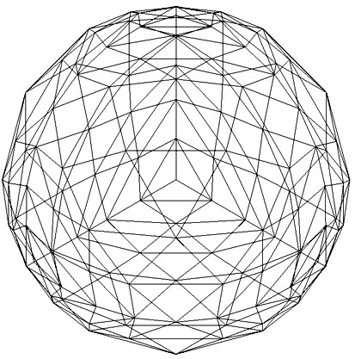
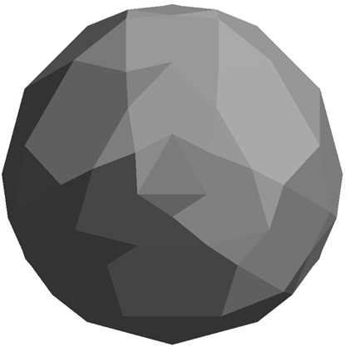
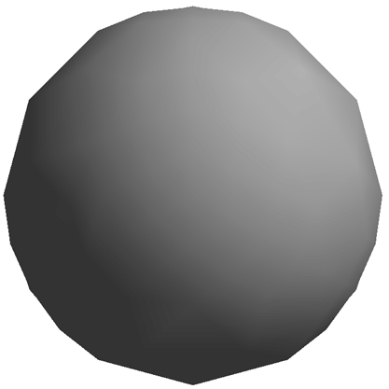
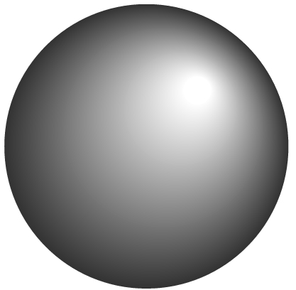
Shading Algorithms
wireframe
faceted
Phong
Gouraud

Slide 34
SHADER USED (with ray-tracing)
Ray tracing always determines visibility and color for each pixel.
But, there are added costs depending upon the type of calculation done:
  shiny, plastic objects need specular (i.e. the highlight) calculations
  reflections are expensive because the rays have to be traced that bounce off the surface
  transparent objects are very time consuming as rays are generated that exit the object

Slide 35
Working with Lights

Slide 36
Shading Model
A shading model dictates how light is scattered or reflected from a surface.
In graphics, we typical use two kinds of lights:
  point light sources - lights that shine on objects
  ambient light - light reflecting off of other surfaces
The amount of light reaching the synthetic camera must be calculated.

Slide 37
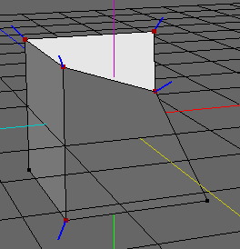
Shading Model
The amount of light that reaches the eye is dependent upon many things:
  Geometry of the surface specified, for example, by
    normal to surface at a point
The normal at a point is a vector
perpendicular to surface at that
point (if point is not corner)
    vector from p to viewer's eye
    vector s from p to light surface
  nature of the material
  the RGB components of the light

Slide 38
LIGHT IN REAL WORLD
Overview
RGB values for a pixel are not enough to give realistic pictures.
Need to handle light.
An object either
  emits light --- for example, a taillight
  or is illuminated by one of the different kinds of light
    Ambient Light: light that is scattered so much that its direction is impossible to determine.
    Diffuse Light: light coming from one direction
    Specular Light: light coming from one direction which bounces off in a reflected direction

Slide 39
Ambient Light
Doesn't come from a particular direction.
Has a source, but has bounced around so much it is directionless.
The intensity is the same at every point on the surface.
Often achieved through large sources that shine through a diffuser that scatters light in all directions.
Typical examples are light from:
a cloudy day
moonlight
sunlight scattered by fog or haze

Slide 40
Diffuse Light
Comes from a particular direction.
The amount of light reflected from a surface depends on the angle between the incoming light and the surfaces.
So, although the reflection is even, the surface is brighter if the light is pointed
Examples are:
fluorescent lighting
noon sunlight streaming in a side window
(not a solid beam)

Slide 41
Specular Light
Directional like diffuse light, but it is reflected sharply and in a particular direction.
A high specular light often leaves a highlight on an object called the specular highlight.
Examples:
spotlight
sun beam

Slide 42
LIGHTING- Some Facts
When light strikes an object, some of it is reflected and the rest is absorbed as heat.
For example, a red surface absorbs all of the light components except the red ones which are what your eye sees. Color is really a reflection property.
Moreover, light is made up of different parts of the 3 types:
specular
diffuse
ambient

Slide 43
AN EXAMPLE
Consider: A RED LASER BEAM IN A LABORATORY
Composed almost entirely of a pure red specular component of the light.
• But, smoke or dust particles scatter the beam so it
can be seen traveling across the room. Scattering
represents the diffuse component of the light.
• If the beam is bright and no other light sources are
present, you might notice objects in the room taking
on a red hue. This would be a very small ambient
component of the light.

Slide 44
AN EXAMPLE
A RED LASER BEAM IN A LABORATORY
In graphics packages, we can specify the different components of light for each gun by specifying a number, perhaps as a percentage:
For example:
For the red laser beam in a laboratory, the laser light
source may be specified as using
  green and blue guns have components of 0.0
  the red gun might be specified as
    specular 0.99 - pure red for gun
    diffuse 0 .10 - scattering due to dust and smoke
    ambient 0.05 - red hue on other objects

Slide 45
Material Properties

Slide 46
Material Properties
-Light Properties Are Not Enough
Given a light, different materials reflect the light differently.
Material settings are set as well as light settings.
When a particular material is chosen, it has certain build in properties depending on its nature.
But, the user can also set some additional properties.

Slide 47
Diffuse Reflector
Brightness Depends Upon:
The components of white light it reflects.
The strength of the ambient and direct light striking the surface.
The position of the direct light sources.
The orientation of the reflecting surface relative to the direct light source.
The type of surface.
Note:Reflected light is scattered in all directions for a
diffuse surface.
Matte surfaces such as flat paint and ordinary paper
are predominately diffuse reflectors.

Slide 48
Specular Reflector
Brightness Depends Upon:
The strength of directional light sources.
The position of directional light sources.
The orientation of the surface with respect to the light sources.
The position of the viewer.
The surface roughness.
Note: Highlights are the result of light being scattering in a narrow range of angles close to angle of reflection.
A mirror is an example of a perfect specular reflector.
Shiny plastic exhibits both diffuse and specular reflection,
but the specular component is high.

Slide 49
Translucent Surfaces
Allow some light to penetrate the surface and emerge from another location on the light.
Some light might be reflected at the surface.
Water and glass are translucent surfaces.
Translucent properties can be set for materials.

Slide 50
Selecting Material Properties
Ambient light: Defines the dominant color when no direct light is on that part of the surface.
Diffuse light: Defines the dominant color when the surface is illuminated.
  For many physically-based materials or real-world materials these are similar values.
Specular light: Determines the color of the highlights shown.
  Colored glass with white light on it has highlights the same color as the glass. So, set this to the same as the object's ambient and diffuse light.
  But, highlights for chrome reflect the color of the light shining on it. So set this to the same as the light's color.
Shininess . Controls the focus of the highlight and determines the spreads of the reflection over the surface – i.e. how much is it concentrated?

Slide 51
Texturing, Bump Mapping, and Environment Mapping

Slide 52
Texturing
One of the quickest ways to see realism.
Texturing is the mapping of a 2D surface onto a 3D surface.
  Even Adobe Illustrator has this in this latest version.
  Texture mappings can be plastered onto a surface in various ways.
A special case of texturing is when the artist can paint onto a surface.
Textures can look really fake if not handled carefully. Textbook has the example on pg 265 of marble that has been cut open.

Slide 53
Bump Mapping
For many years, an attempt was made to create oranges algorithmically.
But, the uneven surfaces never looked natural.
Bump mapping redefines the surface normals to simulate light hitting at different angles.
Texture mapping could be used, but the textures might not “fit” with the lighting that was chosen.
Bump mapping integrates the surface with the lights correctly so that moving the object makes the shadows on the bumps change.

Slide 54
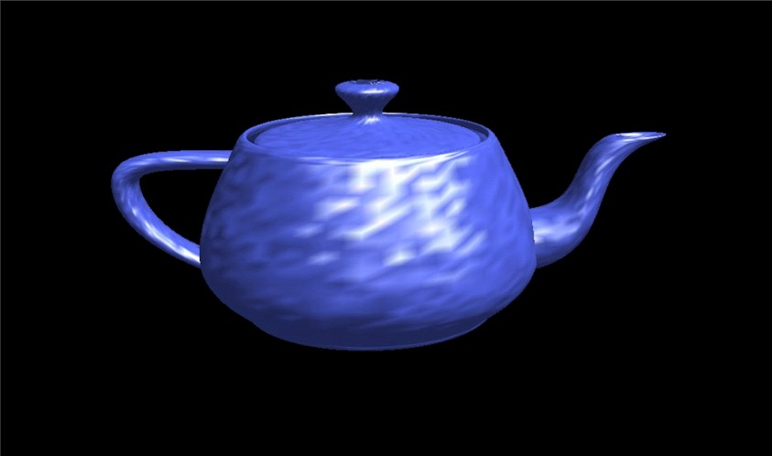

Slide 55
Environment Mapping
Ray tracing is very, very time consuming.
Mirrored effects can be produced easily when ray tracing, but not with other rendering algorithms.
Environment mapping fakes reflections by rendering the scene using the object’s viewpoint and then texture mapping that onto 2D rendering onto the surface.
This technique was first introduced in “Toy Story”.

