Slide 1

An Introduction to the History of Computers and the Visual Arts
Early Computers and Early Computer Art
INTD 390

Slide 2
Brief Survey of Some Inventions and Milestones in the Use of Computers in the Visual Arts
Realize
  No survey can be comprehensive – choices were made to highlight certain points.
  Inventions rarely spring from the heads of one individual, even when only one name is associated with an invention.
  There are many inventions leading up to a specific one. Often we will list only the last one.

Slide 3
The Printing Press
The earliest dated printed book known is the "Diamond Sutra", printed in China in 868 CE (common era).
However, it is suspected that book printing may have occurred long before this date.
In 1041, movable clay type was first invented in China.
Johannes Gutenberg invented the printing press with replaceable wooden or metal letters in 1436.

Slide 4
The Beginning of Photography
The first photographic process or heliography was invented around 1824 by Nicephore Niépce of France.
Images were obtained on a silver plate after an exposure time of many days.
In 1829, Niépce introduced Louis Jacques Mande Daguerre to his research .
In 1832, they introduced a second process producing images in a one day exposure time.
In 1833 Niépce died, Daguerre went on working alone and invented, in 1838, the daguerreotype, the first process including a development stage taking hardly more than 30 minutes.

Slide 5
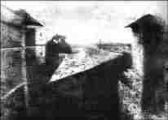
First Known Photograph by Nicéphore Niépce in 1827
Source: Austin, TX, “At the First Light International Symposium”, http://www.niepce.net/live/live.html

Slide 6
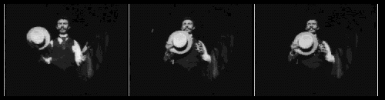
Motion Pictures
1887 Thomas Edison patented the movie camera although a major portion of the ideas are now attributed to his lab assistant William Kennedy Laurie Dickson.
One of the earliest films (1891) is known as Dickson’s Greeting:
Source: http://memory.loc.gov/ammem/edhtml/edmvchrn.html,
American memory Collection, Library of Congress

Slide 7
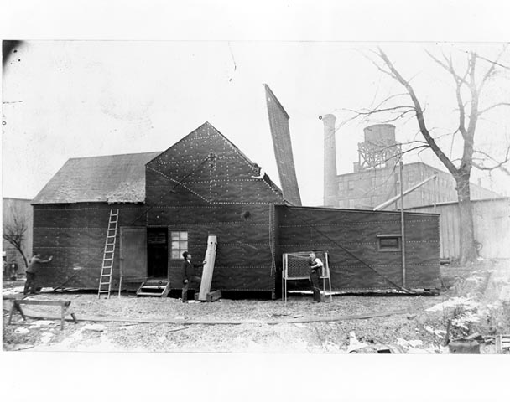
Edison’s Motion Picture Studio 1892-5
Source: http://memory.loc.gov/ammem/edhtml/edmvhist1.html#EE
American memory Collection, Library of Congress

Slide 8
Edison's First Movie Studio in America
The first motion picture studio in America opened in December, 1892, at a cost of $637.67 to build.
The first movies were short productions, none of them exceeding about 30 seconds.
The films were designed to be shown in the Kinetoscope, a peep show device.
The patron would drop a nickel in a slot, peer through a magnifying glass, and view a bit of action.

Slide 9
The Birth of Television
The technology of television actually was the creation of many people in many countries over many years. It is really a series of international inventions around the 1929-1933 period.
A few of the names associated with its development are:
  Paul Nipkow in Germany
  J. L. Baird in England
  C. F. Jenkins in the United States
  Vladimir Zworykin, a Russian immigrant working for RCA in the United States
  Philo Farnsworth in United States
  For a brief history see:
  http://inventors.about.com/library/inventors/bl_television_timeline.htm

Slide 10
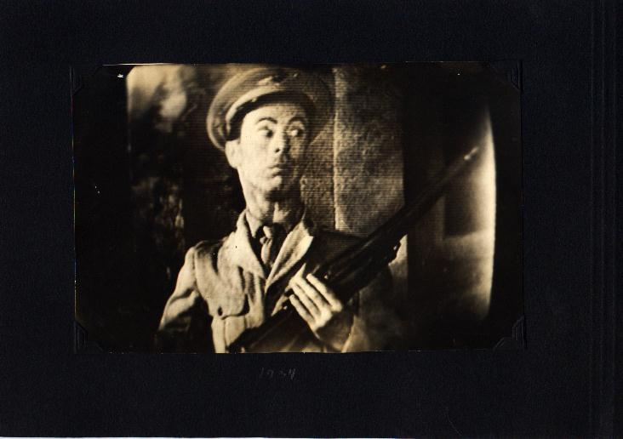
An Early 1933-34 TV Image of a Movie
Source: The Personal Photographs of Dr. Vladimir Kosma Zworykin, Television Pioneer, http://framemaster.tripod.com/1934p4.jpg

Slide 11
By 1935, we had many of the visual art media in place
Printing presses
Photographs
Motion Pictures
Television
Next, came the invention of electronic computers

Slide 12
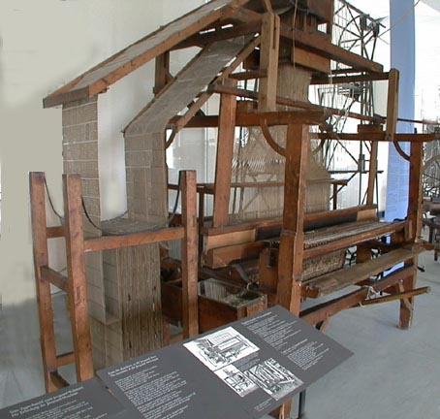
Jacquard Loom
A mechanical art device that influenced early computer design
1805-6
Intricate textile patterns were prized in France in early 1800s.
Jacquard’s loom used punched cards to allow only some rods to bring the thread into the loom on each shuttle pass.
1. Source: http://65.107.211.206/technology/jacquard.html

Slide 13
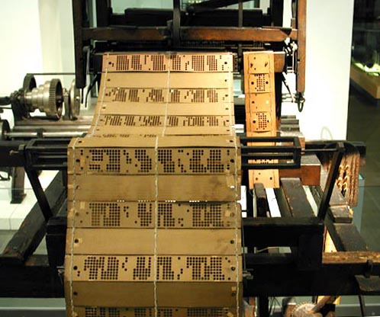
Sheets of punched cards were used to encode the complex patterns
2. Source: http://65.107.211.206/technology/jacquard.html

Slide 14
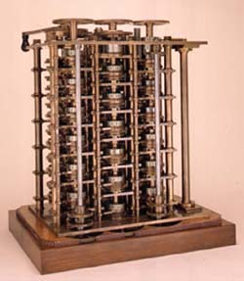
Forerunners of the Computer – Babbage’s Work
In 1821 Babbage invented the Difference Engine to compile mathematical tables.
In 1832, he designed, but was unable to build, a general symbol manipulating machine that could perform any kind of calculation. This Analytical Engine (1856) had some of the characteristics of today’s computers.
In the Science Museum, London.
3. Source: http://www.sciencemuseum.org.uk/on-line/babbage/page3.asp

Slide 15
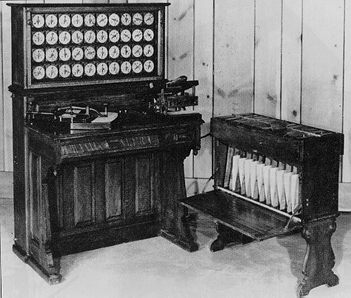
Herman Hollerith’s Tabulation Machine
A Statistical Sorting Device
Developed 1884-1890
This is the 1890 version used in tabulating the 1890 federal census.
It used punched cards for input to the device.
4. Source: http://www.columbia.edu/acis/history/hollerith.html

Slide 16
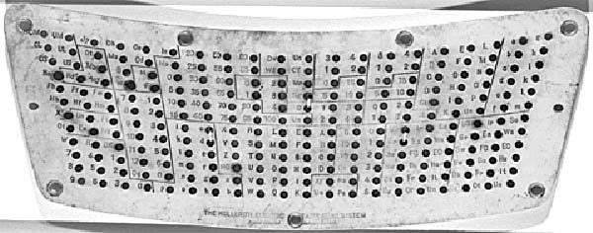
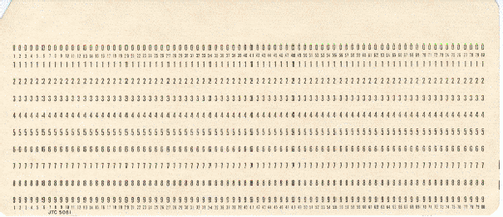
The Punched Card- Input to the Hollerith Tabulator and Early Data Processing Machines and Computers
Punched card used by the Hollerith Tabulator for the 1890 US census.
Punch card standardized in 1928:
It was the primary input media of data processing and computing from 1928 until the mid-1970s and was still in use in voting machines in the 2000 USA presidential election.
5. Source: http://www.columbia.edu/acis/history/hollerith.html

Slide 17
Several Devices Lay Claim to Being
“the First Electronic Digital Computer”
1938-46
1. ABC (Atanasoff-Berry Computer), built by Professor John Atanasoff and a graduate student Clifford Berry at Iowa State University between 1939 and 1942.
2. ENIAC (Electrical Numerical Integrator And Calculator), built by Presper Eckert and John Mauchly at Moore School of Engineering, University of Pennsylvania, 1941-46
3. Z1-Z4 built by Konrad Zuse in Berlin, Germany, 1938 – 1944 (all destroyed in Berlin bombings)
4. Mark I designed by Howard Aiken and Grace Hopper at Harvard University in 1939-1944.

Slide 18
Why is it important in this course to understand some of the characteristics of these early computers?
Computer art, obviously, requires a computer for the creation process.
But, as we look at some of these early computers, ask yourself if you see how it would be possible to produce art on these early machines.
In particular, what was used for input? for output? to control the machine?
Then speculate when the first computer art was created and how it might be created.

Slide 19
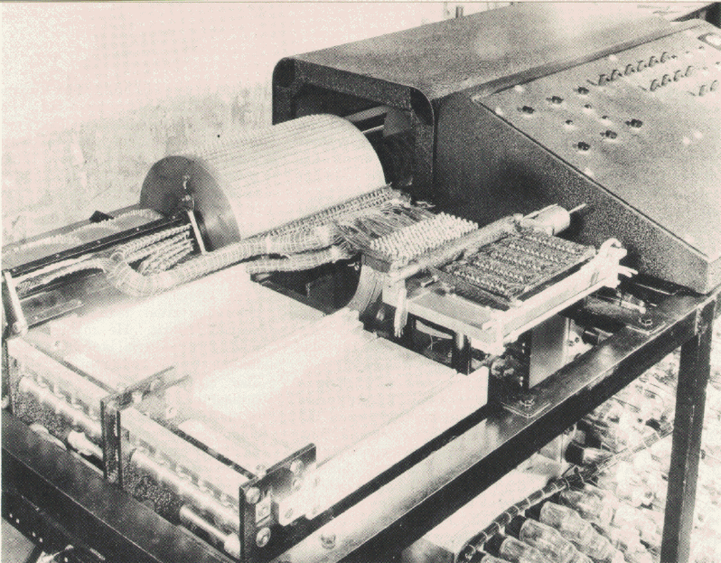
Atanasoff-Berry Computer or the ABC built by John Vincent Atanasoff and Clifford Berry at Iowa State University 1939-42
Special purpose computer and was not truly programmable.
The instructions to the machine were entered by buttons.
Input: Punched paper tape
Output: Punched cards
6. Source: www.cs.iastate.edu/jva/images/abc-1942.gif

Slide 20
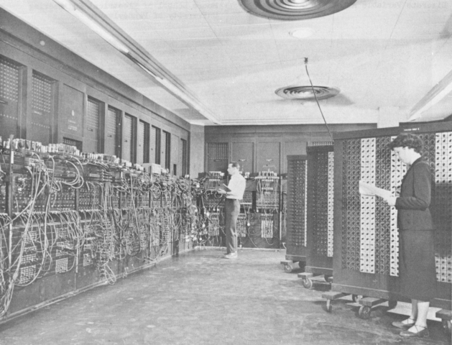
ENIAC
18,000 vacuum tubes and weighed 30 tons
Duration of an average run without some failure was only a few hours, although it was predicted to not run at all!
Input: IBM card reader
Output: Punched cards, lights
Stored a maximum of twenty 10-digit decimal numbers.
7. Source: http://ftp.arl.army.mil/ftp/historic-computers/

Slide 21
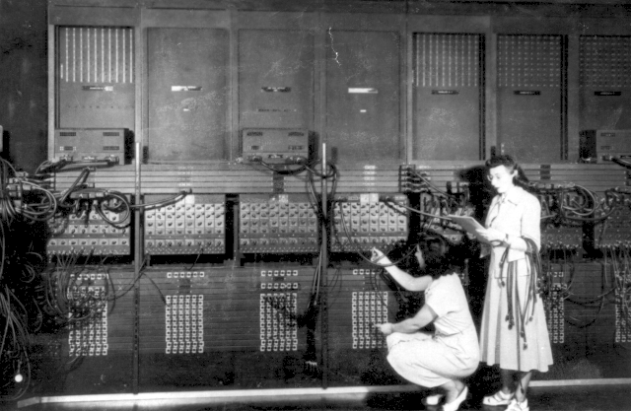
Programming ENIAC
Wiring the right side of the ENIAC with a new program, in the "pre- von Neumann" days.
8. Source: http://ftp.arl.army.mil/ftp/historic-computers/

Slide 22
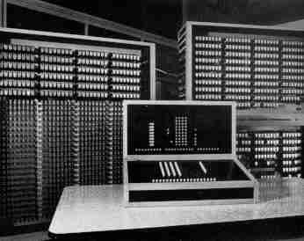
Z3
Input was from a numeric, decimal, 20 digit keyboard
Output: Numbers displayed with lamps, 4 decimal digits with decimal point
Programmed via a punch tape and punch tape reader
Rebuilt model of Z3 housed in Deutsches Technik Museum, Berlin
Multiplication 3 seconds, division 3 seconds, addition 0.7 seconds. Used a 600 relay numeric unit, 1600 relay storage unit
9. Source: http://irb.cs.tu-berlin.de/~zuse/Konrad_Zuse/en/Rechner_Z3.html

Slide 23
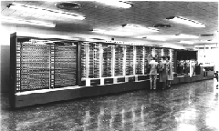
Mark I
Input was provided on punched cards
All output was displayed on an electric typewriter.
Could carry out addition, subtraction, multiplication, division and reference to previous results.
Contained more than 750,000 components, was 50 feet long, 8 feet tall, and weighed approximately 5 tons
Instructions were pre-punched paper tape
Still exists in the Computer Science Building at Harvard University.
10. Source: http://www.digidome.nl/howard_h__aiken.htm

Slide 24
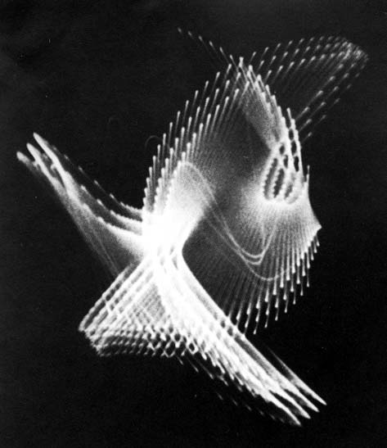
An Oscilloscope Was Used By the Individual Called the First Computer Artist
Could any of the earliest machines produce art?
What kind of output device might be a candidate for the first computer artist to use?
Artist: Ben Laposky (1914-2000)
One of his earliest works (1950)
Oscillon Number Four
11. Source: http://www.dam.org/laposky/

Slide 25
What is an Oscilloscope?
An oscilloscope is a laboratory instrument commonly used to display and analyze the waveform of electronic signals.
The oldest form of oscilloscope, still used in some labs today, is known as the cathode-ray oscilloscope.
Laposky’s works were produced by manipulating electronic beams displayed across the fluorescent face of an oscilloscope's cathode-ray tube and then recording the image onto high-speed film.

Slide 26
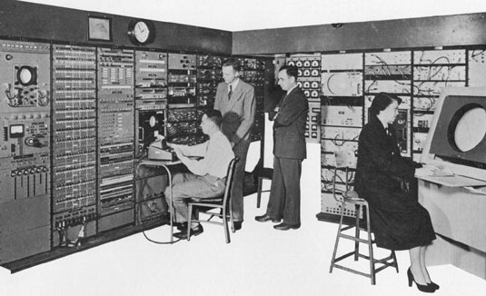
The First Public Demonstration of Computer Art - 1952
On the Whirlwind Computer at MIT -the first digital computer capable of displaying real time text and graphics on a large oscilloscope screen.
A “bouncing ball” animation was produced to demo this feature.
12. Source: http://www.accad.ohio-state.edu/~waynec/history/lesson2.html

Slide 27
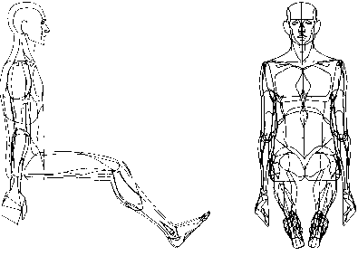
The Term “Computer Graphics”
Coined in 1960 by William Fetter (1928-2002), a trained artist and art director, to describe new design methods he was pursuing at Boeing.
•He created a series of widely reproduced images on a pen plotter exploring cockpit design using a 3D model of a human body.
Early computer art was characterized by being strictly black and white.
13. Source: http://courses.washington.edu/eatreun/html/history/h_nw.html

Slide 28
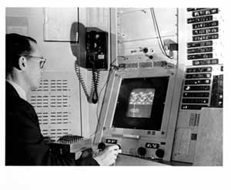
Ivan E. Sutherland – Called the Father of Computer Graphics
Ph.D. Thesis, 1963, MIT : Sketchpad: The First Interactive Computer Graphics Package on TX-2 (forerunner of DEC machines).
TX-2 was a giant machine for the day:
320 kilobytes of memory, about twice the capacity of the biggest commercial machines
magnetic tape storage,
an on-line typewriter,
the first Xerox printer,
paper tape for program input,
and a nine inch CRT!
14. Source: http://www.sun.com/960710/feature3/sketchpad.html#sketch

Slide 29
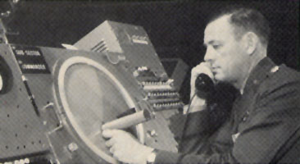
“Sketchpad: A Man-machine Graphical Communications System," used the lightpen to create engineering drawings directly on the CRT
A light pen being used with the SAGE system.
15. Source: http://www.accad.ohiostate.edu/~waynec/history/lesson2.html

Slide 30
Thus, In This New Art Form We See in Its Early Period (through the early 1970s) ...
The computer was a tool where algorithms in programs generated the images.
Often to enliven potentially boring repetitive images, random number generators were used to add variation and make the images have more of a “human-drawn” look.
Output devices were limited:
  oscilloscope screens
  very tiny CRT screens
  pens on flatbed or drum plotters
Input devices were limited:
  light pens
  paper tape
  paper cards
The artist had to program or have someone else do the programming

Slide 31
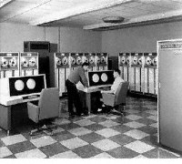
One of the Worst Problems was the Cost and Inaccessibility of Machines
Control Data Corporation
CDC 6600 at U of Texas, 1964-68
Cost: $2,000,000+
Kept in dustfree room behind locked doors
16. Source: http://www.computerhistory.org/timeline/timeline.php?timeline_category=cmptr Computer History Museum

Slide 32
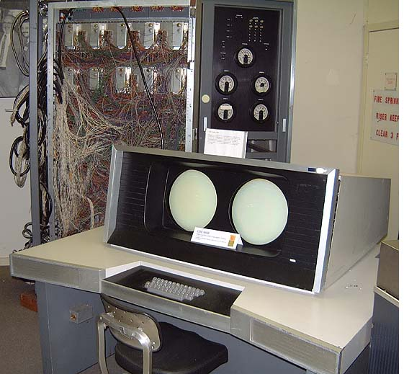
CDC-6600
1964
Workstations available to only a few
Most had to use punched cards handed in through a window
17. Source: http://ed-thelen.org/comp-hist/vs-cdc-6600.jpg Control Data Corporation, CDC-6600 & 7600

Slide 33
The First Period of Computer Art
1950-early 1970s
Note- different artists place different dates on this period
Characterized by
  a difficulty in obtaining access to computing equipment
  a need to learn programming (in a day when few expressive languages were available) --- but many found that intriguing
  black and white work (no color output)
  use of curves or figures that could be described mathematically
  “look” of work was dictated by the limitations of the technology
  Often the artists were scientists who were also artists or at least had an interest in art

Slide 34
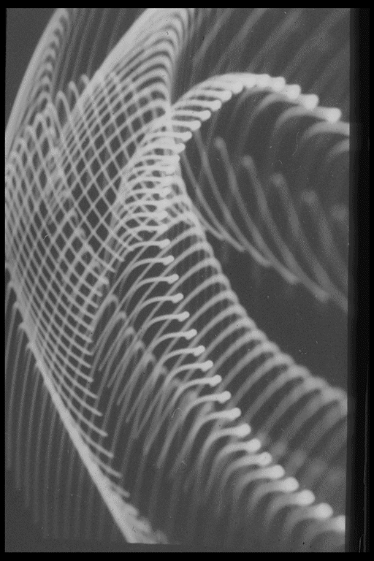
Who Were Some of the Other Early Computer Artists?
From 1953 to 1956, Herbert Franke experimented with oscilloscope imagery, and then later, in the very early 1960s, he created monochrome computer graphics.
Untitled Oscillogram – 1956
18. Source: http://www.zi.biologie.uni-muenchen.de/%7Efranke/index.html

Slide 35
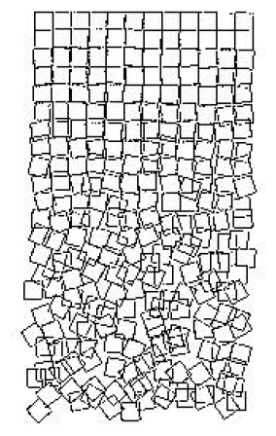
Georg Nees’ plotter piece, called “Gravel Stones” (Cubic Disarray) (1968-71), is a graphic rendering of order and chaos
This was the original inspiration for a series of digital art works representing an example of pen plotter-based art.
Exact mathematical computations model a chaotic image and the progression from the ordered to the disordered.
19. Source: http://www.iit.edu/~krawczyk/rjkiv02.pdf

Slide 36
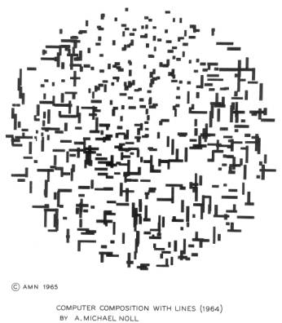
Michael Noll’s algorithmically simulated Mondrian’s painting called “Composition with Lines” (1965).
In his early years, Noll did many black and white computer-generated drawings that were created in the style of various artists:
Picasso
Bridget Riley
Mondrian
20. Source: http://www.citi.columbia.edu/amnoll/

Slide 37
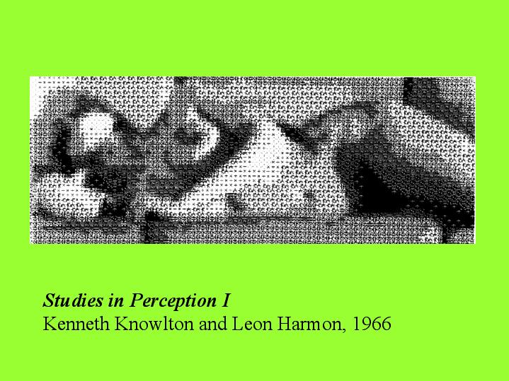
Studies in Perception I
Kenneth Knowlton and Leon Harmon, 1966
21. Source: http://artstream.ucsc.edu/art80f/History%20of%20Electronic%20Art/sld039.htm

Slide 38
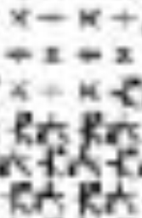
Looking At This Up Close We See ..
The artists scanned a photograph and then assigned different symbols to represent each of the varying gray values. All the selected symbols were composed from the character α.
Note the addition, subtraction, multiply, and divide symbols as well as some others representing computer components.
Art of this type was very common in this early era and many images existed of various objects and scenes using this technique.

Slide 39
An Simple Example of the Way an Earlier Computer Artist Might Work
Choose a basic shape – such as a triangle.
Follow some pattern to produce new shapes. For example,
  1. Rotate the triangle 30 degrees and draw it.
  2. Move the triangle 20 pixels up and 30 pixels to the left. Draw it.
  3. Make each side twice as long. Draw it.
To make this more like what a human would do, introduce randomness – i.e. throw a die and make random choices.

Slide 40
An Example of the Way an Earlier Computer Artist Might Work
Choose a basic shape – such as a triangle.
Follow some pattern to produce new shapes using a die to choose 1 – 6. For example, If the die is 1, choose the first number; if die is 2, choose second, etc.
  1. Rotate the triangle (10, 20, 30, 40, 50, 60) degrees and draw it.
  2. Move the triangle (5,10,15,20,25,30) pixels (N, S, E, W, NE, NW) and (5,10,15,20,25,30) pixels (SE,SW,E,W,N,S) Draw it.
  3. Make each side (0.1, 0.2, 0.3, 0.4, 0.5,2) times as long. Draw it.
  4. Color the last triangle (red, green, blue, cyan, magenta, yellow)
Repeat 1 through 4 (2,3,4,5,6,7) times.

Slide 41
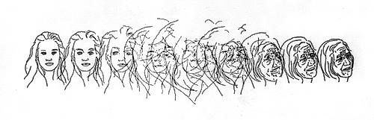
An Artist Close to Us: Charles Csuri
Professor Emeritus at OSU
“For computer graphics the IBM 7094 had as output cards about 4 x 7 inches with holes in them which contained information to drive a drum plotter. Boxes of cards could represent a single image. The cards were entered into a card reader on an IBM 1130 computer with a plotter device. These punch cards had the information to move the pen and pick the pen up or down as well as programmed instructions for end of line, etc.”
Aging Process
22. Source: http://www.siggraph.org/artdesign/profile/csuri/

Slide 42
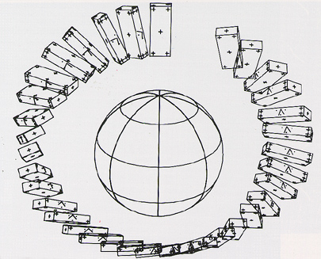
First computer animated film (Two-Gyro Gravity-Gradient Attitude Control System), by Edward Zajak of Bell Labs, 1963
23. Source: http://www.cs.montana.edu/~charon/graphics/1960.html

Slide 43
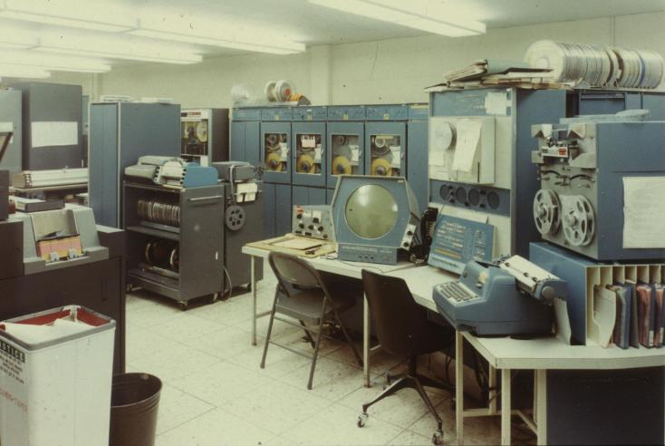
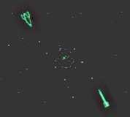
The true purpose of computers is finally realized in 1961, when a MIT student, Steve Russell, creates the first computer game - Spacewar.
Screenshot on PDP 1 – 200 hours to program
24. Sources: http://inventors.about.com/library/weekly/aa090198.htm
http://www.nersc.gov/~deboni/Computer.history/GAM.PDP-1/

Slide 44
Art Shows and Societies
First Show in U.S. of Computer Art, 1965,
Howard Wise Gallery, New York City. Featured works of A. Michael Noll and Bela Julesz.
Other shows followed with computer art becoming more and more accepted in at least some of the art world.
In 1967, Robert Rauschenberg and Billy Kluver from Bell Labs formed Experiments in Art and Technology (EAT) which brought together artists and scientists through organized lecture series.
By 1968 it was possible for Jasia Reichardt to curate a survey of work in the area in the influential Cybernetic Serendipity exhibition held at London's Institute of Contemporary Art – the ICA.
1972- SIGGRAPH founded.

Slide 45
Citations
1. Web Site: http://65.107.211.206/technology/jacquard.html, The Victorian Web, sponsored by University Scholars Program, University of Singapore Consulted: 10/03
2. Ibid
3. Web Site: Source: http://www.sciencemuseum.org.uk/on-line/babbage/page3.asp Science Museum, Consulted 8/02
4. Web Site: http://www.columbia.edu/acis/history/hollerith.html, The Hollerith Tabulator, Computing at Columbia Timeline, Consulted 10/03
5. Ibid
6. Web Site: www.cs.iastate.edu/jva/images/abc-1942.gif, Department of Computer Science, Iowa State University, Consulted 8/03
7. Web Site: http://ftp.arl.army.mil/ftp/historic-computers/ U.S. Army Photo from K. Kempf, "Historical Monograph: Electronic Computers Within the Ordnance Corps" The ENIAC, in BRL building 328, picture in the public domain
8. Web Site: http://ftp.arl.army.mil/ftp/historic-computers/ "U.S. Army Photo" from the archives of the ARL Technical Library, picture in the public domain
9. Web Site: http://irb.cs.tuberlin.de/~zuse/Konra __Zuse/en/Rechner_Z3.html Horst Zuse Web Site, TU Berlin, Electrical Engineering and Computer Science, Consulted 8/02

Slide 46
Citations (Continued)
10. Web Site: http://www.digidome.nl/howard_h__aiken.htm Digidome Computer Museum, Consulted 8/03
11. Web Site: http://www.dam.org/laposky/ Digital Art Museum, Consulted 8/03
12. Web Site:
http://www.accad.ohio-state.edu/~waynec/history/lesson2.html A Critical History of Computer Graphics and Animation, Consulted 8/03
13. Web Site:http://courses.washington.edu/eatreun/html/history/h_nw.html University of Washington, Consulted 8/03
14. Web Site: http://www.sun.com/960710/feature3/sketchpad.html#sketch
Sun Microsystems, Consulted 7/02
15. Web Site http://www.accad.ohiostate.edu/~waynec/history/lesson2.html
A Critical History of Computer Graphics and Animation, Consulted 7/00
16. Web Site: http://www.computerhistory.org/timeline/timeline.php?timeline_category=cmptr Computer History Museum, Consulted 7/02
17. Web Site: http://ed-thelen.org/comp-hist/vs-cdc-6600.jpg Control Data Corporation, CDC-6600 & 7600 , Consulted 7/02
18. Web Site: http://www.zi.biologie.uni-muenchen.de/%7Efranke/index.html
Home Page of Herbert W. Franke, Consulted 1/04

Slide 47
Citations (Continued)
19. Web Site:: http://www.iit.edu/~krawczyk/rjkiv02.pdf “A Shattered Perfection: Crafting a Virtual Sculpture”, Robert J. Krawczyk College of Architecture, Illinois Institute of Technology, Consulted 12/03
20. Web Site: http://www.citi.columbia.edu/amnoll Home Page of A. Michael Noll, Consulted 12/03
21. Web Site: http://artstream.ucsc.edu/art80f/History%20of%20Electronic%20Art/sld039.htm
Studies in Perception I, Kenneth Knowlton and Leon Harmon, 1966, Consulted 12/03
22. Web Site: http://www.siggraph.org/artdesign/profile/csuri/ Csuri, Computer Artist, Consulted 10/03
23. Web Site: http://www.cs.montana.edu/~charon/graphics/1960.html CS525, Presentation2: 1960s, Consulted 8/03
24. Web Site: http://inventors.about.com/library/weekly/aa090198.htm Inventors of the Modern Computer Series, Consulted 8/03 and
Web Site: http://www.nersc.gov/~deboni/Computer.history/GAM.PDP-1/ The PDP-1, by George Michael, Consulted 8/03

