Slide 1
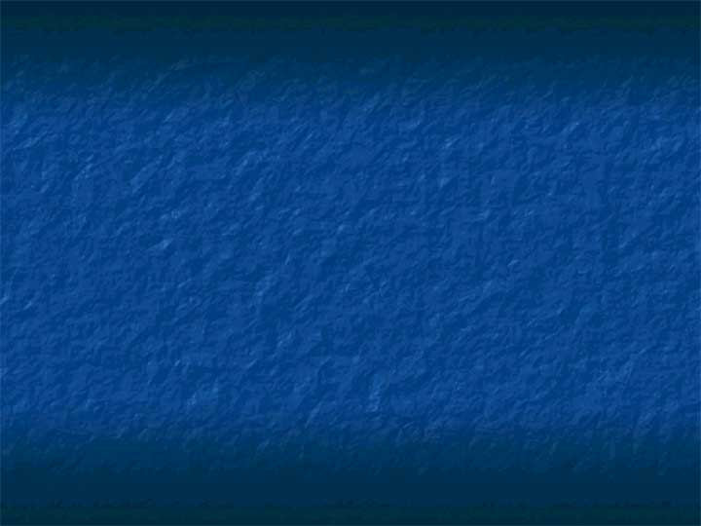
Printing
Chapter 6

Slide 2
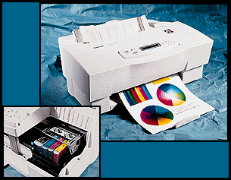
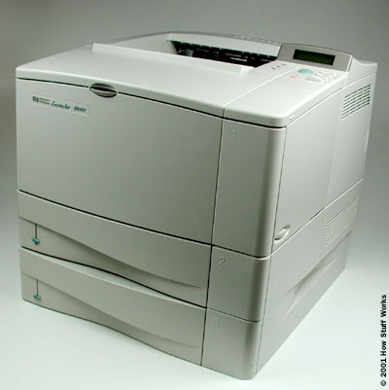
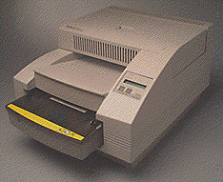
Numerous Technology Exist for Generating Hardcopy Images
Ink Jet
  Drop-on demand
  Continuous ink jet
  Solid ink
Laser
  Monochrome
  Color
Thermal Transfer
  Wax thermal transfer
  Dye thermal transfer (dye-sub)
Others- Cycolor, Autochrome, CRT printer, Dry Silver etc.

Slide 3

Ink Jet Printers Dominate the Desktop Output Market
Inexpensive (to very expensive IRIS prints)
Plain paper output
Light and water fastness of inks in question
Halftone images
1440 dpi

Slide 4
How the Ink Jet Printers Work
Paper is fed into the printer and positioned at top of page.
The print head stepper motor uses the belt to move the print head assembly across the page.
The motor pauses each time that the print head sprays dots of ink on the page and then moves a tiny bit before stopping again.
Multiple CMYK dots are made at each stop.
At the end of each complete pass, the paper feed stepper motor advances the paper a fraction of an inch.
Depending on the inkjet model, the print head is reset to the beginning side of the page, or, in most cases, simply reverses direction and begins to move back across the page as it prints.

Slide 5
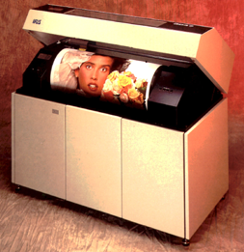
Continuous Ink Jet Printers Are Used at the High-end
Large sizes (30”X40”)
Slow Speed (1”/second)
High initial cost ($30K+)
Continuous inkjet printers were developed by IBM, and use electrically-charged droplets to coat the page with ink very quickly but also waste a lot of ink.
This technology never caught on with consumers, but is used today in industrial settings.

Slide 6
Drop-on Demand Ink Jet Printers
The more popular design among consumers is the drop-on-demand inkjet printer, invented by Siemens in 1977.
These printers spray ink only where needed
They are slower than continuous inkjet printers but less expensive.
Most drop-on-demand printers, including those made by HP, Canon, and Lexmark, use thermal technology to push the drops of ink out of the print head.
Epson uses its own technology, called piezo-electric, to achieve the same effect.

Slide 7
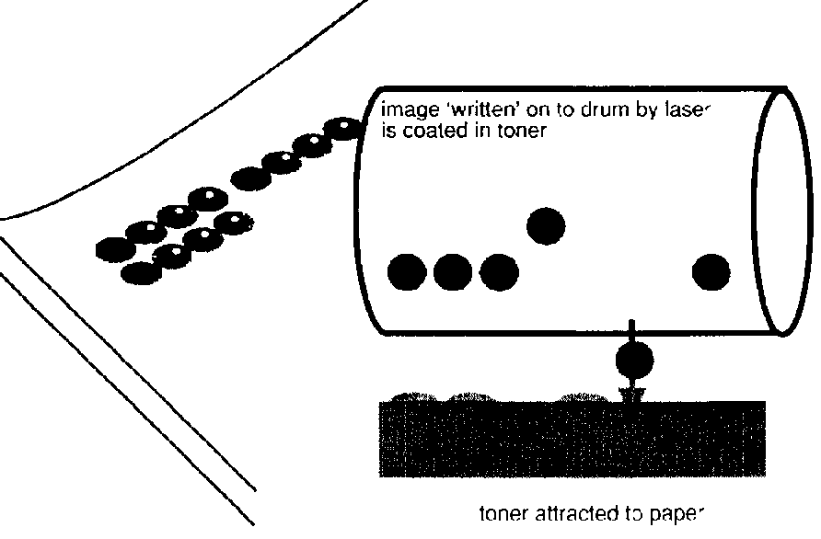
Laser Printers Offer High Throughput, Low-Cost Color
Halftone images
High throughput (8-16 ppm+)
Low cost/page (plain paper output)
Light and water fastness better than inks
Low cost/print (5 cents-50 cents); Higher cost/unit ($100-$5000+); 1200 dpi

Slide 8
How Does a Laser Printer Work?
The core component of a laser printer is a revolving drum or cylinder.
Initially, the drum is given a total positive charge
As the drum revolves, the printer shines a tiny laser beam across the surface to discharge certain points.
In this way, the laser "draws" the letters and images to be printed as a pattern of electrical charges.
After the pattern is set, the printer coats the drum with positively charged toner -- a fine powder.
Since the powder has a positive charge, the toner clings to the negative discharged areas of the drum, but not to the positively charged "background."

Slide 9
Laser Printers- cont’d
With the powder pattern affixed, the drum rolls over a sheet of paper.
Before the paper rolls under the drum, it is given a negative charge so the paper can pull the toner powder away. Since it is moving at the same speed as the drum, the paper picks up the image pattern exactly. To keep the paper from clinging to the drum, it is discharged immediately after picking up the toner.
The printer passes the paper through the fuser, a pair of heated rollers. As the paper passes through these rollers, the loose toner powder melts, fusing with the fibers in the paper. The fuser rolls the paper to the output tray, and the page is finished (and slightly hot).

Slide 10
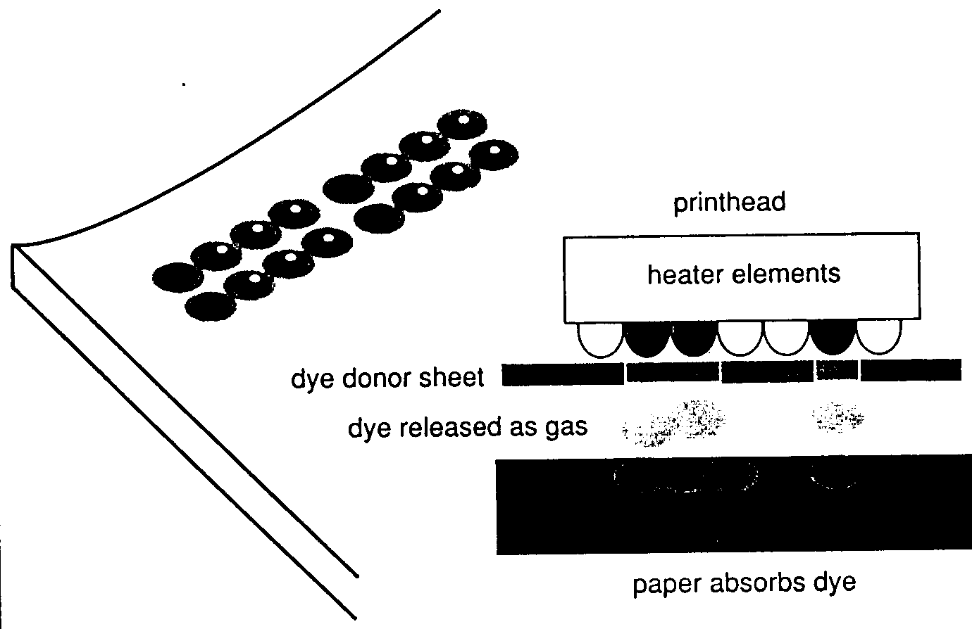
Dye-sublimation Printers Generate Photographic Quality Output
Continuous tone
Photographic Quality output
Expensive: media (special
paper is required) and printers
Same amount of dye used
regardless of picture content
Slow printing speeds
Restricted output sizes (letter/legal)
Smaller “photo-printers” cost $.50/print

Slide 11
Thermal Wax Printers Melt Wax onto Paper
CMYK printing
Halftone images
Quality not as good as Dye-Sublimation
Less expensive than Dye-Sublimation
Uses a wax-coated ribbon and heated pins. As the cyan, magenta, yellow, and black ribbon passes in front of the print head, heated pins melt the wax onto the paper where it hardens.
Works well to produce large quantities of transparencies for colorful business presentations.

Slide 12
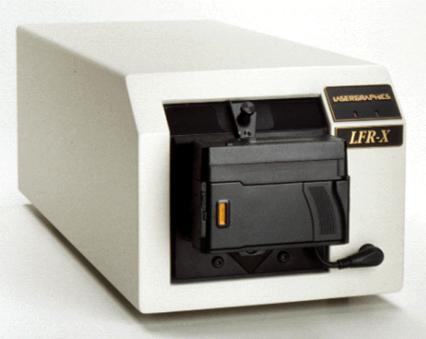
Film recorders take an image of a high-resolution monitor
3 images of a high resolution monitor are taken through red, green and blue filter
Typically, the monitor is a CRT with 4K X 4K or 8K X 8K pixels
Expensive monitor

Slide 13
There are Many Other Printing Technologies
Autochrome - develop with heat; “fix” with UV radiation - Fuji Photo Printers
Cycolor - Photo-initiation + Photo-Polymerization - Photo-Printers
Dry Silver - Thermally developed Silver Halide - Imation Medical Imaging
CRT printers - Expose CRT image onto photographic printers - PhotoLabs

Slide 14
Quality of the Print
Although the type and quality of the printer obviously plays a role, other options also affect quality:
  Rasterization – known as “ripping the image”
  Halftoning
  Dithering
  Output media choices
  Printer settings
  Software choices

Slide 15
A Printer is Composed of the Following Components
= RIP + Marking engine + Interface
RIP - Raster Image Processor
Marking engine
  ink-jet, laser, dye-sub etc
External Interface
  Serial, Parallel, USB, IrDA, Firewire, Ethernet

Slide 16
Steps in the Printing Process
Generate
PDL File
Send PDL
to RIP
Send raster
image to
marking engine
Document
Creation
PDL = page description language

Slide 17
Rasterization
Basically two kinds of printers:
  Vector-based plotters – basic commands include:
    Pen up
    Pen down
    Move to coordinates (x,y)
  Raster-based printers – the frame buffer is output, normally one line at a time.
Raster images can be output directly on a raster-based printer.
Vector graphics images must be converted to raster images in order to be printed with a raster-based printer.
  This process requires sampling that may cause the image on the screen to look differently when it is printed.
Raster-based printers are more common today than vector-based plotters although high quality map making still uses vector-based plotters.

Slide 18
Vector vs. Raster Imaging
A
A vector image describes the “page” in a standard language (like Postscript)
A raster image is a display of 2-D data from memory (pixel for pixel)

Slide 19
How are Images Converted
(Rasterized or Image Ripping)
Three techniques:
  Some printers can convert
  Software on a computer converts
  Use a separate peripheral called a raster image processor (RIP).
Software rasterizing can be time consuming.
Professionals often use hardware RIPs, but they are costly.

Slide 20
A Raster Image Processor (RIP) converts a PDL into a bitmap image
Postscript
(vector )
RIP
(rasterizes)
Raster
Image
A document or photograph is sent to the printer using a standard page description language (PDL) (Postscript, PCL)
A RIP may reside in the host, printer or as a separate unit
Photographs are “halftoned” by the RIP

Slide 21
Adobe Postscript (PS)
What is it?
  A geometric page description language.
  Describes the appearance of text and graphics on printed, or displayed, pages.
Why is it useful?
  It is widely used on all computer platforms as a language for printing documents:
    A word processing application, for example, will translate its proprietary format into a PostScript program which is then interpreted by a laser printer and output as a graphical mage.
  A PostScript drawing looks much better when printed on a 600-dpi printer than on a 300-dpi printer.
  A bit-mapped image looks the same on both printers.

Slide 22
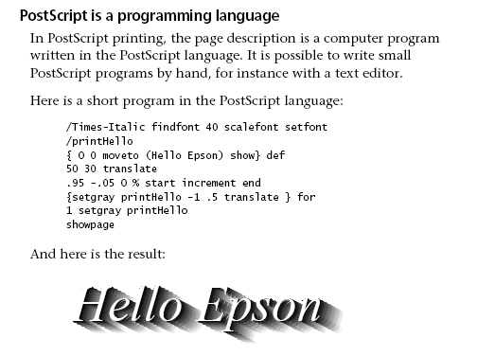
Programming in PostScript

Slide 23
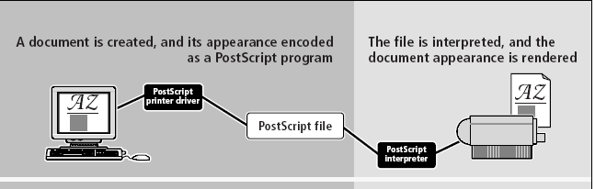
But, The Programming Is Not Typically Done By Humans (except to correct files)!

Slide 24
Postscript
Characteristics
  Device independent
  Can print on any printer with a Postscript interpreter
  Inspired the entire field of desktop publishing.
PostScript is the standard for desktop publishing because it is supported by imagesetters, the very high-resolution printers used by service bureaus to produce camera-ready copy.

Slide 25
Disadvantages of Postscript
Viewing PostScript files on-screen requires a viewer such as GhostView (although it is free).
To print correctly, the client computer must have access to the fonts specified in the PostScript file.
  Unfortunately these fonts tend to be copyrighted, which means that developers wishing to distribute files to a wide audience are constricted to using standard PostScript fonts in order to avoid possible copyright infringements.
PostScript's main weakness is its tendency to generate large files unsuitable for document interchange over the Web.

Slide 26
What is PDF (Portable Document Format)?
It is a unique type of cross platform file format developed by Adobe
Developed in 1993 as a spin off of the Adobe PostScript filing language
Advantages include:
  Cross Platform – free readers are available
  Smaller size than PS.
  Prints correctly on any device.
  Hardly any misprints.
  Retains the integrity of source document – displays exactly as created.
  Compresses graphics up to 4:1 ratio.

Slide 27
PostScript Files and PDF
PDF Files have the same imaging capabilities as PostScript as they share the same underlying architecture of the Adobe Imaging Model.

Slide 28
Both PS and PDF’s are used throughout the working world.
 | PS | PDF
Designers | X | X
Office |  | X
Printing | X | X
Internet Apps |  | X
Corporations | X | X
Government | X | X
Financial Service |  | X
Notes:
These are some examples of people in the industry who would use a PS of PDF file. Note that the industries that would not use PS, is because they use primarily online forms of communication, and PDF’s are more internet friendly.

Slide 29
Vibrant Images
Because computer screens deal with light, images on a screen are more glowing, continuous looking, and vibrant than printer images.
Reasons:
  Additive (creates with light) vs subtractive (reflects light)
  Screen phosphors have up to 256 brightness levels and can blend together to produce over 17 million different colors.
  Printers have only one intensity of ink.
Corrective measures involve:
  Halftoning
  Dithering

Slide 30
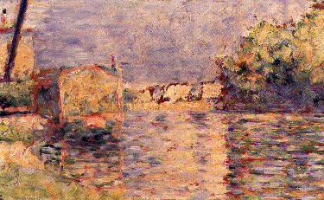
Halftoning – Similar to Pointillism in Art
We have seen pointillism in the work of Georges-Pierre Seurat (1859-1891).
Pointillism is the applying of small strokes or dots of color to a surface so that from a distance they blend together.
Banks of the Seine near Courbevoie, 1883
Oil on wooden panel - Seurat

Slide 31
Halftoning – What is It?
A printer must create different grays and different color brightnesses.
But- unlike a monitor which can vary intensity by the flow from the electron gun, a printer has only one intensity for each color ink – it is either there or not!
Halftones are patterns of dots which when viewed from a distance, blend with each other and the paper to give the appearance of different gray values or colors.
Thus a single monitor pixel may be represented by several printer dots – say 2 X 2, 4 X 4, etc.

Slide 32
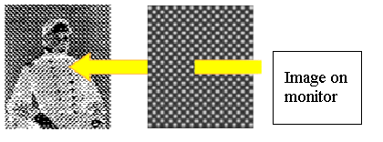
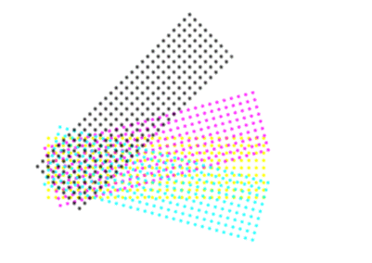
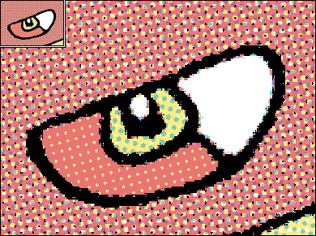
Conventional Halftone - B/W and color
An image is projected through a “halftone screen” to break it up into a number of “dots”
Screens are referred at as having so many “lines/inch”
Color halftones have CMYK screens oriented at different “screen angles” to eliminate Moire patterns

Slide 33
Some Basics of Halftoning
  Halftoning parameters
    Shape of grid -- square, circle, ellipse, hexagon
    Density of lines on grid
      Trade-offs between spatial resolution and intensity resolution
    Screen angle
      45 degree rotated screen is typical for BW
  Color halftoning
    Separate image into 4 channel (CMYK) and use 4 halftone screens with different rotated screens
      For example: Cyan screen at 15 degree,magenta at 75, yellow at 0 and black screen at 45 degree

Slide 34
An Example - Grayscale
Patterning with 4X4 matrix (array, table)
  Represent each image pixel by a block of cells
      Input gray scale is converted into 17 output levels
  Often used when output device has more spatial resolution than source image
      When output device has a resolution of 640X480, the effective resolution with 4X4 patterning matrix becomes 160X120
  Need to choose carefully the patterns of printed cells
    There is a lot of research even today on good algorithms for picking these patterns.

Slide 35
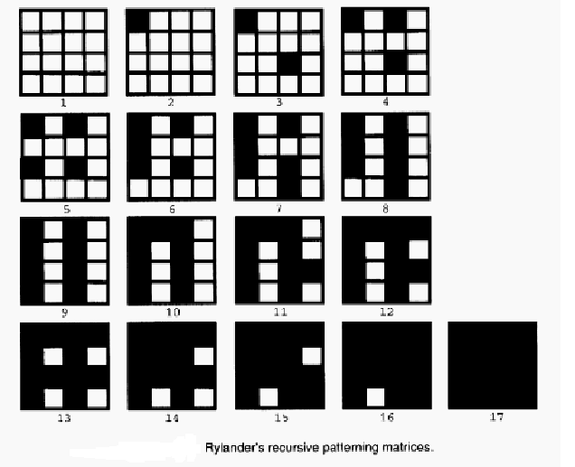
One Algorithm Produces:

Slide 36
Remember: In Halftoning, “black dots” + “white paper” generate different shades of gray
15
4
2
computer
image
7
2
5
0
9
13
A printed halftone
image

Slide 37
In Halftoning, spatial resolution is sacrificed to gain tonal resolution
15
4
2
computer
image
7
2
5
0
9
13
1 pixel = 4 X 4 “dots”
=16 shades of gray
= 4 bits/pixel
1”

Slide 38
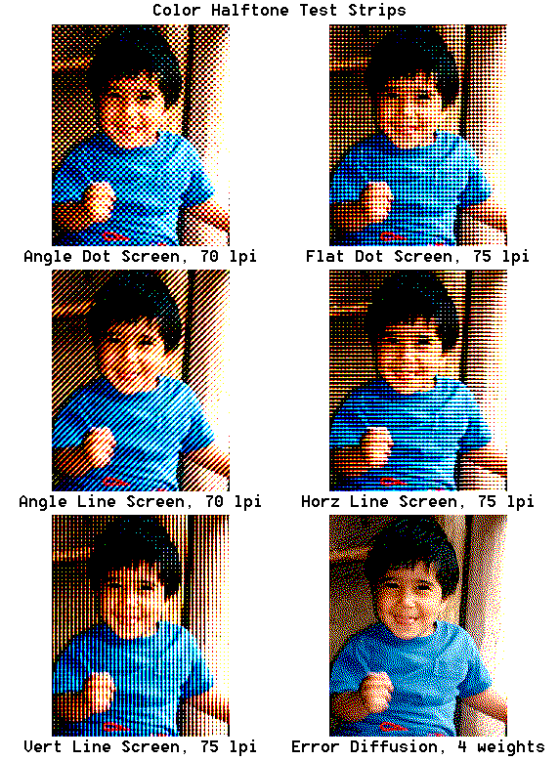
Color halftone images generated using various types of screens

Slide 39
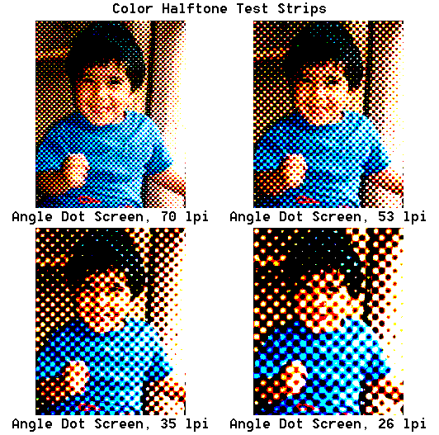
Halftone images generated using various screen rulings

Slide 40
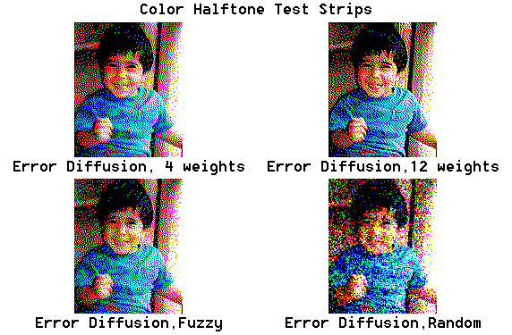
“Stochastic Halftoning” or “FM Screening” varies frequency of dots
First order: Fixed size dots, random distribution
Second Order: Variable size dots and random distribution

Slide 41
Dithering
Halftoning is a special case of dithering which creates a pattern of screen pixels or printer dots to simulate colors or gray levels that can’t be displayed or printed.
Dithering is the attempt by a computer program to approximate a color from a mixture of other colors when the required color is not available i.e. when a display monitor attempts to display images specified with more colors than the monitor is equipped to handle.
Another common example: Dithering occurs when a color is specified for a Web page that a browser on a particular operating system can't support.
  The browser will then attempt to replace the requested color with an approximation composed of two or more other colors it can produce.
  The result may or may not be acceptable to the graphic designer. It may also appear somewhat grainy since it's composed of different pixel intensities rather than a single intensity over the colored space.

Slide 42
Non-dithered Colors
There are 216 colors chosen by both the Windows and MAC operating platforms to make up their palettes of colors.
The colors that aren't in this collection are the colors that these operating systems try to make up by dithering.
Note: This applies only for these two operating platforms – there ARE others – SGIs, Suns, etc.
The 216 colors are shown on the next slide with their color values.
Using these 216 colors only, web pages will display the same (up to gamma correction differences) on both platforms.

Slide 43
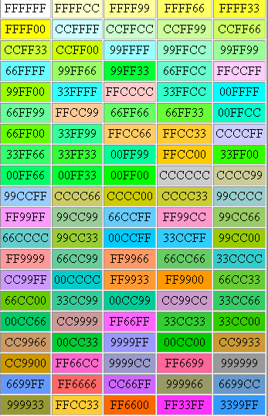
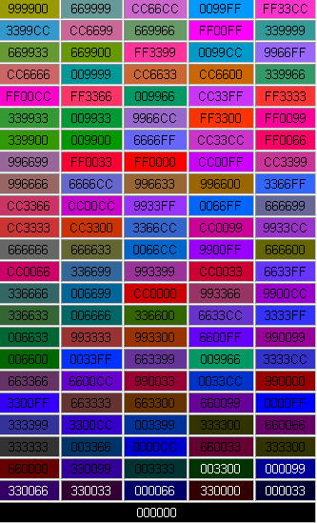

Slide 44
Non-dithered Colors
Note: These are given in hex (or base 16) notation:
digits = 0,1,...,9.A,B,C,D,E
2 hex digits per gun
So: FF0033 is
red = FF₁₆ = (15)(16) + 15 = 255
green = 00₁₆ = 0
blue = 33₁₆ = (3)(16) + 3 = 51

Slide 45
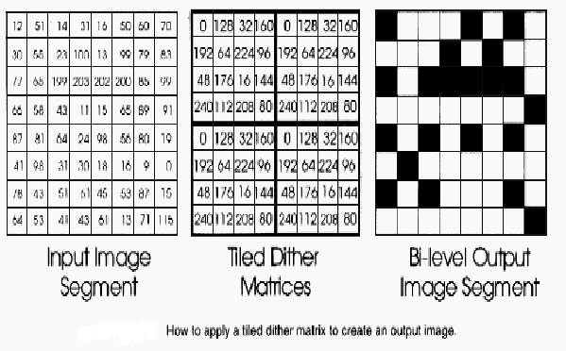
How is Dithering Done?
Research into good algorithms is ongoing.
It is usually done by generalized thresholding with a dither matrix.
A simple example: Adjust input gray scale into 17 levels
    Overlay dither matrix onto input and print output dot everywhere input value is greater than matrix value

Slide 46
Not Just Any Dither Matrix Will Work
  Must satisfy certain properties in order to be effective.
    For example, a cell printed in a block for intensity i must be printed in blocks for intensities greater than i
  Most algorithms either generate the image recursively or by equations.
  Research on halftoning and dithering typically occur in electrical engineering departments that have people interested in signal processing.

Slide 47
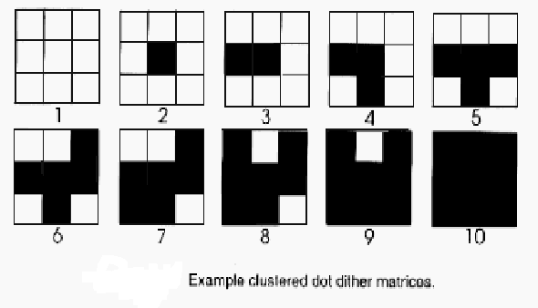
Example: Clustered-dot Ordered Dither Matrix
Used for film recorders and laser printers which have difficulty reproducing dots in isolated cells
Dot begins in the center cell and grows outward

Slide 48
One Last Issue: Image Permanence in the Digital Age – Critical Images
Papers
Inks
Causes of image loss
Testing methods for image permanence
Disclaimer: I know very little about this. In graphics, which is one of my interests, we are interested in the screen image predominately and how to produce the image there.

Slide 49
The Choice of Paper is Critical
Fine art papers-new to the market archival to 50 – 200 years supposedly
Limited only by ink stability
Want acid free which is buffered against atmospheric acid and environmentally friendly
Coated papers lack archival properties
Ink is raised on coated paper, making it susceptible to airborne contaminates
Uncoated papers include fine art papers

Slide 50
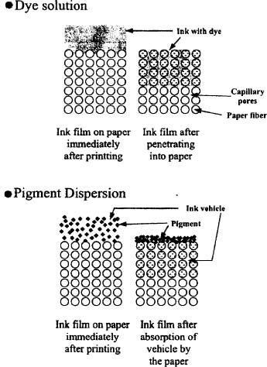
Your Picture Depends Upon the Inks Used
Inks fade under almost any light
Combat fading by placing a protective film over the image
New generation inks are gaining a life span of 20 years before 25% fading

Slide 51
Pigmented Dyes: Next Frontier
Shows a move away from dye based
Better longevity, UV, and water resistance
Drawback: lower color gamut and brilliance
See an excellent discussion on many aspects of printer dyes, inks, and paper at
http://www.colorbat.com/PDF_Files/6006Archival%20Ink%20Printing.pdf

Slide 52
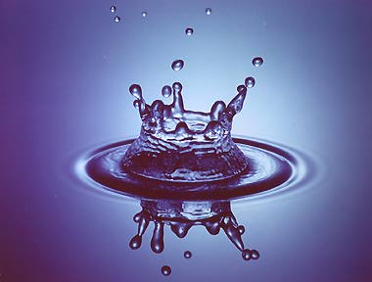
Water- Great to Drink- Not Good for Art
Waterfastness directly related to dye stability
Oil soluble dyes are highly waterfast- good for pigment inks
Increase waterfastness by including a polymer like polyamine
Indoor- dye inks
Outdoor -pigment inks

Slide 53
The Ozone Effect
Airborne contaminates and the environment also effect image quality
Example: Epson premium glossy photo paper- cyan dyes fade leaving a red - orange cast
Paper is sensitive to ozone produced by laser printers, electrostatic air filters and automobile exhaust
Drying a print for 24 hours under a sheet of plain paper then placing it behind glass helps.
Or use a more archival paper.

Slide 54
Testing Is Needed on Newly Created Papers
To improve image permanence tests must include: heat, humidity, light, air, and pollutant testing
Digital media testing must also include: waterfastness, outdoor weathering, fingerprints, and image transfer testing
Check the following research by Henry Wilhelm who is considered an expert on many of the issues involved with computer art and photography printing permanence:
http://www.wilhelm-research.com/

