Slide 1

The World Wide Web
Chapter 12

Slide 2
Let’s Be Precise – A History of the Web
Late 1960s – the ARPANET was conceived as a network of computers in which packets of information (i.e. data) could be transmitted between various computers via telephone lines or higher speed dedicated data lines.
ARPA was Advanced Research Projects Agency.
This allowed remote logins to computers (using telnet), the ability to transfer files between computers (using ftp = file transfer protocol), and e-mail.
Many people now say it was designed for the military, but that was newspaper hype.
The purpose of the ARPANET was to allow the sharing of National Science Foundation (NSF) research project information between researchers.
In 1972, there were 29 nodes (i.e. computer sites that were interconnected).

Slide 3
The ARPANET Introduced the Internet Protocol
To move data from computer A to computer B:
  Break the data up into packets of information.
  Each packet carries the IP (Internet Protocol) address of computer B which consists of 4 numbers.
  At each computer, the address is read and then the envelop is shipped along to another computer using a recipe called a routing algorithm.
  At no time are A and B necessarily physically connected (unless they are adjacent nodes on the network).
  The different packets will not necessarily follow the same route.
  At computer B, the packets are reassembled into the document.
  A packet is typically in the 40 – 1500 byte range
  (1 byte = 1 character)

Slide 4
Computer C
Document
X at A
Packet X-1
for B
Document
Packet X-2
for B
Computer F
Packet X-3
for B
Packet-based transmission of a document from Computer A to Computer B
Computer E
Computer D
Document
X at B
Note: If one computer fails, the document still may be transmitted.
Computer B
Computer G

Slide 5
Tracing the Route Your Packets Take
Traceroute is a tool that traces the route your packets take.
Ping is a tool that tells you whether or not a web site is up.
Ping Plotter (http://www.pingplotter.com/) is a tool that graphically shows you the route your packets take.
  It was free, but can be used for 30 days without a subscription of $0.99 a month today.
  Interesting to see how your packets travel!

Slide 6
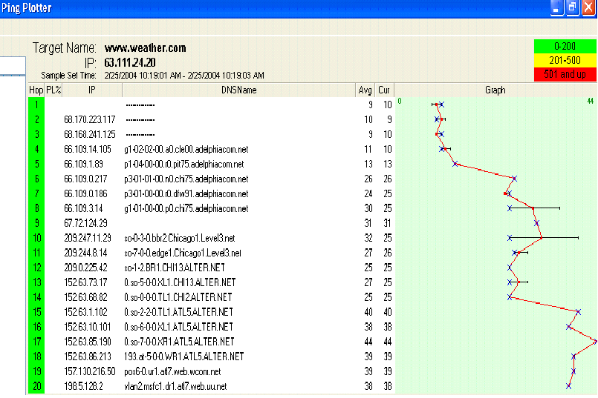
One Ping Plotter Trace to www.weather.com

Slide 7
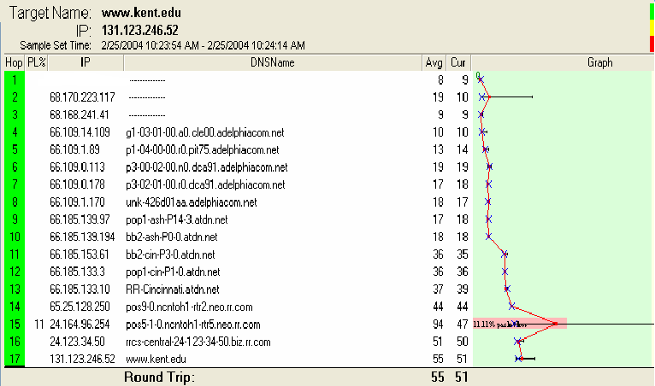
A Trace to KSU
If you watch these interactively you’ll see the route changes.

Slide 8
Internet to World Wide Web
The Internet is a collection of computers using the internet protocol to transmit information
The World Wide Web is a multimedia environment invented by Tim Berners-Lee, in 1990.
  Was a physicist at CERN (the European Organization for Nuclear Research).
  Wrote the first web browser (WorldWideWeb) and the software for the first web server.
  Invented both the HTML markup language in which many web pages are written and the HTTP protocol used to request and transmit web pages between web servers and web browsers

Slide 9
Growth in WWW
Number of Unique Web Sites
The number of Web sites, adjusted to account for sites duplicated at multiple IP addresses.
1998: 2,636,000
1999: 4,662,000
2000: 7,128,000
2001: 8,443,000
2002: 8,712,000
A Web site is defined as a distinct location on the Internet, identified by an IP address, that returns a response code of 200 and a Web page in response to an HTTP request for the root page. The Web site consists of all interlinked Web pages residing at the IP address.
Statistics provided by OCLC Online Computer Library Center, Inc., Office of Research

Slide 10
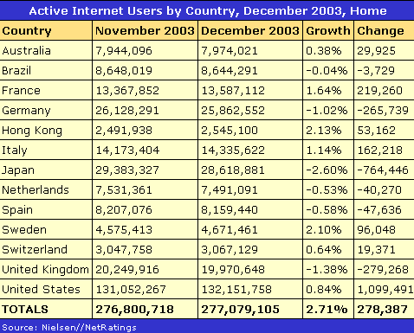
Active Internet Users by Major Country

Slide 11
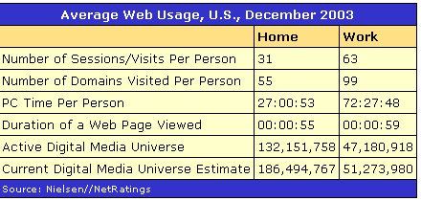
Average Web Usage in U.S.

Slide 12
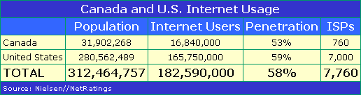
More Than Half of People in U.S. and Canada Regularly Use Internet

Slide 13
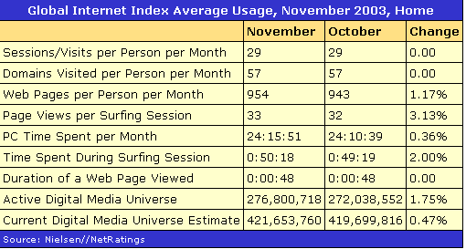
Global Usage – Includes All Countries Monitored :
~20 countries accounting an estimated 90% of all Internet users
For a more complete list see: http://www.clickz.com/stats/big_picture/geographics/article.php/ 5911_151151

Slide 14
Negative Properties of WWW
(Many affect an artist’s usage of the Internet):
Uneven bandwidth – number of bits that can be transmitted per second.
Uneven capabilities of user’s browsers and other software
  i.e. plug-ins differ widely and can interact with each other in strange ways.
No central control – therefore, unregulated and somewhat uncensored.
Anonymity of site owners.
Contrary to popular belief, it is not free.
Device independent – but not all hardware acts the same.
Copyright issues are more pronounced.

Slide 15
Bandwidth
Bandwidth – number of bits that can be transmitted per second
Greatly affects the ability of users to
  Download images and video
  See realistic animation and motion
  Hear good voice transmission
Various sites let you test your bandwidth as it is not always as high as your ISP (Internet Service Provider) claims.

Slide 16
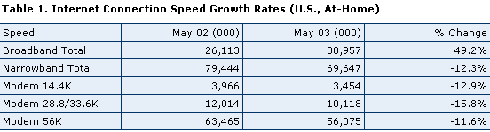
However, in U.S. Broadband Usage is Beginning to Increase
This says there are ~39 million, or 13 percent of Americans, connecting via broadband in the U.S., the highest number to date. Broadband users at-home grew 49 percent year-over-year, while narrowband users declined 12 percent during May 2003.
Source: http://www.nielsen-netratings.com/news.jsp

Slide 17
Plug-ins
Plug-ins are software programs that extend the capabilities of the browser you are using, giving you the ability to do things like
  download and display or hear audio, video, animation, and special image viewing files
  interact with a web page
  have statistics collected for the web page
Many are available to all the main browsers, but you often have to download and install for each browser separately.
Note: Be careful what sites you use for downloads as these can be used to spread viruses, trojan horses, and other nasties.

Slide 18
Some Plug-ins and Capabilities of Possible Interest to Artists
Java applets – small, usually graphics-based Java programs run by a browser.
Javascript provides interactivity on web pages. Can have a web page do things such as:
  Count how many people have visited it.
  Display a date and time.
  Flip images on the web page.
  Randomly select images for a web page.
  Check a form to see if the user has filled out everything needed.

Slide 19
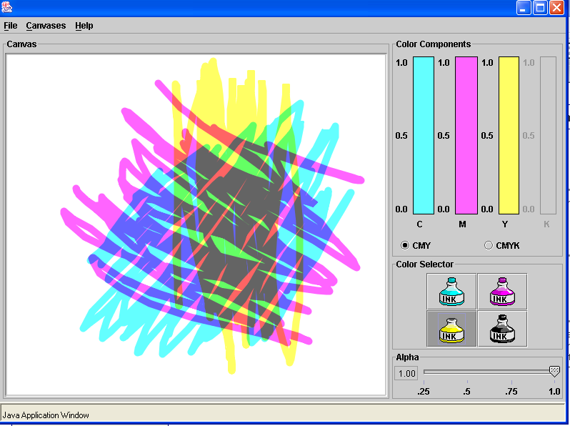
Java Applet Screen Demonstrating Subtractive Colors

Slide 20
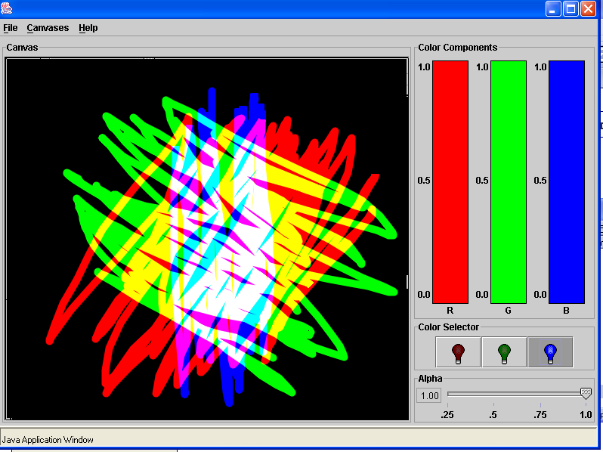
Java Applet Screen Demonstrating Additive Colors

Slide 21
Some Other Plug-ins
Macromedia Shockwave gives full multimedia capabilities such as access to
  Embedded Director movies, (i.e. animated motion pictures; can contain animation, sound, special effects and even video.)
  Authorware pieces (the leading visual authoring tool for creating rich-media e-learning applications for delivery on corporate networks, CD/DVD, and the Web)
QuickTime allows you to view a wide variety of multimedia content in Web pages
VRML viewers display 3D graphics from the web.
  VRML = Virtual Reality Modeling Language
Adobe Acrobat Reader
Macromedia Flash Player – animation player
RealPlayer by RealNetworks
  Lets you play streaming audio, video, animations, and multimedia presentations on the web.

Slide 22
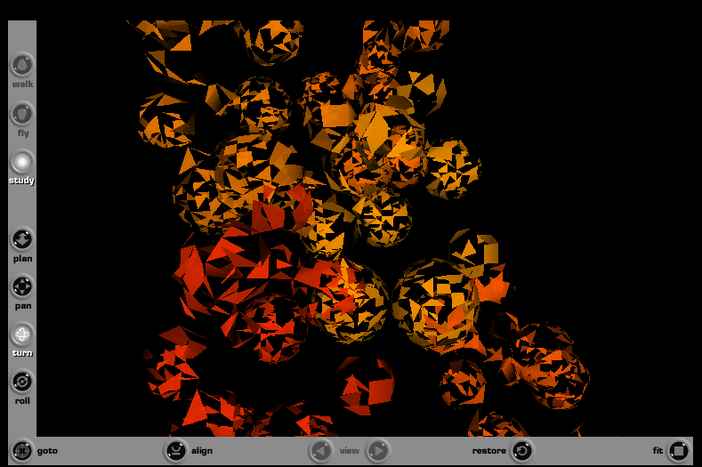
Example of VRML Work – constantly changing

Slide 23
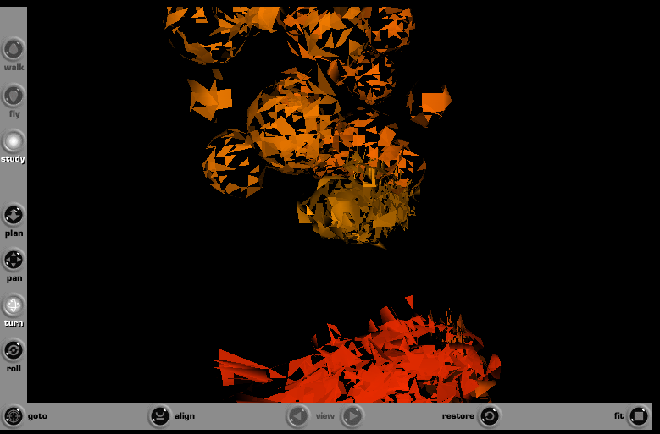
Csuri’s “Trolling the Universe”

Slide 24
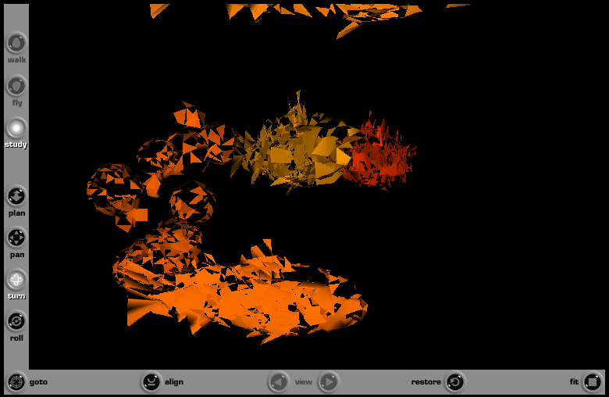
http://www.csurivision.com/csuri

Slide 25
No central control – therefore, unregulated and somewhat uncensored.
Anonymity of site owners.
There are many, many web sites where artists have posted their works.
Some are supported by institutions known in the art world.
Some are just an individual or a group deciding to post.
Raises many questions:
  How is quality judged?
  Is it just a matter of “I like” vs “I don’t like”.
The above questions are disturbing particularly about sites dispensing so-called medical, legal, etc. advice.

Slide 26
Uneven Quality
Even at recognized web sites, the quality of the reproduction on the screen may not be good.
Some interesting sites, well known in the art world:
http://www.louvre.fr/
http://museoprado.mcu.es/home.html
http://www.guggenheim.org/new_york_index.shtml
http://www.clemusart.com/
http://www.metmuseum.org/
http://www.nationalgallery.org.uk
http://www.musee-orsay.fr/

Slide 27
Some Sites Devoted to Digital Art
http://moca.virtual.museum/
http://www.digitalartmuseum.com/
http://www.siggraph.org/artdesign/
http://www.adcglobal.org/hallfame/hallfame.html
http://www.digitalsalon.com/
The above are fairly recognized digital arts sites which maintain collections of digital art.
There are many others plus sites maintained by individual artists. For example, Csuri’s and Davies’:
http://www.csurivision.com/csuri/
http://www.immersence.com/

Slide 28
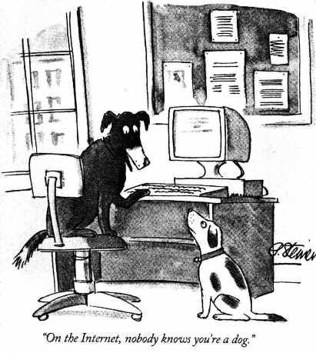
Be Cautious and Critical
There is a famous New Yorker cartoon:
Cartoon by Peter Steiner reproduced from page 61 of July 5, 1993
issue of The New Yorker, (Vol.69 (LXIX) no. 20).

Slide 29
Positive Properties of WWW
(Many affect an artist’s usage of the Internet):
Provides a wider exposure to art to many people.
People can see art from all over the world in their own home.
Allows artists to exhibit their works to a wide audience.
Provides a way of marketing works.
By using multimedia capabilities, the artist has a great deal of freedom to experiment with a variety of styles and techniques.
  Example: Collaborative works as shown at
  http://www.sito.org/

Slide 30
Web Site Building
Originally, anyone doing this had to learn
  HTML – Hypertext Markup Language
and subsequently
  CGI scripting
  JavaScript
  Java
Now, there are many layout tools available such as:
  Adobe Go Live
  Macromedia Dreamweaver
  Front Page
  Visual Page
  HoTMetaL Pro
The goal now is to provide WYSIWYG (What you see is what you get) editing and powerful wizards to customize templates to your liking, but let you dive into the HTML source and tweak each line to perfection if you wish.

Slide 31
It’s Amazing HTML Became the Base Language
Originally, it was strictly a markup language – the designer could not specify exact placement on the screen, color, or even font size.
Tags specify, for example, relative sizes:
  <h1> Heading Level 1 </h1> must be larger than
  <h4> Heading Level 4 </h4> when displayed.
The original idea was to NOT control the layout, but that approach was soon found to be inadequate.
Recent extensions and new languages such as XML (eXtensible Markup Language), VRML (Virtual Reality Modeling Language), and Java3D have greatly extended capabilities.

Slide 32
Web Site Design
At amazon.com, there were 58,026 books found when searching for the above words.
A google search yielded 2,800,000 hits for the above words.
A google search on “web designer” yielded 1,760,000 hits.
Everyone thinks they can design great web sites.
Unfortunately, many can’t and we have to live with their bad designs.
Good designs are based on the understanding of some basic layout principles, good marketing techniques, an artistic sense, and a thorough grounding in what is possible.

Slide 33
For example, some, but not all, of the basics of good web design
Target your site for a particular audience.
Test the pages in different browsers.
Use relative values rather than absolute weights for specifying sizes such as widths and heights.
Keep the size of graphics, sound, and animation files as small as possible to avoid download problems.
Watch page size --- Horizontal and vertical scrolling can be a visitor irritant.
Remember not all colors reproduce the same on all monitors and platforms.
Users work with varying resolution sizes.
Extensive use of plug-ins might limit your site.

Slide 34
For example, some, but not all, of the basics of good web design- continued
Please- check spelling and grammar!!!!
Check that links are active – this needs to be done often.
  Notify webmasters when broken links are found!
Provide simple courtesies: Avoid doing anything that will alter browser settings or cause a user to lose their place.
  Example: Clicking Back makes you lose the site completely.
  Example: Using META for screen refresh or quickly changing background colors or redirection, can tamper with a visitor's browser history.
Too crowded, not aesthetically pleasing, no focus, mixed messages --- avoid!!!

Slide 35
Consider Critiquing These Sites
http://www.justpictureit.ca/
http://faxswitch.com/bear/jeff_rouyer/universal_web/universal_web/page3/page3_c.htm
http://speculativevision.com
http://home.att.net/~dhall4u/donaldhall.html
http://artislife.com/content/artistsandgalleries.cfm
http://halfielding.com/
http://elenamaza.com/index.html
http://members.lycos.co.uk/sam_ann/
http://capecodshopping.com/cgi-bin/frame.cgi?url=http://www.capecodtoday.com/cgi-bin/jump.cgi?ID=2567

