Slide 1

Keyboards, Mice, Tablets, Scanners, and Displays
i.e. 2D Input/Output (I/O) Devices
Chapter 3

Slide 2
Input Devices and Issues

Slide 3
1. Mouse – an input device
There are many different kinds
  Wheeled mouse
  2-button mouse
  3-button mouse
  Optical mouse
  Wireless mouse
  ...

Slide 4
It’s Amazing How Long It Took for the Mouse to Become a Fixture
Early computing applications did not use a pointing device, but pointing is a natural gesture for a human.
Even arrow keys didn’t exist on the early keyboards.
For many years, the popular pointing devices were expensive and there were more of them
  light pens
  graphics tablets – which were poorly designed
  joy sticks – now used predominately for gaming
  touch screens
  foot pedals
  dials and sliders

Slide 5
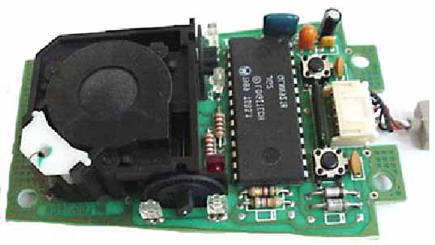
The Purpose of a Mouse
Translate your hand motion into signals that the computer can use to position a cursor on the screen.
It is really a pointing or selection device.
Inside a wheeled mouse:

Slide 6
The Components of Non-optical Mouse
A ball
  Touches the desktop
  Rolls when mouse moves.
Two rollers
  Touch the ball
  Detect motion directions at 90 degrees to each other.
  Drive a shaft that spins a disk with holes in it.
The holes break an infrared LED and an infrared sensor sees pulses of light. The rate of pulsing is related to the speed of mouse and distance it travels.
An on-board processor chip reads the pulses and turns them into binary data used to drive the cursor on the screen.

Slide 7
Optical Mouse
Same goal, but has no moving parts.
Introduced in late 1999.
Uses a tiny camera to take 1,500 pictures every second and sees how patterns have moved from previous image.
Using the image, it is determined how far the mouse has moved and how far the cursor should move on the screen.
Provides increased tracking response that is smoother.
Doesn’t require a special mouse pad.

Slide 8
Problems With Using Mouse for Art
Don’t have a change in touch sensitivity.
Somewhat clunky to move exactly as you wish.
Really designed as a pointing device, not a drawing device.
Dirty mice cause major problems with input.
Problems with Carpal Tunnel Syndrome .
  Need to prevent by using
    Exercises
    Good posture at computer
    Possibly hand braces
    Special equipment

Slide 9
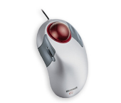
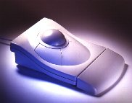
2. Trackball
Basically an upside down mouse.
Base stays still and fingers move a ball.
The advantage of trackballs over mice is that the trackball is stationary so it does not require much space to use it.
You can place a trackball on any type of surface, including your lap.
Most laptops have either a pad or a small stick that acts like a trackball.

Slide 10
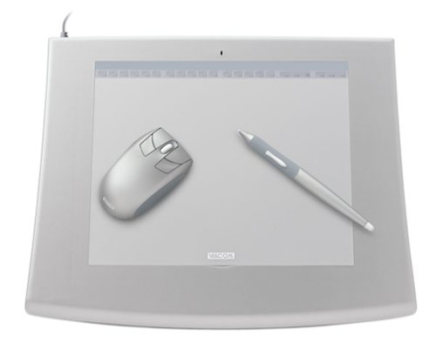
3. Graphics Tablet – an input device
Also called a digitizing tablet, a graphics pad, or drawing tablet
A tablet is an alternate type of input device that can be used in place of, or in conjunction with, a mouse, trackball, or other pointing device.
The tablet consists of two parts, a flat surface for drawing, and a pen, stylus, or puck that is programmed to work with the tablet.
Often used with a mouse also.

Slide 11
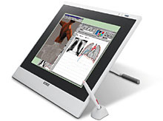
Graphics Tablets
Dimensions given almost always refer to the input surface area of the tablet. The actual footprint of the tablet can be as much as 4 to 5 inches larger than the input area.
Usually connected today through USB port.
Professional grade tablets can be pricey: Intuos2 line of Wacom starts at $199 for the 4x5 size, $349 for the 6x8, and goes on up to $750 for the 12x18 size.
Professional grade tablets can be equipped with a variety of pens-
  Airbrush, stroking, inking, etc.

Slide 12
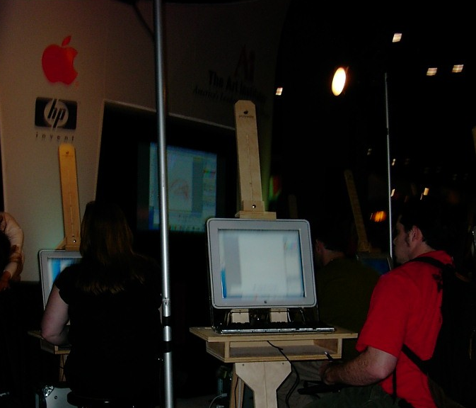
Advantages of Graphics Tablet
Has more of feel that an artist is familiar with.
Can even be placed on an easel!

Slide 13
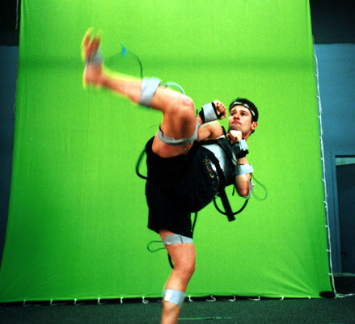
Sampling Motion
The mouse, trackball, and the graphics tablet sample motion by tracking the hand.
When we consider 3D input devices later in the semester, we’ll see that face and body sampling have become popular in the last few years with motion trackers.

Slide 14
Relative vs Absolute Tracking
Absolute tracking uses the position of the input device corresponds directly to cursor on the screen.
  Older light pen and touch screen uses absolute tracking.
  Graphics tablets can be set to this mode.
  Required for tracing which is possible with graphics tablets.
  Many artists like the feel of this tracking style.
Relative tracking allows picking up the input device and moving it without causing the cursor to move.
  Mice and trackballs are relative tracking devices,
  Graphics tablets can be set to this mode also.
  This tracking style is good when desk space is limited.

Slide 15
4. Keyboard
We routinely use two hands, but only the keyboard, which is not a great graphics input device, is a two-handed device readily available to all.
There is a lot of research in interface design.
In high-end graphics laboratories and research sites, the study of various new input devices is proceeding at a rapid pace.
These innovations can usually be seen at conferences such as SIGGRAPH.
http://www.siggraph.org/s2004/

Slide 16
William Buxton
William Buxton began his career in music studied computer science.
His early work in computer-based tools for music performance led him into the area of human-computer interaction, which is where most of his research is focused, especially in the areas of interactive computer graphics and computer supported collaborative work.
He currently directs the Input Research Group at University of Toronto.
He is a consultant for Alias, which markets Maya, among other things.
The following clip at the Alias site emphasizes his life dream of using two hands for input:
http://www.alias.com/eng/community/movie_gallery/research_twohanded_modeling.jhtml

Slide 17
Digitizing Existing Imagery
5. Scanners
Purpose: Sample light intensity and color and translate the information into pixels.
  Desktop, flatbed scanners
    Handle reflective work
  Transparency scanners
    Typically higher resolution and more costly
    Often available as an add-on device, but not suitable for high level professional work
  Drum scanners
    Highest quality

Slide 18
Choosing an Optimal Resolution
Scanner resolution: Number of samples taken per inch = dpi (dots per inch)
  Typically 75-2400 dpi in a flatbed scanner.
  4000-20000 in a drum scanner
Choice depends on many things:
  Quality of your scanner
  Nature of the original image
  What you plan to use the image for
  Your computer setup
  Size of files you can handle

Slide 19
We’ll Look at Some Rules of Thumb for Scanning
But, for a huge, professional discussion of all the ins and outs of scanning, look at
  http://www.scantips.com
Size is the same problem as we encountered before:
  Number of pixels = height X width X
  (resolution)²
  File size (in bytes) = ((number of pixels) X
  (color depth))/8
  So 4” X 6” photo scanned in 24-bit color at 1200 dpi has a file size of
  (4 X 6 X 24 X (1200)² )/8 = 103,680,000 bytes or
  over 103MB

Slide 20
Rules of Thumbs
Web-based images only: 75-dpi suffices as that is what most monitors display
Printer: Assume being printed at original size with the use of halftone screens.
  Scan at 1.5-2 times the number of halftone cells per inch (i.e. line frequency).
Consider the picture:
  Theoretically, you can construct a continuous image from discrete pixels exactly if the image is sampled at twice the Nyquist rate (twice the image’s highest frequency – a measure of the abruptness and degree of brightness change. )

Slide 21
Sampling Causes Information Loss
  As an extreme example:
  Abrupt, high contrast changes require a higher sampling rate than softly changing colors.
Increase the sampling rate if you see Moire’ patterns – a pattern created by interactions between multiple patterns in an image and the scanner’s sampling grid.
See: http://micro.magnet.fsu.edu/primer/java/scienceopticsu/moire/moire.html

Slide 22
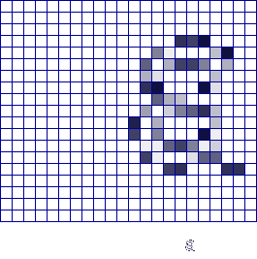
Sampling Causes Information Loss
Aliasing – Too low a sampling rate can cause an image to be misrepresented.
  Particularly occurs
    In areas containing many brightness changes over a short distance or
    With thin lines (such as text)
Well-defined edges require higher sampling rates.
Left- shows aliasing effects
right- shows use of an anti-aliasing technique to reduce the effect

Slide 23
Digital Cameras Add a Wealth of Possibilities
Digital still cameras
  Like a rapid scanner
  Amazing drop in price
Digital video cameras
  Still pricey- especially when you count
    Storage requirements – Several GB for a few minutes of full color film
    Need for a nonlinear editor

Slide 24
For a Comprehensive List of Input Devices See:
http://www.billbuxton.com/InputSources.html

Slide 25
Input Device Dangers
Already mentioned repetitive motions (as with the mouse) can cause strain.
  Frequent breaks
  Good posture
  Good lighting
  Use of function keys
Concern about low-frequency electromagnetic fields from CRTs mentioned in textbook:

Slide 26
See an excellent review of the results by
John Moulder, Professor of Radiation Oncology, Medical College of Wisconsin. Milwaukee, WI”
He summarizes:
“While most public concern about electromagnetic (EM) fields and cancer has concentrated on power-frequency, microwave (MW) and radiofrequency (RF) fields, claims have been made that static magnetic fields cause or contribute to cancer.”
“There is very little theoretical reason to suspect that static fields might cause or contribute to cancer or any other human health problems, and there is very little laboratory or epidemiological evidence for a connection between static fields and human health hazards.”
  See:
  http://www.mcw.edu/gcrc/cop/static-fields-cancer-FAQ/toc.html#Q1

Slide 27
Copyright Issues – Intellectual Property Rights
Granted by Congress to “promote the progress of science and useful arts”
Secures for authors and inventors the right to control the use of their original ideas that have been fixed in a tangible medium (i.e. can be physically copied).
Contrary to popular opinion, images on the web are not in the public domain unless
  Copyright has expired
  Author or artist has relinquished the copyright.
  You do NOT have to apply for a copyright.

Slide 28
Rights Reserved for Artist
Reproduction
Derive works from it
Distribution
Public performance and display
Limited only by doctrine of fair use for teachers, students (using the work as a student), and researchers provided the work is properly attributed and meets four tests:

Slide 29
Fair Use
Purpose and nature – study and nonprofit educational uses if copies are made spontaneously.
Nature of work – published and factual is best
Nature and substantiality of material used
  Best if only a small portion of the work is used
Effect of use on potential market for the work
  Does the copied work compete with the original.
  Economic effect is considered.
Work must be properly cited if it used for study or review purposes.

Slide 30
Output Devices and Issues

Slide 31
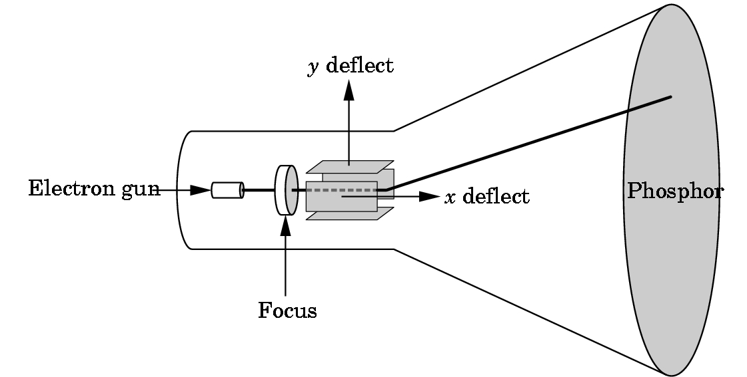
1. CRT Monitors
Until recently, most were cathode ray tubes (CRTs).
At least 60 refreshes (60 Hz) per second.

Slide 32
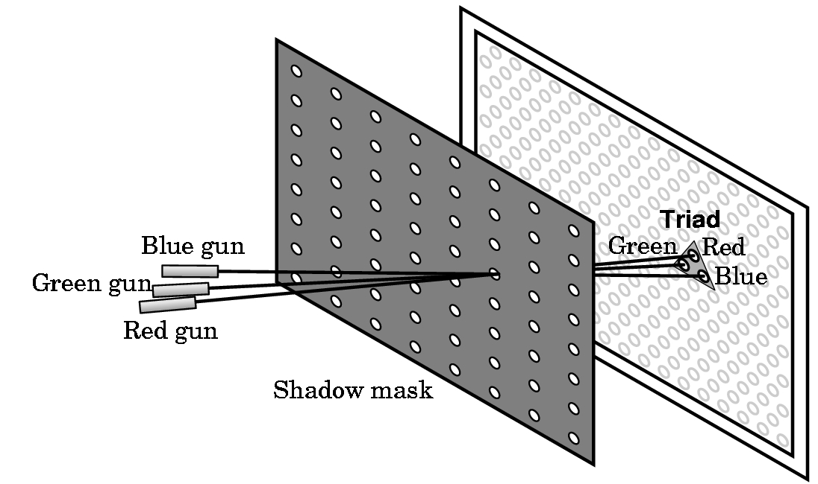
Color Monitor
Dot pitch is the distance between green phosphors and is a good indicator of the screen’s resolution.
Low end: 0.44-0.47 mm
High end: 0.21- 0.27 mm

Slide 33
2. Liquid Crystal Displays
(LCDs)- Flat Panels
Active-Matrix
  Crystals are sandwiched between sheets of glass containing polarized coatings and metal line grids.
  Electrical pulses are send along grids.
  The polarized coating blocks light from stimulated crystals and they appear dark.
  Hard to see on an angle.
Plasma Displays
  Trap neon gas in horizontal and vertical layers.

Slide 34
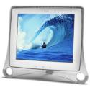
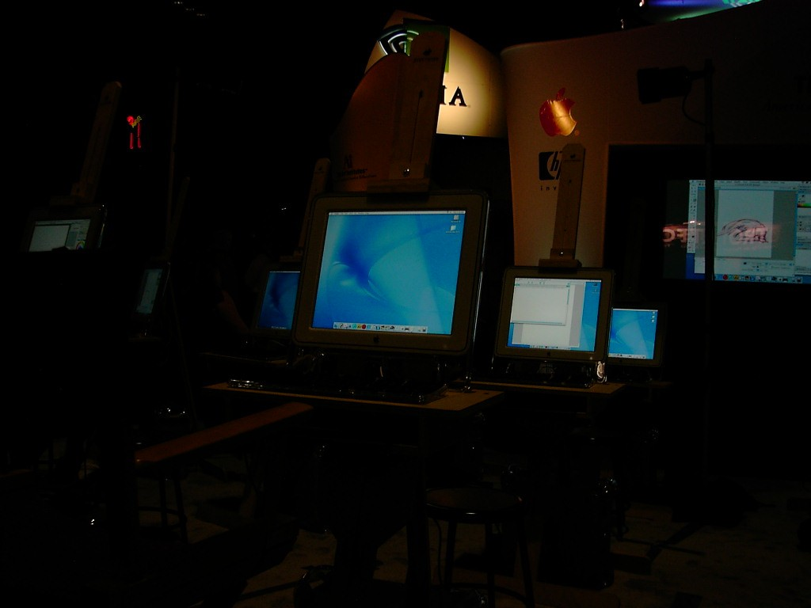
Advantages of Flat Panels
Low power requirements
Sturdier than CRTs
Less weight than CRTs
Less reflection from screen.
Produce flicker-free images with twice the brightness, sharpness, and contrast ratio of a typical CRT display.

Slide 35
Projectors
CRT Projection Systems
  Good for classrooms and large spaces
LCD Panel Projectors
  Good for traveling exhibits
  Tablet placed on top of a projector

Slide 36
In Chapter 6 we consider printing, which includes film output

