Slide 1

Electronic Color
Chapter 5

Slide 2
Color
The topic of “color” uses information from
  Physics- How is light defined?
        Why does an object have the color it does?
  Biology- How do we perceive color?
  Psychology – What are our emotional responses to color?
  Computer science – How do computers represent color?
  Art- How do artists utilize color?

Slide 3
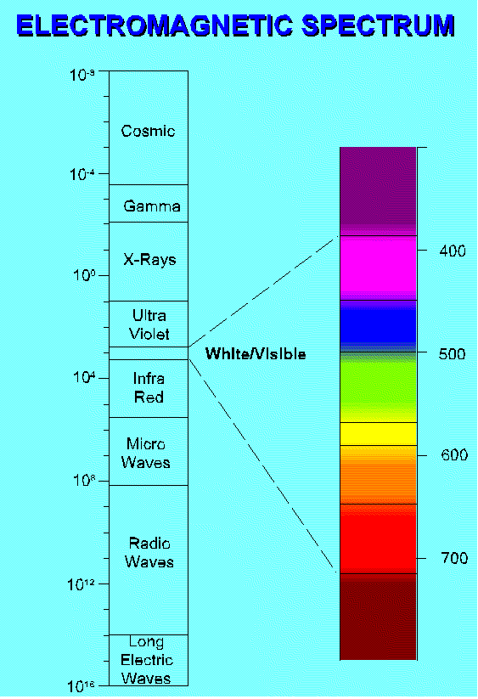
The Electromagnetic Spectrum (EM)
The electromagnet
spectrum is the name
given to various radiations
which are made up of
fluctuations in electric and
magnetic fields.
Our unaided eye sees
only in a narrow band
called the “visible light”
or “white light”.

Slide 4
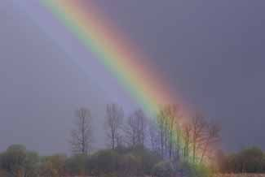
Prisms
In 1637, Rene Descartes studied rainbows in his “Discours de la Methode”. Isaac Newton performed experiments with a prism to further study white light.
  Passing white light through a prism (or water droplets) produces a rainbow:
  Low-frequency/long wavelengths appear in the red-orange range.
  High-frequency/short wavelengths appear in the violet-blue range.
  Passing the rainbow through another prism produces white light showing that white light is composed of all the colors of the spectrum.

Slide 5
Seeing Color
Your eyes have cells that respond to light energy.
When light in a given frequency hits the cell, that cell sends a signal.
You have two types of sensing cells:
  Rods – respond to amount of light and low levels of light (night vision)
  Cones – respond to specific wavelengths.
  Normally called red, blue and green color, but more accurately, red, yellowish-green, and blueish-green.
  There are actually three types of green cones, each with slightly different peak locations. A person usually has two of the three, so people really do perceive slightly different colors!

Slide 6
Color Mixing
Two dominant systems:
1. Additive
2. Subtractive
Usually say a computer monitor uses additive color mixing, but in reality it is a partitive mixing where the eye averages different colored phosphors.
However, practically a monitor acts like an additive mixing system.

Slide 7
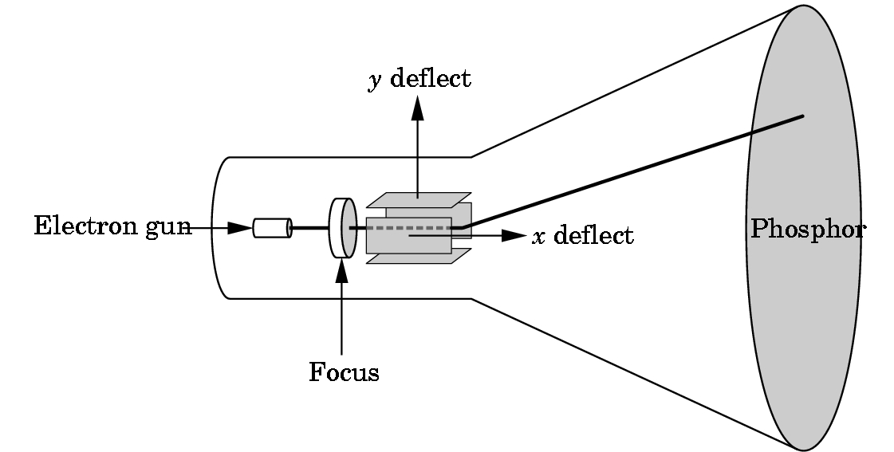
CRT Monitors
Cathode ray tubes (CRTs).
Need at least 60 refreshes
(60 Hz) per second.
Glows when hit by electrons fired by an electron gun.

Slide 8
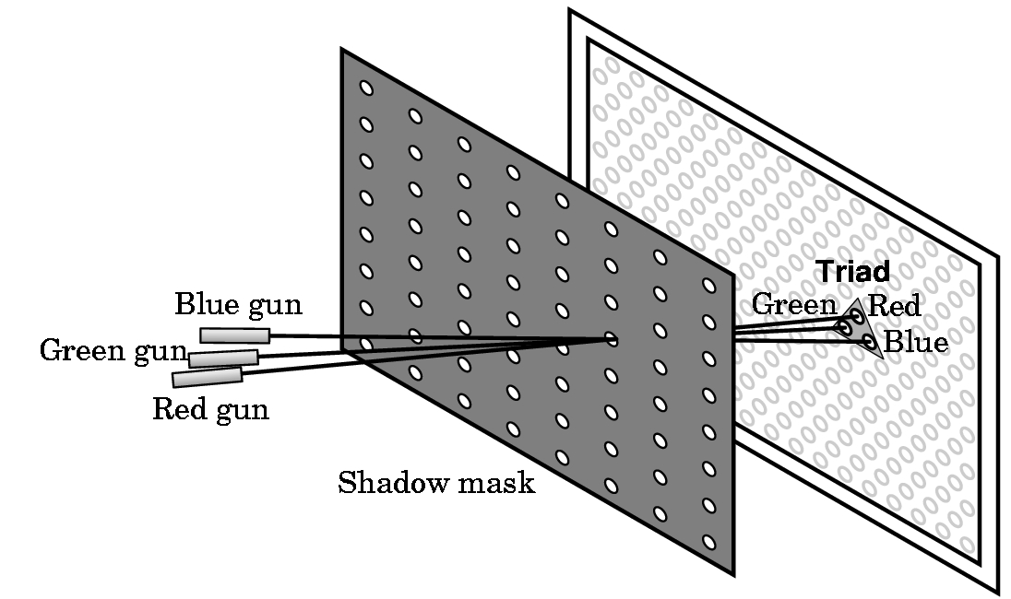
Color Monitor
Partitive mixing – our eye blends the triad of green, red, and blue glowing phosphors.

Slide 9
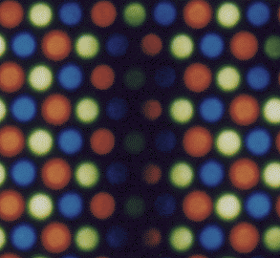
Flat Screen Monitors
The new flat panel monitors are much more direct.
They are a grid of tiny solid state light emitting objects...like tiny light bulbs, and they simply light up.
What the monitor really looks like, either CRTs or flat screens

Slide 10
Additive Mixing – What is It?
Mixes different spectral wavelengths producing an increase in the number of frequencies.
Adding more light energy makes the mixture brighter.
  Example: Theater lights on stage or set.
  Example: For all practical purposes, a computer monitor.
  Applet provided by the author of your textbook demonstrating additive mixing:
  http://www.cs.brown.edu/exploratories/freeSoftware/repository/edu/brown/cs/exploratories/applets/colorMixing/additive_color_mixing_guide.html

Slide 11
Subtractive Mixing – What is It?
Each color when mixed with another acts as a filter, subtracting some set of light frequencies from the total mixture.
Example: Mixing paints or pigments
  The color of paint is a filter that removes all the light frequencies except the one meeting the eye.
  For example, red objects reflect wavelengths that look red to our eye.
  Mixing different paints lead to darker and darker paints.
Explore the following applet from the author’s website:
  http://www.cs.brown.edu/exploratories/freeSoftware/repository/edu/brown/cs/exploratories/applets/colorMixing/subtractive_color_mixing_guide.html

Slide 12
What Color is Perceived?
Strictly depends upon
  which wavelengths reach the eye
  how much total light is present
  NOT on whether the mix is additive or subtractive
  perceiver’s eye and brain
Explore the variations using the following applet on the author’s website:
http://www.cs.brown.edu/exploratories/freeSoftware/repository/edu/brown/cs/exploratories/applets/combinedColorMixing/combined_color_mixing_guide.html

Slide 13
Primary Colors (Primaries)
Within a mixing system, those colors that cannot be mixed from the others.
The additive primaries for light (RGB color):
  Red
  Green
  Blue
The subtractive primaries for paint (CMY)
  Cyan
  Magenta
  Yellow

Slide 14
CMY and Printing
Printing uses a subtractive color scheme.
As a CMY scheme doesn’t produce a rich black (and also because it is expensive to use cyan, magenta, and yellow to try and get close to black), printing usually adds
  Black
to form a CMYK color scheme called
four-color printing.

Slide 15
Part Additive – Part Subtractive
There are drawbacks to both schemes to the computer artist:
  White is produced too quickly when additive mixing is used.
    In physical world, red + white = pink.
  A muddy looking black is produced too quickly when subtractive mixing is used.
Most computer programs for art work simulate both mixing schemes even thought the final monitor image is produced additively.
As we saw in the applets, by using opacity settings, we can create different colors by averaging over the new and old color.
Brushes with different flow and hardness settings also allow us to control the percentages of color that are added.

Slide 16
Gamma (γ)
A measure of the nonlinear relationship between pixel value and displayed intensity .
What does this mean?
  If you send your computer monitor a message that a certain pixel should have intensity equal to x, it will actually display a pixel which has intensity equal to x ^{γ}
  Because the range of voltages sent to the monitor is between 0 and 1, this means that the intensity value displayed will be less than what you wanted it to be. (0.5 ^{2.5} = 0.177 for example).
Gamma affects the image that is scanned, displayed, or printed.

Slide 17
Gamma Correction
Adjust pixel data for a devices nonlinearity:
No standard way to do this.
Different platforms (Macs, PCs, Unix workstations, SGIs, ...) handle this in different ways.
For example, PCs often use γ = 2.5 and Macs
γ = 1.8 for monitors.
Result:
  An image may look great on one platform and washed out or too bright on another.
Note: Sometimes the problem is just a poorly adjusted monitor so fix that problem first!
Lighting in a room and even different monitors on the same platform can produce different images!

Slide 18


An Example
Not gamma corrected.
Great on SGI- lousy on PC.
Gamma corrected by 1.7.
Great on PC – washed out on SGI
Source: http://graphics.stanford.edu/gamma.htm , About Gamma Correction.

Slide 19
Portable Network Graphics (PNG) File Format
Designed to handle files somewhat uniformly over platforms, assuming the monitor is adjusted correctly.
It is a file format.
Very good for web designers.
Includes:
  Alpha channels (variable transparency),
  Gamma correction (cross-platform control)
  Two-dimensional interlacing (a method of progressive display).
  Does compress a file, but only 5% to 25%.

Slide 20
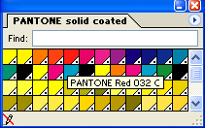
Color-Matching Software
Printers and scanners often have precomputed gamma profiles that can be used by color-matching software to make adjustments.
Systems are available for calibration:
  PANTONE Matching System is major one.
  It is a standardized language for
  color communication from designer to manufacturer to retailer to customer.
  Often choose PANTOME color by number, even if it is not the color seen on the screen.
  In Adobe products such
  as Photoshop or Illustrator
  these are just additional
  swatches:

Slide 21
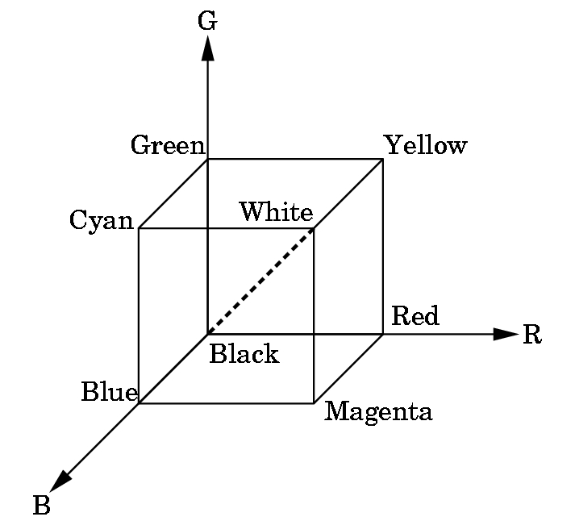
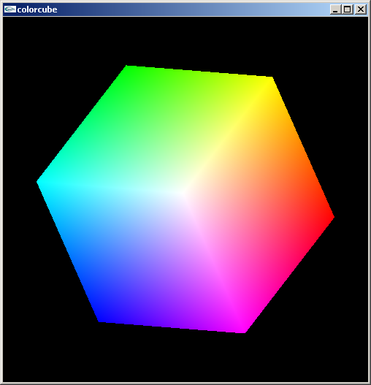
Color Spaces
Various Representations of Color
A way of organizing colors in one, two, or three dimensions to help an artist choose and work with color.
1. The RGB Cube- a color mixing space based on the three phosphor colors of RGB monitor:

Slide 22
RGB SYSTEMS
RGB uses the color cube as a model with intensities between 0.0 and 1.0.
For 24-bit color (true color), this allows 8-bits per gun or a numeric scale from 0 to 255 to be used.
Some of the intensity settings:
R G B R G B
ghost_white 248 248 255 0.97 0.97 1.00
honeydew 240 255 240 0.94 1.00 0.94
ivory 255 255 240 1.00 1.00 0.94
light_grey 211 211 211 0.83 0.83 0.83
slate_grey 112 128 144 0.44 0.50 0.56
coral 255 127 80 1.00 0.50 0.31
aquamarine 127 255 212 0.50 1.00 0.83

Slide 23
SOME OTHER EXAMPLES OF RGB COLOR SETTINGS
There are lists of these available on the web:
http://astronomy.swin.edu.au/~pbourke/colour/colourspace/
Or you can visually pick your color using various sites. One simple one is at
http://wwwartsci.clarion.edu/cis/wyatt/colors.html
To get the number between 0 and 255, you need to read hex (or base 16 numbers).
34 = 52 since 3*16 + 4 = 52
ff = 255 since f =15 and ff = 15*16 + 15
(in base 16, we need 15 digits: 0, 1, ...9,
a, b, c, d, e, and f)

Slide 24
Indexed Color
An 8-bit display only has 256 choices of color.
It can pick any set of 256 colors from the possible 16.7 million colors that the monitor can create.
The 8-bit color display card must remember the 256 choices.
It does this by putting the 256 color definitions into a Color Lookup Table (CLUT, also called the Color Palette) with 256 entries and references a color by its index.
This says only 256 different colors can be displayed simultaneously on a monitor.

Slide 25
A Possible CLUT (or color look up table) for 3-bit graphics
If we say a device has 3-plane graphics or a 3-bit deep frame buffer, we are saying it is using a CLUT with 2³= 8 entries perhaps chosen as:
index red green blue result
===============================================
0 00 00 00 black
1 10 00 00 medium red
2 11 00 10 reddish purple
.
.
.
7 11 11 11 white
Note: Different CLUTs can be defined.

Slide 26
What Can We Do With 2 Bits Per Gun?
2 bits per gun
  00 dark or off
  01 1/3 brightness – i.e. dim
  10 2/3 brightness
  11 bright
Thus, a color of 011100 could give
  1/3 red + 1 green + 0 blue
  i.e. bright green and dim red
  i.e. perceived as yellow tint

Slide 27
The CLUT size determines the number of colors that can be displayed simultaneously
Thus, a 3-plane graphics system has a 2³= 8 LUT size and can display only 8 colors simultaneously.
The palette of a device is the number of colors that can be displayed and is a function of the number of color bits stored per pixel.
In our example, 6 bits were used (2 bits per gun), so the palette is 2⁶= 64 colors.

Slide 28
MORE ON COLOR
Low end displays were typically 8-bit devices, i.e. could display only 256 colors simultaneously.
But, palettes typically exist for 8 bits/gun---i.e. have a palette of 2²⁴= 2⁴ * 2²⁰ = 16M of colors (what is called true color in Windows system)
Note: Number of bits/gun is what determines the size needed for the frame buffer as the frame buffer must hold a copy of the image internally
However, the same gun settings for two different platforms will not necessarily produce the same color due to the gamma correction factor!

Slide 29
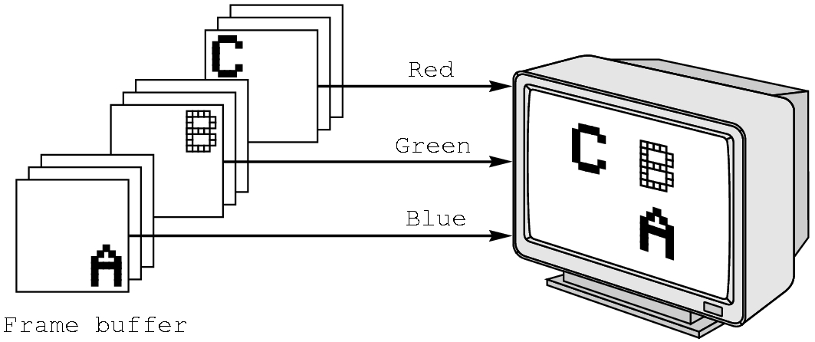
Summary of RGB color
Each color component stored separately in the frame buffer
Usually 8 bits per component in buffer
Note the color values range from 0.0 (none) to 1.0 (all), or from 0 to 255.

Slide 30
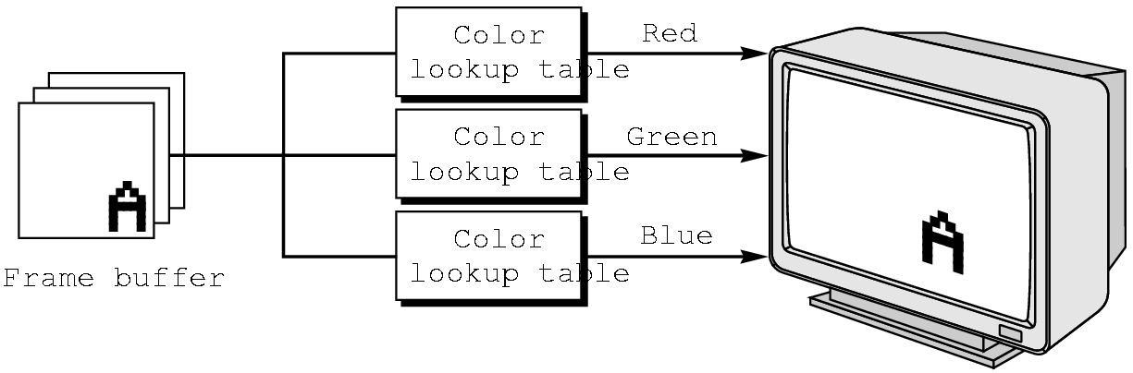
Summary of Indexed Color
Colors are indices into tables of RGB values
Requires less memory
  indices usually 8 bits
  not as important now
    Memory inexpensive
    Need more colors for shading

Slide 31
Other Color Spaces
RGB is a hardware-based color space.
Others are
  YIQ – Used by television, favors luminosity and skin tones (Y = luminance; I and Q encode chromaticity)
The art-based color spaces:
  2. HSV – Hue, saturation and value
  3. HSL/HWB – Hue, saturation and luminance
The print-based color space (we will study later)
  CMY – Cyan, magenta, and yellow (with optional black as CMYB)
  4. Munsell color model
  5. CIE color model

Slide 32
HSV = HSB and HSL Spaces
H = hue : the different color sensations such as red, green, blue, yellow, etc. 100% is a pure color. 0% is a shade of gray.
S = saturation : the amount of white (equal amounts or red, green, and blue) mixed with a hue
V = value or L= lightness : the intensity of light; how much red, green, or blue is present. In traditional color theory, this is the value changes or reflective objects.
B = brightness : the value changes of light-generating luminous objects.
In computer art, the V, L, and B are often used interchangeably although they are defined differently.
In some programs. the HSV or HSB or HSL spaces are used as color pickers.

Slide 33
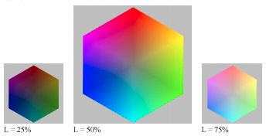
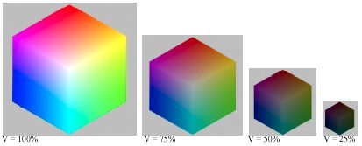
Examples
An excellent description of these spaces is available at:
http://www.normankoren.com/light_color.html
HSL Example
HSV Example

Slide 34
HWB Space
Artists think or reducing value as adding black and desaturating a color by adding white.
In HSL space, fully saturated hues have a lightness of 0.5 and desaturate towards a middle gray, not white.
To make a color whiter in HSV and HSL spaces, the artist must desaturate it and brighten it.
HWB was introduced to solve this problem.
B = blackness in this space.

Slide 35
Comparison of Models
(Actual Descriptions are Mathematical)
RGB
  Hardware-based
  Easy to transform tovideo
  Hard to use in terms of picking and naming colors
  Desn’t cover the entire gamut of perceivable colors
  Non-uniform – equal geometric distance on cube doesn’t translate into equal changes in perception
  Based on Tristimulus theory (1801 theory advanced as to how our eyes see)

Slide 36
Comparisons
HSV
  Easy to convert to RGB
  Easy to specify colors
  Doesn’t cover the gamut of perceivable colors
  Somewhat intuitive, especially to artists
HWB
  Very intuitive, especially to artists
  Mimics actual pigment mixing more closely than other spaces
  Non-standard – few programs support
  Doesn’t cover the gamut of perceivable colors

Slide 37
Comparisons
Munsell Color System
  Used by graphics artists and color designers
  Based on human measurement – How similar are these colors.
CIE (Commission Internationale de l’Eclairage)
  Represents the entire spectrum of colors as a linear sum of three functions.
  Based on human perception – matching experiments run to callibrate
Based on psychological colors (y-b, r-g, w-b)

Slide 38
Palettes
Once you choose colors, many programs allow you to save these in palettes or colormaps.
Allows customization to the colors you use a lot or ones you use in a particular setting.
Customized color spaces can be used to generate these.

