Slide 1

Rendering 3D Worlds-
3D Geometric Graphics II
Chapter 8

Slide 2
Rendering
An Overview

Slide 3
Rendering the Model
Definition: The mapping of the 3D world to the 2D screen.
The mapping is done by an algorithm, basically a recipe of instructions that the computer follows.

Slide 4
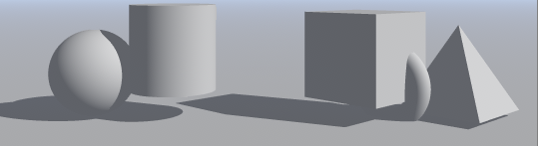
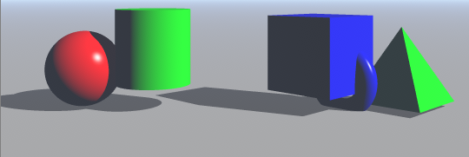
Plastic or Dull Objects
In your first Bryce lab, we had you work with no material settings, other than the dull gray which looks somewhat like dull plastic, although there were shadows that provided some depth cues.
Until about 8-15 years ago, in was not uncommon for most 3D graphics objects to look like plastic – either dull plastic or shiny plastic, depending upon the lighting that was used.
Note your textbook mentions this and it was written in 1999!

Slide 5
3d Modeling- Depth Cues
Definition of 3D modeling: Processes used to create an object that appears to be 3 dimensional in a computer application
These processes provide an illusion that the image is 3 dimensional.The processes have been known for years to artists.
Examples include the use of :
  reflections shading
  lighting highlights
  fogging effects size
  various projections shadows
  refraction effects hiding lines and surfaces
  choice of projections

Slide 6
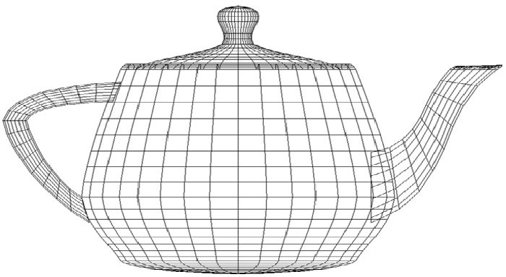
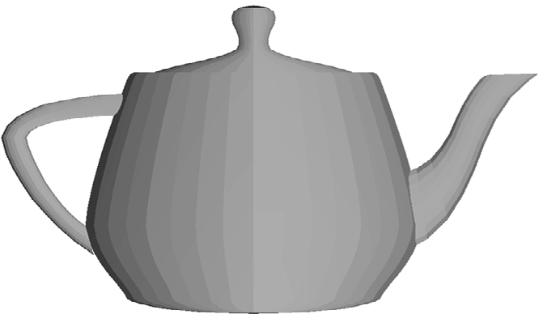
VISIBILITY
As we know, most objects are modeled initially as wireframes as they are easier to generate with a computer than curves. Recall the teapot.
Obtaining depth cues via visibility requires hidden surface algorithms that eliminate lines and surfaces.
A wireframe teapot
shows limited depth.
A filled in image provides
better depth cues.

Slide 7
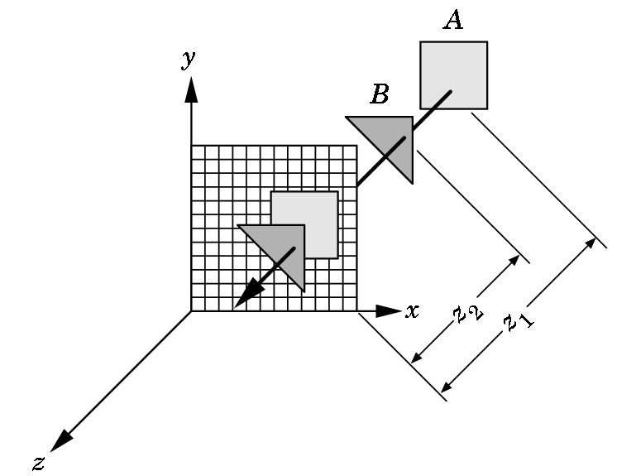
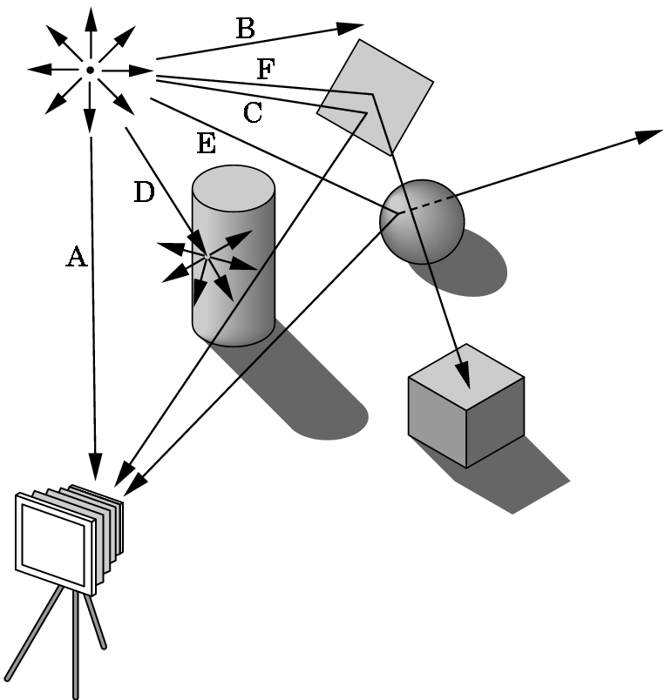
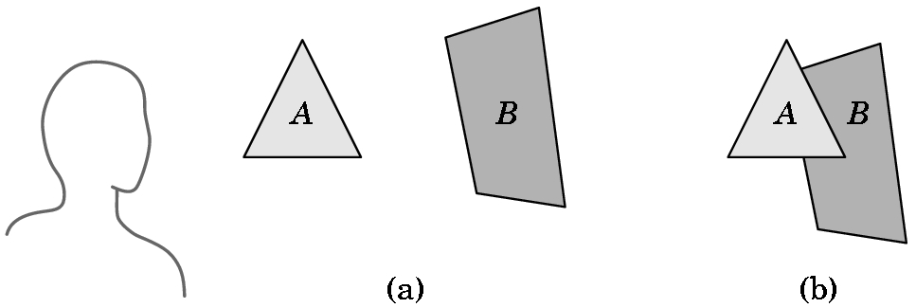
Which Objects Are Visible is a Function of the Rendering Algorithm Used
z-buffer painter's ray-tracing
3 COMMONLY USED ALGORITHMS

Slide 8
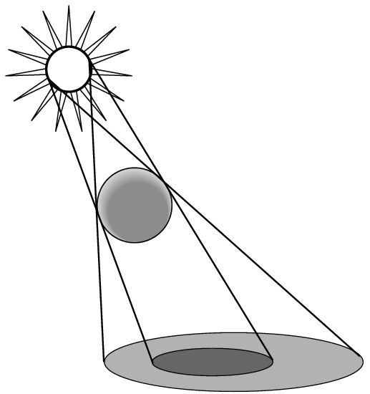
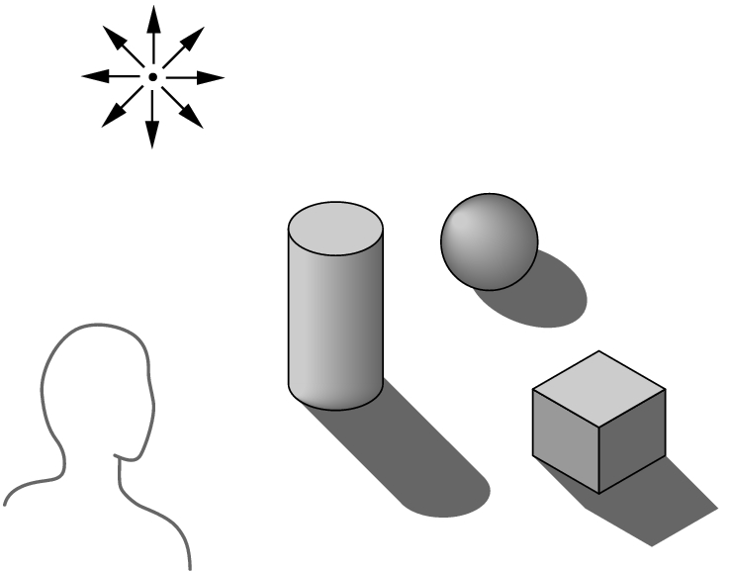
An Example
The algorithm used determines how easy it is to do realistic modeling and how costly the rendering process is. For example, consider shadows.
Without shadows, objects seem to float above their supporting surface.
Shadows add realism to an image as well as depth cues.
The difficulty (or ease) of providing shadows depends upon which algorithms are used to render the scene.

Slide 9
Bryce Uses Ray Tracing as a Rendering Algorithm
The basic idea is that we trace light rays as they bounce around in a scene until we finally determine the color of a pixel.
Theoretically, each light source would generate the light rays to be traced.
If something isn’t hit by a light ray, then it is in shadow if it is part of an object
  or
  it is the background if it is not part of an object.

Slide 10
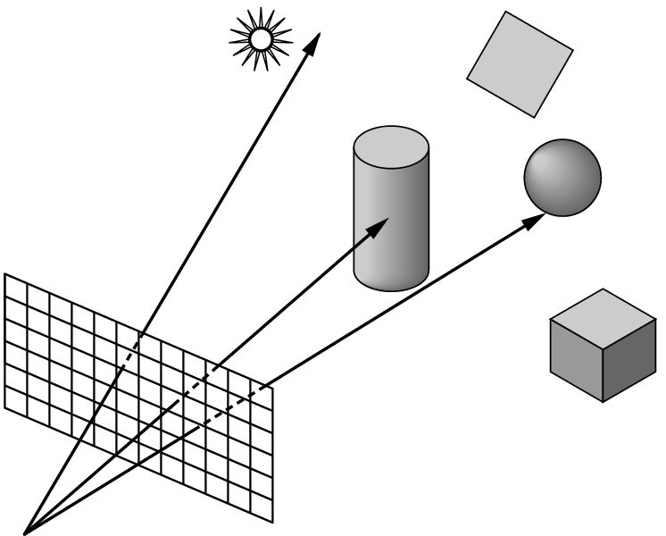
Ray Tracing Can Easily Produce Shadows
But, casting rays from a light source can be a waste of computing power.
Most rays don't ever reach the eye.
Instead, from the eye, we cast one ray for each pixel. Each ray either intersects an object, hits the light source, or goes to infinity.

Slide 11
RAY TRACING- Basic idea of the algorithm
If the ray goes to infinity, it should receive a background color.
If the ray intersects an object
then we must calculate a shade for the point of intersection.
But what is seen, really depends upon the relationship between the object and the light source. To produce realistic images we must use shadow rays also.

Slide 12
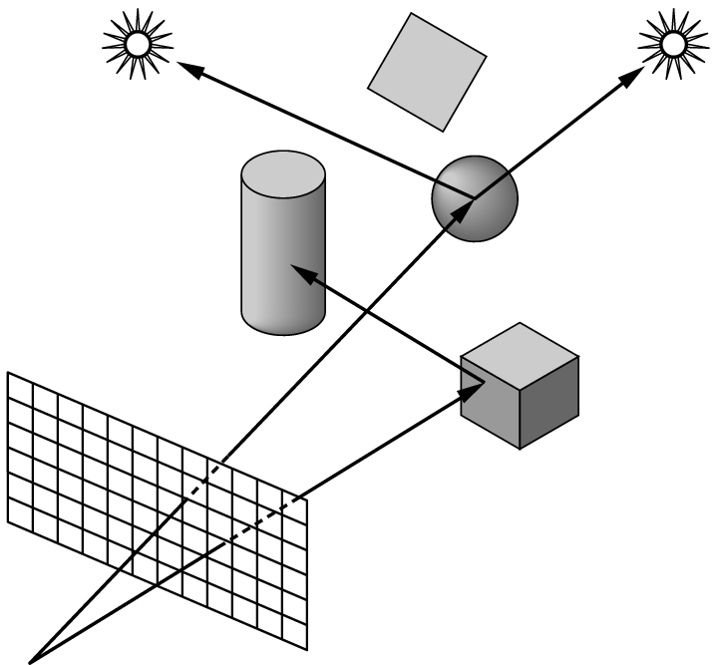
Shadow Rays
At the point of intersection, the ray bounces, depending upon the type of material on the object.
A shadow ray is produced to follow this angle and see if it intersects a light source.
If a shadow ray intersects an object before it hits a light source, then the light is blocked and the original intersection point is in shadow from that source.
If the surface is opaque and doesn't scatter light, we have our shadow areas identified.

Slide 13
Other Rays are Needed Also
If an object is highly reflective, when light hits it, it is projected at an angle from the surface.
If that ray intersects another object, the color of the first object can affect the color of the second.
  Light scattered in a definite direction is handled by casting reflection rays to see what objects are affected. (Nice recursive algorithm as you need to backtrack along the path taken by the light in order to do the color calculations.)
  Light that is scattered in many directions (called diffuse light) is so complex to handle that it is often ignored because it would generate too many additional rays.

Slide 14
Keeping Rendering Under Control When Ray Tracing
If the rendering is stopped after the shadow rays are cast, you obtain scenes like you saw in Bryce without any lighting or material properties selected.
Although complex scenes will still take a lot of time to render, using only the eye and shadow rays will allow for reasonably fast rendering.
The best speedup is when shadow rays are not used at all.
But, the more rays, the better the realism and the longer the render time!

Slide 15
Ray Tracing vs Other Rendering Algorithms
Normally ray-tracing is the best for exciting visual effects such as shadows, transparency, and reflection.
But, it is one of the slowest algorithms in terms of rendering times.
The 114,240 frames of Disney's "Toy Story" were imaged with a z-buffer algorithm as ray-tracing required too much time to render an image.
The z-buffer algorithm can’t do shadows, reflections, and refractions.

Slide 16
Toy Story
But, weren't there shadows in "Toy Story"?
But, wasn't Buzz Lightyear's helmet transparent?
But, couldn't you see Slinky Dog's reflection on the floor?
Yes, because the developers of "Toy Story" modified the original z-buffer algorithm.
This is where computer scientists come into the scene to change existing algorithms without sacrificing speed.

Slide 17
Some Factors Influencing Rendering Speed
Scene composition – number and complexity of objects
Resolution
Antialiasing algorithms chosen
Lighting choices
Computer speed
Rendering algorithms used
Amount of texturing used
Shader used
Projection chosen
  A few comments about these ...

Slide 18
Scene Composition
Independent of all other considerations, the number and complexity of the objects will have a major effect.
All objects are described as a group of polygons.
The more polygons, the longer the time needed to render the object.
A sphere is typically made from at least 500 triangles--- otherwise it looks jagged.
Some manufacturers describe their graphics hardware by how many polygons it can draw per second.

Slide 19
Resolution And Antialiasing
The higher the resolution, the higher the rendering time.
  Example: Going from a 100 X 100 pixel image to one with double the width and double the height increases the size by a factor of 4 (not 2)!
Aliasing - occurs when resolution errors occur in the image. Examples are
  jaggies
  staircasing
  missing or malformed polygons
  disintegrated textures
Antialiasing techniques are techniques to remove these problems

Slide 20
Antialiasing Techniques
When these are invoked, you lose rendering speed.
Typically, each pixel is divided into regions and color is averaged over all the regions.
Most renderers allow you to turn antialiasing on or off.
Often with high-speed animation, you won't see the problems--- this is why video games can do some things that are difficult to do in real time, especially for images projected on a large movie screen. The speed masks the problems that could be seen otherwise.

Slide 21
Antialiasing Techniques
When these are invoked, you lose rendering speed.
Typically, each pixel is divided into regions and color is averaged over all the regions.
Most renderers allow you to turn antialiasing on or off.
Often with high-speed animation, you won't see the problems--- this is why video games can do some things that are difficult to do in real time, especially for images projected on a large movie screen. The speed masks the problems that could be seen otherwise.

Slide 22
Lighting Choices
Multiple light sources complicate the process, but add a lot of realism. Each light source adds a new calculation to the process.
Thus, adding 1 direct light source nearly doubles the cost of determining the color of a pixel.
Spotlights are a little more costly than point sources.
Area lights are the most expensive.
Different 3D packages often provide different algorithm choices for doing lighting. The choice of the algorithm makes a major difference is speed and looks.

Slide 23
Computer Speed
Obviously, the faster the better.
But, speed is not just a function of the MHz of the processor.
For graphics, you need a lot of RAM and a large hard disk for storing images.
The graphics card (or graphics accelerator) is a critical enhancement.
  Unfortunately, rendering software is often sensitive to which graphics card is used.
  Some do well with some rendering software and not with others.
  The market changes so rapidly, you really need to stay on top of it constantly.

Slide 24
Rendering (or Surface) Algorithms
Determining the color and visibility of pixels are the two most time-consuming things done when rendering an image.
The rendering algorithm determines what is visible at this pixel on the screen.
The most commonly used algorithms are
  wireframe
  hidden line
  z-buffer
  ray-tracing
Recall that Bryce uses ray-tracing

Slide 25
Rendering Algorithms
Wireframe- quickest
  Doesn't bother checking visibility. Just draw it
Hidden line- next in line for speed
  Draws only outlines. Doesn't deal with fills.
Z-buffer - slower than above
  Has to process both the interior and perimeter of a polygon.
  But, discards a polygon after determining its visibility
Ray-tracing- slowest of all
  Each and every object and polygon is processed many, many times.

Slide 26
SHADER USED (For Non Ray-tracing)
The shader is an algorithm that determines the coloring for each small polygon in the image. Four shading models are commonly in use:
Constant (or flat)
Faceted
Gouraud (1971)
Phong (1975)
These increase in cost from top to bottom and are dependent upon the number of objects, polygons, vertices, and pixels

Slide 27
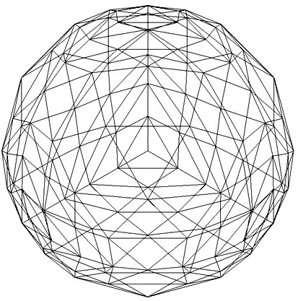
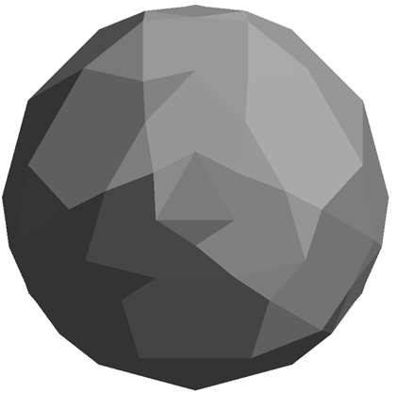
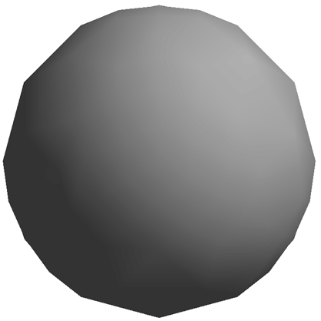
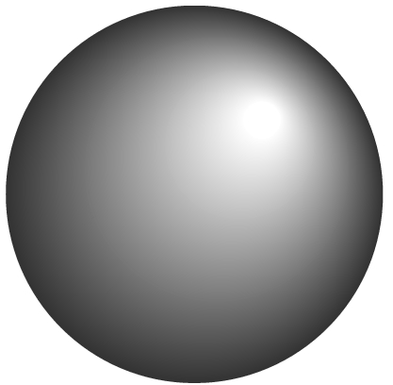
Examples of Shading Algorithms
wireframe
faceted
Phong
Gouraud

Slide 28
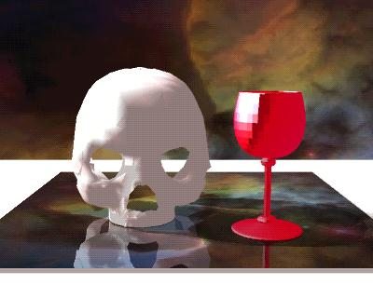
Source: http://www.depaul.edu/~rwolfe/539/hmwk1gallery/gallery.html

Slide 29
SHADER USED (For Non-ray-tracing)
Enhancements such as
  texture mapping- the cheapest
  bump mapping- a bit more expensive
  environment mapping- requires multiple renderings
Are usually done as enhancements to a non-ray-tracing renderer when shading is done
Doing all of these slows the rendering down extensively.

Slide 30
SHADER USED (with ray-tracing)
Ray tracing always determines visibility and color for each pixel.
But, there are added costs depending upon the type of calculation done:
  shiny, plastic objects need specular (i.e. the highlight) calculations
  reflections are expensive because the rays have to be traced that bounce off the surface
  transparent objects are very time consuming as rays are generated that exit the object

Slide 31
Working with Lights

Slide 32
Lights
We need to determine how light is scattered or reflected from a surface.
In graphics, we typical use several kinds of lights:
  point light sources - lights that shine on objects
    Spotlights emit light from a small surface and are highly directional
    Area sources emit light from a large surface such as a fluorescent light
    Remote light emits from a large surface, but is so far away it does not appear as a directional light – Ex. The sun
  ambient light - light reflecting off of other surfaces
The amount of light reaching the synthetic camera must be calculated.

Slide 33
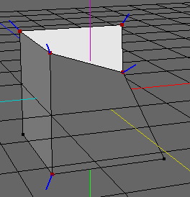
Visibility
The amount of light that reaches the eye is dependent upon many things:
  Geometry of the surface specified, for example, by
    normal to surface at a point
The normal at a point is a vector
(line segment plus direction)
perpendicular to surface at that
point (if point is not corner)
    vector from p to viewer's eye
    vector s from p to light surface
  Nature of the material
  The components of the light

Slide 34
LIGHT IN REAL WORLD
Overview
RGB values for a pixel are not enough to give realistic pictures.
Need to handle light.
An object either
  emits light --- for example, a taillight
  or is illuminated by one of the different kinds of light
    Ambient Light: light that is scattered so much that its direction is impossible to determine.
    Diffuse Light: light coming from one direction
    Specular Light: light coming from one direction which bounces off in a specific direction

Slide 35
Ambient Light
Doesn't come from a particular direction.
Has a source, but has bounced around so much it is directionless.
The intensity is the same at every point on the surface.
Often achieved through large sources that shine through a diffuser that scatters light in all directions.
Typical examples are light from:
a cloudy day
moonlight
sunlight scattered by fog or haze

Slide 36
Diffuse Light
Comes from a particular direction.
The amount of light reflected from a surface depends on the angle between the incoming light and the surfaces.
So, although the reflection is even, the surface is brighter if the light is pointed directly at it
Examples are:
fluorescent lighting
noon sunlight streaming in a side window
(not a solid beam)

Slide 37
Specular Light
Directional like diffuse light, but it is reflected sharply and in a particular direction.
A high specular light often leaves a highlight on an object called the specular highlight.
Examples:
spotlight
sun beam

Slide 38
LIGHTING- Some Facts
When light strikes an object, some of it is reflected and the rest is absorbed as heat.
For example, a red surface in white light absorbs all of the light components except the red ones which are what your eye sees. A red surface in green light would produce a dark, mostly colorless form.
Color is really a reflection property.
Moreover, light is made up of different parts of the 3 types:
specular
diffuse
ambient

Slide 39
AN EXAMPLE
Consider: A RED LASER BEAM IN A LABORATORY
Composed almost entirely of a pure red specular component of the light.
• But, smoke or dust particles scatter the beam so it
can be seen traveling across the room. Scattering
represents the diffuse component of the light.
• If the beam is bright and no other light sources are
present, you might notice objects in the room taking
on a red hue. This would be a very small ambient
component of the light.

Slide 40
AN EXAMPLE
A RED LASER BEAM IN A LABORATORY
In graphics packages, we can specify the different components of light for each gun by specifying a number, perhaps as a percentage:
For example:
For the red laser beam in a laboratory, the laser light
source may be specified as using
  green and blue guns have components of 0.0
  the red gun might be specified as
    specular 0.99 - pure red for gun
    diffuse 0 .10 - scattering due to dust and smoke
    ambient 0.05 - red hue on other objects

Slide 41
Lighting Models and Shading Models

Slide 42
Lighting Models
Specify how light will interact with a surface.
Simplification are made from the physics involved in order to speed up the rendering.
Two models are typically used:
  Lambertian (or diffuse) lighting model: The amount of light reflected from the surface depends on angle between incoming light and the surfaces.
  Phong lighting model: Adds to the above, the angle of the viewer.
Obviously the first one is less costly.

Slide 43
Shading Models
Once a lighting model is chosen, the calculations theoretically should be done for every point on an object’s surface.
Clearly that is costly.
A shading model simplifies the calculations in order to gain rendering speed.
Common models are:
  Constant (or flat) -
  1 color calculation per object
  Faceted-
  1 color calculation per polygon
  Gouraud (1971) -
  1 color calculation per vertex
  Phong (1975) -
  1 color calculation per pixel

Slide 44
Examples of Shading Algorithms
wireframe
faceted
Phong
Gouraud

Slide 45
Material Properties

Slide 46
Material Properties
Light Properties Are Not Enough
Given a light, different materials reflect the light differently.
Material settings must be set as well as light settings.
When a particular material is chosen, it has certain built in properties depending on its nature.
But, the 3D graphics user can also set some additional properties.

Slide 47
A Diffuse Reflector
Brightness Depends Upon:
The components of white light it reflects.
The strength of the ambient and direct light striking the surface.
The position of the direct light sources.
The orientation of the reflecting surface relative to the direct light source.
The type of surface.
Note:Reflected light is scattered in all directions for a
diffuse surface.
Matte surfaces such as flat paint and cotton
are predominately diffuse reflectors.

Slide 48
Specular Reflector
Brightness Depends Upon:
The strength of directional light sources.
The position of directional light sources.
The orientation of the surface with respect to the light sources.
The position of the viewer.
The surface roughness.
Note: Highlights are the result of light being scattering in a narrow range of angles close to angle of reflection.
A mirror is an example of a perfect specular reflector.
Shiny plastic exhibits both diffuse and specular reflection,
but the specular component is high.

Slide 49
Translucent Surfaces
Allow some light to penetrate the surface and then it exits the object
Creates an effect that we call transparency.
Water and glass are translucent surfaces
If a material is 100% translucent, it is invisible.
Refraction
When light passes through a media the light might be bent.
  Example: An object under water or a surface under a highly translucent object.
  Today, if you see refraction, most likely you are seeing a ray tracing rendering.
.

Slide 50

Source: http://www.depaul.edu/~rwolfe/539/hmwk1gallery/gallery.html

Slide 51
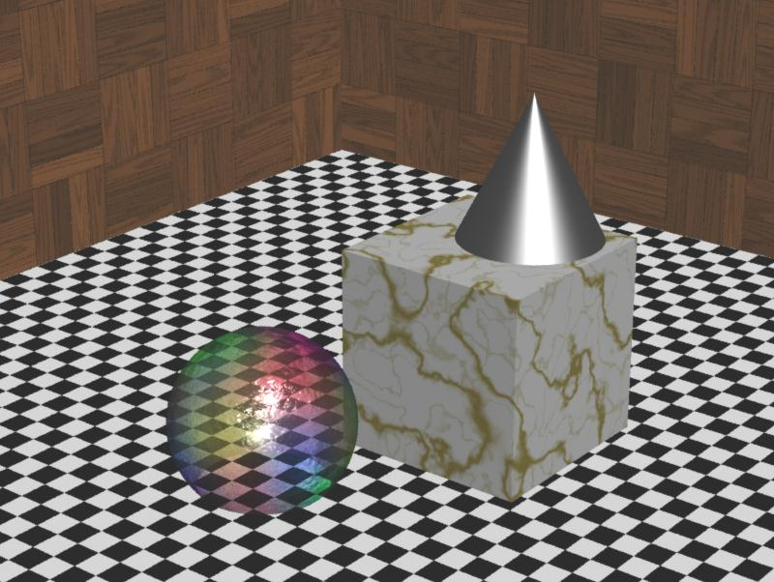
Source: http://www.depaul.edu/~rwolfe/539/hmwk1gallery/gallery.html

Slide 52
Selecting Material Properties
Ambient light: Defines the dominant color when no direct light is on that part of the surface.
Diffuse light: Defines the dominant color when the surface is illuminated.
  For many physically-based materials or real-world materials these are similar values.
Specular light: Determines the color of the highlights shown.
  Colored glass with white light on it has highlights the same color as the glass. So, set this to the same as the object's ambient and diffuse light.
  But, highlights for chrome reflect the color of the light shining on it. So set this to the same as the light's color.
Shininess (or specular halo). Controls the focus of the highlight and determines the spreads of the reflection over the surface – i.e. how much is it concentrated?

Slide 53
Texturing, Bump Mapping, and Environment Mapping
Ways of Obtaining Photorealism by Essentially Pasting or Painting

Slide 54
Texturing
One of the quickest ways to see realism.
Texturing is the mapping of a 2D surface onto a 3D surface.
  Even Adobe Illustrator has this in this latest version.
  Texture mappings can be plastered onto a surface in various ways.
A special case of texturing is when the artist can paint onto a surface.
Textures can look really fake if not handled carefully. Textbook has the example on pg 265 of marble that has been cut open.

Slide 55
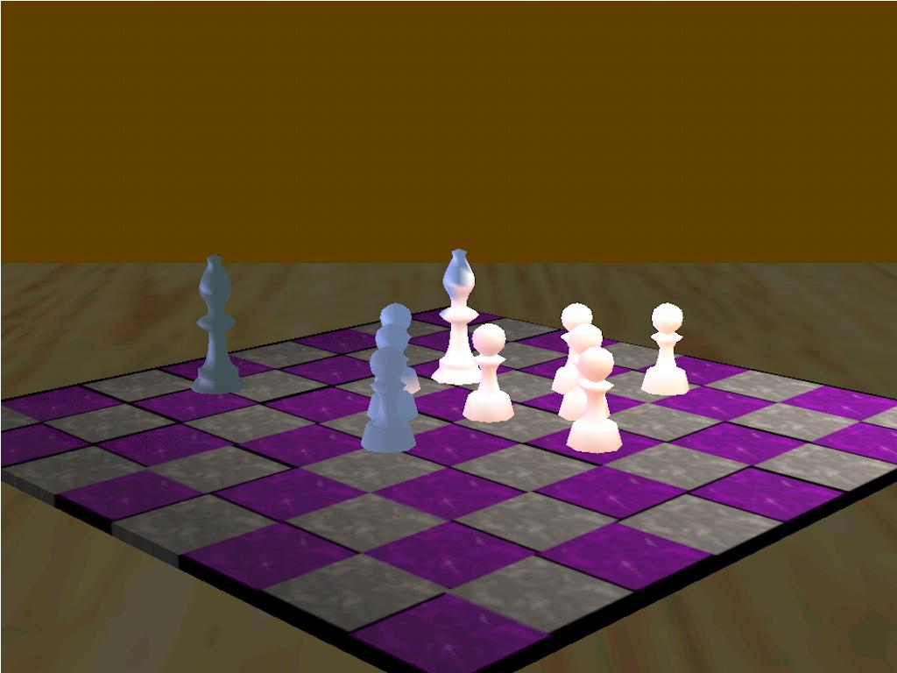
Source: http://www.depaul.edu/~rwolfe/539/hmwk1gallery/gallery.html

Slide 56
Bump Mapping
For many years, an attempt was made to create oranges algorithmically.
But, the uneven surfaces never looked natural.
Bump mapping redefines the surface normals to simulate light hitting at different angles.
Texture mapping could be used, but the textures might not “fit” with the lighting that was chosen.
Bump mapping integrates the surface with the lights correctly so that moving the object makes the shadows on the bumps change.

Slide 57
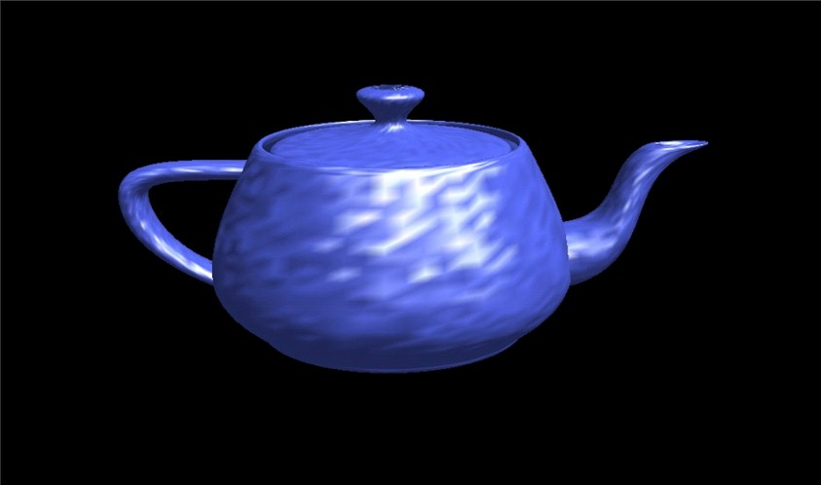

Slide 58
Environment Mapping
Ray tracing is very, very time consuming.
Mirrored effects can be produced easily when ray tracing, but not with other rendering algorithms.
Environment mapping fakes reflections for other rendering algorithms by rendering the scene using the object’s viewpoint and then texture mapping that 2D rendering onto the surface.
This technique was first introduced in “Toy Story”.

Slide 59
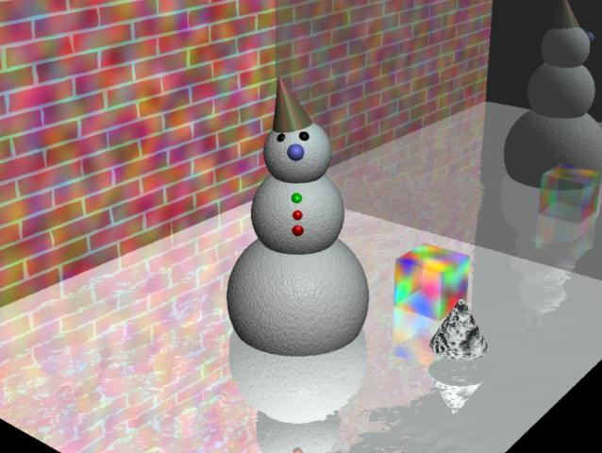
Source: http://www.depaul.edu/~rwolfe/539/hmwk1gallery/gallery.html

Slide 60
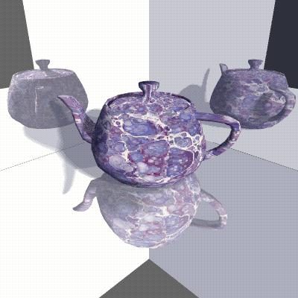
Source: http://www.depaul.edu/~rwolfe/539/hmwk1gallery/gallery.html

Slide 61
A Few Remarks About Bryce-
A brief overview
More to come in the studio lab.
But, please review all the terminology introduced before the studio lab!

Slide 62
Material Structure
You can create two types of materials in Bryce:
  Surface materials – define an object’s surface
    Simulate different physical properties of the surface and their combination defines how the object’s surface interacts with light in the Bryce environment
  Volume materials – define an object’s volume
    Simulate how the interior of object acts to make the object appear bright, dark, shiny, or dull.

Slide 63
Surface Material Settings
14 channels grouped into 3 groups (specifics not given yet) :
Value channels:
  Diffusion
  Ambience
  Specularity
  Metallicity
  Bump height
  Color channels:
    Diffuse color
    Ambient color
    Specular color
    Transparent color
    Specular halo
    Volume color
  Optics channels:
    Transparency
    Reflection
    Refraction

Slide 64
Volume Material Settings
13 channels divided into 3 groups (specifics not given yet):
Color channels:
  Diffuse color
  Ambient color
  Specular color
  Transparent color
  Specular halo
  Volume color
Value channels
  Diffusion
  Ambience
  Specularity
Volume channels
  Base density
  Edge softness
  Fuzzy factor
  Quality/speed

Slide 65
Shading Modes
Determine how material channels are to be applied to create different effects.
There are
  Surface Material Shading Modes
    Normal
    Blend Transparency
    Fuzzy
    Light
  Volume Material Shading Modes
    Flat
    Basic
    Full
    Light Sensitive
    Uniform density
    Sky Integration

Slide 66
Then there are shading mode modifiers!
Additive
Distance Blur
Receive Shadows
Cast Shadows
Self Shadows
Volume Blend-Altitude
Volume Blend-Distance

Slide 67
We won’t look at all of these, but we need enough of them to do realistic images!

