Slide 1

An Introduction to the History of Computers and the Visual Arts
Early Computers and Computer Art
INTD 390

Slide 2
Brief Survey of Some Inventions and Milestones in the Use of Computers in the Visual Arts
Realize
  No survey can be comprehensive – choices were made to highlight certain points.
  Inventions rarely spring from the heads of one individual, even when only one name is associated with an invention.
  There are many inventions leading up to a specific one. Often we will list only the last one.

Slide 3
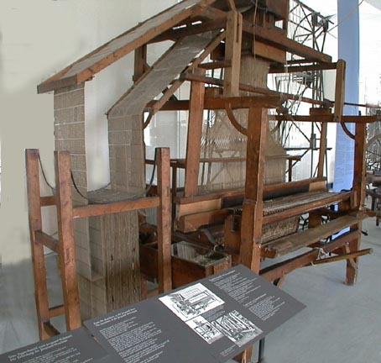
Jacquard Loom
A mechanical art device that influenced early computer design
1805-6
Intricate textile patterns were prized in France in early 1800s.
Jacquard’s loom used punched cards to allow only some rods to bring the thread into the loom on each shuttle pass.
1. Source: http://65.107.211.206/technology/jacquard.html

Slide 4
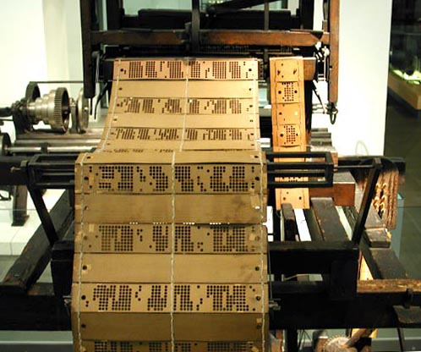
Sheets of punched cards were used to encode the complex patterns
2. Source: http://65.107.211.206/technology/jacquard.html

Slide 5
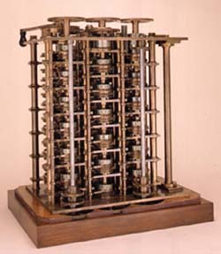
Forerunners of the Computer – Babbage’s Work
In 1821 Babbage invented the Difference Engine to compile mathematical tables.
In 1832, he designed, but was unable to build, a general symbol manipulating machine that could perform any kind of calculation. This Analytical Engine (1856) had some of the characteristics of today’s computers.
In the Science Museum, London.
3. Source: http://www.sciencemuseum.org.uk/on-line/babbage/page3.asp

Slide 6
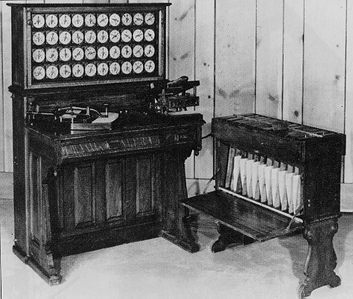
Herman Hollerith’s Tabulation Machine
A Statistical Sorting Device
Developed 1884-1890
This is the 1890 version used in tabulating the 1890 federal census.
It used punched cards for input to the device.
4. Source: http://www.columbia.edu/acis/history/hollerith.html

Slide 7
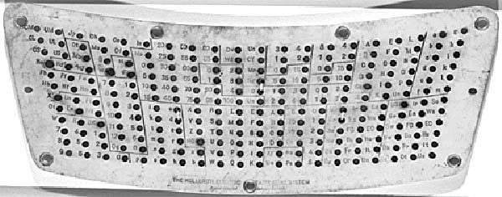
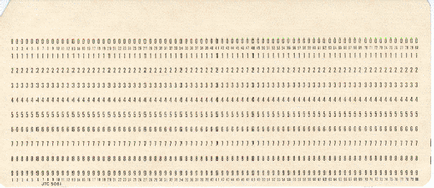
The Punched Card- Input to the Hollerith Tabulator and Early Data Processing Machines and Computers
Punched card used by the Hollerith Tabulator for the 1890 US census.
Punch card standardized in 1928:
It was the primary input media of data processing and computing from 1928 until the mid-1970s and was still in use in voting machines in the 2000 USA presidential election.
5. Source: http://www.columbia.edu/acis/history/hollerith.html

Slide 8
Several Devices Lay Claim to Being
“the First Electronic Digital Computer”
1938-46
1. ABC (Atanasoff-Berry Computer), built by Professor John Atanasoff and a graduate student Clifford Berry at Iowa State University between 1939 and 1942.
2. ENIAC (Electrical Numerical Integrator And Calculator), built by Presper Eckert and John Mauchly at Moore School of Engineering, University of Pennsylvania, 1941-46
3. Z1-Z4 built by Konrad Zuse in Berlin, Germany, 1938 – 1944 (all destroyed in Berlin bombings)
4. Mark I designed by Howard Aiken and Grace Hopper at Harvard University in 1939-1944.

Slide 9
Why is it important in this course to understand some of the characteristics of these early computers?
Computer art, obviously, requires a computer for the creation process.
But, as we look at some of these early computers, ask yourself if you see how it would be possible to produce art on these early machines.
In particular, what was used for input? for output? to control the machine?
Then speculate when the first computer art was created and how it might be created.

Slide 10
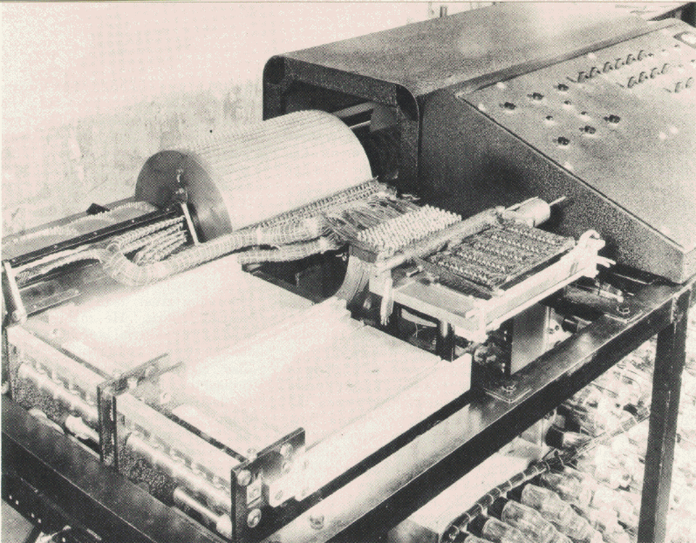
Atanasoff-Berry Computer or the ABC built by John Vincent Atanasoff and Clifford Berry at Iowa State University 1939-42
Special purpose computer and was not truly programmable.
The instructions to the machine were entered by buttons.
Input: Punched paper tape
Output: Punched cards
6. Source: www.cs.iastate.edu/jva/images/abc-1942.gif

Slide 11
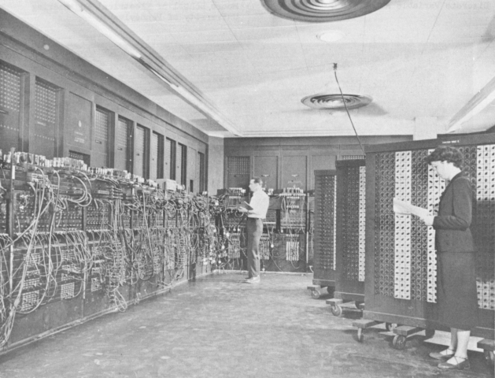
ENIAC
18,000 vacuum tubes and weighed 30 tons
Duration of an average run without some failure was only a few hours, although it was predicted to not run at all!
Input: IBM card reader
Output: Punched cards, lights
Stored a maximum of twenty 10-digit decimal numbers.
7. Source: http://ftp.arl.army.mil/ftp/historic-computers/

Slide 12
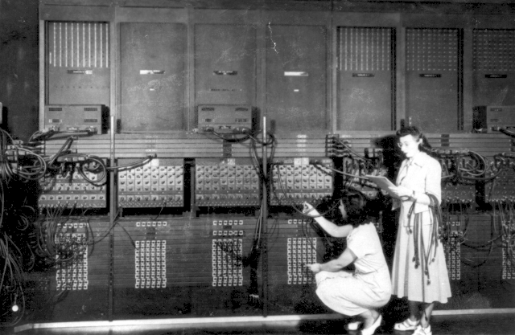
Programming ENIAC
Wiring the right side of the ENIAC with a new program, in the "pre- von Neumann" days.
8. Source: http://ftp.arl.army.mil/ftp/historic-computers/

Slide 13
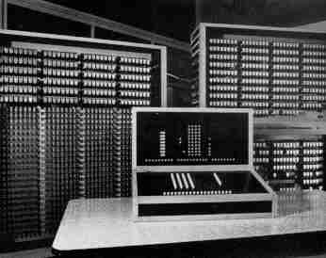
Z3
Input was from a numeric, decimal, 20 digit keyboard
Output: Numbers displayed with lamps, 4 decimal digits with decimal point
Programmed via a punch tape and punch tape reader
Rebuilt model of Z3 housed in Deutsches Technik Museum, Berlin
Multiplication 3 seconds, division 3 seconds, addition 0.7 seconds. Used a 600 relay numeric unit, 1600 relay storage unit
9. Source: http://irb.cs.tu-berlin.de/~zuse/Konrad_Zuse/en/Rechner_Z3.html

Slide 14
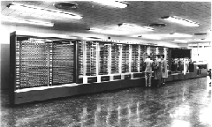
Mark I
Input was provided on punched cards
All output was displayed on an electric typewriter.
Could carry out addition, subtraction, multiplication, division and reference to previous results.
Contained more than 750,000 components, was 50 feet long, 8 feet tall, and weighed approximately 5 tons
Instructions were pre-punched paper tape
Still exists in the Computer Science Building at Harvard University.
10. Source: http://www.digidome.nl/howard_h__aiken.htm

Slide 15
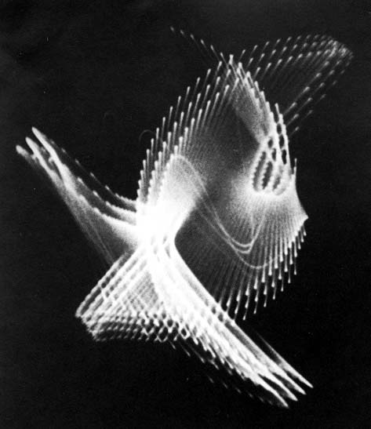
An Oscilloscope Was Used By the Individual Called the First Computer Artist
Could any of the earliest machines produce art?
What kind of output device might be a candidate for the first computer artist to use?
Artist: Ben Laposky (1914-2000)
One of his earliest works (1950)
Oscillon Number Four
11. Source: http://www.dam.org/laposky/

Slide 16
What is an Oscilloscope?
An oscilloscope is a laboratory instrument commonly used to display and analyze the waveform of electronic signals.
The oldest form of oscilloscope, still used in some labs today, is known as the cathode-ray oscilloscope.
Laposky’s works were produced by manipulating electronic beams displayed across the fluorescent face of an oscilloscope's cathode-ray tube and then recording the image onto high-speed film.

Slide 17
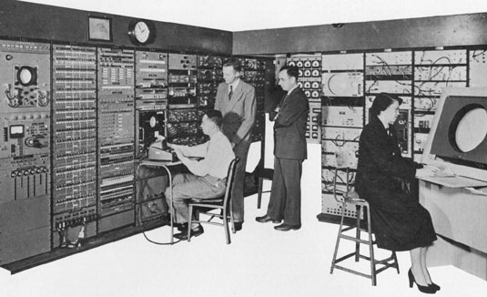
The First Public Demonstration of Computer Art - 1952
On the Whirlwind Computer at MIT -the first digital computer capable of displaying real time text and graphics on a large oscilloscope screen.
A “bouncing ball” animation was produced to demo this feature.
12. Source: http://www.accad.ohio-state.edu/~waynec/history/lesson2.html

Slide 18
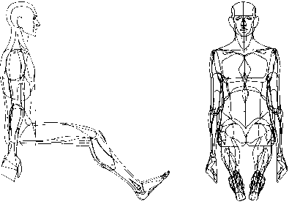
The Term “Computer Graphics”
Coined in 1960 by William Fetter (1928-2002), a trained artist and art director, to describe new design methods he was pursuing at Boeing.
•He created a series of widely reproduced images on a pen plotter exploring cockpit design using a 3D model of a human body.
Early computer art was characterized by being strictly black and white.
13. Source: http://courses.washington.edu/eatreun/html/history/h_nw.html

Slide 19
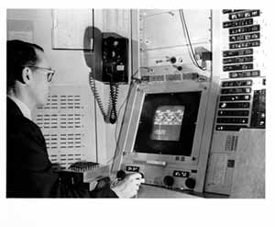
Ivan E. Sutherland – Called the Father of Computer Graphics
Ph.D. Thesis, 1963, MIT : Sketchpad: The First Interactive Computer Graphics Package on TX-2 (forerunner of DEC machines).
TX-2 was a giant machine for the day:
320 kilobytes of memory, about twice the capacity of the biggest commercial machines
magnetic tape storage,
an on-line typewriter,
the first Xerox printer,
paper tape for program input,
and a nine inch CRT!
14. Source: http://www.sun.com/960710/feature3/sketchpad.html#sketch

Slide 20
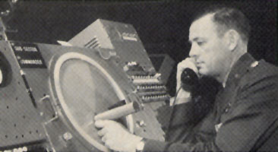
“Sketchpad: A Man-machine Graphical Communications System," used the lightpen to create engineering drawings directly on the CRT
A light pen being used with the SAGE system.
15. Source: http://www.accad.ohiostate.edu/~waynec/history/lesson2.html

Slide 21
Thus, In This New Art Form We See in Its Early Period (through the early 1970s) ...
The computer was a tool where algorithms in programs generated the images.
Often to enliven potentially boring repetitive images, random number generators were used to add variation and make the images have more of a “human-drawn” look.
Output devices were limited:
  oscilloscope screens
  very tiny CRT screens
  pens on flatbed or drum plotters
Input devices were limited:
  light pens
  paper tape
  paper cards
The artist had to program or have someone else do the programming

Slide 22
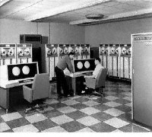
One of the Worst Problems was the Cost and Inaccessibility of Machines
Control Data Corporation
CDC 6600 at U of Texas, 1964-68
Cost: $2,000,000+
Kept in dustfree room behind locked doors
16. Source: http://www.computerhistory.org/timeline/timeline.php?timeline_category=cmptr Computer History Museum

Slide 23
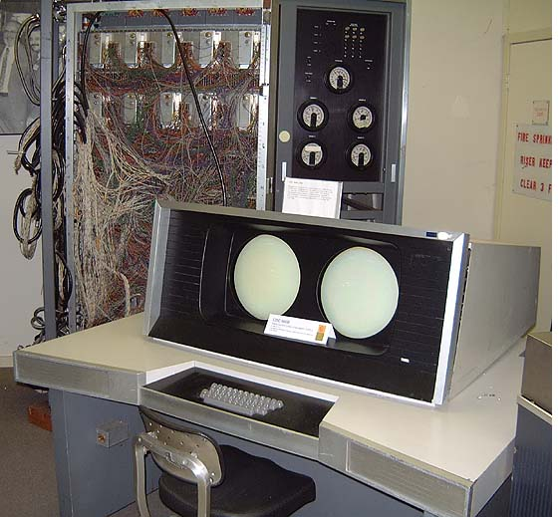
CDC-6600
1964
Workstations available to only a few
Most had to use punched cards handed in through a window
17. Source: http://ed-thelen.org/comp-hist/vs-cdc-6600.jpg Control Data Corporation, CDC-6600 & 7600

Slide 24
The First Period of Computer Art
1950-early 1970s
Note- different artists place different dates on this period
Characterized by
  a difficulty in obtaining access to computing equipment
  a need to learn programming (in a day when few expressive languages were available) --- but many found that intriguing
  black and white work (no color output)
  use of curves or figures that could be described mathematically
  “look” of work was dictated by the limitations of the technology
  Often the artists were scientists who were also artists or at least had an interest in art

Slide 25
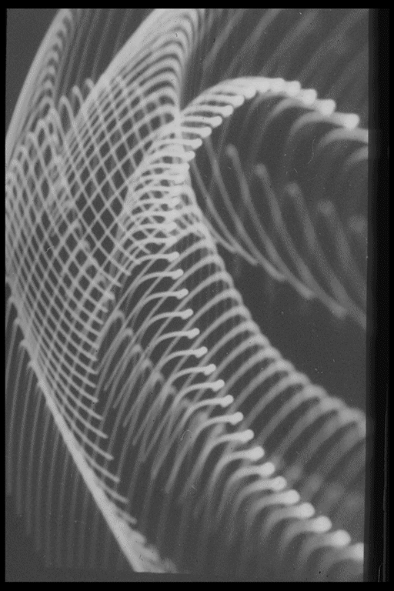
Who Were Some of the Other Early Computer Artists?
From 1953 to 1956, Herbert Franke experimented with oscilloscope imagery, and then later, in the very early 1960s, he created monochrome computer graphics.
Untitled Oscillogram – 1956
18. Source: http://www.zi.biologie.uni-muenchen.de/%7Efranke/index.html

Slide 26
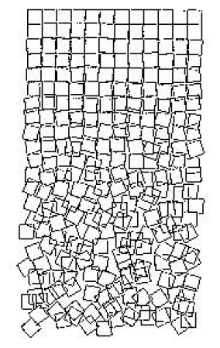
Georg Nees’ plotter piece, called “Gravel Stones” (Cubic Disarray) (1968-71), is a graphic rendering of order and chaos
This was the original inspiration for a series of digital art works representing an example of pen plotter-based art.
Exact mathematical computations model a chaotic image and the progression from the ordered to the disordered.
19. Source: http://www.iit.edu/~krawczyk/rjkiv02.pdf

Slide 27
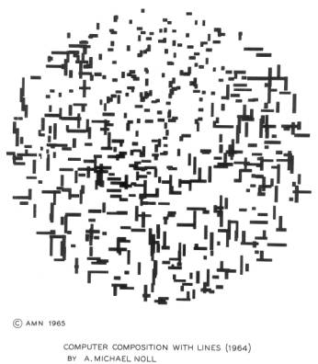
Michael Noll’s algorithmically simulated Mondrian’s painting called “Composition with Lines” (1965).
In his early years, Noll did many black and white computer-generated drawings that were created in the style of various artists:
Picasso
Bridget Riley
Mondrian
20. Source: http://www.citi.columbia.edu/amnoll/

Slide 28
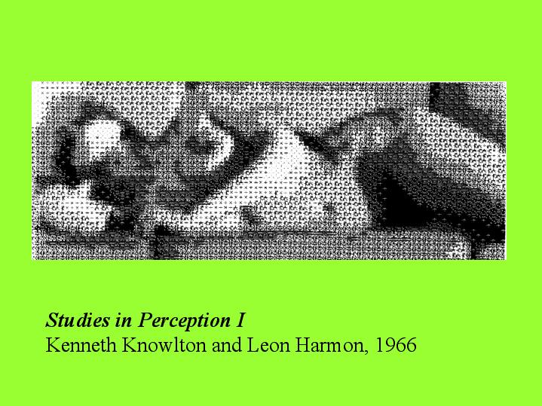
Studies in Perception I
Kenneth Knowlton and Leon Harmon, 1966
21. Source: http://artstream.ucsc.edu/art80f/History%20of%20Electronic%20Art/sld039.htm

Slide 29
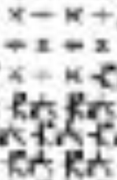
Looking At This Up Close We See ..
The artists scanned a photograph and then assigned different symbols to represent each of the varying gray values. All the selected symbols were composed from the character α.
Note the addition, subtraction, multiply, and divide symbols as well as some others representing computer components.
Art of this type was very common in this early era and many images existed of various objects and scenes using this technique.

Slide 30
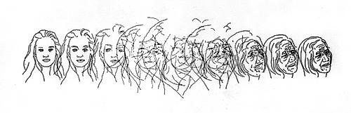
An Artist Close to Us: Charles Csuri
Professor Emeritus at OSU
“For computer graphics the IBM 7094 had as output cards about 4 x 7 inches with holes in them which contained information to drive a drum plotter. Boxes of cards could represent a single image. The cards were entered into a card reader on an IBM 1130 computer with a plotter device. These punch cards had the information to move the pen and pick the pen up or down as well as programmed instructions for end of line, etc.”
Aging Process
22. Source: http://www.siggraph.org/artdesign/profile/csuri/

Slide 31
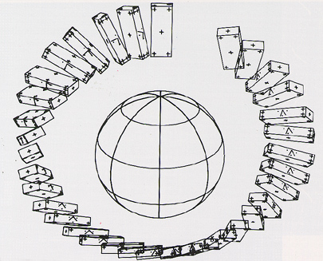
First computer animated film (Two-Gyro Gravity-Gradient Attitude Control System), by Edward Zajak of Bell Labs, 1963
23. Source: http://www.cs.montana.edu/~charon/graphics/1960.html

Slide 32
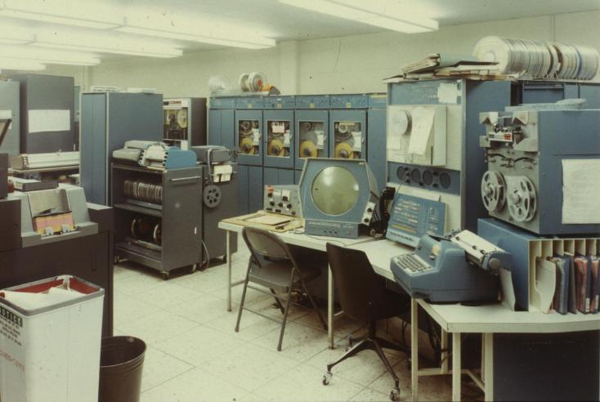
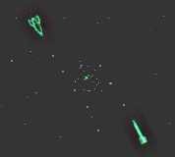
The true purpose of computers is finally realized in 1961, when a MIT student, Steve Russell, creates the first computer game - Spacewar.
Screenshot on PDP 1 – 200 hours to program
24. Sources: http://inventors.about.com/library/weekly/aa090198.htm
http://www.nersc.gov/~deboni/Computer.history/GAM.PDP-1/

Slide 33
Art Shows and Societies
First Show in U.S. of Computer Art, 1965,
Howard Wise Gallery, New York City. Featured works of A. Michael Noll and Bela Julesz.
Other shows followed with computer art becoming more and more accepted in at least some of the art world.
In 1967, Robert Rauschenberg and Billy Kluver from Bell Labs formed Experiments in Art and Technology (EAT) which brought together artists and scientists through organized lecture series.
By 1968 it was possible for Jasia Reichardt to curate a survey of work in the area in the influential Cybernetic Serendipity exhibition held at London's Institute of Contemporary Art – the ICA.
1972- SIGGRAPH founded.

Slide 34
Citations
1. Web Site: http://65.107.211.206/technology/jacquard.html, The Victorian Web, sponsored by University Scholars Program, University of Singapore Consulted: 10/03
2. Ibid
3. Web Site: Source: http://www.sciencemuseum.org.uk/on-line/babbage/page3.asp Science Museum, Consulted 8/02
4. Web Site: http://www.columbia.edu/acis/history/hollerith.html, The Hollerith Tabulator, Computing at Columbia Timeline, Consulted 10/03
5. Ibid
6. Web Site: www.cs.iastate.edu/jva/images/abc-1942.gif, Department of Computer Science, Iowa State University, Consulted 8/03
7. Web Site: http://ftp.arl.army.mil/ftp/historic-computers/ U.S. Army Photo from K. Kempf, "Historical Monograph: Electronic Computers Within the Ordnance Corps" The ENIAC, in BRL building 328, picture in the public domain
8. Web Site: http://ftp.arl.army.mil/ftp/historic-computers/ "U.S. Army Photo" from the archives of the ARL Technical Library, picture in the public domain
9. Web Site: http://irb.cs.tuberlin.de/~zuse/Konra __Zuse/en/Rechner_Z3.html Horst Zuse Web Site, TU Berlin, Electrical Engineering and Computer Science, Consulted 8/02

Slide 35
Citations (Continued)
10. Web Site: http://www.digidome.nl/howard_h__aiken.htm Digidome Computer Museum, Consulted 8/03
11. Web Site: http://www.dam.org/laposky/ Digital Art Museum, Consulted 8/03
12. Web Site:
http://www.accad.ohio-state.edu/~waynec/history/lesson2.html A Critical History of Computer Graphics and Animation, Consulted 8/03
13. Web Site:http://courses.washington.edu/eatreun/html/history/h_nw.html University of Washington, Consulted 8/03
14. Web Site: http://www.sun.com/960710/feature3/sketchpad.html#sketch
Sun Microsystems, Consulted 7/02
15. Web Site http://www.accad.ohiostate.edu/~waynec/history/lesson2.html
A Critical History of Computer Graphics and Animation, Consulted 7/00
16. Web Site: http://www.computerhistory.org/timeline/timeline.php?timeline_category=cmptr Computer History Museum, Consulted 7/02
17. Web Site: http://ed-thelen.org/comp-hist/vs-cdc-6600.jpg Control Data Corporation, CDC-6600 & 7600 , Consulted 7/02
18. Web Site: http://www.zi.biologie.uni-muenchen.de/%7Efranke/index.html
Home Page of Herbert W. Franke, Consulted 1/04

Slide 36
Citations (Continued)
19. Web Site:: http://www.iit.edu/~krawczyk/rjkiv02.pdf “A Shattered Perfection: Crafting a Virtual Sculpture”, Robert J. Krawczyk College of Architecture, Illinois Institute of Technology, Consulted 12/03
20. Web Site: http://www.citi.columbia.edu/amnoll Home Page of A. Michael Noll, Consulted 12/03
21. Web Site: http://artstream.ucsc.edu/art80f/History%20of%20Electronic%20Art/sld039.htm
Studies in Perception I, Kenneth Knowlton and Leon Harmon, 1966, Consulted 12/03
22. Web Site: http://www.siggraph.org/artdesign/profile/csuri/ Csuri, Computer Artist, Consulted 10/03
23. Web Site: http://www.cs.montana.edu/~charon/graphics/1960.html CS525, Presentation2: 1960s, Consulted 8/03
24. Web Site: http://inventors.about.com/library/weekly/aa090198.htm Inventors of the Modern Computer Series, Consulted 8/03 and
Web Site: http://www.nersc.gov/~deboni/Computer.history/GAM.PDP-1/ The PDP-1, by George Michael, Consulted 8/03

