Slide 1

An Introduction to the History of Computers and the Visual Arts
Post 1975
INTD 390

Slide 2
The Second Era in Computer Art
Late 1970s and 1980s
Ushered in by surges in some technology advances including the introduction of
  Raster graphics devices
  The personal computer
  Less expensive mainframe machines called minicomputers
  New input devices such as the mouse
  The GUI (graphical user interface- pronounced “gooey”)
  Interactive graphics techniques and software geared to artists available outside of academia

Slide 3
Raster Graphics Devices
Xerox PARC researchers decided to use a raster device for graphics output instead of devices characterized by the Tektronics terminals.
  You are familiar with raster devices as that is the technology used today in computer monitors and in television screens.
  Graphics output before this was dominated by vector graphics devices such as by Tektronics terminals and pen flatbed or drum plotters.
  All operated on the same principles of drawing lines between two points.
  These devices did not disappear in the 70s and early 80s, however.

Slide 4
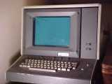
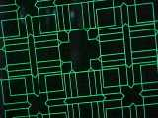
Vector Graphics Terminals
The Tektronics 4013 was a storage tube vector graphics terminal from around 1972.
It was a high-end graphics terminal in its day, frequently used for CAD/CAM applications running on mainframes.
Could achieve
4096 x 3072
resolution but you could only draw lines.
vector graphics
1. Source: http://www.cca.org/vector/tek4013.html

Slide 5
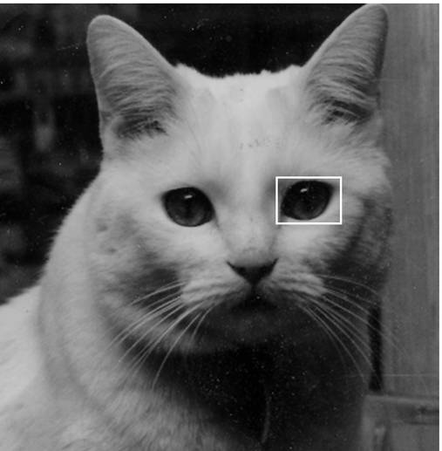
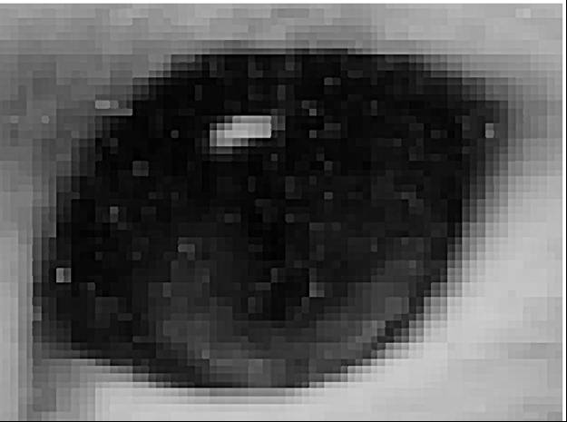
Raster (Bitmapped, Sample-based) Graphics
Raster image of cat
Close up of eye showing pixels

Slide 6
Raster Image is Stored in a Frame Buffer in Computer
Frame buffer is simply the video memory that holds the pixels from which the video display (frame) is refreshed.
Logically think of it being a table (or 2D array)
Information about one pixel – color, brightness, blinking, etc.

Slide 7
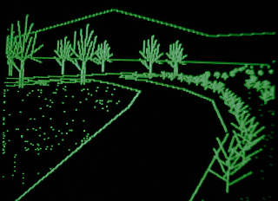
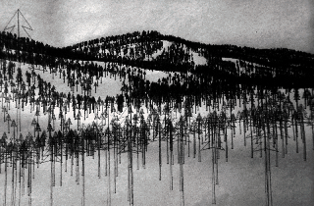
Samples of Vector Graphics in the late 70s and early 80s
Monochrome green-on-black 3D perspective, created on an Apple ][+ computer, c. 1980. By Stephen Ervin.
Pen plotter print c. 1979 .U.S. Forest Service.
2. Source: http://www.landscapemodeling.org/html/ch1/ch1text.htm#1.9
A Brief History of Computer Graphics in Landscape Modeling

Slide 8
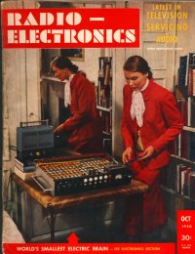
Introduction of the Personal Computer
When? Which one?
Edmund Berkeley first described a personal computer Simon in his 1949 book, "Giant Brains, or Machines That Think" and went on to publish plans to build Simon in a series of Radio Electronics issues in 1950 and 1951.
By 1959, 400 copies had been sold and die-hard computer people were trying to build the machine.
But, few really saw this machine and so it often fails to be listed as the first PC.
3. Source: http://www.blinkenlights.com/pc.shtml

Slide 9
However, Simon was a true personal computer as it had these characteristics:
Digital computer.
Largely automatic.
Programmable by the end-user.
Accessible, either as a commercially manufactured product, as a commercially available kit, or as widely published kit plans.
Small enough to be transportable by an average person.
Inexpensive enough to be affordable by the average professional.
Simple enough to use that it requires no special training beyond an instruction manual assuming some knowledge of computers in advance

Slide 10
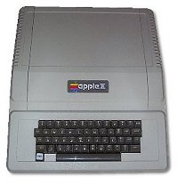
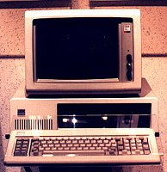
Two Brands That Survived
1977 Apple ][, the first highly successful mass-produced personal computer
The IBM PC was introduced in 1981
See your textbook, pg 27, for a picture of the first Mac in 1984.
4. Source: Ibid

Slide 11
This Mid 1970-1980 Time Period Saw a Proliferation of What We Now Call a Personal Computer
Contrary to popular belief today, these were not cheap – the IBM 5100 in 1975.
Memory | BASIC | APL | Both
16K | $8,975 | $9,975 | $10,975
32K | $11,975 | $12,975 | $13,975
48K | $14,975 | $15,975 | $16,975
64K | $17,975 | $18,975 | $19,975
5. Ibid

Slide 12
Unless You Wanted to Build Your Own Through a Kit
1974- the Mark-8 started the hobby market
Others included:
  MITS Altair kit - $397- first 8080-based kit
    no keyboard, no video display, only 256 bytes of memory, data input by flipping toggle switches, output was the flashing lights in the computer
  Radio Shack's TRS-80 -$500
  The Commodore 64- $260 after a price war with Texas Instruments
  The Heath Desktop was one of the first computers designed as a complete desktop machine including monitor, floppy disks and keyboard.

Slide 13
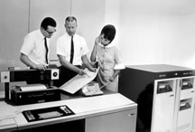
Minicomputers Were Introduced and Made Computing More Available --- The IBM 1130
Machine being used at Hiram College in 1974
16K 16-bit words
16K disc space
card input
line printer output or card
6. Source: http://ibm1130.org/

Slide 14
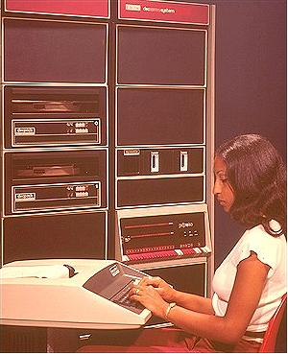
PDP-11/40
Machine purchased in 1974 for Hiram College
CRT input/output
Line printer output
7. Source: http://research.microsoft.com/~gbell/Digital/timeline/1972-2.htm

Slide 15
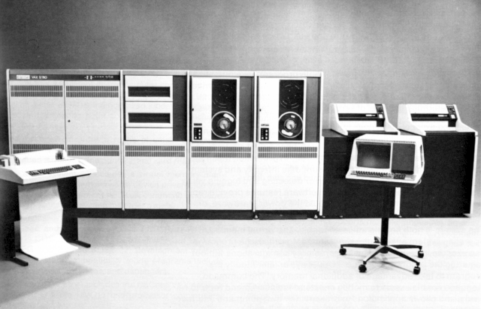
Digital Equipment Corporation (DEC)
VAX-780
Very popular machine
Purchased by Hiram College in 1981 for $175,000 (not counting terminals or terminal/ printers.)
8. Source: http://ftp.arl.army.mil/ftp/historic-computers/#rights

Slide 16
New Input/Output Technology
In 1968 Douglass Engelbart staged a 90-minute public multimedia demonstration of a networked computer system which debuted the computer mouse, 2-dimensional display editing, hypermedia, multiple windows with flexible view control, and on-screen video teleconferencing.
Xerox in 1973 developed its Alto computer which was the first introduction of a GUI, raster graphics, and a mouse in one system.
Since Xerox never marketed the computer, Apple was awarded the credit as its Macintosh (or Mac) used these innovations commercially and became immensely popular.

Slide 17
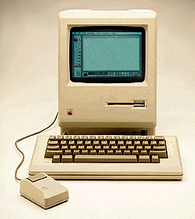
The Mac
The Macintosh was introduced in the famous "1984" TV commercial broadcast during the SuperBowl.
It featured a small built-in high resolution monochrome display, 128 KB of memory, the Macintosh operating system with its graphical user interface, and a klunky looking single button mouse that didn’t fit the hand very well, and MacPaint.
It sold for $2495.
Introduced many people to graphics and the Apple line is still viewed by many artists as the only computer to use!

Slide 18
Although Personal Computers Would Eventually Play a Large Role in Computer Art, We Didn’t See That Initially
Much of the technology that was used, was by today’s standards, still expensive
  ($5,000-$10,000 for a good printer, $50,000+ for a good graphics output device, $200,000 - $1,000,000+ for a minicomputer or mainframe computing system)
  or woefully inadequate for serious work (until 1987, Mac had only a 9” black and white screen)

Slide 19
Trends in Computer Art mid 1970s – 1980s
Two camps were forming: One group continued using programming to generate art, although the work became more complex.
Members of this group were artists-programmers.
The manipulation of the computer was seen as the important aspect of the work.
For example, using artificial intelligence techniques, Harold Cohen had the computer generate paintings.
See examples at : http://www.kurzweilcyberart.com/KCATaaron/STAFsample
Some like Charles Csuri, continued to use programming as the underpinnings of the art work he generated. See many examples at:
http://www.siggraph.org/artdesign/profile/csuri

Slide 20
Trends in Computer Art mid 1970s – 1980s
The other group in the late 80s, became interested in using commercially produced interactive graphics programs and scanners to manipulate and composite images into art creations.
Some of the software at this time included
  MacPaint
  MacDraw
  Autodesk’s AutoCAD
  Adobe Postscript
The basis of many of the works were film photographs scanned into digital form and then manipulated.

Slide 21
Image Processing vs Graphics
Computer scientists distinguish these two modes of handling computer images:
graphics – the generation of images from computer instructions such as a program written in a computer language
image processing – the manipulation of various images produced elsewhere in order to form a new image
Often, however, the first term is used for both modes today.

Slide 22
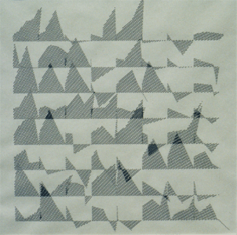
Some of the Artists Using Image Manipulation
Joan Truckenbrod
  Her first works were computer-assisted drawings in the 1970s
‘Computer-Aided Drawing’, 12"H x 12"W, 1975
9. Source: http://www.siggraph.org/artdesign/profile/Truckenbrod/1980_4.html

Slide 23
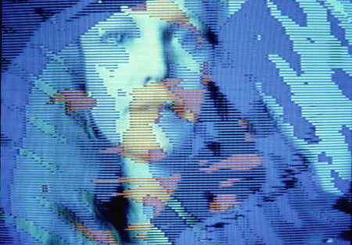
In the 1980s she began splintered various images into collages
‘On Becoming’, Cibachrome Print, 24"H x 30"W, 1984. Joan Truckenbrod
10.Ibid

Slide 24
Many of These Artists Began to Use Computer-Based Art to Deal Directly with Issues Such as Gender, Identity, and Family Structures
Be sure to look at the work of Nancy Burson at
  http://www.nancyburson.com/
and Carol Flax at
  http://cepa.buffnet.net/exhibits/EXHIBIT.19981999/ruinsinreverse/RIR.1000.public.flax.html
which can’t be represented in any meaningful way on a single slide.

Slide 25
The Computer Artists Begin to Form A Community
Took one year in 1967 to obtain 30 signatures to start the ACM (Association for Computing Machinery) Special Interest Committee for Computer Graphics.
ACM SIGGRAPH founded in 1972 was the outgrowth of the committee’s work.
Today, more than 7,000 artists, technicians, researchers and members of the academic and business communities belong to SIGGRAPH. The organization offers its members a wealth of educational opportunities including conferences and workshops, publications and other means of idea exchange.
SIGGRAPH 97, attracted a record-breaking 48,700 attendees to Los Angeles, although more recent meetings such as SIGGRAPH 2002 in San Antonio, Texas, drew only 17,000 people.
Other organizations were begun in the ’80s.

Slide 26
The Third Era in Computer Art
The 1990s and Beyond
Since you have lived in this era, we won’t belabor the innovations here.
But, realize that these were all advances during these last 24 years:
  Cheap personal computers with speed, memory, color I/O, sound, video, and other multimedia capabilities.
  Breakthroughs in special effects in filmmaking
  Virtual reality
  3D graphics
  Internet and web technologies
  Interactive multimedia and hypermedia ...

Slide 27
Moore’s Law
The claim is that computers double in power about every 18 months with no rise in price (Problem #4- pg 35). I wish to clarify one thing on this now:
The observation was made in 1965 by Gordon Moore, co-founder of Intel:
  The number of transistors per square inch on integrated circuits had doubled every year since the integrated circuit was invented.
  He predicted that this trend would continue for the foreseeable future.
  In subsequent years, the pace slowed down a bit, but data density has doubled approximately every 18 months, and this is the current definition of Moore's Law, which Moore himself has blessed.
  Most experts, including Moore himself, expect Moore's Law to hold for at least another two decades. Nothing was really said about price.

Slide 28
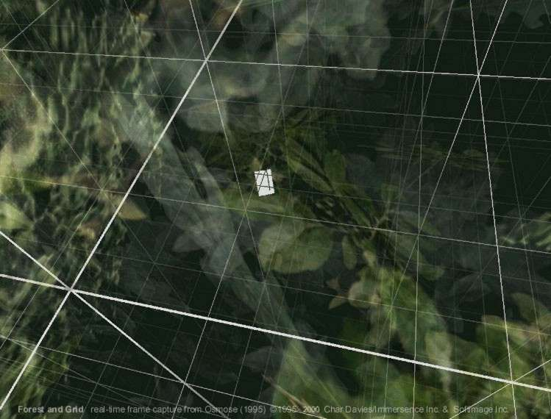
Close With Color Version of Char Davies’ Work Shown on pg 31--- her immersive virtual environment “Osmose”, 1995
11. Source: http://immersence.com/

Slide 29

RoseTree Showing Char Davies’ Vibrant Use of Color
12. Ibid

Slide 30

The Artist, Char Davies, Discusses Her Piece ‘Osmose’
“Osmose (1995) is an immersive interactive virtual-realty environment installation with 3D computer graphics and interactive 3D sound, a head-mounted display and real-time motion tracking based on breathing and balance.”
“Osmose is a space for exploring the perceptual interplay between self and world, i.e. a place for facilitating awareness of one's own self as consciousness embodied in enveloping space.”
13. Ibid

Slide 31
Citations
Source: http://www.cca.org/vector/tek4013.html Vector Graphics Terminals, Consulted 7/00
2. Source: http://www.landscapemodeling.org/html/ch1/ch1text.htm#1.9
A Brief History of Computer Graphics in Landscape Modeling, Consulted 8/03
3. Source: http://www.blinkenlights.com/pc.shtml Pop Quiz: What was the first PC? Consulted 8/03
4. Ibid
5. Ibid
6. Source: http://ibm1130.org/ All about the IBM 1130 Computing System, Consulted 7/00
7. Source: http://research.microsoft.com/~gbell/Digital/timeline/1972-2.htm Digital Computing Timeline, Digital Corp., Consulted 7/00
8. Source: http://ftp.arl.army.mil/ftp/historic-computers/#rights Historic Computer Images, Consulted 7/00
9. Source: http://www.siggraph.org/artdesign/profile/Truckenbrod/1980_4.html
Joan Truckenbrod Portfolio, Consulted 8/03
10. Ibid
11. Source: http://immersence.com/ Char Davies, Consulted 8/03
12. Ibid
13. Ibid

