Slide 1

History of Computers and the Visual Arts
INTD 390

Slide 2
Brief Survey of Some Inventions and Milestones in the Development of the Visual Arts
Realize
  No survey can be comprehensive – choices were made to highlight certain points.
  Inventions rarely spring from the heads of one individual, even when only one name is associated with an invention.
  There are many inventions leading up to a specific one, such as an electronic TV. We will list only the last one.

Slide 3
The Printing Press
The earliest dated printed book known is the "Diamond Sutra", printed in China in 868 CE (common era).
However, it is suspected that book printing may have occurred long before this date.
In 1041, movable clay type was first invented in China.
Johannes Gutenberg invented the printing press with replaceable wooden or metal letters in 1436.

Slide 4
The Beginning of Photography
The first photographic process or heliography was invented around 1824 by Nicephore Niépce of France.
Images were obtained on a silver plate after an exposure time of many days.
In 1829, Niépce introduced Louis Jacques Mande Daguerre to his research .
In 1832, they introduced a second process producing images in a one day exposure time.
In 1833 Niépce died, Daguerre went on working alone and invented, in 1838, the daguerreotype, the first process including a development stage taking hardly more than 30 minutes.

Slide 5
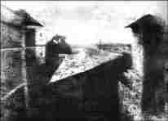
First Known Photograph by Nicéphore Niépce in 1827
Source: Austin, TX, “At the First Light International Symposium”, http://www.niepce.net/live/live.html

Slide 6
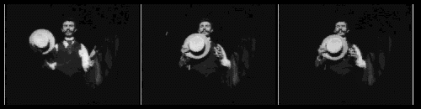
Motion Pictures
1887 Thomas Edison patented the movie camera although a major portion of the ideas are now attributed to his lab assistant William Kennedy Laurie Dickson.
One of the earliest films (1891) is known as Dickson’s Greeting:
Source: http://memory.loc.gov/ammem/edhtml/edmvchrn.html,
American memory Collection, Library of Congress

Slide 7
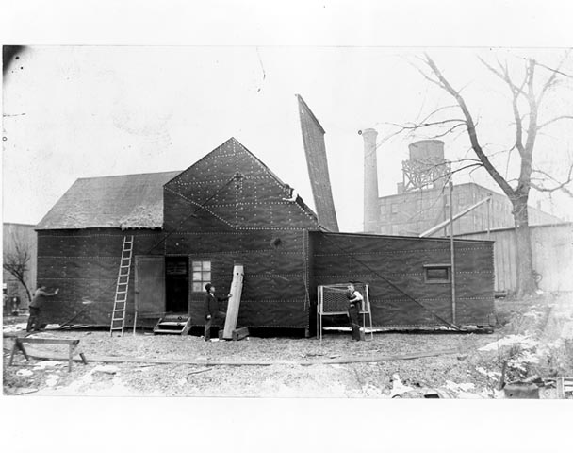
Edison’s Motion Picture Studio 1892-5
Source: http://memory.loc.gov/ammem/edhtml/edmvhist1.html#EE
American memory Collection, Library of Congress

Slide 8
The Birth of Television
The technology of television actually was the creation of many people in many countries over many years. It is really a series of international inventions around the 1929-1933 period.
A few of the names associated with its development are:
  Paul Nipkow in Germany
  J. L. Baird in England
  C. F. Jenkins in the United States
  Vladimir Zworykin, a Russian immigrant working for RCA in the United States
  Philo Farnsworth in United States
  For a brief history see:
  http://inventors.about.com/library/inventors/bl_television_timeline.htm

Slide 9
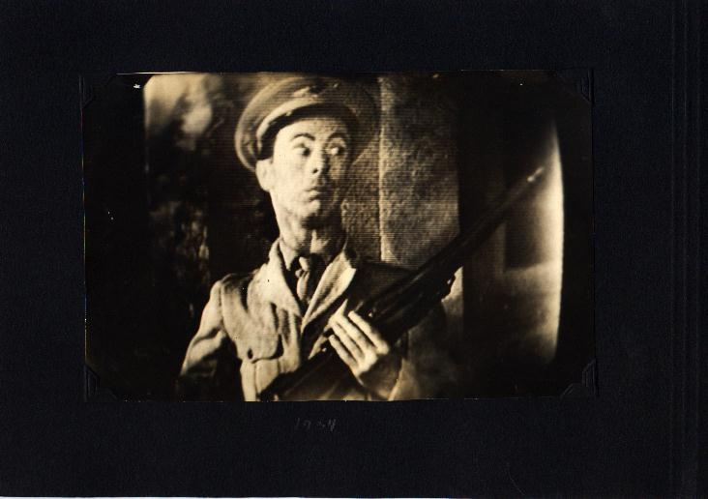
An Early 1933-34 TV Image of a Movie
Source: The Personal Photographs of Dr. Vladimir Kosma Zworykin, Television Pioneer, http://framemaster.tripod.com/1934p4.jpg

Slide 10
By 1935, we had many of the visual art media in place
Printing presses
Photographs
Motion Pictures
Television
Next, came the invention of electronic computers

Slide 11
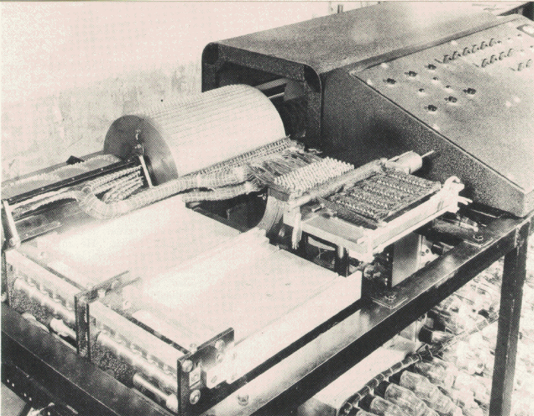
Atanasoff-Berry Computer or the ABC built by John Vincent Atanasoff and Clifford Berry at Iowa State University
SOURCE: www.cs.iastate.edu/jva/images/abc-1942.gif, Department of Computer Science, Iowa State University

Slide 12
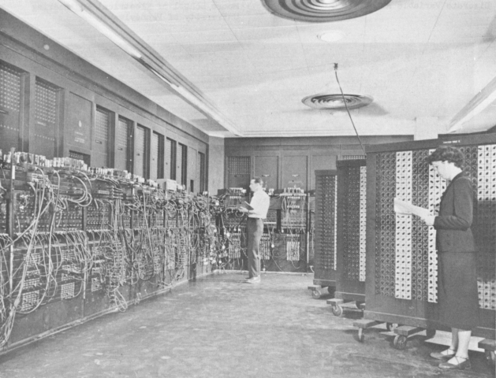
1945-46
Beginnings of Electronic Digital Computers
ENIAC
Build at
U of Penn
"U.S. Army Photo", from K. Kempf, "Historical Monograph: Electronic Computers Within the Ordnance Corps" The ENIAC, in BRL building 328

Slide 13
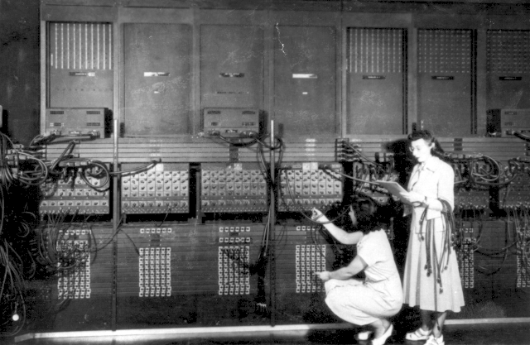
Programming ENIAC
Wiring the right side of the ENIAC with a new program, in the "pre- von Neumann" days. "U.S. Army Photo" from the archives of the ARL Technical Library.

Slide 14
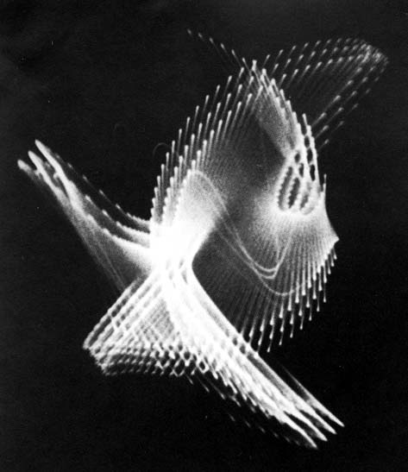
An Oscilloscope Was Used By the Individual Called the First Computer Artist
Artist: Ben Laposky (1914-200)
One of his earliest, 1950, works:
Oscillon Number Four
Source: Digital Art Museum, http://www.dam.org/laposky/

Slide 15
What is an Oscilloscope?
An oscilloscope is a laboratory instrument commonly used to display and analyze the waveform of electronic signals.
The oldest form of oscilloscope, still used in some labs today, is known as the cathode-ray oscilloscope.
It produces an image by causing a focused electron beam to travel, or sweep, in patterns across the face of a cathode ray tube (CRT).
This was what Ben Laposky used to produce his art.

Slide 16
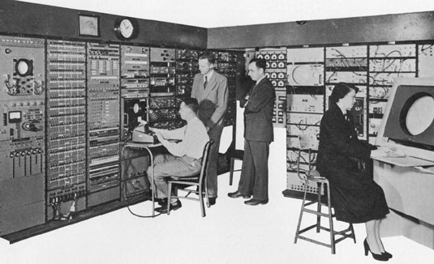
The First Public Demonstration of Computer Art - 1952
On the Whirlwind Computer at MIT -the first digital computer capable of displaying real time text and graphics on a large oscilloscope screen.
Source: A Critical History of Computer Graphics and Animation,
http://www.accad.ohio-state.edu/~waynec/history/lesson2.html

Slide 17
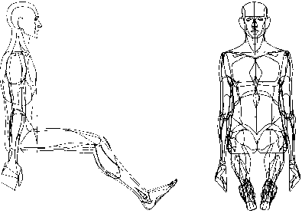
The Term “Computer Graphics”
Coined in 1960 by William Fetter (1928-2002), a trained artist and art director, to describe new design methods he was pursuing at Boeing.
•He created a series of widely reproduced images on a plotter exploring cockpit design using a 3D model of a human body.
Source: http://courses.washington.edu/eatreun/html/history/h_nw.html

Slide 18
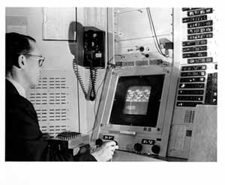
Ivan E. Sutherland – Called the Father of Computer Graphics
Ph.D. Thesis, 1963, MIT : Sketchpad: The First Interactive Computer Graphics Package on TX-2 (forerunner of DEC machines).
TX-2 was a giant machine for the day:
320 kilobytes of memory, about twice the capacity of the biggest commercial machines
magnetic tape storage,
an on-line typewriter,
the first Xerox printer,
paper tape for program input,
and a nine inch CRT!
Source: Sun Microsystems, http://www.sun.com/960710/feature3/sketchpad.html#sketch

Slide 19
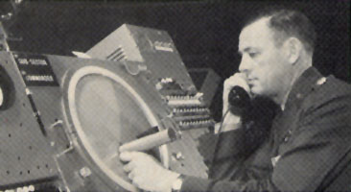
“Sketchpad: A Man-machine Graphical Communications System," used the lightpen to create engineering drawings directly on the CRT
A light pen being used with the SAGE system.
Source: A Critical History of Computer Graphics and Animation,
http://www.accad.ohiostate.edu/~waynec/history/lesson2.html

Slide 20
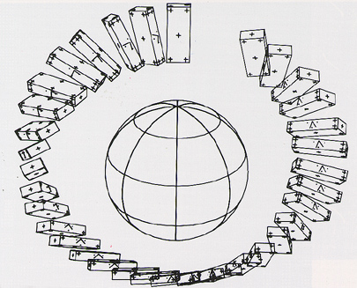
First computer animated film (Two-Gyro Gravity-Gradient Attitude Control System), by Edward Zajak of Bell Labs, 1961
Source: http://www.cs.montana.edu/~charon/graphics/1960.html

Slide 21
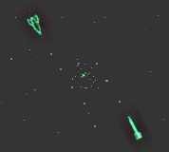
The true purpose of computers is finally realized in 1961, when a MIT student, Steve Russell, creates the first computer game - Spacewar.
Screenshot on PDP 1 – 200 hours to program
Source: Inventors of the Modern Computer Series, http://inventors.about.com/library/weekly/aa090198.htm

