Slide 1
CHAPTER 1
CPSC 352
Introduction – Overview, Terminology, and Security Policies
Professor: Oberta A. Slotterbeck (Obie)
Computer Science Department
Hiram College
obie@hiram.edu

Slide 2
What is a Secure Computer System?
A security policy specifies exactly what types of actions are and are not permitted on the system
Example of a security policy:
  Only authorized users should be able to use the system
  Users should not be able to read, modify, or delete other user’s private files
  The system’s resources should be shared fairly among all users
A secure system always obeys its security policy

Slide 3
Security Breaches
A violation of a system’s security policy is called a security breach
Security breaches can occur:
  Accidentally – such as when a faulty program causes the system to malfunction
  Intentionally – such as when a malicious user discovers a way to access another user’s files
Creating a secure system in which security breaches cannot occur can be either quite easy or nearly impossible, depending on:
  What the security policy requires
  How the system implements the policy

Slide 4
Design Principles for Secure Computer Systems
The Policy Simplicity Principle
  A security policy should be as simple as possible, and no simpler
  It should concisely characterize all actions that are allowed and forbidden
The System Functionality Principle
  A system should include as much functionality as necessary, and no more
  It should be able to perform the job it was designed to do, but it should not carry out additional functions

Slide 5
The Policy Simplicity Principle - Justification
Simplifying security policies makes them easier to get right, to reason about, and to implement
Security breaches caused by policy shortcomings are most often due to:
  An incomplete or inconsistent policy,
  A misunderstanding of the policy’s requirements
  An error in its implementation

Slide 6
The System Functionality Principle - Justification
Limiting system functionality reduces the avenues of attack
Security breaches caused by system functionality can be caused by:
  Software bugs that enable attackers to cause some part of the system to malfunction
  Unforeseen interactions between system components

Slide 7
Relative Security
The complexity of computer systems and the limits on our ability to verify their software imply that few, if any, useful systems will be absolutely secure
We can view security in a more relative sense and examine how difficult, expensive, and dangerous the system makes it to breach security
Note: this does not mean that careful design and analysis of security policies and verifying security-critical software to the best of our abilities is unimportant
Example: Compare to safes

Slide 8
Safes
Given enough time and skill, a safe cracker can crack any safe.
Safes can provide protection against some accidents and can act as a deterrent to attackers.
Increasing the amount of time and skill needed to breach a safe, decreases the pool of safe crackers who can breach it.
By increasing the odds and penalties of getting caught, some with ability to crack a safe might be deterred from trying.
If the cost of cracking exceeds the payoff, most crackers will seek a more promising target.

Slide 9
Trade-offs between Cost and Security
Determining the proper degree of difficulty, danger, and expense a system should impose to form an effective deterrent depends on the value of the items that the system is protecting
There is a trade-off between cost and security, with increased security only coming at the price of increased costs
Users should be able to select systems with a level of security appropriate for their needs and only bear the costs of the security that they choose

Slide 10
Trade-offs between Cost and Security
Example: user authentication
  System A - authenticates the user sitting at a terminal every five minutes by retinal scan
  System B - authenticates users once when they log in using a password
System A is probably more secure than system B, but it is also probably more costly and inconvenient for users
Is the added security and expense of system A called for?
  Perhaps, for a corporation with millions of dollars worth of trade secrets to protect
  Probably not, for an individual with little of value on their system

Slide 11
The Cast of Characters Used When Discussing Security Issues
Alice and Bob are the good guys
Trudy is the bad guy
Trudy is our generic “intruder”
In many papers and presentations you find these characters used repeatedly!

Slide 12
Alice’s Online Bank
Alice opens Alice’s Online Bank (AOB)
What are Alice’s security concerns?
If Bob is a customer of AOB, what are his security concerns?
How are Alice and Bob concerns similar? How are they different?
How does Trudy view the situation?

Slide 13
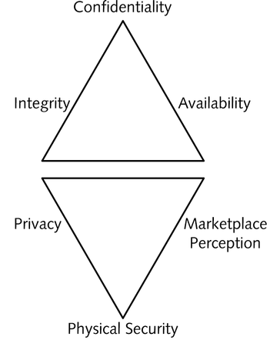
Basic Security Concepts - CIA
Confidentiality – only authorized individuals can access data
Integrity – data changes are tracked and properly controlled
Availability – systems are accessible for business needs

Slide 14
Confidentiality
Confidentiality ensures that only those with sufficient privileges may access certain information
To protect confidentiality of information, a number of measures may be used including:
    Information classification
    Secure document storage
    Application of general security policies
    Education of information custodians and end users
Notes:
Confidentiality
Confidentiality of information ensures that only those with sufficient privileges may access certain information.
To protect the confidentiality of information, a number of measures are used:
Information classification
Secure document storage
Application of general security policies
Education of information custodians and end users

Slide 15
Confidentiality
AOB must prevent Trudy from learning Bob’s account balance
Confidentiality: prevent unauthorized reading of information

Slide 16
Integrity
Integrity is the quality or state of being whole, complete, and uncorrupted
The integrity of information is threatened when it is exposed to corruption, damage, destruction, or other disruption of its authentic state
Corruption can occur while information is being compiled, stored, or transmitted
Notes:
Integrity
Integrity is the quality or state of being whole, complete, and uncorrupted.
The integrity of information is threatened when it is exposed to corruption, damage, destruction, or other disruption of its authentic state.
Corruption can occur while information is being compiled, stored, or transmitted.

Slide 17
Integrity
Integrity means that information can be modified only by an authorized principal
Examples:
  A bank’s system must ensure that only authorized bank personnel can change account balances (privacy is also a concern)
  A company wants to make sure that its freeware program is not modified to behave maliciously (privacy is not a concern)
Message-digest functions can be used to protect the integrity of data

Slide 18
Integrity
Trudy must not be able to change Bob’s account balance
Bob must not be able to improperly change his own account balance
Integrity: prevent unauthorized writing of information

Slide 19
Availability
Availability involves making information accessible to user access without interference or obstruction in the required format
A user in this definition may be either a person or another computer system
Availability means availability to authorized users
Notes:
Availability
Availability is the characteristic of information that enables user access to information without interference or obstruction and in a required format.
A user in this definition may be either a person or another computer system.
Availability does not imply that the information is accessible to any user; rather, it means availability to authorized users.

Slide 20
Availability
Availability means that information will be accessible in a timely manner when it is needed
Examples:
  A non-working laptop containing a student’s notes brought to an open-note exam
  A working laptop containing a student’s notes so poorly organized that the student spends the bulk of the exam searching for relevant information
Replication and fault tolerance can be used to ensure the availability of data

Slide 21
Availability
AOB’s information must be available when needed
Alice must be able to make transactions
  If not, she’ll take her business elsewhere
Availability: Data is available in a timely manner when needed
Availability is a “new” security concern
In response to denial of dervice (DoS)

Slide 22
Beyond CIA
How does Bob’s computer know that “Bob” is really Bob and not Trudy?
Bob’s password must be verified
  This requires some clever cryptography
What are security concerns of pwds?
Are there alternatives to passwords?

Slide 23
Beyond CIA
When Bob logs into AOB, how does AOB know that “Bob” is really Bob?
As before, Bob’s password is verified
Unlike standalone computer case, network security issues arise
What are network security concerns?
Protocols are critically important
Crypto also important in protocols

Slide 24
Protocols
Simple authentication protocols
  “Butterfly effect” --- small change can have drastic effect on security
  Cryptography used in protocols
Real-world security protocols
  SSL, IPSec, Kerberos
  GSM security

Slide 25
Beyond CIA
Once Bob is authenticated by AOB, then AOB must restrict actions of Bob
  Bob can’t view Charlie’s account info
  Bob can’t install new software, etc.
Enforcing these restrictions is known as authorization
Access control includes both authentication and authorization

Slide 26
Beyond CIA
Cryptography, protocols and access control are implemented in software
What are security issues of software?
  Most software is complex and buggy
  Software flaws lead to security flaws
  How to reduce flaws in software development?

Slide 27
Beyond CIA
Some software is intentionally evil
  Malware: computer viruses, worms, etc.
What can Alice and Bob do to protect themselves from malware?
What can Trudy do to make malware more “effective”?

Slide 28
Beyond CIA
Operating systems enforce security
  For example, authorization
OS: large and complex software
  Win XP has 40,000,000 lines of code!
  Subject to bugs and flaws like any other software
  Many security issues specific to OSs
  Can you trust an OS?

Slide 29
Software
Software security-critical flaws
  Buffer overflow
  Other common flaws
Malware
  Specific viruses and worms
  Prevention and detection
  The future of malware

Slide 30
Software
Software reverse engineering (SRE)
  How hackers “dissect” software
Digital rights management
  Shows difficulty of security in software
  Also raises OS security issues
Limits of testing
  Open source vs closed source

Slide 31
Software
Operating systems
  Basic OS security issues
  “Trusted” OS requirements
  NGSCB: Microsoft’s trusted OS for PC
Software is a big security topic
  Lots of material to cover
  Lots of security problems to consider

Slide 32
Other Often Considered Basic Security Concepts P³
Physical security – protect people, equipment, and facilities
Privacy – critical data is not released to the wrong people
(Marketplace) perception – the way the company is perceived by customers, partners, and competitors is protected

Slide 33
Physical Security
We often forget about the need to protect systems, data, and even people in the physical world.
Each year valuable data is lost due to physical destruction.
For example, backups are not safe if everything is kept at the same site.

Slide 34
Physical Security
Physical Security: addresses the design, implementation, and maintenance of countermeasures that protect the physical resources of an organization
Physical resources include:
  People
  Hardware
  Supporting information system elements
Notes:
Physical Security
As the design phase progresses, attention now focuses on physical security, which addresses the design, implementation, and maintenance of countermeasures that protect the physical resources of an organization.
Physical resources include people, hardware, and the supporting system elements and resources associated with the management of information in all its states, transmission, storage, and processing.

Slide 35
Privacy
Privacy means that access to information is limited to authorized entities
Examples:
  Certain files on the system can only be accessed by particular users
  Communications between two users cannot be read by some third party
Cryptography is a common technique used to protect the privacy of data

Slide 36
Privacy
Privacy means that users have some control over what information the system collects and makes available to others
Examples:
  Some users may not want others to know at what times and from what locations they log on, what programs they run, or with whom they are communicating
  Users may not want to receive unsolicited commercial offers through e-mail
Anonymity can help to protect a user’s privacy

Slide 37
(Marketplace) Perception
What security is needed to protect a company’s image?
As we will see, many hacking attacks have been leveled at hitting precisely this area.

Slide 38
Think Like Trudy
In the past, no respectable sources talked about “hacking” in detail
It was argued that such info would help hackers
Very recently, this has changed
  Books on network hacking, how to write evil software, how to hack software, etc.

Slide 39
Think Like Trudy
Good guys must think like bad guys!
A police detective
  Must study and understand criminals
In information security
  We want to understand Trudy’s motives
  We must know Trudy’s methods
  We’ll often pretend to be Trudy

Slide 40
Think Like Trudy
We must try to think like Trudy
We must study Trudy’s methods
We can admire Trudy’s cleverness
Often, we can’t help but laugh at Alice and Bob’s stupidity
But, we cannot act like Trudy

Slide 41
In This Course…
Always think like the bad guy
Always look for weaknesses
Strive to find a weak link
It’s OK to break the rules
Think like Trudy!
But don’t do anything illegal…

Slide 42
Networked and Internetworked Environments – additional challenges
Privacy
  Stand-alone system - the operating system is likely to control all communication channels
  Networked systems - no host controls the communication medium and eavesdropping is usually easy
User authentication
  Stand-alone system – user must be physically present to use the system
  Internetworked systems – user may be far away and may be accessing the system over an insecure communications channel

Slide 43
Summary
A secure computer system always follows the rules set forth in its security policy, which specifies exactly what actions are and are not permitted
The principal security concerns in most systems involve protecting:
  Data privacy - access to information is limited to authorized entities
  Data integrity - information can be modified only by an authorized principal
  Data availability - data is accessible in a timely manner when it is needed
  User authentication – accurately determining user’s identities
  User privacy - control what information is collected and made available to others
Additional security risks arise as systems become networked and internetworked

Slide 44
Developing a Security Policy

Slide 45
What Is a Security Policy?
A set of organization-level rules governing:
  Acceptable use of computing resources
  Security practices
  Operational procedures

Slide 46
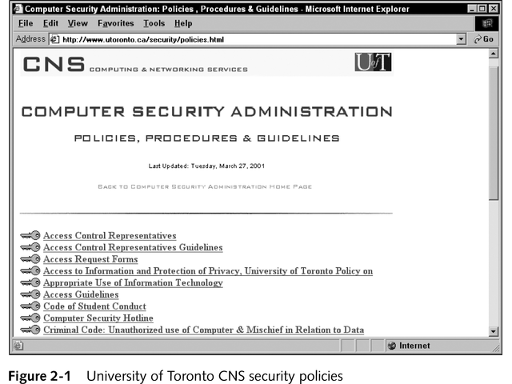
Example of a Security Policy

Slide 47
Essential Information in a Security Policy
Date last updated
Name of office that developed the policies
Clear list of policy topics
Equal emphasis on positive points (access to information) and negative points (unacceptable policies)

Slide 48
Why Is a Security Policy Important?
Essential component of a fully functional security system
  Defines what needs to be done when the system is configured
  Defines intrusion detection and auditing systems that are needed
Minimizes impact of malicious or accidental behavior on:
  Staff time
  Data loss
  Productivity

Slide 49
Setting Goals for an Effective Security Policy
Describe a clear vision for a secure computing environment
Be flexible enough to adapt to changes in the organization
Be consistently communicated and implemented throughout the organization
Specify how employees can and cannot use the system
Define appropriate and inappropriate behavior as it pertains to privacy and security

Slide 50
Seven Steps to Building a Security Policy
Develop a policy team
Determine organization’s overall approach to security
Identify assets to be protected
Determine what should be audited for security
Identify security risks
Define acceptable use
Provide for access

Slide 51
Develop a Policy Team
Members (5-10 people)
  Senior administrator
  Member of legal staff
  Representative from rank-and-file employees
  Member of IT department
  Editor or writer who can structure and present the policy coherently
Identify one person to be the official policy interpreter

Slide 52
Determine Overall Approach to Security
Two primary activities for overall approach:
  Restrictive
  Permissive
Specific security stances:
  Open
  Optimistic
  Cautious
  Strict
  Paranoid

Slide 53
Identify Assets to Be Protected
Physical assets
  Actual hardware devices
Logical assets
  Digital information that can be viewed and misused
Network assets
  Routers, cables, bastion hosts, servers, firewall hardware and software
System assets
  Software that runs the system (ie, server software and applications)

Slide 54
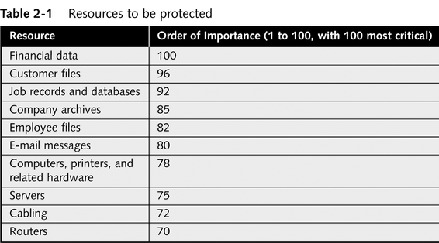
Example of Assets to Be Protected

Slide 55
Determine What Should Be Audited for Security
Auditing
  Process of recording which computers are accessing a network and what resources are being accessed
  Includes recording the information in a log file
Specify types of communication to be recorded and how long they will be stored
There is software available to audit system resources
Logs can audit security events

Slide 56
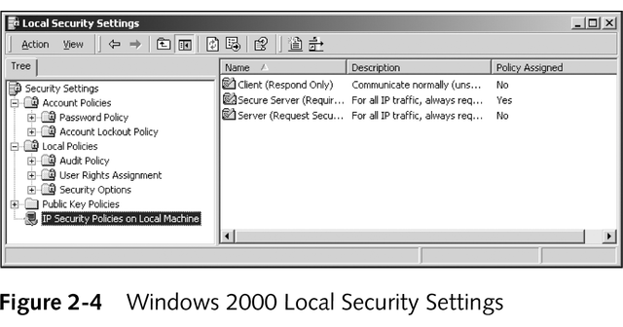
Determine What Should Be Audited for Security
Examples:
  Auditing log files
  Auditing object access

Slide 57
Identify Security Risks
Specify the kinds of attacks that need to be guarded against.
Examples could be
  Denial of service attacks
  Disclosure of information due to fraud
  Unauthorized access
  Many others – we’ll look at specific examples later in the course

Slide 58
Define Acceptable Use
Define acceptable computing and communications practices on the part of employees and business partners
Examples might be policies concerning the use of
  E-mail
  Newsletters
  Bulletin boards
  The web
  After hours computing
  Access to certain databases
  Many others

Slide 59
Other Security Policy Topics – we’ll explore many of these during the course
Passwords
Encryption
Restrictions on removable media
ASPs
Acceptable users
Secure use of office-owned laptop computers
Wireless security
Use of VPNs
Key policy

Slide 60
Defining Responses to Security Violations
Gather information on an incident response form
Define disciplinary action to be pursued if employees behave improperly
Identify who to contact in case of intrusion

Slide 61
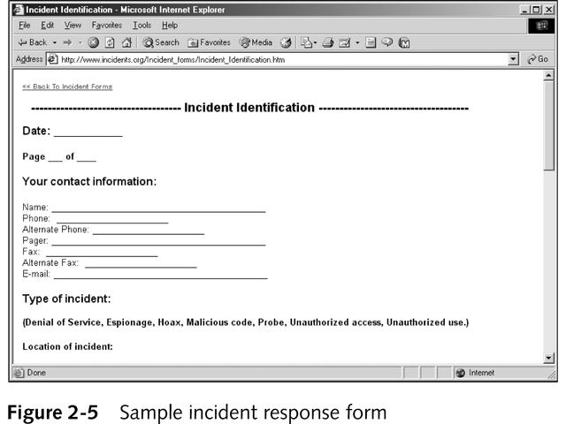
Defining Responses to Security Violations

Slide 62
Educating Employees
Need a Security User Awareness (SUA) program
Advise workers of expectations and consequences
Make policies available
Have everyone sign off on the policies

Slide 63
Presenting and Reviewing the Process
Keep reports short and concise
Give people ample time to respond after a new policy statement is issued

Slide 64
Amending the Security Policy
Change the security policy when:
  The organization makes substantial changes in hardware configuration, or
  A system is reconfigured in response to security breaches

Slide 65
Policy
A critical design element of the information security program is the information security policy
Management must define three types of security policy:
  General or security program policy
  Issue-specific security policies
  Systems-specific security policies
Notes:
Policy
One of the design elements of the information security program is the information security policy of the organization.
Management must define three types of security policy:
1) General or security program policy,
2) Issue-specific security policies and
3) Systems-specific security policies.

Slide 66
SETA
Another integral part of a security program is the security education and training program
A SETA program consists of three elements: security education, security training, and security awareness
Purpose of SETA is to enhance security by:
  Improving awareness
  Developing skills and knowledge
  Building in-depth knowledge
Notes:
SETA
Another integral part of the InfoSec program is the security education and training program.
The SETA program consists of three elements: security education, security training, and security awareness.
The purpose of SETA is to enhance security by:
Improving awareness of the need to protect system resources;
developing skills and knowledge so computer users can perform their jobs more securely and
building in-depth knowledge, as needed, to design, implement, or operate security programs for organizations and systems.

Slide 67
Design
Attention must be paid to the design of the controls and safeguards used to protect information from attacks by threats
Three categories of controls:
  Managerial
  Operational
  Technical
Notes:
Design
As the design phase continues, attention turns to the design of the controls and safeguards used to protect information from attacks by threats.
There are three categories of controls:
Managerial
Operational
Technical

Slide 68
Managerial Controls
Address the design and implementation of the security planning process and security program management
Management controls also address:
  Risk management
  Security control reviews
Notes:
Managerial Controls
Address the design and implementation of the security planning process and security program management.
Management controls also addresses risk management and security controls reviews.

Slide 69
Operational Controls
Cover management functions and lower level planning including:
  Disaster recovery
  Incident response planning
Operational controls also address:
  Personnel security
  Physical security
  Protection of production inputs and outputs
Notes:
Operational Controls
Cover management functions and lower level planning, such as disaster recovery and incident response planning.
Operational controls also address personnel security, physical security and the protection of production inputs and outputs.

Slide 70
Technical Controls
Address those tactical and technical issues related to designing and implementing security in the organization
Technologies necessary to protect information are examined and selected
Notes:
Technical Controls
Address those tactical and technical issues related to designing and implementing security in the organization.
Here the technologies necessary to protect information are examined and selected.

Slide 71
Contingency Planning
Essential preparedness documents provide contingency planning (CP) to prepare, react and recover from circumstances that threaten the organization:
  Incident response planning (IRP)
  Disaster recovery planning (DRP)
  Business continuity planning (BCP)
Notes:
Contingency Planning
Another element of the design phase is the creation of essential preparedness documents.
Contingency planning (CP) is the entire planning conducted by the organization to prepare for, react to and recover from events that threaten the security of information and information assets in the organization, and the subsequent restoration to normal business operations.
Incident response planning (IRP) is the planning process associated with the identification, classification, response, and recovery from an incident.
Disaster recovery planning (DRP) is the planning process associated with the preparation for and recovery from a disaster, whether natural or man-made.
Business continuity planning (BCP) is the planning process associated with ensuring that critical business functions continue if a catastrophic incident or disaster occurs.

Slide 72
Further Discussion on Developing a Security Policy
Will occur later in the course when we discuss security personnel for organizations
  Who are they?
  What do they do?
  What backgrounds should they have?

