Slide 1
CHAPTER 11
CPSC 352 E-mail and WWW Security
Professor: Oberta A. Slotterbeck (Obie)
Computer Science Department
Hiram College
obie@hiram.edu

Slide 2
Overview
Two of the most popular uses of the Internet are:
  Electronic mail
  The World Wide Web
By default, both offer almost no protection for the privacy, integrity, and authenticity of information
Considering the history of the development of both of these, this is not surprising
  Originally, users were researchers that wanted to SHARE their results and communicate uninhibited!
  It was NOT developed for military reasons as many believe.
A number of security mechanisms have been developed for each

Slide 3
Recall in the Article I Posted on SHA-1
SHA-1 is an improvement over SHA (the secure hashing algorithm) that we studied.
SHA-1 is used to create signatures by most of the popular security protocols on the Internet, including SSL (Secure Sockets Layer) and PGP.
Due to some work done by Chinese mathematicians, the algorithm may be breakable.
Although practical attacks that target SHA-1 are still some time off, cryptographers will have to decide on a replacement for SHA-1 within the next couple of years, and organizations that rely on secure protocols that use SHA-1 will have to evaluate whether the algorithm is adequate to use for secure transactions, experts agree.

Slide 4
The Simple Mail Transport Protocol (SMTP)
The protocol on which e-mail is based
Specifies the format of e-mail messages
  Header
    Readable text
    Divided into lines of the form: <keyword>: <value>
      Keywords are either required, optional, or uninterpreted
  Body
    Separated from the header by a blank line
    No restrictions on format or contents
Specifies the details of e-mail exchange between two computers

Slide 5
SMTP (cont)
Specifies how a client on one machine transfers e-mail to a server on another machine
  Client establishes a connection to the server (typically using TCP)
  Client waits for server to send a 220 READY FOR MAIL message
  Client sends a HELO message
  Server replies: 250 <server>, hello <client>, pleased to meet you
  Client sends a MAIL FROM: <sender> message

Slide 6
SMTP (cont)
  Server replies: 250 OK
  Client sends a RCPT TO: <recipient> message
  Server replies:
    250 OK, or
    550 NO SUCH USER HERE
  Client sends a DATA command
  Server replies: 354 START MAIL INPUT; END WITH <CR><LF>.<CR><LF>
  Client transmits mail message followed by termination sequence
  Server replies: 250 OK

Slide 7
SMTP (cont)
  Client can transmit another e-mail message
    MAIL FROM: <sender>
  Client can issue the TURN command to allow the server to transmit messages
    C: TURN
    S: 250 OK
  Client can end the session
    C: QUIT
    S: 221 <server> closing transmission channel

Slide 8
SMTP Security
None
  Intermediate hosts can:
    Read
    Modify
    Delay
    Destroy
  Easy to create phony e-mail messages that appear to have come from an arbitrary source

Slide 9
Pretty Good Privacy (PGP)
Employs public and symmetric key cryptography to protect the privacy, integrity, and authenticity of e-mail messages
History:
  Created in 1991 by Philip Zimmermann
    http://www.pgpi.org
  Freely available in source code form
  Caused controversy:
    Charged with infringing RSA patents (by Public Key Partners)
    Charged with violating the International Traffic in Arms Regulations (ITAR) export restrictions (by the U.S. government)
  Purchased by Network Associates in 1997
    http://www.pgp.com -don’t use http://www.pgp.org/

Slide 10
PGP (cont)
Implements a hybrid cryptosystem:
  Uses public-key cryptography to securely transmit a session key
    RSA, Diffie-Hellman, and others
  Uses session key along with a symmetric-key algorithm to encrypt the e-mail message
    IDEA, Twofish, AES, and others
Protects:
  Privacy: sender encrypts the message contents
  Integrity: sender can create a message digest (MD4, MD5, and others)
  Authenticity: sender signs message digest with his/her private key

Slide 11
PGP (cont)
Upon receipt of the encrypted message:
  The receiver uses her private key to decrypt the first part of the message and learn the session key.
  Using the session key, she can then decrypt the second part, which contains the message.
  If the message is signed, the receiver can use the sender’s public key to:
    Verify the signature (for authenticity)
    Check the message digest (for integrity).

Slide 12
PGP Key Management
A number of Public Key Servers exist throughout the world
Key signing - users sign copies of other users’ public key attesting to their validity
Example #1:
  Two friends, Alice and Bob, with public keys A_{Public} and B_{Public}
  Alice gives Bob a copy of her public key and Bob signs it with his private key
  Alice publishes Bob’s signature (and perhaps others) along with her public key
  Carol wishes to send private e-mail to Alice
  Carol knows Bob and has a copy of his public key

Slide 13
PGP Key Management (cont)
Example #1 (cont):
  Carol retrieves Alice’s public key from a key server
  Using Bob’s public key, Carol can check Bob’s signature
  Result: Carol has created a chain of trust from Alice’s public key back to herself
Example #2:
  Carol wishes to communicate with Dave
  Dave’s public key is signed by Alice (who Carol does not know)
  Bob knows and trusts Alice
  Carol knows and trusts Bob
  Carol can choose to accept Dave’s public key if it is signed by Alice
    Note: not everyone who can sign a key is trustworthy so users need to carefully consider how much they trust each link in the chain

Slide 14
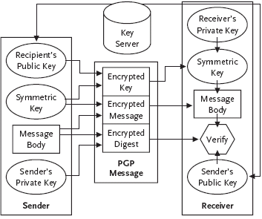
Using PGP to Protect E-mail

Slide 15
Privacy-Enhanced Mail (PEM)
Employs cryptography to protect the privacy, integrity, and authenticity of e-mail messages
Adopted as an Internet standard by the Internet Architecture Board (IAB) in 1993
Uses:
  Data Encrypting Keys (DEK) - used to encrypt messages and message signatures
    DES
  Interchange Keys (IK) - used to encrypt DEKs for distribution
    Symmetric or public-key algorithms
  Message digest function - to protect the integrity of a message
    MD2 or MD5

Slide 16
PEM Using a Symmetric IK
IK is a secret DES key that the sender and receiver share
Sender:
  Chooses a DEK (i.e. session key) and uses it to encrypt the body of the message
  Uses IK to encrypt the DEK
  Uses IK to encrypt the digest of the message
Receiver:
  Uses the IK to check the message digest
  Uses the IK to decrypt the DEK
  Uses the DEK to decrypt the message body

Slide 17
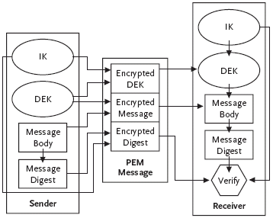
PEM Using a Symmetric IK (cont)

Slide 18
PEM Using an Asymmetric IK
IK is an RSA public/private key pair
Only certain widely trusted entities, called certifying authorities, are allowed sign public keys
Sender:
  Verifies the receiver’s public key using a certificate issued by a CA
  Chooses a DEK (i.e. session key) and encrypts the body of the message
  Uses the receiver’s public key to encrypt the DEK
  Uses the sender’s private key to encrypt the message digest
Receiver:
  Verifies the sender’s public key using a certificate issued by a CA
  Uses the sender’s public key to check the message digest
  Uses the receiver’s private key to decrypt the DEK
  Uses the DEK to decrypt the message body

Slide 19
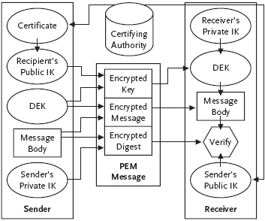
PEM Using an Asymmetric IK (cont)

Slide 20
Anonymous Remailers
Users may want to send e-mail such that:
  The recipient cannot identify the sender of the message
  Intermediate hosts cannot cannot perform traffic analysis
Answer: a simple remailing service:
  A server accepts e-mail messages
  Removes any identifying information about the sender
  Forwards the resulting message to the specified recipient
  Example: anon.penet.fi (run by Johan Helsingius during the mid 1990’s)

Slide 21
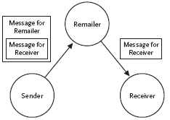
A Single Anonymous Remailer

Slide 22
Limitations of a Single Anonymous Remailer
Remailer is a single point of failure and a potential bottleneck
Traffic analysis is still possible
  Observing messages on their way to the remailer
  Correlating the sending of a message to the remailer with the receipt of a message from it
Solution: encryption and a geographically distributed set of remailers

Slide 23
Mixmaster Remailers
Created in 1994 by Lance Cottrell
  http://sourceforge.net/projects/mixmaster/
Mixmaster servers run on numerous hosts throughout the world
  Each with its own RSA public/private key pair
Mixmaster client software enables users to:
  Divide an e-mail message into one or more fixed-size packets
  Send packets through several of the Mixmaster servers
    Each packet may follow a different path through the remailers
    All packets for that e-mail message must eventually arrive at the same final remailer
    The final remailer reassembles the message and sends it to its final destination

Slide 24
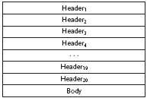
A Mixmaster Packet

Slide 25
Mixmaster Example
Example:
  Path from the sender to the receiver: Sender, Remailer A, Remailer B, Remailer C, Reciever
  The body of the e-mail message is placed in the packet
  The body is padded, if necessary, to ensure that the packet is the same fixed size as all other packets created by Mixmaster
  A key, K₃, is chosen and the body is encrypted (using triple DES)
  Header₃ is preapended to the encrypted body
    Next hop: final destination
    Message ID: the message to which the packet belongs
    Packet ID: the position in the message of the packet’s data
    Encryption key: K₃
  Header3 is encrypted with Remailer C’s public key

Slide 26
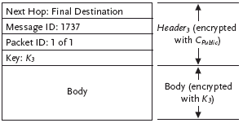
Mixmaster Example (cont)

Slide 27
Mixmaster Example (cont)
Example (cont):
  A key, K₂, is chosen and Header₃ and the body are encrypted
  Header₂ is added:
    Next hop: Remailer C
    Message ID: the message to which the packet belongs
    Packet ID: the position in the message of the packet’s data
    Encryption key: K₂
  Header2 is encrypted with Remailer B’s public key

Slide 28
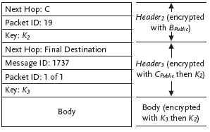
Mixmaster Example (cont)

Slide 29
Mixmaster Example (cont)
Example (cont):
  A key, K₁, is chosen and Header₂, Header₃, and the body are encrypted
  Header₁ is added:
    Next hop: Remailer B
    Message ID: the message to which the packet belongs
    Packet ID: the position in the message of the packet’s data
    Encryption key: K₁
  Header1 is encrypted with Remailer A’s public key

Slide 30
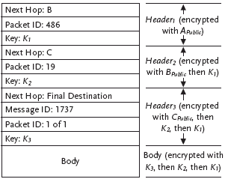
Mixmaster Example (cont)

Slide 31
Mixmaster Example (cont)
Example (cont):
  Sender sends packet to Remailer A
  Remailer A receives packet and uses its private key to decrypt Header₁
  Remailer A checks to see if it has received a packet with Packet ID 486 in the recent past
    If so, the packet is discarded
  Remailer A:
    Uses Key₁ to decrypt the packet
    Moves Header₁ (garbage) just before the body
    Waits some random amount of time
    Sends the packet to Remailer B

Slide 32
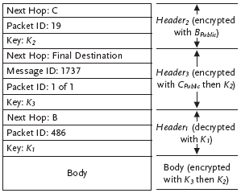
Mixmaster Example (cont)

Slide 33
Mixmaster Example (cont)
Example (cont):
  Remailer A sends packet to Remailer B
  Remailer B receives packet and uses its private key to decrypt Header₂
  Remailer B checks to see it has not seen the packet before
  Remailer B:
    Uses Key₂ to decrypt the packet
    Moves Header₂ (garbage) to the end of the list of headers
    Waits some random amount of time
    Sends the packet to Remailer C

Slide 34
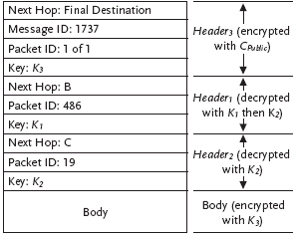
Mixmaster Example (cont)

Slide 35
Mixmaster Example (cont)
Remailer B sends packet to Remailer C
Remailer C receives packet and uses its private key to decrypt Header₃
Remailer C checks to see it has not seen the packet before
Remailer C:
  Uses Key₃ to decrypt the packet
  Removes all headers
  Waits some random amount of time
  Sends the message to the receiver

Slide 36
Mixmaster Security
All messages are encrypted so that they cannot be read by an eavesdropper
Each remailer, can decrypt the topmost header to learn the next hop but all other headers and the body are encrypted
  Compromising a particular remailer yields only the previous and next hops for packets that pass through it
Only the final remailer in the chain can:
  Determine that two different packets are part of the same message
  See the body of the message and the receiver’s address
All Mixmaster packets are:
  Exactly the same length
  Encrypted
  May be stored at intermediate remailers for a random period of time
Result: traffic analysis is difficult

Slide 37
Electronic Mail Security -Summary
The Simple Mail Transport Protocol (SMTP)
  Basic and most widely used; little security
Pretty Good Privacy (PGP)
  Uses public and symmetric key cryptography to protect the privacy, integrity, and authenticity of e-mail messages
  May be compromised in the near future due to some recent research.
Privacy-Enhanced Mail (PEM)
  Internet standard to protect the privacy, integrity, and authenticity of e-mail messages
Anonymous Remailers
  Makes traffic analysis difficult

Slide 38
The World Wide Web
Basis = the HyperText Transfer Protocol (HTTP)
  Follows the client-server model
  Enables the transfer of web pages
Major security concerns:
  The vulnerabilities a web server can introduce to the host on which it is running
  The vulnerabilities a web client (browser) can introduce to its host and user

Slide 39
Server-Side Security
Security of the web server software
  Web servers are a possible source of vulnerabilities and a potential point of entry for attackers
  Attractive targets:
    Almost every site runs a web server
    There are only a few different server programs in wide use

Slide 40
Addressing Web Server Security
Try to avoid bugs (e.g. buffer overflows) that could compromise the security of the host running the server
Limit the amount of damage that can be done if the web server is compromised:
  Server process owned by an unprivileged user, nobody
    Problem: only a privileged user can run a server on the “reserved” port 80
  Access control mechanisms
    Limit web access to certain files and directories
    Limit access to to files or directories to authorized users

Slide 41
Server Side Security (cont)
Security of the Common Gateway Interface (CGI) programs (or scripts)
  CGI is a mechanism that:
    Enables a program to be run on the server that dynamically generates a web page
    Return generated page to the client
  CGI is popular because it allows a web server to:
    Create customized web pages
    Display current information
  A buggy CGI program carries many of the same dangers as a buggy web server program
    Default CGI programs
    User-created CGI programs by naïve users

Slide 42
Addressing Risks of CGI Programs
Do not allow CGI scripts to run
Have one directory (controlled by the system administrator) for all CGI programs
  Authors must submit their programs to the administrator for inspection
Allow users to create CGI scripts
  Wrapper programs to limit the CGI program to exactly the permissions of its creator

Slide 43
Client-Side Security
Web browser programs attempt to offer users some protection against the dangers of using the World Wide Web
  Additional mechanism to protect the privacy of client requests and server replies
  Mechanism to allow the client to safely run mobile code

Slide 44
The Secure Sockets Layer (SSL)
A protocol proposed by Netscape Communications Corporation (now an Internet standard: RFC 2246)
Designed to offer cryptographic protection for the messages exchanged by HTTP and other Internet protocols
Services:
  Enables a server to verify its identity to a client (server authentication)
  Enables a client to verify its identity to a server (client authentication)
  Protects the privacy and integrity of data sent between the client and the server

Slide 45
SSL (cont)
Uses:
  Public-key cryptography
    For authentication and to allow the client and server to agree of a session key
  Symmetric-key cryptography
    To encrypt data using the session key
Note: SSL is another area that may be compromised due to the breakthrough with the SHA-1 algorithm!
To establish an SSL connection, the client and the server engage in a two-step SSL handshake protocol

Slide 46
SSL Handshake Protocol: Phase 1 (Hello)
The client sending a client hello message, which contains:
  The version number of the SSL protocol that the client is using
  28 random bytes generated by the client
  A unique session identifier chosen by the client
  A list of cryptographic algorithms the client supports (in order from the client’s most to least preferred
  A list of compression algorithms the client supports (in order from the client’s most to least preferred)

Slide 47
SSL Handshake Protocol: Phase 1 (Hello)
The server responds with a server hello message similar to the client’s:
  The version number of the SSL protocol that the server is using
  28 random bytes generated by the server
  A unique session identifier (either the one suggested by the client, or one suggested by the server if the client did not supply one or a previously-established session is being resumed)
  A list of cryptographic algorithms the server supports (in order from the server’s most to least preferred)
  A list of compression algorithms the server supports (in order from the server’s most to least preferred)

Slide 48
SSL Handshake Protocol: Phase 1 (Hello)
Server sends its certificate to the client (optional)
The certificate contains:
  The server’s public key
  An expiration date after which the certificate is no longer valid
  A digital signature by a certifying authority attesting to the fact that the public key on the certificate belongs to the named server

Slide 49
SSL Handshake Protocol: Phase 1 (Hello)
Server can also send (optionally):
  A server key exchange message
    Provides additional information besides the certificate needed by the client to verify the server’s identity
  A certificate request message
    Asks that the client authenticate itself to the server by sending a certificate for the client
Server sends a server hello done message to indicate that the first phase of the handshake is done

Slide 50
SSL Handshake Protocol:
Phase 2 (Key Exchange)
The client sends its certificate (if requested)
The client sends a client key exchange message
  Contains a 48-byte premaster secret (generated by the client) that will be known only to the client and the server
    The premaster secret is combined with the random bytes from the client and server’s hello message to create a 48-byte master secret
    The master secret enables the client and server to generate:
      Symmetric encryption keys
      Message Authentication Code (MAC) secrets
The client sends a change cipher spec message
  Signals the server that all subsequent messages will be protected using the agreed upon ciphers and keys
The client sends a finished message

Slide 51
SSL Handshake Protocol:
Phase 2 (Key Exchange)
The server sends its own change cipher spec and finished messages
The SSL connection is established
  Application data messages such as client HTTP request and server replies are compressed and encrypted using the agreed upon parameters
    Used to be 40-bit symmetric keys (128 domestic)
    Now 128-bit symmetric keys (with few exceptions)

Slide 52
Mobile Code
Another approach to dynamic web content (besides CGI): mobile code
  The server sends the client a program to be run on the client’s machine
Advantages:
  More power and flexibility for web content than CGI programs
  The burden of running programs is taken off of the server and distributed over the clients
Disadvantages:
  Bad idea to run programs from untrusted sources (they could be malicious)
Solutions:
  Run code from source that they trust (ActiveX)
  Run code in such a way that it can do no harm even if it is malicious (Java applets)

Slide 53
Java – Review from CPSC 171-172
Java is an object-oriented programming language designed by Sun Microsystems.
One important goal of Java is portability
  A java program can be compiled into an intermediate representation called bytecode
    Bytecode contains instructions for the Java Virtual Machine
    Bytecode allows operations such as:
      Pushing and popping (constant) values to/from a stack
      Reading or writing arrays or registers
      Arithmetical and logical operations
      Object creation and method invocation
      Control transfer and function return
      Data conversion and type casting

Slide 54
The Java Virtual Machine
The Java Virtual Machine (Java VM) is a bytecode interpreter
  Ported to most types of computing platforms.
  Executes bytecode by translating it into native instructions and executing them
Portability: once a program has been written and compiled into bytecode, the bytecode can be executed by any platform that runs a Java VM

Slide 55
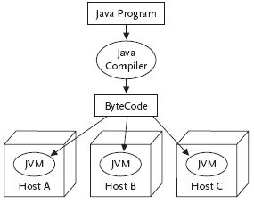
The Java Virtual Machine (cont)

Slide 56
Java Applets
Java programs (called applets) are specially designed to run in Java-enabled web browsers
  Applets which are downloaded from a remote source are loaded into the Java VM by a class loader
  Class loader enforces a name space hierarchy
    Places each class in a unique name space based on its origin
    Result: no ambiguity about the particular class to which a reference belongs

Slide 57
Example:
Two different applets, A₁ from host A and A₂ from host B, both define a class named foo:
  Calls to foo in A₁ refer to the class in A₁
  Calls to foo in A₂ refer to the class in A₂
  Exception: one of the two applets, A₁, is loaded from the local filesystem
    Calls to foo in A₁ and A₂ both refer to the class in A₁

Slide 58
The Java Class Loader
Enforce a name space hierarchy
Pass downloaded applets through a verifier
  Checks that an applet’s bytecode meets several vital safety requirements
    Contains no stack underflows or overflows
    Contains no invalid register reads or writes
    Supplies the correct number and type of parameters to each bytecode operation
    Does not perform any illegal data conversion

Slide 59
The Java Verifier
Checks that the format of the applet is valid
Performs data-flow analysis on each method’s bytecode
  Ensures that certain invariants hold for every operation, no matter what sequence of execution was followed to reach it
    The stack should should always be the same size
    The stack should always contain the exact same types of objects
    No register should be read unless it is known to contain a value of the appropriate type
    Etc.

Slide 60
The Java Security Manager
The security manager is an applet:
  The Java VM is responsible for installing a security manager before running any untrusted applets
  Loaded from the local filesystem (the classes it defines are always invoked rather than any similarly-named classes in other applets)
  The Java VM invokes the security manager prior to executing each bytecode insruction of an untrusted applet
  The security manager raises an exception if an untrusted applets attempts to:
    Read or write files on the local file system
    Make a network connection (except to the host from which the applet originated)
    Start a program (including making system calls) on the local machine
    Read any but a small number of system attributes

Slide 61
The Java File System Loader Class
Trusted applets are handled differently from untrusted applets
  Reside on the local filesystem
  Are digitally signed by an entity that a client trusts
Trusted applets are not loaded into the Java VM by the class loader but by file system loader class
  Not passed through the verifier
  Not under the supervision of the security manager

Slide 62
ActiveX Controls
Created by Microsoft Corporation
Like Java:
  ActiveX controls are programs that can be referenced on a web page, downloaded, and run by a web browser to create more flexible and dynamic web pages
Unlike Java:
  Portability is not a high priority (ActiveX controls contain machine-dependent Windows/x86 instructions)
  No attempt to regulate the actions ActiveX controls can perform
    Security through accountability - an ActiveX control can be digitally signed by its creator
    User decides whether or not he/she trusts the creator

Slide 63
WWW Security - Summary
Server-side security
  Web Servers
  CGI scripts
Client-side security
  SSL
  Mobile code
    Java applets
    ActiveX controls

