Slide 1
CHAPTER 13
CPSC 352: Intrusion Detection Systems
Professor: Oberta A. Slotterbeck (Obie)
Computer Science Department
Hiram College
obie@hiram.edu

Slide 2
Overview
What is an Intrusion Detection System?
  Definition
  Characteristics
  Examples of existing IDSs
    Tripwire
    NIDES
    INBOUNDS

Slide 3
What is an IDS?
An Intrusion Detection System (IDS) is:
  Software and/or hardware
  Monitors a computer system to detect:
    Intrusion: unauthorized attempts to use the system
    Misuse: abuse of existing privileges
  Responds:
    Log activity
    Notify a designated authority
    Take appropriate countermeasures

Slide 4
Why Use an IDS?
Security is often expensive/cumbersome:
  Cost
  Restrictions on users/functionality
Designers try to offer users “reasonable” levels of security
Security breaches will still occur
Detection allows:
  Finding and fixing the most serious security holes
  Perhaps holding intruders responsible for their actions
  Limiting the amount of damage an attacker can do

Slide 5
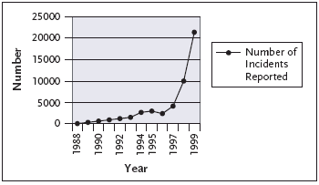
Why Use an IDS? (cont)
The number of attacks is climbing
The damage caused by these attacks is also rising
From CERT (Computer Emergency Response Team):
CERT is based at CMU:
http://www.cert.org/

Slide 6
Goals of an IDS
Be difficult to fool
  Minimize false positives - legitimate actions that causes an alert
  Minimize false negatives - intrusions that do not result in alerts
Also:
  Run continually
  Be fault tolerant
  Resist subversion
  Minimize overhead
  Be easily configurable
  Cope with changing system behavior

Slide 7
IDS Characteristics
Detection Model
  Misuse detection vs. anomaly detection
Scope
  Host based, multihost based, network based
Operation
  Off-line vs. real-time
Architecture
  Centralized vs. distributed

Slide 8
IDS Detection Model
Misuse detection - recognize known attacks
  Define a set of attack signatures
  Detect actions that match a signature
  Add new signatures often
Anomaly detection - recognize atypical behavior
  Define a set of metrics for the system
  Build a statistical model for those metrics during “normal” operation
  Detect when metrics differ significantly from normal
Hybrid

Slide 9
IDS Scope
Host based
  Scrutinize data from a single host
Multihost based
  Analyze data from multiple hosts
Network based
  Examine network traffic (and possibly data from the connected hosts)

Slide 10
IDS Operation
Off-line
  Inspect system logs at set intervals
  Report any suspicious activity that was logged
Real-time
  Monitor the system continuously
  Report suspicious activity as soon as it is detected

Slide 11
IDS Architecture
Centralized
  Data collected from single or multiple hosts
  All data shipped to a central location for analysis
Hierarchical
  Data collected from multiple hosts
  Data is analyzed as it is passed up through the layers
Distributed
  Data collected at each host
  Distributed analysis of the data

Slide 12
Case Study: Tripwire
A file integrity-checking tool
  Developed at Purdue university (released in 1993)
  Off-line, centralized, host-based, misuse detection
  Utilizes digital signatures to check for added, deleted, modified files
  Popular
    Portable
    Configurable
    Scalable
    Manageable
    Automated
    Secure

Slide 13
Background – File Systems
Provide long-term storage for:
  User data and programs
  System programs and databases
A popular target for attackers:
  Unauthorized access to user or system files to uncover private information
  Modify system databases to allow future entry (e.g. /etc/passwd)
  Modify system programs to allow future entry (e.g. back doors)
  Cleansing of system logs to thwart detection

Slide 14
Tripwire - Overview
A checklist is created which contains one entry for each file being monitored
Checklist should:
  Be secure against unauthorized modifications
Each entry in the checklist is a fingerprint for the corresponding file
Fingerprints should:
  Be efficient to compute
  Be hard to invert
  Depend on the entire contents of the file
  Be very likely to change if the file changes
  Be very unlikely to match fingerprints from other files

Slide 15
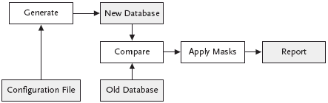
Tripwire – Overview (cont)

Slide 16
Tripwire Database
Unencrypted and world-readable
To prevent the database from being tampered with, it is recommended it be:
  Installed and updated in a secure manner (e.g. single-user mode)
  Stored either:
    On a read-only media
    On a write-protected disk
    On a “secure server” (e.g. read-only NFS)
    Network File System, a client/server application designed by Sun Microsystems that allows all network users to access shared files stored on computers of different types. NFS provides access to shared files through an interface called the Virtual File System (VFS) that runs on top of TCP/IP. Users can manipulate shared files as if they were stored locally on the user's own hard disk.

Slide 17
Tripwire Configuration Files
Contains:
  A list of directories (or files) to be monitored
  A mask for each that describes which attributes can change without being reported
Mask bits (all fields stored in a file’s inode):
  p: permissions
  i: inode number
  n: number of links
  u: user id
  g: group id
  s: size of file
  m: modification timestamp
  a: access timestamp
  [1-10]: signature #1, signature #2, etc.
    Signature algorithms supported (MD5, MD4, MD2, Snefru, SHA, CRC-32, CRC-16)

Slide 18
Tripwire Configuration Files (cont)
Using masks:
  Fields can be added (“+”) or subtracted (“-”) from the set of items to be examined for a file
  Example: +pinugsm12-a = report changes to all fields except access timestamp
Mask templates:
  R = +pinugsm12-a = read-only files; only access timestamp is ignored
  L = +pinug-sma12 = log files; changes to file size, access time, modification time, and signatures are ignored
  N = +pinugsma12 = ignore nothing
  E = -pinugsma12 = ignore everything

Slide 19

Tripwire Configuration File - Example
All files in the /bin directory are read-only
Printer logs under /etc/lp/logs are log files, do not report changes in:
  Size, access or modification time, or contents
Report all changes in /etc/passwd

Slide 20
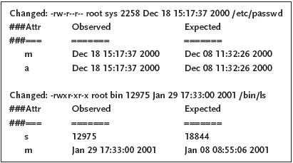
Tripwire Reports
New database is computed and compared with the old one
Any differences are passed through the masks in the configuration file
If not masked out differences are written to a report:

Slide 21
Limitations of Host Based Intrusion Detection
No global knowledge or context information
Must run IDS on host being monitored
  Overhead
  Host compromise = IDS compromise
Recovery options are limited

Slide 22
NIDES
A collection of target hosts collect system audit data and transfer it to a NIDES host for analysis and intrusion detection
Developed at SRI International (released in 1994)
Real-time, centralized, multihost-based anomaly and misuse detection
Next-generation Intrusion Detection Expert System (NIDES) – a follow-on to SRI’s Intrusion Detection Expert System (IDES)

Slide 23
NIDES - Overview
Data collection is performed by target hosts connected by a network
  Agend daemon started on each target host a boot time
    Receives requests to start and stop the agen process on that host
  Agen process:
    Collects system audit data
    Converts it into a system-independent format
    Sends it to the arpool process on the NIDES host
Data analysis is performed on a NIDES host (which is not monitored)
The arpool process collects audit data from the target hosts and provides it to the analysis components
  Statistical analysis component (anomaly)
  Rulebased analysis component (misuse)

Slide 24
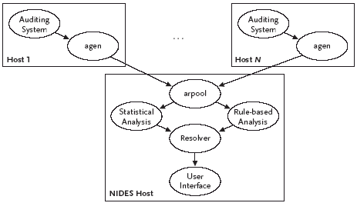
NIDES – Overview (cont)

Slide 25
NIDES – Statistical Analysis
Adaptive historical profiles for each “user” are maintained
  Updated regularly
  Old data “aged” out during profile updates
Alert raised whenever observed behavior differs significantly from established patterns
  Parameters and thresholds can be customized

Slide 26
NIDES – Rulebased Analysis
NIDES comes with a basic rulebase for SUN UNIX
  Encoded in rulebase:
    Known attacks and intrusion scenarios
    Specific actions or patterns of behavior that are suspicious or known security violations
  Expert system looks for matches between current activity and rules in the rulebase and raises alerts
Rulebase can also be extended and updated by sites using NIDES

Slide 27
NIDES – Resolver
Filters alerts to:
  Remove false alarms
  Remove redundancies
  Direct notification to the appropriate authority

Slide 28
Limitations of Multihost Based Intrusion Detection
Much larger volume of data
No information about communications:
  Data
  Patterns
Centralized detection might be fooled by data cleansing
Distributed detection might be fooled by lack of agreement

Slide 29
INBOUNDS
The Integrated Network-Based Ohio University Network Detective Service (INBOUNDS)
  Developed at Ohio University in 1999
  A network-based, real-time, centralized IDS that performs anomaly detection
  Designed to detect:
    New variants of network-based attacks
    Never-before-seen network-based attacks

Slide 30
TCPTrace
Reads network dump files
Groups packets into connections
  Groups of packets that are part of the same conversation
Performs advanced operations
  TCP-level analysis, including
    Piecing together conversations
    Detecting retransmissions
    Calculates round trip times (RTT)
  Traffic analysis
    Aggregate throughput
    Retransmission rates

Slide 31
TCPTrace: Output Example
TCP connection 1:
host a: 132.235.3.133:1084
host b: 132.235.1.2:79
first packet: Wed Jul 20 16:40:30.688114 1994
last packet: Wed Jul 20 16:40:41.126372 1994
elapsed time: 0:00:10.438257
total packets: 13
a->b: b->a:
total packets: 7 total packets: 6
unique bytes sent: 11 unique bytes sent: 1152
actual data pkts: 2 actual data pkts: 1
actual data bytes: 11 actual data bytes: 1152
rexmt data pkts: 0 rexmt data pkts: 0
rexmt data bytes: 0 rexmt data bytes: 0
ttl stream length: 11 bytes ttl stream length: 1152 bytes
missed data: 0 bytes missed data: 0 bytes
truncated data: 0 bytes truncated data: 0 bytes
truncated packets: 0 pkts truncated packets: 0 pkts
idletime max: 10344.1 ms idletime max: 10125.8 ms
throughput: 1 Bps throughput: 110 Bps

Slide 32
Real-Time TCPTrace
Extension to TCPTrace
Captures packets from a network in real-time
Sends messages to an intrusion detection module:
  Open messages - every time a connection is opened
  Close messages - every time a connection is closed
  Activity messages – periodically computes statistics for all currently open connections

Slide 33
Open Messages
Generated when a new connection is opened
Contents:
  The time at which the connection was opened
  The source and destination IP addresses of the connection
  The source and destination port numbers of the connection
  Status field indicating whether or not the opening SYN was seen

Slide 34
Close Messages
Generated when a connection is closed
Contents:
  The time at which the connection was closed
  The source and destination IP addresses of the connection
  The source and destination port numbers of the connection
  Status field indicating whether the connection was closed by:
    Two FINs
    A RST
    A timeout

Slide 35
Activity Messages
Generated every sixty seconds (one per open connection)
Contents:
  Timestamp
  Source and destination IP addresses
  Source and destination port numbers
  Dimensions:
    Interactivity – the average number of “questions” per second
    ASOQ - Average size of “questions”
    ASOA - Average size of “answers”
    QAIT - Average question-to-answer idle time
    AQIT - Average answer-to-question idle time

Slide 36
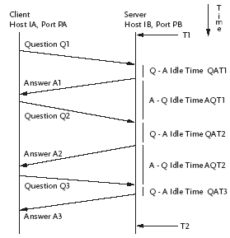
A Sample Conversation

Slide 37
Activity Messages – Example (cont)
Time interval: T1 to T2
Three questions (of sizes Q1, Q2, and Q3)
Three answers (of sizes A1, A2, and A3)
Dimensions:
  Interactivity = 3/(T2-T1)
  ASOQ = (Q1+Q2+Q3)/3
  ASOA = (A1+A2+A3)/3
  QAIT = (QAIT1+QAIT2+QAIT3)/(T2-T1)
  AQIT = (AQIT1+AQIT2+AQIT3)/(T2-T1)

Slide 38
INBOUNDS
Integrated Network-Based Ohio University Network Detective Service
Training:
  Receives messages from Real-Time TCPTrace
  Build profiles of each different network service
Detection:
  Receives messages from Real-Time TCPTrace
  Identify connections behaving abnormally

Slide 39
INBOUNDS Detection: Example #1
A connection to port 79 (finger daemon on Linux system)
Normal profile:
  Interactivity is low
  Question and the answer sizes are small
  Idle times should be small (unless the system is severely overloaded)
Profile during a buffer overflow attack (spawns an interactive shell):
  Interactivity is high
  Average sizes of questions and answers are large

Slide 40
INBOUNDS Detection: Example #2
A connection to port 25 (SMTP)
“Normal” profile:
  Interactivity (ave = 10 questions, sd = 10)
  Question size (ave = 400 bytes, sd = 800)
  Answer size (ave = 50 bytes, sd = 10)
  Idle times (average less than one second)
Profile observed during a mailbomb attack:
  Interactivity (ave = 250 questions)
  Question size (ave = 2000 bytes)
  Answer size (ave = 3500 bytes)
  Idle times (up to 8 seconds)

Slide 41
Limitations of Network-Based Intrusion Detection
Network data rates are very high
Encryption of network traffic is becoming more popular
There are even ways of hiding data in picture files!
Switched environments are becoming more popular
Difficult to insure that network IDS sees the same data as the end hosts

Slide 42
Summary
An Intrusion Detection System (IDS) is a piece of software that monitors a computer system to detect:
  Intrusion (unauthorized attempts to use the system) and misuse (abuse of existing privileges)
And responds by:
  Logging activity, notifying a designated authority, or taking appropriate countermeasures
Many different IDSs are available and they can be categorized according to their:
  Detection model (misuse detection, anomaly detection, hybrid)
  Scope (host based, multihost based, network based)
  Operation (off-line vs. real-time)
  Architecture (centralized, hierarchical, distributed)

