Slide 1
CHAPTER 3
CPSC 352 Modern Cryptography: Symmetric-Key Characteristics
Professor: Oberta A. Slotterbeck (Obie)
Computer Science Department
Hiram College
obie@hiram.edu

Slide 2
Overview
Two important modern symmetric-key cryptosystems:
  The Data Encryption Standard (DES)
    Adopted in 1976
    Block size = 64 bits
    Key length = 56 bits
  The Advanced Encryption Standard (AES)
    Adopted in 2000
    Block sizes = 128, 192, or 256 bits
    Key lengths = 128, 192, or 256 bits

Slide 3
Cryptography Changes Throughout History
Originally – dominated by governments
  Military
  Diplomats
Where cryptologists worked were called black chambers because secrecy was so important.
In early part of 20th century, several crypto machines were invented (including Enigma of World War II fame.)
1970 saw a switch from secrecy for governments’ sake to a commercial use of crytography.

Slide 4
DES (Data Encryption Standard) - History
1973: the National Bureau of Standards (NBS) solicits proposals for a standard cryptographic algorithm which:
  Provides a high level of security
  Is completely specified and easy to understand
  Is available royalty-free to the U.S. government and all other users
  Would be efficient and economically implemented on electronic devices

Slide 5
DES – History (cont)
1974:
  A team of cryptographers at IBM submits a variant of an algorithm they had been using internally named Lucifer
  NBS asks for comments on the algorithm from the National Security Agency (NSA), a world leader in cryptology
  NSA recommends that the algorithm be adopted with several modifications:
    Key size reduced from 128 to 56 bits
    A few minor changes to the details of the algorithm

Slide 6
Concerns About the Changes:
The reduction of the key size from 128 bits to 56 made a brute force attack on the algorithm easier.
With the computers available in mid 1970s, however, probably only the National Security Agency (NSA) could launch a brute force successfully.
Many accused the NSA of weakening the algorithm so they could read everything.
1998: the Electronic Frontier Foundation build a $220,000, special-purpose machine that could recover the key for a message encrypted with DES in about four days

Slide 7
In 1990s- the Clipper Chip Controversy
A hardware cryptographic chip developed in the US in the 1990s, offering encryption functions for a variety of applications.
Embodied a proprietary algorithm, so although it was promoted by the US Government as providing a known standard of security, the strength of the algorithm could not be tested by outside interests.
Attracted concern because each secure communication would be encrypted using a key derived from information stored in each chip, and the key information would be available to US Federal agencies if required for law enforcement (this approach is known as "key escrow").
Attracted significant opposition from organizations concerned about the power it gave government agencies. Petitions were organized against Clipper and the adverse publicity meant that the technology was never widely accepted.

Slide 8
DES – History (cont)
1976:
  NBS approves DES as a U.S. government standard for use on all unclassified communications
  The standard is to be reviewed every five years
1983: NBS recertifies DES
1987: NBS recertifies DES
1988: NBS becomes the National Institute of Standards and Technology (NIST)
1993: NIST recertifies DES
1998: NIST begins a competition to establish an Advanced Encryption Standard to replace DES

Slide 9
DES - Overview
Adopted by the U.S. government as a Federal Information Processing Standard (FIPS) in 1976
Block cipher
  Encrypts 64-bit plaintext blocks to generate 64-bit ciphertext blocks
Symmetric key
  Same algorithm and 56-bit key are used for encryption and decryption

Slide 10
DES - Keys
Key = any 56-bit pattern
Keyspace contains 2⁵⁶ elements
  72,057,594,037,927,936 different keys
Exhaustive search at one trillion keys per second takes:
  2 hours
  Easily handled by today’s computers.
A very small number of weak keys are known and should be avoided (i.e. all 0s or all 1s)
Thus, DES is not completely safe.

Slide 11
DES – The Algorithm
Transforms a 64-bit block of plaintext into a 64-bit block of ciphertext
Each 64-bit block of plaintext goes through:
  An initial permutation
  16 rounds of substitution and transposition operations
    Influenced by a 48-bit subkey for each round, which is derived from the 56-bit DES key
  Final permutation

Slide 12
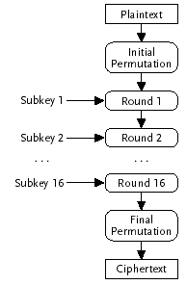
DES – Algorithm Overview

Slide 13

DES – The Initial Permutation
The initial permutation shuffles the 64 bits of the plaintext into a new order:
58th bit is moved into the first position
50th bit is moved into the second position
….
7th bit is moved into the sixty fourth position

Slide 14
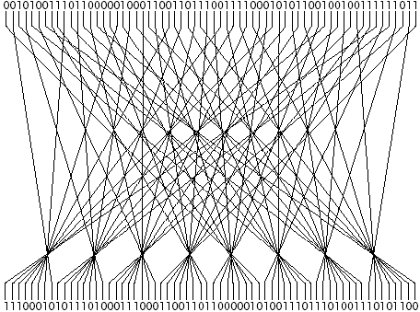
DES Initial Permutation Pictorially
A 64-bit block of plaintext:
  0010100111011000001000110011011100111100010101100100100111111011
Result of the initial permutation:
  1110001010111010001110001100110110000010100111011101001110101100

Slide 15
DES – Subkey Generation
56-bit DES keys are expressed as 64-bit quantities with every eighth bit used for even parity checking
A 56-bit DES key:
  11010001101010101000101011101010101000100011010101010101
A 64-bit representation of the key (8 red parity bits added):
  1101000111010100101000110101110010101010000100011101010010101010
Sixteen 48-bit subkeys are generated from the 64-bit DES key - one for each round of the algorithm

Slide 16

DES – Subkey Generation (cont)
The 64-bit DES key:
  1101000111010100101000110101110010101010000100011101010010101010
A key permutation removes the eight parity bits from the 64-bit key and rearranges the remaining key bits in a new order:
The 57th bit is moved into the first position
The 49th bit is moved into the second position
…
The 4th bit is moved in to the 56th position

Slide 17
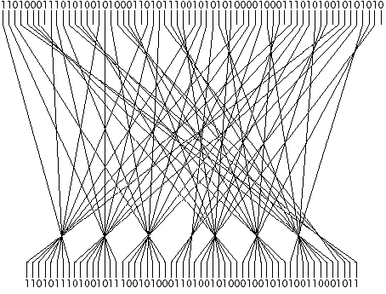
DES Key Permutation Example
A 64-bit block of plaintext:
  1101000111010100101000110101110010101010000100011101010010101010
Result of the key permutation:
  11010111010010111001010001101001010001001010100110001011

Slide 18
DES – Subkey Generation (cont)
56 key bits (from key permutation) are divided into two 28-bit halves:
  Result of the key permutation:
    11010111010010111001010001101001010001001010100110001011
  Left half = 1101011101001011100101000110
  Right half = 1001010001001010100110001011
Each half is circularly shifted left by one bit:
  Circular left shift of left half = 1010111010010111001010001101
  Circular left shift of right half = 0010100010010101001100010111
The left and right halves are then recombined into a 56 bits:
  10101110100101110010100011010010100010010101001100010111

Slide 19

DES – The Compression Permutation
Left and right halves recombined into a 56 bits:
  10101110100101110010100011010010100010010101001100010111
A compression permutation selects 48 of the 56 bits and rearranges them into a new order
The 14th input bit becomes the first of 48 output bits
The 17th input bit becomes the second of 48 output bits
….
The 32nd input bit becomes the last of 48 output bits

Slide 20
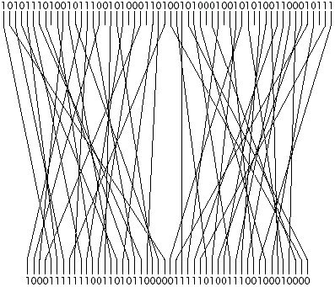
DES Compression Permutation Example
Left and right halves recombined into 56 bits:
  10101110100101110010100011010010100010010101001100010111
The 48-bit result is the round 1 subkey:
  100011111110011010110000011111010011100100010000

Slide 21
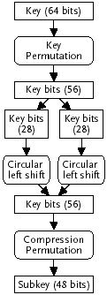
DES Round 1 Subkey Generation Overview

Slide 22
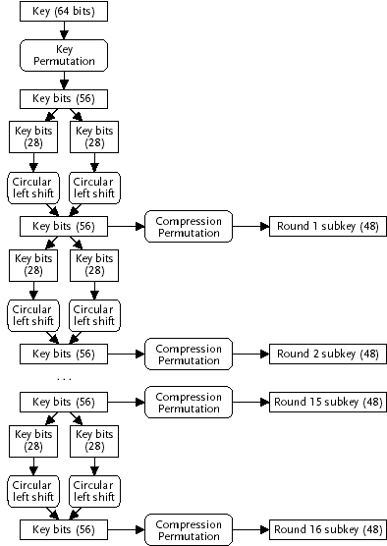
DES - Subkey Generation Overview
One-bit shifts:
  Rounds 1, 2, 9, and 16
Two-bit shifts
  Rounds 3, 4, 5, 6, 7, 8,
  10, 11, 12, 13, 14, 15

Slide 23
DES – Rounds
Each of the sixteen rounds takes a 64-bit block as input and produces a 64-bit block as output
The output from the initial permutation is the input to round one
Round one’s output is the input to round two
Round two’s output is the input to round three
…
The output from round sixteen is the 64-bit block of ciphertext

Slide 24
DES – Round Overview
Input block (64)
L₁ (32)
R₁ (32)
EP
XOR
Subkey₁
S-box
P-box
XOR
L₂ (32)
R₂ (32)
Output block (64)

Slide 25

DES – Round Operations
The 64-bit input block is divided into two 32-bit halves:
  Input block (64 bits)
    1110001010111010001110001100110110000010100111011101001110101100
  Left half = 11100010101110100011100011001101
  Right half = 10000010100111011101001110101100
The 32-bit right half is then sent through an expansion permutation which produces 48 output bits by:
  Rearranging the input bits into a new order
  Repeating some of the input bits in more than one output position

Slide 26
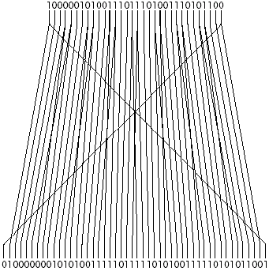
DES – Expansion Permutation Example
Right half of input block (32 bits):
  10000010100111011101001110101100
The 48-bit result of the expansion permutation:
  010000000101010011111011111010100111110101011001

Slide 27

DES – First XOR Operation
An exclusive-or (XOR) operation is applied to the 48-bit output of the expansion permutation and the subkey for the current round:
The resulting 48-bits are passed through S-boxes

Slide 28
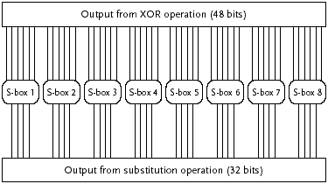
DES – S-boxes
S-boxes perform substitution operations
There are 8 different S-boxes
Each S-box takes 6 input bits and produces 4 output bits:
Bits 1-6 are the input to S-box 1
Bits 7-12 are the input to S-box 2, etc.

Slide 29

DES – S-box Operation
Each S-box contains 4 rows and 16 columns of entries
Example - S-box 1:
The first and last of the 6 input bits to an S-box form a two-digit binary number that specifies one of the 4 rows
  00 for the zeroth row, 01 for the first row, 10 for the second row, and 11 for the third row
The middle four input bits form a four-digit binary number that specifies one of the 16 columns
  0000 for the zeroth column, 0001 for the first column, . . ., and 1111 for the 15th column

Slide 30
DES – S-box Operation (cont)
The entry found at the intersection of the specified row and column is the four-digit binary output for the S-box
Examples using S-box 1:
011010 (input) = row 0, column 13 = 9 = 1001 (output)
110010 (input) = row 2, column 9 = 12 = 1100 (output)
000011 (input) = row 1, column 1 = 15 = 1111 (output)

Slide 31
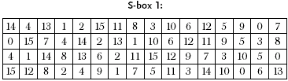
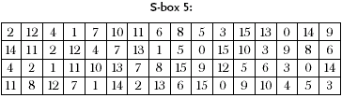
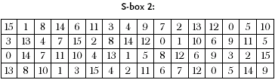
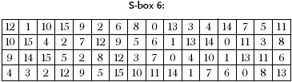
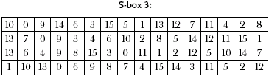
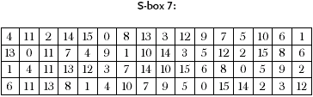
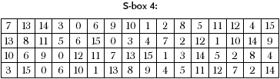
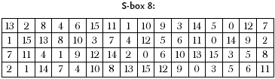
DES – The S-boxes

Slide 32
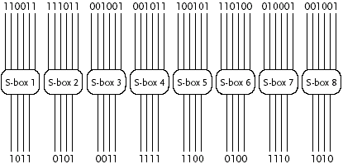
DES – S-box Operation Example
The 48-bit result of the XOR operation:
  110011111011001001001011100101110100010001001001
The 32-bit result of the S-box substitutions:
  10110101001111111100010011101010

Slide 33

DES – P-box
The 32-bit output of the S-boxes is passed through a P-box
The P-box permutes the bits into a new order:
  The first output bit from the S-boxes is moved into position 16
  The second bit is moved into position 7
  The third bit is moved into position 20
  …
  The thirty-second bit is moved into position 25

Slide 34
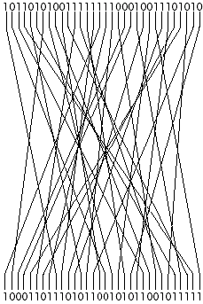
DES – P-box Example
The 32-bit output from the S-boxes:
  10110101001111111100010011101010
The 32-bit result of the P-box permutation:
  10001101110101100101011001011111

Slide 35

DES – Second XOR Operation
The 32-bit output of the P-box is XORed with the left half of the original 64-bit input block
  Output from P-box (32 bits)
    10001101110101100101011001011111
  Left half of input block (32 bits)
    11100010101110100011100011001101
The 32-bit output of the XOR operation:
  01101111011011000110111010010010

Slide 36
DES – Third XOR Operation
The 32-bit right half of the original 64-bit input block is joined with 32-bit output from the second XOR operation:
  Right half of input block (32 bits):
    10000010100111011101001110101100
  Output from second XOR operation (32 bits):
    01101111011011000110111010010010
  Output from round 1 (64 bits):
    1000001010011101110100111010110001101111011011000110111010010010
The 64-bit output from round 1 is the input for round 2
The output from round 2 is the input for round 3
…
The output from round 16 is passed through a final permutation

Slide 37

DES – The Final Permutation
The final permutation is the inverse of the initial permutation
  It takes the 64 bits of output from round 16 and shuffles them into a new order:
  The 40th bit is moved into the first position
  The 8th bit is moved into the second position
  …
  The 25th bit is moved into the last (64th) position
The output of the final permutation is the 64-bit ciphertext block that replaces the 64-bit input block.of plaintext

Slide 38
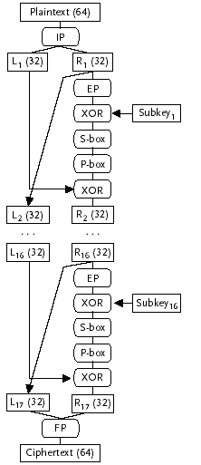
DES – Encryption Overview

Slide 39
DES - Decryption
The same algorithm and key is used for decryption
The subkeys are applied in the opposite order
  Subkey 16 is used during the first round of decryption
  Subkey 15 is used during the second round of decryption
  …
  Subkey 1 is used during the 16th round of decryption

Slide 40
DES - Summary
DES is still a widely used cryptosystem
Increased computing power has weakened the protection offered by DES considerably.
DES helped to focus and unify the public cryptographic research community
NIST’s (National Institute of Standards and Technology) 1998 call for an Advanced Encryption Standard to replace DES produced 15 promising candidate algorithms from researchers all over the world

Slide 41
AES - History
1997: NIST requests proposals for a new Advanced Encryption Standard (AES) to replace DES
NIST required that the algorithm be:
  A symmetric-key cryptosystem
  A block cipher
  Capable of supporting a block size of 128 bits
  Capable of supporting key lengths of 128, 192, and 256 bits
  Available on a worldwide, non-exclusive, royalty-free basis
Evaluation criteria:
  Security - soundness of the mathematical basis and the results of analysis by the research community
  Computational efficiency, memory requirements, flexibility, and simplicity

Slide 42
AES – Round 1 of the Competition-DES-like
NIST selects 15 submissions for evaluation:
  CAST-256 (Entrust Technologies, Inc.)
  Crypton (Future Systems, Inc.)
  DEAL (Richard Outerbridge, Lars Knudsen)
  DFC (Centre National pour la Recherche Scientifique—Ecole Normale Superieure)
  E2 (Nippon Telegraph and Telephone Corporation)
  Frog (TecApro Internacional S.A.)
  HPC (Rich Schroeppel)
  Loki97 (Lawrie Brown, Josef Pieprzyk, Jennifer Seberry)
  Magenta (Deutsche Telekom AG)
  MARS (IBM)
  RC6 (RSA Laboratories)
  Rijndael (Joan Daemen, Vincent Rijmen)
  SAFER+ (Cylink Corporation)
  Serpent (Ross Anderson, Eli Biham, Lars Knudsen)
  Twofish (Bruce Schneier, John Kelsey, Doug Whiting, David Wagner, Chris Hall, Niels Ferguson)

Slide 43
AES – Round 1 Results
After eight months of analysis and public comment, NIST:
  Eliminated DEAL, Frog, HPC, Loki97, and Magenta
    Had what NIST considered major security flaws
    Were among the slowest algorithms submitted
  Eliminated Crypton, DFC, E2, and SAFER+
    Had what NIST considered minor security flaws
    Had unimpressive characteristics on the other evaluation criteria
  Eliminated CAST-256
    Had mediocre speed and large ROM requirements
Five candidates, MARS, RC6, Rijndael, Serpent, and Twofish, advanced to the second round

Slide 44
AES – Results
Analysis and public comment on the five finalists
October 2000: NIST:
  Eliminates MARS
    High security margin
  Eliminates RC6
    Inadequate security margin, fast encryption and decryption on 32-bit platforms
  Eliminates Serpent
    High security margin
  Eliminates Twofish
    High security margin
  Selects Rijndael (authors from Belgium)
    Adequate security margin, fast encryption, decryption, and key setup speeds, low RAM and ROM requirements

Slide 45
AES – The Rijndael Algorithm
Symmetric-key block cipher
  Block sizes are 128, 192, or 256 bits
  Key lengths are 128, 192, or 256 bits
Performs several rounds of operations to transform each block of plaintext into a block of ciphertext
  The number of rounds depends on the block size and the length of the key:
    Nine regular rounds if both the block and key are 128 bits
    Eleven regular rounds if either the block or key are 192 bits
    Thirteen regular rounds if either the block or key is 256 bits
  One, slightly different, final round is performed after the regular rounds

Slide 46
AES – The Rijndael Algorithm (cont)
For a 128-bit block of plaintext and a 128-bit key the algorithm performs:
  An initial AddRoundKey (ARK) operation
  Nine regular rounds composed of four operations:
    ByteSub (BSB)
    ShiftRow (SR)
    MixColumn (MC)
    AddRoundKey (ARK)
  One final (reduced) round composed of three operations:
    ByteSub (BSB)
    ShiftRow (SR)
    AddRoundKey (ARK)

Slide 47
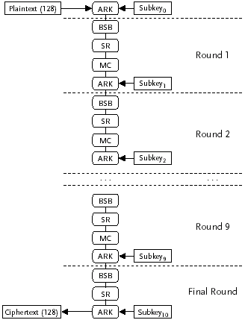
AES – Rijndael Overview

Slide 48
AES – Rijndael Keys
Keys are expressed as 128-bit (or bigger) quantities
Keyspace contains at least 2¹²⁸ elements:
  340,282,366,920,938,463,463,374,607,431,768,211,456
Exhaustive search at one trillion keys per second takes (possible with today’s computers):
  1x10¹⁹ years (the universe is thought to be about 1x10¹⁰ years old)

Slide 49
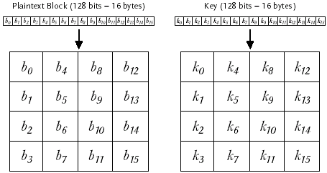
AES – Rijndael Keys (cont)
Blocks and keys are represented as a two-dimensional array of bytes with four rows and four columns:
  Block = 128 bits = 16 bytes = b₀ , b₁, . . ., b₁₅
  Key = 128 bits = 16 bytes = k₀ , k₁, . . ., k₁₅

Slide 50
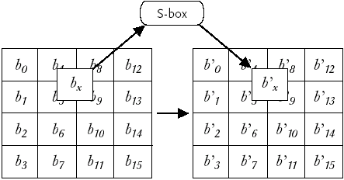
AES - The ByteSub Operation
An S-box is applied to each of the 16 input bytes independently
Each byte is replaced by the output of the S-box:

Slide 51
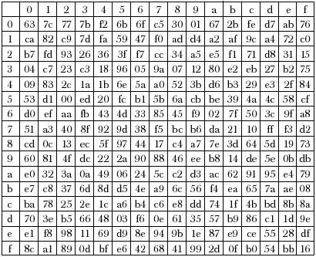
AES – The Rijndael S-box

Slide 52
AES – The Rijndael S-box (cont)
The input to the S-box is one byte:
Example 1:
  b₀ = 01101011 (binary) = 6b (hex)
  b’₀ = row 6, column b = 7f (hex) = 01111111 (binary)
Example 2:
  b₁ = 00001000 (binary) = 08 (hex)
  b’₁ = row 0, column 8 = 30 (hex) = 00110000 (binary)
Example 3:
  b₂ = 11111001 (binary) = f9 (hex)
  b’₂ = row f, column 9 = 99 (hex) = 10011001 (binary)

Slide 53
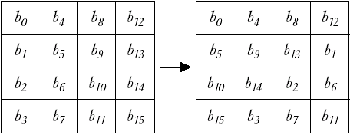
AES - The ShiftRow Operation
Each row of the input is circularly left shifted:
  First row by zero places
  Second row by one place
  Third row by two places
  Fourth row by three places

Slide 54
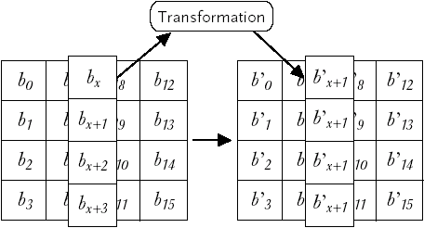
AES - The MixColumn Operation
The four bytes in each input column are replaced with four new bytes:

Slide 55
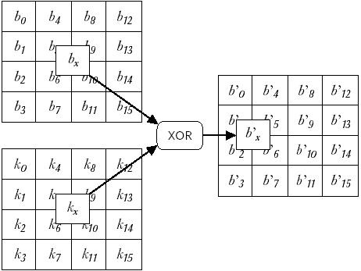
AES - The AddRoundKey Operation
Each byte of the input block is XORed with the corresponding byte of the round subkey:

Slide 56
AES – Rijndael Overview

Slide 57
AES Summary
The research community participated very actively and expertly in the design and evaluation of the candidate algorithms
The AES selection process served to raise public awareness of cryptography and its importance
The AES algorithm is starting to be widely used
The AES should offer useful cryptographic protection for at least the next few decades

Slide 58
Summary
DES (56-bit keys): Each 64-bit block of plaintext goes through:
  Initial permutation
  Sixteen rounds of substitution and transposition operations
  Final permutation
AES (128-bit keys): Each 128-bit block of plaintext goes through:
  An initial AddRoundKey (ARK) operation
  Nine rounds of operations (BSB, SR, MC, ARK)
  One final (reduced) round

