Slide 1
CHAPTER 7
CPSC 352
Authentication and Authorization
Professor: Oberta A. Slotterbeck (Obie)
Computer Science Department
Hiram College
obie@hiram.edu

Slide 2
Access Control
Two parts to access control
Authentication: Who goes there?
  Determine whether access is allowed
  Authenticate human to machine
  Authenticate machine to machine
Authorization: Are you allowed to do that?
  Once you have access, what can you do?
  Enforces limits on actions
Note: Access control often used as synonym for authorization

Slide 3
Important components of computer security
Note- network security will be handled later.
User authentication – determine the identity of an individual accessing the system
Access control policies – stipulate what actions a given user is allowed to perform on the system
Access control mechanisms – enforce the system’s access control policy

Slide 4
The Reference Monitor
Computer systems are comprised of many diverse objects that can be employed by users to accomplish tasks
  Examples: CPU, memory segments, files, printers, etc.
It is the job of a reference monitor to control access to system objects
The reference monitor must:
  Operate correctly
  Always be invoked
  Be tamper-proof
Decisions on whether or not to allow an action are based on the identity of the user performing the action

Slide 5
Authentication

Slide 6
User Authentication
Three basic approaches:
  Knowledge-based – users prove their identity through something that they know
    Example: passwords
  Token-based – users prove their identity through something they possess
    Example: passport
  Biometric – users prove their identity through a unique physiological characteristic
    Example: fingerprint

Slide 7
Knowledge-based Authentication Techniques

Slide 8
Passwords
Passwords are widely-used for user authentication
Advantages:
  Easy to use, understood by most users
  Require no special equipment
  Offer an adequate degree of security in many environments
Disadvantages:
  Users tend to choose passwords that are easy to guess
  Many password-cracking tools are available that are excellent at cracking passwords
  There are many available on the internet.

Slide 9

Using Passwords
User enters username and password
The operating system consults its table of passwords:
Match = user is assigned the corresponding uid
Problem: the table of passwords must be protected

Slide 10
Why Passwords?
Why is “something you know” more popular than “something you have” and “something you are”?
Cost --- passwords are free
Convenience --- easier to reset password than to issue new smartcard

Slide 11
Good and Bad Passwords
Bad passwords
  frank
  Fido
  password
  4444
  Pikachu
  102560
  AustinStamp
Good Passwords?
  jfIej,43j-EmmL+y
  09864376537263
  P0kem0N
  FSa7Yago
  0nceuP0nAt1m8
  PokeGCTall150

Slide 12
Selecting Strong Passwords
Passwords must not be written down, especially not anywhere near the computer to which they provide access
Passwords must be chosen carefully so they can be remembered without a written aid
Passwords should not include easily guessed words or numbers
Users should be taught to never to tell anyone their password

Slide 13
Selecting Strong Passwords
Ideas for creating good passwords:
  A minimum of eight characters should be sufficient
  It should include at least one number or symbol
  It could be one or more words separated by one or more symbols or numbers
  Multiple words works better if they are foreign or altered so that they do not appear in a dictionary
  Using a series of numbers or a pattern of altered letters can make it easier to remember your password

Slide 14
Selecting Strong Passwords
Using strong passwords reduces the possibility of a cracker utilizing social engineering to gain access to your system
Crackers can resort to brute force attacks where all possible combinations are tried until one succeeds in guessing a password
Some system administrators use password cracking tools to randomly test the strength of user’s passwords

Slide 15
Password Experiment
A passphrase is a plain-language phrase, typically longer than a password, from which a virtual password is derived
Example: Alice loves Bob and Bob loves Trudy!
AlBaBlT!
Three groups of users --- each group advised to select passwords as follows
  Group A: At least 6 chars, 1 non-letter
  Group B: Password based on passphrase
  Group C: 8 random characters
Results
  Group A: About 30% of pwds easy to crack
  Group B: About 10% cracked
    Passwords easy to remember
  Group C: About 10% cracked
    Passwords hard to remember
winner →

Slide 16
Password Experiment
User compliance hard to achieve
In each case, 1/3rd did not comply (and about 1/3rd of those easy to crack!)
Assigned passwords sometimes best
If passwords not assigned, best advice is
  Choose passwords based on passphrase
  Use pwd cracking tool to test for weak pwds
  Require periodic password changes?

Slide 17
Attacks on Passwords
Attacker could…
  Targeted one particular account
  Target any account on system
  Target any account on any system
  Attempt denial of service (DoS) attack
Common attack path
  Outsider → normal user → administrator
  May only require one weak password!

Slide 18
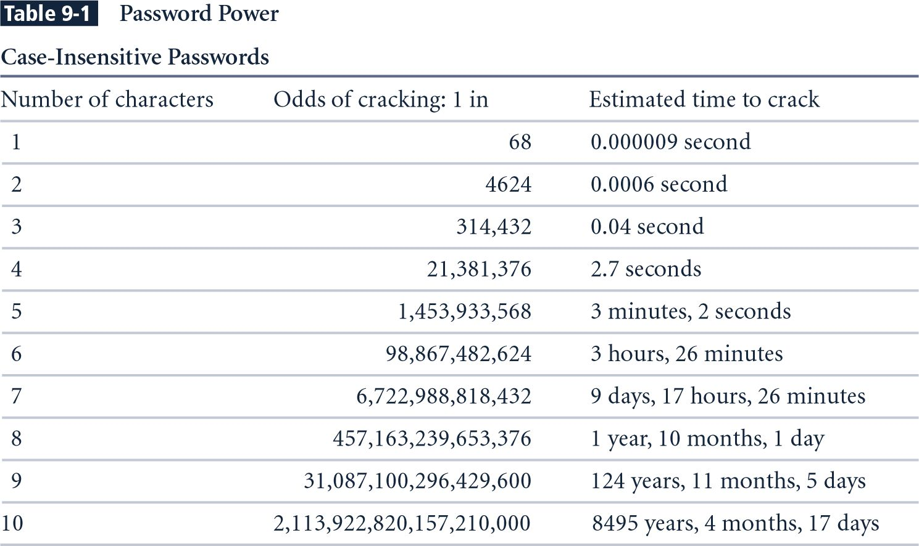
Brute Force Tries-Pentium 4 performing 8 million guesses per second
Notes:
Estimated Time to Crack is based on a Pentium 4 computer performing 8 million guesses per second. The estimates take into consideration all keyboard characters, some of which are not allowed by some systems.

Slide 19
Password Retry
Suppose system locks after 3 bad passwords. How long should it lock?
  5 seconds
  5 minutes
  Until SA restores service
What are +’s and -’s of each?

Slide 20

Using Passwords and One-Way Functions
User’s password is not stored in the table
A one-way hash* of the password, h(password), is stored in the table
  h(dumptruck) = JFNXPEMD
  h(baseball) = WSAWFFVI
* hash is just a fancy word for a function or method that has few collisions and cannot be reversed.

Slide 21
Using Passwords and One-Way Functions (cont)
User enters username and password
The operating system hashes the password
The operating system compares the result to the entry in the table
Match = user is assigned the corresponding uid
Advantage: password table does not have to be protected
Disadvantage: dictionary attacks do work

Slide 22
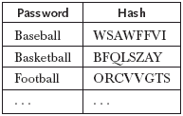
A Dictionary Attack
An attacker can compile a dictionary of several thousand common words and compute the hash for each one:
Look for matches between the dictionary and the password table
  Example: WSAWFFVI tells us Bob’s password is baseball

Slide 23
Dictionary Attacks (cont)
Dictionary attacks are a serious problem:
  Costs an intruder very little to send tens of thousands of common words through the one-way function and check for matches
  Between 20 and 40 percent of the passwords on a typical system can be cracked in this way
Solution #1: don’t allow users to select their own passwords
  System generates a random password for each user
  Drawback:
    Many people find system-assigned passwords hard to remember and therefore they write them down
    Example: L8f#n!.5rH’
  You can find huge numbers of post-it notes on screens, under keyboards, and in top drawers of desks that contain passwords!

Slide 24
Combating Dictionary Attacks
Solution #2: password checking
  Allow users to choose their own passwords
  Do not allow them to use passwords that are in a common dictionary
Solution #3: salt the password table
  A salt is a random string that is concatenated with a password before sending it through the one-way hash function
    Random salt value chosen by system
      Example: plre
    Password chosen by user
      Example: baseball

Slide 25

Salting the Password Table
Password table contains:
  Salt value = plre
  h(password+salt) = h(baseballplre) = FSXMXFNB

Slide 26
Salting the Password Table (cont)
User enters username and password
The operating system combines the password and the salt and hashes the result
The operating system compares the result to the entry in the table
Match = user is assigned the corresponding uid
Advantages:
  Password table does not have to be protected
  Dictionary attacks are much harder

Slide 27
A Dictionary Attack
Attacker must now expand the dictionary to contain every possible salt with each possible password:
  baseballaaaa
  baseballaaab
  baseballaaac
  ….
  baseballaaaz
  baseballaaba
  baseballaabb
  ….
26⁴ (about half a million) times more work to check each word in the dictionary (for 4-letter salts)
And, how do they know a 4-letter salt is being used?

Slide 28
Password Cracking – Some More Probabilities
Assumptions:
Pwds are 8 chars, 128 choices per character
  Then 128⁸ = 2⁵⁶ possible passwords
There is a password file with 2¹⁰ pwds
Attacker has dictionary of 2²⁰ common pwds
Probability of 1/4 that a pwd is in dictionary

Slide 29
Password Cracking
Attack 1 password without dictionary
  Must try 2⁵⁶/2 = 2⁵⁵ on average
  Just like exhaustive key search
Attack 1 password with dictionary
Work is measured by number of hashes
  Expected work is about
  1/4 (2¹⁹) + 3/4 (2⁵⁵) = 2^{54.6}
  But in practice, try all in dictionary and quit if not found --- work is at most 2²⁰ and probability of success is 1/4

Slide 30
Password Cracking
Attack any of 1024 passwords in file
Without dictionary
  Assume all 2¹⁰ passwords are distinct
  Need 2⁵⁵ comparisons before expect to find password
  If no salt, each hash computation gives 2¹⁰ comparisons ⇒ the expected work (number of hashes) is 2⁵⁵/2¹⁰ = 2⁴⁵
  If salt is used, expected work is 2⁵⁵ since each comparison requires a new hash computation
Notes:
Picture would be useful here

Slide 31
Password Cracking
Attack any of 1024 passwords in file
With dictionary
  Probability at least one password is in dictionary is 1 - (3/4)¹⁰²⁴ = 1
  We ignore case where no pwd is in dictionary
  If no salt, work is about 2¹⁹/2¹⁰ = 2⁹
  If salt, expected work is less than 2²²
  Note: If no salt, we can precompute all dictionary hashes and amortize the work
Notes:
Calculation for salted case:
Number the passwords in file, pwd1, pwd2, …,pwd1024
Consider checking each pwd in turn. The probability pwd1 is in the dictionary is 1/4 and, if so, expected work (no. of hashes) is 2^19. If pwd1 is not in dictionary but pwd2 is, we do 2^20 hashes (for pwd1) plus an expected 2^19 hashes for pwd2. The probability of this is (3/4)(1/4). Continuing, we find the expected work factor is
(1/4)*(2^19) + (3/4)*(1/4)*(2^20+2^19) + (3/4)^2*(1/4)*(2*2^20+2^19)+…+ + (3/4)^1023*(1/4)(1023*2^20+2^19) < 2^22

Slide 32
Other Password Issues
Too many passwords to remember
  Results in password reuse
  Why is this a problem?
Who suffers from bad password?
  Login password vs ATM PIN
Failure to change default passwords
Social engineering
Error logs may contain “almost” passwords
Bugs, keystroke logging, spyware, etc.

Slide 33
Packet Sniffers
Packet sniffer
  Network tool that collects and analyzes packets on a network
  Can be used to eavesdrop on network traffic
  Must be connected directly to a local network from an internal location
  Passwords are often sent in plaintext!
To use a packet sniffer legally, you must:
  Be on a network that the organization owns, not leases
  Be under the direct authorization of the network’s owners
  Have the knowledge and consent of users
  Have a justifiable business reason for doing so
Notes:
Packet Sniffers
A packet sniffer is a network tool that collects and analyzes copies of packets from the network.
In the wrong hands, it can be used to eavesdrop on network traffic.
To use a packet sniffer most effectively, you must be connected directly to a local network from an internal location.
To use a packet sniffer legally, you must:
(1) be on a network that the organization owns, not leases;
(2) be under the direct authorization of the network’s owners;
(3) have the knowledge and consent of the users; and
(4) have a justifiable business reason for doing so.

Slide 34
Passwords
The bottom line
Password cracking is too easy!
  One weak password may break security
  Users choose bad passwords
  Social engineering attacks, etc.
The bad guy has all of the advantages
All of the math favors bad guys
Passwords are a big security problem

Slide 35
Password Cracking Tools
Popular password cracking tools
  Password Crackers
  Password Portal
  L0phtCrack and LC4 (Windows)
  John the Ripper (Unix)
Admins should use these tools to test for weak passwords since attackers will!
Good article on password cracking
  Passwords - Conerstone of Computer Security

Slide 36
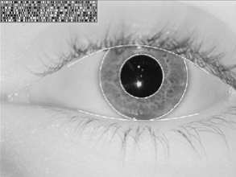
Biometrics

Slide 37
Something You Are
Biometric
  “You are your key” --- Schneier
Examples
  Fingerprint
  Handwritten signature
  Facial recognition
  Speech recognition
  Gait (walking) recognition
  “Digital doggie” (odor recognition)
  Many more!
Are
Know
Have

Slide 38
Why Biometrics?
Biometrics seen as desirable replacement for passwords
Cheap and reliable biometrics needed
Today, a very active area of research
Biometrics are used in security today
  Thumbprint mouse
  Palm print for secure entry
  Fingerprint to unlock car door
But biometrics generally not used
  Has not lived up to its promise (yet?)

Slide 39
Ideal Biometric
Universal --- applies to (almost) everyone
  In reality, no biometric applies to everyone
Distinguishing --- distinguish with certainty
  In reality, cannot hope for 100% certainty
Permanence --- physical characteristic being measured never changes
  In reality, want it to remain valid for a long time
Collectable --- easy to collect required data
  Depends on whether subjects are cooperative
Safe, easy to use, etc.

Slide 40
Biometric Modes
Identification --- Who goes there?
  Compare one to many
  Example: The FBI fingerprint database
Authentication --- Is that really you?
  Compare one to only one
  Example: Thumbprint mouse
Identification problem more difficult
  More “random matches” since more comparisons
We are interested in authentication

Slide 41
Enrollment vs Recognition
Enrollment phase
  Subject’s biometric info put into database
  Must carefully measure the required info
  OK if slow and repeated measurement needed
  Must be very precise for good recognition
  A weak point of many biometric schemes
Recognition phase
  The biometric detection used in practice
  Must be quick and simple
  But must still be accurate

Slide 42
Cooperative Subjects
We are assuming cooperative subjects
In identification problem often have uncooperative subjects
For example, facial recognition
  Proposed for use in Las Vegas casinos to detect known cheats
  Also as way to detect terrorists in airports, etc.
  Probably do not have ideal enrollment conditions
  Subject will try to confuse recognition
Cooperative subject makes is much easier!

Slide 43
Biometric Errors
Fraud rate vs insult rate
  Fraud --- user A (mis)authenticates as user B
  Insult --- user A not authenticate as user A
For any biometric, can decrease fraud or insult, but other will increase
For example
  99% voiceprint match ⇒ low fraud, high insult
  30% voiceprint match ⇒ high fraud, low insult
Equal error rate: rate where fraud == insult
  The best measure for comparing biometrics

Slide 44
Modern History Fingerprints
1823 -- Professor Johannes Evangelist Purkinje discussed 9 fingerprint patterns
1856 -- Sir William Hershel used fingerprint (in India) on contracts
1880 -- Dr. Henry Faulds article in Nature about fingerprints for ID
1883 -- Mark Twain in Life on the Mississippi a murderer ID’ed by fingerprint

Slide 45
Modern History Fingerprints
1888 -- Sir Francis Galton (cousin of Darwin) developed classification system
  His system of “minutia” is still in use today
  Also verified that fingerprints do not change
Some countries require a number of points (i.e., minutia) to match in criminal cases
  In Britian, 15 points
  In US, no fixed number of points required

Slide 46
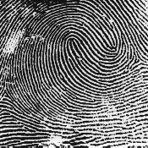
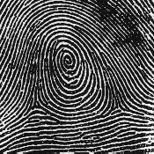
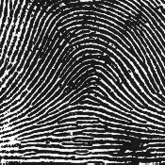
Fingerprints Comparison
Examples of loops, whorls and arches
Minutia extracted from these features
Loop (double)
Whorl
Arch

Slide 47
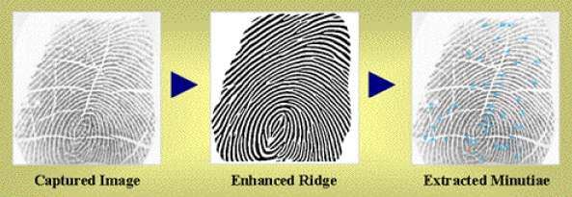
Fingerprint Biometric
Image of fingerprint captured
Image enhanced
The minutia are identified

Slide 48
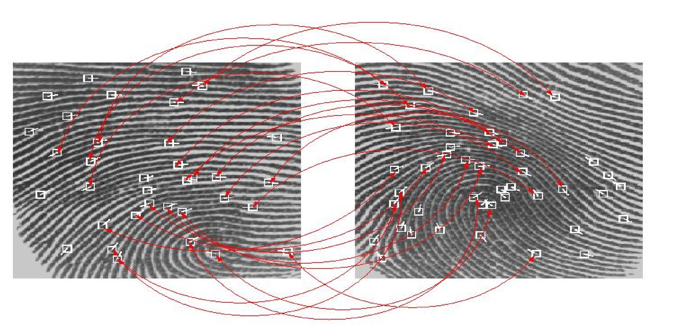
Fingerprint Biometric
Extracted minutia are compared with the supposed user’s minutia stored in database
Look for a statistical match

Slide 49
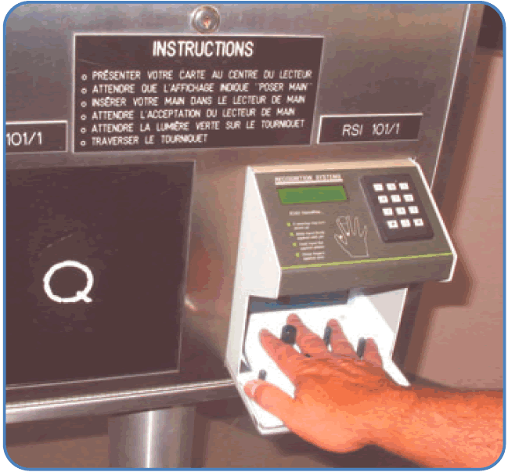
Hand Geometry
Popular form of biometric
Measures shape of hand
  Width of hand, fingers
  Length of fingers, etc.
Human hand not unique
Hand geometry sufficient for many situations
Suitable for authentication
Not useful for ID problem

Slide 50
Hand Geometry
Advantages
  Quick
  5 seconds for recognition
  1 minute for enrollment
  Hands symmetric (use other hand backwards)
Disadvantages
  Cannot use on young or old
  Relatively high equal error rate

Slide 51
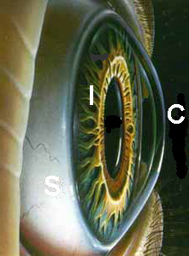

Iris Patterns
Iris pattern development is “chaotic”
Little or no genetic influence
Different even for identical twins
Pattern is stable through lifetime

Slide 52
Iris Recognition: History
1936 --- suggested by Frank Burch
1980s --- James Bond films
1986 --- first patent appeared
1994 --- John Daugman patented current best approach
  Patent owned by Iridian Technologies

Slide 53

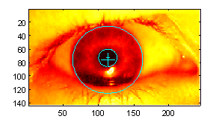
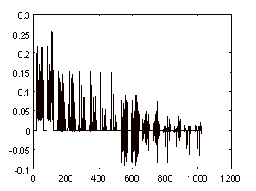
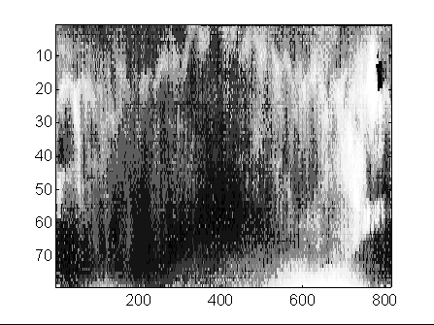
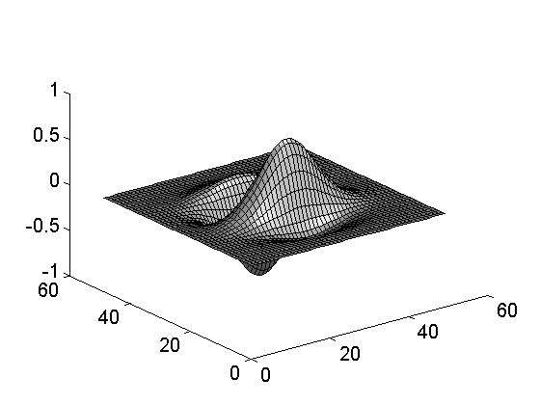
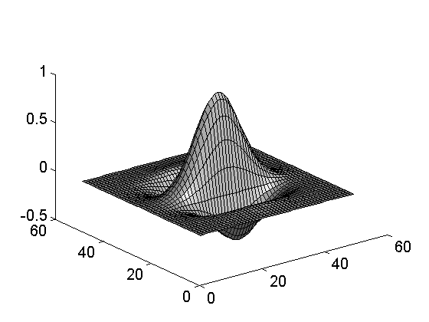
Iris Scan
Scanner locates iris
Take b/w photo
Use polar coordinates…
Find 2-D wavelet trans
Get 256 byte iris code

Slide 54
Measuring Iris Similarity
Based on Hamming distance
Define d(x,y) to be
  # of non match bits/# of bits compared
  d(0010,0101) = 3/4 and d(101111,101001) = 1/3
Compute d(x,y) on 2048-bit iris code
  Perfect match is d(x,y) = 0
  For same iris, expected distance is 0.08
  At random, expect distance of 0.50
  Accept as match if distance less than 0.32

Slide 55
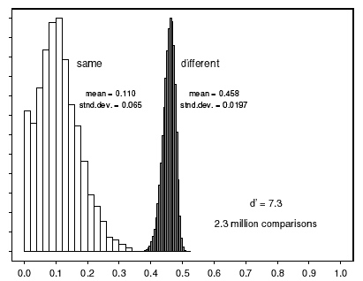

Iris Scan Error Rate
distance
Fraud rate
0.29 | 1 in 1.3∗10¹⁰
0.30 | 1 in 1.5∗10⁹
0.31 | 1 in 1.8∗10⁸
0.32 | 1 in 2.6∗10⁷
0.33 | 1 in 4.0∗10⁶
0.34 | 1 in 6.9∗10⁵
0.35 | 1 in 1.3∗10⁵
: equal error rate
distance

Slide 56

Attack on Iris Scan
Good photo of eye can be scanned
Then attacker can use photo of an eye
Afghan woman was authenticated by iris scan of old photo
To prevent attack, scanner could use light to be sure it is a “live” iris

Slide 57
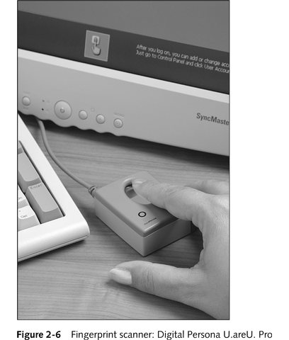
Fingerprint Biometrics
Ref for pictures 2-4 to 2-10: Security+ Guide to Network Security Fundamentals, Course Technology

Slide 58
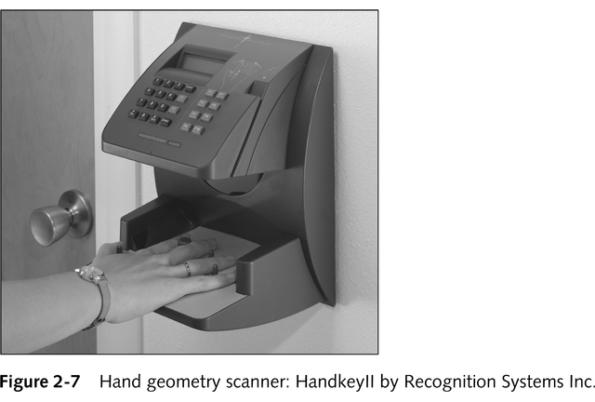
Hand Geometry Authentication

Slide 59
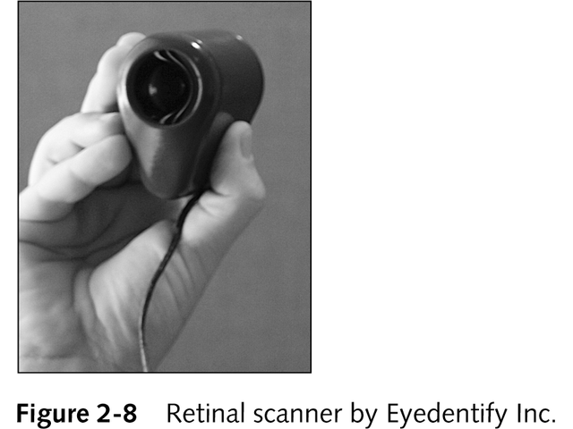
Retinal Scanning

Slide 60
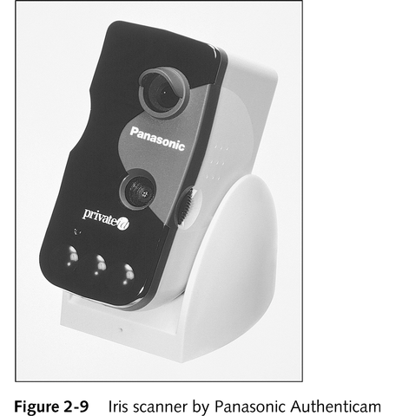
Iris Scanning

Slide 61
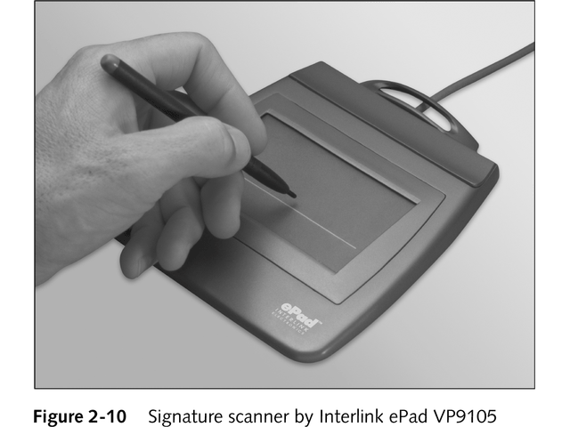
Signature Verification

Slide 62
Equal Error Rate Comparison
Equal error rate (EER): rate for fraud == insult
Fingerprint biometric has EER of about 5%
Hand geometry has EER of about 10⁻³
In theory, iris scan has EER of about 10⁻⁶
  But in practice, hard to achieve
  Enrollment phase must be extremely accurate
Most biometrics much worse than fingerprint!
ID biometrics are almost useless today

Slide 63
Biometrics: The Bottom Line
Biometrics are hard to forge
But attacker could
  Steal Alice’s thumb
  Photocopy Bob’s fingerprint, eye, etc.
  Subvert software and/or database and/or “trusted path”
Also, how to revoke a “broken” biometric?
Biometrics are not foolproof!
Biometric use is limited today
That should change in the future…

Slide 64
Something You Have

Slide 65
Something You Have
Something in your possession
Many examples including
Car key
Laptop computer
  Or specific MAC address
Password generator
  We’ll look at this next
ATM card, smartcard, etc.

Slide 66
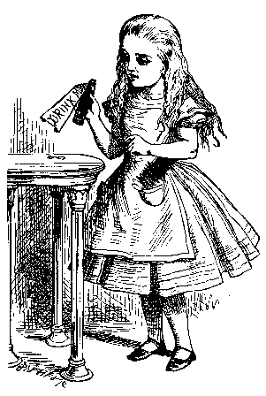


Password Generator – a Challenge-Handshake Method
“I’m Alice”
PIN, R
R
F(R)
F(R)
Password
generator
Bob
Alice
Alice gets “challenge” R from Bob
Alice enters R into password generator
Alice sends “response” back to Bob
Bob is convinced Alice has pwd generator

Slide 67
Password Generators are One-Time Passwords
Used only once for limited period of time; then is no longer valid
Uses shared keys and challenge-and-response systems, which do not require that the secret be transmitted or revealed
Strategies for generating one-time passwords
  Counter-based tokens
  Clock-based tokens

Slide 68
Single Sign-on
A hassle to enter password(s) repeatedly
  Users want to authenticate only once
  “Credentials” stay with user wherever the user goes
  Subsequent authentication is transparent to user
Single sign-on for the Internet?
  Microsoft: Passport
  Everybody else: Liberty Alliance
  Security Assertion Markup Language (SAML)

Slide 69
Cookies
Cookie is provided by a Website and stored on user’s machine
Cookie indexes a database at Website
Cookies maintain state across sessions
Web uses a stateless protocol: HTTP
Cookies also maintain state within a session
  Like a single sign-on
  Though a very weak form of authentication
Cookies and privacy concerns

Slide 70
Digital Signature
Digital signatures
  Encrypted messages independently verified by a central facility (registry) as authentic
Digital certificate
  Electronic document attached to a file certifying that the file is from the organization it claims to be from and has not been modified from the original format
Certificate authority (CA)
  Agency that manages the issuance of certificates
  Serves as the electronic notary public to verify certificate origin and integrity
Notes:
Digital Signatures
When the asymmetric process is reversed—the private key encrypts a (usually short) message, and the public key decrypts it—the fact that the message was sent by the organization that owns the private key cannot be refuted.
This nonrepudiation is the foundation of digital signatures.
Digital signatures are encrypted messages that are independently verified by a central facility (registry) as authentic.
A digital certificate is an electronic document, similar to a digital signature, attached to a file certifying that the file is from the organization it claims to be from and has not been modified from the original format.
A certificate authority (CA) is an agency that manages the issuance of certificates and serves as the electronic notary public to verify their origin and integrity.

Slide 71
How Much Trust
Should One Place in a CA?
Reputable CAs have several levels of authentication that they issue based on the amount of data collected from applicants
Example: VeriSign

Slide 72
Certificate-Based Authentication
Can use digital certificates to authenticate users
Organization sets up a Public Key Infrastructure (PKI) that generates keys to users
  User receives a code (public key) that is generated using the server’s private key and uses the public key to send encrypted information to the server
  Server receives the public key and can decrypt the information using its private key
We will consider this more after we discuss encrypting schemes.

Slide 73
Security Tokens
Authentication devices assigned to specific user
Small, credit card-sized physical devices
Incorporated into two-factor authentication methods discussed shortly
Utilize base keys that are much stronger than short, simple passwords a person can remember

Slide 74
Cards or Tokens
This authentication mechanism makes use of something (a card, key, or token) that user or system possesses
One example is a dumb card (such as an ATM cards) with magnetic stripes
Another example is the smart card containing a processor
Another device often used is the cryptographic token, a processor in a card that has a display
Tokens may be either synchronous or asynchronous
Notes:
Something You Have
This authentication mechanism makes use of something (a card, key, or token) that the user or the system has.
While there are many implementations of this mechanism, one example is a dumb card, a category that includes ID and ATM cards with magnetic strips containing the digital (and often encrypted) PIN against which user input is compared.
A more capable object is the smart card, which contains a computer chip that can verify and validate other information in addition to PINs.
Another device often used is the cryptographic token, a computer chip in a card that has a display.
Tokens may be either synchronous or asynchronous.
Once synchronous tokens are synchronized with a server, each device (server and token) uses the time to generate the authentication number that is entered during the user login. Asynchronous tokens use a challenge–response system, in which the server challenges the user with a number.

Slide 75
Types of Security Tokens
Passive
  Act as a storage device for the base key
  Do not emit, or otherwise share, base tokens
Active
  Actively create another form of a base key or encrypted form of a base key that is not subject to attack by sniffing and replay
  Can provide variable outputs in various circumstances

Slide 76
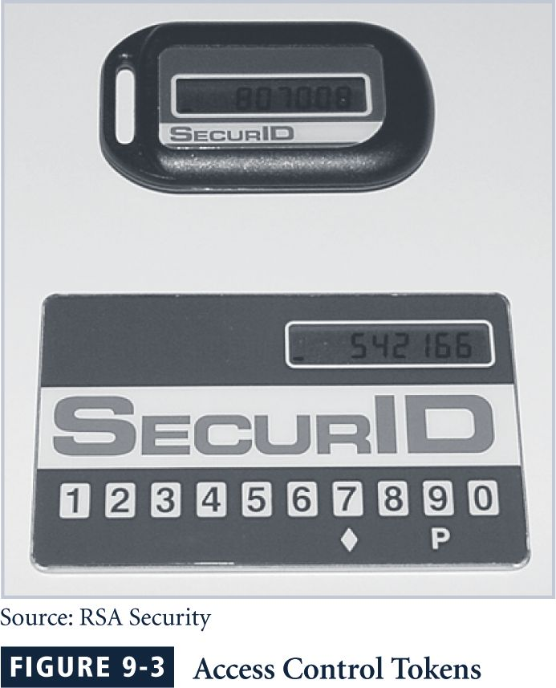
Access Control Tokens

Slide 77
Why Use Only One Strategy?

Slide 78
2-factor Authentication
Requires 2 out of 3 of
  Something you know
  Something you have
  Something you are
Examples
  ATM: Card and PIN
  Credit card: Card and signature
  Password generator: Device and PIN
  Smartcard with password/PIN
Multi-factor authentication is being strongly proposed for purchases made by cell phones.

Slide 79
Disadvantages of 2-factor Authentication
Users don’t like to authenticate twice.
Do you deny all that fail at one, but not the other? – can cause dissatisfaction
Are 2 authentications really more secure?

Slide 80
Some Linux Specific Authentication Strategies

Slide 81
Managing Linux Passwords
Linux includes several facilities for managing passwords and enabling security measures
When a new user account is added to the system, a single line is added to the /etc/password file, but the actual encrypted password is stored in /etc/shadow
The shadow password file controls the username, the encrypted password data, last password change date, password expiration date, account expiration date, and more

Slide 82
Managing Linux Passwords
A user can change their password using the passwd utility
When this command is entered, the user is prompted to enter their current password, then their new password two times
passwd will perform a few basic checks on the entered password, but it can’t prevent the use of poor passwords
The shadow password system is used by default on all major Linux distributions

Slide 83
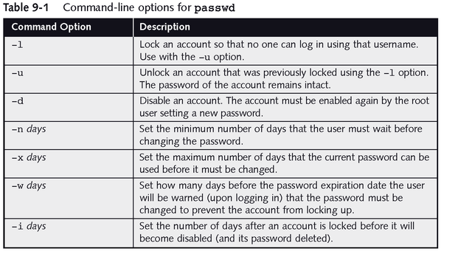
Managing Linux Passwords

Slide 84
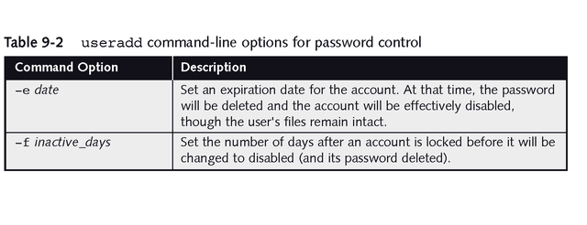
Managing Linux Passwords

Slide 85
Using Pluggable Authentication Modules
The Pluggable Authentication Module (PAM) architecture was developed by Sun and is now used on virtually every Linux distribution
PAM provides improved user-level security, flexibility in managing user authentication and smoother Linux to non-Linux data integration
To use PAM, select the modules necessary to to control the activity of a program, and list them in the program’s configuration file

Slide 86
Using Pluggable Authentication Modules
PAM is configured using either a single file, etc/pam.conf, or a series of files in /etc/pam.d
PAM supports four module types:
  auth modules are used for identifying a user, normally by prompting for a password
  account modules typically restrict account access
  session modules tend to tasks required before user’s can work, such as creating a log file
  password modules are executed when a user needs to change a password

Slide 87
Using Pluggable Authentication Modules
The control_flag element determines how PAM processes stacked modules, and ultimately to permit or deny access:
  required means all modules are executed and if one fails, access is denied
  requisite means that if a module fails, remaining modules are not executed, and access is denied
  sufficient means that the final result can be access permitted, even if this module fails
  optional means that the result of the module does not affect the final result of the stack

Slide 88
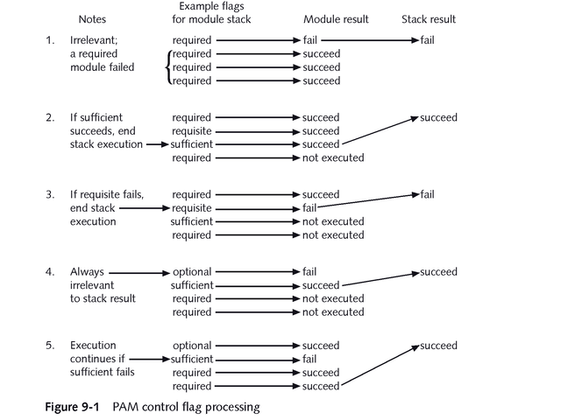
Using Pluggable Authentication Modules

Slide 89
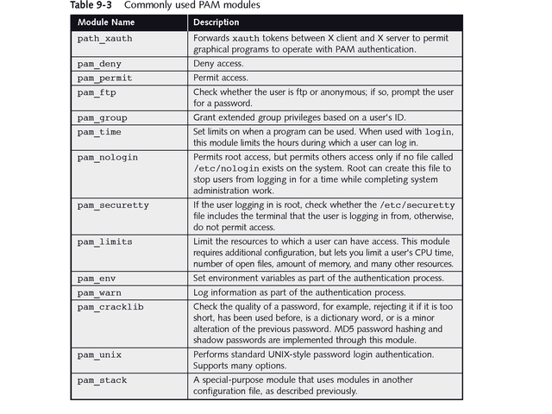
Using Pluggable Authentication Modules

Slide 90
Security Tools for Users
There are many security utilities and related files that system administrators and users need to be aware of, some PAM controlled
Screen locking programs disable keyboard input and hide the screen so that private information is not visible nor accessible
  vlock is used from a text console to lock the current screen, or all of the virtual consoles
  xlock is similar to vlock, only it is employed from a graphical interface, and is a feature of X Windows

Slide 91
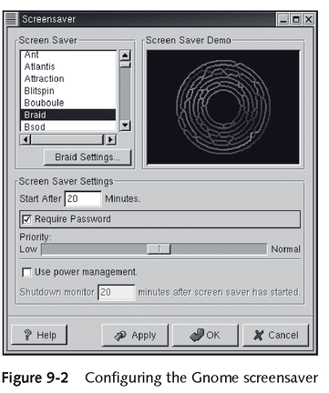
Security Tools for Users

Slide 92
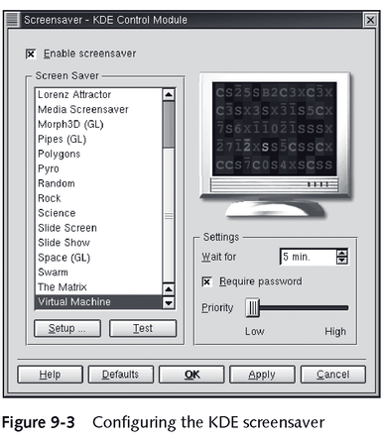
Security Tools for Users

Slide 93
Security Files and Utilities
Linux provides several methods for safeguarding or controlling the login process:
  The root user can only log in from terminals that are listed in the file /etc/securetty
  If the /etc/nologin file exists, only root can log in at that time and when this file is deleted, all users can log in again
  Executable files can have a special file permission set (the Set UID bit, or SUID) that causes them to take on the permissions of the user who owns the file rather than the user who executed the file

Slide 94
Security Files and Utilities
More Linux-provided security methods:
  The Linux file systems support a number of attributes that can be set on any file
  The PAM module pam_time can be used with the login program to limit when a user can log in
  If the standard bash shell for Linux is running, an environment variable can be set which will log a user out after a certain number of idle seconds
  In the tsch shell, an environment variable accomplishes the same thing, but in a matter of minutes, not seconds

Slide 95
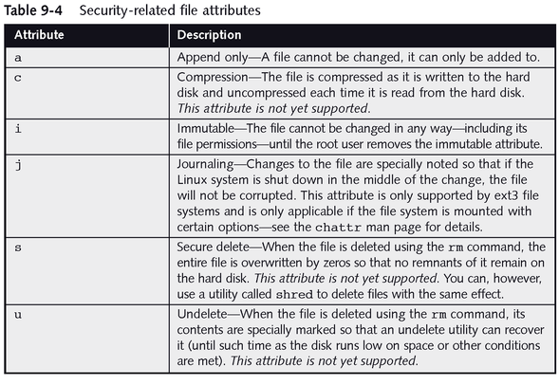
Security Files and Utilities

Slide 96
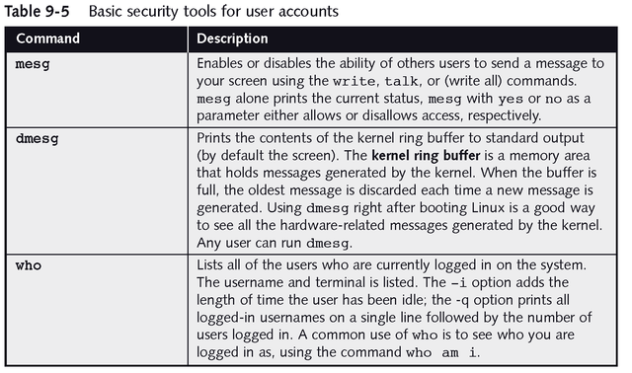
Seeing Who Is Using Linux

Slide 97
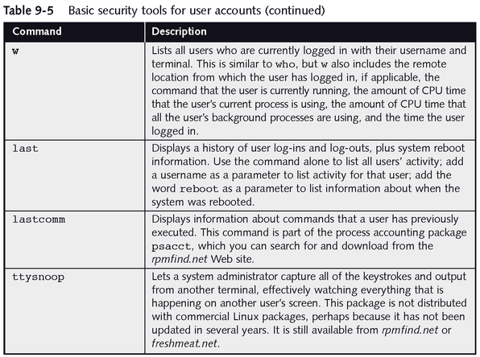
Seeing Who Is Using Linux

Slide 98
Authorization

Slide 99
Authorization
Authorization entails determining whether or not the protection policy permits a given user to perform a given action
Example:
  Badges at a military installation
Many operating systems base authorization decisions on a user’s unique user identifier (or uid):
  User is authenticated during log on and given an appropriate uid
    Must enter valid username and password
  The uid is used to determine which actions are authorized

Slide 100
Access Control Policies
Once a user has logged in the system must decide which actions he or she can and cannot perform
  Examples:
    Bob may be allowed to read files that Alice cannot
    Alice may be permitted to use a printer that Bob cannot
In general, we view the system as a collection of:
  Subjects (users)
  Objects (resources)
An access control policy specifies how each subject can use each object

Slide 101
The Access Control Matrix
Suggested by Butler Lampson
Forms the basis of protection in many real operating systems
  Resources to be protected are called objects
  Every object is within one or more protection domain
  A domain specifies what operations are permitted on the objects it contains
  Authorization to perform an operation on an object in a domain is called an access right

Slide 102
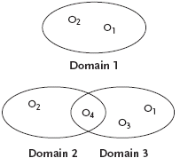
Protection Domains - Example
Assume:
  All students are in domain 1
  All faculty members are in domain 2
  All system administrators are in domain 3

Slide 103
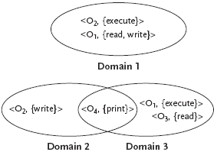
Protection Domains – Example (cont)
Students can execute O₂ and read and write O₁
Faculty can write O₂ and print O₄
Sys admins can execute O₁, read O₃, and print O₄

Slide 104
Protection Domains (cont)
A user can only be in one protection domain at any given time
  Static: a user always operates in the same domain
    Simple
    Inflexible
  Dynamic: a user can switch from one domain to another
    Complex
    More flexible
The domain in which a user is operating determines what actions are and are not permitted

Slide 105

Lampson’s Access Control Matrix
Represent the protection domains and access rights using a matrix:
  Rows represent the domains
  Columns correspond to the objects
  Matrix entries specify the access rights to an object in the corresponding domain

Slide 106
Access Control Policy
The matrix specifies an access control policy for the system:
  Stipulates what actions a given user is allowed to perform on the system
  Examples:
    A student (domain 1) is allowed to read object 1
    A faculty member (domain 2) is not allowed to read object 1
    A faculty member (domain 2) is allowed to write to object 2

Slide 107
Access Control Mechanisms
A mechanism is required to enforce the access control policy
Mechanism #1: store the matrix in (protected) memory
  The matrix is likely to be large and sparse so store only non-empty entries
  One ordered triple that represents the domain, object, and access rights corresponding to each non-empty cell in the matrix:
    (Domain 1, Object 1, {read, write})
    (Domain 1, Object 2, {execute})
    (Domain 2, Object 2, {write})
    (Domain 2, Object 4, {print})
    (Domain 3, Object 1, {execute})
    (Domain 3, Object 3, {read})
    (Domain 3, Object 4, {print})

Slide 108
Access Control Mechanisms (cont)
An attempt by a user in Domain i to perform operation O on Object j
  The operating system consults the list of triples
    Allow: if there is a triple (i, j, R) where O ∈ R, the access rights
    Deny: otherwise
  Examples:
    Allow: attempt to write to Object 2 by a user operating in Domain 2
    Deny: attempt by a user in Domain 1 to write to Object 2
    (Domain 1, Object 1, {read, write})
    (Domain 1, Object 2, {execute})
    (Domain 2, Object 2, {write})
    …

Slide 109
Access Control Mechanisms (cont)
Mechanism #1: store the matrix in (protected) memory
Drawbacks:
  The matrix must be protected against unauthorized modification
  Searching may be slow (if there are many entries)
  Cannot take advantage of special groupings of objects
    Example: the system clock
      Can be read by all users
      Matrix requires an entry in every domain specifying that the clock is readable

Slide 110
Access Control Mechanisms (cont)
Mechanism #2: represent the matrix as an access list
  An access list enumerates, for each object, a set of (domain, access rights) pairs
  Matrix:
  Access list:
    Object 1: (<Domain 1, {read, write}>, <Domain 3, {execute}>)
    Object 2: (<Domain 1, {execute}>, <Domain 2, {write}>)
    Object 3: (<Domain 3, {read}>)
    Object 4: (<Domain 2, {print}>, <Domain 3, {print}>)

Slide 111
Access Control Mechanisms (cont)
An attempt by a user in Domain i to perform operation O on Object j
  The operating system to consult the entry in the access list for Object j
  Object j’s list is searched for Domain i’s entry
    Allow: if there is an access right for O
    Deny: Otherwise
  Access list:
    Object 1: (<Domain 1, {read, write}>, <Domain 3, {execute}>)
    Object 2: (<Domain 1, {execute}>, <Domain 2, {write}>)
    Object 3: (<Domain 3, {read}>)
    Object 4: (<Domain 2, {print}>, <Domain 3, {print}>)
  Examples:
    Allow: attempt to write to Object 2 by a user operating in Domain 2
    Deny: attempt by a user in Domain 1 to write to Object 2

Slide 112
Access Control Mechanisms (cont)
Access lists also allow a default set of rights to be specified for each object
Example: make Object 2 readable in every domain:
Object 2: (<Default, {read}>, <Domain 1, {execute}>, <Domain 2, {write}>)
Advantages:
  Can specify rights available in every domain in a single entry
    Reduces the total amount of storage space required
    Increases efficiency (for default rights)
Disadvantages:
  Must be stored in memory, protected, and searched

Slide 113
Access Control Mechanisms (cont)
Mechanism #3: represent the matrix as capabilities
  A capability list represents the matrix as a list of (object, rights) pairs for each domain
  Matrix:
  Capability list:
  Domain 1: (<Object 1, {read, write}>, <Object 2, {execute}>)
  Domain 2: (<Object 2, {write}>, <Object 4, {print}>)
  Domain 3: (<Object 1, {execute}>, <Object 3, {read}>, <Object 4, {print}>)

Slide 114
Access Control Mechanisms (cont)
Capability lists are not stored in memory by the operating system
Users are given a copy of the capability list for the domain in which they are operating
Each (object, rights) pair for a given domain is called a capability
Example:
  A user in Domain 2 would be given copies of the following two capabilities:
    <Object 2, {write}>
    <Object 4, {print}>

Slide 115
Access Control Mechanisms (cont)
An attempt to perform some operation, O, on Object j
  The capability for j is passed as one of the parameters of O
Example: a user (in Domain 2) might request to write to Object 2
  Pass her copy of the <Object 2, {write}> capability
  The operating system verifies:
    The capability is for Object 2
    Writing is one of the access rights in the capability
  Allow: if the capability is valid
  Deny: otherwise

Slide 116
Access Control Mechanisms (cont)
The operating system must ensure that users cannot:
  Create their own capabilities
  Alter the capabilities they are given
Solution: operating system encrypt capabilities with a secret key before giving them to the users
Capabilities also allow users to share their access rights with others:
  If Alice has the right to read a file but Bob does not
  Alice can give Bob a copy of her capability that will allow him to read the file

Slide 117
Access Control Mechanisms (cont)
Mechanism #3: represent the matrix as capabilities
Advantages:
  OS need not store all the access-control information
    Capabilities are given to users and stored by them
  Access control decisions require no searching of a list
    Capabilities need to be checked
  Allow users to share their capabilities with others
Disadvantages:
  Capabilities must be protected (encrypted)
  Sharing and revoking capabilities is complex

Slide 118
Other Access Control Policies
The HRU model
  Named for its inventors, Harrison, Ruzzo, Ullman
  Describes a protection system using an access matrix
    Rows: the subjects in the system (S₁, S₂, and S₃)
    Columns: the objects in the system (S₁, S₂, S₃, O₁, O₂, and O₃)
    Note: the subjects are considered objects in the system
  A subject is allowed to perform an operation on an object only if it has an access right

Slide 119
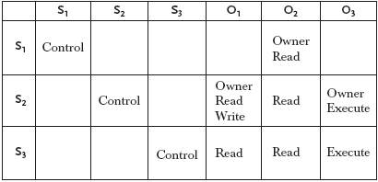
The HRU Model
The access matrix:
Examples:
  S₁ should be allowed to read O₂
  S₃ should not be allowed to write O₁

Slide 120
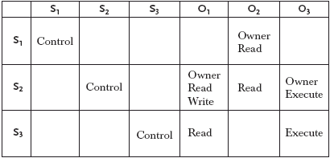
The HRU Model (cont)
The HRU model allows the protection system to change:
  Subjects and objects can be created or destroyed
  Access rights can be entered or deleted from the matrix
Example: S₃’s right to read O₂ can be deleted:

Slide 121
The HRU Model (cont)
The matrix can be changed by a well-defined set of commands that consist of:
  A list of conditions that must be satisfied
  A list of primitive operations that modify the matrix
    Add/delete a subject to the matrix
    Add/delete an object to the matrix
    Add/delete a right to the matrix
Example: the command used to delete S₃’s right to read O₂
  If a subject is the owner of an object
  The subject can perform the delete operation on a right in the matrix

Slide 122
The HRU Model (cont)
A right, r, is said to leak if:
  The execution of some set of commands causes r to be entered into a cell that did not previously contain r
A state where r has leaked is called unsafe
If, starting from an initial state unsafe states are unreachable:
  The matrix is said to be safe for r, since r cannot be leaked

Slide 123
The HRU Model (cont)
The HRU model was designed to be general enough to represent most real protection systems
Main result: Harrison, Ruzzo, Ullman proved that:
  Determining whether or not unsafe states are reachable from a given initial state is not possible for an arbitrary set of commands
  Safety is decidable in some restricted cases:
    No command contains an operation that add subjects or objects
    Mono-operational systems: every command performs only a single primitive operation

Slide 124
The HRU Model (cont)
The HRU model demonstrates that for most useful access control policies:
  Substantial restrictions must be placed on the policy to facilitate analysis
  Even with restrictions analysis is likely to be difficult
  If the policy is proven safe, we still need to show that the system properly implements the policy

Slide 125
Other Access Control Policies (cont)
The take-grant model:
  More restricted than the HRU model
    Not powerful enough to represent an arbitrary protection policy
  Designed to be both useful and efficiently analyzable
  An unlimited number of subjects and objects can be created
  Four primitive operations:
    Take
    Grant
    Create
    Revoke

Slide 126
The Take-Grant Model
A policy is not represented as a matrix
A policy is represented as a directed graph
  Nodes represent subjects and objects
    Unlike the HRU model, subjects are not themselves objects
  Edges represent access rights
Safety question:
  Can a subject gain a given access right to a given object?

Slide 127
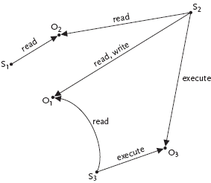
The Take-Grant Model (cont)

Slide 128


The Take-Grant Model (cont)
The create operation
  Allows a subject to add a new object node to which the subject then has a certain set of access rights
  Example: S executes create(O,{read,write}):
The revoke operation
  Allows a subject to delete one or more of its access rights to an object
  Example: S executes revoke(O,{write}):

Slide 129


The Take-Grant Model (cont)
The take operation
  Allows a subject to acquire one or more of the access rights possessed by another subject or object
  Example: S1 takes S2’s read right:
The grant operation
  Allows a subject to confer one or more of its access rights to another subject or object
  Example: S1 grants S2 a read right:

Slide 130
The Take-Grant Model (cont)
More restricted than the HRU model
  Not powerful enough to represent an arbitrary protection policy
Designed to be both useful and efficiently analyzable
  There is an efficient algorithm for determining whether or not a particular subject can acquire a specific right to an object
Work has been done to define useful protection systems based on the take-grant model

Slide 131
Discretionary Vs. Mandatory Access Control
All the access control policies and mechanisms discussed so far have been discretionary
  The owner of an object fully controls what users have what access rights
Mandatory access control policies and mechanisms
  Control over what users have what access rights resides with the system and not the object’s owner
Examples: Bob creates a file
  Discretionary: Bob can give Alice read access to the file if he wishes
  Mandatory: The system may deny Alice read access to Bob’s file regardless of Bob’s wishes

Slide 132
Information Flow Policies
An important class of mandatory access control policies are information flow policies
  Control both direct and indirect paths through which information can flow
Example:
  Alice does not have permission to read a file but Bob does
  Alice convince Bob to read the file and transmit its contents to her
Result: Alice has gained unauthorized access to the file’s contents
  Discretionary access-control policies cannot prevent this breach
  Information flow policies can prevent this breach

Slide 133
The Bell-LaPadula Model
An information flow security policy
Distinguishes between different levels of sensitivity for information and users
  Information: Public records are not sensitive
  Users: Everybody should have access to public records
  Information: The tax returns of individuals are somewhat sensitive
  Users: Only employees of the Internal Revenue Service should have access to tax returns
  Information: Nuclear secrets are extremely sensitive
  Users: Only the most trusted nuclear scientists should have access to nuclear secrets

Slide 134
The Bell-LaPadula Model (cont)
Every user and every piece of information can be assigned a level from a partially ordered set
Example: levels used by the U.S. military
  The set has four elements:
    L = {unclassified, classified, secret, top secret}
  The < relational operator is used to specify a partial ordering on the set:
    unclassified < classified < secret < top secret
  This is a partial ordering since the < relation is:
    Reflexive (L1 < L1)
    Antisymmetric (if L1 < L2 and L2 < L1, then L1 = L2)
    Transitive (if L1 < L2 and L2 < L3, then L1 < L3)

Slide 135
The Bell-LaPadula Model (cont)
Every subject and object in the system is assigned a security level from L
Example:
  Alice might be assigned the level secret
  Bob might be unclassified
  Carol might be classified
  The file memo1 might be classified
  The file memo2 might be top secret

Slide 136
The Bell-LaPadula Model (cont)
The information flow security policy:
  The simple security property: a subject should not be able to read an object at a higher level
    A subject, S, may read an object, O, only if O < S
  The star property (written “∗-property”): a subject should not be able to write to an object at a lower level
    A subject, S, may write to an object, O, only if S < O

Slide 137
The Bell-LaPadula Model (cont)
Example:
  Alice’s level is secret, Bob’s level is unclassified, Carol’s level is classified
  Memo1 is classified, and memo2 is top secret
The simple security property specifies that:
  Memo2 should not be read by Alice, Bob, or Carol
    Memo2’s level (top secret) is higher than theirs (secret, unclassified, and classified, respectively)
  Bob is not allowed to read memo1 (classified), but both Alice and Carol are allowed to read it

Slide 138
The Bell-LaPadula Model (cont)
Example:
  Alice’s level is secret, Bob’s level is unclassified, Carol’s level is classified
  Memo1 is classified, and memo2 is top secret
The *-property specifies that:
  Bob and Carol can write to memo1, since its level (classified) is not lower than theirs
  Alice’s level is secret, so she is not permitted to write to memo1
  Alice, Bob, and Carol are all at a lower level than memo2 and can therefore write to it

Slide 139
The Bell-LaPadula Model (cont)
This information flow policy controls both direct and indirect paths through which information can flow
Example: Bob cannot learn the contents of memo1
  Bob (unclassified) is not allowed to read memo1 (classified) himself
  Alice (secret) is allowed to read memo1 (classified)
    Alice is not allowed to write anything but secret or top secret documents which Bob cannot read
    Bob cannot read anything that Alice writes so Alice cannot tell Bob the contents of memo1
    Problem: Alice may be able to communicate with Bob without writing any files

Slide 140
The Bell-LaPadula Model (cont)
Suppose that Bob can observe some aspect of the system that Alice can control
Example: Bob can determine whether or not Alice is logged in to the system
Bob and Alice agree that:
  Every minute Alice spends logged in will represent a 1
  Every minute Alice spends logged out will represent a 0
Alice could read memo1 and then begin transmitting it, one bit every minute, to Bob using their covert channel
  There are many other covert channels available on most time-sharing systems
  Eliminating all possible covert channels can be challenging

Slide 141
Summary
Important components of computer security:
  User authentication – determine the identity of an individual accessing the system
    Knowledge-based, token-based, and biometrics
  Access control policies – stipulate what actions a given user is allowed to perform on the system
    Discretionary: access control matrix
    Mandatory: the Bell-LaPadula model
  Access control mechanisms – enforce the system’s policy
    Discretionary: access lists, capabilities

