Slide 1
PARALLEL COMPUTERS:
Neat Tools
12 Nov 2004
Oberta A. Slotterbeck
(Obie)
Department of Computer Science
Hiram College

Slide 2
Introduction to This Talk
In this Science Seminar, you’ve heard presentations on
  Biology
  Chemistry
  Physics
  Mathematics
  Computer Science
Although this talk is listed as a computer science talk, you will see it is really interdisciplinary in nature.
Computer Science is the “new kid on the block”, but already it is reaching into and influencing the other, older sciences.

Slide 3
Classical Science
Nature
Observation
Physical
Experimentation
Theory

Slide 4
Modern Science
Nature
Observation
Numerical
Simulation
Physical
Experimentation
Theory

Slide 5
Thus, the Study of Science is Changing Rapidly
The change influences the way we acquire knowledge in science.
In the past, we typically took two different approaches:
  The experimental approach
  The theoretical approach
In recent years, in addition to the above, we take another approach, namely
  The computational approach

Slide 6
Consequently, we are now seeing disciplines such as:
Bioinformatics
Chemical Informatics
Physics Informatics
Biochemical Informatics
Mathematical Informatics
Medicinal Chemistry Informatics
...
Computational Biology
Computational Chemistry
Computational Physics
Computational Biochemistry
Computational Mathematics
...
Just google one of these phrases “computational” or “informatics” and you will locate many programs, research groups, and research level journals with these types names in the title.
Weaving through all of these disciplines is computer science.

Slide 7
Various Flavors of Computation
Computational Science: The systematic development and application of computing systems and computational solution techniques to models of scientific and engineering phenomena.
Two mainstream subareas:
  Scientific computation: Tools, techniques, and theories required to solve mathematical models of science and engineering problems
  Informatics: Techniques for analyzing data obtained by experiments, modeling, database search, and instrumentation.

Slide 8
Grand Challenge Problems
This is a general category of unsolved problems.
To be a Grand Challenge Problem, the problem must exhibit the following characteristics:
  The problem is demonstrably hard to solve, requiring huge amounts of computing power and memory to solve.
  The problem can not be unsolvable.
  The solution must have a significant economical or social impact.
Note: There is some subjectivity to this definition.
Each year a committee selects specific projects for NSF and other government funding under this title.

Slide 9
Some Common Themes in Grand Challenge Problems
The problems are BIG – requiring huge memories
Memories on the order of hundreds of gigabytes
  Gigabyte = 1 billion bytes
When modeling we find
    The larger degrees of freedom we model, the better the approximation
    Interesting models require higher/better approximations
    The problem size often grows as the square or the cube of the resolution.

Slide 10
Some Common Themes in Grand Challenge Problems (Continued)
The problems consume computing power
Interesting computational science problems can (and will) absorb as much computing power as is available at any given time!
Our most powerful machines today are operating in the teraflop range.
What is a teraflop?

Slide 11
Measuring Speed in a Computer
When dealing with PCs, normally stated in clock speed --- i.e. the number of pulses per second generated by an oscillator that sets the tempo for the processor.
Measured in Hertz (Hz).
Clock speed has been roughly doubling every 18 months.
  1990 Intel 8088 was 4.77 MHz
  Today – Intel Pentium 4 is 3.6 GHz

Slide 12
Clock Speed – only one measure of power
Although you often hear the clock speed quoted as a measure of power, it is not always directly proportional to the performance level.
If you double the clock speed and keep all the other hardware the same, you do not necessarily double the processing speed.
Other factors are: type of microprocessor, bus architecture, nature of the instruction set, amount of RAM, amount of cache memory, memory access speed, etc.
In fact, excessive clock speed can be detrimental to the operation of a computer.
Clock speed is a hardware parameter only loosely connected to output or throughput.

Slide 13
Better measures of speed – MIPS, MOPS, or FLOPS
MIPS = millions of instructions executed per second
MOPS = millions of operations executed per second
Floating point operations – arithmetic operations executing on real numbers as opposed to integer numbers.
FLOPS = number of floating point operations executed per second.
  Floating point operations take more time than integer operations

Slide 14
FLOPS vx Hz
Unfortunately, there is no simplistic, realistic, universal relation between clock speed, MIPS, MOPS, and FLOPS although some use a rough approximation of
  4 GFLOPS for PC/Desktops of today.
Remember,
  1 GFLOP = 10⁹ = 1 billion
    There are 6 billion people on earth
  1 TFLOP = 10¹² = 1 trillion (1000 times the number above)

Slide 15
When Do FLOPS Matter?
Running word processing programs, spreadsheets, etc – no big deal how many FLOPS the machine has.
There is a BIG difference when you are
  Working with Grand Challenge Problems
  Working with many other scientific problems
  Gaming (because the 3D world requires floating point calculations)
For these types of problems, we are concerned with FLOPS.
Our most powerful machines today are operating in the teraflop range – i.e. over 1 trillion floating point operations per second.

Slide 16

50 Years of Speed Increases
Today
> 1 trillion flops
One Billion Times Faster!
ENIAC
350 flops

Slide 17
Some Common Themes in Grand Challenge Problems (Continued)
Most require computer simulations.
  Computer simulation uses a mathematical model to simulate a real world situation or problem, and then uses computers to calculate the results of these mathematical models.
  Often a simulation has many characteristics that make it much more desirable than actually performing an experiment in the real world.
    For example, perform computer simulations of nuclear weapons explosions.
    Obviously the ability to avoid actually testing the nuclear weapons provides considerable savings in terms of environmental as well as monetary costs.

Slide 18
Some Common Themes in Grand Challenge Problems (Continued)
Many simulations require real time results.
  Perform a large number of calculations in order to provide real time data to researchers.
    For example, astronomers want radio telescope images to appear in real time so that they can use these images to point the instruments more accurately.
    Another application is to use virtual modeling techniques to allow more accurate controls of scanning electron microscopes.

Slide 19
Some Common Themes in Grand Challenge Problems (Continued)
Supercomputers are needed.
A supercomputer is one in a collection of machines at any given time that is among the fastest in the world.
Supercomputers today are usually parallel machines with multiple processors, not just single processors.
An interesting site: Every 6 months, the fastest 500 machines in the world are updated. This is the list from June, 2004.
http://www.top500.org/list/2004/06

Slide 20
Supercomputer
General-purpose computer
Solves individual problems at high speeds, compared with contemporary systems
Typically costs $10 million or more
$100 million is not an unusual price tag
Found in government and university research labs.
Normally involve some form of parallelism.
Today, need teraflop speeds and 100 gigabyte memories for problems we want to solve.

Slide 21
Some Examples of Grand Challenge Problems That Have Been Funded Recently
Real Time Virtual Reality Modeling
The Human Genome Project
Real Time Radio-Astronomy
Galaxy Simulations
Seismic Models
Total Climate Model
Human Vision Modeling
Combustion Modeling
Nuclear Modeling

Slide 22
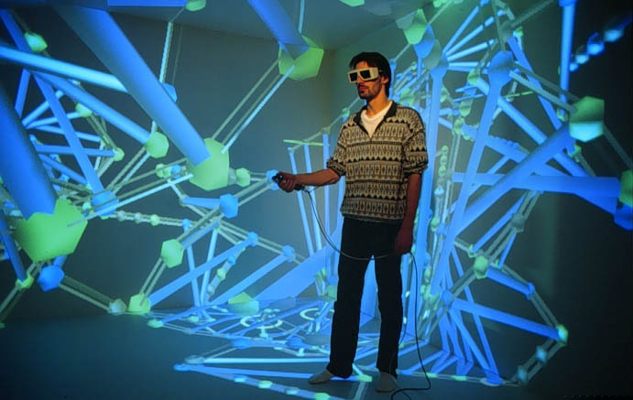
Example of a Virtual Reality Setup
6-Surface VR-CUBE
(Sweden-Center for Parallel Computers)

Slide 23
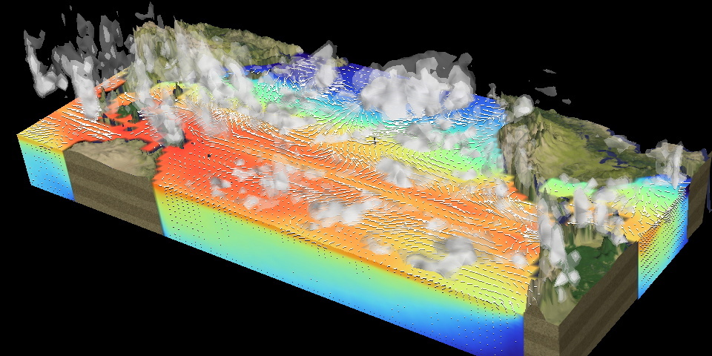
Earth-Simulator – Japan
Fastest computer in world (as of 6/04)*
35.8 TFlops – max 40.9 TFlops - peak
Simulation to study the variability and the predictability in the coupled atmosphere–ocean system.
* Just announced this week- surpassed by IBM Blue Gene/L

Slide 24
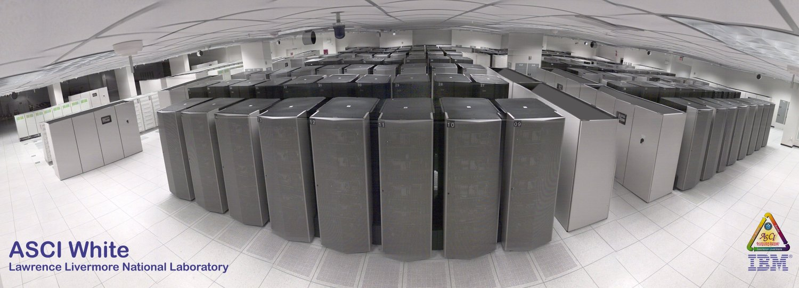
ASCI White (10 teraops/sec)- ranking 13th in world

Slide 25
Demonstration of a simple simulation : Emergency Room
Arena software by Rockwell Software
Simulation is simplistic as we are using only a single processor.
But, includes features usually found in a simulation:
  Graphical output
  Presentation of facts about the simulation
  Ability to run multiple times with different results possibly
Our computer science students use this software to build simulations in CPSC 362: Computer Simulation

Slide 26
CPSC 361 to Research at Virginia University in bioinformatics on an internship
Letter from Gaurav Rana, a computer science-biology major in 2004, to me during an internship.
“I went to one of the postdoc project outlines where around 12 professors were discussing a program to simulate an organism's (Trapanasoma Cruzi) attack scheme on human cells that eventually cause the Chagas disease. I wasn't supposed to actually partake in the discussion, but I proposed a rough draft of the large scale simulation project on Arena, and told them about my project that I completed with you. They really liked the idea and think it will save them a lot of money on errors that may go unseen if programmed in C++.”

Slide 27
The Game of Life – a simple simulation for you to play with
Not really a game, but a simulation.
Posed by J.H. Conway in 1970.
The Conway world basically consists of a board divided evenly by grids.
Each grid can be occupied by only one cell at any time.
A cell once it exists can survive a minimum of one time unit or Generation.
The fate of each cell from generation to generation will be determined by the following rules:

Slide 28
DEFINITION: Each cell with an N is a neighbor of the cell with an X:
 | N | N | N
 | N | X | N
 | N | N | N

Slide 29
Rules of the Game of Life
If the cell:
(a) Has one or no neighbors it will die due to loneliness.
(b) Has four or more neighbors it will die due to over-population.
(c) Has two or three neighbors it will survive.
(d) Is unoccupied it will become populated if it has precisely three neighbors.
All changes take place simultaneously so no births or deaths affect the current generation, only the next one.
In the next generation, cells that died are removed from the grid; cells that survived remain; and an empty cell that fulfilled rule (d) is occupied by a new cell.

Slide 30
Question: What patterns can be generated?
Following these rules, generations may produce a variety of outcomes.
For example, the colony may thrive for a period of time before it abruptly collapses, just like a fallen empire in a real life.
By changing these simple rules one essentially changes the behavior of cell colonies.
Interestingly, the above-mentioned Conway rules are among the few that are able to generate interesting patterns.

Slide 31
Play the Game of Life and Try to Answer These Questions
http://www.bitstorm.org/gameoflife/
Characterize the behavior of the different examples.
Try to design a pattern that acts the same as one of the examples, but starts with a different configuration.
Possible examples are on the next slide ...

Slide 32
Describe an initial pattern different from the examples that produces (eventually)
1) A pattern that never changes its shape.
2) A pattern that oscillates between two or more different patterns.
3) A pattern that glides across the grid continuously.
4) A very long living pattern – one that changes continuously for long periods of time
5) A pattern that dies in the first generation
6) Some other “interesting” pattern, where “interesting” is defined by you!

Slide 33
In case the first site is too slow, other possible sites are provided below:
http://www.bitstorm.org/gameoflife/
  Left drop down menu gives examples
http://www.math.com/students/wonders/life/life.html
  The Open gives examples
http://www.igs.net/~tril/life/life.html
  The Load Pattern gives examples
http://www.cse.sc.edu/~h6h6h6/
  A hexagonal grid. Pattern gives examples.
There are even 3D versions:
  http://www.people.nnov.ru/fractal/Life/Game.htm

