Slide 1
PARALLEL COMPUTERS:
Neat Tools
15 Nov 2004
Oberta A. Slotterbeck
(Obie)
Department of Computer Science
Hiram College

Slide 2
Today:
Parallel Computers
and
Algorithms Designed for Them

Slide 3
Definitions
Parallel computing
  Using multiple computers (or processors) to solve single problems faster
Parallel computer
  Multiple-processor system supporting parallel programming
Algorithm
  A set of instructions to perform a task (often on a computer).

Slide 4
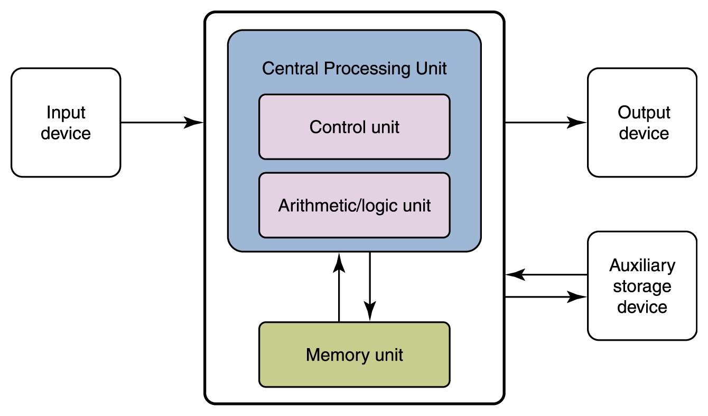
Von Neumann Computer Architecture- Basically, All Are the Same – Example: Your PC

Slide 5
Designing Algorithms for von Neumann Machine
Doesn’t matter which manufacturer made the hardware, an algorithm to solve a problem can be designed for any one of them:
  Mac
  PC
  Sun workstation
  HP workstation
  ●●●

Slide 6
However, there are a lot of different architectures for parallel computers
Characterized by
  Number of processors
  Number of control units
  Location of memory
  The synchronization of the operations
  Interconnection network configuration
Unfortunately, different parallel architectures require different algorithms

Slide 7
Flynn’s Taxonomy for Computers
A Bit Simplistic, but a Good Starting Point
Instruction stream- I
Data stream - D
Single vs. multiple – S vs M
Flynn characterizes four combinations
  SISD
  SIMD
  MISD
  MIMD

Slide 8
SISD
Single Instruction, Single Data
Single-CPU systems
Note: co-processors don’t count
  Functional – like floating point or graphics accelerators
  I/O
Examples: Most computers that you are familiar with such as PCs and workstations

Slide 9
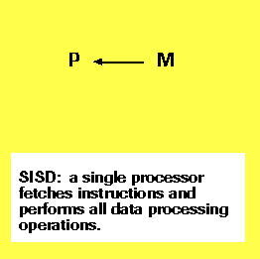
SISD Diagram

Slide 10
Algorithm: Search for a target value among n values using a SISD machine
Let n = number of values
Sequential search
  Requires time proportional to n.
Binary search – provided the values are sorted
  Requires time proportional to log₂n

Slide 11
SIMD
Single Instruction, Multiple Data
Two architectures typically fit this category
  Pipelined vector processor
  (e.g., Cray-1)
  Processor array
  (e.g., Connection Machine)

Slide 12
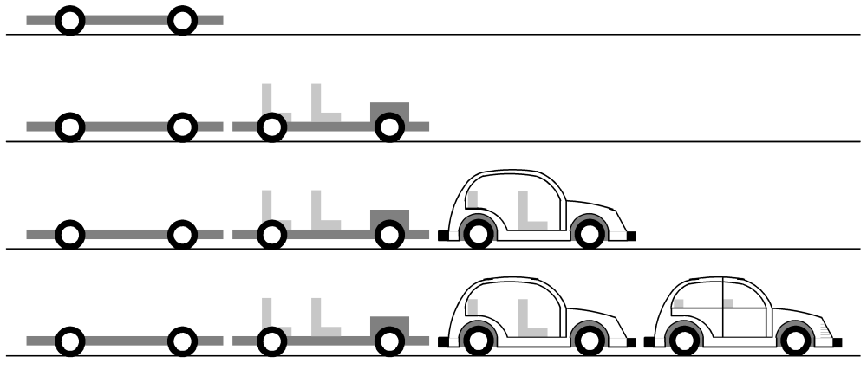
Pipelining – one type of SIMD
Divide a process into stages
Produce several items simultaneously

Slide 13
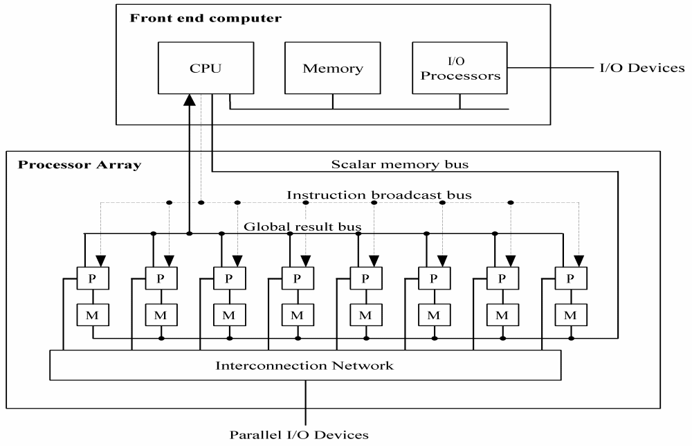
Processor Array – another type of SIMD – (In this lecture, this is what I will mean by SIMD)

Slide 14
SIMDs (Processor Array Types)
Typically the processors (PE = processor elements) are inexpensive and simple.
Consequently, there are many PEs in this type of machine.
One of the Connection Machines from Thinking Machines, Inc., had 64K (~ 64 thousand PEs) and one of the MasPar machines had 16K PEs.

Slide 15
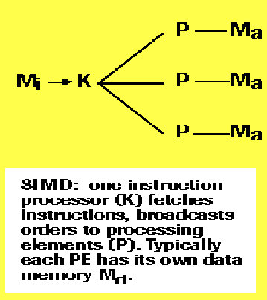
A SIMD Diagram – Analogy – a drill team
Each PE either executes the broadcast instruction or does nothing.

Slide 16
Algorithm: Search for a target value among n values using a SIMD machine
Let n = number of values
If n < number of processors,
  Give one value to each processor
  Requires time proportional to 1.
Otherwise,
  Distribute the values to the processors, with k per processor.
  Requires time proportional to k.

Slide 17
MIMD
Multiple Instruction, Multiple Data
Multiple-CPU computers – typically of two main types
  Multiprocessors – share data through shared memory
  Multicomputers – share data through message passing
Because these are full fledged computers, you rarely see more than 64 processors in a configuration except on a few machines (clusters) which do use up to 512 processors.
However, the clusters do not have sophisticated interconnection networks so message passing is slow.

Slide 18
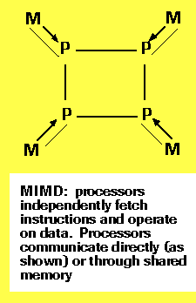
A MIMD Diagram

Slide 19
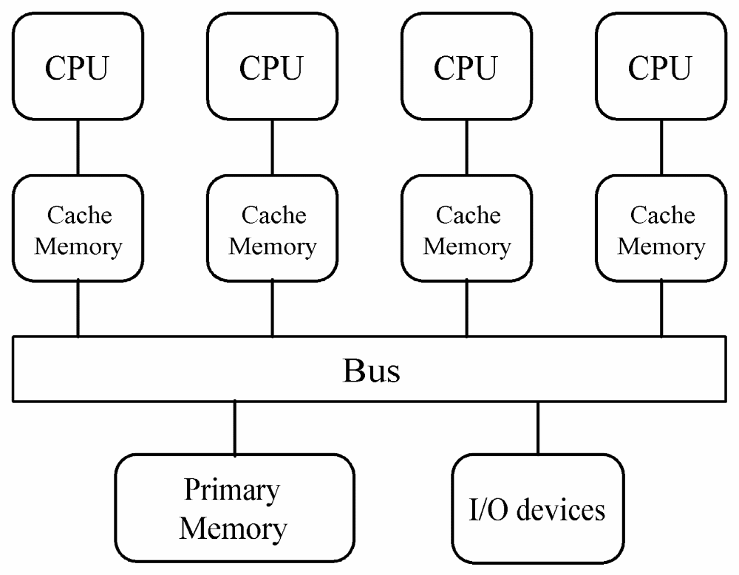
One Type of Multiprocessor with Shared Memory

Slide 20
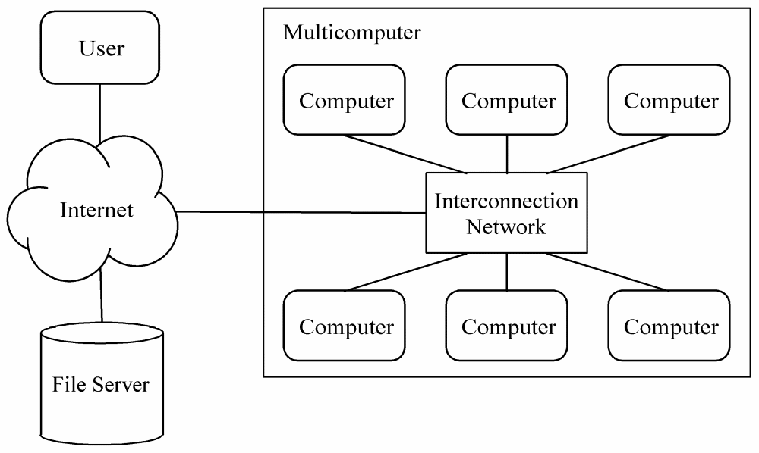
One Type of Multicomputer – a Symmetrical Multicomputer

Slide 21
Algorithm: Search for a target value among n values using a MIMD machine
Let n = number of values
Let k = number of processors
It is unlikely that n < k (number of processors) as searching through say 64 (or even 512) items is trivial.
Thus, assume n >> k.
  Distribute the values to the processors, with n/k per processor
  Requires time proportional to n/k.
  n/k could be large – for example, if n = 64,000 and there are 16 machines, we would have 64000/16 = 4000 items per machine.
  We are in a similar situation to the SISD machine!

Slide 22
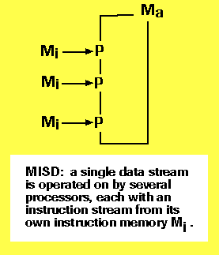
A MISD Diagram – for completeness sake

Slide 23
An Example of a MISD – a Systolic Array Machine
By analogy with the regular pumping of blood by the heart, a systolic array is an arrangement of in an array, also known as a vector or list, where data flows synchronously across the array between neighbors, usually with different data flowing in different directions.
Each processor at each step takes in data from one or more neighbors (e.g. North and West), processes it and, in the next step, outputs results in the opposite direction (South and East).
We won’t look at a search algorithm for this type of machine, although these are interesting to study.

Slide 24
In addition to Flynn’s classification, the interconnection network of a parallel machine plays a role.
An interconnection network
  Connects processors to shared memory
  Connects processors to each other
Various topologies exist
The kind of topology influences
  The ease with which a “problem” is mapped to the parallel computer
  The type of algorithm required for the parallel computer

Slide 25
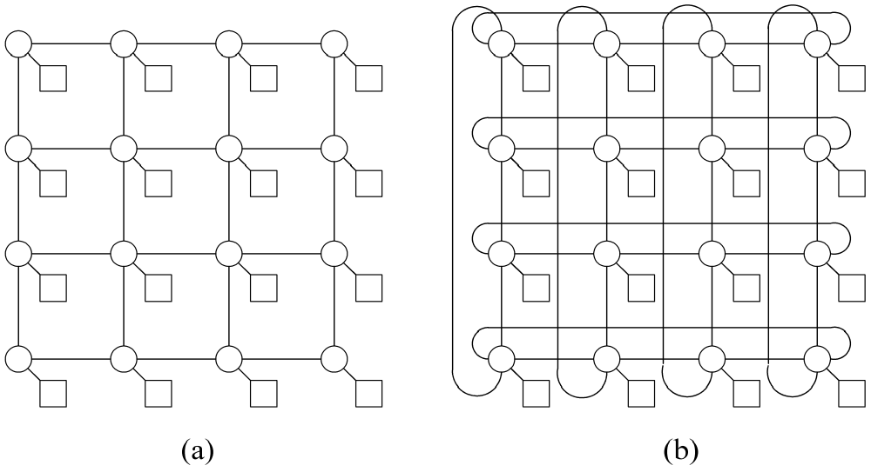
2-D Meshes – plain and wraparound

Slide 26
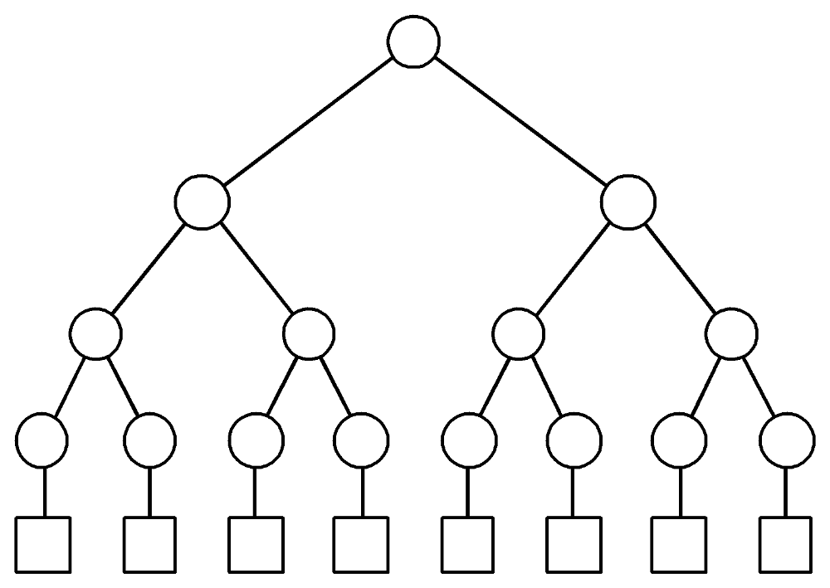
Binary Tree Network

Slide 27
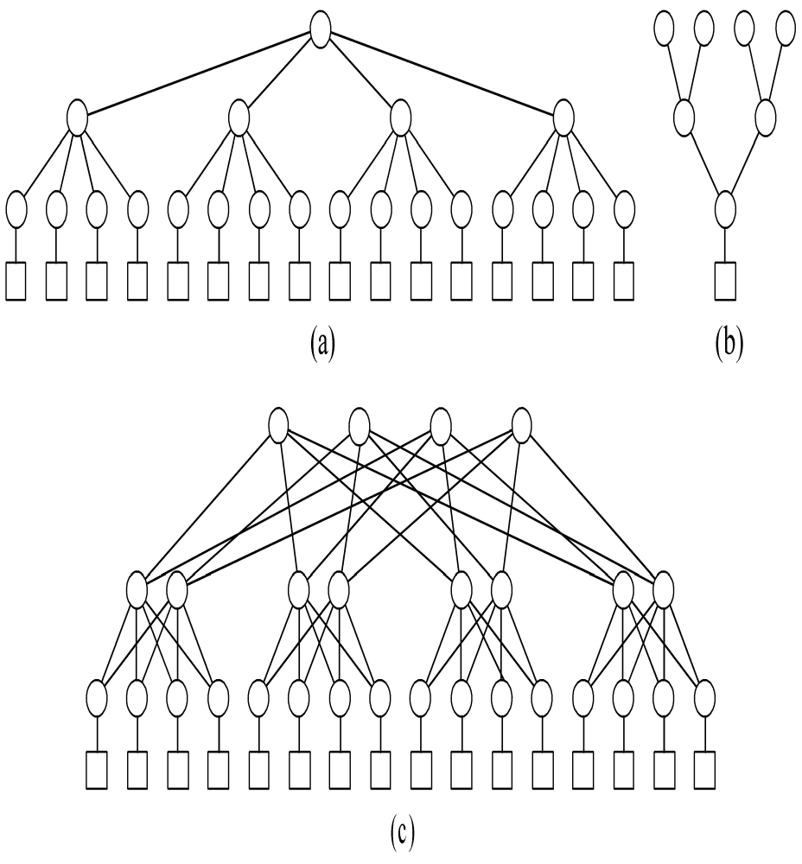
Hypertree Network
From “front” looks like k-ary tree of height d
From “side” looks like upside down binary tree of height d

Slide 28
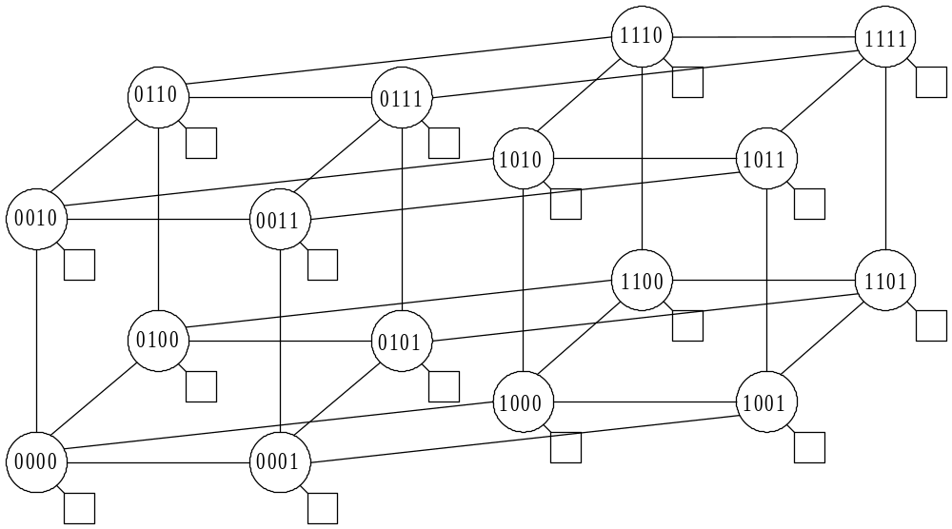
Hypercube Network

Slide 29
Sorting Demos
We looked at searching on various machines.
Let’s investigate sorting.
First, a couple of demos.
On SISD machines, there are many sorting algorithms.
Two of these SISD algorithms are shown here along with two parallel sorting algorithms
Sorting Demos

Slide 30
Demo of Bubble Sort- SISD Machine
15
23
18
12
6
11
49
0
7

Slide 31
Demo of Bubble Sort- SISD Machine
15
23
18
12
6
11
49
0
7

Slide 32
Demo of Bubble Sort- SISD Machine
15
23
18
12
6
11
49
0
7

Slide 33
Demo of Bubble Sort- SISD Machine
15
18
23
12
6
11
49
0
7

Slide 34
Demo of Bubble Sort- SISD Machine
15
18
23
12
6
11
49
0
7

Slide 35
Demo of Bubble Sort- SISD Machine
15
18
12
23
6
11
49
0
7

Slide 36
Demo of Bubble Sort- SISD Machine
15
18
12
23
6
11
49
0
7

Slide 37
Demo of Bubble Sort- SISD Machine
15
18
12
6
23
11
49
0
7

Slide 38
Demo of Bubble Sort- SISD Machine
15
18
12
6
23
11
49
0
7

Slide 39
Demo of Bubble Sort- SISD Machine
15
18
12
6
11
23
49
0
7

Slide 40
Demo of Bubble Sort- SISD Machine
15
18
12
6
11
23
49
0
7

Slide 41
Demo of Bubble Sort- SISD Machine
15
18
12
6
11
23
49
0
7

Slide 42
Demo of Bubble Sort- SISD Machine
15
18
12
6
11
23
0
49
7

Slide 43
Demo of Bubble Sort- SISD Machine
15
18
12
6
11
23
0
49
7

Slide 44
Demo of Bubble Sort- SISD Machine
15
18
12
6
11
23
0
7
49

Slide 45
Demo of Bubble Sort- SISD Machine
15
18
12
6
11
23
0
7
49
End of Pass 1 – repeat with the first 8 items

Slide 46
Demo of Bubble Sort- SISD Machine
15
12
6
11
18
0
7
23
49
End of Pass 2 – repeat with the first 7 items
It should be clear that after 8 passes, these should be in ascending order from left to right.
Unfortunately, as demonstrated, this sort is slow (although easy to understand).
Timing is proportional to n^{2.}

Slide 47
Demo of QuickSort- SISD Machine
15
23
18
12
6
11
49
0
7
Basic idea – 1st Partition the collection – i.e.
1) Move first item (15) into its proper slot
2) Move all numbers less than or equal to 15 to the left of 15 to form Piece 1.
3) Move all numbers greater than 15 to right of 15 to form Piece 2.
Then repeat the QuickSort on Piece 1 and Piece 2

Slide 48
Demo of QuickSort- SISD Machine
Partition first
15
23
18
12
6
11
49
0
7

Slide 49
Demo of QuickSort- SISD Machine
Partition first
15
23
18
12
6
11
49
0
7

Slide 50
Demo of QuickSort- SISD Machine
Partition first
15
7
18
12
6
11
49
0
23

Slide 51
Demo of QuickSort- SISD Machine
Partition first
15
7
18
12
6
11
49
0
23

Slide 52
Demo of QuickSort- SISD Machine
Partition first
15
7
18
12
6
11
49
0
23

Slide 53
Demo of QuickSort- SISD Machine
Partition first
15
7
0
12
6
11
49
18
23

Slide 54
Demo of QuickSort- SISD Machine
Partition first
15
7
0
12
6
11
49
18
23

Slide 55
Demo of QuickSort- SISD Machine
Partition first
15
7
0
12
6
11
49
18
23
Crossed

Slide 56
Demo of QuickSort- SISD Machine
End of first partitioning
11
7
0
12
6
15
49
18
23
Note: 15 is in the correct location
Everything to left of 15 is less than or equal to it
Everything to right of 15 is larger than it.

Slide 57
Demo of QuickSort- SISD Machine
End of first partitioning. Quicksort on left side
11
7
0
12
6
15
49
18
23

Slide 58
Demo of QuickSort- SISD Machine
End of Quicksort on left side. Quicksort on right side.
0
6
7
11
12
15
49
18
23

Slide 59
Demo of QuickSort- SISD Machine
End of Quicksort on right side – all sorted
0
6
7
11
12
15
18
23
49
It can be shown the timing for Quicksort is proportional to n log₂n (which is better than n² for large n.)

Slide 60
Demo of Odd-Even Sort- SIMD Machine with Even Number of Processors with Interconnection Network as Shown
15
23
18
12
6
11
49
0
Each processor holds one number.
Two processors can communicate and move data between them only if they are connected.

Slide 61
Demo of Odd-Even Sort- SIMD Machine with Even Number of Processors with Interconnection Network as Shown
15
23
18
12
6
11
49
0
Simultaneously, compare numbers in same color PEs
Start with PE 1,3,5, and 7 on left – ie. odd numbered processors

Slide 62
Demo of Odd-Even Sort- SIMD Machine with Even Number of Processors with Interconnection Network as Shown
15
23
12
18
6
11
0
49
Swap to place smallest on left

Slide 63
Demo of Odd-Even Sort- SIMD Machine with Even Number of Processors with Interconnection Network as Shown
15
23
12
18
6
11
0
49
Simultaneously, compare numbers in same color PEs
Start with PE 2,4, and 6 on left – i.e. even numbered processors
Note the first and last PEs are not used in this step

Slide 64
Demo of Odd-Even Sort- SIMD Machine with Even Number of Processors with Interconnection Network as Shown
15
12
23
6
18
0
11
49
Swap to place the smallest on left.

Slide 65
Demo of Odd-Even Sort- SIMD Machine with Even Number of Processors with Interconnection Network as Shown
15
12
23
6
18
0
11
49
Now, repeat with odd numbered processors.
12
15
6
23
0
18
11
49

Slide 66
Demo of Odd-Even Sort- SIMD Machine with Even Number of Processors with Interconnection Network as Shown
12
15
6
23
0
18
11
49
Now, repeat with even numbered processors.
12
6
15
0
23
11
18
49

Slide 67
Continuing, we have a maximum number of 8 compare and swap cycles.
12
6
15
0
23
11
18
49
6
12
0
15
11
23
18
49
6
0
12
11
15
18
23
49
0
6
11
12
15
18
23
49
Odd-even sort is proportional to n for n processors.

Slide 68
Sorting Demos
We looked at sorting on various machines.
On SISD machines, there are many sorting algorithms.
Two of these SISD algorithms are shown here along with two parallel sorting algorithms.
We only looked at the Odd-Even Sort.
Sorting Demos

Slide 69
Summary – I hope I have demonstrated, in the short time available, that:
Parallel computers ARE neat tools
  They are needed to investigate computational science and Grand Challenge Problems.
  They challenge us to design algorithms that are different than those used for SISD machines.
We certainly won’t run out of problems in either computational science or parallel algorithm design in the near future!

