Slide 1
Extending Software Engineering Teamwork Beyond Physical and Curricular Boundaries
Oberta A. Slotterbeck
Ellen L. Walker
Hiram College
{obie, walkerel}@hiram.edu

Slide 2
Observations
Software development is best learned by doing it
Communication and teamwork skills are crucial to software engineering
One term is too short for a realistic software development experience, including relevant instruction

Slide 3
Our Approach: Break up the Software Engineering Course
Each course emphasizes one technical aspect, all involve teamwork
Large-scale projects persist between courses
Teams mix experience levels, backgrounds (traditional vs. returning students)
Team compositions change in each course; students may or may not change projects

Slide 4
Courses Included
2000-2001 Academic Year
  Database Design, Sep-Nov 2000 (12 weeks)
  Project Management, Dec 2000 (3 weeks)
  Interface Design, Apr-May 2001 (3 weeks)
2001-2002 Academic Year
  Systems Analysis, Sep-Nov 2001 (12 weeks)
  Verification and Testing, Dec 2001 (3 weeks)
  Software Evaluation, Apr-May 2002 (3 weeks)
+ Integrated Research Projects

Slide 5
<catalog descriptions here>

Slide 6
Connecting Courses
Projects consist of artifacts
  Teams use artifacts from prior courses
  Teams generate artifacts for future courses
Initialization
  Specifications from faculty members
  Specifications from external customers
Storage
  Written submissions and presentations
  CASE documents (using Rational Rose)

Slide 7
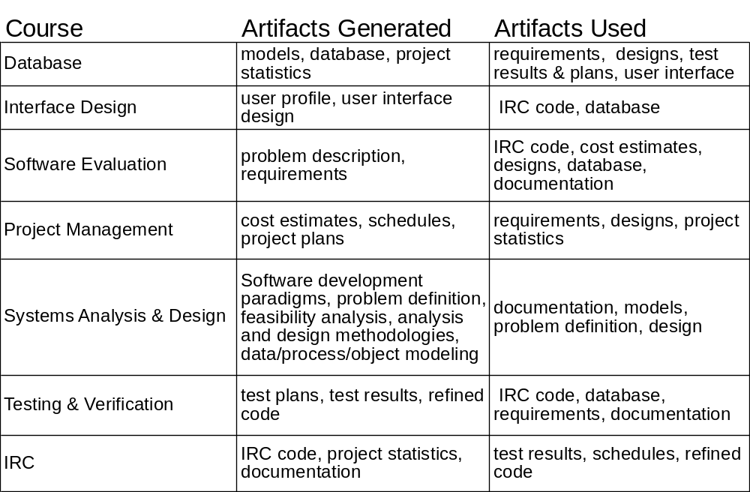
Courses and Artifacts

Slide 8
Database Projects
Genealogy Database
  Customer: Professor / hobbyist
Gravestone Research Database
  Customer: Librarian / researcher
Internship Database
  Customer: Psychology department
“Books for Zimbabwe” database
  Customer: Professor / Project director

Slide 9
Database Deliverables
Design documents
  Requirements documents, elicited from customers
  ER diagram, relational design (graphical & SQL)
  Proof of BCNF
  User documentation
Working implementation
User approval

Slide 10
Project Management Projects
Automating the advising process
Web-based registration
Both projects chosen to reflect current administrative software needs

Slide 11
Project Management Deliverables
Project Plan
  Overview & summary of recommendations
  Feasibility assessment, cost-benefit analysis & risk analysis
  Requirements (system description to be added in Systems Analysis course)
  Work breakdown structure, Function Point and COCOMOII analyses, Gantt chart, CPM analysis
Statement of Work

Slide 12
Team Assignments
Teams balanced among traditional & weekend students
  Traditional: 18-22, full-time students, 11% women
  Weekend: older, working full-time, 42% women
Experimenting with team structure
  Database: assigned teams, rotation of roles
  Project Management: self-selected teams and roles

Slide 13
Team Structure: Database
Teams assigned by professor
Members had explicit roles / duties
  Roles rotated three times during 12 weeks
Explicit instruction in collaboration
  Meeting guidelines provided
  Minutes, interim reports and evaluation required
Adapted from S.W. Dietrich and S.D. Urban’s work at Arizona State University (DUE 9451489) http://cse.asu.edu/~cse412

Slide 14
Team Structure: Project Mgmt
Teams self-selected
  Each to include at least one weekend and one traditional student
Student roles self-selected
  Role-switching was not suggested or mandated
  Most leaders had completed Database
No explicit instruction in collaboration

Slide 15
Communication among Teams
No collaborative software (yet)
  Lab not available until Jan 2001 !
Successful teams met face-to-face at least weekly
Successful teams used email frequently
Future work: Will collaborative software (e.g. whiteboards, chat software) change this?

Slide 16
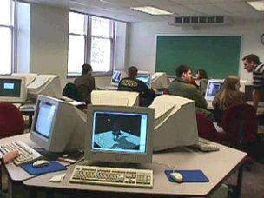
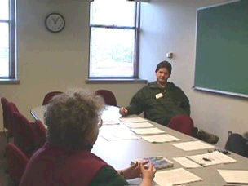
CS Collaborative Lab
Computer Classroom
Conference Room

Slide 17
Design Goals for Lab
Physical setup encourages collaboration
Individual or team use of workstations
Good sight lines for presentation
Plenty of blackboard space (enough for several groups to use simultaneously)
Private meeting space (conference room)
Comfortable for long-term use

Slide 18
Summary of Progress
Two of six courses have been taught so far
CS Collaboration Lab, server and software now available, but not for those courses
Artifacts from 7 projects currently available for modification / use

Slide 19
Evaluation
Both courses used:
  Peer evaluations of the group experience
  Presentation evaluations by the audience
  Professor evaluations of each group and the project produced.
The database course required write-ups and evaluations for the 3 phases of the project.

Slide 20
Groupwork Evaluation
Database Course
Most successful group spoke of
  strong leadership
  good communication
  learning from each other
  dedication of each individual to group
  enjoyment in working with others
Least successful group spoke of
  difficulties with finding times to meet
  poor communication
  attempt of one individual to take possession of project
  failure of individuals to do their part

Slide 21
Groupwork Evaluation
Project Management Course
Most students were pleased with their groupwork.
  Deliverables were simpler than for the database course.
  The main pressure was the short working time.
Each group had at least one person who had been in the database course. Interestingly,
  They assumed leadership roles.
  They claimed their previous experience in the database course had taught them better how to work in a group.
  One of the most successful groups had 2 members that had been in the least successful group in the database course!

Slide 22
Evaluation
Continual themes were:
  "It is difficult to schedule times to meet."
  "We all had different working schedules and had problems communicating."
  "E-mail helped, but face-to-face meetings were best."
  "In-class work is where things went well; outside of class we needed better organization."
  "We needed more time to discuss and define the work together."
  "We live so far apart we had trouble meeting."
Hopefully, with our groupware (whiteboards, chat software) in place in the future we can address some of these concerns.

Slide 23
The talk
I suggest using slides 1, 2, 3, 7, 16, 18 for the talk
Be careful not to spend too much time on any of them though :-)

