Slide 1

MANAGING UNDERGRADUATE COMPUTER SCIENCE RESEARCH
Oberta A. Slotterbeck
obie@hiram.edu

Slide 2
OUR ENVIRONMENT
Small, liberal arts, BA-I, 4-year, 152 year-old college in NE rural Ohio
College has ~850 traditional students (+ ~300 FTE weekend college students)
No graduate program
First computer science degree was in 1977
3 permanent faculty + 3 adjuncts in Computer Science Department
Searching for a 4th permanent faculty member
  I would be delighted in talking with anyone about the tenure track position!

Slide 3
OUR ENVIRONMENT
~50 traditional computer science majors (sophomore and beyond)
~57 weekend college students in a computer systems management major (joint with Management and Communications Departments)
Remarks today deal ONLY with the traditional computer science major.

Slide 4
TYPICAL STUDENT PROFILE
Residential
Not wealthy- 87% on aid (most need-based and some merit-based)
At most one parent has a college degree
Unlikely to have any understanding of what a graduate degree or research is.
Most believe you must pay for graduate work just as you do for college.
Some of our majors are international students
  Financially better off than our other majors
  Still do not have an understanding of what research is
  But, they plan to go to graduate school.

Slide 5
HISTORY OF OUR ATTEMPTS TO INTRODUCE RESEARCH EXPERIENCES
We tried all sorts of capstone experiences in 28 years:
  Topic chosen by professor
  by student
  Time frame of one term
  more than one term
  Start research in senior year
  in junior year
  Research done by one individual
  by a group
  Professor compensated by course reduction
  extra pay
  nothing!

Slide 6
WE WERE DISSATIFIED ...
Many students felt they would do better if they had more introductory experiences
  Time management was a major problem!
  When do students learn what research is about?
There was little time for recovery if things did not go well.
A bad experience meant an unpleasant experience was the last thing the student remembered about their major!
Younger students didn't learn from the seniors' experiences as they viewed the senior seminar as something to worry about in the future.

Slide 7
WE WERE DISSATIFIED ...
Faculty were stretched thin if students chose their own topics.
Students were not happy when all seniors had to work in the same area.
Meaningful research experiences were being introduced too late in college for many students to think seriously about a career in research.

Slide 8
NECESSITY IS THE MOTHER OF INVENTION
Hiram College, always quite innovative in its educational approaches, decided to introduce in 1995:
An unusual calendar- each semester is a
  12 week term (3 courses max for student; 2 for faculty) followed by a
  3 week term (1 course max for student and faculty)
In trying to place our senior seminar, we frankly had problems.
We decided to change what we were doing.

Slide 9
PROJECT-RESEARCH COURSES (initially)
Decided to require two "project-research" courses of each student.
These had to be taken in two of the three areas:
  Artificial Intelligence
  Graphics
  Compiler Design---example
These could be taken anytime the courses were offered.
This worked fairly well, but we had scheduling problems as these courses were on 2 or 3 year rotation schedules.

Slide 10
INTEGRATED RESEARCH COMPONENTS (IRCs)
QUESTION: Why only allow research experiences in these 3 areas?
Allow a student to have an integrated research experience with any upper division course as long as
  The student is taking the course and doing all the usual work in it.
  The professor decides to offer an IRC with the course.
  The department agrees.
Try to offer at least one IRC each 12-week session.

Slide 11
IRCs
Courses are 2 hours for the student.
A student is required to take two IRCs.
Students can take the upper division course without taking an IRC.
Faculty are paid as if this is an extra course.

Slide 12
IRCs
IRCs offered in the 1999-2002 years (and enrollment):
Graphics - 20
Computer Vision (2 classes) - 16
Computer Simulation -11
Parallel and Distributed Computing -8
Artificial Intelligence - 7
Systems Administration - 6
Database Design - 4
Operating Systems - 3
Compiler Design -1

Slide 13
WHAT WE ARE SEEING
Good students are urged to do an IRC at the end of their sophomore year.
Thus, some students are turned on very early to research.
Typically, one IRC is done in the junior year and one in the senior year.
Unsuccessful IRCs (on the first attempt) are followed in most cases by very successful (or at least much improved) IRCs later.
There is recovery time before graduation looms!

Slide 14
WHAT WE ARE SEEING
There is a nurturing and supportive culture that has developed as students at all levels are participating in IRCs.
Presentations are at the end of each 12-week in the evening--- professional meeting style (plus food!).
  Parents and friends are invited.
A surprise to us: Although it looks like the faculty member is doing twice the work, that really isn't happening! Students are teaching students--- especially wrt time management!

Slide 15
We've Discovered ...
Some research starts in one IRC and then is expanded in another.
  Examples
Students must propose research and work on it while they are enrolled in the corresponding course and learning material.
  This uncertainty is not uncommon in "real" research.
As all students take IRCs, not all the research is deep--- but, some is!!
Students are encouraged to present at student conferences and to publish with a faculty member.

Slide 16
Questions about details are welcome!
Obie Slotterbeck: obie@hiram.edu
Ellen Walker: walkerel@hiram.edu
Maher Atwah: atwahmm@hiram.edu
Departmental web page: http://cs.hiram.edu

Slide 17
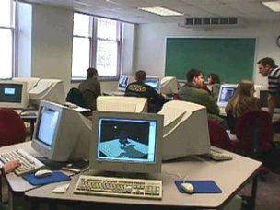
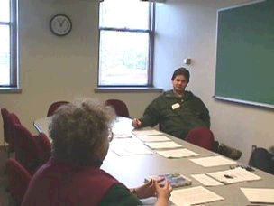
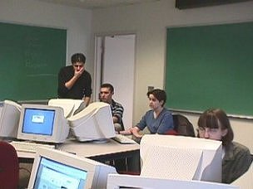

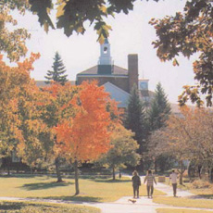
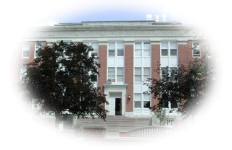
DON'T FORGET- WE HAVE A POSITION!!

