Slide 1
Extending Software Engineering Teamwork Beyond Physical and Curricular Boundaries
Oberta A. Slotterbeck
Ellen L. Walker
Hiram College
{obie, walkerel}@hiram.edu

Slide 2
Observations
Software development is best learned by doing it
Communication and teamwork skills are crucial to software engineering
One term is too short for a realistic software development experience, including relevant instruction

Slide 3
OUR ENVIRONMENT
Small, liberal arts 4-year college
Classes involved are
  predominately in our Weekend College
  a mix of Weekend College students (average age 35; working; 42% female; living as far as 50 miles from the campus) and traditional students (18-22 years old; residential; predominately male)
Unusual calendar- each semester is a
  12 week term (3 courses max for student)
  3 week term (1 course max for student)

Slide 4
Our Approach: Break up the Software Engineering Course
Each course emphasizes one technical aspect, all involve teamwork
Large-scale projects persist between courses
Teams mix experience levels, backgrounds (traditional vs. returning students)
Team compositions change in each course; students may or may not change projects

Slide 5
Connecting Courses
Projects consist of artifacts
  Teams use artifacts from prior courses
  Teams generate artifacts for future courses
Initialization
  Specifications from faculty members
  Specifications from external customers
Storage
  Written submissions and presentations
  CASE documents (using Rational Rose)

Slide 6
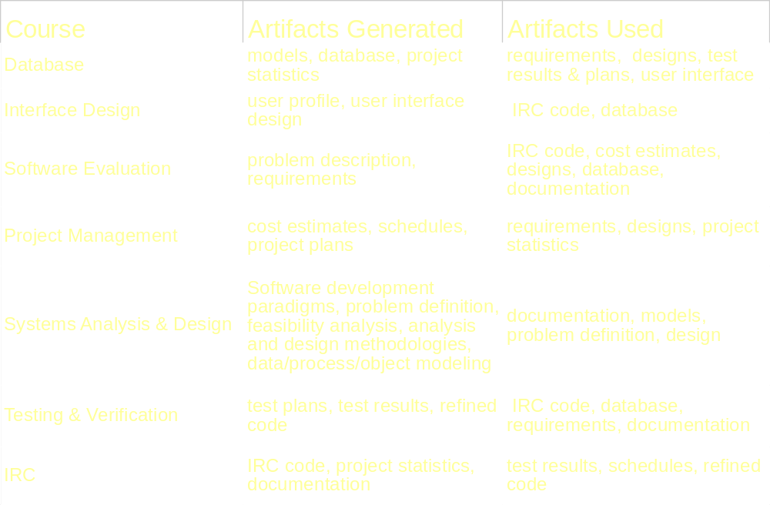
Courses and Artifacts

Slide 7
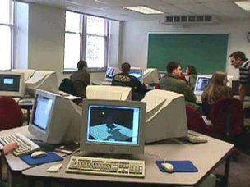
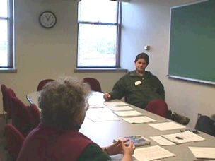
CS Collaborative Lab
Computer Classroom
Conference Room

Slide 8
Summary of Progress
Two of six courses have been taught so far
CS Collaboration Lab, server and software now available, but not for those courses
Artifacts from 7 projects currently available for modification / use

