Slide 1
Legal and Ethical Issues in Computer Security
Chapter 11

Slide 2
Legal Issues

Slide 3
Note
I am not a lawyer, nor do I have training in the law.
I am not an expert on all the various interpretations that exist concerning today's laws.
Remember that much of law is defined by what happens in the courts when a law is challenged or used.
This section is more to make you aware of the fact that prosecution for cyber crimes is being boosted by much stiffer laws than in the past.
Many people have the mistaken belief, even today, that cyber crimes are often not prosecuted.
This is not true today after a flurry of laws were passed in the late 1990s.

Slide 4
Many Legal Considerations
Intellectual property law
Privacy law
Contract law
Tort law
Legislation enacted in US to encompass computer and online acts
State laws
International laws

Slide 5
What is Intellectual Property?
An intangible product of the mind
Free for anyone to use unless protected
Protected by governments to promote various public policies
Treated like personal property, i.e., can be sold, licensed, destroyed
Examples: patents, trademarks, copyrights, trade secrets

Slide 6
Types of Protections for Intellectual Property
Patents – inventions (about 20 years)
  Protect ideas – new ways of doing something
Copyrights – expressions (about 90 years)
  Ideas NOT protected – only the way it is conveyed
Trademarks – symbols (perpetual if actually used)
  Protects consumers and brand value
Trade Secrets – secrets (perpetual if kept secret)
  Competitive advantages maintained secret
Notes:
focus on patents and copyright

Slide 7
Patents
Protect useful, new and non-obvious Ideas
Right to exclude others from making, using, selling or importing the invention
Fixed term legal monopoly granted by the federal government
  Encourage inventors to publicly disclose their inventions to advance the state of art
Claims define the scope of protection
  Competitors can design around
  Can have a patent on an invention but still infringe someone else’s patent

Slide 8
Subject Matter of Patents
Can protect compositions of matter, articles of manufacture, processes, “new uses” of known products, new combinations of known elements, business methods – including computer software
Cannot protect pure “ideas,” products of nature, mathematical algorithms, physical or chemical laws or principles, or abstract mechanisms
Implementation of the idea is not a prerequisite for patent protection

Slide 9
Patent Ownership
Average time from filing to issuance is 3 years
Term – 20 years from first effective filing date
  was 17 years from issuance (June 8, 1995)
Default - owned by the individual inventors
  U.S. applications must be filed for in the names of the inventors
  Employment agreement may provide that employees are required to assign inventions to company
  Inventors sign Assignment to grant rights to company

Slide 10
Patent Costs
Cost to obtain a U.S. patent is high
  Range is typically $10,000 to $40,000
Maintenance fees after issuance add even more to the cost
Cost to enforce (or defend against) a U.S. patent
  Range usually depends upon amount in controversy
    < $1 million - $350,000 to $750,000
    $1 million to $25 million - $1,000,000 to $3,000,000
    > $25 million - $2,300,000 to $6,000,000

Slide 11
Copyright Subject Matter
ORIGINAL works of authorship FIXED in any tangible medium of EXPRESSION
Does not require publication or distribution
Copyright is secured as soon as the work is created or fixed in a tangible medium
Federal copyright registration provides: public record, right to sue in court, statutory damages and attorney. fees, etc.
Notice is no longer required, but still desirable
Registration is not required, but is
  Prerequisite to infringement suit and remedies
  Prima facie evidence of validity
Notes:
only slight amount of originality required, but more than a phonebook listing
registration within 5 years of publication, registration establishes prima facie evidence court of the validity of the copyright and of the facts stated in the certificate.
If registration is made within 3 months after publication of the work or prior to an infringement of the work, statutory damages and attorney's fees will be available to the copyright owner in court actions. Otherwise, only an award of actual damages and profits is available to the copyright owner.
Registration allows the owner of the copyright to record the registration with the U. S. Customs Service for protection against the importation of infringing copies.

Slide 12
Copyright Subject Matter
Categories (but not limited to these)
  literary works
  musical works
  dramatic works
  pantomimes and choreographic works
  pictorial, graphic, and sculptural works
  motion pictures and other audiovisual works
  sound recordings
  architectural works
Notes:
only slight amount of originality required
but more than a phonebook listing

Slide 13
Copyright = Bundle of Rights
Owner has 6 exclusive rights:
  To reproduce the work
  To create “derivative works”
  To distribute copies to the public
  To display the work publicly
  To perform the work publicly
  To perform through digital transmission

Slide 14
How Long is
Copyright Protection?
Single Author = Life + 70 years
Joint Authors = Last Life + 70 years
Work For Hire = Shorter Of 95 years from first publication or 120 years from creation

Slide 15
Copyright Law Traps
Copyright law is counter-intuitive
  You may own the physical object but not the underlying copyright!
Lots of misinformation out there!
  “I can copy if I do not make any money”
The Internet makes it SO EASY!!
  Over $11 billion lost to piracy each year
A notice is no longer necessary to have a copyright for works published after March 1, 1989
A notice is still desirable to inform public
  Eliminates any innocent infringer defense

Slide 16
Work Made For Hire
Who owns software created by an independent contactor that I paid a “salary”?
  The independent contractor – all you have is a license unless there is a written assignment from the independent contractor
Copyrights are owned by the author, except:
  Works prepared by an employee within the scope of employment; or
  Works specially commissioned for use as a contribution to …(list of 9 types of works, e.g. an atlas or a test), and if the parties signed an agreement calling the work a “work made for hire.”
Notes:
collective work, part of a motion picture or other audiovisual work, translation, supplementary work, compilation, instructional text, test, answer material for a test, atlas

Slide 17
Copyright Infringement
The elements:
  Copying
  Access
  Substantial similarities

Slide 18
Fair Use
Fair use was originally designed to allow educators and reviewers to use works without citing everything.
Four Fair Use Factors:
  Purpose - commercial vs. nonprofit and educational
    Criticism, comment, news reporting, teaching, research
  Nature – published vs. non-published
  Amount and Substantiality
    Even 2% can be too much if it is the “heart and soul”
  Effect on the Market of the Original Work
    Was a license available for a fee?
    Is it a transformative work?

Slide 19
Liability from Copyright Infringement of Another
Vicarious liability arises when the defendant possesses the right and ability to supervise the infringing conduct and has a direct financial interest in it.
Contributory infringement occurs when a defendant induces, causes, or materially contributes to the infringing conduct of another, with knowledge of the infringing activity.
Notes:
Napster

Slide 20
Copyright Costs
Cost to obtain a copyright registration - $500
  $30 filing fee
Cost to enforce (or defend against) a copyright
  Range usually depends upon amount in controversy
    < $1 million - $100,000 to $300,000
    $1 million to $25 million - $200,000 to $1,000,000
    > $25 million - $500,000 to $1,650,000
Loss of statutory damages and attorneys fees
  If registration is obtained after infringement

Slide 21
Trade Secrets
Examples:
  Chemical formulas
  Manufacturing processes
  Machine designs
  Plant designs
  Computer programs
  Customer/supplier lists
  Recipes

Slide 22
What Can Be a Trade Secret?
Valuable information not generally known
Reasonable attempt to protect
Economically valuable to competitors
Not discoverable by examination of products, services or publications

Slide 23
Protecting Computer Objects
Copyrights, patents, and trade secrets provide different forms of protection to sensitive objects.
Which ones are appropriate for objects that computer scientists deal with - namely,
  Hardware
  Firmware
  Object code
  Source code
  Documentation
  Web sites
  Domain names and URLs

Slide 24
Patenting Hardware
Hardware such as chips, disk drives, floppy disks, USB keys, etc. can be patented
The medium itself can be patented.
If a new process is invented for manufacturing, it can be patented also.
Consequently, most hardware to be protected is protected by patenting.

Slide 25
Patenting Firmware
This is a murkier area.
The physical devices on which microcode is stored or special-purpose chips such as a graphics card can be patented.
However, data (instructions, algorithms, microcode, programs) are generally not patentable.
What about a copyright?
  They aren't an expression of an idea in a form that promotes dissemination of the idea.
A trade secret seems a reasonable approach.

Slide 26
Copyright of Computer Software
Software usually is classified as a “literary work”
Requires the deposit of first 25 and last 25 pages of source code although what is to be accepted for object code protection is not clear.
One difficulty is to develop legal precedents to define the equivalence of two pieces of computer code.
Some companies purposely embedded small errors in the code in order to determine if a copyright violation has occurred.
Many companies combine copyright protection with trade secret protection.

Slide 27
Protecting Other Computer Objects
Documentation: A copyright is appropriate as documentation can be compared to a work of fiction or non-fiction.
  The documentation has to be copyrighted separately from a program.
Web Site: Content on a web site is media, like a book or photograph.
  Thus, copyright protection is the obvious choice.
Domain names and URLs: Typically these are best protected by a trademark, which gives exclusive rights of use to the owner of such identifying marks.
The "look and feel" of an interface: The courts have decided this is a copyrighted object.

Slide 28
Information - A New Commodity for Sale
Formerly, objects to be protected were
  Things - i.e. glassware, cars, etc.
  Services - i.e. hair styling, an operation, etc.
Today there is a 3rd category for sale which has a need for protection - information.

Slide 29
Information - A New Commodity for Sale
But, information has characteristics that differ from the other two:
  Information is not depletable.
  It can be replicated without affecting the original.
  It has minimal marginal cost - i.e. the cost to produce another item.
  The value is often time dependent.
  Information is often transferred intangibly.

Slide 30
These Characteristics Affect the Legal Treatment of Information
This is an area where the law is still evolving.
  Software is often downloaded. How do you prevent it from being passed to someone who did not pay for it?
  Newspapers and magazines are posted on line, but protecting them from uncompensated access is difficult.
  What about data in a database - how can it be protected?
  Electronic commerce has special problems especially when the goods are traded electronically.

Slide 31
Comparing Copyright, Patent and Trade Secret Protection
 | Copyright | Patent | Trade Secret
Protects | Expression of idea, not idea itself | Invention—way something works | Secret, competitive advantage
Protected Object Made Public | Yes; intention is to promote publication | Design filed at Patent Office | No
Must Distribute | Yes | No | No
Ease of filing | Very easy, do-it-yourself | Very complicated; specialist lawyer suggested | No filing
Duration | Originator’s life + 70 yrs; 95 y. For company | 19 years | Indefinite
Legal Protection | Sue if unauthorized copy sold | Sue if invention copied/reinvented | Sue if secret improperly obtained

Slide 32
Computer Crime - Difficulties in Handling
A separate category for computer crime is needed
  because special laws are needed.
Special laws are needed to deal with:
  New rules of property for computer crime
    Bits of information are now considered property (were not in 1984)
  New rules of evidence for computer crime
    Hard to prove authenticity of evidence (easy to change!)

Slide 33
Computer Crime - Difficulties in Handling
  Value of privacy is now recognized by several federal/state laws
  Value of data - courts understand value of data better
  Acceptance of computer terminology
    Law lags behind technology in acceptance of new terminology
  Difficulty in defining computer crime
    Legal community is slow in accommodating advances in computing
    Law changes are cautious/conservative by nature

Slide 34
Computer Crime - Difficulties in Handling
.
Difficulty in prosecuting computer crime
  Reasons:
    Lack of understanding of what is done
    Lack of physical evidence
    Lack of recognition of assets
    Lack of political impact
    Complexity of computer cases
    Lenient treatment of juveniles involved in computer crime

Slide 35
Privacy
  The Internet is obviously a privacy threat
    Unencrypted e-mail / web surfing / attacks
  Corporate rights and private business
    Companies may collect data that U.S. gov’t is not allowed to
  Privacy for sale - many traps
    “Free” is not free…
      E.g., accepting frequent-buyer cards reduces your privacy

Slide 36
Privacy
Identity theft – the crime many consider the most serious crime against privacy
Threats to privacy
  Aggregation and data mining
  Poor system security
  Government threats
    Government has a lot of people’s most private data
      Taxes / homeland security / etc.
    A tension: People’s privacy vs. homeland security concerns

Slide 37
Privacy - Some Questions
Should you expect privacy with your emails?
Should you expect privacy with your computer/online activities at work?
Should you expect privacy with data related to your visit at a website? (website privacy policy)
Should you expect privacy with your medical records? (HIPAA or Health Insurance Portability and Accountability Act)
Should you expect privacy with your credit records? (Privacy Act of 1988)

Slide 38
Origins of Privacy Law
Tort law
  Intrusion upon seclusion of another
  Appropriation of name or likeness of another
  Publicity given to private life of another
  Publicity placing another person in false light
Constitutional law
Statutes

Slide 39
Some Controls for Protecting Privacy
Authentication
Anonymity
  Needed particularly if we ever have computer voting
Pseudonymity
Encryption
Legal privacy controls

Slide 40
Some Legal Privacy Controls
  1996 — HIPAA
    Privacy of individuals’ medical records
  1998 — EU Data Protection Act
    Privacy protections stronger than in the U.S.
  1999 — Gramm-Leach-Bliley Act
    Privacy of data for customers of financial institutions

Slide 41
Contract Law
Contract or agreement governs what the parties agreed to: what each party will do and not do under the agreement
Written preferred over verbal
Software license such as shrinkwrap or clickwrap licenses spells out the what rights are granted to the licensees
Employment and subcontractor agreements may determine who owns the IP

Slide 42
Some of the Specific Laws

Slide 43
Know the Law Before You Experiment With Some of the Software We Will Study
We will look at some laws that you should know about.
We will not thoroughly consider each law, but only consider some of the critical sections and highlights.
Realize there are other pertinent laws in the U.S. and when you leave the U.S., different countries have their own laws, also.
In the last few years, there has been a significant change in that more people have been prosecuted under these laws than in earlier years.

Slide 44
Laws regulating computer use and misuse haven't developed as swiftly as the technology.
In the last few years, Congress and the courts have started responding aggressively to the threat posed by computer crime.
Before 1996--when the Computer Fraud and Abuse Act was amended significantly--prosecutors had to rely on old statutes to make their cases and many of these statutes were inadequate when applied to the new area of computer crime.
The scene as changed considerably, however, since then.

Slide 45
Earlier Laws
One of the difficulties initially was that many of the laws used when computers started to be used were not written for electronic crime.
Thus, laws written for other types of crime were invoked to prosecute electronic crime - often unsuccessfully.
One of the first of these was:
  1934 The National Stolen Property Act (NSPA).

Slide 46
1934 - The National Stolen Property Act
The National Stolen Property Act (NSPA) prohibits the transportation in interstate commerce of "any goods, wares, securities, or money" valued at $5,000 or more that are known to be stolen or fraudulently obtained.
This has been interpreted to include computerized transfers of funds.

Slide 47
1952 - The Wire Fraud Act
Wire fraud is an act of fraud that uses electronic communications, such as making false representations on the telephone, to obtain money.
The federal Wire Fraud Act provides that any artifice to defraud by means of wire or other electronic communications (such as radio or television) in foreign or interstate commerce is a crime.
Fraud is a knowing misrepresentation of the truth or concealment of a material fact to induce to another to act to his or her detriment.

Slide 48
1952 - The Wire Fraud Act
Violation of the Wire Fraud Act can result in a fine, imprisonment of up to 20 years, or both.
If the violation affects a financial institution, the fine will not exceed $1,000,000, nor will imprisonment exceed 30 years.
The Wire Fraud Act makes it illegal to use interstate wire communications systems, which ostensibly includes the internet, to commit a fraud to obtain money or property.
In addition, computer-aided theft involving the use of interstate wires or mails is considered criminal under this law.

Slide 49
1986 - The Electronic Communications Privacy Act (ECPA) [Title 18 USC Sections 2510-2521, 2701-2710]
This law extended government restrictions on wire taps from telephone calls to include transmissions of electronic data by computer.
Later, the ECPA was amended, and weakened to some extent, by some provisions of the USA PATRIOT Act.
Part of the act which allowed the FBI to order ISPs to disclose records about their customers was ruled unconstitutional under the First (and possibly Fourth) Amendments in ACLU v. Ashcroft (2004).

Slide 50
1986 - Electronic Communications Privacy Act
This act made it a crime to intercept or disclose the contents of wire, oral or electronic communication
Exceptions:
  A commercial system operator can view e-mail if it suspects damage to its system or harm to another user
  An employer may have company-wide rules permitting the company to read your e-mail
  Law enforcement officials

Slide 51
Under the ECPA, unauthorized access to computer messages, whether in transit or in storage, is a federal crime.
There is a clause that permits the ISP employees to read messages in order to maintain service or to protect the provider from damage.
  For example, if an ISP suspects that a virus is being disseminated via its systems, it has a right to intercept messages to determine whether its service is, indeed, a carrier of a virus.
Like traditional wiretapping, the ECPA allows the government to obtain a warrant to access electronic communications or records.

Slide 52
1986 - Electronic Communications Privacy Act
The wiretap act states there cannot be any intentional “interception” of wire, oral or electronic communication in an illegal manner
Interception- lawyers asked what does this word mean? Only while being transmitted? What about stored?
Lawyers decided “intercept” only means when data is traveling, not when stored => thus need for the Stored Communications Act

Slide 53
Application of Electronic Communication Privacy Act
Some people did not like web cookies.
These people argued cookies obtained by a company violated stored communications act because it is info stored on your hard drive.
Also some claimed this violated the wiretap law because the company intercepted the user’s communication to other sites
  But the Electronic Communication Privacy Act states if one of the parties of the communications authorizes these types of interceptions, then laws not broken

Slide 54
1986 - The Stored Communications Act
This act regulates when an electronic communication service provider may look at the contents of or other information about a customer’s emails and other electronic communications to private parties.
Congress passed the SCA to prohibit a provider of an electronic communication service from knowingly divulging the contents of any communication while in electronic storage by that service to any person other then the addressee or intended recipient.

Slide 55
1986 - The Stored Communications Act
As courts have held, the SCA protects users whose electronic communications are in electronic storage with an ISP or other electronic communications facility.
It reflects Congress’s judgment that users have a legitimate interest in the confidentiality of communications in electronic storage at a communications facility.
Under the act, an offense is committed by anyone who:

Slide 56
1986 - The Stored Communications Act
  (1) intentionally accesses without authorization a facility through which an electronic communication service is provided;
  (2) intentionally exceeds an authorization to access that facility; and thereby obtains...[an] electronic communication while it is in electronic storage in such system.
  However, it does not apply to an electronic communication that is readily accessible to the general public.

Slide 57
1994 - Fraudulent Presentment and Related Unauthorized Credit Card Transactions Made by Access Device—18 U.S.C.1029.
Access device – type of application or piece of hardware that is specifically created to generate access credentials (Passwords, Credit card numbers, long distance telephone service access codes, PINs, etc.) for the purpose of unauthorized access
Trial and error are used.
Defense now is to have an additional 3 digit identifier in addition to 16 digit credit card number

Slide 58
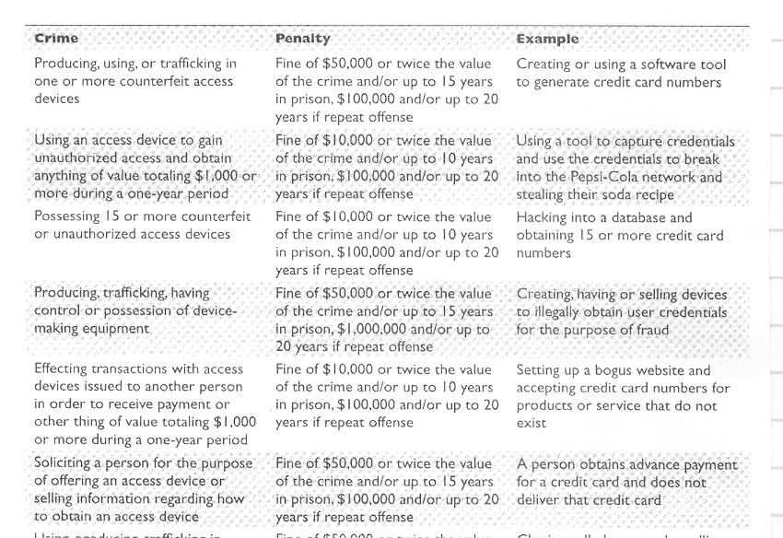
18 USC 1029: Fraud And Related Activity In Connection With Access Devices - 1994

Slide 59
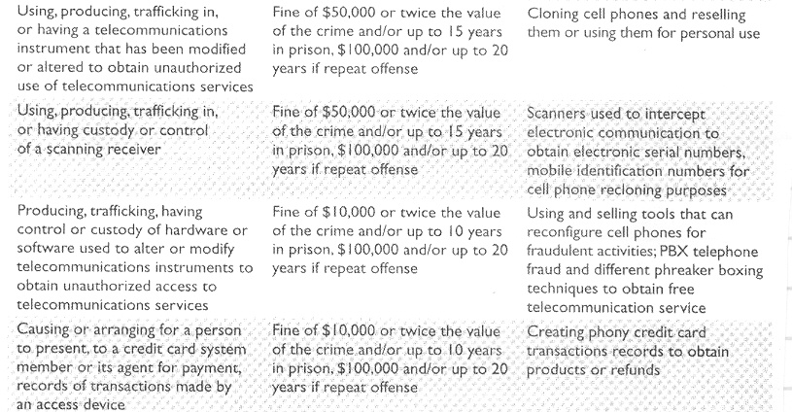
18 USC 1029: Fraud And Related Activity In Connection With Access Devices - 1994

Slide 60
Example “Access Device” Crime
2003 Lowe’s Retail store
Three crackers circumvented a wireless network at a Lowe’s store in Michigan to gain entrance to the central computer system in North Carolina
They installed programs in several retail stores networks across country to capture credit card numbers from customers making a purchase
Charges: conspiracy, wire fraud, computer fraud, unauthorized computer access, intentional transmission of computer code, attempted possession of unauthorized access devices

Slide 61
1996 - Title 18 USC Section 1030 of the Computer Fraud and Abuse Act (CFAA)
In the United States, the primary federal statute criminalizing cracking was the Computer Fraud and Abuse Act (CFAA) of 1986.
In 1996, the Act was amended by the National Information Infrastructure Protection Act of 1996 and codified as Title18 USC. Subsection 1030.
The CFAA was amended further in October 2001 by the USA PATRIOT Act, Section 1030, in particular to deal with fraud and associated activities carried out with computers.
These acts give jurisdiction to the FBI and the Secret Service for computer crimes under these acts.

Slide 62
Originally the CFAA applied only to government computers and computers with projects on it that were funded by the government.
Today, as extended, it applies to a broad group of protected computers, including any used in interstate commerce or foreign commerce or communication.
  This makes almost all computers protected!
The CFAA, drafted and extended with the future in mind, provides the principal basis for criminal prosecution of cybercrime in the United States.
Broad in its application, the CFAA can be modified to reflect emerging changes in technology and criminal techniques.

Slide 63
1996 - CFAA
Computer Fraud and Abuse Act covers development and release of malware such as worms and viruses.
Example: web-TV attack: hacker sent an email to web-TV subscribers that reset their internet dial in number for TV schedules to 911.
Max penalty is 10 years in prison and $250,000 fine

Slide 64
1996 - CFAA
It is not a comprehensive provision, instead it fills gaps in the protection afforded by other state and federal criminal laws.
It is a work that over the last two decades, Congress has kneaded, reworked, recast, and amended to bolster the uncertain coverage of more general federal trespassing, threat, malicious mischief, fraud, and espionage statutes.

Slide 65
In Simple Terms, What Does the CFAA Prohibit?
Accessing a computer without authorization and subsequently transmitting classified government information. [Subsection 1030(a)(1)];
Theft of financial information [Subsection 1030(a)(2)];
Accessing a "protected computer," which the courts have recently interpreted as being any computer connected to the internet, even if the intruder obtains no data [Subsection 1030(a)(3)];
http://www.pbs.org/wgbh/pages/frontline/shows/hackers/blame/crimelaws.html

Slide 66
In Simple Terms, What Does the CFAA Prohibit?
Computer fraud [Subsection 1030(a)(4)];
Transmitting code that causes damage to a computer system [Subsection 1030(a)(5)];
Trafficking in computer passwords for the purpose of affecting interstate commerce or a government computer [Subsection 1030(a)(6)];
and computer extortion [Subsection 1030(a)(7)].
http://www.pbs.org/wgbh/pages/frontline/shows/hackers/blame/crimelaws.html

Slide 67
1996 - CFAA - Penalties Imposed
A conviction for violation of most of the provisions of the CFAA can be up to fifteen years in prison and up to a $50,000 fine or twice the value involved.
Second offenses can penalize with up to twenty years in prison and up to a $100,000 fine or twice the value involved.
The law also allows any target suffering damage or loss by reason of a violation of the CFAA to bring a civil action against the perpetrator for damages.

Slide 68
1996 - CFAA
Basically, there are two types of unauthorized access that can be prosecuted under the CFAA:
  Wholly unauthorized access by outsiders.
  Situations where individuals, such as employees, contractors, and others with permission, exceed their authorized access and commit crimes.
Realize that crimes that fall under the CFAA jurisdiction are labeled as federal crimes.

Slide 69
1996 - CFAA
Computer Fraud and Abuse states if someone accesses a computer in an unauthorized manner or exceeds one’s access rights, they can be found guilty of a federal crime
Example: several Cisco employees exceeded their system rights and issued themselves almost 8 million shares of Cisco stock

Slide 70
1996 - CFAA
“Protected Computer” – computer used by US government, financial institutions, and any system used in interstate or foreign commerce or communications => this means all computers not just government computers
FBI given responsibility for cases with national security, financial institutions, organized crime.
Secret Service – crimes pertaining to treasury department and any other crime not covered by FBI jurisdiction including “critical infrastructure”

Slide 71
1996 - CFAA: Clarifying the Word "Damage"
One of the most confusing definitions under the CFAA was the term “damage.”
The old version of the CFAA defined “damage” as a loss aggregating at least $5,000 in value during any one-year period to one or more individuals.
There were several confusing terms in that definition.
  First, what constituted a loss?
    Did it include just wages and downtime?
    Did it also include lost business profits and enhanced security costs?

Slide 72
1996 - CFAA: Clarifying the Word "Damage"
  Second, what if a hacker caused $1,000 to five computers?
    Could those different losses be aggregated to reach the $5,000 threshold?
  Finally, there was debate whether the loss had to be to an “individual,” as the statute required.
    Was a company an “individual”?
Network administrators were constantly confused about which hacking incidents actually invoked the CFAA.

Slide 73
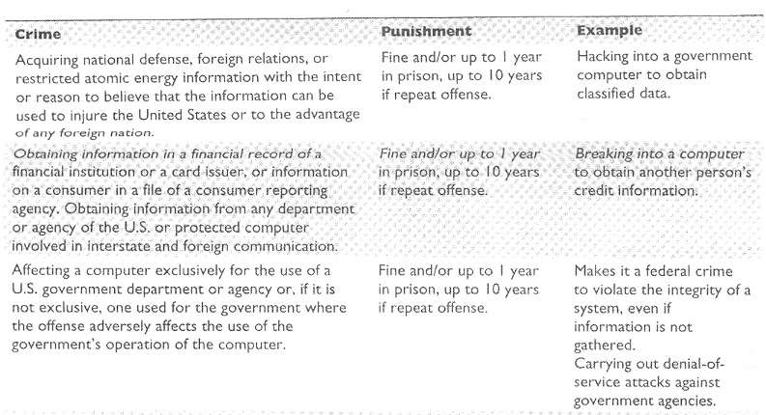
1996 - More Details on CFAA

Slide 74
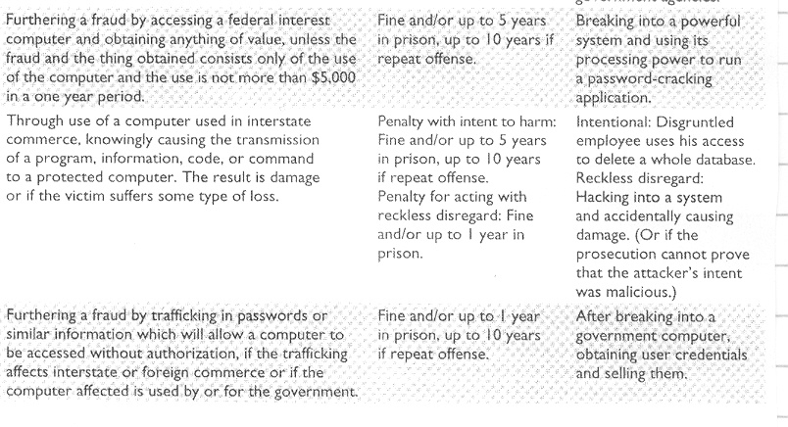
1996 - More Details on CFAA

Slide 75
1996 - Economic Espionage Act
Enacted in 1996, the Economic Espionage Act (EEA) has both domestic and international components and condemns foreign espionage as well as theft of trade secrets.
It has been used to prosecute industrial espionage through traditional means as well as the newer electronic pilfering methods.
In essence, the EEA makes it a federal crime to take, download, receive, or possess trade secret information obtained without the owner's authorization.

Slide 76
1996 - The Economic Espionage Act
This act criminalizes the misappropriation of trade secrets (including conspiracy to misappropriate trade secrets and the subsequent acquisition of such misappropriated trade secrets) with the knowledge or intent that the theft will benefit a foreign power.
Penalties for violation are fines of up to US $500,000 per offense and imprisonment of up to 15 years for individuals, and fines of up to US $10 million for organizations.

Slide 77
1996 - The Economic Espionage Act
It also criminalizes the misappropriation of trade secrets related to or included in a product that is produced for or placed in interstate (including international) commerce, with the knowledge or intent that the misappropriation will injure the owner of the trade secret.
Penalties for violation for this are imprisonment for up to 10 years for individuals (no fines) and fines of up to US $5 million for organizations.

Slide 78
1998 - Digital Millennium Copyright Act (DMCA)
DMCA implements two 1996 treaties of the World Intellectual Property Organization for the US.
It criminalizes production and dissemination of technology, devices, or services intended to circumvent measures that control access to copyrighted works and it also criminalizes the act of circumventing an access control, whether or not there is actual infringement of copyright itself.
In addition, the DMCA heightens the penalties for copyright infringement on the Internet.

Slide 79
1998 - Digital Millennium Copyright Act (DMCA)
Prohibits devices or services that are primarily designed to circumvent, that have only limited commercial significance purpose or use other than to circumvent, or that are marketed for use in circumventing technological measures to prevent unauthorized access or copying of copyrighted work.

Slide 80
1998 - Digital Millennium Copyright Act
Exceptions:
  Law enforcement, intelligence and other government activities
  Nonprofit library, archive and educational institution for the purpose of making a good faith determination whether to obtain authorized access
  Reverse engineering to identify and analyze for the purpose of achieving interoperability

Slide 81
1998 - Digital Millennium Copyright Act
Exceptions:
  Research to identify flaws and vulnerabilities of encryption technologies
  When the technology is capable of collecting or disseminating personally identifying information of online activity of a natural person
  Testing the security of a computer, computer system or computer network with the authorization of its owner or operator

Slide 82
1998 - Digital Millennium Copyright Act (DMCA)
Does not allow one to tamper with and break an access control mechanism that is put into place to protect an item that is protected under the copyright law.
If an item is not copyrighted but you have an access control mechanism that someone breaks, DCMA does not apply!
There does not need to be any infringement upon the item that is protected by the copyright law for prosecution to take place
If someone reverse-engineers some type of control and does nothing with actual content, still can be prosecuted.

Slide 83
1998 - DMCA Remedies
Civil action in Federal Court for damages
Criminal action for up to $500K fine or up to five years imprisonment for first offense, to up to $1 million fine or up to ten years imprisonment for repeat offense

Slide 84
1998 - DMCA OSP Safe Harbor
Limits liability for copyright infringement by online service providers (OSPs) if they merely provide:
  Transitory communications
  System caching
  Storage of information at direction of users
  Information location tools (directories, search engines)
Notes:
transitory: transmission not initiated by OSP, done by automatic process without selection of material by OSP, OSP doesn’t determine the recipient, transmitted without modification
caching: retain copies for limited time material provided by someone other than the OSP, comply with rules to refresh the material, cannot modify material, must remove material once properly notified by owner
storage: OSP not have the requisite knowledge of infringing activity, not receive financial benefit directly attributable to infringing activity, remove material upon proper notice

Slide 85
1998 - The Identity Theft and Assumption Deterrence Act (ITADA) [Title 18 U.S.C. Section 1028(a)(7)]
Passed by Congress in 1998, this act criminalizes identity theft and allows courts to assess the losses suffered by individual consumers.
Identity theft is defined as follows:
"Whoever knowingly transfers or uses, without lawful authority, a means of identification of another person with the intent to commit, or otherwise promote, carry on, or facilitate any unlawful activity that constitutes a violation of federal law ..."

Slide 86
1998 - The Identity Theft and Assumption Deterrence Act
The Identity Theft and Assumption Deterrence Act makes identity theft a Federal crime with penalties up to 15 years imprisonment and a maximum fine of $250,000. It establishes that the person whose identity was stolen is a true victim. Previously, only the credit grantors who suffered monetary losses were considered victims.

Slide 87
2001 - The USA PATRIOT Act
The name stands for "Uniting and Strengthening America by Providing Appropriate Tools Required to Intercept and Obstruct Terrorism Act of 2001"
The act expands the authority of U.S. law enforcement agencies for the stated purpose of fighting terrorism in the United States and abroad.
The act increases the ability of law enforcement agencies to search telephone, e-mail communications, medical, financial and other records.
It eases restrictions on foreign intelligence gathering within the United States

Slide 88
2001 - The USA PATRIOT Act
The act expands the Secretary of the Treasury’s authority to regulate financial transactions, particularly those involving foreign individuals and entities
It enhances the discretion of law enforcement and immigration authorities in detaining and deporting immigrants suspected of terrorism-related acts.
The act also expands the definition of terrorism to include domestic terrorism, thus enlarging the number of activities to which the USA Patriot Act’s expanded law enforcement powers can be applied.

Slide 89
2001 - US Patriot Act Extends CFAA
This act specifically extended the CFAA to any computers located outside the US as long as they affect interstate or foreign commerce or communication of the US.
So, if the US can physically arrest the attackers, they can prosecute them no matter where they live in the world.
Recall when the FBI agent was here on a recruiting visit last year, she stated the usual requirement of 3 years in industry before beginning FBI agent training is being waived for computer science majors because the FBI is concentrating on computer crimes.

Slide 90
2001 - US Patriot Act Extends CFAA
The USA Patriot Act radically changed the structure of the CFAA by adding an entire new subsection that clarifies the above issues.
First, the Act now specifies that a “loss” is “any reasonable cost to any victim, including
  the cost of responding to an offense,
  the cost of conducting a damage assessment,
  the cost of restoring the data, program, system, or information to its condition prior to the offense,
  and any revenue lost, cost incurred, or other consequential damages incurred because of interruption of service.”

Slide 91
2001 - US Patriot Act Extends CFAA
The result of this is that it will be difficult to show that an incident does not meet the $5,000 threshold.
The definition is very open-ended by including all costs and consequential damages, as well as lost revenue.
Second, under the new CFAA (as represented by the US Patriot Act), the federal government may now aggregate “loss resulting from related course of conduct affecting one or more protected computers.”

Slide 92
2001 - US Patriot Act Extends CFAA
This means that if the hacking incident involves several computers and those losses are related to the same “conduct,” then the losses can be lumped together to meet the $5,000 threshold.
So if the hacker uses a proxy machine to launch an attack on another machine, the loss from both machines can be combined.
This represents a major change in the way computer crimes are viewed.

Slide 93
2003 - The CAN-SPAM Act of 2003
This act establishes the United States first national standards for the sending of commercial e-mail and requires the Federal Trade Commission to enforce its provisions.
The acronym CAN-SPAM derives from the bill's full name: Controlling the Assault of Non-Solicited Pornography And Marketing Act of 2003.

Slide 94
2003 - CAN-SPAM Act
Establishes requirements for those who send commercial email
Spells out penalties for spammers and companies whose products are advertised in spam if they violate the law
Gives consumers the right to ask emailers to stop spamming them.
The law, which became effective January 1, 2004, covers email whose primary purpose is advertising or promoting a commercial product or service, including content on a Web site.

Slide 95
First People Prosecuted Under the CAN-SPAM Act in April, 2004
However, they merely had a slap on the wrist - $20,000 fine (vs $230,000 sales of a bogus diet patch).
Many people have called the CAN-SPAM Act toothless
The New York Times reported in 2006 the grim news that anybody watching their e-mail in-boxes already knew: Spam is making a comeback.
Although initially, spam rates dropped to 67% worldwide spam volumes doubled from 2005 to 2006.
Spam now accounts for more than 90% of e-mail worldwide.

Slide 96
2007 - Cyber Security Enhancement Act
Legislation introduced in 2007 by a bipartisan group of lawmakers would pump $10 million a year into federal law enforcement efforts to crack down on cybercrime.
The spending surge, which would last until 2011, would help give the U.S. Secret Service, the FBI and the attorney general's staff the training and computer forensics tools they need to investigate online scams. identity theft and other cybercrimes.

Slide 97
2007 - Cyber Security Enhancement Act
If an attacker carries out a crime that could result in the bodily harm or death of another, can get life in prison
The act also allows service providers to report suspicious behavior and not risk consumer litigation.
Allows service providers to work with law officials with reports being exempt from the freedom of information act
The Cyber-Security Enhancement Act of 2007 also would expand sentencing guidelines for cybercrime as a means to create, in the words of the bill, “an effective deterrent to computer crime and the theft or misuse of personally identifiable information."

Slide 98
State Laws - Don't Forget
According to a March 1999 study in Information & Communications Technology Law, 33 states had enacted their own laws to combat computer crime, while 11 more had laws pending in state legislatures.
The laws from state to state vary widely in structure and wording, but not in intent.
Almost all of the present state laws criminalize the unauthorized access to or use of computers and databases, using a computer as an instrument of fraud, and known and foreseeable acts of computer sabotage.

Slide 99
By nature, however, state laws are limited in scope.
While most law enforcement has historically been left to the states, states are ill-equipped to deal with the extraterritoriality of computer crime.
State law enforcement agencies cannot execute search warrants, subpoena witnesses, or make arrests beyond their own borders.
Yet computer crimes are hardly ever confined to a specific locality. The "Morris Worm," for example, ultimately crippled 6,200 computers all over the country.
See references to state laws at http://www.onlinesecurity.com/forum/article46.php

Slide 100
Example: Texas Computer Crimes Law
It is a crime to
  Make unauthorized use of protected computer systems or data files on computers
  Make intentionally harmful use of such computers or data files

Slide 101
Currently Under Consideration
The Intellectual Property Protection Act (HR 2391)
Piracy Deterrence in Education Act (HR 4077)
The Pirate Act (S 2237)
The Artists’ Rights and Theft Prevention Act (S 1932)

Slide 102
Some International Computer Crime Laws
Why computer criminals are hard to catch
  Multinational activity
  Complexity
    E.g., attackers bouncing attacks thru many places to cover tracks
  1994 — EU Data Protection Act
  Restricted Internet content — e.g., China
  Cryptography use — different laws in different countries

Slide 103
Some International Computer Crime Laws
Law is not precise
  Problems with definitions of computer, object value, privacy
Cryptography Challenges
  Controls on its use internally (allowing government to track illegal activities) and for export
  Free speech issues: restricting
  Government wanted key escrows (Clipper)

Slide 104
Times Are Changing
For years, it was difficult to prosecute those who committed computer crimes.
Moreover, previously even if prosecution occurred, those found guilty would receive only small sentences.
However, this is changing now.
See http://www.usdoj.gov/criminal/cybercrime/cccases.html
You might find the following site interesting also:
www.cyberspacelaw.org

Slide 105
Ethics of Ethical Hacking
Many (but not all) points taken from "Grey Hat Hacking: The Ethical Hacker’s Handbook"
By Shon Harris, Allen Harper, Chris Eagle, Jonathan Ness, Michael Lester
Notes:
Legal and Ethical Aspects of Computer Hacking
ECE4883 – Internetwork Security
Georgia Institute of Technology

Slide 106
Terminology
  Ethical hackers vs. crackers
    A hacker usually is a programmer that constantly seeks further knowledge, freely shares what they have discovered, and never intentionally damages data.
    A cracker breaks into or otherwise violates system integrity with malicious intent. They destroy vital data or cause problems for their targets.

Slide 107
More Terminology
  Self proclaimed ethical hacking
    Anyone who without authority performs system and network testing on their own or their companies hosts.
  Hacktivism
    One who hacks for political purposes
  Professional ethical hacking
    Security researchers
    Security consultants and workers in security agencies
    Hacker hired by an institution to test a system.

Slide 108
Skills Required for Ethical Hacking
First and foremost, they must be completely trustworthy
Typically have very, very strong programming and computer networking skills
Adept at installing and maintaining systems that use the more popular operating systems
Detailed knowledge of the hardware and software provided by the more popular computer and networking hardware vendors.
Finally, good candidates for ethical hacking have more drive and patience than most people.
IBM, the Federal Government. and many other companies will not hire ex-hackers (crackers).

Slide 109
What Do Ethical Hackers Do
An ethical hacker's evaluation of a system's security seeks answers to four basic questions:
    What can an intruder see on target systems?
    What can an intruder do with that information?
    Will anyone at the target notice the intruder's attempts or successes?
    How can vulnerabilities be eliminated?

Slide 110
Hired Hackers Need a "Get Out of Jail Free Card"
A “Get out of jail free card" is the contractual agreement between the client and the ethical hackers, who typically write it together.
This agreement also protects the ethical hackers against prosecution, since much of what they do during the course of an evaluation would be illegal in most countries.
The best evaluation is done under a “no-holds-barred” approach.

Slide 111
Security Evaluation Plan
When the client requests an evaluation, there is quite a bit of discussion and paperwork that must be done up front. The discussion begins with the client's answers to these questions
      What are you trying to protect?
      What are you trying to protect against?
      How much time, effort, and money are you willing to expend to obtain adequate protection?

Slide 112
Security Evaluation Includes Testing
  Of the following:
    Remote network.
    Remote dial-up network.
    Local network.
    Stolen laptop computer.
    Social engineering.
    Physical entry
  Each of these kinds of testing can be performed from three perspectives: as a total outsider, a “semi-outsider,” or a valid user.

Slide 113
Testing Types
Blue Teaming – tests performed with the knowledge and consent of the organization’s IT staff.
  Least expensive and most frequently used
Red Teaming – tests performed without the knowledge of the organization’s IT staff, but with the full knowledge and permission of upper management.
  Requires more time
  More expensive
  Provides a better indication of target system security controls

Slide 114
Ethical Hacking Report
The final report is a collection of all of the ethical hacker's discoveries made during the evaluation.
Main point of the whole exercise: it does clients no good just to tell them that they have problems.
The report must include specific advice on how to close the vulnerabilities and keep them closed.

Slide 115
Hacking Report
The actual delivery of the report is also a sensitive issue.
If vulnerabilities were found, the report could be extremely dangerous if it fell into the wrong hands.
The final report is typically delivered directly to an officer of the client organization in hard-copy form.
The ethical hackers should have an ongoing responsibility to ensure the safety of any information they retain, so in most cases all information related to the work is destroyed at the end of the contract.

Slide 116
Motivation
Why do militaries all over the world study their enemy’s tactics. Tools, strategies, technologies?
The more you know what the enemy is up to, the better idea you have as to what protection mechanisms you need to put into place to defend yourself.

Slide 117
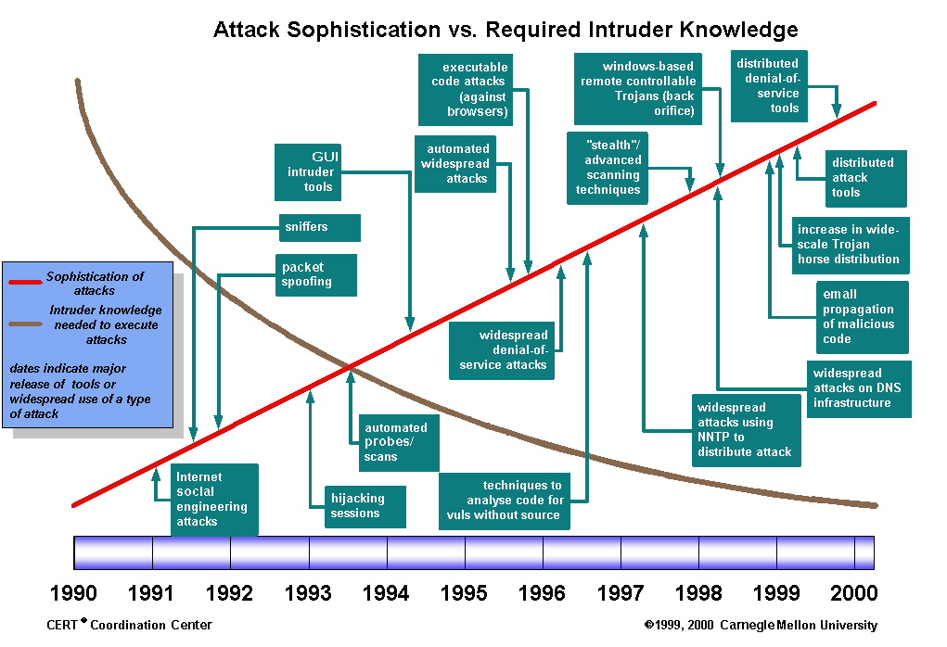
Threats
Hacker Capability Trend – It’s getting easier to launch a sophisticated attack

Slide 118
Vulnerability Assessment Versus Penetration Testing
Vulnerability assessment uses a network scanner to probe the parts and services on a range of IP addresses and also looks at the operating system, application software versions, patch levels, etc.
Penetration testing tests the vulnerabilities to determine the actual threat and risk of the vulnerability- i.e. try to break into the system.

Slide 119
Controversy of Hacking Books and Classes
Malicious attackers use the same toolset as those used by security professionals.
What we are really doing in part is security professional tool set education
However, some people believe that security techniques should not be taught in the classroom as doing so would encourage students to experiment in the real world.
DO NOT DO THIS!!

Slide 120
What is Security?
Security is much larger than just packets, firewalls, and hackers. Security includes:
  Policies and procedures
  Liabilities and laws
  Human behavior patterns
  Corporate security programs and implementation
  Technical aspects- firewalls, intrusion detection systems, proxies, encryption, antivirus software, hacks, cracks, and attacks
Understanding hacking tools and how attacks are carried out is only one piece of the puzzle.

Slide 121
Common Steps for Attackers
Reconnaissance
  Intelligent work of obtaining information either actively or passively
  Examples:
    Passive: Sniffing Traffic, eaves dropping
    Active: Obtaining data from American Registry for Internet Numbers (ARIN), whois databases, web sites, and social engineering

Slide 122
Common Steps for Attackers
Scanning
  Identifying systems that are running and services that are active on them
  Identifying open ports
  Examples: Ping sweeps and port scans

Slide 123
Common Steps for Attackers
Gaining Access
  Exploiting identified vulnerabilities to gain unauthorized access
  Examples: Exploiting a buffer overflow, smashing the stack, SQL injection, or brute forcing a password and logging onto a system

Slide 124
Common Steps for Attackers
Maintaining Access
  Uploading malicious software to ensure re-entry is possible
  Example: Installing a backdoor on a system

Slide 125
Common Steps for Attackers
Covering Tracks
  Carrying out activities to hide one’s malicious activities
  Example: Deleting or modifying data in a system and its application logs

Slide 126
Where Do Attackers Get the Most Traction?
Flaws within software code are the root of the problem of successful attacks and exploits
Security does not like complexity
The more complex the software becomes, the harder it is to properly predict how it will react in all possible scenarios making it much harder to secure
Windows XP is approximately 40 million lines of code
Linux is approximately 2 million lines of code

Slide 127
Where Do Attackers Get the Most Traction?
Estimate in industry: 5 to 10 bugs per 1,000 lines of code => windows XP has approximately 200,000 bugs
With object-oriented language applications and operating systems using each other’s code, DLLs are installed and shared, many applications communicate with each other => Operating systems cannot control this flow and provide protection against possible compromises

Slide 128
Majority of Successful Attacks Occur Because:
Software vendors do not integrate security into the design and specification phases
Programmers have not been properly taught how to code securely
Vendors are not being held liable for faulty code
Consumers are not willing to pay more for properly developed and tested code which typically takes a third more time and a third more in cost.

Slide 129
Novice Versus Advanced
The novice ethical hacker will use tools/techniques developed by others
A more advanced ethical hacker will not only depend upon other people’s tools, but will have the skill set and understanding to develop their own tools/techniques

Slide 130
Black Versus Grey Versus White Hat
Ethical hackers must understand and follow proper methods of disclosing vulnerabilities to software vendors and others
If an individual finds a vulnerability and exploits it or tells others how to attack => They are a Black Hat
If a person uncovers a vulnerability, does not illegally exploit it, tell others how to, and works with the vendor to fix it => They are a Grey Hat
If an individual is hired to test and find vulnerabilities => They are a White Hat.
However, if a person uncovers a vulnerability by hacking, some vendors do not feel the person is either ethical or legal.

Slide 131
Public Disclosure
The issue of public disclosure is controversial because the consumer and the software vendor view it differently
Many think security vulnerabilities should be disclosed as a matter of principle.
Some consumers think the only way to get quick results from a large software vendor is to pressure it to fix the problem by threatening to make the information public.
Vendors think the details of a flaw will help hackers exploit the vulnerability and the release of information can hurt the reputation of the company
Several organizations have created policies, guidelines, and general suggestions on how to handle software vulnerability disclosures.

Slide 132
Disclosure of Vulnerabilities
SecurityFocus is one of the Internet's largest and most comprehensive databases of computer security knowledge and resources for the public. See http://www.securityfocus.com/
It hosts the BugTraq mailing list a full disclosure moderated mailing list for the detailed discussion and announcement of computer security vulnerabilities: what they are, how to exploit them, and how to fix them. See http://www.securityfocus.com/archive/1
You can also check outstanding vulnerabilities on different software. See http://www.securityfocus.com/vulnerabilities

Slide 133
CERT Disclosure Policy
The CERT coordination center (CERT/CC) is a federally funded research and development center focused on Internet security and related issues.
Their policy is:
  Full disclosure will be announced to the public within 45 days of being reported to CERT/CC
  CERT/CC will notify a vendor immediately so a solution may be found
  Along with a description of the problem, CERT/CC will forward the name of the finder if desired
  During a 45 day period CERT/CC will update the reporter on current status

Slide 134
Disclosure of Vulnerabilities
Many security consulting firms have their own policies.
In 2002 Atlanta’s Internet Security Systems (ISS) initiated its own disclosure policy.
Vulnerability details would be released to paying subscribers one day after the vendor notified
They run an Internet Threat Information Center which documents some of the threats, but without the details the subscribers receive.

Slide 135
Full Disclosure Policy (Rain Forest Puppy Policy)
Rain Forest Puppy is a Hacker with a long history of successfully and unsuccessfully working with vendors
Disclosure Policy:
  Date of contact is when originator EMAILS the software vendor
  Software vendor must acknowledge the contact within 5 days
  Originator will assist the vendor in reproducing the problem
  Vendor status reports must be made every 5 days
  Vendor will credit originator
  Originator and vendor make disclosure statements in conjunction with each other.

Slide 136
Organization for Internet Safety (OIS)
Group of founding companies @stake, Bindview corporation, the SCO group, Foundstone, Guardent, Internet Security Systems, Microsoft, Oracle, SGI, and Symantec
Policy:
  Reduce the risk of software vulnerabilities by providing an improved method of identification, investigation, and resolution
  Improve overall engineering quality of software by tightening security placed upon end product

Slide 137
Organization for Internet Safety (OIS)
  Includes
    Discovery, notification, validation, investigation (shared code products issues), findings (confirmation/disproof), resolution, time frame, release (patches, maintenance updates, future product versions)

