Slide 1
Is There a Security Problem in Computing?
Chapter 1
Obie Slotterbeck

Slide 2
What is Computer Security?
Information is a commodity: its purchase and sale is central to the free enterprise system
Protection mechanisms are like putting a lock on the door of a merchant's warehouse
The protection of resources (including data and programs) from accidental or malicious modification, destruction, or disclosure is an overarching goal of security.

Slide 3
Defining Computer Security
Wikipedia: Computer security is the effort to create a secure computing platform, designed so that agents (users or programs) cannot perform actions that they are not allowed to perform, but can perform the actions that they are allowed to.
Pfleeger and Pfleeger: Define in terms of goals
What does “allowed” or “expect” mean?
– Policy is all-important: defines specifically what is and is not allowed, and what to expect (and who is responsible!)
– Technical security is then: how to make sure systems are used in accordance with policy
What policies make sense? How do we enforce these policies?

Slide 4
Security Goals
Confidentiality
Integrity
Availability

Slide 5
Goals of Computer Security
Basic Goals (CIA)
  Confidentiality: Information is only available to authorized parties
  Integrity: Information is precise, accurate, modified only in acceptable ways, consistent, meaningful, and usable
  Availability: Services provide timely response, fair allocation of resources, quality of service

Slide 6
CIAAAN
Added when people talk about “Information Assurance”
  Authentication: Establishing the validity of a transmission, message, or originator (including verifying the identity of a participant)
  Authorization: Is the originator allowed to perform the action?
  Non-repudiation: Messages or actions are accompanied by proof which cannot be denied that something took place

Slide 7
User Privacy
Privacy means that users have control over information collected and made available to others
Examples:
  User may not want others to know which programs they run, who they communicate with, etc.
  User may not want to receive spam
Anonymity can protect privacy

Slide 8
Summarizing
Confidentiality - ensures that sensitive information is not disclosed to unauthorized recipients
Integrity - ensures that the data and programs are modified or destroyed only in a specified and authorized way
Availability - ensures that the resources of the system will be usable whenever they are needed by an authorized user
Privacy - ensures that only the information that an individual wishes to disclose is disclosed

Slide 9
There is a Need to Balance CIA
Example 1: C vs. I+A
  Disconnect computer from Internet to increase confidentiality
  Availability suffers
  Integrity suffers due to lost updates
Example 2: I vs. C+A
  Have extensive data checks by different people/systems to increase integrity
  Confidentiality suffers as more people see data
  Availability suffers due to locks on data

Slide 10
Confidentiality
“Need to know” basis for data access
  How do we know who needs what data?
    Approach: access control specifies who can access what
  How do we know a user is the person they claim to be?
    Need their identity and need to verify this identity
    Approach: identification and authentication
Analogously: “Need to access/use” basis for physical assets
  E.g., access to a computer room, use of a desktop

Slide 11
Confidentiality
Confidentiality is:
  Difficult to ensure
  Easiest to assess in terms of success (binary in nature: Yes / No)
Confidentiality is the security property we understand best because its meaning is narrower than the other two.
We also understand confidentiality well because we can relate computing examples to those of preserving confidentiality in the real world.

Slide 12
Integrity
Integrity vs. Confidentiality
  Integrity is concerned with unauthorized modification of assets (= resources)
  Confidentiality - concered with access to assets
  Integrity is more difficult to measure than confidentiality
    Not binary – degrees of integrity
    Context-dependent - means different things in different contexts
    Could mean any subset of these asset properties:
  { precision / accuracy / currency / consistency /
  meaningfulness / usefulness / ...}

Slide 13
Integrity
There are different types of integrity—an example
  Quote from a politician
  Preserve the quote (data integrity) but misattribute (origin integrity)

Slide 14
Availability
Not understood very well yet
The full implementation of availability is security’s next challenge
  E.g. Full implemenation of availability for Internet users (while ensuring security)
Complex characteristic
  Context-dependent
  Could mean any subset of these asset (data or service) properties :
  { usefulness / sufficient capacity / progressing at a proper pace / completed in an acceptable period of time / ...}

Slide 15
Availability
We can say that an asset (resource) is available if there is
  A timely response to a request
  A fair allocation of resources (no starvation!)
  Fault tolerance (no total breakdown)
  Ease of use in the intended way
  Controlled concurrency (concurrency control, deadlock control, ...)

Slide 16
The CNSS Model
CNSS stands for Committee on National Security Systems (a group belonging to the National Security Agency [NSA]).
CNSS has developed a National Security Telecommunications and Information Systems Security (NSTISSI) standards.
NSTISSI standards are 4011, 4012, 4013, 4014, 4015, 4016.

Slide 17
CNSS Security Model
Technology
Education
Policy
Confidentiality
Integrity
Availability
Storage Processing Transmission

Slide 18
CNSS Security Model
The model identifies a 3 x 3 x 3 cube with 27 cells
Security applies to each of the 27 cells
These cells deal with people, hardware, software, data, and procedures
A hacker uses a computer (hardware) to attack another computer (hardware).
Procedures describe steps to follow in preventing an attack.
An attack could be either direct or indirect
In a direct attack one computer attacks another.
In an indirect attack one computer causes another computer to launch an attack.

Slide 19
Four Basic Principles of Security (from Pfleeger)
Principle of Easiest Penetration
– An attacker will use any available means of penetrating. That may not be most obvious means or the most expected means, but the easiest!
Principle of Weakest Link
– Security is no stronger than the weakest link
Principle of Adequate Protection
– Protect assets to a degree consistent with their value
Principle of Effectiveness
– Controls must be efficient, easy to use, appropriate, ... and used.

Slide 20
System Functionality
Limiting functionality limits attacks
Security breaches caused by system functionality can be caused by
  Software bugs
  Unforeseen interactions between components

Slide 21
Relative Security
Few useful systems will be absolutely secure and few need to be
To decide whether a computer system is “secure”, you must first decide what “secure” means to you, then identify the threats you care about.
We view security in a relative sense
This does not mean that good security design and implementation is unimportant
    Example: safes
Proper security level depends on the value of the items that system is protecting (other concerns?)
There is a major trade-off between cost and security
Select the security level appropriate for the user's needs

Slide 22
Cost vs Security
Example: user authentication
  System A - authenticates the user by retinal scan
  System B - authenticates users once with password
System A is probably more secure than system B, but more costly and inconvenient
Is added security and expense called for?
  Maybe for NSA (National Security Agency)
  Maybe not for an individual

Slide 23
Some History
1967: People starting to publish papers on computer security
1970: Influential (in some circles!) RAND report: “Security Controls for Computer Systems”
– Originally classified – declassified in 1979
Mid-70’s: Many influential papers published in open literature
Mid-70’s: Cryptography takes off in public research
1985: Department of Defense publishes “Trusted
Computer System Evaluation Criteria” (Orange Book)
1994: Publication of “Common Criteria for Information Technology Security Evaluations”
2003: Publication of “The National Strategy to Secure Cyberspace”

Slide 24
Some History – The Other Side
1970’s: Age of phone phreaking
1980’s: BBSes, Legion of Doom, and Chaos Computer Club
1983: War Games movie comes out
1984: 2600 (The Hacker Quarterly) publication starts
1986: First PC virus in the wild (the “Brain virus”)
1988: The “Morris worm”
– Automated spreading across the Internet
– Exploited several bugs, including the first highly-visible “buffer overflow” exploit (of fingerd)
– Around 6000 computers affected – 10% of the Internet at the time!
– Morris convicted in 1990
– CERT created largely because of this

Slide 25
Some History – The Other Side (cont’d)
  CERT is Carnegie Mellon University's Computer Emergency Response Team.
  This is one of the most active groups for studying security issues.
  See: http://www.cert.org/
  There is now a US-CERT group - United States Computer Emergency Readiness Team
Early 1990’s: Kevin Mitnick (“Condor”) years
– Arrested several times and went “underground” in 1992.
– Caught in Raleigh, NC in 1995
– Well-known for “social engineering” skill

Slide 26
Some History – The Other Side (cont’d)
1993: Kevin Poulsen hacks phones so he wins radio station contests (Porches, trips, cash, …)
1999 – present: Widespread worms/viruses
– 1999: Melissa (Word macro virus/worm)
– 2000: Love Letter (VBScript – did damage!)
– 2001: Nimda (hit financial industry very hard)
– 2001: Code Red (designed to DoS the White House, but hard-coded IP address so defeated!)
– 2003: “Slammer” (spread astoundingly fast!)
1999: DDoS networks appear
– 2000: Big attacks on Yahoo, eBay, CNN, …
– Today: “Bot-nets” with 10’s of thousands of bots

Slide 27
How Bad is it?
September 2001 - Nimbda worm spread nationwide in less than an hour and attacked 86,000 computers
January 2003 – Sapphire/Slammer SQL worm was able to spread nationwide in less than 10 minutes, doubling in size every 8.5 seconds. At its peak (3 minutes after its release) it scanned at over 55 million IP addresses per second, infecting 75,000 victims

Slide 28
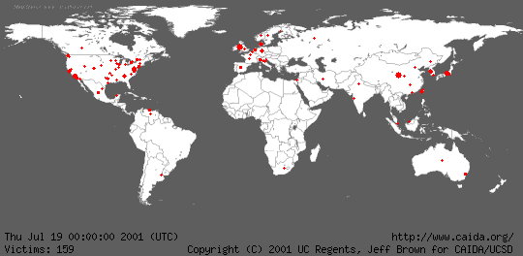
Geographic Spread of Code Red Worm

Slide 29
Why is it So Bad?
Computers are everywhere
Internet has become a mission-critical infrastructure for business, government, and financial institutions
Today’s networks are very heterogeneous, highly critical applications run side by side with noncritical systems
Cyber attacks against non-critical services may produce unforeseen side-effects of devastating proportions

Slide 30
Why is it So Bad?
Home users increase vulnerabilities
Today most homes are connected, particularly with the advent of DSL and cable modems
Most home users:
– are unaware of vulnerabilities
– don’t use firewalls
– think they have nothing to hide or don’t care if others get their data
– don’t realize their systems can serve as jump off points for other attacks (zombies)

Slide 31
Why is it So Bad?
Computer security is predominately reactive
– usually reacting to latest attack
– offense is easier than defense
Security is expensive both in dollars and in time
There is not now, and never will be, a system with perfect security (unless you put it in a vault , don't connect to any networks, and never turn it on!)

Slide 32
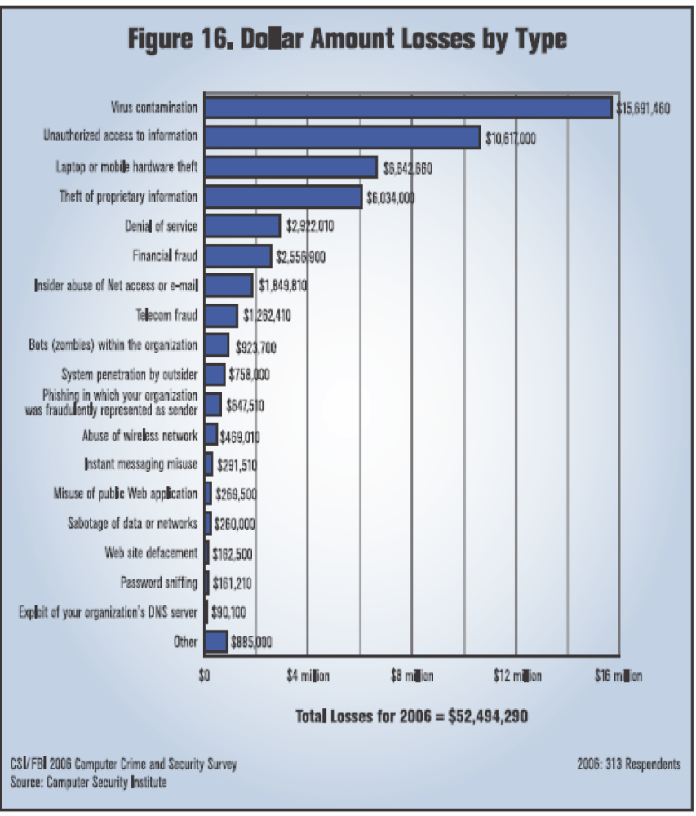
Damage Done
Average total loss per
respondent: $203,606
But a wide range of
respondent organization
sizes:
• 22% revenue <$10 million
• 34% revenue >$1 billion

Slide 33
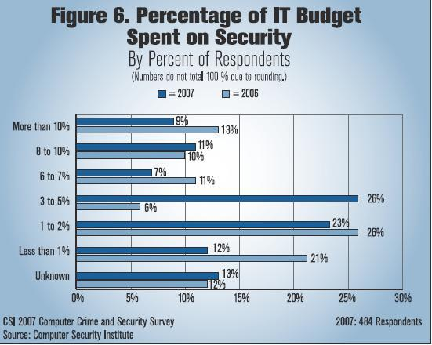

Slide 34
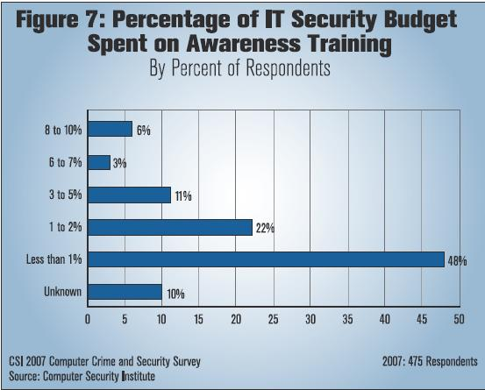

Slide 35
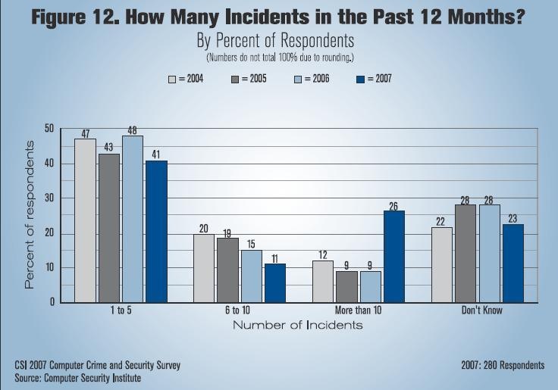

Slide 36
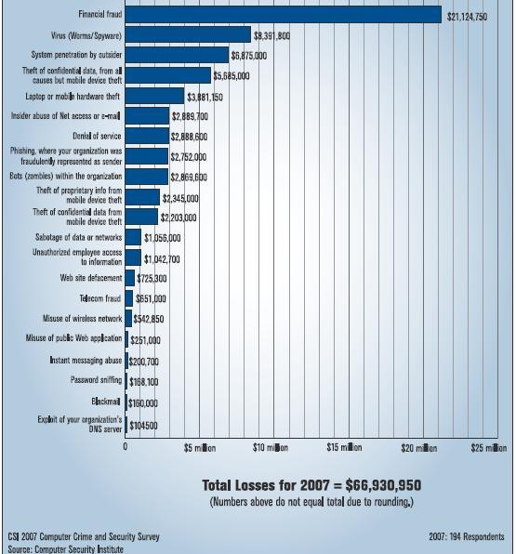

Slide 37
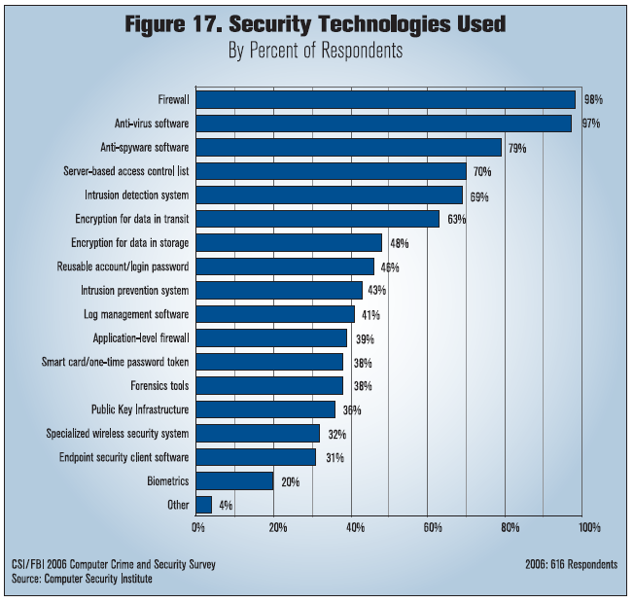

Slide 38
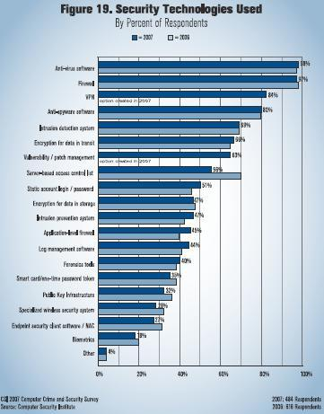

Slide 39
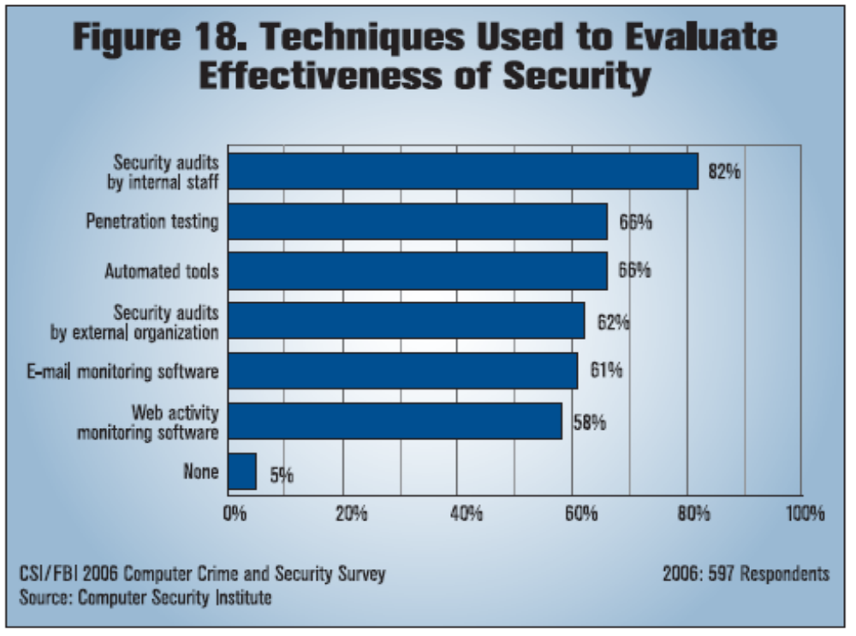

Slide 40
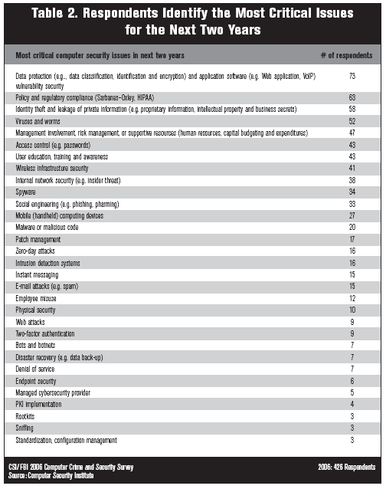

Slide 41
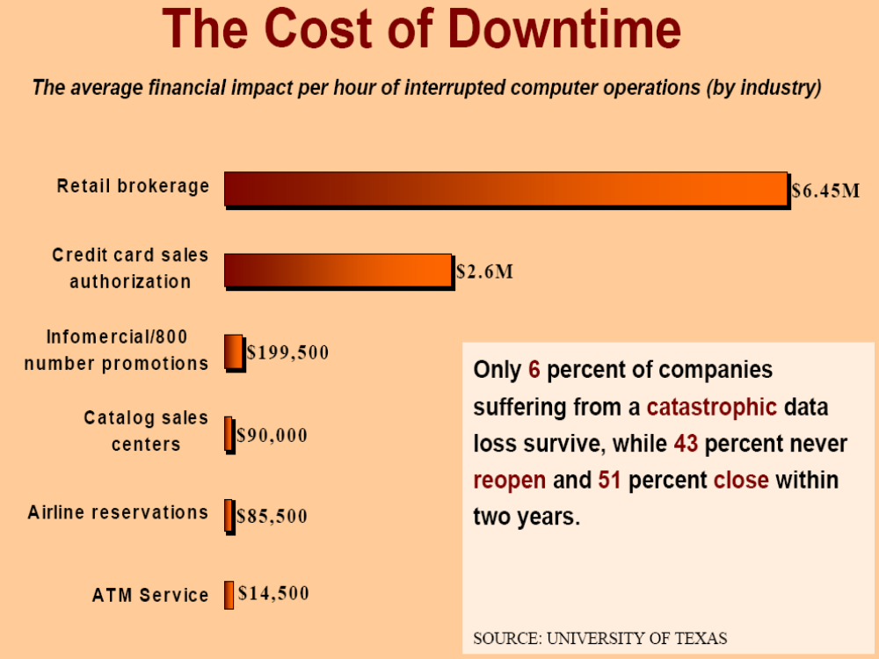
(1996 Cost of Downtime Study – by Contingency Planning Research)

Slide 42
Vulnerabilities, Threats, Controls, and Attacks
  Vulnerability = a weakness in a security system
  Threat = circumstances that have a potential to cause harm
  Controls = means and ways to block a threat, which tries to exploit one or more vulnerabilities
    Most of the course discusses various controls and their effectiveness

Slide 43
An Example
Example - New Orleans disaster (Hurricane Katrina)
  Q: What were city vulnerabilities, threats, and controls?
  A: Vulnerabilities: location below water level, geographical location in hurricane area, …
  Threats: hurricane, dam damage, terrorist attack, …
  Controls: dams and other civil infrastructures, emergency response plan, …

Slide 44
Attacks
Attack (materialization of a vulnerability/threat combination) = an exploitation of one or more vulnerabilities by a threat; tries to defeat controls
    Attack may be:
      Successful (a.k.a. an exploit)
        resulting in a breach of security, a system penetration, etc.
      Unsuccessful
        when controls block a threat trying to exploit a vulnerability

Slide 45
Threats and Attacks
A threat is a “potential” violation of security
  The violation need not actually occur
  The fact that the violation might occur makes it a threat
  It is important to guard against threats and be prepared for the actual violation
The actual violation of security is called an attack

Slide 46
Some Common Threats/Attacks
Interruption, delay, denial of receipt or denial of service
  System assets or information become unavailable or are rendered unavailable
Interception or snooping
  Unauthorized party gains access to information by browsing through files or reading communications
Modification or alteration
  Unauthorized party changes information in transit or information stored for subsequent access

Slide 47
Some Common Threats/Attacks
Repudiation of origin
  False denial that an entity did (send/create) something
Fabrication, masquerade, or spoofing
  Spurious information is inserted into the system or network by making it appear as if it is from a legitimate entity

Slide 48
Some Computer Security Threats
Browsing
Searching through main and secondary memory for residue information
Leakage
Transmission of data to an unauthorized user from a process that is allowed to access the data
Inference
Deducing confidential data about an individual by
correlating unrelated statistics about groups of
individuals

Slide 49
Some Computer Security Threats
Tampering - Making unauthorized changes to the value of information
Accidental Data Destruction - Unintentional modification of information
Masquerading - Gaining access to the system under another user's account
Denial of Service - Prevention of authorized access to computer resources or the delaying of time-critical operations

Slide 50
Threats and Vulnerabilities
A vulnerability is a weakness in a security system.
– Can be in design, implementation, or procedures
A threat is a set of circumstances that has the potential to cause loss or harm.
– Threats can be
Accidental (natural disasters, human error, …)
Malicious (attackers, insider fraud, …)
– NSA “major categories of threats”:
fraud, hostile intelligence service (HOIS), malicious logic, hackers, environmental and technological hazards, disgruntled employees, and careless employees

Slide 51
Threats to Confidentiality
Interception/Eavesdropping/Wiretapping (sniffers)
– Used to be commonly installed after a system break-in
– Can (could?) capture passwords, sensitive info, ...
– Some resurgence with wireless networks
– Has always been a problem with wireless transmission!
– Electromagnetic emanations (TEMPEST security)
Illicit copying (proprietary information, etc.)
– Copied company documents, plans, ...
– Copied source code for proprietary software
– Non-electronic: “dumpster diving”, social engineering

Slide 52
Threats to Integrity
Modification
– Changing data values (database)
– Changing programs (viruses, backdoors, trojan horses, game cheats, ...)
– Changing hardware (hardware key capture, ...)
– Can be accidental corruption (interrupted DB transaction)
– Many small changes can be valuable (e.g., salami attack)
Fabrication
– Spurious transactions
– Replay attacks
Identity spoofing
– Somewhat related: fake web sites and “phishing”

Slide 53
Threats to Availability
Denial of Service (DoS)
– Commonly thought of as network/system flooding
– Can be more basic: disrupting power
– Deleting files
– Hardware destruction (fire, tornado, etc.)
Latest: Distributed Denial of Service (DDoS)
– Bot-nets of zombie machines that can be commanded to flood and disable “on-command”
– Discovery of botnets with 10-100 systems is a daily occurrence; 10,000 system botnets are found almost weekly; and one botnet with 100,000 hosts has even been found (according to Johannes Ullrich, CTO of the Internet Storm Center).

Slide 54
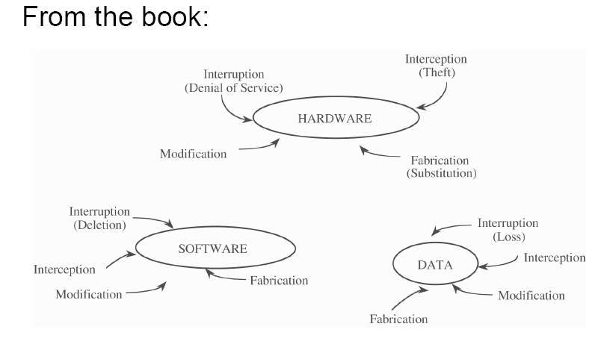
Vulnerabilities

Slide 55
Attacks and Attackers
An attack is when a vulnerability is exploited to realize a threat
– Typical attack actions were discussed in previous threats/attack slides
An attacker is a person who exploits a vulnerability
Attackers must have Means, Opportunity, and Motive (MOM)
– Means: Often just an Internet connection!
– Opportunity: Presence of vulnerabilities
– Motive may be complex, or not what you think!

Slide 56
Attackers – Motives
Intellectual challenge
– Some people see it as a game
Espionage (government or corporate)
Financial reward
– Credit card numbers sold, spam-nets rented, fraud, ...
Revenge
Showing off
– DoS (Denial of Service) attacks on CNN, eBay, Yahoo, etc.
Civil disobedience
– Basic vandalism
– “Hactivism”

Slide 57
Who are the Attackers?
Amateurs
  Are often just ordinary users exploiting a weakness found in a system
  Often these are accidental discoveries
  Normally does not require any technical skill.
  However, the damage done can be considerable.
  Insiders
  Are legitimate system users who access data that they have no rights to access

Slide 58
Who are the Attackers?
Script kiddies
  Download malicious software from hacker web sites
  Do mischief with scripts and rootkits written by others, often without understanding what they are using.
  Have limited technical expertise
  Use easy-to-operate, pre-configured, and/or automated tools to conduct disruptive activities against networked systems.
  Since most of these tools are fairly well-known by the security community, the adverse impact of such actions is usually minimal.

Slide 59
Who are the Attackers?
Hackers
  "Hacker" originally just meant someone who was very savvy about computers because that person could "hack bits" and understand computers at a deep level.
  Now viewed as one who tries to prove to peers that they can compromise a specific system sooner and better than others.
  A person who delights in having an intimate understanding of the internal workings of a system, computers, programming, and computer networks.

Slide 60
Hackers (Continued)
  Believe that information-sharing is a powerful positive good, and that it is an ethical duty of hackers to share their expertise by writing open-source code and facilitating access to information and to computing resources wherever possible.
  Believe that system-cracking for fun and exploration is ethically OK as long as the cracker commits no theft, vandalism, or breach of confidentiality.

Slide 61
Black, White, and Gray Hats
Black hats are any who attack a system for fun or profit.
White hats are any who attack on the invitation of a company to test their security.
  Note: They do not attack without permission and then inform a company of the vulnerabilities.
The term gray hats has been applied recently to those involved in security research.
The last two are often called ethical hackers.

Slide 62
Others
Government/military information warfare security experts
  This would include personnel at, for example,
    NSA (National Security Agency)
    The FBI cybercrime specialists
    Special units in the armed services.

Slide 63
Dealing With Risk
The possibility for harm to occur is called risk.
We can deal with harm in several ways:
  Prevent it - block the attack or close the vulnerability
  Deter it - make the attack harder to carry out, but not impossible
  Deflect it - make another target more attractive or this one less so
  Detect it - either as it happens or after the fact
  Recover from its effects

Slide 64
Methods of Defense
We will study several methods of defense during this course.
  Controls - both software and hardware
  Encryption
  Policies and procedures
  Preventive measures
We will also be looking at a wide range of tools that can be used to find vulnerabilities.
At the end of each chapter, the authors provide sections entitled "Where the Field is Headed" that discuss current work that is being done.
  If you are considering pursuing a career in security, these may pique your interest.

Slide 65
Controls - Cryptography
Cryptography is an important tool that can enhance system security by providing:
  Confidentiality, in that it prevents unauthorized parties from reading protected information
  Integrity, because information that cannot be read cannot be easily altered in a useful way

Slide 66
Controls – Software Controls
Programs themselves must be robust and secure from outside attack. Some examples where program controls are especially important are:
  Operating system software
  Software development tools
  Access control software

Slide 67
Controls - Hardware
Hardware devices can help support system security. Some examples include:
  Smart cards
  Secure circuit boards
  Removable media

Slide 68
Controls - Physical
Physical controls used to bolster computer security include many of the same controls used to secure other facilities, such as banks and government buildings:
  Door locks
  Backups
  Sentries
  Alarms
  Shredders

Slide 69
Controls - Policies
Policies aim to describe how an organization will posture itself with regard to security:
  User awareness & training
  What to audit and when
  Etc.

Slide 70
Basic Security Principles
In order to design effective security mechanisms we will refer to some general security principles. For example:
  Principle of least privilege : Give a user or process only those privileges needed to perform task at hand -- no more, no less.
  Minimize the amount of trusted components : Identify what components of the system need to be trusted and aim to keep those small and simple.
  Do not aim for perfection : Total security is basically impossible. Instead be prepared to detect problems, to design countermeasures and to recover from attacks.

