Slide 1
Program Security
Part 1
Insecure Code
Non-malicious Program Flaws
Chapter 3

Slide 2
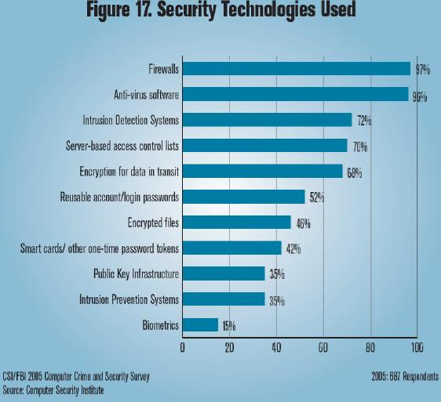
Traditional Security Is Reactive
Perimeter defense (firewalls)
Intrusion detection (after the fact)
Over-reliance on cryptography
Penetrate and patch techniques
Penetration testing

Slide 3
Problems With Reactive Responses
Firewalls, cryptography, and intrusion detection do not protect you against the ability of a hacker to exploit architectural (i.e. design) flaws or coding flaws in a program.
As we will see, design and coding flaws can open the gates to penetration attempts. Moreover, there are a lot of ways these flaws can be exploited.

Slide 4
Penetrate and Patch Has Been the Norm
Discover flaws after deployment
  Often by attackers
Patches may have security flaws themselves!
  Estimates run as high as 15% have flaws
Patches provide road maps to vulnerabilities
  Attackers only have to reverse engineer the patches in order to create attacks.
A major problem is that many users fail to deploy patches.

Slide 5
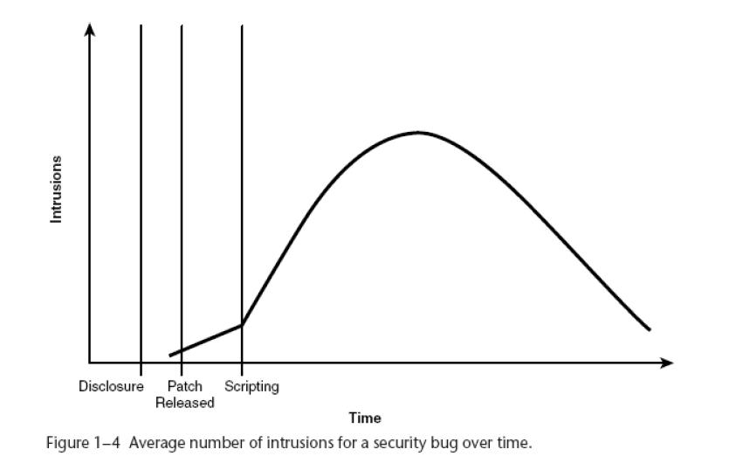
Look at the Typical Intrusion Pattern

Slide 6
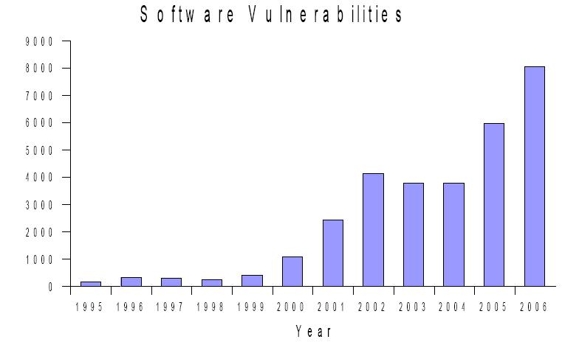
A Growing Problem

Slide 7
Software Is The Main Problem
“We wouldn’t have to spend so much time and effort on network security if we didn’t have such bad software security.”
Bruce Schneider
“Applied Cryptography”
“Secrets & Lies: Digital Security in a Networked World”

Slide 8
Hackers
“Malicious hacker’s don’t create security holes; they simply exploit them. Security holes and vulnerabilities – the real root cause of the problem – are the result of bad software design and implementation.”
John Viega & Gary McGraw

Slide 9
Developers Aren’t Ready
“64% of developers are not confident in their ability to write secure applications.”
Bill Gates, RSA Conference 2005
“ Have you ever written a program section with a security hole? How did you know?”
Mark G. Graff & Kenneth R. van Wyk

Slide 10
An Industry Problem
There is no software liability – no incentive for secure software.
Most developers never learned to produce secure code.
Secure code often takes a performance hit – i.e. the software runs about 1/3 slower – something many users don’t want to tolerate.
Writing secure code also takes a lot more time – hence, development costs are higher than usual.
Consequently, the longer development times and the longer running times discourage developers from writing secure code.

Slide 11
Complexity Is An Additional Problem
Software products are growing in size.
Windows XP has 40 million lines of code –
  A page is typically 52 lines of code.
  So, we are talking about ~1539 reams of standard one-sided xerox paper!
Typically there are 5-50 bugs per KLOC (a thousand lines of code.)
10% of the bugs result in security faults.
40,000 KLOC*5*10% = 25,000 security bugs (lower bound)
One difficulty is that software is often written in low-level languages such as C/C++.

Slide 12
Some Security Problems With Programs
CODING BUGS – 50%
Information leakage
Control hijacking
Buffer overflow
Smashing the stack
Command injection
Cross-site scripting
Integer overflow
Race conditions
Formatted strings
Segment overwrite
Heap overflows
Incomplete mediation
SQL injection
PHP include
Non-trusted input
Realize these problems are not mutually exclusive!

Slide 13
Some Security Problems With Programs
DESIGN FLAWS – 50%
Cryptography misuse
Lack of compartmentalization
More privilege used than necessary
Relying on secret algorithms
Sharing resources
Usability problems

Slide 14
Non-malicious Program Erros
Many of these problems are non-malicious, but they can be exploited to do nasty things.
A system exploit could be:
  Attacker can execute arbitrary code
  Attacker can gain access to a system
  Attacker can put the system in an illegal state
  Attacker can crash the program causing, for example, a denial of service.

Slide 15
Warning
Examples can come from various operating systems, languages, and browsers.
Realize that almost all operating systems and languages have problems - they're just not all the same vulnerabilities.
UNIX/LINUX is an operating system that is used on a lot for servers.
C/C++ are languages that are used a lot for development purposes as they allow low level manipulation of the hardware.
Internet Explorer is a browser used by many people.

Slide 16
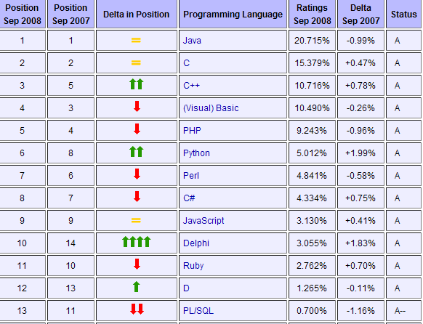
Language Usage Statistics
Source: http://www.tiobe.com/index.php/content/paperinfo/tpci/index.html

Slide 17
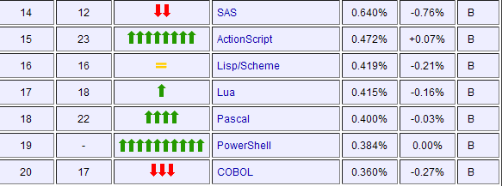
Continued

Slide 18
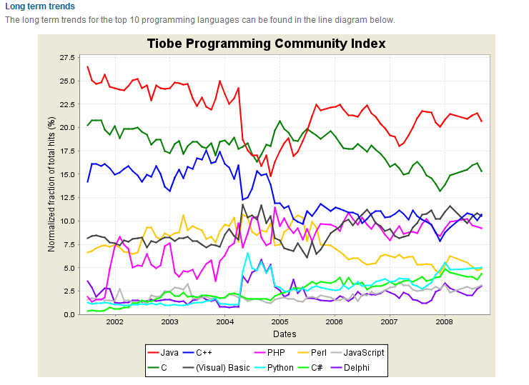
Long Term Trends

Slide 19
Some Commonly Exploitable Flaws
A vulnerability is a program flaw (or bug) that when exercised has a security implication
Notice that two things need to be true in order to have a system exploit.
  There has to be a flaw or a bug
  That flaw can be exploited by an attacker to weaken the security of a system
Many examples of program flaws are shown on slide 12-13.
There are others as we will see.

Slide 20
Information Leakage
Attacks

Slide 21
A Simple Example
Where’s the error in this program?
  int main () {
  int array[5] = {1,2,3,4,5};
  printf(“%d\n”, array[5]);
  }
Program output:
>gcc –o badindex badindex.c
> ./badindex
What happens?
gcc --- UNIX C compiler
-o badindex --- store compiled code in a file called buffer (which is executable)
buffer.c --- the source code
./buffer --- invokes buffer in the current directory

Slide 22
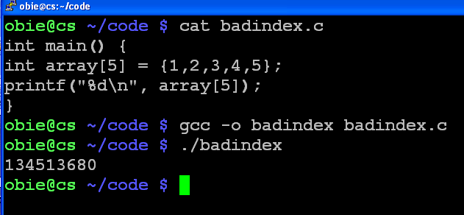
A Run on cs.hiram.edu (OS - Linux)
The next memory location contents after array[4] is the output - namely 134513680

Slide 23
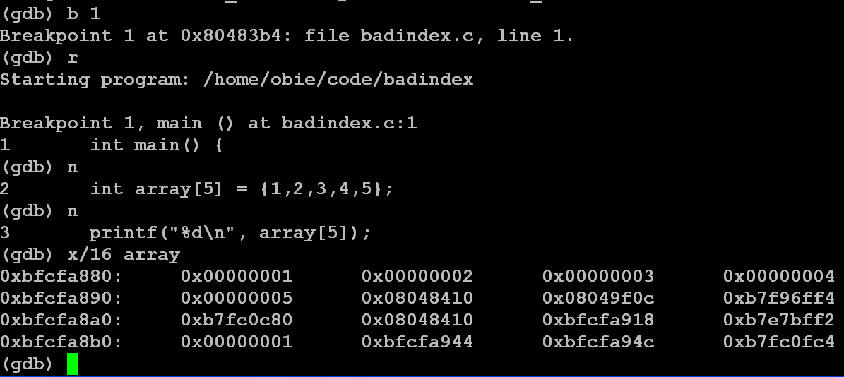
How Do You Know It Is The Next Memory Location After Array?
Hex for the output value 134513680 which is in array[5]’s location.

Slide 24
Doing The Calculation To Verify That
08048410₁₆ = 134513680
Remember from cpsc 171 that a hex number can be converted to binary easily:
08048410₁₆
= 0000 1000 0000 0100 1000 0100 0001 0000
= 2^27 + 2^18 + 2^15 + 2^10 + 2^4
= 134217728 + 262144 + 32768 + 1024 + 16
= 134513680

Slide 25
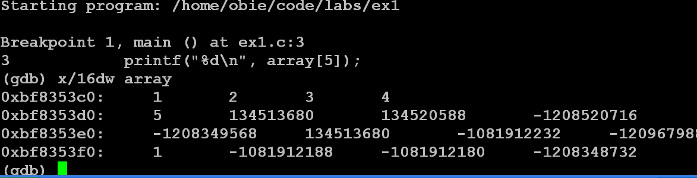
Or, Use the x/16dw Command in gdb

Slide 26
What Happened To The Last Program?
The information leakage exists because C does not check array bounds - C++ doesn't either!
Thus, whatever was in the position where array[5] should be will be output.
Do array out of bounds errors always produce access to a memory location?
  No, we will see other possibilities.
  This example just leaks information.
  There are worst consequences as we will see soon.

Slide 27
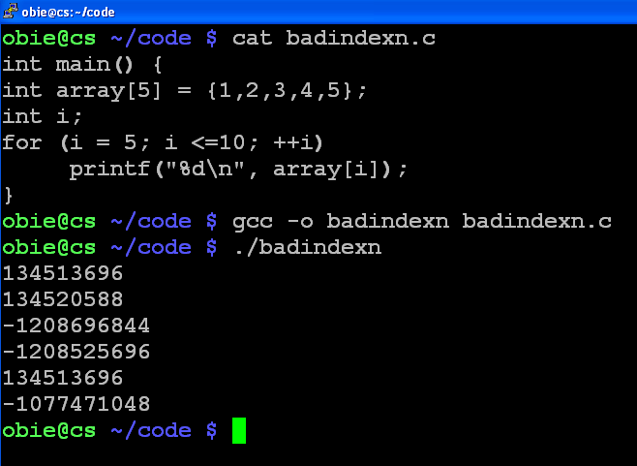
Can We Leak More Information?

Slide 28
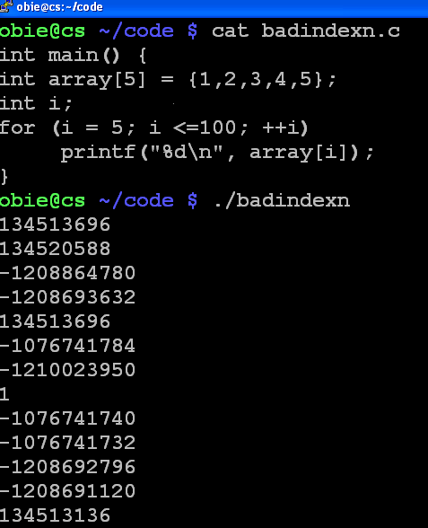
Or Even More?

Slide 29
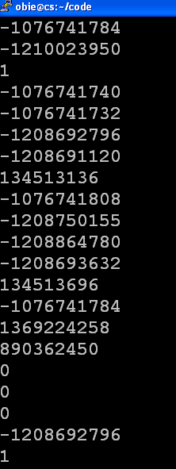
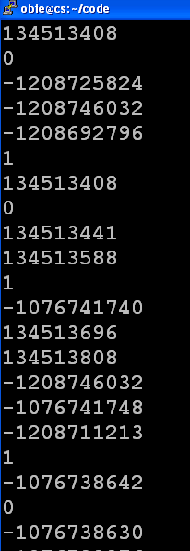
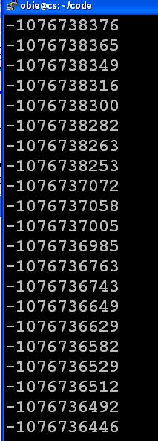
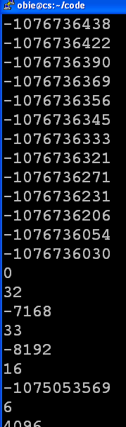
And More Leakage!

Slide 30
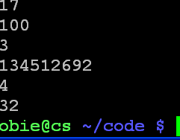
And, At Last It Terminates!
Observe that to use this information you do need to know how to read the machine code that is output!
But, that's no big deal for a hacker who has patience to check out the code.
Note: Some people call this a buffer overflow problem, but some prefer to think of it as an information leakage problem.

Slide 31
Control Hijacking Attacks

Slide 32
Control Hijacking
(or, Why to Avoid C Like the Plague)
A control hijacking attack causes a program to crash or it injects new code into a running process that changes the developers' flow of control.
Crashing is what is desired, for example, when a Denial of Service attack is being conducted.
There are many ways to hijack a C program.
The most common technique is the buffer overflow: writing outside the bounds of a specified chunk of memory.

Slide 33
Buffer Overflow Attacks
These are sometimes distinguished by where the buffer resides

Slide 34
Code Injection Via Buffer Overflows
Extremely common bug.
  First major exploit in 1988: Morris Worm exploited fingerd and used a buffer overflow to insert code.
10 years later: over 50% of all CERT advisories:
  1997: 16 out of 28 CERT advisories.
  1998: 9 out of 13 advisories
  1999: 6 out of 12 advisories
Often leads to the total compromise of a host because of arbitrary code execution
Fortunately: exploit requires expertise and patience to determine just how to do this for a specific program.

Slide 35
What Is a Buffer Overflow?
Definition: When a program allows data to be copied to a location in memory that exceeds the size of the reserved destination area a buffer overflow occurs.
Consider:
short C;
char A(C);
short B=3;
.
.
.
gets(A);
A | A | A | A | A | A | A | A | B | B
0 | 0 | 0 | 0 | 0 | 0 | 0 | 0 | 0 | 3
A | A | A | A | A | A | A | A | B | B
o | v | e | r | f | l | o | w | s | 0

Slide 36
What Can Be Done When A Buffer Overflow Is Not Detected?
Excess bytes can be inserted into memory next to the buffer area.
Those bytes can
  Corrupt the original program causing it to crash.
    Often this technique is used in Denial-of-Service (DoS) attacks.
  Be malicious code that is inserted at this point and, as we will see, there are often ways to make this code executable.
Buffer overflows are the most common type of memory corruption.

Slide 37
Some Real-world Buffer Overflow Examples
Morris Worm
  Took down most of Internet in 1988
  Exploited a buffer overflow in fingerd
  Subsequent worms used overflow attacks also.
MS07-004 Internet Explorer
  Buffer overflow in VML (a language used to produce vector graphics – stands for Vector Markup Language)
  Allowed remote code execution
  Not the first overflow in IE or other browsers.
Word 2000
  Using Find/Replace with the Replace field larger than 200 characters caused a crash and wiped out any unsaved data.

Slide 38
More Buffer Overflow Examples
In July 2000, a vulnerability to buffer overflow attack was discovered in Microsoft Outlook and Outlook Express.
A programming flaw made it possible for an attacker to compromise the integrity of the target computer by simply sending an e-mail message.
Unlike the typical e-mail virus, users could not protect themselves by not opening attached files; in fact, the user did not even have to open the message to enable the attack.

Slide 39
More Buffer Overflow Examples
The programs' message header mechanisms had a defect that made it possible for senders to overflow the area with extraneous data, which allowed them to execute whatever type of code they desired on the recipient's computers.
Because the process was activated as soon as the recipient downloaded the message from the server, this type of buffer overflow attack was very difficult to defend.
Microsoft has since created a patch to eliminate the vulnerability.

Slide 40
Some More Buffer Overflows
A buffer overflow in Apple’s Quicktime
(January 7, 2007)
http://www.us-cert.gov/cas/techalerts/TA07-005A.html
Buffer overflows in Mozilla products (December 20, 2006)
http://www.us-cert.gov/cas/techalerts/TA06-354A.html

Slide 41
More Buffer Overflow Examples
Other examples include:
  RTF format
  .doc files
  Acrobat products - .pdf, Photoshop etc.
  Blaster worm
  and the list goes on and on ....
As we will see, these examples can be hard to find.

Slide 42
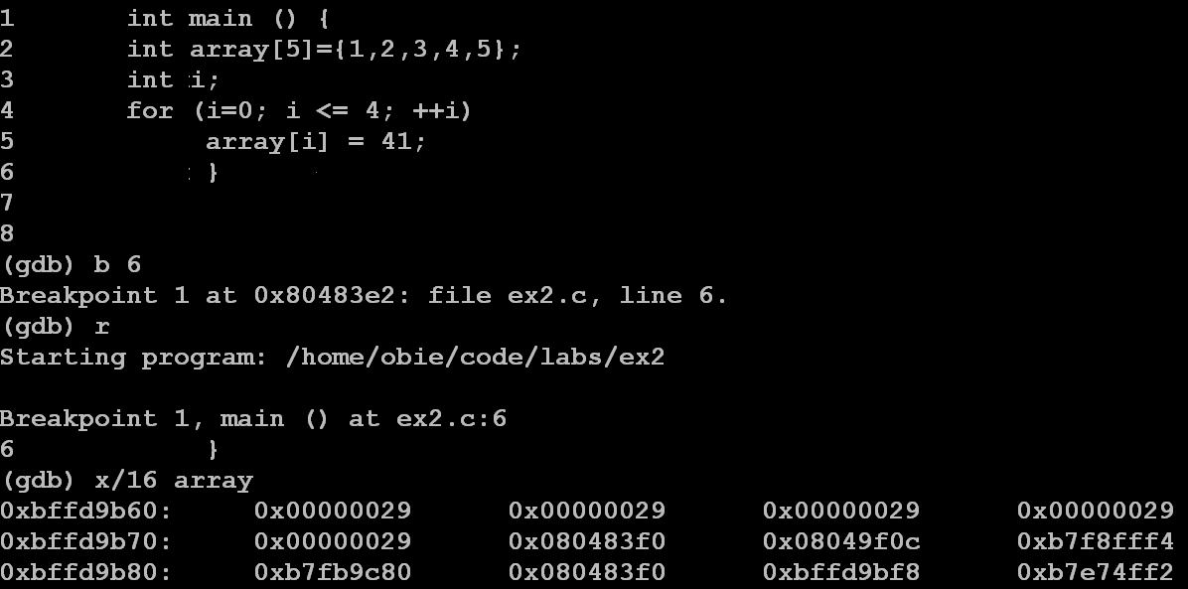
No Problem With ex2.c As 41₁₀= 29₁₆

Slide 43
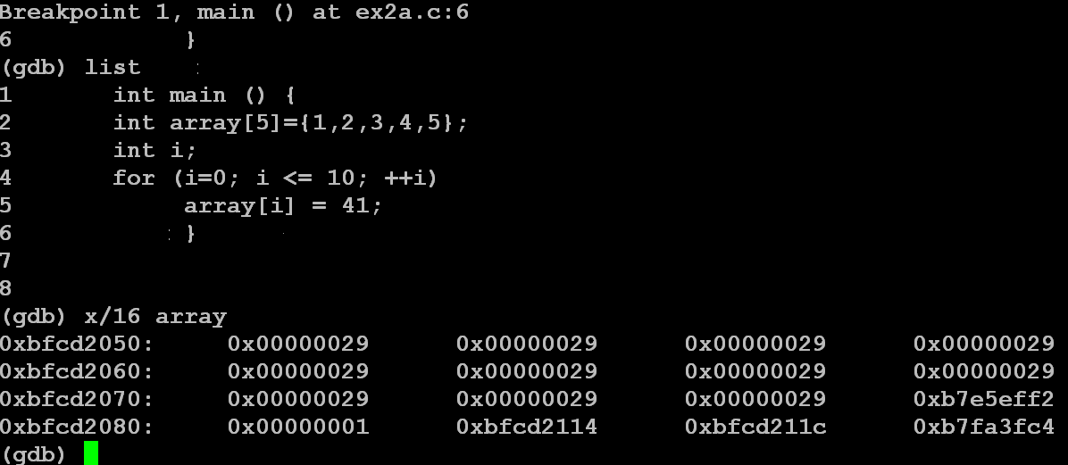
ex2a.c Runs OK - So Nothing is Overwritten That Hurts the Run

Slide 44
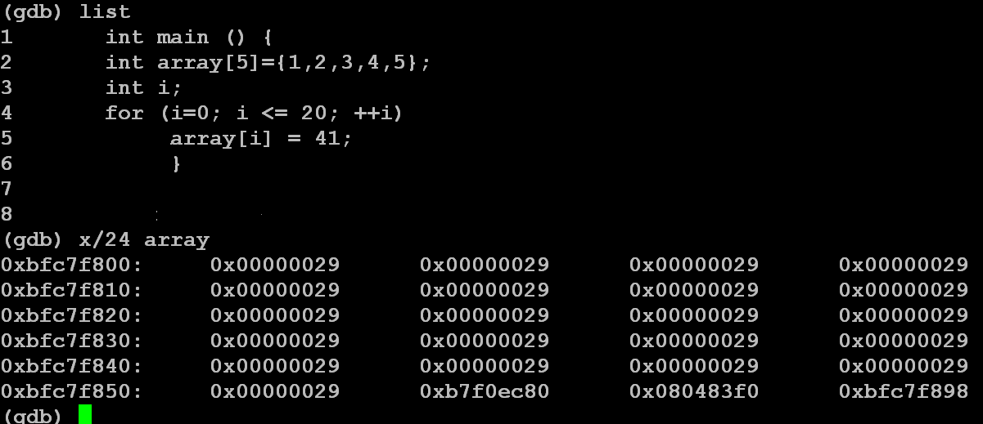
But, For ex2b.c, Something is Corrupted As the Run Crashes

Slide 45
ex2b.c
Obviously, any values can be written past the declared bounds of array.
However, as no input is involved, a hacker can't change any values in order to obtain control.
But, these examples show that if user input is allowed, this same concept can be used to corrupt the return address or other elements on the stack.

Slide 46
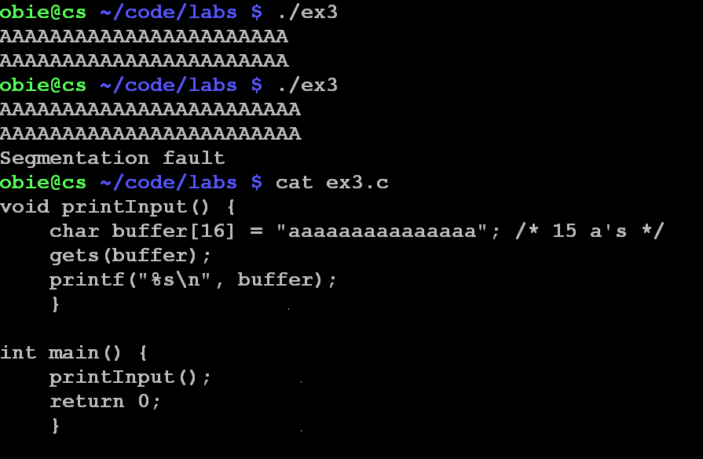
ex3.c
23 A s OK
24 A s are not OK

Slide 47
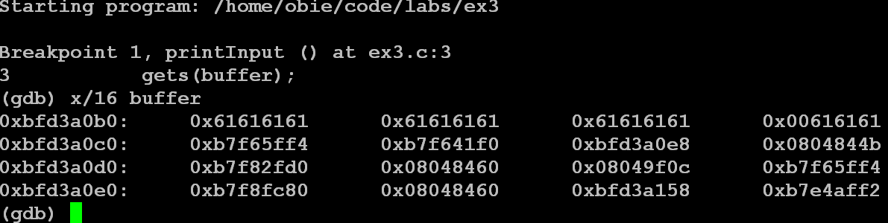
15 a's Initialized With A Null At the End
61₁₆ is ASCII Code for "a"

Slide 48
15 a's Initialized With A Null At the End
61₁₆ is ASCII Code for "a"
Word address where buffer starts

Slide 49
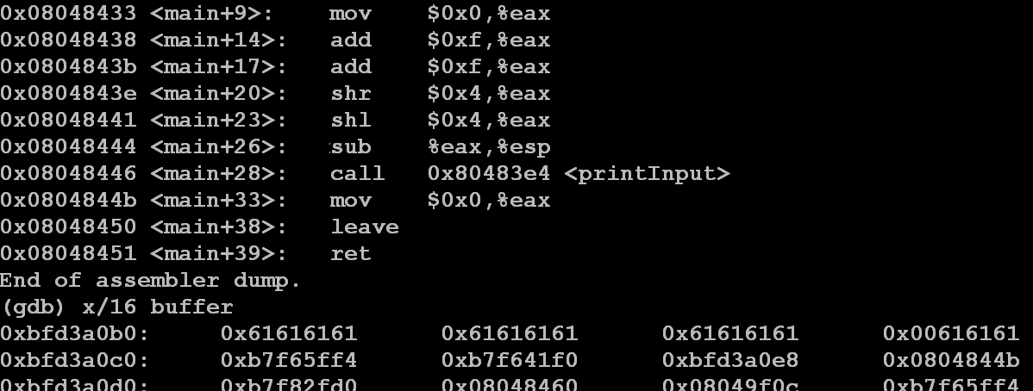
Locate the Return Address in the Frame
Return Address

Slide 50
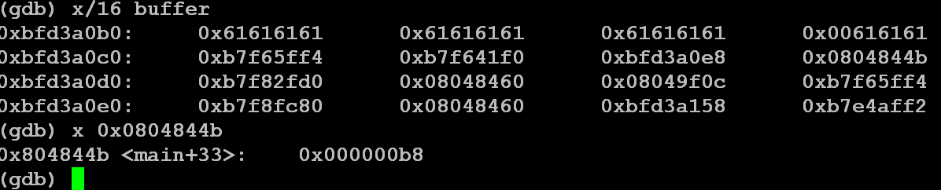
Examine Address and Observe It Is in main

Slide 51
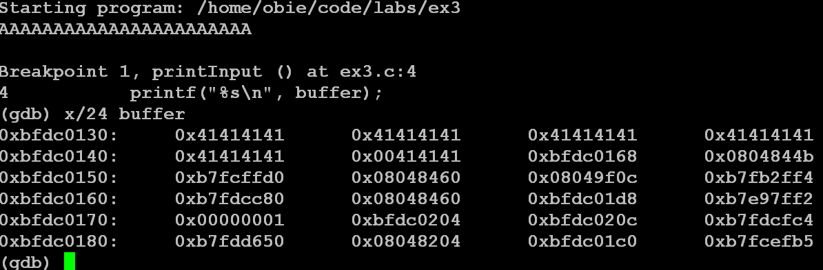
23 A s OK

Slide 52
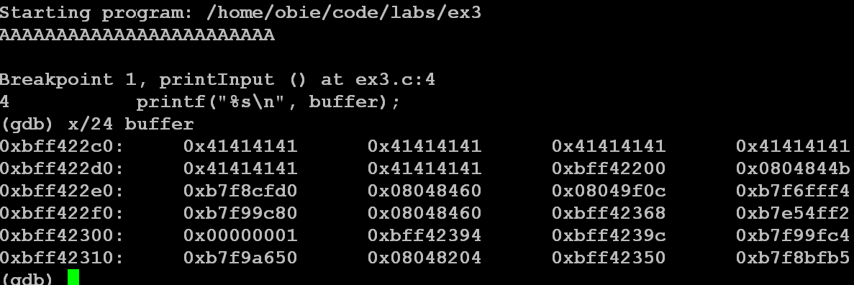
24 A s Causes a Segmentation Fault
Corruption for 24 A s

Slide 53
Observe Security Faults Exposed Here
The return address has been located and, consequently, could be corrupted by the input.
  Another return address could be inserted.
  The existing return address could be corrupted causing a crash.
If the stack area allows execution, a hacker could insert malicious code at this point.

Slide 54
Stack-based Overflows
Called "Smashing the stack"

Slide 55
Stack-based Buffer Overflows
Stack-based buffer overflows were the first type of vulnerability that was described as a separate class, in 1996.
How to exploit this vulnerability was described in the Phrack article "Smashing the Stack for Fun and Profit," by Aleph1, a.k.a. Elias Levy.
Phrack is an underground e-zine written by and for hackers that was first published in 1985.
It has a wide circulation which includes both hackers and computer security professionals.

Slide 56
Stack-based Buffer Overflows
Since the Phrack article's release, these stack-based buffer overflows have been considered the most common type of remotely exploitable programming errors found in software applications.
As with other overflows, the problem here is the mixing of data and control information when the executable image is loaded into memory.
Thus, by incorrectly changing data, it is sometimes possible to change program execution flow.

Slide 57
Memory Layout Process
(and how it affects security)
A process can be laid out in memory in any way the host operating system chooses.
But, nearly all contemporary systems observe a few common conventions.
Generally, a process is organized into the following major areas:
  Program code
  Program data
  Program stack

Slide 58
Program Code Section
Includes compiled code for the running program and additional code to use the shared libraries needed by the program.
Shared libraries are usually not mapped into areas contiguous with the program code.
Anything in the section is assumed to be executable.
Consequently, recalling from CPSC 171, in the fetch-decode-execute cycle, when the program counter points to a sequence of bytes, those bytes are assumed to be an executable.

Slide 59
Program Data Section
Stores program variables that aren't local to functions.
Includes both global and static variables.
Contains a dynamic memory region, called the "program heap" for storing dynamically allocated variables.

Slide 60
Program Stack
First, what is a stack?
A stack is an abstract data type used for the ordered storage and retrieval of data with a distinguished end called the top and two associated operations:
  push() - Add an element at the top of the stack
  pop() - Remove the top element of the stack and return its value.
Stacks are also called last-in, first-out (LIFO) data structures.
A good physical example of a stack is the mechanism in many cafeterias that holds and dispense trays or dishes.

Slide 61
Stack Overflows
These are buffer overflows in which the target buffer is located on the program stack.
These are the most understood security attacks and, historically, the most straightforward type of buffer overflow to exploit.
We'll examine how the program stack works Note: This material is covered in CPSC 252: Computer Organization
and then how attackers can exploit it.
Note: The program stack is also called the "runtime stack", the "call stack", or just the "stack" when talking about a program.

Slide 62
How The Program Stack Works
The runtime stack provides the underpinnings necessary for the functions used in every structured programming language.
Functions can be called in arbitrary order.
Functions can be recursive - i.e. they can call themselves or, after a chain of calls, be called again.
The runtime stack supports this functionality with activation records or function frames.
Activation records contain the return address for the function, local variables, the saved machine state (i.e. register contents) , and function parameters.

Slide 63
How The Program Stack Works
Because runtime stacks are an integral part of how programs work, they are implemented by the CPU assistance by the use of a special register that points to the top of the stack.
On Intel x86 CPUs, this register is called ESP (extended stack pointer).
On most modern CPUs , the stack grows downward - i.e. it starts at a high address in virtual memory and grows towards a lower address.

Slide 64
How The Program Stack Works
Every time a function is called, the program creates a new stack frame (or activation record) which is a reserved block of contiguous memory that a function uses for storing the necessary information.
This block of memory is reserved for exclusive use by the function until it returns, at which time it is removed from the stack.

Slide 65
How The Program Stack Works
Consider the following snippet of code:
int B(int a, int b) {
int x,y;
x = a*a; y = b*b;
return (x*y); }
int A(int p, int q) {
int c;
c = p * q * B(p,p);
return c; }
int main (int argc, char **argv, char **envp) {
int ret;
ret = A(1,2);
return ret; }

Slide 66
Stack While In A
When the function A is entered, a stack frame for A is allocated and placed on the top of the stack as shown.
The diagram is simplified, because main is not the first function on the call stack as system functions are called first to set up the environment for the process.
0xBFFFFC00
A's stack frame
main's stack frame
Stack grows this way
0xFFFFF00
stack base

Slide 67
Stack While In B
When the function B is called from A and B is entered, a stack frame for B is allocated and placed on the top of the stack as shown.
When B finishes, it returns to A and B's stack frame is popped off of the stack.
The stack again looks like the one on the previous slide and ESP is restored to its previous value.
0xBFFFFC00
A's stack frame
main's stack frame
B's stack frame
Stack grows this way
0xFFFFF00
stack base

Slide 68
Internal State Information In Stack Frame
This varies among processor architectures, but usually it includes the previous function's frame pointer and a return address.
The return address is saved so that when the currently running function returns, the CPU knows where execution should continue.
Also, the frame pointer must be restored so that local variable accesses remain consistent after a function has called a subfunction that allocates its own stack frame.
The stack pointer must also be restored to its previous state.

Slide 69
Using The Stack Frame Data
Each function manages its own stack frame which is sized by how many local variables are present and the size of each variable.
Local variables need to be accessed directly as the function requires them.
Thus, pop and push can be inefficient to use.
Consequently, many programs make use of another register called EBP (extended base pointer) which points to the beginning of the stack frame.
Variables can then be accessed by a fixed offset from the EBP.
Note - many programs do this, but it is not required.

Slide 70
How The Program Stack Works
Consider the following snippet of code (as seen earlier)
int B(int a, int b) {
int x,y;
x = a*a; y = b*b;
return (x*y); }
int A(int p, int q) {
int c;
c = p * q * B(p,p);
return c; }
int main (int argc, char **argv, char **envp) {
int ret;
ret = A(1,2);
return ret; }

Slide 71
A Possible Stack Layout When B Is Called
Note that local variables are arranged contiguously in memory.
B's stack frame
A's stack frame
Start of main's stack frame
int y
int x
saved EBP - base pointer
saved EIP - return point in A
B's argument a
B's argument b
int c
saved EBP - base pointer
saved EIP - return point in main
A's argument p
A's argument q
int ret etc.

Slide 72
Smashing The Stack
As local variables are contiguous in memory, if a program has a vulnerability allowing data to be written past the end of a local stack buffer, the data overwrites adjacent variables.
These adjacent variables can include other local variables, program stack information, and even function arguments.
Depending on how many bytes can be written, attackers might also be able to corrupt variables, state information in previous stack frames, and return addresses.

Slide 73
Overwriting The Return Address
Of the two variables, the frame pointer and the return address, the return address is most useful to attackers.
If a buffer overflow can overwrite the saved return address, the program can be redirected to an arbitrary point after the executing function returns.
Several scenarios are possible when execution is redirected by overwriting the return address.

Slide 74
Where Is The Program Typically Redirected?
Redirect to the code section of the application being run.
Redirect to some code in a shared library that does something such as run commands via the shell.
Redirect to an area of memory containing data the attacker controls, such as a global variable, a stack location, or a static buffer.
  In this situation, the attacker fills the targeted return location with a small stub of position independent code to do something such as connecting back to the attacker and spawning a shell on the connected socket.
  This code is commonly referred to as shellcode.

Slide 75
An Aside About Linux and Shells
A shell for Linux (or Unix) is a user program or an environment provided for user interaction.
A shell is an command language interpreter that executes commands read from the standard input device (keyboard) or from a file.
These reside in the directory (folder in Windows' terminology) /bin
The most used shells are
  bash - Bourne again shell (default on cs.hiram.edu)
  csh - C shell
  ksh - Korn shell

Slide 76
Shellcode
Buffer overflows are usually exploited by directing execution to a known location in memory where attacker-controlled data is stored.
For an exploit to be successful, this location must contain executable machine code that allows attacks to perform malicious activities.
This is done by constructing small snippets of machine code designed to launch a shell, connect back to the originating user, or do whatever the attacker chooses.
Today the most common trend in shellcode construction uses stubs capable of loading additional components on demand over a connected socket, as needed by an attack on the other end.

Slide 77
Writing The Code
At the most basic level, shellcode is a small chunk of position-independent code that uses system APIs to achieve an attacker's objectives.
To see how this is done, consider the simple case of spawning a shell in UNIX.
In this case, the code to run is roughly the following:
char *args[] = {"/bin/sh", NULL};
execve("/bin/sh", args, NULL);
This code spawns a command shell when it runs.
If this code were run in a network service, the socket descriptor the user is connected with would need to be duplicated over stdin, stdout, and optionally stderr as well.

Slide 78
Writing The Code
To construct the machine code required to spawn the shell, we need to understand how this code works at a lower level.
The execve function is exported by the standard C library, so a normal program would first locate the libc execve implementation with a little help from the loader, and then call it.
Because this functionality could be difficult to duplicate in reasonably sized shellcode, generally we need to look for a simpler solution.
As it turns out, execve is also a system call on UNIX systems, and all the libc function does is perform the system call.

Slide 79
Writing The Code
Invoking system calls on an Intel-based operating system, usually involves building an argument list (in registers or on the stack, depending on the operating system) and then asking the kernel to perform a system call on behalf of the process.
This can be done with a variety of methods.
For Intel systems, the system call functionality can rely
  on a software interrupt, initiated by the int instruction;
  a call gate, invoked with an lcall;
  or special purpose machine support, such as sysenter.

Slide 80
Writing The Code
For Linux and many BSD variants, the int 128 interrupt is reserved for system calls.
When the interrupt is generated, the kernel handles it, determines that the process needs some system function performed, and carries out the required task.
The procedure for Linux systems is as follows:
  1. Put the system call parameters in general purpose registers starting at EBX; If a system call requires more than 5, put them on the stack.
  2. Put the system call number of the desired system call in EAX.
  3. Use the int 128 instruction to perform the system call.

Slide 81
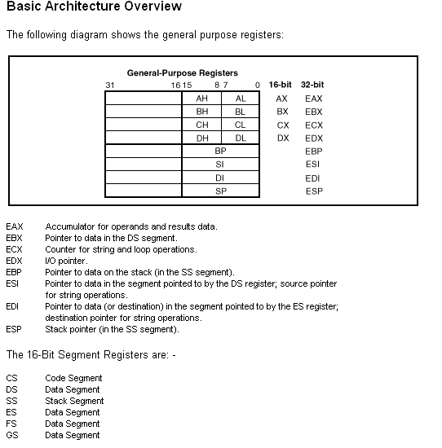
Guide To Intel x86 Register Names

Slide 82
Finding The Code In Memory
Usually on Intel x86 CPUs, the strings or data required by shellcode are supplied alongside the code and their addresses are calculated independently.
To understand how this works, consider the semantics of the call instruction.
This function implicitly saves a return address on the stack, which is the address of the first byte after the call construction.
Thus, shellcode is often constructed using the format on the next slide.

Slide 83
Finding The Code In Memory
jmp end
code: ...shellcode ...
end: call code
.string "/bin/sh"
This example jumps to the end of the code and then uses call to run code located directly after the jmp instruction.
What is the point of this indirection?
Basically, the relative address of the string "/bin/sh" is on the stack because of the call instruction implicitly pushing a return address on the stack.
Hence the address of the string can be calculated automatically, regardless of where the shellcode is located in the target application.

Slide 84
Finding The Code In Memory
Combining this with the information in the previous section, execve shellcode would look something like:
jmp end
code:
popl %ebx ; EBX = pathname argument
xorl %eax, %eax; zero out EAX
movl %eax, %edx; EDX = envp
pushl %eax; put NULL in argv array
pushl %ebx; put "/bin/sh" in argv array
movl %esp, %ecx; ECX = argv
movb $0x0b, %al; 0x0b = execve system call
int $0x80; system call
call code
.string "/bin/sh"

Slide 85
Finding The Code In Memory
You should observe that the code to start a shell is fairly straightforward.
You simply need to fill the registers EBX, ECX, and EDX with pathname, argv, and envp respectively, and then invoke a system call.
This example is a simple shellcode snippet, but more complex shellcode is based on the same principles.

Slide 86
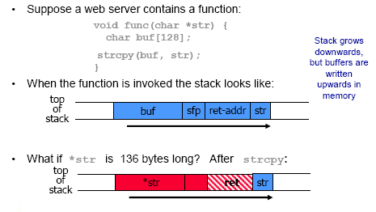
Simplified Example of Technique

Slide 87
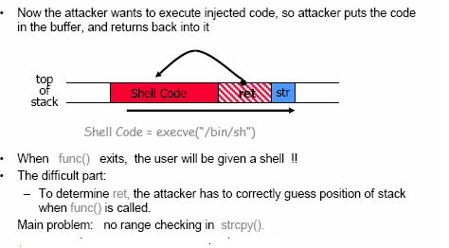
Example Continued
Source: David Lie ECE1776

Slide 88
Another Example - Memory Organization
Text segment has code
Data segment has static variables
Heap segment has dynamic data
Stack segment has
  Dynamic local variables
  Parameters to functions
  Return address
low
address
text
data
heap
↓
↑
SP
stack
high
address
Source of next 11 slides: Warren Page, Ohio University

Slide 89
Simplified Stack Example
low →
void func(int a, int b){
char buffer[10];
}
void main(){
func(1, 2);
}
:
:
SP
buffer
SP
ret
return
address
a
SP
high →
b
SP

Slide 90
Smashing the Stack
low →
What happens if buffer overflows?
???
:
:
Program “returns” to wrong location
buffer
SP
overflow
SP
A crash is likely
ret
ret…
NOT!
overflow
a
SP
high →
b
SP

Slide 91
Smashing the Stack
low →
With code injection, attacker can run any code on affected system
:
:
SP
mal. code
ret
ret
SP
a
SP
high →
b
SP

Slide 92
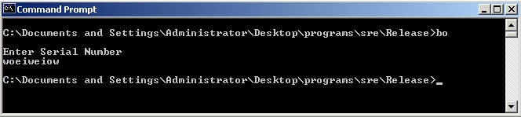
Stack Smashing Example
Program asks for a serial number that attacker does not know
Attacker also does not have source code
Attacker does have the executable (exe)
Program quits on incorrect serial number

Slide 93
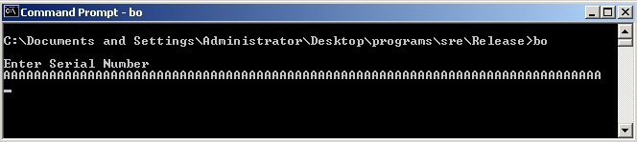
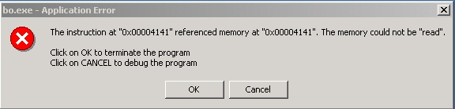
Example
By trial and error, attacker discovers an apparent buffer overflow
Note that 0x41 is “A”
Looks like ret overwritten by 2 bytes!

Slide 94
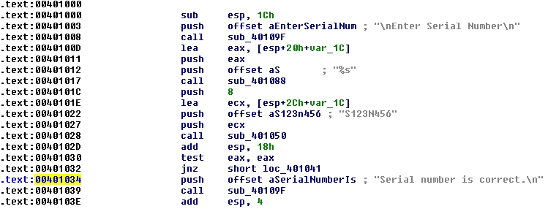
Example
Next, disassemble bo.exe to find
The goal is to exploit buffer overflow to jump to address 0x401034

Slide 95
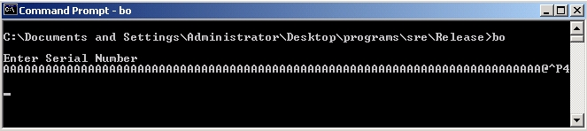
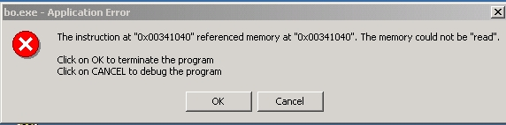
Example
We find that 0x401034 is “@^P4” in ASCII
Byte order is reversed? Why?
x86 processors are “little-endian”

Slide 96
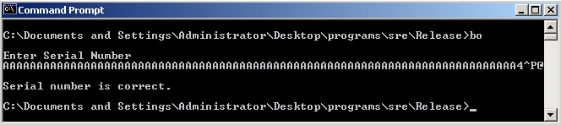
Example
Reverse the byte order to “4^P@” and…
Success! We’ve bypassed serial number check by exploiting a buffer overflow
Overwrote the return address on the stack

Slide 97
Example
Attacker did not require access to the source code
Only tool used was a disassembler to determine address to jump to
But, can find address by trial and error
  This is necessary if attacker does not have exe
  For example, a remote attack
  All that is needed is patience, time, and a knowledge of how different programs are laid out in memory!

Slide 98
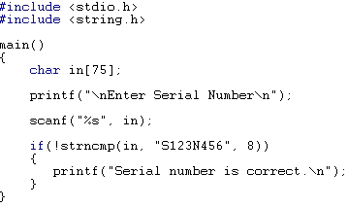
Example
Source code of the buffer overflow
Flaw easily found by attacker
Even without the source code!

Slide 99
Non-trusted Input

Slide 100
Input Validation
Before using an input value check that it is safe:
  NULL, Out of range, invalid format, too long, too short, etc…
Err on the side of caution:
  I know this will be safe vs
  I can’t think of a way to break this…
E.g. whitelist safe inputs, rather than blacklist dangerous ones.

Slide 101
ex4.c
int main(int argc, char *argv[]) {
int valid = 0; /* 0=false */
char str1[8];
char str2[8];
gets(str1);
gets(str2);
if (strncmp(str1,str2,8) == 0)
valid = 1; /* 1 = true */
printf("buffer1:str1(%s),str2(%s), valid(%d)\n",
str1, str2,valid);
if (valid == 0) /* zero is viewed as false */
printf("No match - deny access\n");
if (valid != 0) /*any nonzero value is viewed as true */
printf("Match - allow access\n");
}

Slide 102
strncmp
2.14.11 strncmp
Declaration:
int strncmp (const char *str1, const char *str2, size_t n)
Compares at most the first n bytes of str1 and str2.
Stops comparing after the null character. Returns zero if the first n bytes (or null terminated length) of str1 and str2 are equal.
Returns less than zero or greater than zero if str1 is less than or greater than str2 respectively.
http://www.acm.uiuc.edu/webmonkeys/book/c_guide/

Slide 103
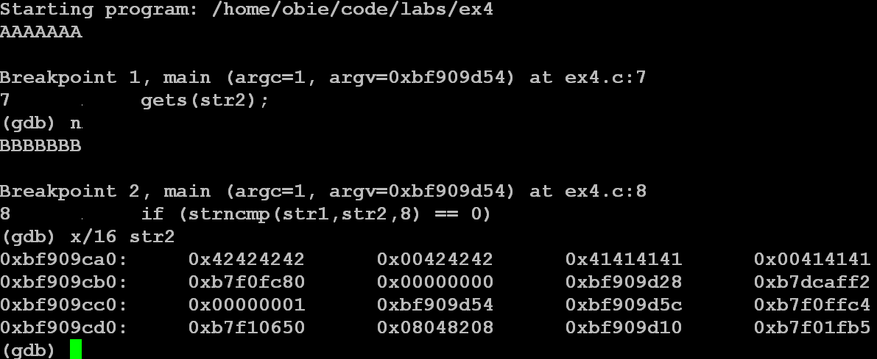
See Input to Locate str1 and str2 in Memory
str2
str1

Slide 104
Now You Can See Why BADINPUT and BADINPUTBADINPUT Passes
str2
str1

Slide 105
Security Problem
Note that discovering this flaw, allows someone to enter a password protected site or database, when they don't know the password!
Note the number 8 is irrelevant.
Any number chosen would cause similar problems.

Slide 106
Writing Over A Local Variable - A Simple Attack Via Input
int authenticate(char *username, char *password){
int authenticated;
char buffer[1094];
authenticated = verify_password (username, password);
if (authenticated == 0) {
sprintf(buffer, "bad password for username %s\n";
log("%s", buffer); }
return authenticated; }

Slide 107
What Is Intended
authenticated = verify_password (username, password);
After asking the user for the username and password, these are checked in the password file.
Supposedly, if the username and password are not correct, then a 0 is returned signaling false; otherwise a 1 is returned signaling true.
Note: Computers typically interpret any non-zero integer as true.

Slide 108
The Layout For The Program
Not all compilers layout the program the same.
Some rearrange variables for optimization purposes.
Thus, without studying specific compilers, you can't conclusively determine from source code how variables are laid out in the source frame.
Unfortunately, attackers study different compilers and there are web sites that post this information.
For this example, let's assume that authenticated is located at the top of the stack.
Thus, authenticated is at a higher memory location than the variable buffer.

Slide 109
Off-by-one Length Miscalculation
The authenticate function has a buffer overflow possibility because the sprintf function doesn't limit the amount of data it writes to the output buffer.
Thus, if the username string is 1024 bytes since a null character is written at the end of the string, the data is written past the end of the buffer variable and into the authenticated variable.
The authenticated variable is a state variable indicating whether the user was able to successfully log in.
The overflow makes this variable nonzero and the program treats the attacker as successfully authenticated

Slide 110
Is This A Good Attack Technique?
Overwriting adjacent local variables is a handy attack technique, but it's not generally applicable.
The technique depends on
  What variables are available to overwrite.
  How the compiler orders the variables in memory.
  What the program does after the overflow happens.
A more general technique is to target the saved state information in every stack frame - namely
  The saved frame pointer
  The saved return address

Slide 111
Common Security Bugs
Like buffer overflows, the most common reason for security bugs is invalid assumptions.
An adversary will look for these assumptions
and find ways to invalidate them.
Adversaries can often control program inputs:
  Direct input: command line, keyboard, …
  Function calls
  Config files
  Network packets
  Web forms…
Bug: it is common to assume input is “benign”

Slide 112
Example: system()
Web forms are often processed by scripts that need to run other programs on the server.
Usually scripts use C’s system() or popen()
Bug: these calls invoke a shell.
Command separators like “|” and “;” allow the user to run other commands on the server.
Form.cgi:
# … start html …
system(“grep $test file”);
# … do other stuff …
Attacker inputs:
“; cat /etc/passwd”
Web Server runs:
“grep ; cat /etc/passwd file”

Slide 113
Structured Exception Handling

Slide 114
Structured Exception Handling (SEH) Attacks
The Windows operating systems can be vulnerable to a slight variation on the traditional stack overflow attacks because of the way they handle exceptions.
Programs can register a handler to act on errors (called exceptions )in a consistent manner.
Exception handling is a feature of many modern languages and was popularized by the C++ language.
C++'s exception handling is significantly more complex than SEH and is implemented on top of SEH in Window environments.

Slide 115
How Does SEH Work?
When a thread causes an exception to be thrown, the thread has a chance to catch that exception and recover.
When a function registers an exception handler, it's placed at the top of a chain of currently registered exception handlers.
When an exception is thrown, the chain is traversed from the top until an applicable handler is found for the thrown exception.
If no appropriate handler is found, the process is generally terminated.

Slide 116
Exploiting Stack Overflows With SEH
On Windows, the exception handler registration structures are located on the program stack and a series of pointers point into the various records.
If an attacker can trigger a stack overflow that overwrites a handler and then force some sort of exception, the exception handler registrations are examined.
One of these can then jump to code controlled by an attacker.

Slide 117
Attempting To Prevent Overflow
Example:
void process string (char *src) {
char dest[32];
for (i = 0; src[i] && (i <= sizeof(dest)); i++)
dest[i] = src[i];
...
The code attempts to prevent an overflow if src has more than 32 characters.
However, it can write one element out of bounds into dest because i can become sizeof(dest) or 32, but the indices are only valid for 0, 1, ..., 31.
So dest[32], an unknown memory location, is set to src[32] which contains unknown data.

Slide 118
Attempting To Prevent Overflow
Another example:
int get_user(char *user) {
char buf[1024];
if (strlen(user) > sizeof(buf)
die("error: user string too long\n");
strcpy(buf,user);
...
strlen returns the number of characters in a C string, but it doesn't count the NULL terminating character.
In the function above, if the supplied user string is exactly 1024 characters, strlen returns 1024, sizeof returns 1024, and the length check passes.
Therefore, the strcpy function writes 1024 bytes of string data plus the trailing NULL character.

Slide 119
Suppose Error Handling Doesn’t Exist in a Language?
Check “error conditions” on return values
  E.g. malloc(), open(), etc…
Catch exceptions or declare them
Think about where to handle errors
  Fix locally?
  Propagate to caller?
  Fail-stop?

Slide 120
Off-by-one Errors

Slide 121
Off-by-one Errors - Problem.
Off-by-one errors occur when a programmer takes the proper precautions in terms of bounds checking, but maybe puts a 512 where she should have put a 511.
Can happen to the best programmers no matter how well-informed they are about buffer overflows.
Usually off-by-one errors can do no more than crash the program. They can be made to compromise security-sensitive data. But any buffer overflow is a security risk.

Slide 122
Off-by-one Errors - Recommendations.
If you have a 512 byte buffer you can only store 511 characters in the string (the last character is a NULL).
If you use scanf() to read into a buffer you also have to account for the NULL: use scanf(“%511s”, &My512ByteBuffer) instead of scanf(“%512s”, &My512ByteBuffer) or scanf(“%s”,
&MY512ByteBuffer) which are both unsafe.
If you declare an array as int A[100], remember that you can’t access A[100], the highest index you can access is A[99] and the lowest is A[0].
The best defense against off-by-one errors of any kind is a thorough combination of testing and code inspection.

Slide 123
Off-by-one Errors In The Coding
On operating systems running on Intel x86 machines, these off by one errors can cause crashes and are often exploitable because the least significant byte of the saved frame pointer can be overwritten.
Recalling how the runtime stack is organized, this means the restored base pointer is incorrect by up to 255 bytes when the function returns.
If the new base pointer points to some user-controllable data (such as a character buffer), users can then specify local variable values from the previous stack frame as well as the saved base pointer and the return address.
What does this allow?

Slide 124
Off-by-one Errors In The Coding
When the calling function returns, an arbitrary return address might be specified, and total control over the program can be seized.
Off-by-one errors can also be exploitable when the element is written out of bounds into another variable used by that function.
The security implications of the off-by-one error in this situation depend on how the adjacent variable is used subsequent to the overflow.
If the variable is an integer, it's truncated and the program could make incorrect calculations based on its value.

Slide 125
Off-by-one Errors In The Coding
The adjacent variable might also affect the security model directly.
For example, it might be a user ID, allowing users to receive permissions they aren't entitled to.
Although these types of exploits are implementation specific, their impact can be severe as generalized attacks.

Slide 126
Heap Overflows

Slide 127
Heap Overflows
Heap overflows are a more recent advance in exploitation.
Although common now, general heap exploitation techniques didn't surface until July 2000.
These techniques were originally presented by an accomplished security researcher known as Solar Designer.
His original advisory is available at http://www.openwall.com/advisories/OW-002-netscape-jpeg/

Slide 128
Heap Management
To understand how heap exploitation works, we need to be familiar with how the heap is managed.
Although heap implementations vary widely, some common elements are present in most algorithms.
Essentially, when a call to malloc or a similar memory allocation is made, some memory is fetched from the heap and returned to the user.
When this memory is deallocated by using free, the system must mark it as free so that it can be used later.

Slide 129
Heap Management
Consequently, a state must be kept for regions of memory that are returned to the callers so that memory can be handed out and reclaimed efficiently.
Most implementations return a block of memory to the user which is preceded by a header describing some basic characteristics of the block as well as some additional information about adjacent block.
The block header usually includes the following:
  Size of current block
  Size of previous block
  Whether the block is free or in use
  Possibly some additional flags

Slide 130
Heap Management
Free blocks are often chained together using a standard data structure, such as a singly or doubly linked list.
Most heap implementations define a minimum size of a block big enough to hold pointers to previous and next elements in a list and use this space to hold pointers when the block isn't in use.
The next slide shows the two basic block structures specific to libc malloc implementations.

Slide 131
Heap Management
Previous size
Current size Flags
User data
Previous size
Current size Flags
List forward pointer
List backward pointer
Free space
GLIBC in-use chunk
GLIBC free chunk
Note that the organization of blocks in this way means that triggering an overflow results in corrupting header information for allocated memory chunks as well as list management data.

Slide 132
Exploiting Heap Overflows
The ability to modify header data and list pointers arbitrarily through a buffer overflow gives attackers the opportunity to disrupt the management of heap blocks.
These disruptions can be used to manipulate block headers and to leverage the heap maintenance algorithms, especially the list maintenance of free blocks.
Let's describe the standard technique for doing this in depth.

Slide 133
Exploiting Heap Overflows
1. Blocks marked as free are assumed to contain list pointers to next and previous blocks in the free chunks list.
2. When a block is freed, it's often coalesced with adjacent blocks if they are also free.
3. Because two blocks are being merged into one, the heap algorithm removes the next chunk that was originally on the free list, adjusts the size of the chunk being freed to reflect that it's now bigger, and then adds the new larger chunk onto the free list.
4. An overflow buffer sets the list pointers in the corrupted chunk to locations useful to the attacker.

Slide 134
Exploiting Heap Overflows
5. The overflow buffer sets the list pointers in the corrupted chunk to locations useful to an attacker.
6. When the unlink operation is performed, an attacker-supplied, fixed-size value is written to an attacker-determined memory location.
Being able to overwrite a memory location with a controllable value is usually all that attackers need to gain control of a process.

Slide 135
Exploiting Heap Overflows
To understand why unlinking a chunk leads to an arbitrary overwrite, consider the following code for unlinking an element from a doubly linked list:
int unlink(ListElement *element) {
ListElement *next = element->next;
ListElement *prev = element->prev;
next->prev = prev;
prev->next = next;
return 0; }
If the element->next and element->prev values can be specified by an overflow, the code unwittingly updates arbitrary memory locations with corrupted values.

Slide 136
Exploiting Heap Overflows
Many useful values can be overwritten to enable attackers to compromise an application.
Some popular targets are:
  1. Global offset table (GOT)/process linkage table (PLT)
  UNIX ELF binaries use several loader structures to resolve called functions from libraries into addresses.
    These structures enable shared libraries to be located anywhere in memory so that the application doesn't need static addresses for API functions at compile time.
    By targeting these structures, attackers can redirect execution to an arbitrary location when a certain API function is called (for example free)

Slide 137
Exploiting Heap Overflows
2. Exit handlers
    Exit handlers are a table of function pointers that are called when the process exits in a UNIX operating system.
    By overwriting one of these values, it's possible to gain arbitrary execution when the process calls the exit function or returns to the main function.
  3. Lock pointers
    Windows uses a set of function pointers in the process environment block (PEB) to prevent unsynchronized modification of process information by competing threads.
    These lock pointers can be overwritten and then triggered by certain types of exceptional conditions.

Slide 138
Exploiting Heap Overflows
4. Exception handler routines
    The Windows PEB maintains an address for the unhandled exception filter routine.
    The routine is called when an exception isn't handled successfully by any other exception handler.
    A common technique is to use the list maintenance code to overwrite the unhandled exception routine when updating one part of the list (such as the previous element) and then cause a memory access violation when updating the next element.
    This technique ensures that the unhandled exception filter is called immediately, assuming that another exception handler doesn't successfully catch the resulting access violation exception.

Slide 139
Exploiting Heap Overflows
5. Function pointers
    Applications use function pointers for various reasons, such as calling functions from dynamically loaded libraries, for C++ virtual member functions, or for abstracting low-level worker functions in opaque structures.
    Overwriting application specific function pointers can provide a reliable exploit against an application.

Slide 140
Global And Static Data Overflows
Global and static variables are used to store data that persists between different function calls, so they are generally stored in a different memory segment than stack and heap variables are.
Normally, these locations don't contain general program runtime data structures, such as stack activation records and heap chunk data, so exploiting an overflow in this segment requires application specific attacks similar to the authenticate function.

Slide 141
Global And Static Data Overflows
Exploitability depends on what variables can be corrupted with the buffer overflow occurs and how the variables are used.
For example, if pointer variables can be corrupted, the likelihood of exploitation increases, as this corruption introduces the possibility for arbitrary memory updates.

Slide 142
Function Point Vulnerabilities

Slide 143
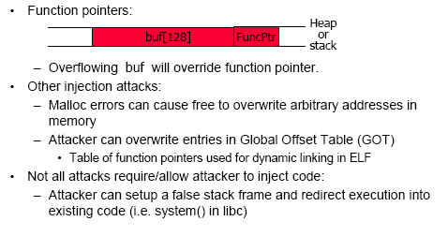
Function Pointer Vulnerabilities

Slide 144
Incomplete Mediation

Slide 145
Incomplete Mediation
These are cases where access should have been controlled/checked but was not, as a result the access is “unmediated” e.g.:
  The “debug” mode for sendmail
  Recent do_brk vulnerability in Linux 2.4.22 kernels
Incorrect checking of arguments allows a user to map pages from kernel into process address space
  Undocumented system calls (in windows) allow direct access to protected structures
Somewhat less common than code-injection, but still common enough
These missed checks are not always obvious

Slide 146
Incomplete Mediation
Incomplete mediation flaw — often nonmalicious but with serious security consequences
Incomplete mediation:
Sensitive data are in exposed due to an uncontrolled condition where access is not checked
Example - A real world example documented in an article by the authors of our textbook:
http://www.informit.com/articles/article.aspx?p=31782&seqNum=2

Slide 147
  A URL is to be generated by client’s browser to access server, e.g.:
  http://www.things.com/order/final&custID=101&part=555A&qy=20&price=10&ship=boat&shipcost=5&total=205
  Suppose input is validated on client.
  Suppose input is not checked on server
  Why bother since input was checked on client?
  The user edits URL directly, changing price and total cost as follows: http://www.things.com/order/final&custID=101&part=555A&qy=20&price=1&ship=boat&shipcost=5&total=25

Slide 148
User uses forged URL to access server
  The server takes $25 as the total cost
Surprise! This really worked.
The attacker could have ordered Objects from Things in any quantity at any price.
And yes, this code was running on the web site for a while before the problem was detected.
From a security perspective, the most serious concern about this flaw was the length of time that it could have run undetected.
Had the whole world suddenly made a rush to Things's web site and bought Objects at a fraction of their price, Things probably would have noticed.

Slide 149
But, Things is large enough that it would never have detected a few customers a day choosing prices that were similar to (but smaller than) the real price, say 30 percent off.
The e-commerce division would have shown a slightly smaller profit than other divisions, but the difference probably would not have been enough to raise anyone's eyebrows; the vulnerability could have gone unnoticed for years.
Fortunately Things hired a consultant to do a routine review of its code, and the consultant found the error quickly.

Slide 150
This web program design flaw is easy to imagine in other web settings.
Those of us interested in security must ask ourselves how many similar problems are there in running code today?
And how will those vulnerabilities ever be found?

Slide 151
Another Example of a Missing Check
/* 2.4.5/drivers/char/drm/i810_dma.c */
if(copy_from_user(&d, arg, sizeof(arg)))
return –EFAULT;
if(d.idx > dma->buf_count)
return –EINVAL;
buf = dma->buflist[d.idx];
Copy_from_user(buf->virtual, d.address, d.used);
Missing lower bounds check for d.idx, what if d.idx < 0?
This allows attacker to put arbitrary kernel address into buf, and then copy arbitrary data (in d.used) into that address

Slide 152
Concurrency and Race Conditions

Slide 153
Concurrency and Race Condition
Concurrency
  Execution of multiple flows (threads, processes, tasks, etc)
  If not controlled can lead to nondeterministic behavior
Race conditions
  Software defect/vulnerability resulting from unanticipated execution ordering of concurrent flows
    E.g., two people simultaneously try to modify the same account (withdrawing money)

Slide 154
Race Condition
Necessary properties for a race condition
  Concurrency property
    At least two control flows executing concurrently
  Shared object property
    The concurrent flows must access a common shared race object
  Change state property
    At least one control flow must alter the state of the race object

Slide 155
Race Window
A code segment that accesses the race object in a way that opens a window of opportunity for race condition
  Sometimes referred to as a critical section
Traditional approach
  Ensure race windows do not overlap
    Make them mutually exclusive
    Language facilities – synchronization primitives (SP)
  Deadlock is a risk related to SP
    i.e. Denial of service is the result!

Slide 156
Race Conditions
A race condition occurs when there is a nonzero time interval between checking some property and when it needs to hold true.
Race conditions are often called Time of Check / Time of Use (TOCTOU) vulnerabilities.

Slide 157
Example
Ghostscript creates a lot of temporary files:
name = mktemp("/tmp/gs_XXXXXXXX");
fp = fopen(name,"w");
Attacker creates symlink
/tmp/gs_12345A -> /etc/passwd
between call to mktmp and fopen, when root
is running gs (just has to happen once!)
Ghostscript (as root) overwrites /etc/passwd.

Slide 158
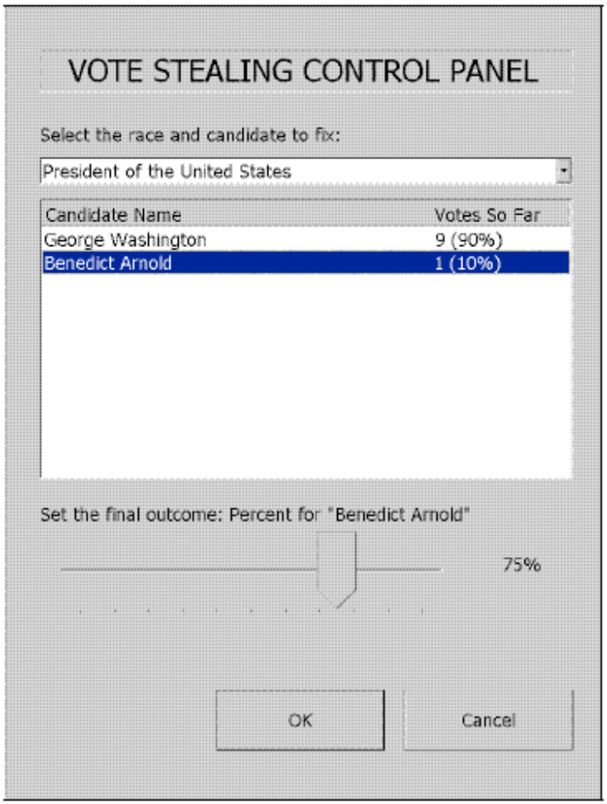
Diebold Case Study
Feldman et al. demonstrated exploitable vulnerabilities in the AccuVote-TS DRE system.
On reboot, the terminal checks
CF card for the bootloader.
If fboot.nb0 exists, boot from
(unauthenticated) CF card.
The CF card slot is protected by
a hotel mini-bar key.
CF Cards are used to upload
ballot definitions, and download
results.

Slide 159
Time of Check, Time of Use
Source of race conditions
  Trusted (tightly coupled threads of execution) or untrusted control flows (separate application or process)
TOCTOU race conditions
  Can occur during file I/O
  Forms a RW by first checking some race object and then using it

Slide 160
Time-of-check to Time-of-use Errors (TOCTTOU)
Time-of-check to time-of-use flaw — often nonmalicious, but with serious security consequences
A.K.A. synchronization flaw / serialization flaw
TOCTTOU — mediation with “bait and switch”
  Non-computing example:
    Swindler shows buyer real Rolex watch (bait) and after buyer pays, switches real Rolex to a forged one
  In computing:
    Change of a resource (e.g., data) between time access checked and time access used
    Q: Any examples of TOCTTOU problems from computing?

Slide 161
Time-of-check to Time-of-use Errors (TOCTTOU)
A: E.g., DBMS/OS: concurrency problem:
X is 10 initially
  a. pgm1 reads value of X
  b. pgm1 adds X = X+ 5
  c. pgm1 writes X
  d. pgm2 reads X
  e. pgm2 adds 3 to X
  f. pgm2 writes X
  If the order of execution is a, b, d, c, e, f then X ends up with value 13
  If the order of execution is a, b, d, e, f, c then
  X ends up with value 15
Any other possibilities?

Slide 162
Concurrency Vulnerabilities
Involve the time between time-of-check to time-of-use where the attacker is able to manipulate the system state in a way to gain access or privileges.
In a recent Usenix Security 2005 paper some authors demonstrated a similar file system race:
  Programs like the print daemon, run as root. To determine whether you are allowed to print a file or not, they check the ownership of the file
  To cause the race to happen, try to print a file in a VERY deep directory structure with a sym-link at the end, so it takes a long time to open the file.
  Initially point the sym-link to a file you own. After the print daemon has checked the permissions, the OS spends a long time opening the file. At this time, switch the sym-link to point at a file that doesn’t belong to you and print it out.

Slide 163
More recently (in Linux 2.2.x and 2.4.x) there was a ptrace-kmod exploit:
  Ptrace is a facility used by debuggers to observe and modify another process, can stop the process, examine memory, and inject code
  Normally, a user process cannot ptrace a root process.
  A user process can attach to a root setuid process before it becomes root.
  However, a race condition allows the tracing process to remain attached even if the setuid process takes on its root privileges, thus the tracing process inherits control over a root process.
Exploits for these are rarer, since the flaws are very difficult to find.

Slide 164
Timing Attacks: Example
Consider the following pwd checking code:
int password-check( char *inp, char *pwd)
if (strlen(inp) != strlen(pwd)) return 0;
for( i=0; i < strlen(pwd); ++i)
if ( *inp[i] != *pwd[i] ) return 0;
return 1;
A simple timing attack will expose the password one character at a time.

Slide 165
Correct Code
int password-check( char *inp, char *pwd) {
oklen = ( strlen(inp) == strlen(pwd) ) ;
for( ok=1, i=0; i < strlen(pwd) ; ++i)
ok = ok & ( inp[i] == pwd[i] ) ;
return ok & oklen;
}
Make the function take the same amount of time no matter what

Slide 166
Formatted String Errors

Slide 167
Format String Bugs
int func(char *user_input) {
printf( user_input );
}
Problem: what if user =
“%s%s%s%s%s%s%s”
Most likely program will crash…
If not, program will print memory contents.
Correct form:
int func(char *user) {
fprintf(stdout,“%s”,user);
}

Slide 168
Format-string Overflows
char outbuf[512], errmsg[512];
sprintf(errmsg, “Illegal cmd: %.400s”, input);
printf(outbuf, errmsg);
How could we use format strings to overflow
outbuf?
input = “%512x|Any 394 byte overflow value”

Slide 169
Exploit
Important things about format strings:
printf(“%4$c”, ‘a’, ‘b’, ‘c’, ‘d’) prints ‘d’.
printf(“%42x%n”, 0, &var) sets var=42.
Suppose we want to change the byte at address ADDR to VALU, and know that the buffer with the format string is POS-4 words up the stack:
buf = “%VALUx%POS$hhnxxADDR”

Slide 170
Preventing Format-string Bugs
Correct usage, input validation, snprintf
www.usenix.org/events/sec01/cowanbarringer.html
FormatGuard: count arguments to printf, parameters in format string.
Tainting: reject format strings from “untrusted” sources, strings with %n, etc…
Whitelisting: allow writes only to program
  addressable locations.
www.cs.washington.edu/homes/miker/format_string.pdf

Slide 171
Integer Overflow

Slide 172
What is Integer Overflow?
Integer overflow is the result of trying to place into computer memory an integer that is too large for the integer data type in a given system.
Integer overflow can result in a request for dynamically allocated memory that is far too large or too small than that which is needed by the program.
An integer overflow often passes undetected and the condition may lead to a security breach through a buffer overflow or other malicious code.

Slide 173
Release Date: 2008-06-10
A vulnerability has been reported in OpenOffice, which can be exploited by malicious people to compromise a user's system.
The vulnerability is caused due to an integer overflow error in "rtl_allocateMemory()" and can be exploited to cause heap-based buffer overflows via a specially crafted document.
Successful exploitation may allow execution of arbitrary code.
The vulnerability is reported in versions 2.0 to 2.4.

Slide 174
Public Advisory: 09.09.08
Apple QuickTime PICT Integer Overflow Vulnerability
Quicktime is Apple's media player product, and is used to render video and other media.
The PICT file format was developed by Apple Inc. in 1984.
PICT files can contain both object oriented images and bitmaps.
Remote exploitation of an integer overflow in Apple Inc.'s QuickTime could allow an attacker to execute arbitrary code in the security context of the current user.

Slide 175
QuickTime is vulnerable to an integer overflow vulnerability when handling malformed PICT files.
This issue results in heap corruption which can lead to arbitrary code execution.
An attacker would need to host a web page containing a malformed PICT file.
Upon visiting the malicious web page exploitation would occur.
Alternatively a malicious PICT file could be attached to an e-mail.

Slide 176
Apple Inc.'s QuickTime versions 7.4.5 and 7.4 have been confirmed to be vulnerable to this issue. Older versions are also suspected to be vulnerable.
iDefense recommends disabling the QuickTime Plug-in and altering the .pic and .pict file type associations within the registry.
Apple has released QuickTime 7.5.5 which resolves this issue.
More information is available via Apple's QuickTime Security Update.

Slide 177
Dangers of Reusing Code

Slide 178
Old Code Used For New Purposes - Problem
Often old code is reused in new projects. Even if the old code was thoroughly tested and written in a safe manner, it might not have accounted for things that the new code expects it to support, like international character sets.

Slide 179
Old Code Used For New Purposes - Consequences.
“HELLO” in ASCII is 0x48-0x45-0x4C-0x4C-0x4F
“HELLO” in UNICODE is
0x00-0x48- 0x00-0x45-0x00-0x4C-0x00-0x4C-0x00-
0x4F
The old code might tell the new code to give it no more than 5 characters because it uses a 5-byte buffer.
The new code gives it 5 characters, but in UNICODE instead of ASCII, so they fill 10 bytes. (The assumption that 5 characters = 5 bytes is a
dangerous one.)

Slide 180
• This is more common and more easily exploitable than you might think.
A “Venetian exploit” can hijack a program with a
reasonably sized buffer overflow even if UNICODE format forces the attacker to have half of his attack code bytes be zeros.

Slide 181
Old Code For New Purposes - Recommendations
Enumerate and challenge all assumptions you’ve made about the interaction between old code and new.
Test thoroughly.
Test old code when you’re using it for new purposes, even if you tested it before.
If your software allows the user to use UNICODE then do all of the testing you did for ASCII with UNICODE as well.
Include the old code in code inspection, even if you inspected it before.

Slide 182
Summary
We've looked at some basic vulnerabilities that can be exploited in code.
Most of our examples came from C code and Linux, but only because C and Linux are more open and there are not too many variations (as with Java, Windows, etc.)
Have we explored all possible types of problems?
No way! Hackers spend a huge amount of time locating these vulnerabilities and they share them amongst themselves.

Slide 183
All Sorts Of Other Far-fetched But Deadly-Serious Things You Should Think About - Consequences.
Your software might be a UNIX utility that spawns two processes.
One sets an environment variable to either “CHUCKY” or “CHEESE”, and the second reads it.
The reading process doesn’t bother to check the size before it puts it in a buffer because it is just an environment variable you made up and is guaranteed to have six characters, right? There is no user I/O involved.

Slide 184
But an attacker can force a race condition that changes the environment variable between when one process writes it and when the
other process reads it.
They give the environment variable more than
six characters causing a buffer overflow. (Add getenv() to the long list of dangerous library functions.)

Slide 185
All Sorts Of Other Far-fetched But Deadly-SeriousThings You Should Think About - Recommendations.
Challenge all of your assumptions like an attacker would.
Never assume that a well inspected and thoroughly tested piece of software is absolutely defect free.
As long as programmers use C there will always be problems, hopefully just not as many if we train programmers properly.
Also, remember other languages have problems also and there is a lot of legacy code out there!

Slide 186
For More Details
The following three papers show some of the deep details needed to exploit vulnerabilities.
I covered parts of these, particularly the first one.
http://insecure.org/stf/smashstack.html
http://www.w00w00.org/files/articles/heaptut.txt
http://www.milw0rm.com/papers/3

