Slide 1
Chapter 7 – Security in Networks
Part 2

Slide 2
Inherent Domain Name Server (DNS)Vulnerabilities
Users/hosts typically trust the host-address mapping provided by DNS
Obvious problems
  Interception of requests or compromise of DNS servers can result in incorrect or malicious responses
  Solution – authenticated requests/responses
Some funny stuff allowed by RFC
  Name server may delegate name to another NS (this is OK)
  If name is delegated, may also supply IP addr (this is trouble)

Slide 3
Pharming
DNS poisoning attack (less common than phishing)
  Change IP addresses to redirect URLs to fraudulent sites
  Potentially more dangerous than phishing attacks
  No email solicitation is required

Slide 4
Many DNS poisoning attacks have occurred:
  January 2005, the domain name for a large New York ISP, Panix, was hijacked to a site in Australia.
  In November 2004, Google and Amazon users were sent to Med Network Inc., an online pharmacy
  In March 2003, a group dubbed the "Freedom Cyber Force Militia" hijacked visitors to the Al-Jazeera Web site and presented them with the message "God Bless Our Troops"

Slide 5
DNS Rebinding Defenses
Browser mitigation: DNS Pinning
  Refuse to switch to a new IP
  Interacts poorly with proxies, VPN, dynamic DNS, …
  Not consistently implemented in any browser
Server-side defenses
  Check Host header for unrecognized domains
  Authenticate users with something other than IP
Firewall defenses
  External names can’t resolve to internal addresses
  Protects browsers inside the organization

Slide 6
User Datagram Protocol
UDP
IP provides routing
  IP address gets datagram to a specific machine
UDP separates traffic by port
  Destination port number gets UDP datagram to particular application process, e.g., 128.3.23.3 to 53
  The source port number provides the return address
Minimal guarantees
  No acknowledgment
  No flow control
  No message continuation

Slide 7
Transmission Control Protocol
TCP
Connection-oriented, preserves order
  Sender
    Break data into packets
    Attach packet numbers
  Receiver
    Acknowledge receipt; lost packets are resent
    Reassemble packets in correct order
Book
Mail each page
Reassemble book
1
19
1
5
1

Slide 8
Internet Control Message Protocol
ICMP
Provides feedback about network operation
  Error reporting
  Reachability testing
  Congestion control
Example message types
  Destination unreachable
  Time-to-live exceeded
  Parameter problem
  Redirect to better gateway
  Echo/echo reply - reachability test
  Timestamp request/reply - measure transit delay

Slide 9
Basic Security Problems
Network packets are passed by untrusted hosts
  Eavesdropping, packet sniffing (e.g., “ngrep”)
IP addresses are public
  Smurf attack - a way of generating a lot of computer network traffic to a victim host. Specifically, it floods a target system via spoofed broadcast ping messages.
TCP connection requires state
  SYN flooding attack
TCP state can be easy to guess
  TCP spoofing attack

Slide 10
Packet Sniffing
Promiscuous NIC (network interface card) reads all packets
  Reads all unencrypted data (e.g., “ngrep”)
  ftp, telnet send passwords in clear!
Eve
Network
Alice
Bob
Prevention: Encryption, improved routing

Slide 11

Smurf DoS Attack
1 ICMP Echo Req
Src: Dos Target
Dest: brdct addr
3 ICMP Echo Reply
Dest: Dos Target
Send ping request to broadcast addr (ICMP Echo Req)
Lots of responses:
  Every host on target network generates a ping reply (ICMP Echo Reply) to victim
  Ping reply stream can overload victim
  Prevention: reject external packets to broadcast address
DoS
Source
gateway
DoS
Target

Slide 12
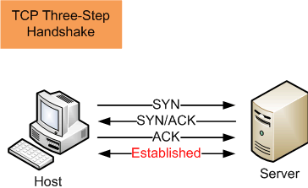
TCP Handshake
C
S
SYN_{C}
Listening
Store data
SYN_{S}, ACK_{C+1}
Wait
ACK_{S+1}
Connected

Slide 13
SYN Flooding Attack
SYN flooding is a method that the user of a hostile client program can use to conduct a denial-of-service (DOS) attack on a computer server.
The hostile client repeatedly sends SYN (synchronization) packets to every porton the server, using fake IP addresses.
When an attack begins, the server sees the equivalent of multiple attempts to establish communications.
The server responds to each attempt with a SYN/ACK (synchronization acknowledged) packet from each open port, and with a RST (reset) packet from each closed port.

Slide 14
In a normal three-way handshake, the client would return an ACK (acknowledged) packet to confirm that the server's SYN/ACK packet was received, and communications would then commence.
However, in a SYN flood, the ACK packet is never sent back by the hostile client.
Instead, the hostile client program sends repeated SYN requests to all the server's ports.
The hostile client makes the SYN requests all appear valid, but because the IP addresses are fake ones, it is impossible for the server to close down the connection by sending RST packets back to the hostile client.

Slide 15
Before time-out can occur, another SYN packet arrives from the hostile client.
A connection of this type is called a half-open connection.
Under these conditions, the server becomes completely or almost completely busy with the hostile client.
Communications with legitimate clients is difficult or impossible.
A hostile client can exploit half-open connections and possibly get access to server files.
The transmission by a hostile client of SYN packets for the purpose of finding open ports and hacking into one or more of them, is called SYN scanning.

Slide 16
Instead, the connection stays open.
A hostile client always knows a port is open when the server responds with a SYN/ACK packet.

Slide 17
SYN Flooding
C
S
SYN_{C1}
Listening
SYN_{C2}
Store data
SYN_{C3}
SYN_{C4}
SYN_{C5}

Slide 18
SYN Flooding - Summary
Attacker sends many connection requests
  Spoofed source addresses
Victim allocates resources for each request
  Connection requests exist until timeout
  Fixed bound on half-open connections
Resources exhausted ⇒ requests rejected

Slide 19
Protection against SYN Attacks
Client sends SYN
Server responds to Client with SYN-ACK cookie
  sqn = f(src addr, src port, dest addr, dest port, rand)
  Normal TCP response but server does not save state
Honest client responds with ACK(sqn)
Server checks response
  If matches SYN-ACK, establishes connection
    “rand” is top 5 bits of 32-bit time counter
    Server checks client response against recent values
  See http://cr.yp.to/syncookies.html

Slide 20
Network Mapping and Scanning
Reconnaissance Tools

Slide 21
Safe Downloading
  Many of the tools we will consider will need downloads to be installed.
  Not all are on the site below, but the site is considered very safe for downloads and should be considered first when searching for software.
  http://tucows.com
  This site is a leader in wholesale internet services
  The site contains a large library of free or shareware software.

Slide 22
Network Mapping
Purpose:
  Identify targets, piece together map of the network
Steps
  Scope the network
  Looking for critical hosts, routers, firewalls
  If no prior knowledge, will begin by scanning machines that can be reached
    Web, Mail, Ftp, DNS servers
  Probe systems trying to understand Internet perimeter
  If internal knowledge, just start scanning and mapping network

Slide 23
Footprinting
What is footprinting?
  Systematic collection of information on an intended target with the goal to create a complete profile of the organization’s security posture.
  System and security administrators information is particularly useful.
Steps for gathering information
  Search engines: Google, Netscape, Alta Vista, Ask Jeves, Yahoo, etc.
  Databases: EDGAR (Education Department General Administrative Regulations), Credit Bureau, Social Security, Voting, Financial, Vital Statistics, Registrar

Slide 24
whois/fwhois
whois and fwhois access whois databases for information about a domain name or an IP address.
whois databases are servers that are maintained by domain name authorities around the world.
A whois database contains a lot of information.
The most relevant are the location, contact information, and the IP address ranges for every domain name under its authority.
whois tools often are installed by default on Linux/Unix distributions.
Windows users can gain identical functonality throught the Cygwin environment.

Slide 25
whois – internet user name directory service (See “man whois” on your own machine if it is installed.)
American Registry
  http://www.arin.net/whois/
Europe & North Africa
  http://www.ripe.net/perl/whois
Asia Pacific
  http://www.apnic.net/
Others Afrinic, lacnic, apjii, cnnic, jpnic, krnic, twnic

Slide 26
Analyzing Whois Output
  Shows:
    The registrant
    The domain name
    The administrative contact
    When record was created/updated
    Primary & secondary DNS servers

Slide 27
nslookup
  Tool to query the DNS (Domain Name Server)
    Two modes of operation interactive or command line
    Cmd nslookup IP # (returns name)
    Cmd nslookup name (returns IP)
    Nslookup <enter>
    Now in interactive mode – type ? For help - but may not be active
    Linux suggests “host” or “dig” instead

Slide 28
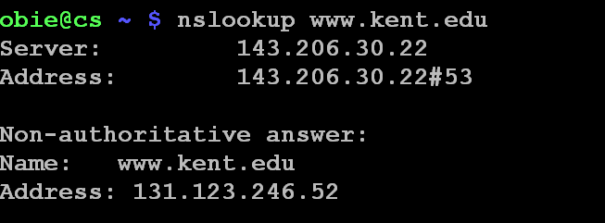
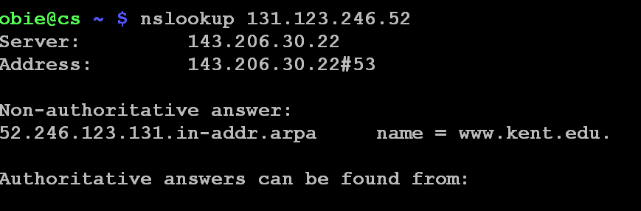

Slide 29
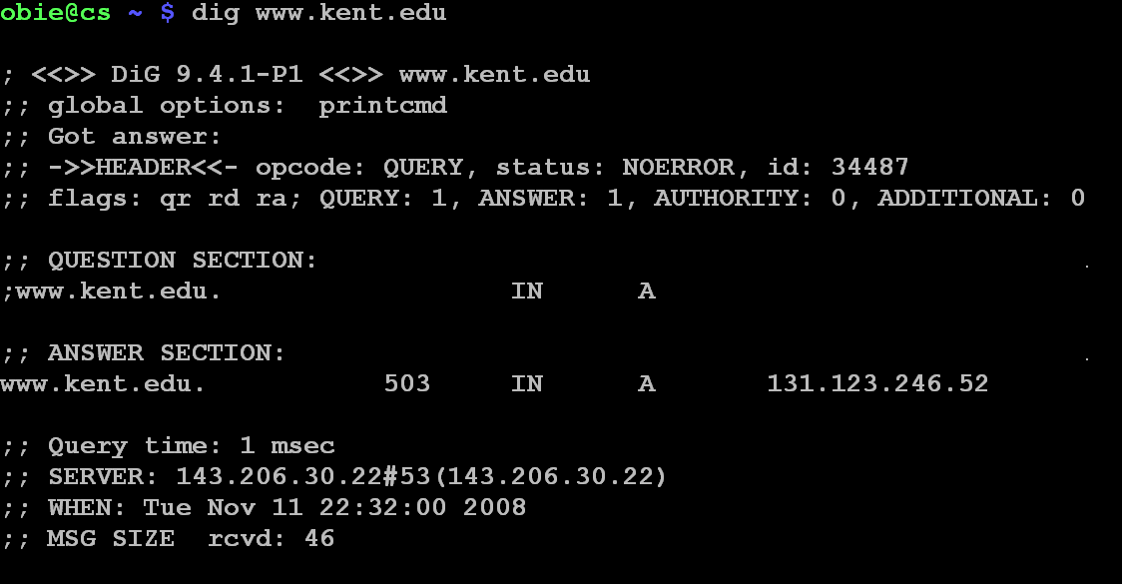

Slide 30
ping
One of the most basic network diagnostic tools.
Ping sends out Internet Control Message Protocol (ICMP) echo requests and waits for replies.
Ping is used to test network connectivity primarily, but it has other uses.
In Linux,Unix, ping typically will continue pinging until ctrl/c is pressed.
In Windows, normally only 4 requests are made.
  Use ping -t if you want continual pings.

Slide 31
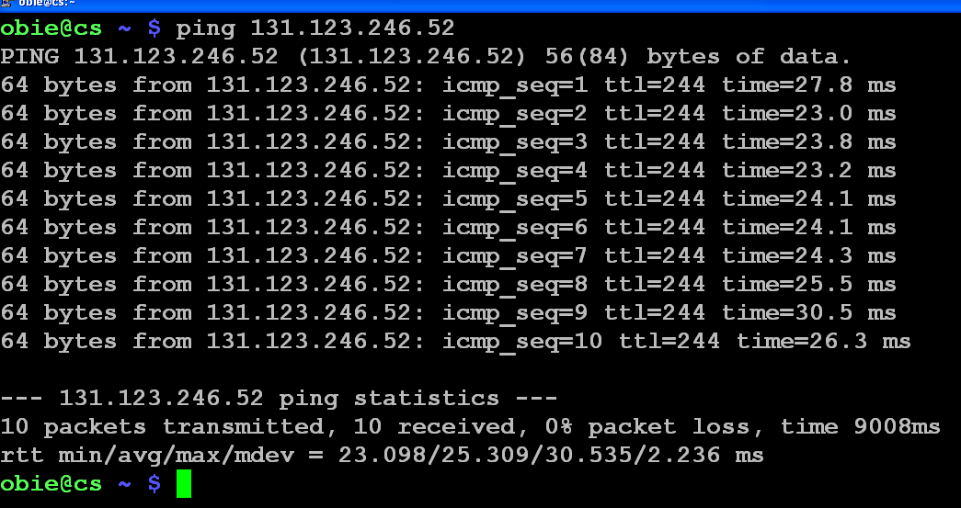

Slide 32
Ping of Death Attack
A ping packet larger that 65,536 bytes is sent.
IP won't support this size of datagram, but the packet can be fragmented in IP, sent, and then when reconstructed at the target, the system crashes.
This isn't really a bug, but a problem with the way ping reconfigures the datagram.
Many systems won't let this happen, but Windows 95 and Windows NT will.
Some systems will reject datagrams this large, but otherwise the only projection is a firewall or port filters that reject these datagrams.

Slide 33
A Form of Smurf Attack
In computer networks, a broadcast address is an IP address that allows information to be sent to all machines on a given subnet rather than a specific machine.
The exact notation can vary by operating system.
Generally, the broadcast address is found by taking the bit complement of the subnet mask and then
OR-ing it bitwise with the IP address.

Slide 34
Example
To broadcast a packet to an entire class B subnet using a private IP address space, the broadcast address would be 172.16.255.255.
This can be found from the subnet mask (255.255.0.0) and the IP address (eg. 172.16.48.196)
  The complement of the subnet mask is 0.0.255.255
  172.16.48.196 | 0.0.255.255 = 172.16.255.255.
  Hint: Write in binary to see this!

Slide 35
Smurf Attack
Pinging the broadcast IP address of a class B network (with more than 65,000 hosts) would cause all to respond with ICMP echo replies.
Naturally, you wouldn't want to do this as your system would be over loaded.
But, what if the pinging host's IP address is spoofed.
Then the only defense is to have firewalls and routers configured to keep this from happening.

Slide 36
fping
fping stands for Fast Ping.
It is ping for an entire network.
Both Unix/Linux and Windows versions are available, but are not installed by default.

Slide 37
Traceroute
This tool is intended as a network troubleshooting tool but it can be useful to determine network topology as well as potential access paths to the target.
It does exactly what its name implies - it traces the route internet packets take.
Spelled “tracert” on Windows due to legacy issues.
Note default on Unix is to use UDP packets with option (-I) to use ICMP.

Slide 38
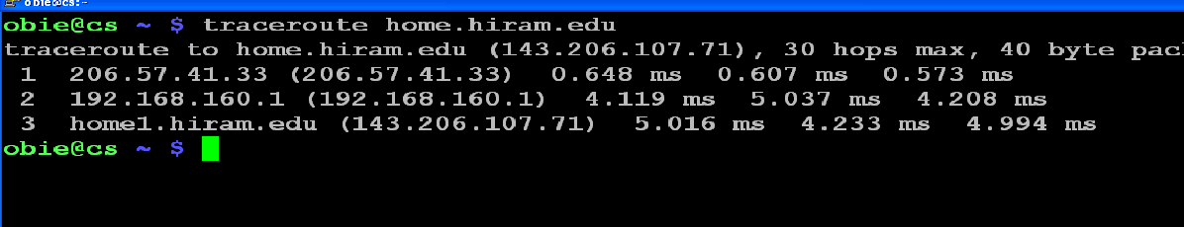

Slide 39
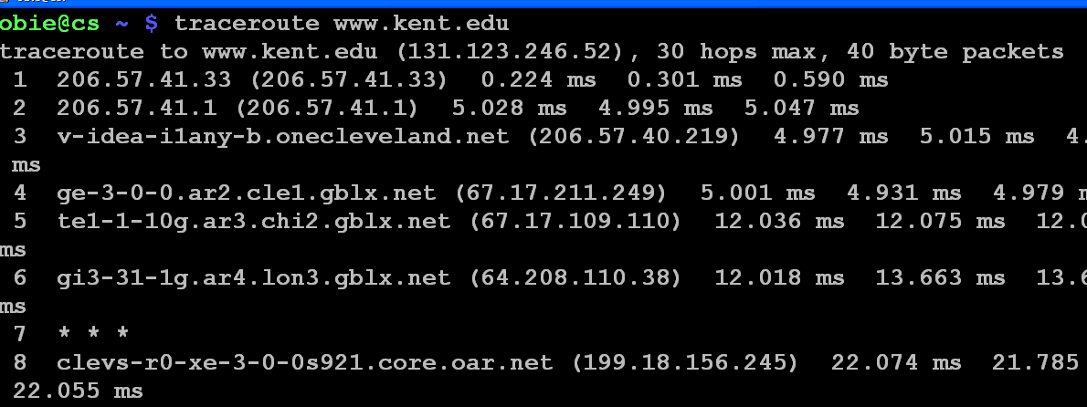
timeout is signalled
3 probes for each node

Slide 40
Graphically Tracing the Route Your Packets Take
Traceroute is a tool that traces the route your packets take.
Ping is a tool that tells you whether or not a web site is up.
Ping Plotter (http://www.pingplotter.com/) is a tool that graphically shows you the route your packets take using both ping and traceroute.
  It was free, but can be used for 30 days without a subscription.
  Interesting to see how your packets travel!
  But, can also be used to map a network.

Slide 41
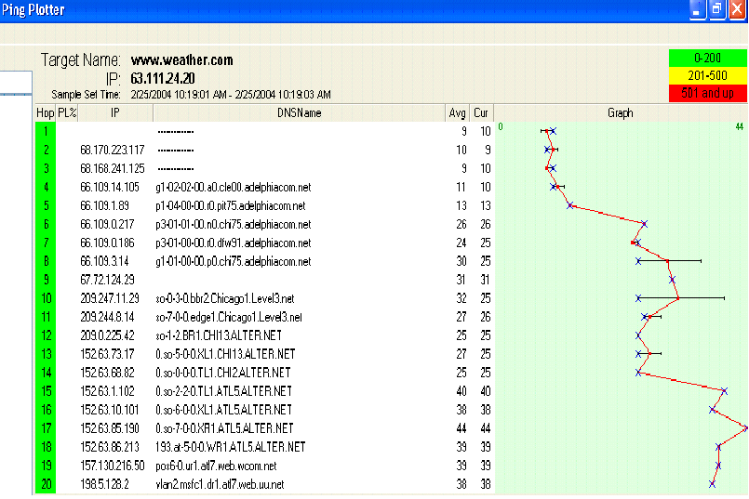
One Ping Plotter Trace to www.weather.com

Slide 42
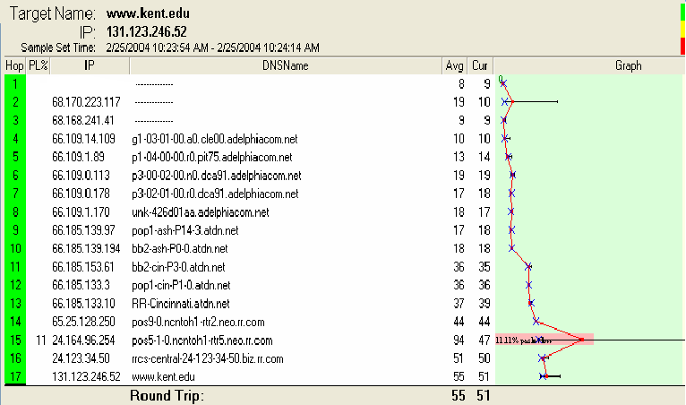
A Trace to KSU
If you watch these interactively you’ll see the route changes.

Slide 43
hping
Ping uses ICMP echo responses which some firewalls are configured to not allow through.
Hping can do the same kind of testing but using other IP packets such as ICMP, UDP,and TCP.
This is an extremely versatile tool.
It can be used for
  Mapping networks
  Testing firewall rules
  Stealth port scanning
  Remotely identifying operating systems.

Slide 44
hping
There is another tool named Netcat that is similar to this one.
Both focus on user low-level control of network protocols.
But, Netcat focuses on the data part of the network connection, and hping focuses on the individual protocol headers.
Hping allows the user to build TCP, UDP, ICMP, raw IP, or any other protocols you wish.
Hping lets the user manipulate header fields, flags, and options.
The user can build up a particular packet, send it out, and see what kind of response you get.

Slide 45
Week 2: Footprinting
  Hacking Tool: Sam Spade
  Can suck down entire web sites and search source pages for juicy information.
    Windows http://www.samspade.org/ssw
    Any platform w/web client http://www.samspade.org

Slide 46
Week 2: Footprinting
  Finding Address Range of Network
    Lists of registrars are available at
      http://www.internic.net/alpha.html
    List of whois servers outside US
      http://www.allwhois.com

Slide 47
Week 2: Footprinting
  ARIN
    American Registry for Internet Numbers (North America, South America, the Caribbean and sub-Saharan Africa)
    If IP number not assigned to ARIN it will indicate which registry is authority for the number.
    Few numbers are not assigned yet or used for testing.

Slide 48
Week 2: Footprinting
  Hacking Tool: NeoTrace
    This tool will provide a graphical depiction of each network hop.
    http://www.neotrace.com/
  Visual Route
    Graphical geographic display of each hop.
    http://www.visualroute.com

Slide 49
Week 2: Footprinting
  Visual Lookout
    For the experienced technician VisualLookout is best described as a real-time netstat that also provides history and a rich set of features to help locate unwelcome visitors."

Slide 50
Week 2: Footprinting
  Hacking Tool: Smart Whois
    Unlike standard Whois utilities, SmartWhois can find the information about a computer located in any part of the world, delivering all the related records within a few seconds. Even if an IP address cannot be resolved to a hostname, it's not a problem for SmartWhois.
    http://software-tower.com/smart-whois.html

Slide 51
Week 2: Footprinting
  Hacking Tool: eMailTracking Pro
    I am unable to find any info on this tool except from several other ethical security courses who have this same tool in their syllabus.

Slide 52
Week 2: Footprinting
  Hacking Tool: MailTracking.com

Slide 53
Week 2: Footprinting
  Summary
  Reconnaissance is the first step of Profiling the target
  Does not involve direct contact with the target but acquires the information from other sources.

Slide 54
Network Mapping
Sometimes ping all possible hosts on your network – send an ICMP echo request
  Looking for a response to a ping
  ICMP echo reply
  Since ICMP messages might be blocked,
    Send TCP packets to commonly open ports
    Web - 80 or email - 25

Slide 55
Network Mapping
Programs to do this
  Network Scanner
    SuperScan – www.foundstone.com
      Free Windows utility
    fping – www.fping.com
      Free Unix scanner
  Nmap can also do host discovery
    ping sweep

Slide 56
Network Mapping
Traceroute
  Goes by TTL field in IP header
  Map path to each computer, overlay results from each traceroute of target
  Create a hypothetical network topology
  Automated tool can do this
    Cheops-ng – runs on Linux
    cheops-ng.sourceforce.net

Slide 57
Network Mapping
Traceroute
Cheops-ng
  Uses ping and traceroute
  Does OS fingerprinting and has both FTP and SSH clients
  Plus builds a very nice network map complete with hosts and routes to each host on the network
  See http://cheops-ng.sourceforge.net/

Slide 58
From the Website
"Cheops-ng is a network management tool for mapping and monitoring your network.
It has host/network discovery functionality as well as OS detection of hosts.
Cheops-ng has the ability to probe hosts to see what services they are running.
On some services, cheops-ng is actually able to see what program is running for a service and the version number of that program."

Slide 59
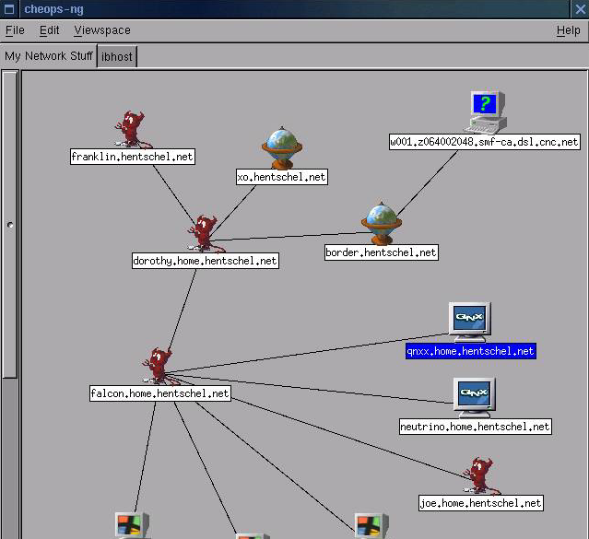

Slide 60
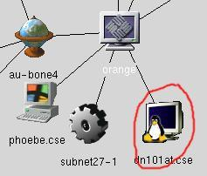
Cheops-ng
OS Detection: Cheops can optionally determine the OS of hosts on the network, selecting appropriate icons for them.

Slide 61
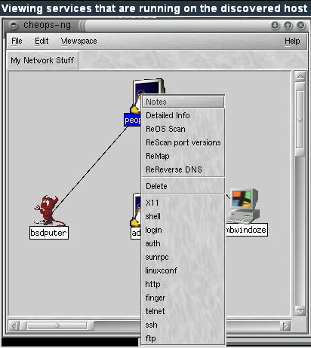

Slide 62
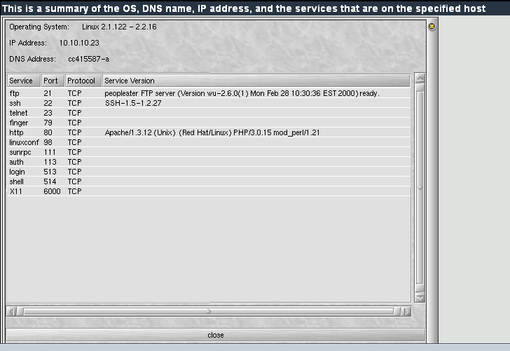

Slide 63
fping Tool
fping is a ping like program which uses the Internet Control Message Protocol (ICMP) echo request to determine if a host is up.
fping is different from ping in that you can specify any number of hosts on the command line, or specify a file containing the list of hosts to ping.
Instead of trying one host until it timeouts or replies, fping will send out a ping packet and move on to the next host in a round-robin fashion.
If a host replies, it is noted and removed from the list of hosts to check.
If a host does not respond within a certain time limit and/or retry limit it will be considered unreachable.
Unlike ping, fping is meant to be used in scripts and its output is easy to parse.

Slide 64
Defense Against Network Mapping
Use firewalls and packet filtering capabilities of routers
At Internet gateway, block incoming ICMP messages
  Except for hosts meant to be public Web servers
  Can configure filters to allow specific IP’s like your ISP to be able to send pings
  Can filter ICMP Time Exceeded messages too
  Limits attacker information but also network management too
    Always tradeoff between security and functionality

Slide 65
Ports
Transmission Control Protocol (TCP) and User Datagram Protocol (UDP) are transport layer protocols used for communication between computers.
The Internet Assigned Numbers Authority (IANA) is responsible for assigning port numbers for specific uses.

Slide 66
Scanning Purpose
Purpose of scanning if you are an attacker?
  At point you do a port scan you typically have the machines – know they exist
  Point is to discover which TCP or UDP ports are open
    That tells what services are running on those ports
    Services tell you the vulnerabilities available
  Also tells you operating system being run

Slide 67
Scanning Basics - Ports
Each machine with TCP/IP stack has 65,536 TCP and 65,536 UDP ports
Every Service connected to a port is a potential doorway into the machine for an attacker
Attacker has list of official known port assignments
  Internet Assigned Numbers Authority (IANA)
    http://www.iana.org/assignments/port-numbers
  Wikipedia List of same thing
  http://en.wikipedia.org/wiki/List_of_TCP_and_UDP_port_numbers

Slide 68
Scanning Basics - Ports
The port numbers are divided into three ranges:
  Well Known Ports – 0 – 1023
    Typically only for root or privileged processes
  Registered Ports - 1024 – 49151
    Registered known programs with IANA
  Dynamic and/or Private Ports 49152 – 65535
    Dynamic or ephemeral ports, assigned by programs for one-time connections – no known programs associated

Slide 69
Ports
Only root-privileged programs are allowed to open the lower numbered ports, common programs:
Examples
    ftp-data 20/udp
    ftp 21/tcp
    ssh 22/tcp
    telnet 23/tcp
    Time 37/tcp
    Time 37/udp
    Whois 43/tcp
    DNS 53/udp
    Web 80/tcp
    Imap 143/tcp

Slide 70
Ports
Ordinary programs can use these
  shockwave2 1257/tcp
  shockwave2 1257/udp
  ingreslock 1524/tcp ingres
  ingreslock 1524/udp ingres
  orasrv 1525/tcp oracle
  orasrv 1525/udp oracle
  x11 6000-6063/tcp
  X Window System x11 6000-6063/udp

Slide 71
More Information About Ports
Port Numbers Used by Malware
General List of Port Number Uses
Port Numbers for MACs

Slide 72
Ports and Port Scan Signature
Signature of a Port scan
  What does it look like?
    Several packets to different destination ports from the same source within a “short period” of time.
    TCP SYN to a non-listening port
    A detector like Snort can inform us that we have been port-scanned

Slide 73
Scanning Program
The best known scanning software is Nmap
  Written by Fyodor
  http://www.insecure.org/Nmap
  Lots and lots of options
  Just gets better with age
  Runs on Linux, Unix and Windows
  Can run it from the command line and from a GUI interface

Slide 74
Scanning Program - Nmap
  Goal of attacker = scan without being caught!
  May want to avoid some of Nmap’s scans for this reason
  A partial list of scans include
    Connect scan Null stealth scan
    Syn stealth scan Xmas tree scan
    Ack stealth scan TCP window scan
    FTP Bounce scan UDP port scan
    Fin Stealth scan IP protocol scan ...

Slide 75
Scanning Program - Nmap
Scans that may get you caught include
    TCP connect – Usual 3-way handshake
      Terminates normally
      Web server or other service can keep a record including your IP address
    TCP Syn Scan – Sends a Syn packet, waits for machine to send a Syn/Ack response, then sends a reset
      If port open, get a syn/ack response
      If port closed, no response, get a reset or ICMP port unreachable message

Slide 76
Scanning Program - Nmap
More stealthy scans
  Xmastree, TCP fin and Null scans
    All violate TCP protocol, out of sequence packets
    No logging done
    Sends odd bits set, fin bit but no connection or no bits set
    If port closed, response is a Reset
    If port open, Response is nothing

Slide 77
Scanning Program - Nmap
TCP Ack Scan
    Use this scan to get by filtering rules
    Many firewalls will filter initiating TCP connections from the outside
    Filter out packets with just Syn bit set for an opening connection
    To avoid filtering, Nmap offers an Ack scan
    Sets Ack bit on packets and filter thinks its a response to an existing connection

Slide 78
Scanning Program - Nmap
TCP Ack Scan
  Nmap uses Ack scan to figure out which ports are allowed unfiltered traffic by the firewall
  If get a reset, means packet got through firewall, and port is open
  If get no response, or ICMP port unreachable, Nmap marks port as filtered

Slide 79

Nmap ACK Scan
ACK dsk Port 1024
Packet
Filter
Device
ACK dsk Port 1025
ACK dsk Port 1026
Protected System
Reset
Attacker
Internal Network
External Network

Slide 80
Scanning Program
Nmap
  Version scan – find hidden applications
    Smart administrators
      Hide services behind odd port numbers
      Or, applications can be run over other services like SSL

Slide 81
Scanning Program
  Version scan - How it works
    Nmap starts with normal scan
    Gathers list of open ports on a target
    For TCP, completes the 3-way handshake, waits for application to present itself
    Many do banners
    Try to match banner to internal DB Nmap has
    If Finds SSL, Nmap completes SSL handshake and then runs detection to see what service is behind SSL encryption - Http or Ftp

Slide 82
Scanning
Speed of Scans
    Can vary the rate of packets sent to a target
      Attacker doesn’t want to have it known that he/she is performing a scan or has a slow system that doesn’t respond in the expected amount of time
    Nmap has different modes for scanning
    Paranoid – one packet every 5 minutes
    Sneaky – one packet every 15 seconds
    Polite – one packet every .4 seconds
    Normal – try to send packets at a speed that doesn’t miss target ports

Slide 83
Scanning
Anonymous Scans
  Can hide attacker inside set of fake IP addresses
  Want to confuse target into thinking this is not a scan but more normal traffic
  Need real IP too, want response back from Nmap
  Say, 30 or more IP’s sent along with attacker IP
  Would need to investigate all 30 addresses …
  Not likely!!

Slide 84
More Scanning
OS Identity by Stack Fingerprinting
  Attacker needs to know OS and version
  Looking for way into system
    What vulnerabilities does system have?
  Nmap does this by TCP Stack Fingerprinting
  TCP is standard, but different implementations of TCP stack respond in various ways to illegal packets
    Windows is distinct compared to Solaris
    Both are distinct compared to Linux

Slide 85
More Scanning
OS Identity - Stack Fingerprinting
    Nmap sends packets to various ports including:
      Syn packets to open ports and closed ports
      Null packet to both open and closed ports
      Ack packet to closed and open ports
    Some implementations send RST in response
    Some send nothing and some send ICMP port unreachable
    Nmap includes a DB of different system responses
    Over 1000 platforms
    Solaris, Windows many flavors, NetBSD, MacOS, HP-UX, HP-printers, Cisco IOS plus others

Slide 86
Scanning Defenses
What can you do against Scanning?
  Close down all unnecessary ports
    Find them first
    netstat –nao | find “LISTENING” in Windows XP
      Shows listening ports and Process ID’s of listening processes
    Third party tools actually show more information
      Fport – www.foundstone.com
      TCPView – www.sysinternals.com

Slide 87
Defenses Against Scanning
On-line scanners can help ...
For people who want to on-line scan their computers, there are several on-line sites
  www.auditmypc.com
  www.crucialtests.com
  www.hackerwatch.org/probe
  www.dslreports.com/scan
Most do simple scans for obvious vulnerabilities
Good for novice users ...

Slide 88
Scanning Defenses
Once find all open ports
  See if services are needed
  If not, disable the service permanently
    Start->Run …
    services.msc
    Then, click service, click Stop and set its Startup type to Disabled
  Linux
    netstat –nap finds in-use ports and PID’s and program
    lsof –p shows all TCP/IP ports and associated files

Slide 89
Scanning Defenses
Linux continued
  Disable services
    Comment out its line in /etc/inetd.conf
    If started by xindetd, delete file in /etc/xinetd.d/[service]
    chkconfig --list is another way to see services installed
      Comes with Redhat, Mandrake and other Linux versions
      Can type chkconfig [service] off

Slide 90
Scanning Defenses
Stateful Packet Filtering
  Will keep track of existing connections
    Typically has a connection table TCP connections
  Won’t allow ACK packets into the Network unless they belong to existing TCP conversation
    There must have been an earlier Syn packet
    For FTP, must have been a control connection set up already
  More intelligent than simple packet filtering
    Defeats ACK scans and FTP Bounce scans plus several others

Slide 91
Port Scanning Legal
From the Sans FAQ – www.sans.org
  Port scanning is like ringing the doorbell to see whether someone's at home.
  The police usually can't do anything about it.
  They have to wait until a crime is committed.
  Sometimes, if a computer system is affected too much by a port scan, one can argue that the port scan was, in fact, a denial-of-service (DoS) attack, which is usually an offense
  But- realize that port scanning is viewed as an attack by or Computer Center.

Slide 92
More Legality
More answers ...
  http://www.computerworld.com/securitytopics/security/story/0,10801,106849,00.html

