Slide 1
Security in Networks
Chapter 7
Part 2

Slide 2
RFCs
A Request for Comments (RFC) is a memorandum published by the Internet Engineering Task Force (IETF) describing methods, behaviors, research, or innovations applicable to the working of the Internet and Internet-connected systems.
Through the Internet Society, engineers and computer scientists may publish discussions in the form of an RFC, either for peer review or simply to convey new concepts, information, or (occasionally) engineering humor.
The IETF adopts some of the proposals published as RFCs as Internet standards.

Slide 3
Some Network Attacks
Others Will Be Discussed In Connection With Certain Security Tools

Slide 4
Inherent Domain Name Server (DNS) Vulnerabilities
Users/hosts typically trust the host-address mapping provided by DNS
Obvious problems
  Interception of requests or compromise of DNS servers can result in incorrect or malicious responses
  Solution – authenticated requests/responses
Some funny stuff allowed by RFC
  Name server may delegate name to another NS (this is OK)
  If name is delegated, may also supply IP address (this is trouble)

Slide 5
Pharming
DNS poisoning attack (less common than phishing)
  Change IP addresses to redirect URLs to fraudulent sites
  Potentially more dangerous than phishing attacks
  No email solicitation is required

Slide 6
Many DNS poisoning attacks have occurred:
  January 2005, the domain name for a large New York ISP, Panix, was hijacked to a site in Australia.
  In November 2004, Google and Amazon users were sent to Med Network Inc., an online pharmacy
  In March 2003, a group dubbed the "Freedom Cyber Force Militia" hijacked visitors to the Al-Jazeera Web site and presented them with the message "God Bless Our Troops"

Slide 7
DNS Rebinding Defenses
Browser mitigation: DNS Pinning
  Refuse to switch to a new IP
  Interacts poorly with proxies, VPN, dynamic DNS, …
  Not consistently implemented in any browser
Server-side defenses
  Check Host header for unrecognized domains
  Authenticate users with something other than IP
Firewall defenses
  External names can’t resolve to internal addresses
  Protects browsers inside the organization

Slide 8
User Datagram Protocol (UDP)
IP provides routing
  IP address gets datagram to a specific machine
UDP separates traffic by port
  Destination port number gets UDP datagram to particular application process, e.g., 128.3.23.3 to 53
  The source port number provides the return address
Minimal guarantees
  No acknowledgment
  No flow control
  No message continuation

Slide 9
Transmission Control Protocol (TCP)
Connection-oriented, preserves order
  Sender
    Break data into packets
    Attach packet numbers
  Receiver
    Acknowledge receipt; lost packets are resent
    Reassemble packets in correct order
Book
Mail each page
Reassemble book
1
19
1
5
1

Slide 10
Internet Control Message Protocol (ICMP)
Provides feedback about network operation
  Error reporting
  Reachability testing
  Congestion control
Example message types
  Destination unreachable
  Time-to-live exceeded
  Parameter problem
  Redirect to better gateway
  Echo/echo reply - reachability test
  Timestamp request/reply - measure transit delay

Slide 11
Basic Security Problems
Network packets are passed by untrusted hosts
  Eavesdropping, packet sniffing (e.g., “ngrep”)
IP addresses are public
  Smurf attack - a way of generating a lot of computer network traffic to a victim host. Specifically, it floods a target system via spoofed broadcast ping messages.
TCP connection requires state
  SYN flooding attack
TCP state can be easy to guess
  TCP spoofing attack

Slide 12
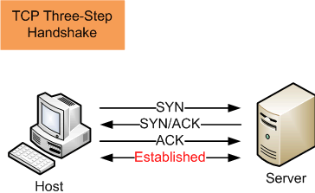
TCP Handshake
C
S
SYN_{C}
Listening
Store data
SYN_{S}, ACK_{C+1}
Wait
ACK_{S+1}
Connected

Slide 13
SYN Flooding Attack
SYN flooding is a method that the user of a hostile client program can use to conduct a denial-of-service (DOS) attack on a computer server.
The hostile client repeatedly sends SYN (synchronization) packets to every porton the server, using fake IP addresses.
When an attack begins, the server sees the equivalent of multiple attempts to establish communications.
The server responds to each attempt with a SYN/ACK (synchronization acknowledged) packet from each open port, and with a RST (reset) packet from each closed port.

Slide 14
In a normal three-way handshake, the client would return an ACK (acknowledged) packet to confirm that the server's SYN/ACK packet was received, and communications would then commence.
However, in a SYN flood, the ACK packet is never sent back by the hostile client.
Instead, the hostile client program sends repeated SYN requests to all the server's ports.
The hostile client makes the SYN requests all appear valid, but because the IP addresses are fake ones, it is impossible for the server to close down the connection by sending RST packets back to the hostile client.

Slide 15
Before time-out can occur, another SYN packet arrives from the hostile client.
A connection of this type is called a half-open connection.
Under these conditions, the server becomes completely or almost completely busy with the hostile client.
Communications with legitimate clients is difficult or impossible.
A hostile client can exploit half-open connections and possibly get access to server files.
The transmission by a hostile client of SYN packets for the purpose of finding open ports and hacking into one or more of them, is called SYN scanning.

Slide 16
Instead, the connection stays open.
A hostile client always knows a port is open when the server responds with a SYN/ACK packet.

Slide 17
SYN Flooding
C
S
SYN_{C1}
Listening
SYN_{C2}
Store data
SYN_{C3}
SYN_{C4}
SYN_{C5}

Slide 18
SYN Flooding - Summary
Attacker sends many connection requests
  Spoofed source addresses
Victim allocates resources for each request
  Connection requests exist until timeout
  Fixed bound on half-open connections
Resources exhausted ⇒ requests rejected

Slide 19
Protection against SYN Attacks
Client sends SYN
Server responds to Client with SYN-ACK cookie
  sqn = f(src addr, src port, dest addr, dest port, rand)
  Normal TCP response but server does not save state
Honest client responds with ACK(sqn)
Server checks response
  If matches SYN-ACK, establishes connection
    “rand” is top 5 bits of 32-bit time counter
    Server checks client response against recent values
  See http://cr.yp.to/syncookies.html

Slide 20
TCP/IP Problems
Steve Bellovin
  AT&T Bell labs researcher
  One of the first to publicize problems in the TCP/IP protocols
  Wrote his original paper in 1989 in which he documented many problems not all of them important
  Not all problems still valid
  Useful to understand current problems and past problems

Slide 21
Trusted Host Problem
Unix Tradition
    One host can extend trust to another host
    User who has same username on both machines
      Login or execute remote commands from trusted host to trusting host without presenting password
    Trusted username and hostnames are maintained in two types of special files
      .rhosts
      hosts.equiv

Slide 22
Trusted Host Problem
Works Like This ...
    List of trusted hosts in /etc/hosts.equiv
    Any user of any host in list may access an account on trusting host (with the same username) without presenting password
    Can execute remote commands on trusting host
    Known as r* commands
      rlogin – login from remote host
      rcp – remote file copy
      rsh – begin a remote shell

Slide 23
Trusted Host Problem
Trust scheme based entirely on IP address authentication
    When r* commands used, receiving host checks IP address of sending machine against trusted host list
      If match, command executed
      Else, permission for execution is denied or
      login and password is requested of user
    Still in use as it is handy for Sys Admins wanting to execute commands remotely on many machines

Slide 24
Trusted Host Problem
IP Spoofing
    Not really an attack but a vulnerability exploited in order to execute an attack
    Most spoofing seeks to violate trust between target and trusted host
    If someone can spoof, they are from a trusted host and can access the target

Slide 25
Steps in an IP Spoof Attack
Steps in general
  Eve – Evil machine, Alice and Bob – Innocent machines
  Alice and Bob have a trusted relationship
  Eve needs to figure out how ISN of Bob’s machine changes
  She is going to spoof Alice’s IP address and pretend she is Alice
  Eve also needs to prevent Alice from sending a TCP Reset which will drop the connection to Bob
  Eve will then establish a real connection with Bob

Slide 26
Steps in an IP Spoof Attack
Steps in detail
  Eve – Evil machine, Alice and Bob – Innocent machines
    Eve sends a lot of syn packets to Bob without spoofing. Uses her real IP address.
    Tries to determine the rate at which ISN’s from Bob’s machine are changing with time.
    2. Eve launches DoS attack against Alice - syn flood. Alice is overwhelmed for a time with traffic.
    This prevents Alice from sending a Reset to Bob which would result in Bob dropping the spoofed connection

Slide 27

Steps in an IP Spoof Attack
Eve
1. Many TCP connections, get ISN sequence
2. DoS against Alice, Syn flood
Alice
Bob

Slide 28
Steps in an IP Spoof Attack
Steps in detail
    3. Eve initiates a connection to Bob using Alice’s IP address.
    4. Bob responds with Syn-Ack and his ISN. This gets routed to Alice which normally would have responded with a Reset. But, she is busy fending off syn-attack.
    5. Using info from Step 1., Eve sends Ack to Bob with ISN_{B} + 1 using Alice’s IP Address.
    Eve won’t see Bob’s response and ISN_{B} to Alice
    If guess is correct, she begins TCP connection pretending to be Alice.

Slide 29
Steps in an IP Spoof Attack
1. Many TCP connections, ISN sequence
Eve
2. DoS against Alice, Syn flood
Alice
3. Sends Syn (A,ISN_A)
5. Sends Ack (B,ISN_B+1)
Bob
4. Sends Ack (A,ISN_A+1),
Syn (B, ISN_B)

Slide 30
Steps in an IP Spoof Attack
  Eve might need to cycle through steps 1 to 5 hundreds of times.
    After finally getting connected ...
    Eve can execute one of remote r* commands
    Next step is to insert a “backdoor” into Bob
    Executes command, ‘echo ++ >> ~./rhosts’
    Extends trust to any user from any host
    Or, puts her own IP into the /etc/hosts.equiv file

Slide 31
Source Routing Abuse
Routing Information Protocol (RIP)
  Used to propagate routing information on local networks
  Routers need to exchange information using routing protocols
  Typically will exchange information every so many seconds
  Source routing feature
    Allows source machine to specify path packet will take through network

Slide 32
Source Routing Abuse
Attack in general
  Send bogus routing information trying to impersonate a particular host
  Want packets to be sent to the attacker machine
  Attacker can intercept packets and gain passwords, credit card numbers or other sensitive information

Slide 33
Steps in Source Route Attack
Attack Steps (Same players, Eve, Alice and Bob)
  Eve generates packets with fake source route
  Packets claim to come from Alice
  Source route includes Eve’s IP
    Eve looks like a router between Alice and Bob
  Bob is the destination.
  Routers between Eve and Bob read source route and deliver packets to Bob via Eve

Slide 34
Steps in Source Route Attack
Eve
Packet with Route
1. Alice
2. Eve
3. Bob
Alice
Bob
Packet with Route
1. Bob
2. Eve
3. Alice

Slide 35
Steps in Source Routing Abuse
Attack Steps
  Bob responds by sending packets through Eve to Alice
  Eve never forwards packets to Alice, doesn’t need to even do a DoS on Alice
Comment
This attack doesn’t work across the Internet
Most gateways block Source Routed packets
Yet, not blocked on internal networks
Insiders can get away with this type of attack

Slide 36
Routing Overview – A Bit More Details
Packet switched networks
  Route packets dynamically
Is one reason Internet works in spite of its size and constant change
Yet, routing protocols are historically vulnerable to attack
  Minimal security
  Designed for speed and flexibility

Slide 37
Routers/
Switches
Routing
SRC
DST
I want to know
the shortest path
So, routers exchange local information!

Slide 38
Routing Overview
Two major classes of routing algorithms
  Vector Distance Algorithms
    Based on exchange of distance and reachability information between routers
  Link-state Algorithms
    Based on exchange of more extensive information
    Includes complete database of how routing node reaches other nodes in network
      Type of link and more detailed cost information
      Each node has more complete state of all links in network, able to identify shortest path to destination node or network

Slide 39
Distribution of Routes - Distance Vector
Every node sends its neighbor
a vector: # of hops of
reaching each
other node.
B
A
C

Slide 40
Link State
A node sends to its
neighbors state of its
directly connected links: up/down and
costs. Each node that receives
information forwards it to all its
neighbors.

Slide 41
Routing Protocols
Routers have the job of receiving and forwarding packets through subnets
  Each router makes routing decisions based on knowledge of topology and current traffic conditions
  Routers exchange information using routing protocols

Slide 42
Routing Definitions
Autonomous Systems (AS)
  An autonomous system is a network connected by routers under the administration of a single administrative entity
  An AS is a connected group of IP networks that adhere to a single and clearly defined routing policy See: www.arin.net

Slide 43
Routing Definitions
Routing Protocols
  Within an autonomous system
    Routers use an Interior Routing Protocol (IRP)
  Between autonomous systems the routing tables may be different
  Two systems may need to exchange information
    Between autonomous systems different protocol is used, Exterior Routing Protocol (ERP)

Slide 44
Routing Protocols
Border Gateway Protocol (BGP)
    One of the Exterior Routing Protocols (ERP)
    Similar to Vector Distance algorithm but no cost information
    Developed for networks that use TCP/IP
    Became the standard ERP for Internet
    Was designed to allow routers known as “gateways” in different autonomous systems to cooperate in exchange of routing information
    Messages are sent over TCP connections

Slide 45
Routing Protocols - RIP
Was one of the earliest interior routing protocols and is still widely used today
  An example of a Vector-distance protocol
  RIP is a distance protocol that uses hop count as a cost metric
  Each link has a cost of 1 and a maximum cost of 15
  Limits the use of RIP to AS’s of < 15 hops in diameter
  In RIP, routing tables exchanged between neighbors every 30 seconds
  If router doesn’t hear from its neighbors every 180 seconds, neighbor is considered unreachable

Slide 46
RIP 2
RIP-2 Has Advantages Over RIP
  RIP2 is an updated version of RIP and is backwards compatible with RIP
  More information than RIP including ability to include subnet information
  Some Authentication
    Shared password, in plain text

Slide 47
RIP
RIP is a simple protocol
Initialization:
  When the routing daemon is initialized, it sends requests through each network interface
  Neighboring routers will reply with routing table information
Updates:
  Routers advertise tables with neighbors periodically (~30 seconds); or triggered by route changes.

Slide 48
RIP
To prevent route oscillation, existing routes are retained until a new one is discovered with strictly lower cost
Split-Horizon Update
  Routers do not advertise a route on an interface from which it learned of the route in the first place
RIP Has problems with false advertising …
False data can result in instability or Black Holes

Slide 49
Black Hole Anomaly
On 23 April 1997, Internet service providers lost contact with nearly all U.S. Internet backbone operators.
Result, much of the Internet was disconnected, some parts for 20 minutes, some for as long as 3 hours.
Problem was attributed to MAI Network Services in McLean, Virginia (www.mai.net), which gave Sprint and other backbone providers incorrect routing tables, the resulting in MAI being flooded with traffic

Slide 50
Routing Protocol Attacks
Some reported attacks
RIP Attack
  Intruder sends bogus information to target host and to gateways along way to impersonate particular host
  1. Impersonate host that’s not used much
    Attacker sends information that he is unused host. All packets now routed to attack machine.
    Doesn’t need to forward them since host is unused
  2. Can impersonate an active machine
    Packets routed to attacker machine
    Who then sends them on to destination machine using IP source routing.
    Inspect packets, gain passwords, other information or can alter packets and then forward them

Slide 51
ICMP Attacks
ICMP Redirect message
    Used by gateways to advice hosts of better routes
    Abused in same way RIP is.
    However more constraints on its use
      Tied to existing connection
      Must only be sent from first gateway to originating host

Slide 52
ICMP Attacks
ICMP Redirect message
  1. Host C sends a Syn packet to S via A, a router
  2. Before packet can get there, Host X, our attacker sends an ICMP redirect for Host X to C spoofing the address A.
  3. C now redirects packets to X
  4. X forwards packets to S to avoid suspicion

Slide 53
ICMP Attacks
ICMP Redirect
  Still a threat if not ignored
  Current recommendation is to turn off redirects on CISCO routers
  Routing protocol takes care of best paths, hosts should ignore ICMP redirect messages

Slide 54
Conclusion
TCP/IP was never designed to be a secure protocol
Architecture flaw was that sequence numbers have no security properties
Some problems have been fixed
  Less address authentication being used
  More crypto protocols for remote login, e-mail, web browsers

Slide 55
Conclusion
Yet, problems remain
  DNS still a major problem for Internet
  Routing attacks are an area of huge concern, still needs more research
  E-mail has problems – no real authentication
    However, problem with e-mail is people
  ARP Attacks easy to launch and switches don’t really help

Slide 56
Security/Attack Tools

Slide 57
Security/Attacker Tools
As always, most of the tools used by security administrators, are also available and used by attackers.
If you want to be overwhelmed, look at the list:
http://sectools.org/sniffers.html
We will consider a representation of tools in this part as well as Part 3.
As I have repeatedly said, do not experiment with these.

Slide 58
Safe Downloading
  Many of the tools we will consider will need downloads to be installed.
  Not all are on the site below, but the site is considered very safe for downloads and should be considered first when searching for software.
  http://tucows.com
  This site is a leader in wholesale internet services
  The site contains a large library of free or shareware software.

Slide 59
Network Mapping

Slide 60
Network Mapping
Purpose:
  Identify targets, piece together map of the network
Steps
  Scope the network
  Looking for critical hosts, routers, firewalls
  If no prior knowledge, will begin by scanning machines that can be reached
    Web, Mail, Ftp, DNS servers
  Probe systems trying to understand Internet perimeter
  If internal knowledge, just start scanning and mapping network

Slide 61
Footprinting
What is footprinting?
  Systematic collection of information on an intended target with the goal to create a complete profile of the organization’s security posture.
  System and security administrators information is particularly useful.
Steps for gathering information
  Search engines: Google, Netscape, Alta Vista, Ask Jeves, Yahoo, etc.
  Databases: EDGAR (Education Department General Administrative Regulations), Credit Bureau, Social Security, Voting, Financial, Vital Statistics, Registrar

Slide 62
whois/fwhois
whois and fwhois access whois databases for information about a domain name or an IP address.
whois databases are servers that are maintained by domain name authorities around the world.
A whois database contains a lot of information.
The most relevant are the location, contact information, and the IP address ranges for every domain name under its authority.
whois tools often are installed by default on Linux/Unix distributions.
Windows users can gain identical functonality throught the Cygwin environment.

Slide 63
whois – internet user name directory service (See “man whois” on your own machine if it is installed.)
American Registry
  http://www.arin.net/whois/
Europe & North Africa
  http://www.ripe.net/perl/whois
Asia Pacific
  http://www.apnic.net/
Others Afrinic, lacnic, apjii, cnnic, jpnic, krnic, twnic

Slide 64
Analyzing Whois Output
  Shows:
    The registrant
    The domain name
    The administrative contact
    When record was created/updated
    Primary & secondary DNS servers

Slide 65
Sam Spade
If you don’t have whois (or some of the other tools), check out this site:
http://samspade.org/
The next slide shows what is available as data.

Slide 66
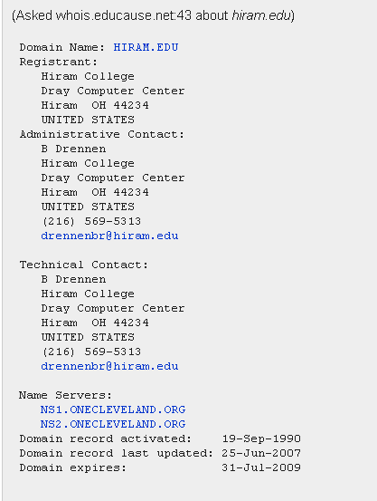

Slide 67
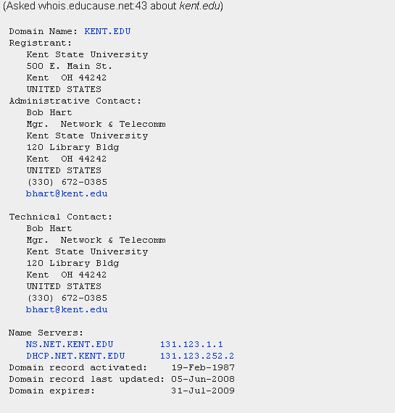

Slide 68
nslookup
  Tool to query the DNS (Domain Name Server)
    Two modes of operation interactive or command line
    Cmd nslookup IP # (returns name)
    Cmd nslookup name (returns IP)
    Nslookup <enter>
    Now in interactive mode – type ? For help - but may not be active
    Linux suggests “host” or “dig” instead

Slide 69
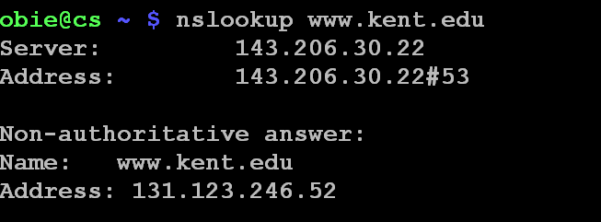
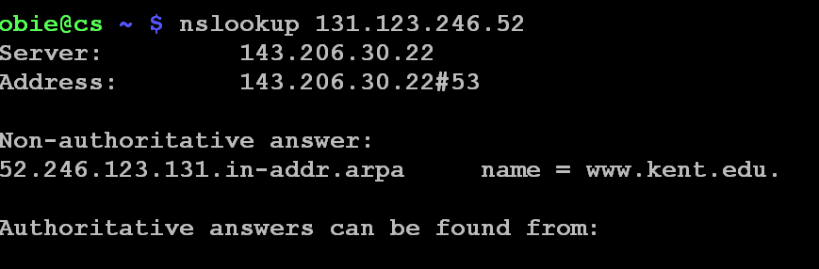

Slide 70
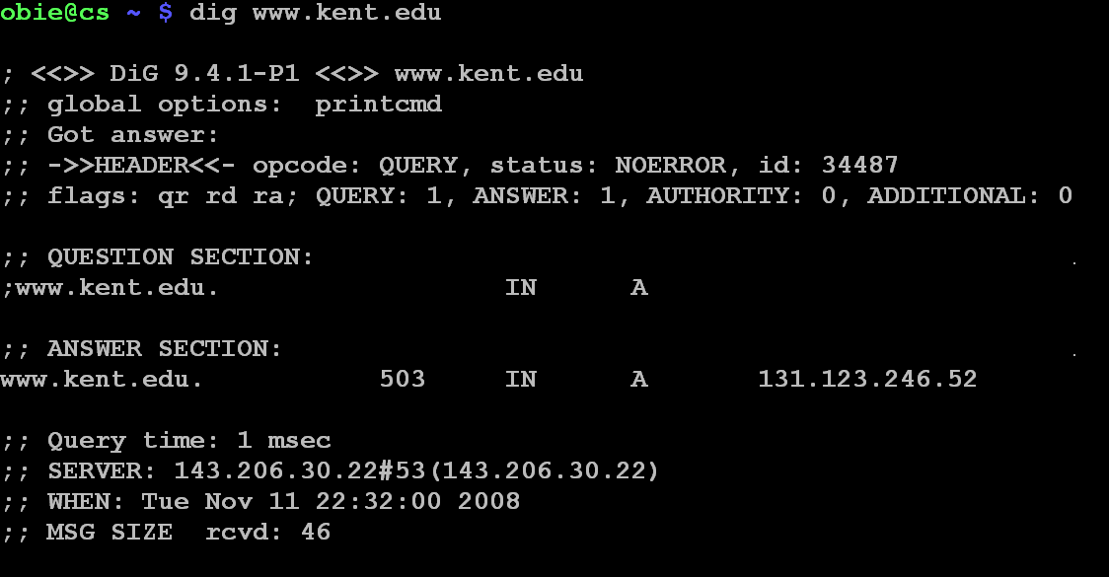

Slide 71
ping
One of the most basic network diagnostic tools.
Ping sends out Internet Control Message Protocol (ICMP) echo requests and waits for replies.
Ping is used to test network connectivity primarily, but it has other uses.
In Linux, Unix, ping typically will continue pinging until ctrl/c is pressed.
In Windows, normally only 4 requests are made.
  Use ping -t if you want continual pings.

Slide 72
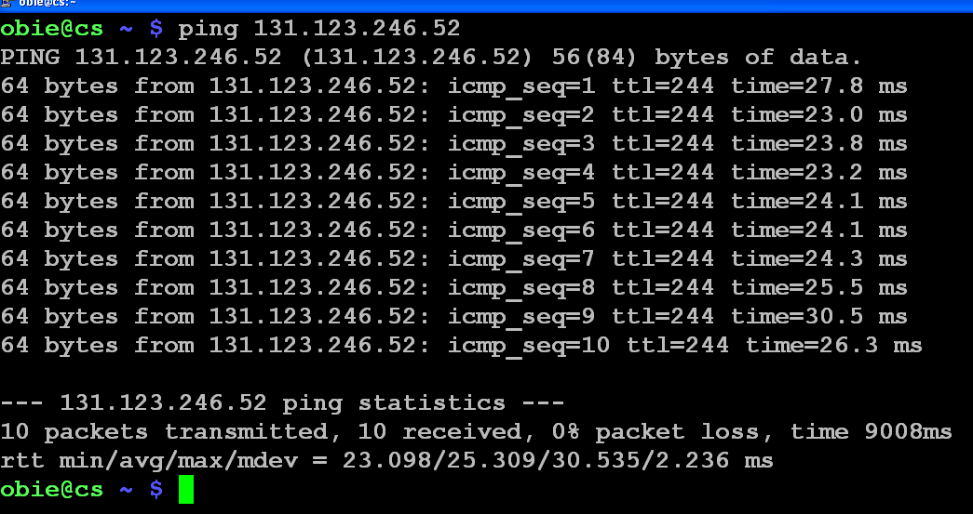

Slide 73
Ping of Death Attack - 1st in 1996
A ping packet larger that 65,536 bytes is sent.
IP won't support this size of datagram, but the packet can be fragmented in IP, sent, and then when reconstructed at the target, the system crashes.
This isn't really a bug, but a problem with the way ping reconfigures the datagram.
Many systems won't let this happen, but Windows 95 and Windows NT will.
Some systems will reject datagrams this large, but otherwise the only projection is a firewall or port filters that reject these datagrams.

Slide 74
A Form of Smurf Attack
In computer networks, a broadcast address is an IP address that allows information to be sent to all machines on a given subnet rather than a specific machine.
The exact notation can vary by operating system.
Generally, the broadcast address is found by taking the bit complement of the subnet mask and then
OR-ing it bitwise with the IP address.

Slide 75
Example
To broadcast a packet to an entire class B subnet using a private IP address space, the broadcast address would be 172.16.255.255.
This can be found from the subnet mask (255.255.0.0) and the IP address (eg. 172.16.48.196)
  The complement of the subnet mask is 0.0.255.255
  172.16.48.196 | 0.0.255.255 = 172.16.255.255.
  Hint: Write in binary to see this!

Slide 76
Smurf Attack
Pinging the broadcast IP address of a class B network (with more than 65,000 hosts) would cause all to respond with ICMP echo replies.
Naturally, you wouldn't want to do this as your system would be over loaded.
But, what if the pinging host's IP address is spoofed.
Then the only defense is to have firewalls and routers configured to keep this from happening.

Slide 77

A Smurf DoS Attack - Pictorially
1 ICMP Echo Req
Src: Dos Target
Dest: brdct addr
3 ICMP Echo Reply
Dest: Dos Target
Send ping request to broadcast address (ICMP Echo Req)
Lots of responses:
  Every host on target network generates a ping reply (ICMP Echo Reply) to victim
  Ping reply stream can overload victim
  Prevention: reject external packets to broadcast address
DoS
Source
gateway
DoS
Target

Slide 78
Fraggle (Similar to Smurf)
  The UDP port 7 is used for echo service
  An attacker can create a stream of user datagrams with a random source port and a spoofed source address
  The destination port is 7 and the destination source is a broadcast address at some intermediate site
  The attack can get worse if the source port = 7
  Could be prevented by filtering out UDP echo requests destined for broadcast addresses

Slide 79
Victim’s
host
spoofed
source
broadcast
destination
random
source port
destination
Port = 7
Stream of UDP datagrams
Victim’s
host
spoofed
source
broadcast
destination
source
Port = 7
destination
Port = 7
Stream of UDP datagrams

Slide 80
Trinoo
Distributed denial of service attack tool that enables an attacker to inundate a victim with UDP traffic from many different hosts simultaneously
    Setup of daemon program:
      Search for machines and attempt to break into them using a number of different exploits
      Install the trinoo daemon
    Attack:
      When given a victim by a master server, sends a large number of UDP packets to random ports on the victim
  Master server – installed with a root kit

Slide 81
Trinoo (cont)
Master servers
  Each master server controls a number of daemons on different hosts (commands are password protected)
  An attacker normally controls a number of master servers (on different hosts)
    Commands are password protected:
      Start/stop it running
      Test that it is alive/listening
      Ask for a list of all the daemons that it controls
      Instruct it to order its daemons to attack a given victim

Slide 82
Trinoo (cont)
August, 1999:
  Trinoo daemons running on over 200 different machines flooded a University of Minnesota host for several days
February, 2000:
  Trinoo (and other distributed denial of service tools) used to attack several major e-commerce sites on the Web

Slide 83
attacker
master
master
master
master
daemon
daemon
daemon
daemon
Large number of UDP packets to random ports

Slide 84
Tribe Flood Network (TFN)
Distributed denial of service attack tool
  Newer versions have been developed (TFN2K, TFN3K, Stacheldraht)
  Used in February, 2000 to attack several major e-commerce sites on the Web
Similar to trinoo:
  Daemon programs: listen for and execute commands from a master
  Master programs
    Control a number of daemons
    Communicate with an attacker and pass his/her commands on to daemons

Slide 85
TFN (cont)
“Improvements” over trinoo:
  Random protocol (TCP, UDP, or ICMP) for communication between master and daemons
  Can send out “decoy” packets to random IP addresses to obscure the true target of the attack
  Daemons spoof the source IP address in the attack packets they send
  Daemons can attack multiple targets
  Wider variety of attacks

Slide 86
TFN (cont)
Daemon attack strategies:
  UDP flood (like with trinoo)
  TCP SYN flood
  ICMP ping flood
  ICMP directed broadcast flood (smurf)
  All of the above

Slide 87
fping
fping stands for Fast Ping.
fping is a ping like program which uses the Internet Control Message Protocol (ICMP) echo request to determine if a host is up.
It is ping for an entire network.
Both Unix/Linux and Windows versions are available, but are not installed by default.

Slide 88
fping Tool
fping is different from ping in that you can specify any number of hosts on the command line, or specify a file containing the list of hosts to ping.
Instead of trying one host until it timeouts or replies, fping will send out a ping packet and move on to the next host in a round-robin fashion.
If a host replies, it is noted and removed from the list of hosts to check.
If a host does not respond within a certain time limit and/or retry limit it will be considered unreachable.
Unlike ping, fping is meant to be used in scripts and its output is easy to parse.

Slide 89
Traceroute
This tool is intended as a network troubleshooting tool but it can be useful to determine network topology as well as potential access paths to the target.
It does exactly what its name implies - it traces the route internet packets take.
Spelled “tracert” on Windows due to legacy issues.
Note default on Unix is to use UDP packets with option (-I) to use ICMP.

Slide 90
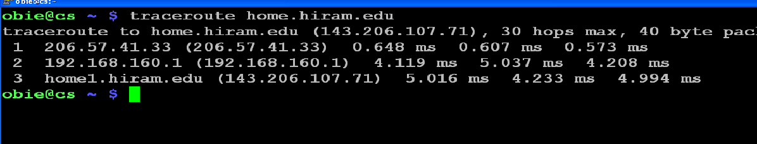

Slide 91
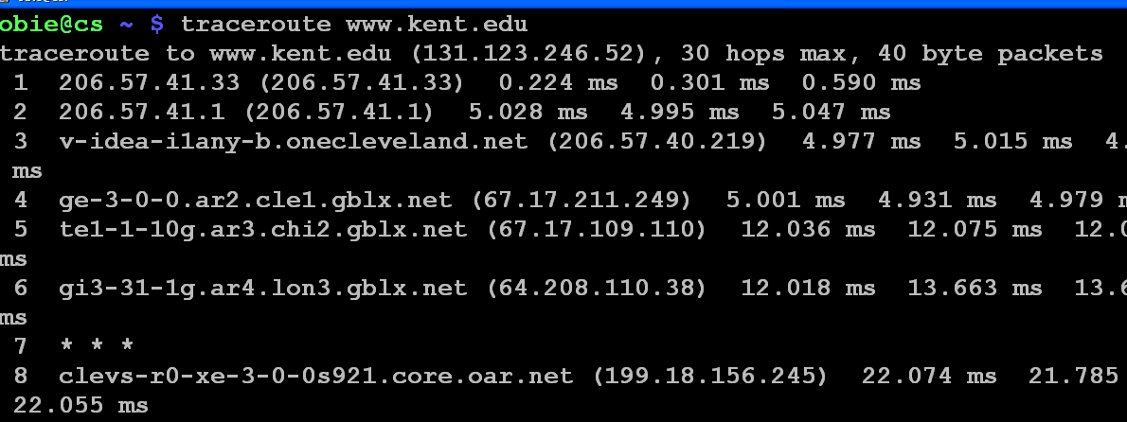
timeout is signalled
3 probes for each node

Slide 92
Graphically Tracing Your Packets’ Route
Traceroute is a tool that traces the route your packets take and Ping is a tool that tells you whether or not a web site is up.
Why not combine them with a graphical interface?
Ping Plotter (http://www.pingplotter.com/) is a tool that graphically shows you the route your packets take using both ping and traceroute.
  It was free, but can be used for 30 days without a subscription.
  Interesting to see how your packets travel!
  But, can also be used to map a network.

Slide 93
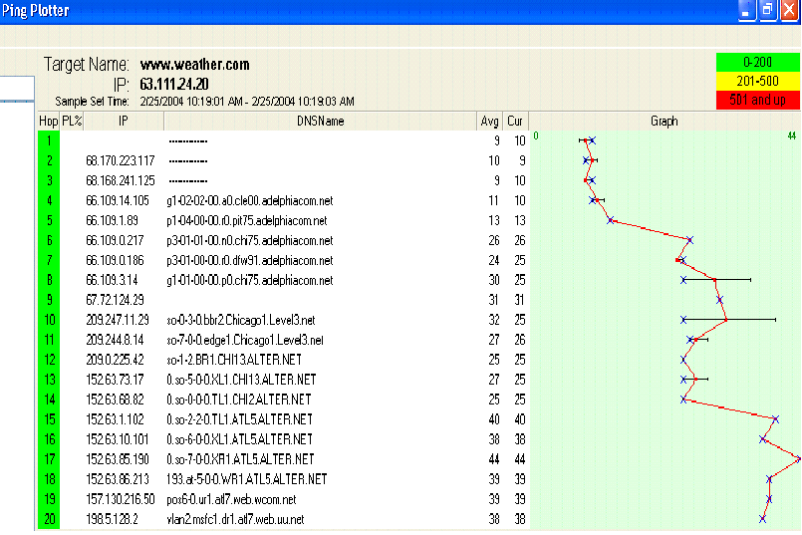
One Ping Plotter Trace to www.weather.com

Slide 94
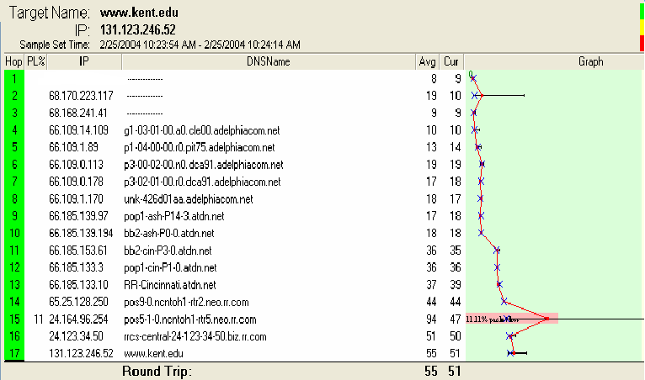
A Trace to KSU
If you watch these interactively you’ll see the route changes.

Slide 95
hping
Ping uses ICMP echo responses which some firewalls are configured to not allow through.
Hping can do the same kind of testing but using other IP packets such as ICMP, UDP,and TCP.
This is an extremely versatile tool.
It can be used for
  Mapping networks
  Testing firewall rules
  Stealth port scanning
  Remotely identifying operating systems.

Slide 96
hping
There is another tool named Netcat that is similar to this one.
Both focus on user low-level control of network protocols.
But, Netcat focuses on the data part of the network connection, and hping focuses on the individual protocol headers.
Hping allows the user to build TCP, UDP, ICMP, raw IP, or any other protocols you wish.
Hping lets the user manipulate header fields, flags, and options.
The user can build up a particular packet, send it out, and see what kind of response you get.

Slide 97
Cheops-ng
Uses ping and traceroute, but is different from PingPlotter.
  Does OS fingerprinting and has both FTP and SSH clients
  Plus builds a very nice network map complete with hosts and routes to each host on the network
  See http://cheops-ng.sourceforge.net/

Slide 98
From the Website
"Cheops-ng is a network management tool for mapping and monitoring your network.
It has host/network discovery functionality as well as OS detection of hosts.
Cheops-ng has the ability to probe hosts to see what services they are running.
On some services, cheops-ng is actually able to see what program is running for a service and the version number of that program."

Slide 99
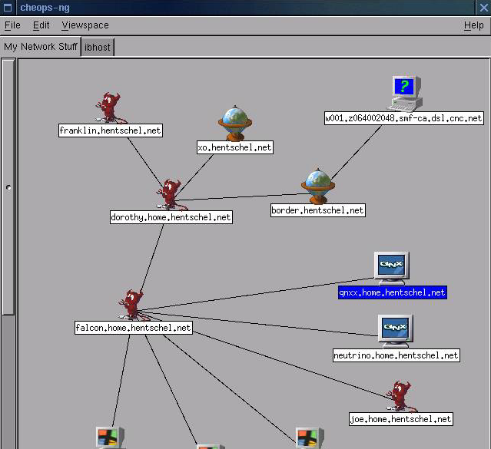

Slide 100
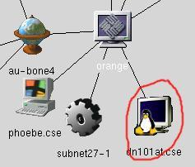
Cheops-ng
OS Detection: Cheops can optionally determine the OS of hosts on the network, selecting appropriate icons for them.

Slide 101
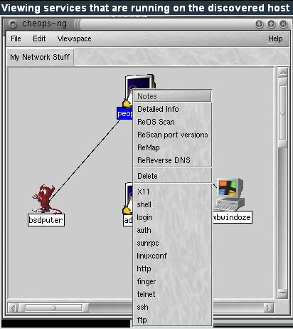

Slide 102
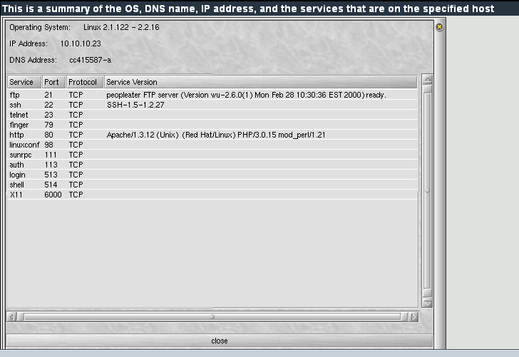

Slide 103
Defense Against Network Mapping
Use firewalls and packet filtering capabilities of routers
At Internet gateway, block incoming ICMP messages
  Except for hosts meant to be public Web servers
  Can configure filters to allow specific IP’s like your ISP to be able to send pings
  Can filter ICMP Time Exceeded messages too
  Limits attacker information but also network management too
    Always tradeoff between security and functionality

Slide 104
Ports
Transmission Control Protocol (TCP) and User Datagram Protocol (UDP) are transport layer protocols used for communication between computers.
The Internet Assigned Numbers Authority (IANA) is responsible for assigning port numbers for specific uses.

Slide 105
Scanning Purpose
Purpose of scanning if you are an attacker?
  At point you do a port scan you typically have the machines – know they exist
  Point is to discover which TCP or UDP ports are open
    That tells what services are running on those ports
    Services tell you the vulnerabilities available
  Also tells you operating system being run

Slide 106
Scanning Basics - Ports
Each machine with TCP/IP stack has 65,536 TCP and 65,536 UDP ports
Every Service connected to a port is a potential doorway into the machine for an attacker
Attacker has list of official known port assignments
  Internet Assigned Numbers Authority (IANA)
    http://www.iana.org/assignments/port-numbers
  Wikipedia List of same thing
  http://en.wikipedia.org/wiki/List_of_TCP_and_UDP_port_numbers

Slide 107
Scanning Basics - Ports
The port numbers are divided into three ranges:
  Well Known Ports – 0 – 1023
    Typically only for root or privileged processes
  Registered Ports - 1024 – 49151
    Registered known programs with IANA
  Dynamic and/or Private Ports 49152 – 65535
    Dynamic or ephemeral ports, assigned by programs for one-time connections – no known programs associated

Slide 108
Ports
Only root-privileged programs are allowed to open the lower numbered ports, common programs:
Examples
    ftp-data 20/udp
    ftp 21/tcp
    ssh 22/tcp
    telnet 23/tcp
    Time 37/tcp
    Time 37/udp
    Whois 43/tcp
    DNS 53/udp
    Web 80/tcp
    Imap 143/tcp

Slide 109
Ports
Ordinary programs can use these
  shockwave2 1257/tcp
  shockwave2 1257/udp
  ingreslock 1524/tcp ingres
  ingreslock 1524/udp ingres
  orasrv 1525/tcp oracle
  orasrv 1525/udp oracle
  x11 6000-6063/tcp
  X Window System x11 6000-6063/udp

Slide 110
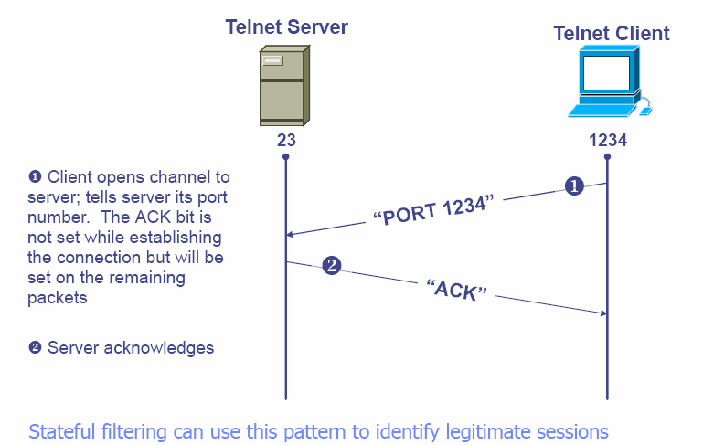
Telnet Example

Slide 111
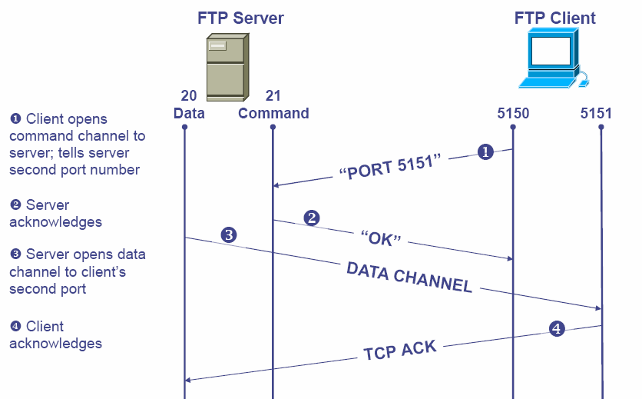
FTP Example

Slide 112
More Information About Ports
Port Numbers Used by Malware
General List of Port Number Uses
Port Numbers for MACs

Slide 113
I Was Asked-"What is a Port?"
There are physical ports on the back of your machine which are used to connect devices to your machine.
However, here we are talking about TCP and UDP ports.
A TCP or UDP port is not a physical port on your PC; rather, it is a virtual port in the TCP or UDP network protocol by which an application using this protocol can communicate.

Slide 114
What is a Port?
It works similar to a phone call.
If I dial a phone number, I am specifically requesting to speak to someone at the location on the other end of that phone.
If I dial the same number, I will continue to go to that location unless that location physically changes its phone number.
In the case of TCP or UDP ports, if I have an application using port 5555, it will be able to communicate with an application monitoring that port that is capable of understanding the data that is being passed.

Slide 115
Ports and Port Scan Signature
Signature of a Port scan
  What does it look like?
    Several packets to different destination ports from the same source within a “short period” of time.
    TCP SYN to a non-listening port
    A detector like Snort can inform us that we have been port-scanned

Slide 116
Scanning Program
The best known scanning software is Nmap
  Written by Fyodor
  http://www.insecure.org/Nmap
  Lots and lots of options
  Just gets better with age
  Runs on Linux, Unix and Windows
  Can run it from the command line and from a GUI interface

Slide 117
Scanning Program - Nmap
  Goal of attacker = scan without being caught!
  May want to avoid some of Nmap’s scans for this reason
  A partial list of scans include
    Connect scan Null stealth scan
    Syn stealth scan Xmas tree scan
    Ack stealth scan TCP window scan
    FTP Bounce scan UDP port scan
    Fin Stealth scan IP protocol scan ...

Slide 118
Scanning Program - Nmap
Scans that may get you caught include
    TCP connect – Usual 3-way handshake
      Terminates normally
      Web server or other service can keep a record including your IP address
    TCP Syn Scan – Sends a Syn packet, waits for machine to send a Syn/Ack response, then sends a reset
      If port open, get a syn/ack response
      If port closed, no response, get a reset or ICMP port unreachable message

Slide 119
Scanning Program - Nmap
More stealthy scans
  Xmastree, TCP fin and Null scans
    All violate TCP protocol, out of sequence packets
    No logging done
    Sends odd bits set, fin bit but no connection or no bits set
    If port closed, response is a Reset
    If port open, Response is nothing

Slide 120
Scanning Program - Nmap
TCP Ack Scan
    Use this scan to get by filtering rules
    Many firewalls will filter initiating TCP connections from the outside
    Filter out packets with just Syn bit set for an opening connection
    To avoid filtering, Nmap offers an Ack scan
    Sets Ack bit on packets and filter thinks its a response to an existing connection

Slide 121
Scanning Program - Nmap
TCP Ack Scan
  Nmap uses Ack scan to figure out which ports are allowed unfiltered traffic by the firewall
  If get a reset, means packet got through firewall, and port is open
  If get no response, or ICMP port unreachable, Nmap marks port as filtered

Slide 122

Nmap ACK Scan
ACK dsk Port 1024
Packet
Filter
Device
ACK dsk Port 1025
ACK dsk Port 1026
Protected System
Reset
Attacker
Internal Network
External Network

Slide 123
Scanning Program
Nmap
  Version scan – find hidden applications
    Smart administrators
      Hide services behind odd port numbers
      Or, applications can be run over other services like SSL

Slide 124
Scanning Program
  Version scan - How it works
    Nmap starts with normal scan
    Gathers list of open ports on a target
    For TCP, completes the 3-way handshake, waits for application to present itself
    Many do banners
    Try to match banner to internal DB Nmap has
    If Finds SSL, Nmap completes SSL handshake and then runs detection to see what service is behind SSL encryption - Http or Ftp

Slide 125
Scanning
Speed of Scans
    Can vary the rate of packets sent to a target
      Attacker doesn’t want to have it known that he/she is performing a scan or has a slow system that doesn’t respond in the expected amount of time
    Nmap has different modes for scanning
    Paranoid – one packet every 5 minutes
    Sneaky – one packet every 15 seconds
    Polite – one packet every .4 seconds
    Normal – try to send packets at a speed that doesn’t miss target ports

Slide 126
Scanning
Anonymous Scans
  Can hide attacker inside set of fake IP addresses
  Want to confuse target into thinking this is not a scan but more normal traffic
  Need real IP too, want response back from Nmap
  Say, 30 or more IP’s sent along with attacker IP
  Would need to investigate all 30 addresses …
  Not likely!!

Slide 127
More Scanning
OS Identity by Stack Fingerprinting
  Attacker needs to know OS and version
  Looking for way into system
    What vulnerabilities does system have?
  Nmap does this by TCP Stack Fingerprinting
  TCP is standard, but different implementations of TCP stack respond in various ways to illegal packets
    Windows is distinct compared to Solaris
    Both are distinct compared to Linux

Slide 128
More Scanning
OS Identity - Stack Fingerprinting
    Nmap sends packets to various ports including:
      Syn packets to open ports and closed ports
      Null packet to both open and closed ports
      Ack packet to closed and open ports
    Some implementations send RST in response
    Some send nothing and some send ICMP port unreachable
    Nmap includes a DB of different system responses
    Over 1000 platforms
    Solaris, Windows many flavors, NetBSD, MacOS, HP-UX, HP-printers, Cisco IOS plus others

Slide 129
Scanning Defenses
What can you do against Scanning?
  Close down all unnecessary ports
    Find them first
    netstat –nao | find “LISTENING” in Windows XP
      Shows listening ports and Process ID’s of listening processes
    Third party tools actually show more information
      Fport – www.foundstone.com
      TCPView – www.sysinternals.com

Slide 130
Defenses Against Scanning
On-line scanners can help ...
For people who want to on-line scan their computers, there are several on-line sites
  www.auditmypc.com
  www.crucialtests.com
  www.hackerwatch.org/probe
  www.dslreports.com/scan
Most do simple scans for obvious vulnerabilities
Good for novice users ...

Slide 131
Scanning Defenses
Once find all open ports
  See if services are needed
  If not, disable the service permanently
    Start->Run …
    services.msc
    Then, click service, click Stop and set its Startup type to Disabled
  Linux
    netstat –nap finds in-use ports and PID’s and program
    lsof –p shows all TCP/IP ports and associated files

Slide 132
Scanning Defenses
Linux continued
  Disable services
    Comment out its line in /etc/inetd.conf
    If started by xindetd, delete file in /etc/xinetd.d/[service]
    chkconfig --list is another way to see services installed
      Comes with Redhat, Mandrake and other Linux versions
      Can type chkconfig [service] off

Slide 133
Scanning Defenses
Stateful Packet Filtering
  Will keep track of existing connections
    Typically has a connection table TCP connections
  Won’t allow ACK packets into the Network unless they belong to existing TCP conversation
    There must have been an earlier Syn packet
    For FTP, must have been a control connection set up already
  More intelligent than simple packet filtering
    Defeats ACK scans and FTP Bounce scans plus several others

Slide 134
Port Scanning Legal
From the Sans FAQ – www.sans.org
  Port scanning is like ringing the doorbell to see whether someone's at home.
  The police usually can't do anything about it.
  They have to wait until a crime is committed.
  Sometimes, if a computer system is affected too much by a port scan, one can argue that the port scan was, in fact, a denial-of-service (DoS) attack, which is usually an offense
  But- realize that port scanning is viewed as an attack by our Computer Center.

Slide 135
More Legality
More answers ...
  http://www.computerworld.com/securitytopics/security/story/0,10801,106849,00.html

Slide 136
Security Assessment Tools
Some other tools that allow system administrators to scrutinize their sites for vulnerabilities
Examples:
  SAINT (http://www.wwdsi.com/saint)
  SARA (http://www-arc.com/sara)
  Many others
Some automate the fixing of vulnerabilities that are identified

Slide 137
Firewalls and Network Defense
Firewalls can be an effective means of protecting a local system or network from network based security threats
At the same time it offers access to the outside world via WANS and the Internet

Slide 138
Information System Evolution
A Historical Approach
Central mainframe with directly connected terminals
LANs interconnecting PCs and a mainframe
Networks consisting of several LANs, PCs Servers, and a mainframe or two
Enterprise wide network with multiple distributed networks, connected through WAN
Internet connectivity - all networks connected through internet and may or may not be connected by a private WAN

Slide 139
Firewall Design Principles
Internet connectivity - no longer appropriate for most organizations
  Provides benefits but also threats
Can equip each workstation with intrusion protection - but not practical
An alternative is a firewall- used to protect the network from Internet based attacks.
But, rarely do these protect the network from internally based attacks!

Slide 140


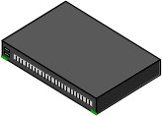

Firewalls
Idea: Separate local network from the Internet
Trusted hosts and networks
Firewall
Intranet
Router
DMZ
(DMZ) Demilitarized Zone: publicly accessible servers and networks

Slide 141
Firewall Characteristics
All traffic in both directions
(inside <-> outside) must pass through the firewall
Only authorized traffic, allowed by local security policy, is allowed to pass
The firewall is made immune to penetration and provides perimeter defense
More like the moat around a castle than a firewall
  Restricts access from the outside
  Restricts outbound connections, too (!!)
    Important: filter out undesirable activity from internal hosts!

Slide 142
Firewall Limitations
Cannot protect from attacks bypassing it
  eg sneaker net, utility modems, trusted organizations, trusted services (eg SSL/SSH)
Cannot protect against internal threats
  eg disgruntled employee
  Unless there are internally placed firewalls
Cannot protect against transfer of all virus infected programs or files
  Because of huge range of OS and file types

Slide 143
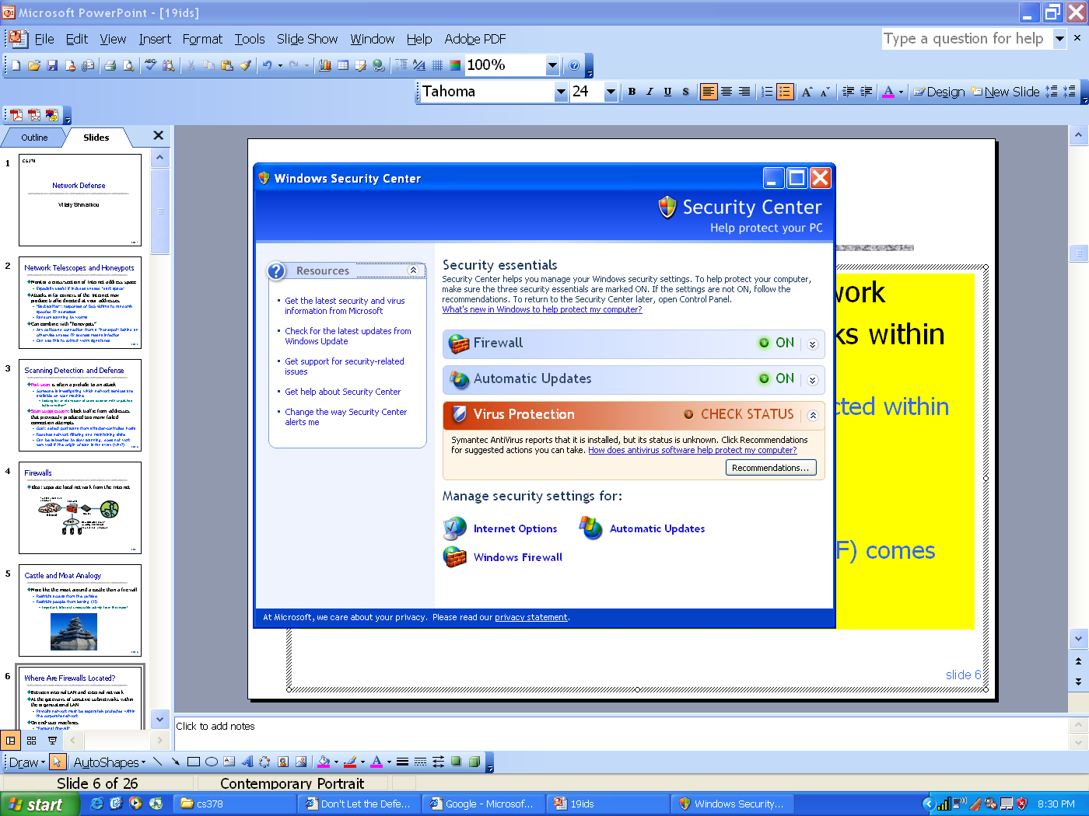
Firewall Locations in the Network
Between internal LAN and external network
At the gateways of sensitive sub-networks within the organizational LAN
  Payroll’s network must be protected separately within the corporate network
On end-user machines
  “Personal firewall”
  Microsoft’s Internet Connection
  Firewall (ICF) comes standard
  with Windows XP

Slide 144
Firewall Types
Packet- filtering Routers
Application level gateways
Circuit level Gateways

Slide 145
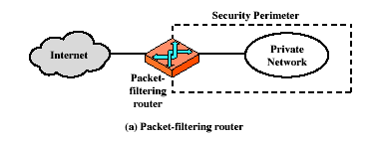
Firewalls – Packet Filters

Slide 146
Firewall Types: Packet Filters
Packet- or session-filtering router
  Filters packets in both directions, based on IP address, IP protocol and interface
  Set up as a list of rules, based on matches to fields
    If there is a match the rule is invoked
    Otherwise a default action is taken
  Default = discard anything not permitted is prohibited OR
  Default = forward anything not expressly prohibited
Advantages - simplicity and speed
Weaknesses : cannot prevent attacks that employ application specific vulnerabilities; they have limited logging functionality; do not support advanced user authentication; vulnerable to network layer address spoofing and security breaches caused by improper configuration

Slide 147
Packet Filtering
For each packet, firewall decides whether to allow it to proceed
  Decision must be made on per-packet basis
    Stateless; cannot examine packet’s context (TCP connection, application to which it belongs, etc.)
To decide, use information available in the packet
  IP source and destination addresses, ports
  Protocol identifier (TCP, UDP, ICMP, etc.)
  TCP flags (SYN, ACK, RST, PSH, FIN)
  ICMP message type
Filtering rules are based on pattern-matching

Slide 148
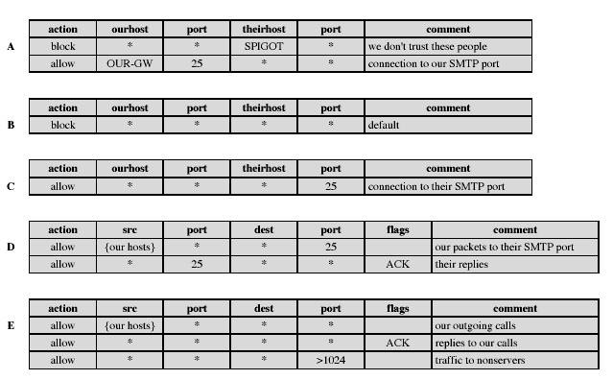
Packet Filtering Examples

Slide 149
Stateless Filtering Is Not Enough
In TCP connections, ports with numbers less than 1024 are permanently assigned to servers
  20, 21 for FTP, 23 for telnet, 25 for SMTP, 80 for HTTP…
Clients use ports numbered from 1024 to 16383
  They must be available for clients to receive responses
What should a firewall do if it sees, say, an incoming request to some client’s port 5612?
  It must allow it: this could be a server’s response in a previously established connection…
  …OR it could be malicious traffic
  Can’t tell without keeping state for each connection

Slide 150
Firewalls – Stateful Packet Filters
Examine each IP packet in context
  Keeps tracks of client-server sessions
  Checks each packet validly belongs to one
Better able to detect bogus packets out of context
Obviously, requires space for keeping context information and requires time for the checks

Slide 151
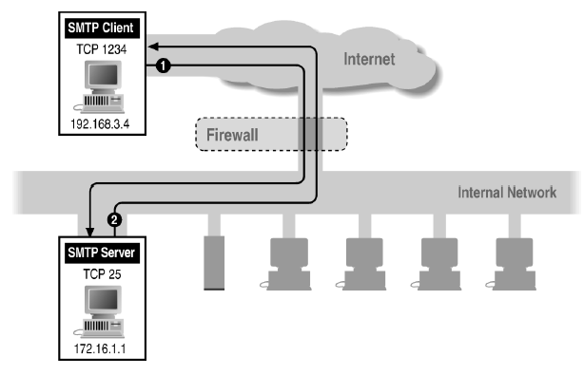
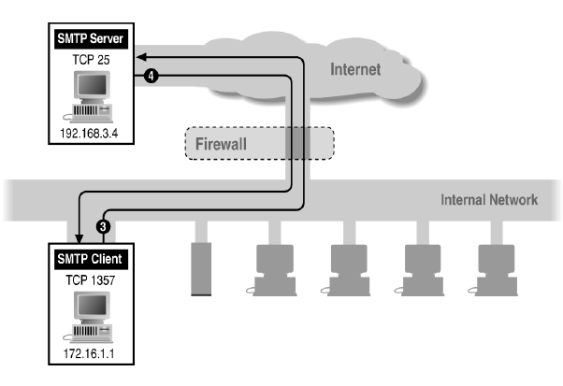
Example: Variable Port Use Is Common
Inbound SMTP
Outbound SMTP

Slide 152
Session Filtering
Decision is still made separately for each packet, but in the context of a connection
  If new connection, then check against security policy
  If existing connection, then look it up in the table and update the table, if necessary
    Only allow incoming traffic to a high-numbered port if there is an established connection to that port
Hard to filter stateless protocols (UDP) and ICMP
Typical filter: deny everything that’s not allowed
  Must be careful filtering out service traffic such as ICMP
Filters can be bypassed with IP tunneling

Slide 153
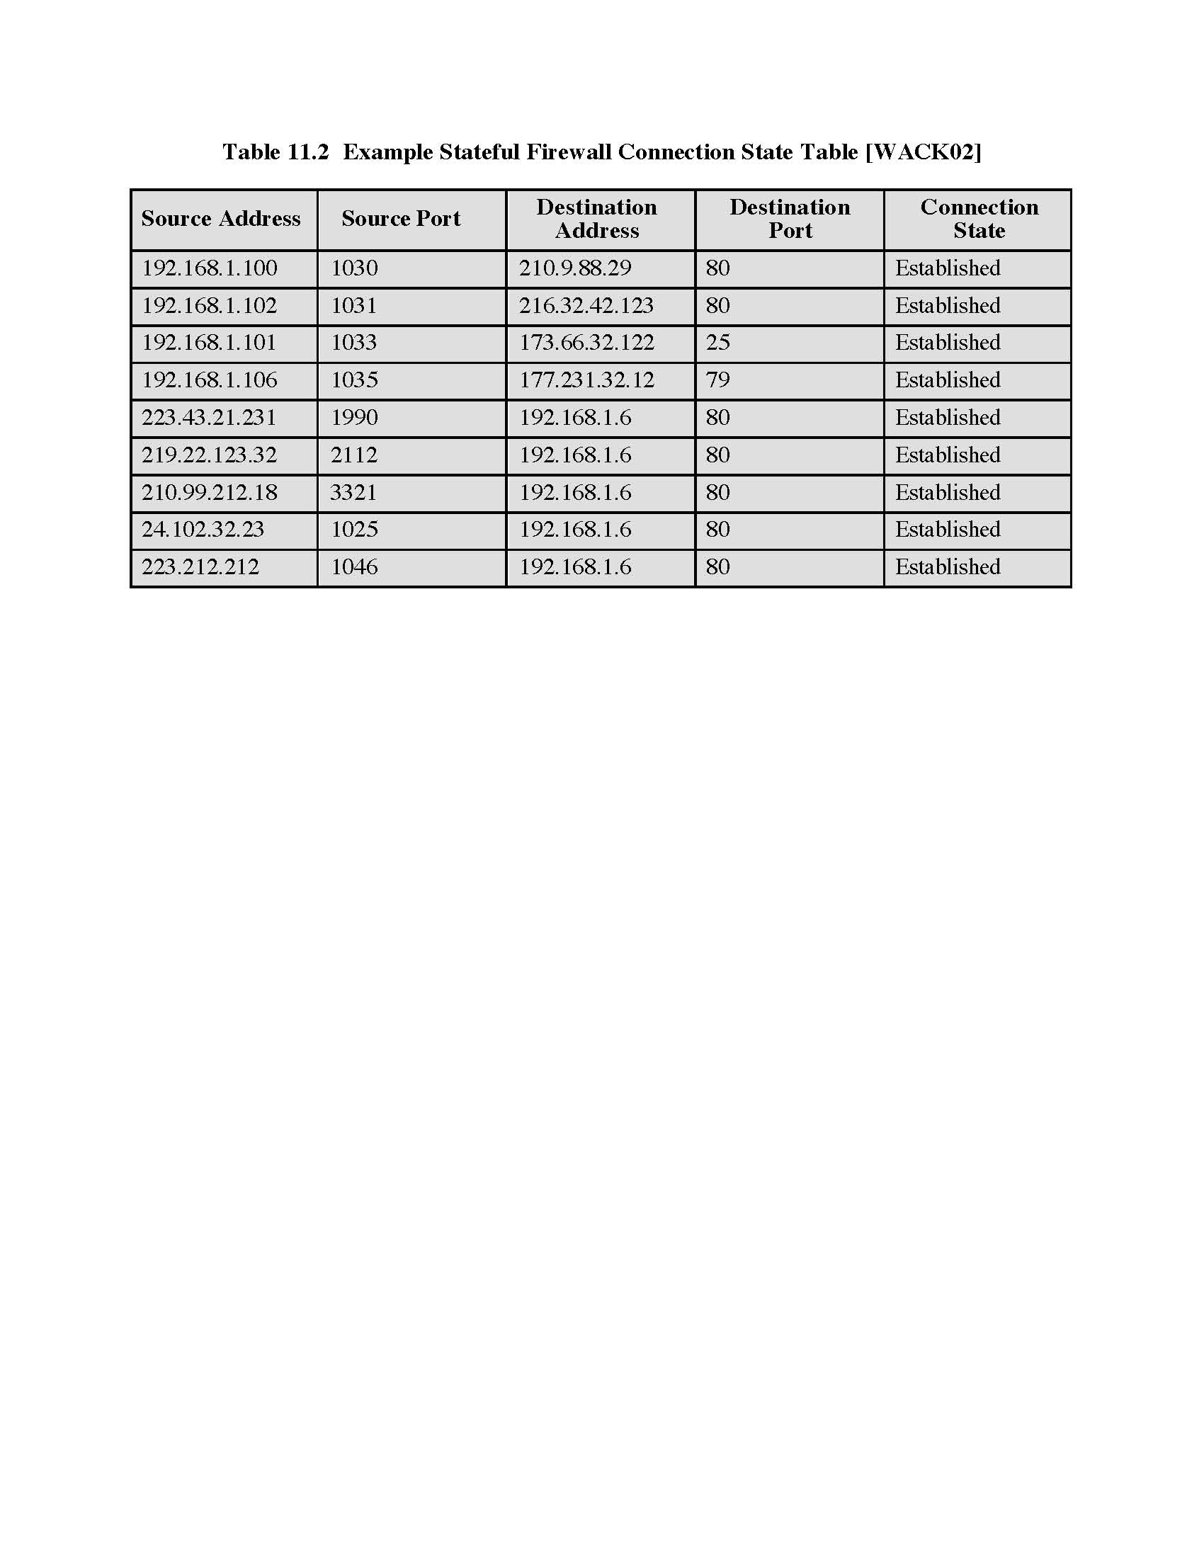
Example: Connection State Table

Slide 154

Example: FTP
FTP server
FTP client
20
Data
21
Command
Connection from a random port on an external host
5150
5151
◆ Client opens command channel to server; tells server second port number
◆
“PORT 5151”
❖
⬥
❖ Server acknowledges
“OK”
DATA CHANNEL
⬥ Server opens data channel to client’s second port

TCP ACK
 Client acknowledges

Slide 155
FTP Packet Filter
The following filtering rules allow a user to FTP from any IP address to the FTP server at 172.168.10.12
access-list 100 permit tcp any gt 1023 host 172.168.10.12 eq 21
access-list 100 permit tcp any gt 1023 host 172.168.10.12 eq 20
! Allows packets from any client to the FTP control and data ports
access-list 101 permit tcp host 172.168.10.12 eq 21 any gt 1023
access-list 101 permit tcp host 172.168.10.12 eq 20 any gt 1023
! Allows the FTP server to send packets back to any IP address with TCP ports > 1023
interface Ethernet 0
access-list 100 in ! Apply the first rule to inbound traffic
access-list 101 out ! Apply the second rule to outbound traffic
!
Anything not explicitly permitted by the access list is denied!

Slide 156
Weaknesses of Packet Filters
Do not prevent application-specific attacks
  For example, if there is a buffer overflow in URL decoding routine, firewall will not block an attack string
No user authentication mechanisms
  … except (spoofable) address-based authentication
  Firewalls don’t have any upper-level functionality
Vulnerable to TCP/IP attacks such as spoofing
  Solution: list of addresses for each interface (packets with internal addresses shouldn’t come from outside)
Security breaches due to misconfiguration are a major headache!

Slide 157
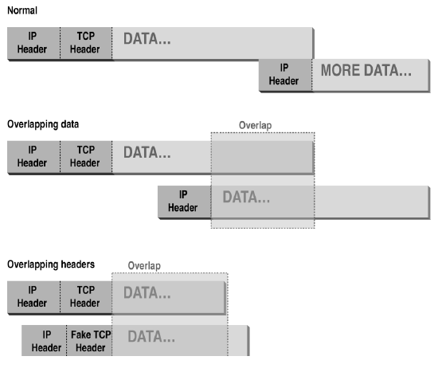
Abnormal Fragmentation
For example, ACK bit is set in both fragments,
but when reassembled, SYN bit is set
(can stage SYN flooding through firewall)

Slide 158
Fragmentation Attack
Telnet Server
Telnet Client
, Send 2 fragments with the ACK bit set; fragment offsets are chosen so that the full datagram re-assembled by server forms a packet with the SYN bit set (the fragment offset of the second packet overlaps into the space of the first packet)
23
Allow only if ACK bit set
1234
◆
FRAG1 (with ACK)
❖
FRAG2 (with ACK)
SYN packet (no ACK)
⬥
ACK
⬥ All following packets will have the ACK bit set

Slide 159
More Fragmentation Attacks
Split ICMP message into two fragments, the assembled message is too large
  Buffer overflow, OS crash
Fragment a URL or FTP “put” command
  Firewall needs to understand application-specific commands to catch this
“chargen” attacks
  “Character generation” debugging tool: connect to a certain port and receive a stream of data
  If attacker fools it into connecting to itself, CPU locks

Slide 160
Attacks on Packet Filters
IP address spoofing
  Fake source address to be trusted
  Add filters on router to block
Source routing attacks
  Attacker sets a route other than default
  Block source routed packets
Tiny fragment attacks
  Split header info over several tiny packets
  Either discard or reassemble before check

Slide 161
Firewall Types: Gateways
Proxy gateway
  All incoming traffic is directed to firewall, all outgoing traffic appears to come from firewall
  Application-level: separate proxy for each application
    Different proxies for SMTP (email), HTTP, FTP, etc.
    Filtering rules are application-specific
  Circuit-level: application-independent, “transparent”
    Only generic IP traffic filtering (example: SOCKS –see next slide for a definition.)
Personal firewall with application-specific rules
  E.g., no outbound telnet connections from email client

Slide 162
SOCKS
SOCKS is an Internet protocol that allows client-server applications to transparently use the services of a network firewall.
SOCKS is an abbreviation for "sockets", a reference to he Berkeley socket interface.
Clients behind a firewall, needing to access exterior servers, may connect to a SOCKS proxy server instead.
Such a proxy server controls the eligibility of the client to access the external server and passes the request on to the server.
SOCKS can also be used in the opposite way, allowing the clients outside the firewall ("exterior clients") to connect to servers inside the firewall (internal servers).

Slide 163
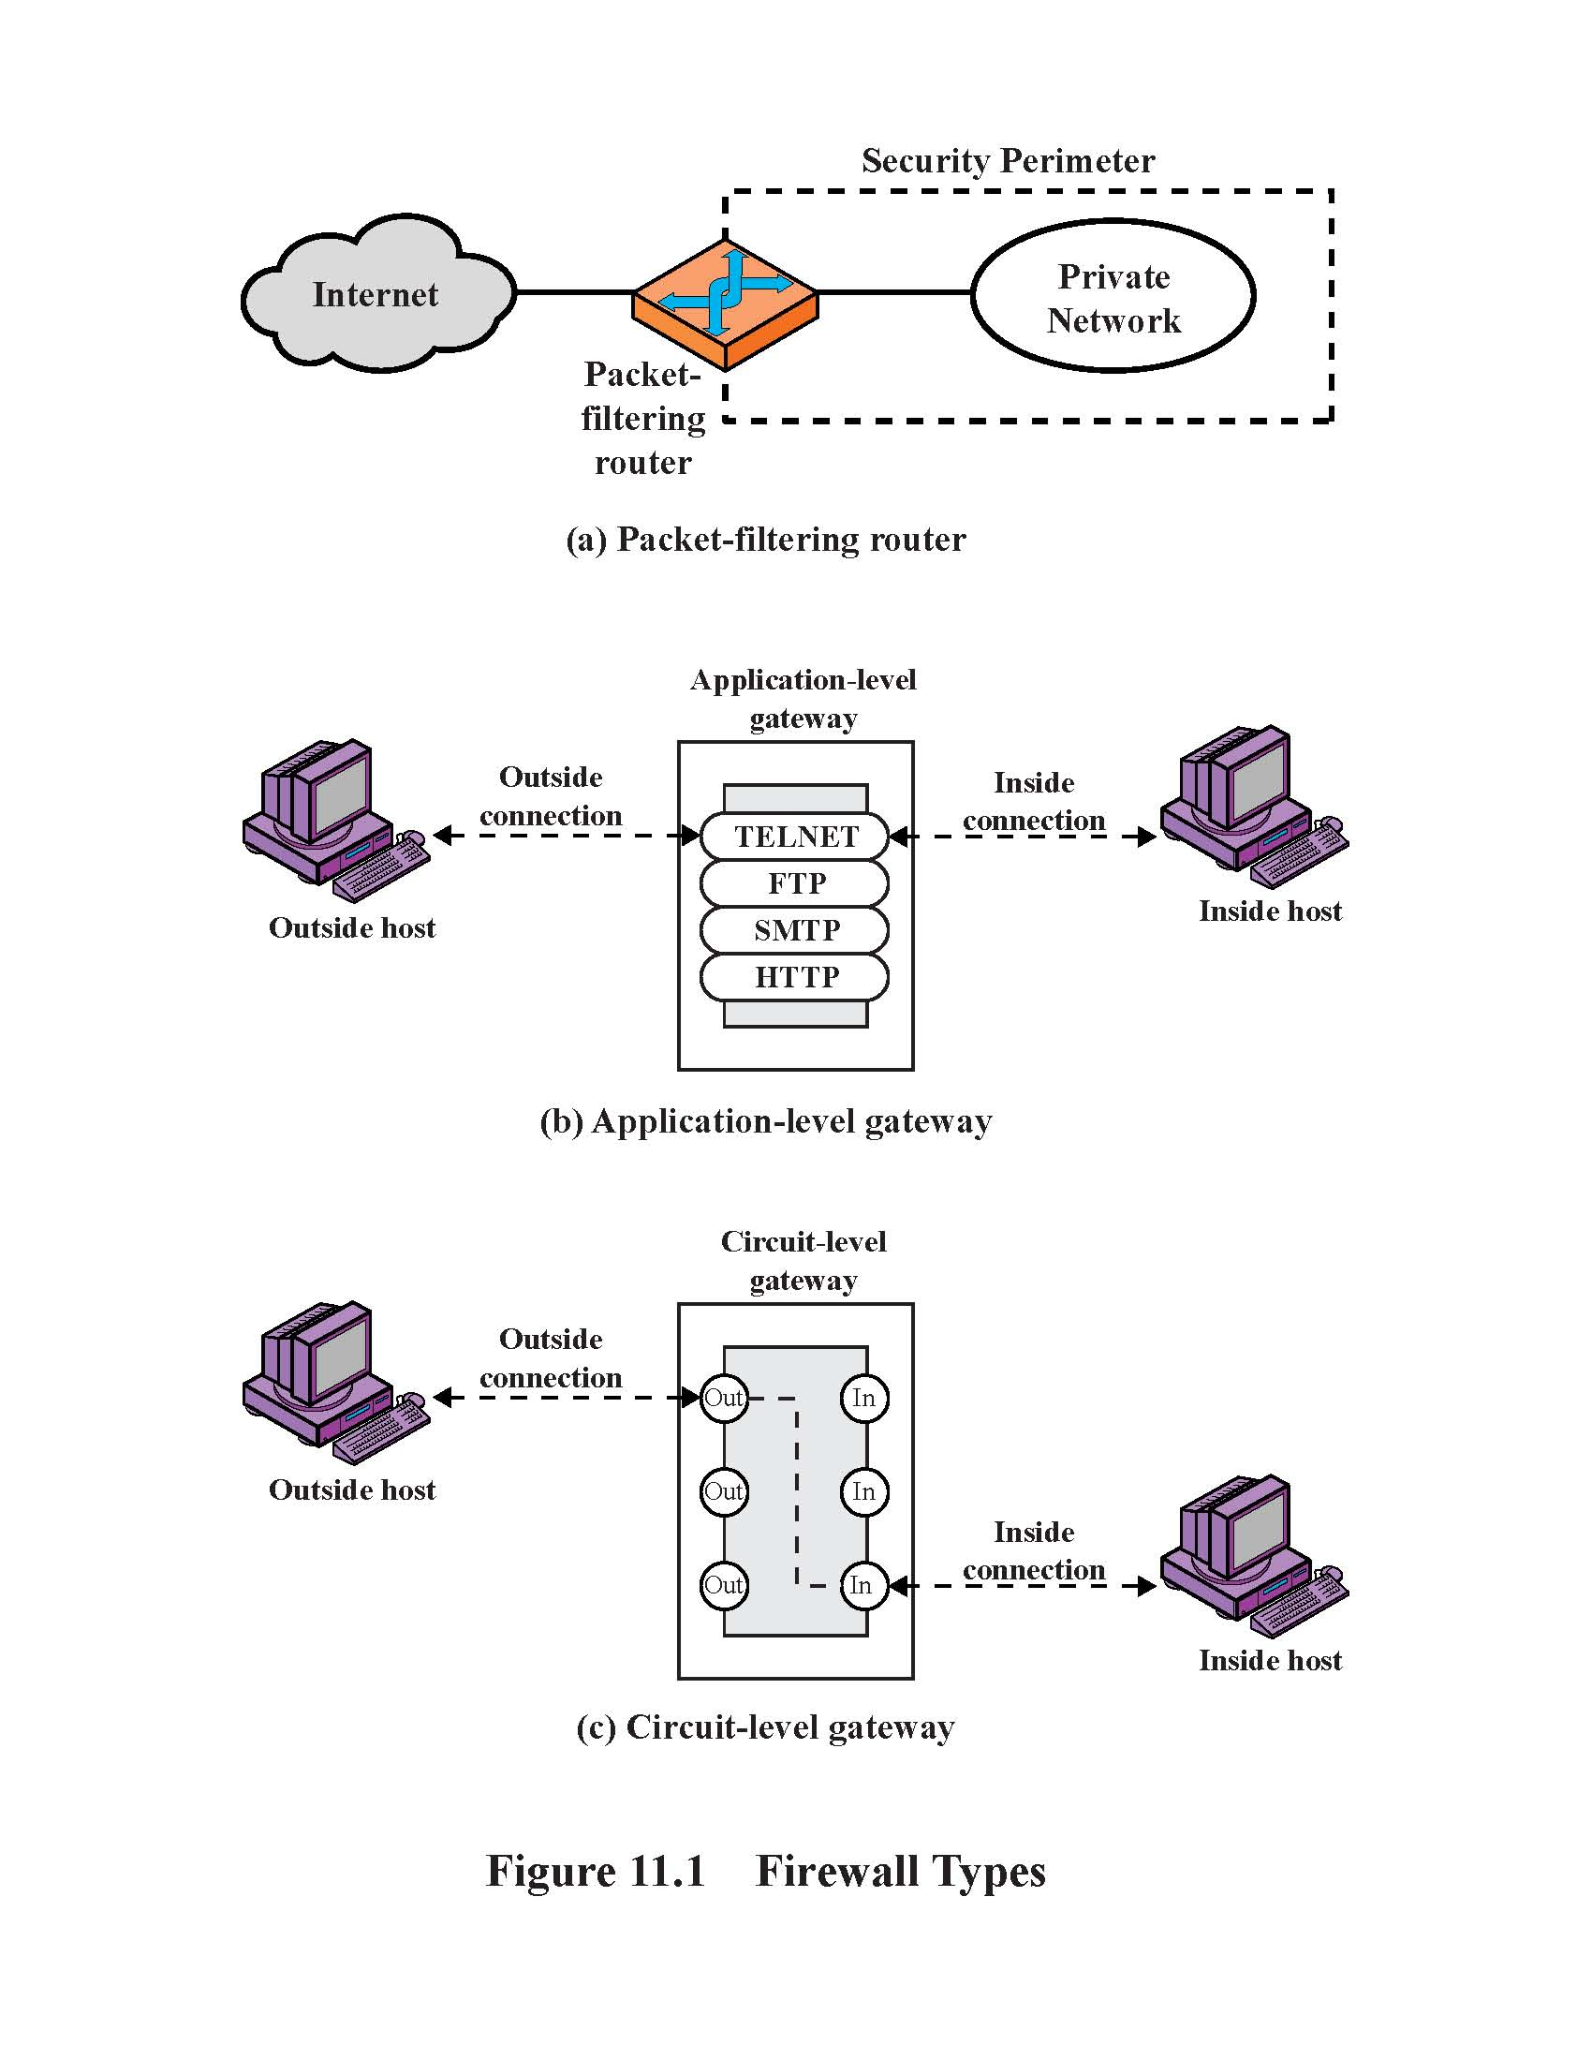
Application-Level Gateway
Splices and relays two application-specific connections
  Example: Web browser proxy
  Daemon spawns proxy process when communication is detected
  Big processing overhead, but can log and audit all activity
Can support high-level user-to-gateway authentication
  Log into the proxy server with your name and password
Simpler filtering rules than for arbitrary TCP/IP traffic
Each application requires implementing its own proxy

Slide 164
Circuit-Level Gateway
Splices two TCP connections, relays TCP segments
Less control over data than application-level gateway
  Does not examine the contents of TCP segment
Client’s TCP stack must be aware of the gateway
  Client applications are often adapted to support SOCKS
Often used when internal users are trusted
  Application-level proxy on inbound connections, circuit-level proxy on outbound connections (lower overhead)

Slide 165
Firewall Types: Summary

Slide 166
Comparison
Performance
Modify client
application
Defends against
fragm. attacks
Packet filter Best No No
Session filter No Maybe
Circuit-level gateway Yes (SOCKS) Yes
Application-level Worst Yes Yes
gateway

Slide 167
Bastion Host
Highly secure host system
Potentially exposed to "hostile" elements
and is secured to withstand this
May support 2 or more net connections
May be trusted to enforce trusted separation between network connections
Runs circuit / application level gateways
Or provides externally accessible services

Slide 168
Bastion Host
Bastion host is a hardened system implementing application-level gateway behind packet filter
  All non-essential services are turned off
  Application-specific proxies for supported services
    Each proxy supports only a subset of application’s commands, is logged and audited, disk access restricted, runs as a non-privileged user in a separate directory (independent of others)
  Support for user authentication
All traffic flows through bastion host
  Packet router allows external packets to enter only if their destination is bastion host, and internal packets to leave only if their origin is bastion host

Slide 169
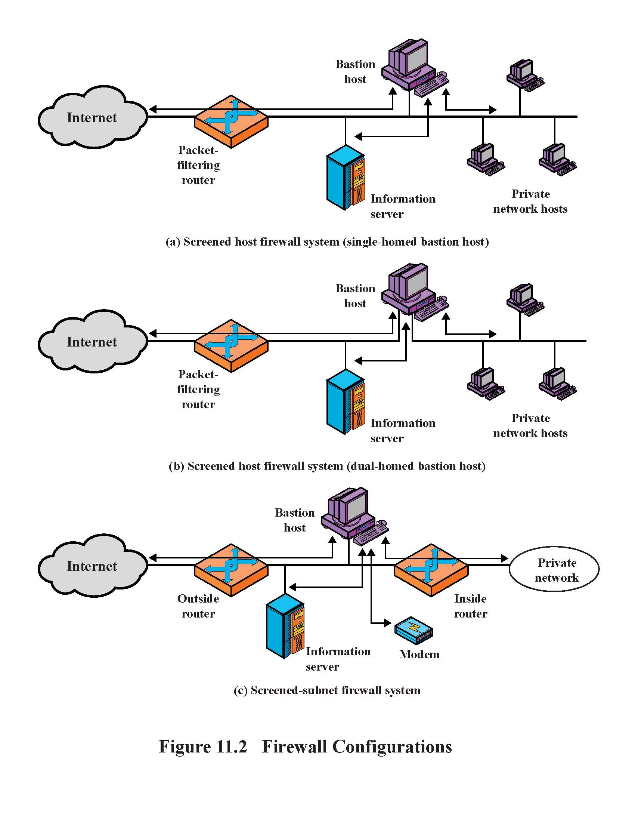
Single-Homed Bastion Host
If packet filter is compromised,
traffic can flow to interrnal network

Slide 170
Dual-Homed Bastion Host
No physical connection between
internal and external networks

Slide 171
Screened Subnet
Only the screened subnet is visible
to the external network;
internal network is invisible

Slide 172
Protecting Addresses and Routes
Hide IP addresses of hosts on internal network
  Only services that are intended to be accessed from outside need to reveal their IP addresses
  Keep other addresses secret to make spoofing harder
Use NAT (network address translation) to map addresses in packet headers to internal addresses
  1-to-1 or N-to-1 mapping
Filter route announcements
  No need to advertise routes to internal hosts
  Prevent attacker from advertising that the shortest route to an internal host lies through it

Slide 173
General Problems with Firewalls
Interfere with networked applications
Don’t solve the real problems
  Buggy software (think buffer overflow exploits)
  Bad protocol design (think WEP in 802.11b)
Generally don’t prevent denial of service
Don’t prevent insider attacks
Increasing complexity allows for an increasing potential for misconfiguration

Slide 174
Access Control
Given system has identified a user
Determine what resources they can access
General model is that of access matrix with
  subject - active entity (user, process)
  object - passive entity (file or resource)
  access right – way object can be accessed
Can decompose by
  Columns as access control lists
  Rows as capability tickets

Slide 175
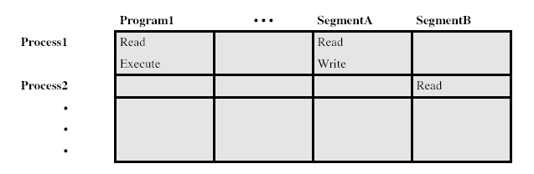
Access Control Matrix

Slide 176
Trusted Computer Systems
Information security is increasingly important
Have varying degrees of sensitivity of information
  military info classifications: unclassified, confidential, secret, top secret, etc
Subjects (people or programs) have varying rights of access to objects (information)
Want to consider ways of increasing confidence in systems to enforce these rights
Known as multilevel security
  Subjects have maximum & current security level
  Objects have a fixed security level classification

Slide 177
Bell LaPadula (BLP) Model
One of the most famous security models
Implemented as mandatory policies on system
Has two key policies:
no read up (simple security property)
  A subject can only read/write an object if the current security level of the subject dominates (>=) the classification of the object
no write down (*-property, star property)
  a subject can only append/write to an object if the current security level of the subject is dominated by (<=) the classification of the object

Slide 178
Reference Monitor Concept
Reference monitor is controlling element in the hardware and operating system that regulates access of subjects to objects on the basis of security parameters
File or kernel security database- lists access privileges
Monitor enforces rules and has 3 properties:
  complete mediation -security rules are enforced on every access
  isolation- reference monitor and database are protected from unauthorized modification
  verifyability- reference monitor’s correctness must be provable
  Systems that provide this are called trusted systems

Slide 179
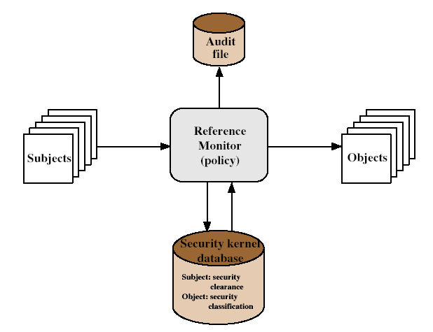
Reference Monitor

Slide 180
Evaluated Computer Systems
Governments can evaluate IT systems
against a range of standards:
  TCSEC, IPSEC and now Common Criteria
Define a number of “levels” of evaluation with increasingly stringent checking
Have published lists of evaluated products
  Though aimed at government/defense use
  Can be useful in industry also

