Slide 1
Security in Networks
Chapter 7
Part 3

Slide 2
Packet Sniffing
Promiscuous NIC (network interface card) reads all packets
  Reads all unencrypted data (e.g., “ngrep”)
  ftp, telnet send passwords in clear!
Eve
Network
Alice
Bob
Prevention: Encryption, improved routing

Slide 3
What is a Sniffer?
A sniffer is a piece of software that grabs all of the traffic flowing into and out of a computer attached to a network.
They are available for several platforms in both commercial and open-source variations.
Some of simplest packages are actually quite easy to implement in C or Perl, use a command line interface and dump captured data to the screen.
More complex projects use a GUI, graph traffic statistics, track multiple sessions and offer several configuration options.

Slide 4
What is a Sniffer?
Sniffers are also the engines for other programs.
Intrusion Detection Systems (IDS) use sniffers to match packets against a rule-set designed to flag anything malicious or strange.
Network utilization and monitoring programs often use sniffers to gather data necessary for metrics and analysis.
Law enforcement agencies that need to monitor email during investigations, likely employ a sniffer designed to capture very specific traffic.

Slide 5
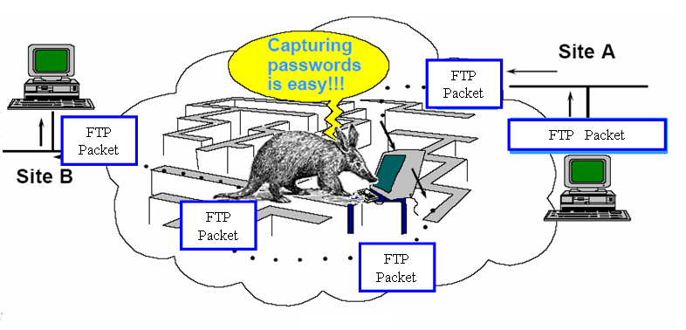
Sniffer Set Up

Slide 6
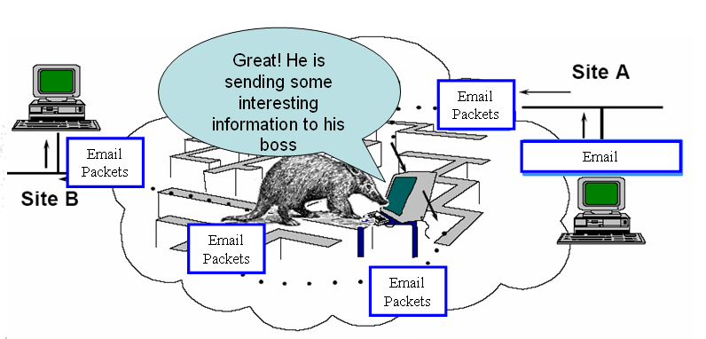
Not Only Passwords Are Available

Slide 7
How Does a Sniffer Work?
The sniffer program tells a computer, specifically its Network Interface Card (NIC), to stop ignoring all the traffic headed to other computers and pay attention to them.
It does this by placing the NIC in a state known as promiscuous mode.
Once a NIC is promiscuous, a status that requires administrative or root privileges, a machine can see all the data transmitted on its segment.
The program then begins a constant read of all information entering the PC via the network card.

Slide 8
How Does a Sniffer Work?
As we know, data traveling along the network comes as frames, or packets, bursts of bits formatted to specific protocols.
Because of this strict formatting, a sniffer can peel away the layers of encapsulation and decode the relevant information stored within: source computer, destination computer, targeted port number, payload, in short - every piece of information exchanged between two computers.

Slide 9
How Does a Sniffer Work?
On a normal LAN there are thousands of packets exchanged by multiple machines every minute, ample supply for any attacker.
Anything transmitted in plaintext over the network will be vulnerable - passwords, web pages, database queries and messaging to name a few.
A sniffer can easily be customized to capture specific traffic like telnet sessions or e-mail.

Slide 10
How Does a Sniffer Work?
Once traffic has been captured, crackers can quickly extract the information they need - logins, passwords and the text of messages.
Unfortunately, the users will likely never know they were compromised - sniffers cause no damage or disturbance to a network environment.
Sniffing is a passive activity, hence done properly it is impossible to detect a sniffer!
Difficult to prevent it.

Slide 11
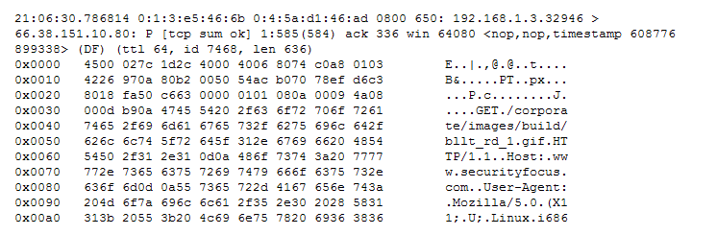
A Typical Captured Packet
A HTTP Request From a Client
Note that the first few lines of each sniffed packet provide a summary of the transaction: timestamps, source and destination MAC addresses, source and destination IP addresses and several other bits of information. The numbered lines (0x00##) show the data transmitted by each packet in hexadecimal format. Additionally, an ASCII decode of the payload is located off to the right - a convenient feature for crackers and nosy neighbors watching you on the network.

Slide 12
Using a Sniffer - For Good and Evil
A scary aspect of these tools is who can, and will, use them.
Sniffers can be used for both legitimate and illegitimate purposes.
A network manager can use them to monitor the flow of traffic on the network to ensure that the network is operating efficiently.
But, sniffers can also be used by malicious users to obtain valuable personal information.

Slide 13
Whether it is passwords or private communication, both crackers and co-workers can benefit from reading your data.
Defending against sniffers, as with any other threat, needs to start from the top and filter down to the user.
As on any network, administrators need to secure individual machines and servers.
A sniffer is one of the first things a cracker will load to see what is taking place on and around their newly compromised machine.

Slide 14
RTT Detection Technique -One Way Of Detecting a Sniffer
The RTT ( Round Trip Time), time taken by a packet to reach destination + time that the response took to reach the source.
The samples of the collected RTT measurements represents two different populations, normal mode population and the promiscuous mode population
Measurements are statistically different enough and therefore represent two different populations.

Slide 15
Anti-Sniffing Tools
Another method of protection involves tools, such as Antisniff, that scan networks to determine if any NICs are running in promiscuous mode.
Anti-sniffing detection tools should be run regularly, since they act as an alarm of sorts, triggered by evidence of a sniffer.
To see popular sniffers that are free or low cost, see http://sectools.org/sniffers.html

Slide 16
How to Avoid Sniffers
Use a switched network
Never send clear-text messages on the Net
  SSH for telnet
  SFTP for FTP
  VPN for general traffic

Slide 17
VPN and Tunneling
A virtual private network (VPN) is a computer network in which some of the links between nodes are carried by open connections or virtual circuits in some larger network (e.g., the Internet) instead of by physical wires.
The link-layer protocols of the virtual network are said to be tunneled through the larger network when this is the case.
One common application is to provide secure communications through the public Internet.

Slide 18
WWW Threats

Slide 19
WWW Threats
There are many risks associated with the World Wide Web:
  Credit card fraud/abuse
  Content hijacking
  Hostile content
  Cookies
Many users do not understand the dangers

Slide 20
Fraud on the Web
Scams:
  Many of the same ones circulated via e-mail
Credit card fraud
  Theft of credit card information on the Internet
  Theft of credit card information from a merchant’s database
  Abuse of credit card information by a merchant/employee

Slide 21
Content Hijacking
Content hijacking - one site steals content from another
The stolen content can be
  Graphics
  Information
  Web pages
Impersonation
  Mistyped URLs
  Misleading links

Slide 22
Content Hijacking - Example
April, 2000 - a web page was created that resembled the Bloomberg news site – a highly respected financial news site
The page contained a false “news release” reporting that a certain company was about to be acquired for much more than its current share price
A link to this page was posted on several web-based message boards devoted to discussion of the company’s stock
The URL in the link referred to the page by its IP address rather than by its domain name, but many readers did not notice

Slide 23
Content Hijacking – Example (cont)
Many people read the story and immediately bought the stock in order to profit from the rise in price that would result from the acquisition
The price of the stock rose quickly and then plummeted a few hours later when the hoax was discovered
The perpetrator(s) of this scam:
  Probably bought stock in the company prior to posting the false information
  Probably sold in the first few hours for a huge profit
Many of the investors who were fooled by the fake story suffered large losses

Slide 24
Hostile Content
Hostile content on the Web is designed to annoy or assail an unsuspecting victim:
  Recursive frames bug
    An HTML page that has two frames that each refer to the original page. So, each frame contains 2 frames and each of these contain 2 frames, etc.
    The result is a crash due to exhausting memory.
  Popup windows
  Flaws in implementations of the Java Virtual Machine allowing access to memory when that shouldn’t be allowed.
  Plug-in programs – great for delivering hostile content

Slide 25
Cookies
A cookie is a small amount of information that a server sends to a browser which is stored on the client’s computer
Every time a browser makes a request to a server the browser checks the stored cookie list and sends any cookies from that server along with the request
Uses:
  Maintain persistent state
  Customize web pages to a client’s preferences
Partial protection mechanisms:
  Have a browser only send a cookie to the site from which it originated

Slide 26
Cookies - Format
Format:
Set-Cookie: NAME=VALUE; expires=DATE; path=PATH; domain=DOMAIN_NAME; secure
Set-cookie – tag (required)
Name field – identifier (required)
Expires – expiration date (optional)
  Expired cookies will not be sent by the browser

Slide 27
Cookies – Domain Field
Domain field - allows the browser to determine to which hosts a cookie can be sent (optional)
  Defaults to the name of the server from which the cookie originated (e.g. www.carol.com)
  Servers can set the domain field in a cookie (e.g. carol.com)
    Browser checks domain field in cookies (e.g. won’t accept bob.com in a cookie from www.carol.com)

Slide 28
Domain Field
  Browser uses the domain field to determine which cookie(s) to send to a server
    The suffix of the domain name of the server must match the domain specified in the cookie
  Example: DOMAIN = carol.com
    www.carol.com, c1.carol.com, c1.foo.carol.com

Slide 29
Cookies – Path Field
Path field - restrict which pages at a particular site will cause a cookie to be sent by the browser
  Cookie must first pass domain checking
  A prefix of the path must appear in the URL in order for the cookie to be sent
  Defaults to /
  Example: PATH =/carol
    http://www.carol.com/carol/index.html = send cookie
    http://www.carol.com/bob/index.html = do not send cookie

Slide 30
Cookies – Secure Field
Secure field – specifies a “secure” cookie
  Defaults to false
  If set, tells the browser that the cookie should only be sent if there is a secure (e.g. SSL) connection between the client and the server
  Is that a good setting for the default?
Most browsers allow the user to set options to:
  Accept all cookies without consulting the user
  Ask the user before accepting a cookie
  Reject all cookies

Slide 31
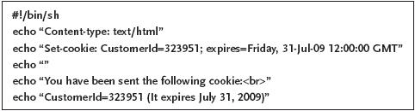
A CGI Script that Sends a Cookie

Slide 32
The Privacy Risks of Cookies
Spying by employers/coworkers
  Cookies identify many of the sites that the user has visited
  Anyone with access to the machine can examine the user’s browsing habits
User profiling by advertisers
  Site places ads (served by its own servers) on a wide variety of other sites
  Cookies are used to track how many times the company’s ads are displayed on each site and how often users click on the ads

Slide 33
The Privacy Risks of Cookies
  The company will tend to advertise on sites where their ads tend to be well received and not on sites where their ads fare poorly
  The company can also build elaborate profiles of users

Slide 34
Server-Side Security
Security of the web server software
  Web servers are a possible source of vulnerabilities and a potential point of entry for attackers
  Attractive targets:
    Almost every site runs a web server
    There are only a few different server programs in wide use

Slide 35
Addressing Web Server Security
Try to avoid bugs (e.g. buffer overflows) that could compromise the security of the host running the server
Limit the amount of damage that can be done if the web server is compromised:
  Server process owned by an unprivileged user, nobody
    Problem: only a privileged user can run a server on the “reserved” port 80
  Access control mechanisms
    Limit web access to certain files and directories
    Limit access to to files or directories to authorized users

Slide 36
Server Side Security (cont)
Security of the Common Gateway Interface (CGI) programs (or scripts)
  CGI is a mechanism that:
    Enables a program to be run on the server that dynamically generates a web page
    Return generated page to the client
  CGI is popular because it allows a web server to:
    Create customized web pages
    Display current information

Slide 37
  A buggy CGI program carries many of the same dangers as a buggy web server program
    Default CGI programs
    User-created CGI programs by naïve users

Slide 38
Addressing Risks of CGI Programs
Do not allow CGI scripts to run
Have one directory (controlled by the system administrator) for all CGI programs
  Authors must submit their programs to the administrator for inspection
Allow users to create CGI scripts
  Wrapper programs to limit the CGI program to exactly the permissions of its creator

Slide 39
Client-Side Security
Web browser programs attempt to offer users some protection against the dangers of using the World Wide Web
  Additional mechanism to protect the privacy of client requests and server replies
  Mechanism to allow the client to safely run mobile code

Slide 40
The Secure Sockets Layer (SSL)
A protocol proposed by Netscape Communications Corporation (now an Internet standard: RFC 2246)
Designed to offer cryptographic protection for the messages exchanged by HTTP and other Internet protocols
Services:
  Enables a server to verify its identity to a client (server authentication)
  Enables a client to verify its identity to a server (client authentication)
  Protects the privacy and integrity of data sent between the client and the server

Slide 41
SSL (cont)
Uses:
  Public-key cryptography
    For authentication and to allow the client and server to agree of a session key
  Symmetric-key cryptography
    To encrypt data using the session key
Note: SSL is another area that may be compromised due to the breakthrough with the SHA-1 algorithm!
To establish an SSL connection, the client and the server engage in a two-step SSL handshake protocol

Slide 42
SSL Handshake Protocol: Phase 1 (Hello)
The client sending a client hello message, which contains:
  The version number of the SSL protocol that the client is using
  28 random bytes generated by the client
  A unique session identifier chosen by the client
  A list of cryptographic algorithms the client supports (in order from the client’s most to least preferred
  A list of compression algorithms the client supports (in order from the client’s most to least preferred)

Slide 43
SSL Handshake Protocol: Phase 1 (Hello)
Server sends its certificate to the client (optional)
The certificate contains:
  The server’s public key
  An expiration date after which the certificate is no longer valid
  A digital signature by a certifying authority attesting to the fact that the public key on the certificate belongs to the named server

Slide 44
SSL Handshake Protocol: Phase 1 (Hello)
Server can also send (optionally):
  A server key exchange message
    Provides additional information besides the certificate needed by the client to verify the server’s identity
  A certificate request message
    Asks that the client authenticate itself to the server by sending a certificate for the client
Server sends a server hello done message to indicate that the first phase of the handshake is done

Slide 45
SSL Handshake Protocol:
Phase 2 (Key Exchange)
The client sends its certificate (if requested)
The client sends a client key exchange message
  Contains a 48-byte premaster secret (generated by the client) that will be known only to the client and the server
    The premaster secret is combined with the random bytes from the client and server’s hello message to create a 48-byte master secret
    The master secret enables the client and server to generate:
      Symmetric encryption keys
      Message Authentication Code (MAC) secrets

Slide 46
The client sends a change cipher spec message
  Signals the server that all subsequent messages will be protected using the agreed upon ciphers and keys
The client sends a finished message

Slide 47
SSL Handshake Protocol:
Phase 2 (Key Exchange)
The server sends its own change cipher spec and finished messages
The SSL connection is established
  Application data messages such as client HTTP request and server replies are compressed and encrypted using the agreed upon parameters
    Used to be 40-bit symmetric keys (128 domestic)
    Now 128-bit symmetric keys (with few exceptions)

Slide 48
Mobile Code
Another approach to dynamic web content (besides CGI): mobile code
  The server sends the client a program to be run on the client’s machine
Advantages:
  More power and flexibility for web content than CGI programs
  The burden of running programs is taken off of the server and distributed over the clients
Disadvantages:
  Bad idea to run programs from untrusted sources (they could be malicious)

Slide 49
Solutions:
  Run code from source that they trust (ActiveX)
  Run code in such a way that it can do no harm even if it is malicious (Java applets)

Slide 50
Java – Review from CPSC 171-172
Java is an object-oriented programming language designed by Sun Microsystems.
One important goal of Java is portability
  A java program can be compiled into an intermediate representation called bytecode
    Bytecode contains instructions for the Java Virtual Machine

Slide 51
    Bytecode allows operations such as:
      Pushing and popping (constant) values to/from a stack
      Reading or writing arrays or registers
      Arithmetical and logical operations
      Object creation and method invocation
      Control transfer and function return
      Data conversion and type casting

Slide 52
The Java Virtual Machine
The Java Virtual Machine (Java VM) is a bytecode interpreter
  Ported to most types of computing platforms.
  Executes bytecode by translating it into native instructions and executing them
Portability: once a program has been written and compiled into bytecode, the bytecode can be executed by any platform that runs a Java VM

Slide 53
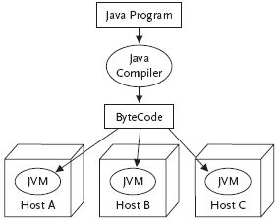
The Java Virtual Machine (cont)

Slide 54
Java Applets
Java programs (called applets) are specially designed to run in Java-enabled web browsers
  Applets which are downloaded from a remote source are loaded into the Java VM by a class loader
  Class loader enforces a name space hierarchy
    Places each class in a unique name space based on its origin
    Result: no ambiguity about the particular class to which a reference belongs

Slide 55
Example:
Two different applets, A₁ from host A and A₂ from host B, both define a class named foo:
  Calls to foo in A₁ refer to the class in A₁
  Calls to foo in A₂ refer to the class in A₂
  Exception: one of the two applets, A₁, is loaded from the local filesystem
    Calls to foo in A₁ and A₂ both refer to the class in A₁

Slide 56
The Java Class Loader
Enforces a name space hierarchy
Pass downloaded applets through a verifier
  Checks that an applet’s bytecode meets several vital safety requirements
    Contains no stack underflows or overflows
    Contains no invalid register reads or writes
    Supplies the correct number and type of parameters to each bytecode operation
    Does not perform any illegal data conversion

Slide 57
The Java Verifier
Checks that the format of the applet is valid
Performs data-flow analysis on each method’s bytecode
  Ensures that certain invariants hold for every operation, no matter what sequence of execution was followed to reach it
    The stack should should always be the same size
    The stack should always contain the exact same types of objects
    No register should be read unless it is known to contain a value of the appropriate type
    Etc.

Slide 58
The Java Security Manager
The security manager is an applet:
  The Java VM is responsible for installing a security manager before running any untrusted applets
  Loaded from the local filesystem (the classes it defines are always invoked rather than any similarly-named classes in other applets)
  The Java VM invokes the security manager prior to executing each bytecode insruction of an untrusted applet

Slide 59
  The security manager raises an exception if an untrusted applets attempts to:
    Read or write files on the local file system
    Make a network connection (except to the host from which the applet originated)
    Start a program (including making system calls) on the local machine
    Read any but a small number of system attributes

Slide 60
The Java File System Loader Class
Trusted applets are handled differently from untrusted applets
  Reside on the local filesystem
  Are digitally signed by an entity that a client trusts
Trusted applets are not loaded into the Java VM by the class loader but by file system loader class
  Not passed through the verifier
  Not under the supervision of the security manager

Slide 61
ActiveX Controls
Created by Microsoft Corporation
Like Java:
  ActiveX controls are programs that can be referenced on a web page, downloaded, and run by a web browser to create more flexible and dynamic web pages
Unlike Java:
  Portability is not a high priority (ActiveX controls contain machine-dependent Windows/x86 instructions)

Slide 62
Unlike Java:
  No attempt to regulate the actions ActiveX controls can perform
    Security through accountability - an ActiveX control can be digitally signed by its creator
    User decides whether or not he/she trusts the creator

