Slide 1
Chapter 7 - Networks

Slide 2
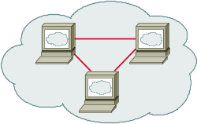


Internet Infrastructure
Backbone
ISP
ISP
Local and interdomain routing
  TCP/IP for routing, connections
  BGP for routing announcements
Domain Name System
  Find IP address from symbolic name (cs.hiram.edu)

Slide 3
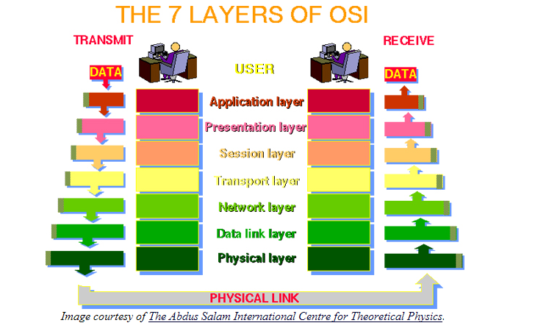
The 7 Layers of the OSI Model

Slide 4
What is the OSI Model?
OSI, or Open System Interconnection, model defines a networking framework for implementing protocols in seven layers.
Control is passed from one layer to the next, starting at the application layer in one station, proceeding to the bottom layer, over the channel to the next station and back up the hierarchy.

Slide 5
Application - Layer 7
This layer supports application and end-user processes.
Communication partners are identified, quality of service is identified, user authentication and privacy are considered, and any constraints on data syntax are identified.
Everything at this layer is application-specific.
This layer provides application services for file transfers, e-mail, and other network software services.
Telnet and FTP are applications that exist entirely in the application level.

Slide 6
Presentation- Layer 6
This layer provides independence from differences in data representation (e.g., encryption) by translating from application to network format, and vice versa.
The presentation layer works to transform data into the form that the application layer can accept.
This layer formats and encrypts data to be sent across a network, providing freedom from compatibility problems. It is sometimes called the syntax layer.

Slide 7
Sesion - Layer 5
This layer establishes, manages and terminates connections between applications.
The session layer sets up, coordinates, and terminates conversations, exchanges, and dialogues between the applications at each end.
It deals with session and connection coordination.

Slide 8
Transport - Layer 4
This layer provides transparent transfer of data between end systems , or hosts, and is responsible for end-to-end error recovery and flow control.
It ensures complete data transfer.

Slide 9
Network - Layer 3
This layer provides switching and routing technologies, creating logical paths, known as virtual circuits, for transmitting data from node to node.
Routing and forwarding are functions of this layer, as well as addressing, internetworking, error handling, congestion control and packet sequencing.

Slide 10
Data Link - Layer 2
At this layer, data packets are encoded and decoded into bits.
It furnishes transmission protocol knowledge and management and handles errors in the physical layer, flow control and frame synchronization.
The data link layer is divided into two sub layers:

Slide 11
Sub Layers of Data Link Layer
The Media Access Control (MAC) layer and the Logical Link Control (LLC) layer.
The MAC sub layer controls how a computer on the network gains access to the data and permission to transmit it.
The LLC layer controls frame synchronization, flow control and error checking.

Slide 12
Physical - Layer 1
This layer conveys the bit stream - electrical impulse, light or radio signal -- through the network at the electrical and mechanical level.
It provides the hardware means of sending and receiving data on a carrier, including defining cables, cards and physical aspects.
Fast Ethernet, RS232, and ATM are protocols with physical layer components.

Slide 13
TCP Protocol Stack
Application protocol
Application
Application
Transport
TCP protocol
Transport
Network
IP protocol
IP
IP protocol
Network
Link
Data Link
Network Access
Data Link
Link

Slide 14
Data Formats
TCP Header
Application
Application message - data
message
Transport (TCP, UDP)
segment
TCP
data
TCP
data
TCP
data
Network (IP)
packet
IP
TCP
data
Link Layer
frame
ETH
IP
TCP
data
ETF
IP Header
Link (Ethernet)
Header
Link (Ethernet)
Trailer

Slide 15
Internet Protocol
IP
Connectionless
  Unreliable
  Best effort
Transfer datagram
  Header
  Data
Version
Header Length
Type of Service
Total Length
Identification
Flags
Fragment Offset
Time to Live
Protocol
Header Checksum
Source Address of Originating Host
Destination Address of Target Host
Options
Padding
IP Data

Slide 16
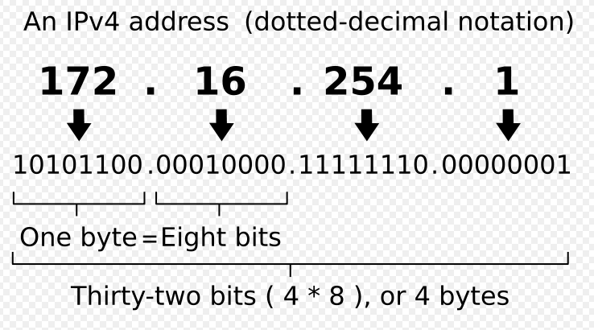
The IP Address

Slide 17
PROXY SERVERS

Slide 18
What is a Proxy Server?
A proxy server is a server on a network which services the requests of its clients by forwarding requests to other servers.
A client connects to the proxy server, requesting some service, such as a file, connection, web page, or other resource, available from a different server.
The proxy server provides the resource by connecting to the specified server or to another proxy server and, eventually, requesting the service on behalf of the client.

Slide 19
There Are Many Kinds of Proxy Servers
We're concerned here with the following:
Anonymous proxy server
  An anonymous proxy server (sometimes called a web proxy) generally attempts to provide a certain degree of anonymous web surfing.
  These can easily be overridden by site administrators, and thus rendered useless in some cases.

Slide 20
Hostile proxy server
  Proxies can be installed by online criminals, in order to eavesdrop upon the dataflow between the client machine and the web.
  All accessed pages, as well as all forms submitted, can be captured and analyzed by the proxy operator.
  For this reason, passwords to online services should be changed if an unauthorized proxy is detected.

Slide 21
Transparent proxy server
A transparent proxy is a proxy that does not modify the request or response beyond what is required for proxy authentication and identification.
Some providers of proxy server listings specify additional modifying words such as high anonymous proxy server or elite anonymous proxy server.
There is are clear definitions for these.

Slide 22
Some of the Reasons for Using a Proxy
It helps provide a way to hide your identity from the sites which can see your personal information.
It can provide you greater flexibility to control your network.
It can give access to sites which are blocked in your area.
Some times it increases the browsing speed by storing frequently used pages in cache.
Since an identity can be hid, a cracker can enter sites without revealing who they are.

Slide 23
Where are Some of the Proxy Servers?
There are many lists available:
http://www.proxy4free.com/page1.html
http://samair.ru/proxy/
Tor is both a network of proxy servers and software that allow access to the network which is run by volunteers.
  The free software for accessing Tor can be found at http://www.torproject.org/index.html.en
I do not guarantee that these are secure.

Slide 24
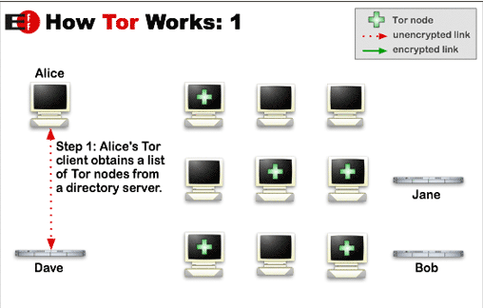
How Tor Works
Tor helps to reduce the risks of traffic analysis by distributing transactions over several places on the Internet, so no single point can link source to destination.
http://www.torproject.org/overview.html.en

Slide 25
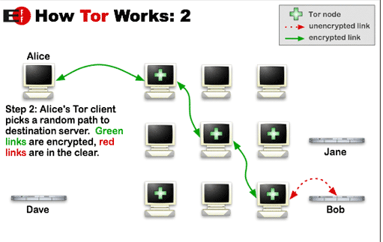
The user's software or client incrementally builds a circuit of individually negotiated encrypted connections through relays on the network.
The circuit is extended one hop at a time.
Each relay along the way knows only which relay gave it data and which relay it is giving data to.
No individual relay ever knows the complete path that a data packet has taken.

Slide 26
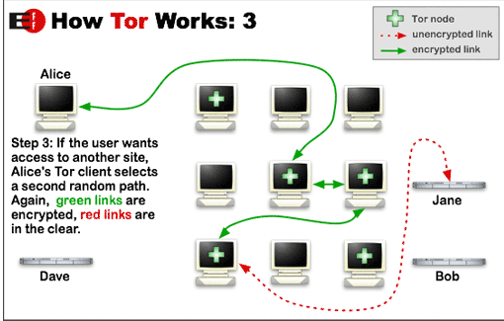
Once a circuit has been established, data can be exchanged and some software applications can be deployed over the Tor network.
Each relay sees only one hop in the circuit.
For efficiency, the Tor software uses the same circuit for connections that happen within the same ten minutes or so.
Later requests are given a new circuit, to prevent the linking of earlier actions to the new ones.

Slide 27
Risks With Some Proxy Servers
A malicious proxy server can record everything sent to it: including unencrypted logins and passwords.
By chaining proxies which do not reveal data about the original requester, it is possible to obfuscate activities from the eyes of the user's destination.
  However, then more traces will be left on the intermediate hops, which could be used to trace the user's activities.

Slide 28
Risks With Some Proxy Servers
If the policies and administrators of these other proxies are unknown, the user may fall victim to a false sense of security just because those details are out of sight and mind.
Be wary when using proxy servers, and only use proxy servers of known integrity.
If there is no choice but to use unknown proxy servers, do not pass any private information (unless it is properly encrypted) through the proxy.

Slide 29
Risks With Some Proxy Servers
In what is more of an inconvenience than a risk, proxy users may find themselves being blocked from certain Web sites, as numerous forums and Web sites block IP addresses from proxies known to have spammed or trolled the site.
There is still another problem to overcome when you wish to make an anonymous connection.
Your browser broadcasts a lot of information about you.

Slide 30
IP Addresses
An IP address (or Internet Protocol address) is a unique address that certain electronic devices use in order to identify and communicate with each other on a computer network utilizing the Internet Protocol standard (IP)- i.e., a computer address.
Any participating network devices such as routers, switches, computers, infrastructure servers, printers, Internet fax machines, and some telephones—can have its own address that is unique within the scope of the specific network.
Some IP addresses are intended to be unique within the scope of the global Internet, while others need to be unique only within a local scope.

Slide 31
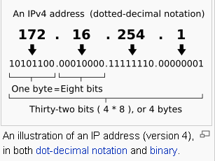
Format of an IP Address
The Internet Protocol (IP) has two versions currently in use.
Each version has its own format.
Because of its prevalence, "IP address" typically refers to those defined by IPv4, and this is the only one we'll consider.
http://en.wikipedia.org/wiki/IP_address

Slide 32
Obtaining an IP Address
On the public Internet, IP addresses are managed and created by the Internet Assigned Numbers Authority (IANA).
The IANA generally allocates super-blocks to Regional Internet Registries, who in turn allocate smaller blocks to Internet service providers and enterprises.
A system administrator, after obtaining the first two numbers of an IP address, can allocate the other two numbers for their private internets or intranets.

Slide 33
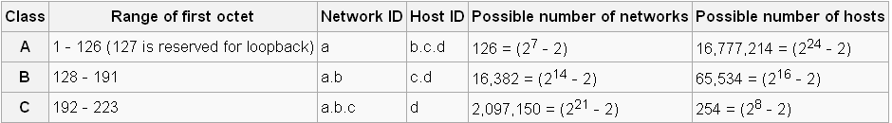
The IP Address Provides Some Information About the Possible Network Size
Currently, three classes of networks are used.
If a.b.c.d is the IP address, the chart below shows the relationship between the address and the possible size of a network.
Note: cs.hiram.edu is 206.57.41.44
home.hiram.edu is 143.206.107.71
http://en.wikipedia.org/wiki/IP_address

Slide 34
Unfortunately, the IP Address Provides More Than the Network Size
Many websites and most hackers use IP addresses to monitor your personal business
If your IP address is known, there is a lot of information immediately available about your computer configuration
Your home address and other personal information about you can be retrieved once your IP address is known

Slide 35
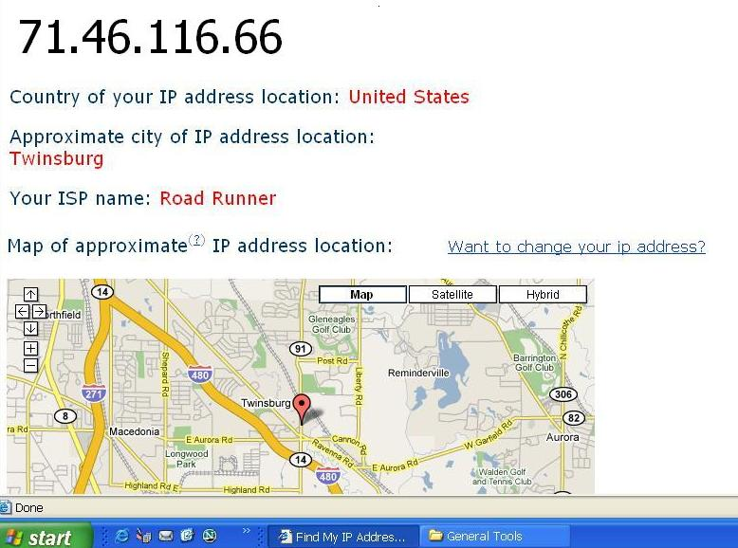
Before IP Address Is Hidden

Slide 36
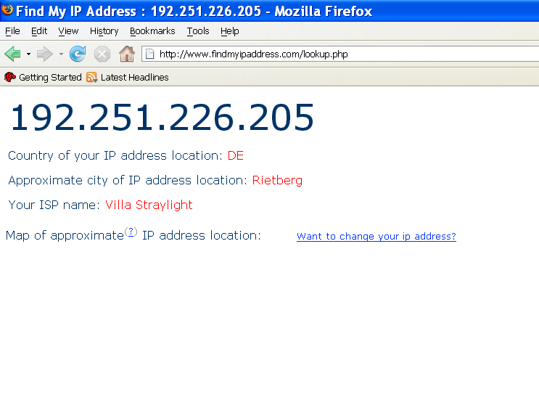
After Using Proxy Servers

Slide 37
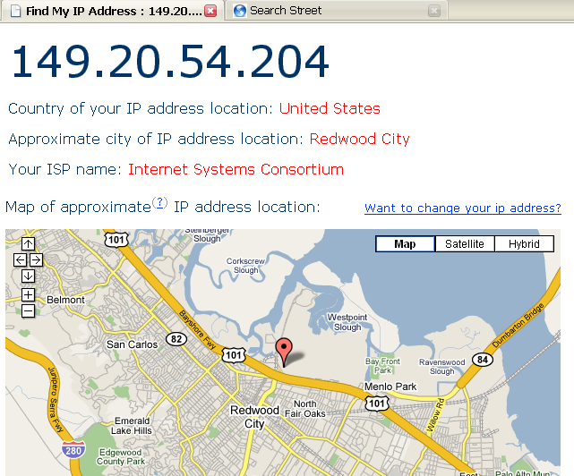
Another Session With Proxy Servers

Slide 38
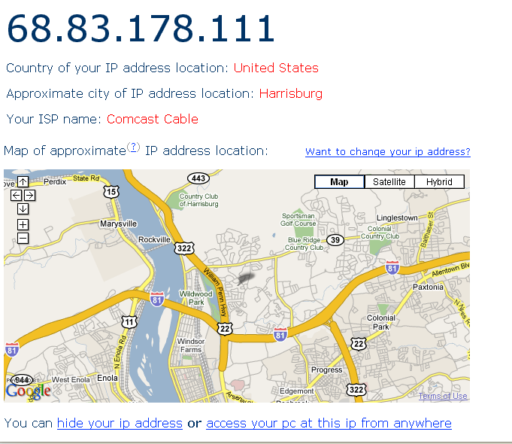
And, One More

Slide 39
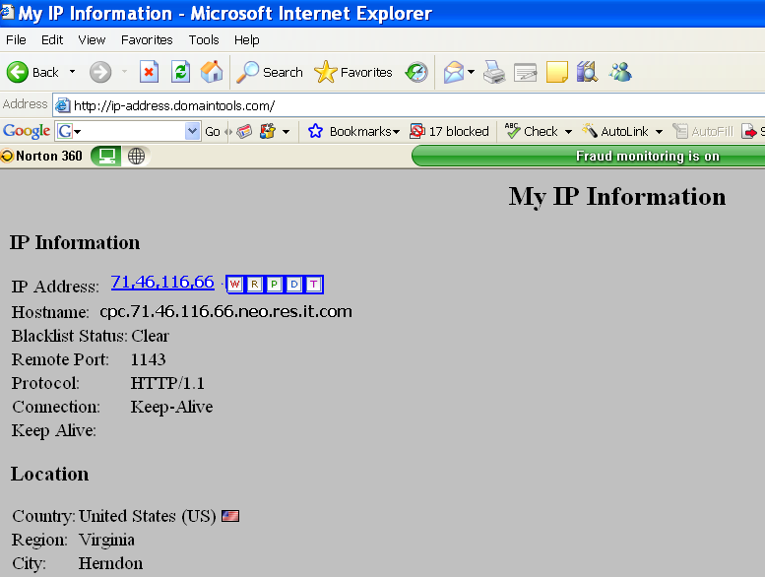
This Website Shows Even More for the IP Address

Slide 40
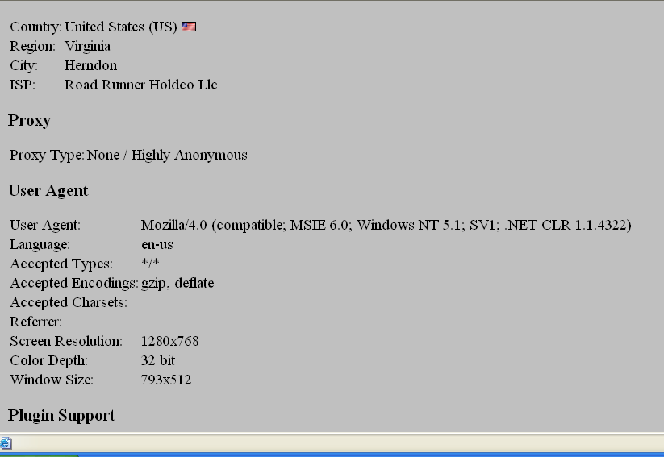
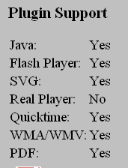

Slide 41
What is the Concern About Knowing This Information?

Slide 42
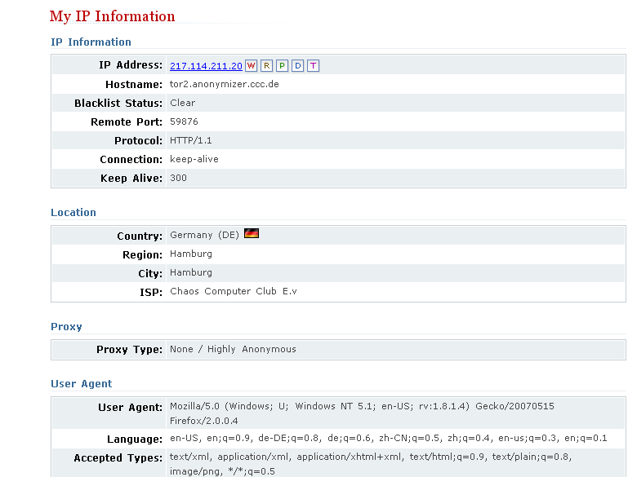
Using the Tor Network

Slide 43
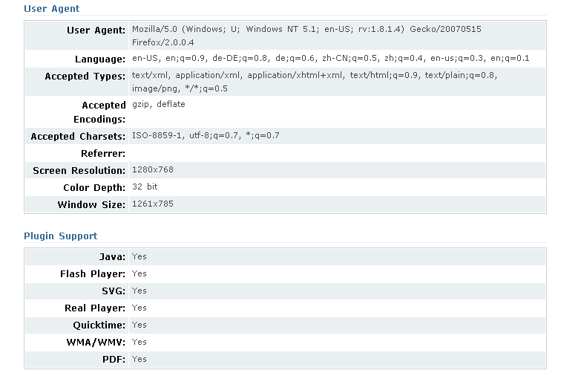

Slide 44
How Can You Net Surf Somewhat Anonymously?
Download software such as the Tor software (free) and use that network of proxies.
  Torbutton is a Firefox plugin that allows you to access the Tor network seamlessly.
  http://www.torproject.org/download.html.en
Change your IP address when you surf.
  There are many free and low cost services available for doing this.
  (free) http://www.computerhope.com/issues/ch000784.htm
  (low cost - changes IP and automatically uses Tor)- $29.95 http://www.hide-my-ip-address.com/hideip/?pu=false&srec=true

Slide 45
There Are Many Web Sites That Will Check Your IP Address
http://ip-address.domaintools.com/
http://www.findmyipaddress.com/lookup.php
http://www.findmyip.com/
http://www.hide-my-ip.com/
and many others exist!
Note: You should ALWAYS hide your IP address and use proxies if you decide to cruise hacker sites!!!

Slide 46
Pitfalls Still Exist When Using Proxy Networks Like Tor
Tor only protects Internet applications that are configured to send their traffic through Tor — it doesn't magically anonymize all your traffic just because you install it.
Browser plugins such as Java, Flash, ActiveX, RealPlayer, Quicktime, Adobe's PDF plugin, and others can be manipulated into revealing your IP address.
You should probably uninstall your plugins (go to "about:plugins" to see what is installed), or investigate QuickJava, FlashBlock, and NoScript if you really need them.

Slide 47
Pitfalls
Consider removing extensions that look up more information about the websites you select (like Google toolbar), as they may bypass Tor and/or broadcast sensitive information.
Some people use two browsers (one for Tor, one for unsafe browsing).
Beware of cookies: if you ever browse without Tor and Privoxy and a site gives you a cookie, that cookie could identify you even when you start using Tor again.
You should clear your cookies frequently. CookieCuller can help protect any cookies you do not want to lose.

Slide 48
Pitfalls
Tor anonymizes the origin of your traffic, and it encrypts everything inside the Tor network, but it can't encrypt your traffic between the Tor network and its final destination.
If you are communicating sensitive information, you should use as much care as you would on the normal scary Internet — use HTTPS or other end-to-end encryption and authentication.
While Tor blocks attackers on your local network from discovering or influencing your destination, it opens new risks: malicious or misconfigured Tor exit nodes can send you the wrong page, or even send you embedded Java applets disguised as domains you trust.

Slide 49

Normal IP Routing
Meg
Office gateway
Packet
Source
121.42.33.12
Tom
121.42.33.12
Destination
132.14.11.51
132.14.11.1
ISP
132.14.11.51
121.42.33.1
Internet routing uses numeric IP address
Typical route uses several hops

Slide 50
IP Protocol Functions (Summary)
Routing
  IP host knows location of router (gateway)
  IP gateway must know route to other networks
Fragmentation and reassembly
  If max-packet-size less than the user-data-size
Error reporting
  ICMP packet to source if packet is dropped

Slide 51
Inherent Domain Name Server (DNS)Vulnerabilities
Users/hosts typically trust the host-address mapping provided by DNS
Obvious problems
  Interception of requests or compromise of DNS servers can result in incorrect or malicious responses
  Solution – authenticated requests/responses
Some funny stuff allowed by RFC
  Name server may delegate name to another NS (this is OK)
  If name is delegated, may also supply IP addr (this is trouble)

Slide 52
Pharming
DNS poisoning attack (less common than phishing)
  Change IP addresses to redirect URLs to fraudulent sites
  Potentially more dangerous than phishing attacks
  No email solicitation is required

Slide 53
DNS poisoning attacks have occurred:
  January 2005, the domain name for a large New York ISP, Panix, was hijacked to a site in Australia.
  In November 2004, Google and Amazon users were sent to Med Network Inc., an online pharmacy
  In March 2003, a group dubbed the "Freedom Cyber Force Militia" hijacked visitors to the Al-Jazeera Web site and presented them with the message "God Bless Our Troops"

Slide 54

DNS Rebinding Attack
[DWF’96, R’01]
<iframe src="http://www.evil.com">
DNS-SEC cannot
stop this attack
Firewall
www.evil.com?
ns.evil.com
DNS server
171.64.7.115 TTL = 0
192.168.0.100
www.evil.com
web server
corporate
web server
171.64.7.115
192.168.0.100
Read permitted: it’s the “same origin”

Slide 55
DNS Rebinding Defenses
Browser mitigation: DNS Pinning
  Refuse to switch to a new IP
  Interacts poorly with proxies, VPN, dynamic DNS, …
  Not consistently implemented in any browser
Server-side defenses
  Check Host header for unrecognized domains
  Authenticate users with something other than IP
Firewall defenses
  External names can’t resolve to internal addresses
  Protects browsers inside the organization

Slide 56
User Datagram Protocol
UDP
IP provides routing
  IP address gets datagram to a specific machine
UDP separates traffic by port
  Destination port number gets UDP datagram to particular application process, e.g., 128.3.23.3 to 53
  The source port number provides the return address
Minimal guarantees
  No acknowledgment
  No flow control
  No message continuation

Slide 57
Transmission Control Protocol
TCP
Connection-oriented, preserves order
  Sender
    Break data into packets
    Attach packet numbers
  Receiver
    Acknowledge receipt; lost packets are resent
    Reassemble packets in correct order
Book
Mail each page
Reassemble book
1
19
1
5
1

Slide 58
Internet Control Message Protocol
ICMP
Provides feedback about network operation
  Error reporting
  Reachability testing
  Congestion control
Example message types
  Destination unreachable
  Time-to-live exceeded
  Parameter problem
  Redirect to better gateway
  Echo/echo reply - reachability test
  Timestamp request/reply - measure transit delay

Slide 59
Basic Security Problems
Network packets are passed by untrusted hosts
  Eavesdropping, packet sniffing (e.g., “ngrep”)
IP addresses are public
  Smurf attack - a way of generating a lot of computer network traffic to a victim host. Specifically, it floods a target system via spoofed broadcast ping messages.
TCP connection requires state
  SYN flooding attack
TCP state can be easy to guess
  TCP spoofing attack

Slide 60
Packet Sniffing
Promiscuous NIC (network interface card) reads all packets
  Reads all unencrypted data (e.g., “ngrep”)
  ftp, telnet send passwords in clear!
Eve
Network
Alice
Bob
Prevention: Encryption, improved routing

Slide 61
Smurf DoS Attack
1 ICMP Echo Req
Src: Dos Target
Dest: brdct addr
3 ICMP Echo Reply
Dest: Dos Target
Send ping request to broadcast addr (ICMP Echo Req)
Lots of responses:
  Every host on target network generates a ping reply (ICMP Echo Reply) to victim
  Ping reply stream can overload victim
  Prevention: reject external packets to broadcast address
DoS
Source
gateway
DoS
Target

Slide 62
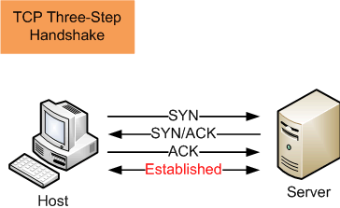
TCP Handshake
C
S
SYN_{C}
Listening
Store data
SYN_{S}, ACK_{C+1}
Wait
ACK_{S+1}
Connected

Slide 63
SYN Flooding Attack
SYN flooding is a method that the user of a hostile client program can use to conduct a denial-of-service (DOS) attack on a computer server.
The hostile client repeatedly sends SYN (synchronization) packets to every porton the server, using fake IP addresses.
When an attack begins, the server sees the equivalent of multiple attempts to establish communications.
The server responds to each attempt with a SYN/ACK (synchronization acknowledged) packet from each open port, and with a RST (reset) packet from each closed port.

Slide 64
In a normal three-way handshake, the client would return an ACK (acknowledged) packet to confirm that the server's SYN/ACK packet was received, and communications would then commence.
However, in a SYN flood, the ACK packet is never sent back by the hostile client.
Instead, the hostile client program sends repeated SYN requests to all the server's ports.
The hostile client makes the SYN requests all appear valid, but because the IP addresses are fake ones, it is impossible for the server to close down the connection by sending RST packets back to the hostile client.

Slide 65
Before time-out can occur, another SYN packet arrives from the hostile client.
A connection of this type is called a half-open connection.
Under these conditions, the server becomes completely or almost completely busy with the hostile client.
Communications with legitimate clients is difficult or impossible.
A hostile client can exploit half-open connections and possibly get access to server files.
The transmission by a hostile client of SYN packets for the purpose of finding open ports and hacking into one or more of them, is called SYN scanning.

Slide 66
Instead, the connection stays open.
A hostile client always knows a port is open when the server responds with a SYN/ACK packet.

Slide 67
SYN Flooding
C
S
SYN_{C1}
Listening
SYN_{C2}
Store data
SYN_{C3}
SYN_{C4}
SYN_{C5}

Slide 68
SYN Flooding - Summary
Attacker sends many connection requests
  Spoofed source addresses
Victim allocates resources for each request
  Connection requests exist until timeout
  Fixed bound on half-open connections
Resources exhausted ⇒ requests rejected

Slide 69
Protection against SYN Attacks
Client sends SYN
Server responds to Client with SYN-ACK cookie
  sqn = f(src addr, src port, dest addr, dest port, rand)
  Normal TCP response but server does not save state
Honest client responds with ACK(sqn)
Server checks response
  If matches SYN-ACK, establishes connection
    “rand” is top 5 bits of 32-bit time counter
    Server checks client response against recent values
  See http://cr.yp.to/syncookies.html

Slide 70
Network Mapping and Scanning

Slide 71
Network Mapping
Purpose:
  Identify targets, piece together map of the network
Steps
  Scope the network
  Looking for critical hosts, routers, firewalls
  If no prior knowledge, will begin by scanning machines that can be reached
    Web, Mail, Ftp, DNS servers
  Probe systems trying to understand Internet perimeter
  If internal knowledge, just start scanning and mapping network

Slide 72
Network Mapping
Sometimes ping all possible hosts on your network – send an ICMP echo request
  Looking for a response to a ping
  ICMP echo reply
  Since ICMP messages might be blocked,
    Send TCP packets to commonly open ports
    Web - 80 or email - 25

Slide 73
Network Mapping
Programs to do this
  Network Scanner
    SuperScan – www.foundstone.com
      Free Windows utility
    fping – www.fping.com
      Free Unix scanner
  Nmap can also do host discovery
    ping sweep

Slide 74
Tracing the Route Your Packets Take
Traceroute is a tool that traces the route your packets take.
Ping is a tool that tells you whether or not a web site is up.
Ping Plotter (http://www.pingplotter.com/) is a tool that graphically shows you the route your packets take.
  It was free, but can be used for 30 days without a subscription.
  Interesting to see how your packets travel!
  But, can also be used to map a network.

Slide 75
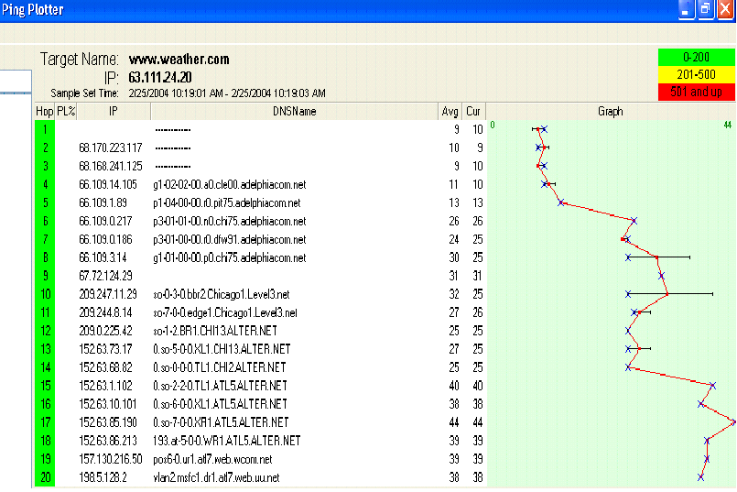
One Ping Plotter Trace to www.weather.com

Slide 76
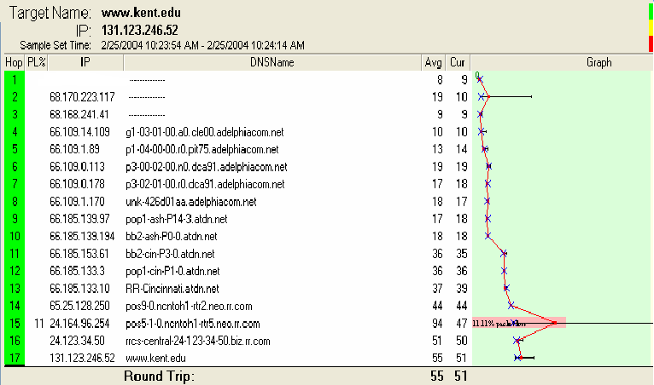
A Trace to KSU
If you watch these interactively you’ll see the route changes.

Slide 77
Network Mapping
Traceroute
  Goes by TTL field in IP header
  Map path to each computer, overlay results from each traceroute of target
  Create a hypothetical network topology
  Automated tool can do this
    Cheops-ng – runs on Linux
    cheops-ng.sourceforce.net

Slide 78
Network Mapping
Traceroute
  Cheops-ng
    Uses ping and traceroute
    Does OS fingerprinting and has both FTP and SSH clients
    Plus builds a very nice network map complete with hosts and routes to each host on the network

Slide 79
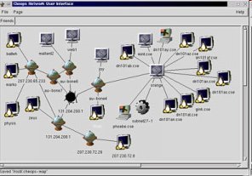
Cheops-ng

Slide 80
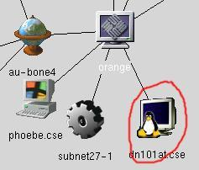
Cheops-ng
OS Detection: Cheops can optionally determine the OS of hosts on the network, selecting appropriate icons for them.

Slide 81
fping Tool
fping is a ping like program which uses the Internet Control Message Protocol (ICMP) echo request to determine if a host is up.
fping is different from ping in that you can specify any number of hosts on the command line, or specify a file containing the list of hosts to ping.
Instead of trying one host until it timeouts or replies, fping will send out a ping packet and move on to the next host in a round-robin fashion.
If a host replies, it is noted and removed from the list of hosts to check.
If a host does not respond within a certain time limit and/or retry limit it will be considered unreachable.
Unlike ping, fping is meant to be used in scripts and its output is easy to parse.

Slide 82
Defense Against Network Mapping
Use firewalls and packet filtering capabilities of routers
At Internet gateway, block incoming ICMP messages
  Except for hosts meant to be public Web servers
  Can configure filters to allow specific IP’s like your ISP to be able to send pings
  Can filter ICMP Time Exceeded messages too
  Limits attacker information but also network management too
    Always tradeoff between security and functionality

Slide 83
Ports
Transmission Control Protocol (TCP) and User Datagram Protocol (UDP) are transport layer protocols used for communication between computers.
The Internet Assigned Numbers Authority (IANA) is responsible for assigning port numbers for specific uses.

Slide 84
Scanning Purpose
Purpose of scanning if you are an attacker?
  At point you do a port scan you typically have the machines – know they exist
  Point is to discover which TCP or UDP ports are open
    That tells what services are running on those ports
    Services tell you the vulnerabilities available
  Also tells you operating system being run

Slide 85
Scanning Basics - Ports
Each machine with TCP/IP stack has 65,536 TCP and 65,536 UDP ports
Every Service connected to a port is a potential doorway into the machine for an attacker
Attacker has list of official known port assignments
  Internet Assigned Numbers Authority (IANA)
    http://www.iana.org/assignments/port-numbers
  Wikipedia List of same thing
  http://en.wikipedia.org/wiki/List_of_TCP_and_UDP_port_numbers

Slide 86
Scanning Basics - Ports
The port numbers are divided into three ranges:
  Well Known Ports – 0 – 1023
    Typically only for root or privileged processes
  Registered Ports - 1024 – 49151
    Registered known programs with IANA
  Dynamic and/or Private Ports 49152 – 65535
    Dynamic or ephemeral ports, assigned by programs for one-time connections – no known programs associated

Slide 87
Ports
Only root-privileged programs are allowed to open the lower numbered ports, common programs:
Examples
    ftp-data 20/udp
    ftp 21/tcp
    ssh 22/tcp
    telnet 23/tcp
    Time 37/tcp
    Time 37/udp
    Whois 43/tcp
    DNS 53/udp
    Web 80/tcp
    Imap 143/tcp

Slide 88
Ports
Ordinary programs can use these
  shockwave2 1257/tcp
  shockwave2 1257/udp
  ingreslock 1524/tcp ingres
  ingreslock 1524/udp ingres
  orasrv 1525/tcp oracle
  orasrv 1525/udp oracle
  x11 6000-6063/tcp
  X Window System x11 6000-6063/udp

Slide 89
More Information About Ports
Port Numbers Used by Malware
General List of Port Number Uses
Port Numbers for MACs

Slide 90
Ports and Port Scan Signature
Signature of a Port scan
  What does it look like?
    Several packets to different destination ports from the same source within a “short period” of time.
    TCP SYN to a non-listening port
    A detector like Snort can inform us that we have been port-scanned

Slide 91
Scanning Program
The best known scanning software is Nmap
  Written by Fyodor
  http://www.insecure.org/Nmap
  Lots and lots of options
  Just gets better with age
  Runs on Linux, Unix and Windows
  Can run it from the command line and from a GUI interface

Slide 92
Scanning Program - Nmap
  Goal of attacker = scan without being caught!
  May want to avoid some of Nmap’s scans for this reason
  A partial list of scans include
    Connect scan Null stealth scan
    Syn stealth scan Xmas tree scan
    Ack stealth scan TCP window scan
    FTP Bounce scan UDP port scan
    Fin Stealth scan IP protocol scan ...

Slide 93
Scanning Program - Nmap
Scans that may get you caught include
    TCP connect – Usual 3-way handshake
      Terminates normally
      Web server or other service can keep a record including your IP address
    TCP Syn Scan – Sends a Syn packet, waits for machine to send a Syn/Ack response, then sends a reset
      If port open, get a syn/ack response
      If port closed, no response, get a reset or ICMP port unreachable message

Slide 94
Scanning Program - Nmap
More stealthy scans
  Xmastree, TCP fin and Null scans
    All violate TCP protocol, out of sequence packets
    No logging done
    Sends odd bits set, fin bit but no connection or no bits set
    If port closed, response is a Reset
    If port open, Response is nothing

Slide 95
Scanning Program - Nmap
TCP Ack Scan
    Use this scan to get by filtering rules
    Many firewalls will filter initiating TCP connections from the outside
    Filter out packets with just Syn bit set for an opening connection
    To avoid filtering, Nmap offers an Ack scan
    Sets Ack bit on packets and filter thinks its a response to an existing connection

Slide 96
Scanning Program - Nmap
TCP Ack Scan
  Nmap uses Ack scan to figure out which ports are allowed unfiltered traffic by the firewall
  If get a reset, means packet got through firewall, and port is open
  If get no response, or ICMP port unreachable, Nmap marks port as filtered

Slide 97

Nmap ACK Scan
ACK dsk Port 1024
Packet
Filter
Device
ACK dsk Port 1025
ACK dsk Port 1026
Protected System
Reset
Attacker
Internal Network
External Network

Slide 98
Scanning Program
Nmap
  Version scan – find hidden applications
    Smart administrators
      Hide services behind odd port numbers
      Or, applications can be run over other services like SSL

Slide 99
Scanning Program
  Version scan - How it works
    Nmap starts with normal scan
    Gathers list of open ports on a target
    For TCP, completes the 3-way handshake, waits for application to present itself
    Many do banners
    Try to match banner to internal DB Nmap has
    If Finds SSL, Nmap completes SSL handshake and then runs detection to see what service is behind SSL encryption - Http or Ftp

Slide 100
Scanning
Speed of Scans
    Can vary the rate of packets sent to a target
      Attacker doesn’t want to have it known that he/she is performing a scan or has a slow system that doesn’t respond in the expected amount of time
    Nmap has different modes for scanning
    Paranoid – one packet every 5 minutes
    Sneaky – one packet every 15 seconds
    Polite – one packet every .4 seconds
    Normal – try to send packets at a speed that doesn’t miss target ports

Slide 101
Scanning
Anonymous Scans
  Can hide attacker inside set of fake IP addresses
  Want to confuse target into thinking this is not a scan but more normal traffic
  Need real IP too, want response back from Nmap
  Say, 30 or more IP’s sent along with attacker IP
  Would need to investigate all 30 addresses …
  Not likely!!

Slide 102
More Scanning
OS Identity by Stack Fingerprinting
  Attacker needs to know OS and version
  Looking for way into system
    What vulnerabilities does system have?
  Nmap does this by TCP Stack Fingerprinting
  TCP is standard, but different implementations of TCP stack respond in various ways to illegal packets
    Windows is distinct compared to Solaris
    Both are distinct compared to Linux

Slide 103
More Scanning
OS Identity - Stack Fingerprinting
    Nmap sends packets to various ports including:
      Syn packets to open ports and closed ports
      Null packet to both open and closed ports
      Ack packet to closed and open ports
    Some implementations send RST in response
    Some send nothing and some send ICMP port unreachable
    Nmap includes a DB of different system responses
    Over 1000 platforms
    Solaris, Windows many flavors, NetBSD, MacOS, HP-UX, HP-printers, Cisco IOS plus others

Slide 104
Scanning Defenses
What can you do against Scanning?
  Close down all unnecessary ports
    Find them first
    netstat –nao | find “LISTENING” in Windows XP
      Shows listening ports and Process ID’s of listening processes
    Third party tools actually show more information
      Fport – www.foundstone.com
      TCPView – www.sysinternals.com

Slide 105
Defenses Against Scanning
On-line scanners can help ...
For people who want to on-line scan their computers, there are several on-line sites
  www.auditmypc.com
  www.crucialtests.com
  www.hackerwatch.org/probe
  www.dslreports.com/scan
Most do simple scans for obvious vulnerabilities
Good for novice users ...

Slide 106
Scanning Defenses
Once find all open ports
  See if services are needed
  If not, disable the service permanently
    Start->Run …
    services.msc
    Then, click service, click Stop and set its Startup type to Disabled
  Linux
    netstat –nap finds in-use ports and PID’s and program
    lsof –p shows all TCP/IP ports and associated files

Slide 107
Scanning Defenses
Linux continued
  Disable services
    Comment out its line in /etc/inetd.conf
    If started by xindetd, delete file in /etc/xinetd.d/[service]
    chkconfig --list is another way to see services installed
      Comes with Redhat, Mandrake and other Linux versions
      Can type chkconfig [service] off

Slide 108
Scanning Defenses
Stateful Packet Filtering
  Will keep track of existing connections
    Typically has a connection table TCP connections
  Won’t allow ACK packets into the Network unless they belong to existing TCP conversation
    There must have been an earlier Syn packet
    For FTP, must have been a control connection set up already
  More intelligent than simple packet filtering
    Defeats ACK scans and FTP Bounce scans plus several others

Slide 109
Port Scanning Legal
From the Sans FAQ – www.sans.org
  Port scanning is like ringing the doorbell to see whether someone's at home.
  The police usually can't do anything about it.
  They have to wait until a crime is committed.
  Sometimes, if a computer system is affected too much by a port scan, one can argue that the port scan was, in fact, a denial-of-service (DoS) attack, which is usually an offense
  But- realize that port scanning is viewed as an attack by or Computer Center.

Slide 110
More Legality
More answers ...
  http://www.computerworld.com/securitytopics/security/story/0,10801,106849,00.html

