Slide 1
Network Basics

Slide 2
What is a Protocol?
A protocol is a set of rules and procedures governing communication between entities connected by a computer network.
Transmission Control Protocol / Internet Protocol. (TCP/IP) -- the communications protocol that underlies most of the internet and communications between computers in a network.

Slide 3
Open Systems Interconnect (OSI) Model
Seven-layer model describing how networks communicate
It describes the various protocols and activities and it shows how protocols and activities relate to each other.
The seven-layer model was created to enable problem isolation
Each layer supports the layer above and performs a very specific function
One layer will communicate only with the layer directly above or below it.
Notes:
MEMORIZE THE OSI MODEL. It is on all the certification exams.
A mnemonic device: Please, Do Not Throw Sausage Pizza Away.

Slide 4
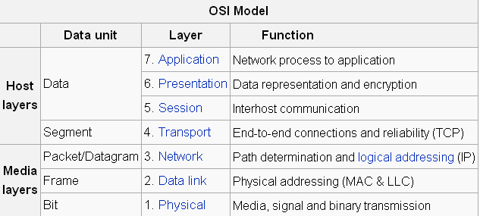
The OSI Model
http://en.wikipedia.org/wiki/OSI_model

Slide 5
Network Basics
A network is two or more connected computers
Connected via Network Interface Card, or NIC
NIC operates on the Physical layer
Uses a RJ 45 connector
Allows the host to connect to the network
Notes:
The part of the NIC that is external to the computer has an opening that looks like a telephone jack, but larger. The cable plugs in there and connects to the network.
Wireless networks also use a NIC, but connect via infrared signals rather than a slot and cable.

Slide 6
Network Basics (cont.)
Media Access Control (MAC) addresses
Physical address, as opposed to the IP address
Burned on the NIC in hexadecimal
It is the layer 2 address used for identification within the network
Notes:
This is the physical address of the computer.
It never changes; as opposed to the IP address, which is a virtual address that may change as often as the network admin allows.
It is represented by a six-byte hexadecimal number.
The first three octets identify the manufacturer and the last three are randomly generated numbers.

Slide 7

Network Basics (cont.)
DNS Servers – Domain Name Server
Translates domain name (URL) to IP address
www.explain.com or 198.203.167.9?
URL – Universal Resource Locator
Notes:
Which would you rather remember?
A DNS server resolves URLs, the global address of documents and other resources on the World Wide Web.
The first part of the address indicates what protocol to use, and the second part specifies the IP address or the domain name where the resource is located. When you type in the URL, the DNS server translates it to the appropriate IP address.
There are DNS servers all over the globe. They keep each other current with zone transfers–mass transfers of all their new data.

Slide 8
Network Basics – Cabling
10BASE5 – Thick Ethernet or Thicknet
10BASE2 – Thin Ethernet, Thinnet
10BASE-T
10BASE-F
Notes:
10BASE5—Thick Ethernet or Thicknet is the original Institute of Electronic and Electrical Engineers (IEEE)802.3 Ethernet.
10BASE2—Thin Ethernet, Thinnet, or Cheapernet – Resembles 10BASE5; was introduced to reduce the cost and complexity of installation and became very popular for replacing Thick Ethernet as an office-cabling solution.
10BASE-T – A completely new physical layer; is IEEE 802.3i and uses two pairs of unshielded twisted-pair (UTP) telephone-type cable: one to transmit and the other to receive.
10BASE-F – Refers to three different fiber-optic specifications:
10BASE-FL (Fiber Link) replaces the 1987 Fiber Optic Inter-Repeater Link (FOIRL) specification and is backward compatible with existing FOIRL devices. It is the most popular 10-Mbps fiber standard.
10BASE-FP and 10BASE-FB are dead. P means passive; B means backbone.

Slide 9
Network Basics – Cabling (cont.)
Fast Ethernet 100BASE-T
Gigabit or 1000-Mb Ethernet
Notes:
Fast Ethernet 100BASE-T is 10BASE-T with the original Ethernet Media Access Controller (MAC) at 10 times the speed. It allows three physical-layer implementations, all part of IEEE 802.3u:
100BASE-TX, which has two pairs of category 5 UTP or type 1 STP cabling and is most popular for horizontal connections;
100BASE-FX, which has two strands of multimode fiber and is most popular for vertical or backbone connections;
100BASE-T4, which has four pairs of category 3 or better cabling and is not common.
Gigabit or 1000-Mb Ethernet is the 1998 IEEE 802.3z standard that includes the Gigabit Ethernet MAC and three physical layers. Gigabit uses 8B/10B encoding and encompasses three physical standards:
1000BASE-SX Fiber (horizontal fiber)
1000BASE-LX Fiber (vertical or campus backbone)
1000BASE-CX Copper (Copper-Twinax cabling)
1000BASE-T

Slide 10
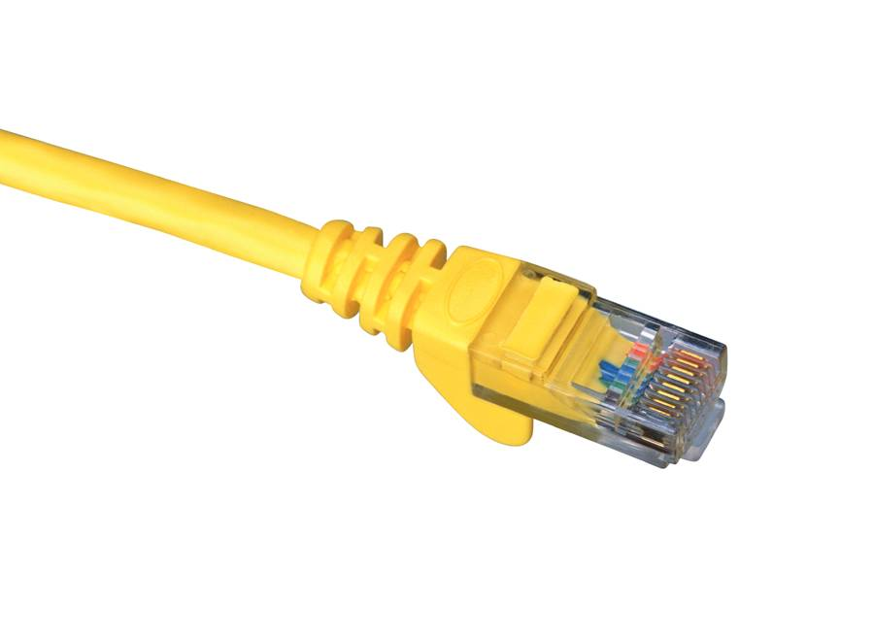
Network Basics (cont.)
RJ 45 connects computer to patch panel
A phone jack uses an RJ 11 connection
RJ 45 looks like a phone jack, but larger
RJ 45 connector
Notes:
Computers with hard-wired NICs are connected using cables with RJ 45 jacks.
Phone line jacks have four wires, whereas RJ 45 jacks have eight.

Slide 11
Network Basics (cont.)
The hub is the simplest connection device
  Four or more ports
  Creates a simple network
  No more than 10 ports
  A layer 1 device
Notes:
The hub is the simplest connection device.
It has four or more ports; usually RJ 45 jacks.
It creates a simple network that must remain small. It does NO filtering.
Any more than 10 ports cause too much congestion on the network.
It is a layer 1 device.
The problem with a hub is that it is an indiscriminate gossip. It tells everybody everything. Therefore, there is a lot of traffic on the hubbed network.

Slide 12
Network Basics (cont.)
The switch is a smart hub
  Sends packets only to the intended host
  Can have up to 24 ports
  A layer 2 device
Notes:
The switch sends packets only to the intended host, limiting traffic and freeing up bandwidth.
It can have up to 24 ports.
It is a layer 2 device.
Traffic is limited to only local traffic. No traffic that is not going to the host is allowed on the wire.

Slide 13
Network Basics (cont.)
The router is more sophisticated
Limits traffic to the intended network
Utilizes fewer ports
A layer 3 device
Notes:
The router is a far more sophisticated device.
It limits traffic to the intended network.
As it connects networks, it utilizes fewer ports.
It is a layer 3 device.
The router separates networks and makes very complex decisions. It is also the location for security devices such as Access Control lists, firewalls, and so forth.

Slide 14
Network Basics (cont.)
The Internet connection
Uses transmission media such as:
  DSO
  ISDN
  T1 and T3
  OC3, OC12, and OC48
Notes:
An Internet Service Provider (ISP) uses other transmission media, such as:
T1 – most common in business and education; often shared, as in a partial T1
1.54 mbs
OC3 – optical, fast and expensive; common in telecommunications
155 mbs

Slide 15
Network Basics (cont.)
How is data actually transmitted?
  A packet is sent
  The packet, or datagram, consists of bytes
  Packet is divided into header and body
Notes:
How is data actually transmitted?
The OSI model calls the data and how it is handled at each layer by various names.
The packet, or datagram, is composed of changes in electrical power or levels of light or sine waves. These changes are measured and calculated to be either a 1 or a 0.
These binary digits carry information that is collected into packets.

Slide 16
Network Basics (cont.)
Packet headers tell where the packet is going
Network devices read the headers to determine where the packet should be sent
Notes:
The packets have headers that tell the various devices it meets in its travels across the network exactly where it came from and where it wants to go.
The devices, switches, routers, and NICs read the headers and make decisions based on the information in the headers.
These decisions may include NOT letting the packet through.

Slide 17
Network Basics (cont.)
Protocols
  Rules that control network and Internet communication
  IETF – Internet Engineering Task Force controls these rules
  Different rules for different purposes
Notes:
Protocols
The rules that control network and Internet communication.
IETF – the Internet Engineering Task Force controls these rules.
Different rules for different purposes.
The concept is similar to the various communication rules in your life. You do not communicate with your friends the same way you communicate with your parents. Different circumstances call for different behavior.

Slide 18
Network Basics (cont.)
Protocols
  TCP (Transmission Control Protocol) is connection-oriented
  IP (Internet Protocol) is connectionless
    Together, they guarantee a successful delivery across the Internet.
Notes:
TCP is the workhorse. It works hard to make a connection and guarantee error-free data.
IP just puts the address on the envelope and drops it in the mailbox.

Slide 19
Network Basics (cont.)
Protocols
  UDP (User Datagram Protocol) is connectionless
  ICMP (Internet Control Message Protocol) is used to notify devices of trouble on the network
Notes:
UDP is connectionless. UDP is great for RIP updates, clock setting, and so forth. If you miss one, there’s another coming along.
ICMP – PING, tracert, source quench, and so forth. It is used to notify devices of trouble on the network.
See Table 2.4 in the text.

Slide 20
Network Basics (cont.)
Port
  A connection point
  Not physical ports on a computer
  Used by protocols to communicate
Notes:
In this case, we are talking about virtual ports; not referring to serial or parallel ports or RJ 45 ports on a computer.
A port is a numeric designation for a communication pathway.
See Table 2.4 in the text. Telnet is 23, FTP is 20 & 21, DNS is 53, etc.

Slide 21
Internet
To connect to the Internet, you log on to your Internet Service Provider (ISP)
The ISP connects to another ISP or a backbone provider
One backbone provider connects to another at a Network Access Point (NAP)
Notes:
When you connect to the Internet, your computer logs on to your Internet Service Provider (ISP).
The ISP connects to another ISP or a backbone provider.
The backbone provider connects to another backbone provider at a Network Access Point (NAP).

Slide 22
Internet (cont.)
IP (Internet Protocol) Addresses
  Necessary to navigate the Internet
  It is a unique identifier, like a Social Security number
  Usually in binary form
  Consists of four octets separated by decimals
Notes:
Without IP addresses, no one would find their way around the Internet.
The IP address is a unique identifier, like a Social Security number.
Usually in binary form, it consists of four octets separated by decimals.
It will be helpful for you to review your knowledge of the binary number system.

Slide 23
Internet (cont.)
Public versus Private IP Addresses
  Public addresses are routable on the Internet
  Must be leased from an ISP
  Private addresses are not routable on the Internet
Notes:
Public versus Private Internet Protocol Addresses:
Public addresses are routable on the Internet.
They must be leased from an ISP, which leases them from one of four regional Internet registries.
Private addresses are not routable on the Internet; use them only inside your private network.

Slide 24
Internet (cont.)
Network Classes
  Each octet in an IP address means something specific
  The first octet defines the class to which the IP belongs
Notes:
See Table 2.5 in the text.

Slide 25
Internet (cont.)
Availability of IP addresses
  IP addresses are not infinite
  IPv4 will be replaced by IPv6
  A subnet is a portion of a network that shares the same subnet address
  Subnet masks describe what subnet the address belongs to
Notes:
Availability of IP addresses:
IP addresses are not infinite; they will soon run out.
IPv4, the current addressing scheme, will be replaced by IPv6. IP addresses will be four times as long – 128-bit instead of 32-bit.
Subnetting allows for the division of a leased network address into more subnetwork addresses.
Subnet masks are used to determine to which subnet the IP address belongs.

Slide 26
Internet (cont.)
Uniform Resource Locators (URLs)
  The easy way to remember a Web site
  Translated by the DNS, or Domain Name Server
  Error messages can be sent by the Web server

Slide 27
Internet (cont.)
  Error Messages
    100 series messages are informational
    200s are not seen because they indicate success
    300s are redirects
    400s are client errors
    500s are server errors
Notes:
Error messages that appear when connecting to an Internet site:
100 series messages are informational.
200s are not seen because they indicate success.
300s are redirects; the site has moved and your browser is directed to the new location.
400s are client errors, or an error on your side. You may have mistyped the address, or typed an address that does not exist.
500s are server errors, or an error on the server side.

Slide 28
Basic Network Utilities
  IPConfig
  Ping
  Tracert
Notes:
These are some of the basic troubleshooting and diagnostic tools used by technicians to solve network connectivity problems from the command prompt (CLI).
IPConfig
Ping
Tracert

Slide 29
Basic Network Utilities (cont.)
IPConfig will give you information about your system
    Open the Start menu
    Select Run
    Enter cmd and click OK
    At the CLI prompt, enter ipconfig
    The output will look like Figure 2.4 (next slide)

Slide 30
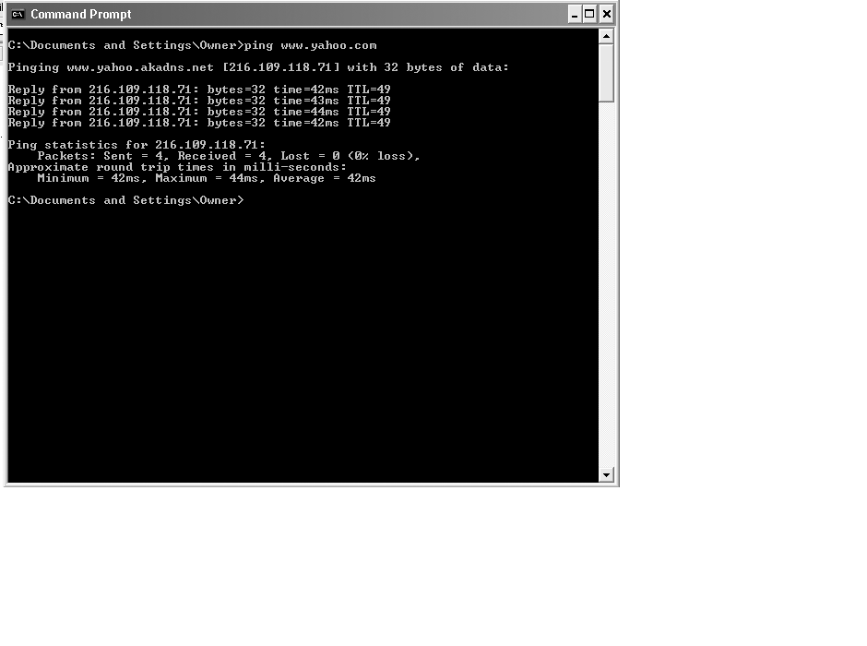
Basic Network Utilities (cont.)

Slide 31
Basic Network Utilities (cont.)
IPConfig will show your system’s
    IP address
    Subnet mask
    Default gateway
Notes:
Disconnect your computer from the network, then try this again. What do you see?

Slide 32
Basic Network Utilities (cont.)
IPConfig
  Other commands to use:
    Type ipconfig -?
    Other options appear
    The most common is ipconfig/all
Notes:
Try these commands. What do you see?

Slide 33
Basic Network Utilities (cont.)
Ping will tell if a system is connected to the network
  It also tells how long it takes for an “echo request” packet to arrive at the destination host
Notes:
Ping will tell you whether or not a system is “alive” or connected to the network. Ping is used by network technicians to determine connectivity.
It is used by hackers to determine who is available.
It also tells you how long it takes for a 32-byte “echo request” packet to arrive at the destination host.
That information is carried by a 32-byte “echo reply” packet.

Slide 34
Basic Network Utilities (cont.)
Tracert
  “Ping deluxe”
  Uses the same syntax as ping
  Show every “hop” between host and destination address
  Useful tool for technicians and hackers alike
  See Figure 2.8 on the next slide
Notes:
Tracert
This command uses the same syntax as ping. It will show you every “hop” or router between your host and the destination address.
This a very useful tool for technicians and hackers alike.
Each of these utilities is, in one sense, like a gun. In the hands of the police, guns are used for good. In the hands of a criminal, they are used for evil. These tools are used for information gathering by network technicians and by hackers.

Slide 35
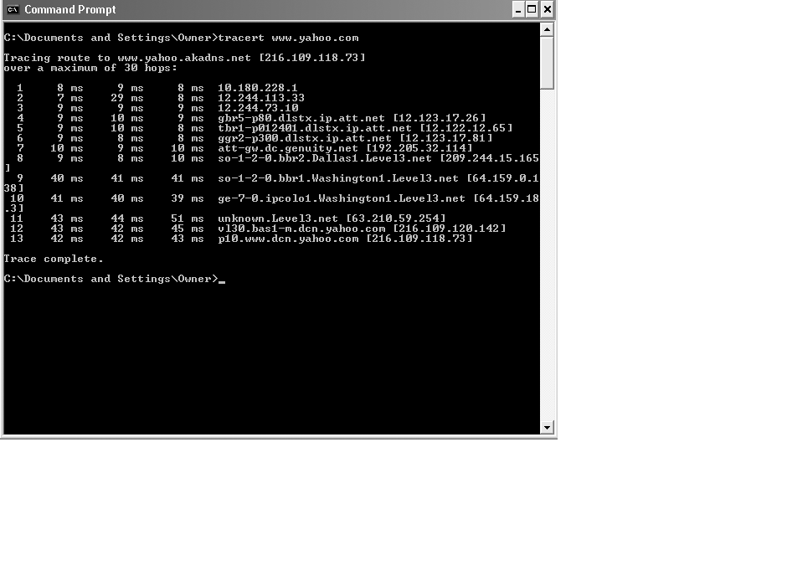
Basic Network Utilities (cont.)

Slide 36
Other Network Devices
Firewalls
  Hardware or software
  Filter packets as they enter the network
  Deny unacceptable packets
Proxy servers
  Disguise the network
  Substitute their IP address for that of hosts accessing the Internet
Notes:
Firewalls can use different techniques to protect the network, but packet filtering is the most common.
A proxy server and a firewall are basic network security devices. It would be negligent to run a network without them.

Slide 37
Summary
You should now understand
  The structure of networks and the Internet
  How networks work
  The uses of some network utilities and devices
This chapter is a very basic tour of networks; review it before continuing if the material is new to you.

Slide 38
Port Scanners

Slide 39
For Good and For Evil
Port scanners can be used in several ways:
  As a tool by a system administrator to check for some port vulnerabilities on their network.
  As a tool by a home computer user to check for some port vulnerabilities on their own computer.
  By a hacker to hunt for networks and computers that can be attacked through their open ports.
Much malware such as Blaster prowls the nets looking for open ports to use to infect a system.
On the defense side, it is important to locate open ports that are not needed, and close them or, at least, protect them.

Slide 40
What is a Port?
Computers that use TCP/IP obtain services from one another through ports.
The port is a number assigned to user sessions and server applications in an network.
The port number resides in the TCP or UDP header of a packet traveling over a network.

Slide 41
An Analogy
An IP addresses can be viewed as the street address of an apartment building.
Then the port number can be viewed as the number of a particular apartment within that building.
If a data packet is sent to an IP address without a port number on it, then the packet doesn't know which service it is for.

Slide 42
Definitions
The source port, which can be a random number, is assigned to the client and is used to keep track of user sessions.
The combination of port number and IP address is called a socket.
The destination port is used to route packets from a server to the appropriate network application.
The destination port numbers follow a general scheme (explained on the next slide).
On a return trip for the packet the two roles are reversed.

Slide 43
Specific Port Numbers
For example, port 80 is the standard port number for HTTP traffic, and port 80 packets are processed by a Web server.
Destination ports are typically well-known ports (0-1023) for common Internet applications such as HTTP, FTP and SMTP.
For example, port 21 is designated as the FTP port.
They can also be a registered port (1024-49151) that vendors use for proprietary applications.
The Internet Assigned Numbers Authority (IANA) registers ports 1024 to 49151 for the convenience of the Internet community.

Slide 44
For example, 1102 is registered to Adobe.
Port numbers from 49152 to 65535 are private ports, called dynamic ports.
The software that responds to a port number is said to be listening for its packets.
In Windows, this program is called a service, while in Unix, the program is called a daemon.
More accurately, the term should be looking for its packets, because the software is comparing numbers, not listening to numbers.
See http://iana.org/assignments/port-numbers
for a listing of all non-dynamic port designations.
(or post my List of TCP and UDP ports which is more readable.

Slide 45
Two Kinds of Ports: TCP and UDP
TCP ports are used by the Transmission Control Protocol which allows a server to conduct a session with another machine.
When a computer requests a Web page from a server, it sends a packet to the server requesting the use of TCP port 80.
When the server sees the request for port 80, it activates its web server program to create a packet of the page to return to the original requester.
Once the port is open for a particular computer, the interaction between them can continue as long as needed.
The two computers are said to be connected.

Slide 46
UDP Ports
UDP ports are used by the User Datagram Protocol, which lets machines send short message to each other.
Unlike TCP ports, UDP ports do not establish continuing sessions, but operate on a once only basis.
As we will see when we look at malware in detail, any program that listens on a particular port represents a potential liability if the malware activates by using that port .
In general, it is a good strategy to close as many ports as possible.

Slide 47
Back to Port Scanners
Now you can see why a program that checks a network or a computer for open ports can be useful.
From a protection standpoint, it useful to find open ports that are not needed and close them.
From an attack standpoint, it is useful to hunt for specific ports the malware will use by scanning for them.
(To see ports that malware has exploited in the past, see the Word file "PortNumbers-malware ports used" in the directory C:\Documents and Settings\ObieS\MyDocuments\Classes\ComputerSecurity\PortsExplained)

Slide 48
Netstat
netstat (network statistics) is a command-line tool that displays network connections (both incoming and outgoing), routing tables, and a number of network interface statistics. It is available on Unix, Unix-like, and Windows NT-based operating systems.

Slide 49
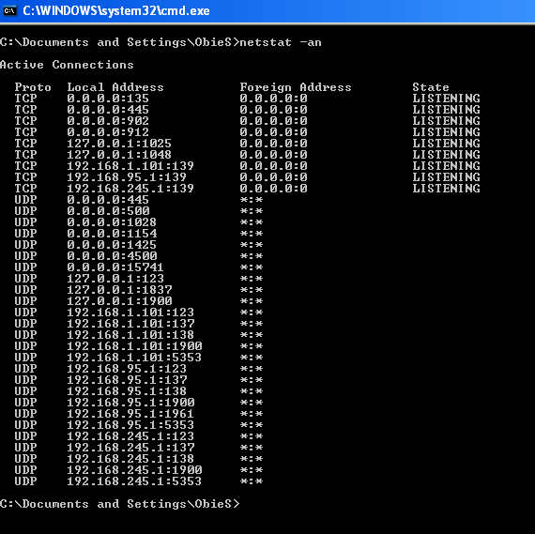

Slide 50
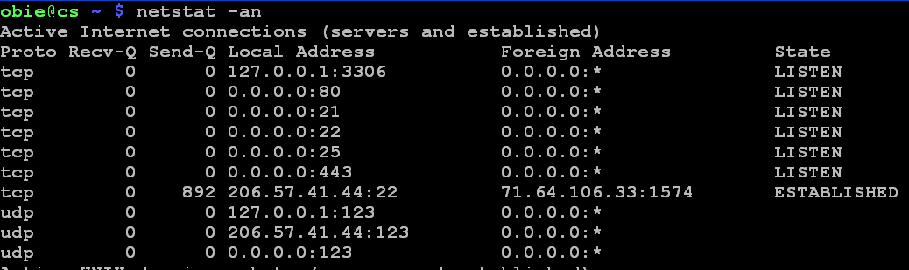

Slide 51
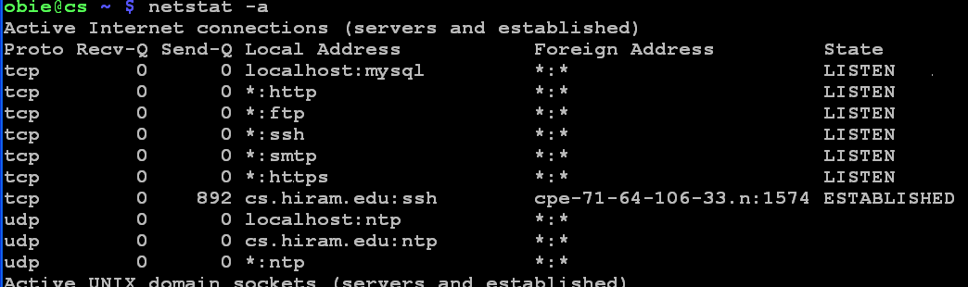

Slide 52
Attacking Your Own Network

Slide 53
Why and How Would You Attack Your Own Network?
You might be humbled by running a vulnerability scanner on your network, particularly if you think you have locked it down well.
A vulnerability scanner is a program that probes computers on a network for potential weakness.
Such tools have been around for years, but only recently have they matured into more comprehensive and user-friendly, if still complex products, with features like customized reporting, distributed threat assessment, and automatic correction of potential problems.

Slide 54
Reviews of Several Vulnerability Scanners
See http://www.pcmag.com/article2/0,1759,1400382,00.asp
A good free one is Nessus, available at http://www.nessus.org/download/
Caution: Running a vulnerability scanner on your own private network is something you should do.
BUT, realize that running it against someone else's network could put you into an illegal situation (which could be detected and lead to prosecution.)

Slide 55
