Slide 1
Is There a Security Problem in Computing?
Chapter 1

Slide 2
What is Computer Security?
Information is a commodity: its purchase and sale is central to the free enterprise system
Protection mechanisms are like putting a lock on the door of a merchant's warehouse
The protection of resources (including data and programs) from accidental or malicious modification, destruction, or disclosure is an overarching goal of security.

Slide 3
Defining Computer Security
Wikipedia: Computer security is the effort to create a secure computing platform, designed so that agents (users or programs) cannot perform actions that they are not allowed to perform, but can perform the actions that they are allowed to.
Pfleeger and Pfleeger: Define in terms of goals
• What does “allowed” or “expect” mean?
– Policy is all-important: defines specifically what is and is not allowed, and what to expect (and who is responsible!)
– Technical security is then: how to make sure systems are used in accordance with policy
What policies make sense? How do we enforce these policies?

Slide 4
Security Goals
Confidentiality
Integrity
Availability

Slide 5
Goals of Computer Security
Basic Goals (CIA)
  Confidentiality: Information is only available to authorized parties
  Integrity: Information is precise, accurate, modified only in acceptable ways, consistent, meaningful, and usable
  Availability: Services provide timely response, fair allocation of resources, quality of service

Slide 6
CIAAAN
Added when people talk about “Information Assurance”
  Authentication: Establishing the validity of a transmission, message, or originator (including verifying the identity of a participant)
  Authorization: Is the originator allowed to perform the action?
  Non-repudiation: Messages or actions are accompanied by proof which cannot be denied that something took place

Slide 7
User Privacy
Privacy means that users have control over information collected and made available to others
Examples:
  User may not want others to know which programs they run, who they communicate with, etc.
  User may not want to receive spam
Anonymity can protect privacy

Slide 8
Summarizing
Confidentiality - ensures that sensitive information is not disclosed to unauthorized recipients
Integrity - ensures that the data and programs are modified or destroyed only in a specified and authorized way
Availability - ensures that the resources of the system will be usable whenever they are needed by an authorized user
Privacy - ensures that only the information that an individual wishes to disclose is disclosed

Slide 9
There is a Need to Balance CIA
Example 1: C vs. I+A
  Disconnect computer from Internet to increase confidentiality
  Availability suffers
  Integrity suffers due to lost updates
Example 2: I vs. C+A
  Have extensive data checks by different people/systems to increase integrity
  Confidentiality suffers as more people see data
  Availability suffers due to locks on data

Slide 10
Confidentiality
“Need to know” basis for data access
  How do we know who needs what data?
    Approach: access control specifies who can access what
  How do we know a user is the person they claim to be?
    Need their identity and need to verify this identity
    Approach: identification and authentication
Analogously: “Need to access/use” basis for physical assets
  E.g., access to a computer room, use of a desktop

Slide 11
Confidentiality
Confidentiality is:
  Difficult to ensure
  Easiest to assess in terms of success (binary in nature: Yes / No)
Confidentiality is the security property we understand best because its meaning is narrower than the other two.
We also understand confidentiality well because we can relate computing examples to those of preserving confidentiality in the real world.

Slide 12
Integrity
Integrity vs. Confidentiality
  Integrity is concerned with unauthorized modification of assets (= resources)
  Confidentiality - concered with access to assets
  Integrity is more difficult to measure than confidentiality
    Not binary – degrees of integrity
    Context-dependent - means different things in different contexts
    Could mean any subset of these asset properties:
  { precision / accuracy / currency / consistency /
  meaningfulness / usefulness / ...}

Slide 13
Integrity
There are different types of integrity—an example
  Quote from a politician
  Preserve the quote (data integrity) but misattribute (origin integrity)

Slide 14
Availability
Not understood very well yet
The full implementation of availability is security’s next challenge
  E.g. Full implemenation of availability for Internet users (while ensuring security)
Complex characteristic
  Context-dependent
  Could mean any subset of these asset (data or service) properties :
  { usefulness / sufficient capacity / progressing at a proper pace / completed in an acceptable period of time / ...}

Slide 15
Availability
We can say that an asset (resource) is available if there is
  A timely response to a request
  A fair allocation of resources (no starvation!)
  Fault tolerance (no total breakdown)
  Ease of use in the intended way
  Controlled concurrency (concurrency control, deadlock control, ...)

Slide 16
The CNSS Model
CNSS stands for Committee on National Security Systems (a group belonging to the National Security Agency [NSA]).
CNSS has developed a National Security Telecommunications and Information Systems Security (NSTISSI) standards.
NSTISSI standards are 4011, 4012, 4013, 4014, 4015, 4016.

Slide 17
CNSS Security Model
Technology
Education
Policy
Confidentiality
Integrity
Availability
Storage Processing Transmission

Slide 18
CNSS Security Model
The model identifies a 3 x 3 x 3 cube with 27 cells
Security applies to each of the 27 cells
These cells deal with people, hardware, software, data, and procedures
A hacker uses a computer (hardware) to attack another computer (hardware).
Procedures describe steps to follow in preventing an attack.
An attack could be either direct or indirect
In a direct attack one computer attacks another.
In an indirect attack one computer causes another computer to launch an attack.

Slide 19
Four Basic Principles of Security (from Pfleeger)
Principle of Easiest Penetration
– An attacker will use any available means of penetrating. That may not be most obvious means or the most expected means, but the easiest!
Principle of Weakest Link
– Security is no stronger than the weakest link
Principle of Adequate Protection
– Protect assets to a degree consistent with their value
Principle of Effectiveness
– Controls must be efficient, easy to use, appropriate, ... and used.

Slide 20
System Functionality
Limiting functionality limits attacks
Security breaches caused by system functionality can be caused by
  Software bugs
  Unforeseen interactions between components

Slide 21
Relative Security
Few useful systems will be absolutely secure and few need to be
To decide whether a computer system is “secure”, you must first decide what “secure” means to you, then identify the threats you care about.
We view security in a relative sense
This does not mean that good security design and implementation is unimportant
    Example: safes
Proper security level depends on the value of the items that system is protecting (other concerns?)
There is a major trade-off between cost and security
Select the security level appropriate for the user's needs

Slide 22
Cost vs Security
Example: user authentication
  System A - authenticates the user by retinal scan
  System B - authenticates users once with password
System A is probably more secure than system B, but more costly and inconvenient
Is added security and expense called for?
  Maybe for NSA (National Security Agency)
  Not for an individual

Slide 23
Some History
1967: People starting to publish papers on computer security
1970: Influential (in some circles!) RAND report: “Security Controls for Computer Systems”
– Originally classified – declassified in 1979
Mid-70’s: Many influential papers published in open literature
Mid-70’s: Cryptography takes off in public research
1985: Department of Defense publishes “Trusted
Computer System Evaluation Criteria” (Orange Book)
1994: Publication of “Common Criteria for Information Technology Security Evaluations”
2003: Publication of “The National Strategy to Secure Cyberspace”

Slide 24
Some History – The Other Side
1970’s: Age of phone phreaking
1980’s: BBSes, Legion of Doom, and Chaos Computer Club
1983: War Games movie comes out
1984: 2600 (The Hacker Quarterly) publication starts
1986: First PC virus in the wild (the “Brain virus”)
1988: The “Morris worm”
– Automated spreading across the Internet
– Exploited several bugs, including the first highly-visible “buffer overflow” exploit (of fingerd)
– Around 6000 computers affected – 10% of the Internet at the time!
– Morris convicted in 1990
– CERT created largely because of this
Early 1990’s: Kevin Mitnick (“Condor”) years
– Arrested several times
– Went “underground” in 1992 and achieved cult status
– Caught in Raleigh, NC in 1995
– Well-known for “social engineering” skill

Slide 25
Some History – The Other Side (cont’d)
1993: Kevin Poulsen hacks phones so he wins radio station contests (Porches, trips, cash, …)
1999 – present: Widespread worms/viruses
– 1999: Melissa (Word macro virus/worm)
– 2000: Love Letter (VBScript – did damage!)
– 2001: Nimda (hit financial industry very hard)
– 2001: Code Red (designed to DoS the White House, but hard-coded IP address so defeated!)
– 2003: “Slammer” (spread astoundingly fast!)
1999: DDoS networks appear
– 2000: Big attacks on Yahoo, eBay, CNN, …
– Today: “Bot-nets” with 10’s of thousands of bots

Slide 26
How Bad is it?
September 2001 - Nimbda worm spread nationwide in less than an hour and attacked 86,000 computers
January 2003 – Sapphire/Slammer SQL worm was able to spread nationwide in less than 10 minutes, doubling in size every 8.5 seconds. At its peak (3 minutes after its release) it scanned at over 55 million IP addresses per second, infecting 75,000 victims

Slide 27
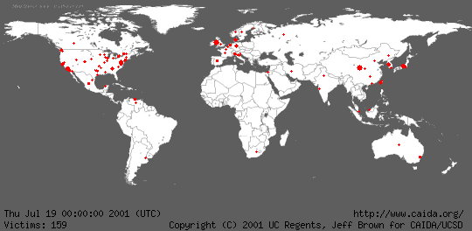
Geographic Spread of Code Red Worm

Slide 28
Why is it So Bad?
Computers are everywhere
Internet has become a mission-critical infrastructure for business, government, and financial institutions
Today’s networks are very heterogeneous, highly critical applications run side by side with noncritical systems
Cyber attacks against non-critical services may produce unforeseen side-effects of devastating proportions

Slide 29
Why is it So Bad?
Home users increase vulnerabilities
Today most homes are connected, particularly with the advent of DSL and cable modems
Most home users:
– are unaware of vulnerabilities
– don’t use firewalls
– think they have nothing to hide or don’t care if others get their data
– don’t realize their systems can serve as jump off points for other attacks (zombies)

Slide 30
Why is it So Bad?
Computer security is predominately reactive
– usually reacting to latest attack
– offense is easier than defense
Security is expensive both in dollars and in time
There is not now, and never will be, a system with perfect security (unless you put it in a vault and never turn it on!)

Slide 31
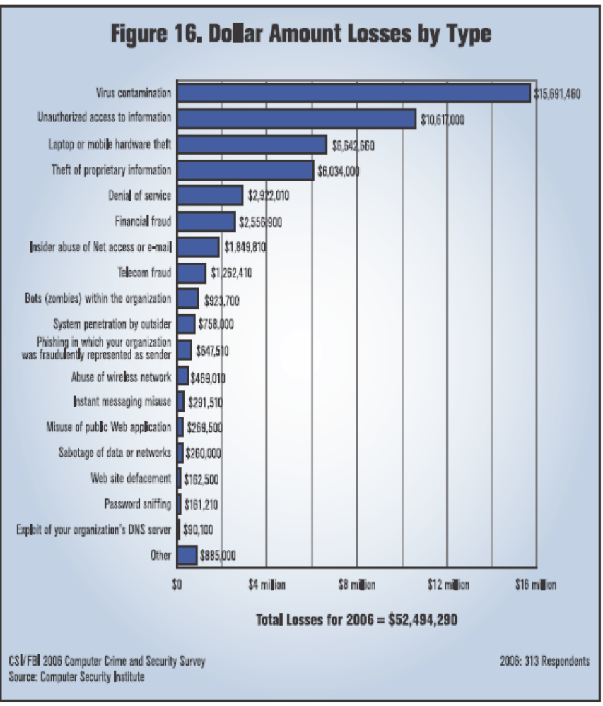
Damage Done
Average total loss per
respondent: $203,606
But a wide range of
respondent organization
sizes:
• 22% revenue <$10 million
• 34% revenue >$1 billion

Slide 32
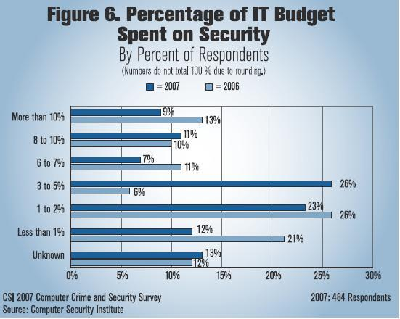

Slide 33
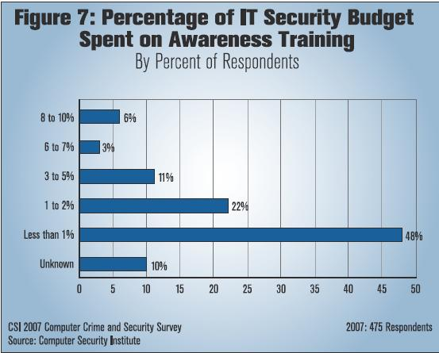

Slide 34
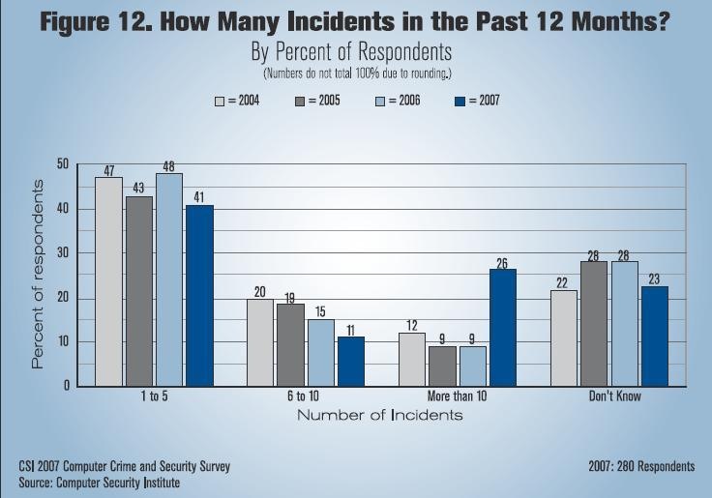

Slide 35
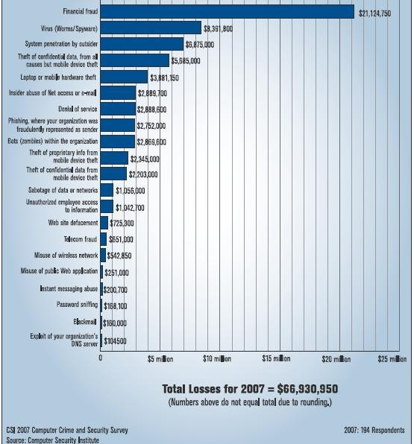

Slide 36
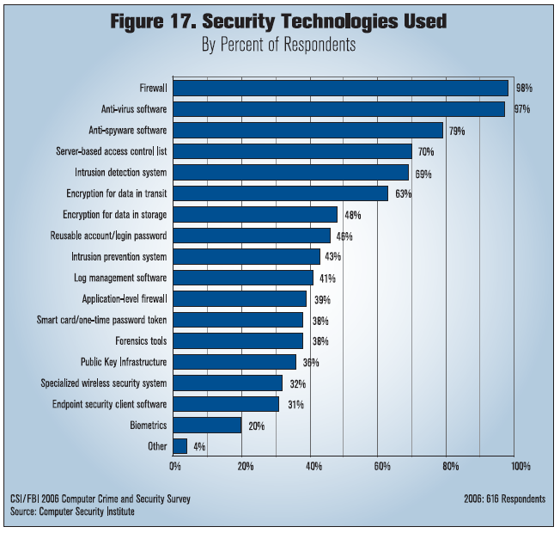

Slide 37
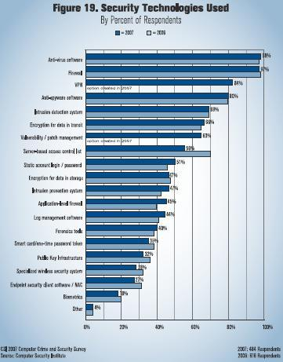

Slide 38
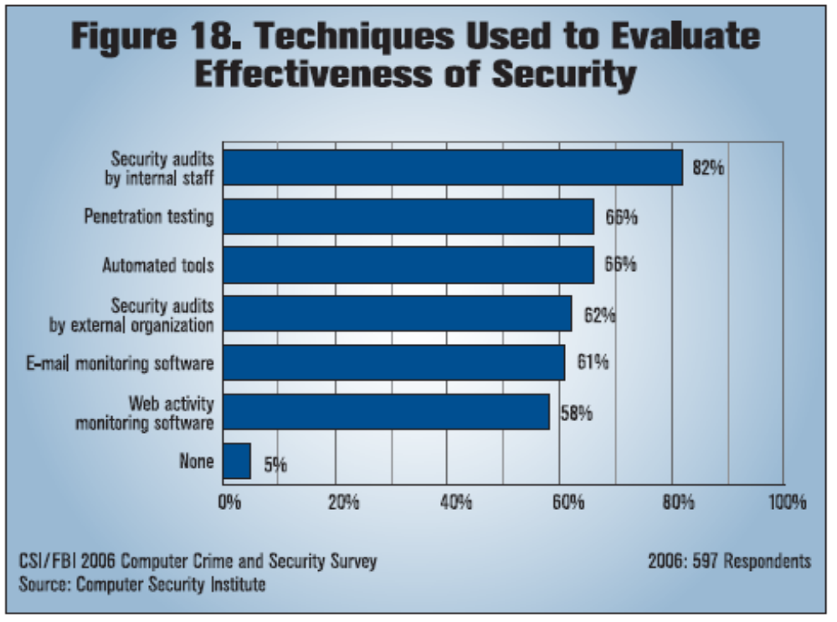

Slide 39
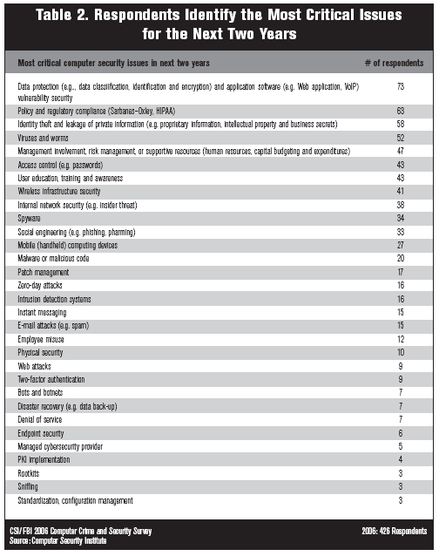

Slide 40
Vulnerabilities, Threats, Controls, and Attacks
  Vulnerability = a weakness in a security system
  Threat = circumstances that have a potential to cause harm
  Controls = means and ways to block a threat, which tries to exploit one or more vulnerabilities
    Most of the course discusses various controls and their effectiveness

Slide 41
An Example
Example - New Orleans disaster (Hurricane Katrina)
  Q: What were city vulnerabilities, threats, and controls?
  A: Vulnerabilities: location below water level, geographical location in hurricane area, …
  Threats: hurricane, dam damage, terrorist attack, …
  Controls: dams and other civil infrastructures, emergency response plan, …

Slide 42
Attacks
Attack (materialization of a vulnerability/threat combination) = an exploitation of one or more vulnerabilities by a threat; tries to defeat controls
    Attack may be:
      Successful (a.k.a. an exploit)
        resulting in a breach of security, a system penetration, etc.
      Unsuccessful
        when controls block a threat trying to exploit a vulnerability

Slide 43
Threats and Attacks
A threat is a “potential” violation of security
  The violation need not actually occur
  The fact that the violation might occur makes it a threat
  It is important to guard against threats and be prepared for the actual violation
The actual violation of security is called an attack

Slide 44
Some Common Threats/Attacks
Interruption, delay, denial of receipt or denial of service
  System assets or information become unavailable or are rendered unavailable
Interception or snooping
  Unauthorized party gains access to information by browsing through files or reading communications
Modification or alteration
  Unauthorized party changes information in transit or information stored for subsequent access

Slide 45
Repudiation of origin
  False denial that an entity did (send/create) something
Fabrication, masquerade, or spoofing
  Spurious information is inserted into the system or network by making it appear as if it is from a legitimate entity

Slide 46
Who are the Attackers?
Amateurs
  Are often just ordinary users exploiting a weakness found in a system
  Often these are accidental discoveries
  Normally does not require any technical skill.
  However, the damage done can be considerable.
  Insiders are legitimate system users who access data that they have no rights to access

Slide 47
Who are the Attackers?
Script kiddies
  Download malicious software from hacker web sites
  Do mischief with scripts and rootkits written by others, often without understanding what they are using.
  Have limited technical expertise
  Use easy-to-operate, pre-configured, and/or automated tools to conduct disruptive activities against networked systems.
  Since most of these tools are fairly well-known by the security community, the adverse impact of such actions is usually minimal.

Slide 48
Who are the Attackers?
Hackers
  "Hacker" originally just meant someone who was very savvy about computers because that person could "hack bits" and understand computers at a deep level.
  Now viewed as one who tries to prove to peers that they can compromise a specific system sooner and better than others.
  A person who delights in having an intimate understanding of the internal workings of a system, computers, programming, and computer networks.

Slide 49
  Believe that information-sharing is a powerful positive good, and that it is an ethical duty of hackers to share their expertise by writing open-source code and facilitating access to information and to computing resources wherever possible.
    Believe that system-cracking for fun and exploration is ethically OK as long as the cracker commits no theft, vandalism, or breach of confidentiality.

Slide 50
Who are the Attackers?
Crackers
  Compromise a system for financial or political gain
  People looking specifically to attack with malice
  Distinguishing a "hacker" from a "cracker" by motives is a recent invention.
  We will not always keep these as separate entities and the word "hacker" will also include crackers.
  Includes career criminals, organized crime, terrorists,

Slide 51
Black, White, and Gray Hats
Black hats are any who attack a system for fun or profit.
White hats are any who attack on the invitation of a company to test their security.
  Note: They do not attack without permission and then inform a company of the vulnerabilities.
The term gray hats has been applied recently to those involved in security research.
The last two are often called ethical hackers.

Slide 52
Others
Government/military information warfare security experts
  This would include personnel at, for example,
    NSA (National Security Agency)
    The FBI cybercrime specialists
    Special units in the armed services.

Slide 53
Attacks and Attackers
An attack is when a vulnerability is exploited to realize a threat
– Typical attack actions were discussed in previous threats/attack slides
An attacker is a person who exploits a vulnerability
Attackers must have Means, Opportunity, and Motive (MOM)
– Means: Often just an Internet connection!
– Opportunity: Presence of vulnerabilities
– Motive may be complex, or not what you think!

Slide 54
Attackers – Motives
Intellectual challenge
– Some people see it as a game
Espionage (government or corporate)
Financial reward
– Credit card numbers sold, spam-nets rented, fraud, ...
Revenge
Showing off
– DoS (Denial of Service) attacks on CNN, eBay, Yahoo, etc.
Civil disobedience
– Basic vandalism
– “Hactivism”

Slide 55
Some Computer Security Threats
Browsing
Searching through main and secondary memory for residue information
Leakage
Transmission of data to an unauthorized user from a process that is allowed to access the data
Inference
Deducing confidential data about an individual by
correlating unrelated statistics about groups of
individuals

Slide 56
Some Computer Security Threats
Tampering - Making unauthorized changes to the value of information
Accidental Data Destruction - Unintentional modification of information
Masquerading - Gaining access to the system under another user's account
Denial of Service - Prevention of authorized access to computer resources or the delaying of time-critical operations

Slide 57
Threats and Vulnerabilities
A vulnerability is a weakness in a security system.
– Can be in design, implementation, or procedures
A threat is a set of circumstances that has the potential to cause loss or harm.
– Threats can be
Accidental (natural disasters, human error, …)
Malicious (attackers, insider fraud, …)
– NSA “major categories of threats”:
fraud, hostile intelligence service (HOIS), malicious logic, hackers, environmental and technological hazards, disgruntled employees, and careless employees

Slide 58
Threats to Confidentiality
Interception/Eavesdropping/Wiretapping (sniffers)
– Used to be commonly installed after a system break-in
– Can (could?) capture passwords, sensitive info, ...
– Some resurgence with wireless networks
– Has always been a problem with wireless transmission!
– Electromagnetic emanations (TEMPEST security)
Illicit copying (proprietary information, etc.)
– Copied company documents, plans, ...
– Copied source code for proprietary software
– Non-electronic: “dumpster diving”, social engineering

Slide 59
Threats to Integrity
Modification
– Changing data values (database)
– Changing programs (viruses, backdoors, trojan horses, game cheats, ...)
– Changing hardware (hardware key capture, ...)
– Can be accidental corruption (interrupted DB transaction)
– Many small changes can be valuable (e.g., salami attack)
Fabrication
– Spurious transactions
– Replay attacks
Identity spoofing
– Somewhat related: fake web sites and “phishing”

Slide 60
Threats to Availability
Denial of Service (DoS)
– Commonly thought of as network/system flooding
– Can be more basic: disrupting power
– Deleting files
– Hardware destruction (fire, tornado, etc.)
Latest: Distributed Denial of Service (DDoS)
– Bot-nets of zombie machines that can be commanded to flood and disable “on-command”
– Discovery of botnets with 10-100 systems is a daily occurrence; 10,000 system botnets are found almost weekly; and one botnet with 100,000 hosts has even been found (according to Johannes Ullrich, CTO of the Internet Storm Center).

Slide 61
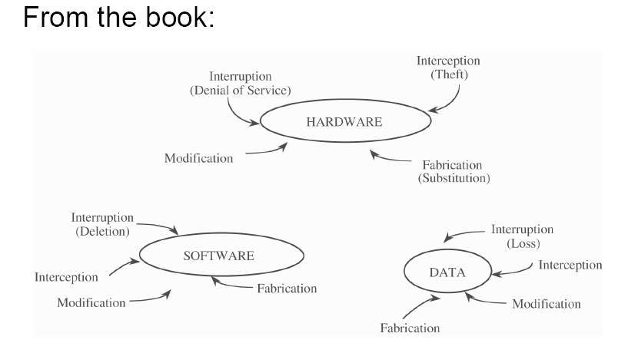
Vulnerabilities

Slide 62
Most Common Threat
Password Guessing
More of a problem with the availability of personal computers and fast connections
Exhaustive search for passwords
Lists of commonly used passwords
Distributed default passwords

Slide 63
Spoofing
Duping a user into believing that he is talking to the system and revealing information (e.g., password)

Slide 64
Browsing
After an intruder has gained access to a system he may peruse any files that are available for reading and glean useful information for further penetrations
Often done by legitimate users

Slide 65
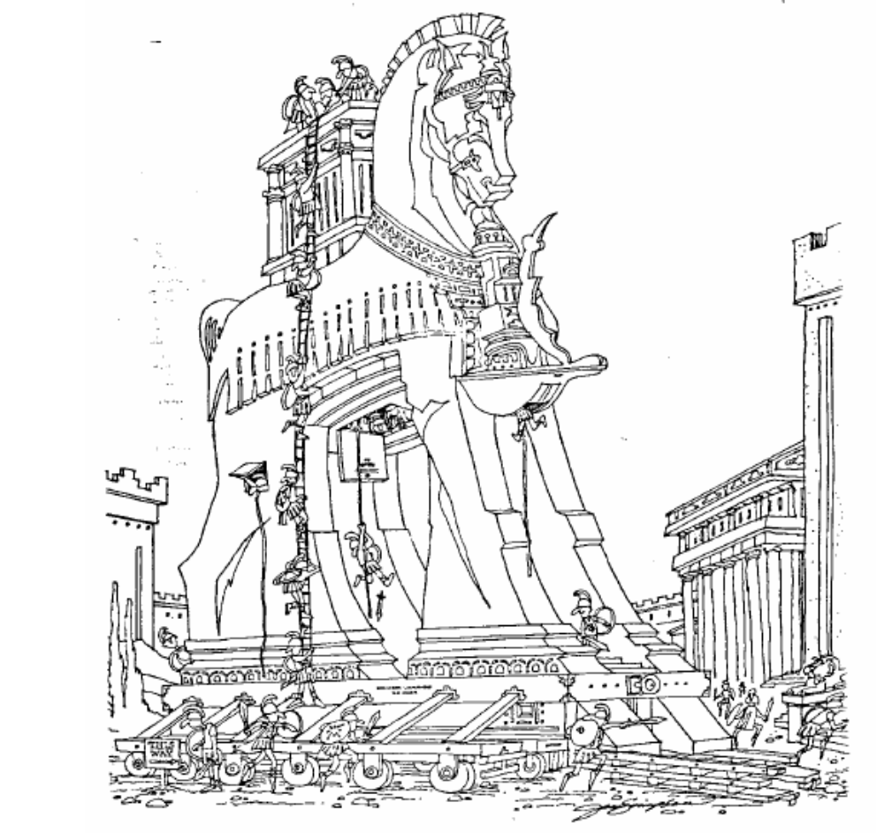
Trojan Horse

Slide 66
Trojan Horse
A program that does more than it is supposed to do
More sophisticated threat
A text editor that sets all of your files to be publicly readable in addition to performing editing functions
Every unverified program is suspect

Slide 67
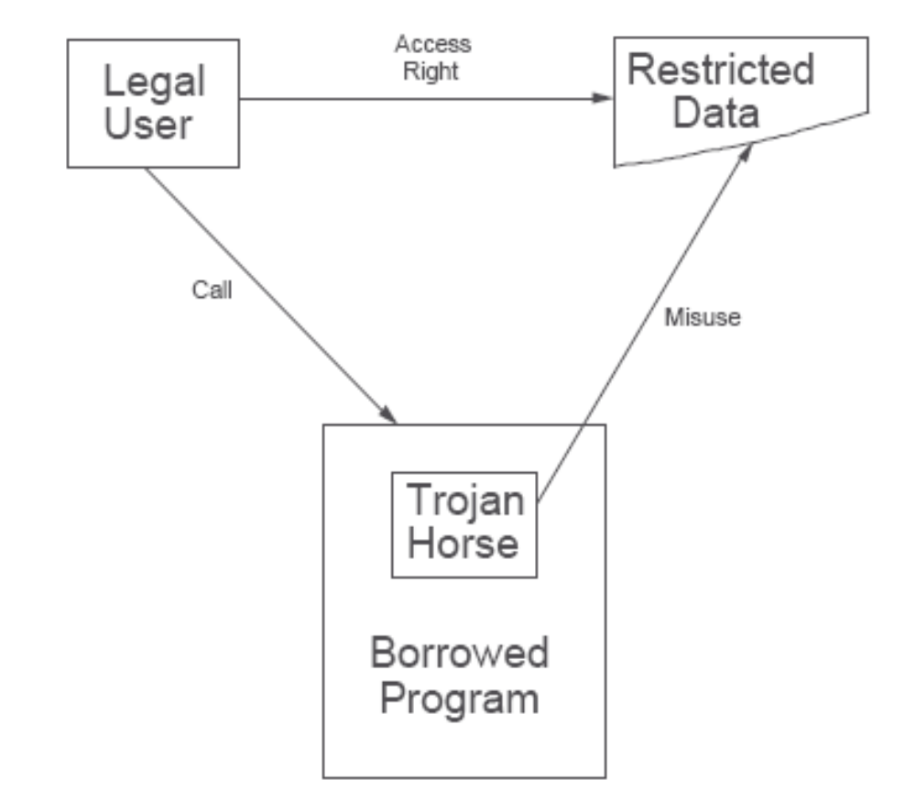
Trojan Horse

Slide 68
Trap Door
A system modification installed by a penetrator that opens the system on command
May be introduced by a system developer
Bogus system engineering change notice

Slide 69
Virus
A program that can infect other programs by modifying them to include a possibly evolved copy of itself

Slide 70
Examples
Amiga Virus
Resident on boot block
IBM Christmas Virus
Names and netlog files
Denial of service
Census Bureau
County and City Data Book CD-ROM
WWW Pages Containing Applets
MIME-encoded Mail
Code Red Worm
Blast

Slide 71
Statistical Database
A statistic is sensitive if it discloses confidential information about some individual, organization, or company
Nonsensitive statistics may lead to the disclosure of sensitive data

Slide 72
Inference of Sensitive Data
From Nonsensitive Information
Can detect information about an individual by querying about a group where the individual is the only member in the group or the only one not in the group
For example:
If Smith is the only foreign worker, one can
deduce information about Smith by querying
about non-foreigners

Slide 73
Why Computer Crime is not Reported
A successful attack reveals vulnerabilities to other potential intruders
Adverse publicity discourages new clients and disappoints shareholders
Often viewed as a harmless prank

Slide 74
Security Policy
A security policy is a statement of what is and what is not allowed
May be informal (English statements) or formal (mathematical logic statements)

Slide 75
Policy Simplicity
Simpler security policies are easier to get right, reason about and implement
Security breaches caused by policy shortcomings are most often due to
  Incomplete or inconsistent policy
  Misunderstanding the policy’s requirements
  Error in implementation

Slide 76
Secure Computer System
A security policy specifies exactly what types of actions are and are not permitted on the system
Example security policy
  Only authorized users able to use the system
  Authorization/Access control
  Resources sharing among users
A secure system obeys its security policy

Slide 77
Security Breaches
A violation of a system’s security policy is called a security breach
Security breaches can occur
  Accidentally – faulty program
  Intentionally – virus
Creating a system where security breaches cannot occur can be easy or impossible depending on
  What the security policy requires
  How the system implements the policy

Slide 78
Secure Systems Design
Policy Simplicity Principle
  Policy as simple as possible (but no simpler)
  Should state what is allowed and forbidden
System Functionality Principle
  Include necessary functionality (and no more)
  Perform job it was designed to do (and no more)

Slide 79
Defenses and Controls
A control is a protective measure to remove or reduce a vulnerability
– Action, device, procedure, or technique
Business motivation: Manage risk
– Main purpose: Balance risk with costs
– Risks can be prevented, deterred, detected and responded to, transferred, or accepted
Risk Analysis:
– Determine what controls are most cost-effective
– Most “bang for the buck”

Slide 80
Controls – Examples
Policies/procedures (acceptable use, password, training)
Cryptography
Access Control
– Operating System controls (file rights, capabilities, ...)
– Application access restrictions (DB, web server, ...)
– Network boundary (firewall, VPN, ...)
– Advanced authentication (smart cards, tokens, ...)
Detection programs (virus scanners, IDS’s)
Regularly test/evaluate (called “penetration testing” or “red teams” or “tiger teams”)
Development controls (secure software development)
Physical controls (door locks, media management)

Slide 81
Defense in Depth
Definition: Using multiple layers of security to protect against failure of individual controls.
Non-computer example:
– Multi-walled (or concentric) castles
– Vats of boiling oil helped too…
Computer security example:
– Internal systems with access control protections, on an internal network with an intrusion detection system, with connections from outside controlled by a firewall.

Slide 82
The Role of Trust
Who/what to trust is fundamental!
Trust in certain people
– Background checks, references, ...
Trust in systems
– Evaluation through certifications, etc.
– Do you trust your software?
– Do you trust your hardware?

Slide 83
Access Control
A means of limiting a user's access to only those entities that the policy determines should be accessed
Subjects - Active entities in the system (e.g. , users, processes, programs)
Objects - Resources or passive entities in the system (e.g. , files, programs, devices)
Access Modes - Read, write, execute, append, update
Access Control Mechanisms - Determine for each subject what access modes it has for each object

Slide 84
Access Control
Discretionary Access Control (DAC)
The owner specifies to the system what other users can access his files (Access is at the user's discretion)
Mandatory Access Control (MAC)
The system determines whether a user can access a file
based on the fixed security attributes of the user and of
the file (Non-discretionary access)

Slide 85
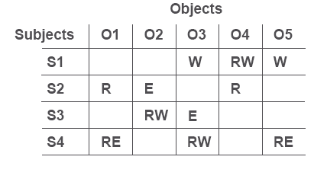
Access Control Matrix

Slide 86
Access Control List
(Authorization List)
Associated with each object
Contains subject name and type of access allowed
Corresponds to column in the matrix

Slide 87
Capability List (C-list)
Associated with each subject
Contains object name and type of access allowed
Corresponds to a row in the matrix
Defines the environment or domain that the subject may access

Slide 88
Mandatory Control Policy
Each subject has an access class (authorization)
Each object has an access class (classification)
Access class made up of
- level
- category set
Comparison of access classes
(=, <, >, NC (not comparable))

Slide 89
Example Mandatory Controls
Three security levels
Unclassified, Confidential, Secret
Three security categories
Crypto, Nuclear, Intelligence
Comparisons
SECRET/ {CRYPTO} = SECRET/ {CRYPTO}
SECRET/ {CRYPTO} > CONFIDENTIAL/ {CRYPTO}
SECRET/ {CRYPTO} < SECRET/{CRYPTO,NUCLEAR}
SECRET/ {CRYPTO} NC SECRET/ {NUCLEAR}

Slide 90
Access Rules
Simple security property
Read permission if:
Access class (subject) >= Access class (object)
Write permission if:
Access class (subject) <= Access class (object)

Slide 91
Approaches to Security
Procedural
Functions and Mechanism
Assurance

Slide 92
Procedural Approaches
Prescribes appropriate behavior for a user interacting with the system
– periods processing
– guidelines for managing passwords
– appropriate handling of removable
storage devices

Slide 93
Periods Processing
Split the day into periods and run different classification jobs in each period

Slide 94
Guidelines for Choosing Passwords
Long (8 character minimum)
Non-obvious
Not written in an obvious place
Changed at appropriate intervals
Not shared
Not stored
Many guidelines can be enforced by the system

Slide 95
Non-Obvious Passwords
NOT:
First name
Middle name
Last name
Spouse's name
Login name
Null
Name backwards
Name repeated twice

Slide 96
Appropriate Handling of Hardware
Management of removable media
Disposal of hardware
study showed that confidential information is often left in hardware to be salvaged
(IEEE Security & Privacy magazine, January 2003)

Slide 97
Functions and Mechanisms
Enforce security policy
Examples are the 3As
Authentication: assures that a particular user is who he/she claims to be
Access control: a means of limiting a user's access to only those entities that the policy determines should be accessed
Audit: a form of transaction record keeping.
The data collected is called an audit log

Slide 98
Authentication Mechanisms
Authenticates users at login time
– Secure attention key
(e.g., control-alt-delete)
– One way functions

Slide 99
Secure Attention Key
Foils attempts at spoofing
Guarantees trusted path to the system
User must use it

Slide 100
One-Way Function
A function whose inverse is computationally infeasible to determine
– Enciphered passwords are stored in a password file
– At login time password presented by the user is enciphered and compared to what is in the password file

Slide 101
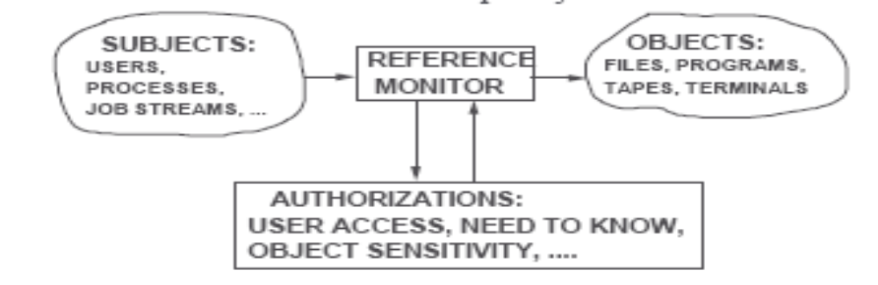
Access Control
Reference Monitor
Provides mediation of all accesses to assure that the access control policy is enforced (part of OS security kernal)
Reference Monitor must be
- Invoked on every reference
- Tamperproof
- Subject to analysis/test whose completeness can be assured

Slide 102
Assurance Techniques
Penetration analysis
Covert channel analysis
Formal verification

Slide 103
Penetration Analysis
Uses a collection of known flaws, generalizes the flaws, and tries to apply them to the system being analyzed
– Penetration team known as "Tiger Team“
– Demonstrates the presence not the absence of protection failures

Slide 104
Covert Channels
Security analysis of both overt and covert channels is necessary
Overt channel – Uses the system's protected data objects to transfer information
Covert channel – Uses entities not normally viewed as a data object to transfer information

Slide 105
Two Types of Covert Channels
Storage channels – the sender alters the value of a data item and the receiver detects and interprets the altered value to receive information covertly
Timing channels – the sender modulates the amount of time required for the receiver to perform a task or detect a change in an attribute, and the receiver interprets the delay or lack of delay to receive information covertly

Slide 106
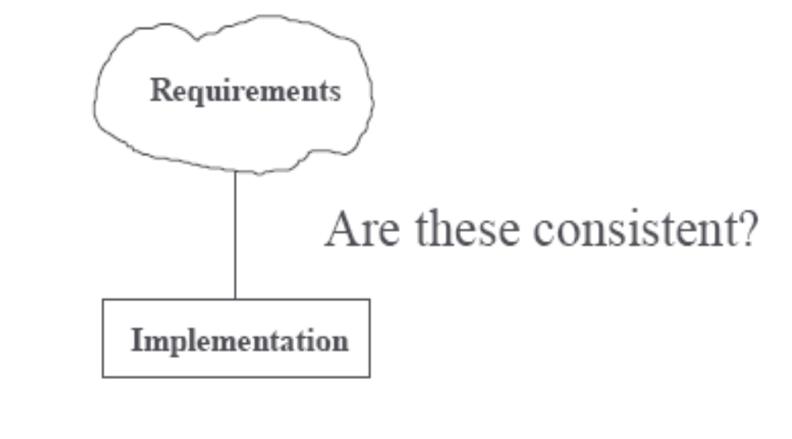
Systems Development Problem

Slide 107
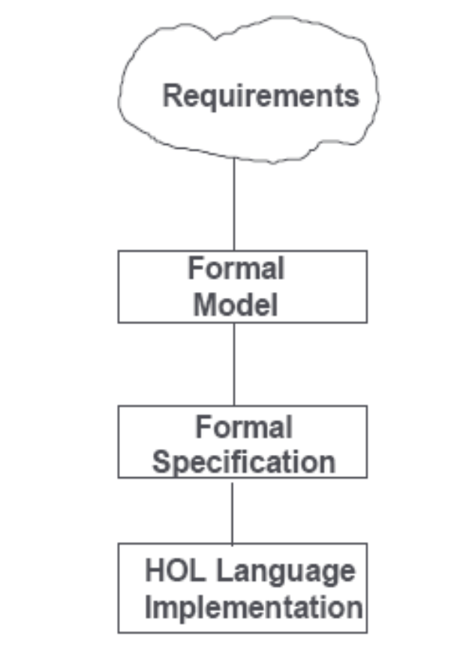
Formal Specification and Verification

Slide 108
Models
Access Control
Considers subjects and objects requirements:
1) If subject s has read access to object o, then
Security _level(s) >= Security_level(o)
2) If subject s has write access to object o, then
Security_level(s) <= Security_level(o)

Slide 109
Formal Specifications
State Machine
Relates values of variables before and after each state transition
E.G.
Exchange (x,y)
New_ value(x) = y
& New_value(y) = x

Slide 110
Formal Specifications
Algebraic
Relates results of sequences of operations
E.G.
Exchange (Exchange(pair)) = pair
First (Exchange(pair)) = Last (pair)
Last (Exchange(pair)) = First (pair)

Slide 111
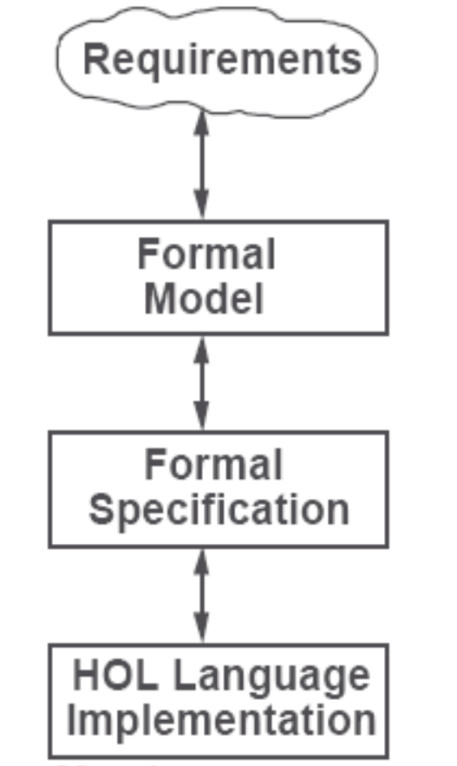
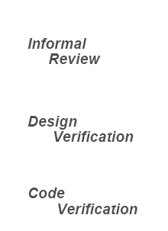
Formal Verification Techniques

Slide 112
Formal Verification
Design Verification
Consistency between the model and the specification
Assumes:
Model is appropriate
Specification is complete
Code Verification
Consistency between specification and the implementation
Assumes:
Specification is appropriate
Implementation language is correctly defined

Slide 113
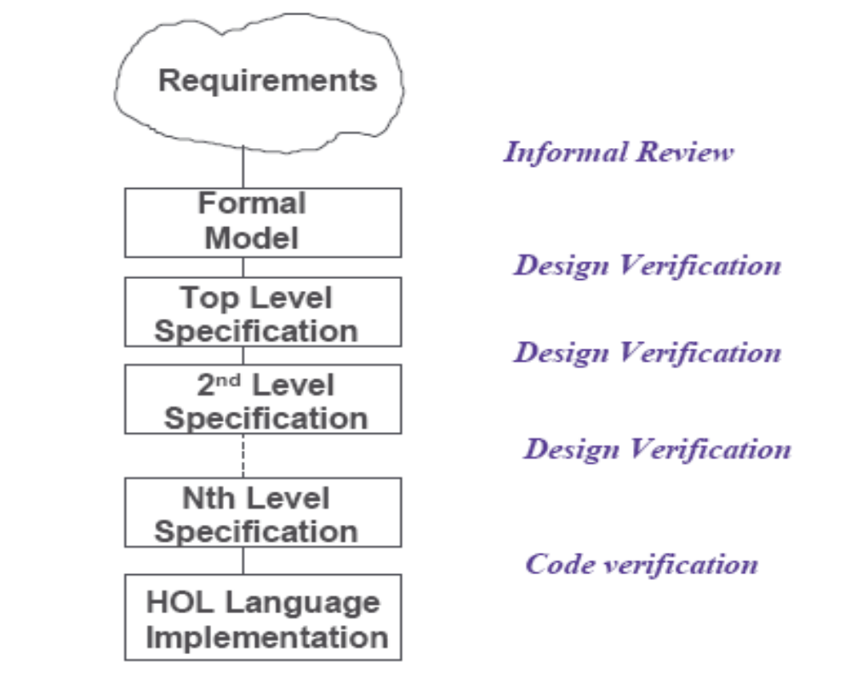
Formal Verification

