Slide 1
Misc Topics

Slide 2
Identity Theft

Slide 3
Measuring Identity Theft Claims
Many people believe banks (and other businesses) should report basic statistics showing how many identity theft claims occur.
Chris Hoofnagle (Berkeley Center for Law and Technology. Law and Technology Scholarship) ran a study during 2006 to see how many claims were made to various banks.
He obtained the data from the Freedom of Information Act.
The full report is available at http://repositories.cdlib.org/bclt/lts/44/

Slide 4
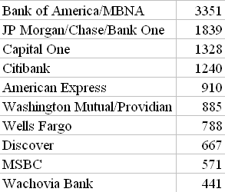
Total ID Theft Events per Billion Dollars of Deposits in 3 Months-Jan, Feb, Sep 2006
Hoofnagle observes that it is hard to draw conclusions due to the lack of standards for collecting the data.
The data is on account takeovers, not the creation of new accounts,
So, is a specific institution bad if its score is high or is it just a more likely target?
Extracted from the report and an article in PC Magazine, June, 2008, pg 104.

Slide 5
Encrytion

Slide 6
A Research Team Cracks Disk Encryption
Various operating systems try to prevent the theft of disk data from a stolen or lost laptop by using various encryption programs:
  Window's BitLocker Drive Encryption
  Apple's FileVault
  Linux's dm-crypt
  Open source TrueCrypt
All have been cracked by a team from the Electronic Frontier Foundation (EFF) and Princeton University.
See http://citp.princeton.edu/memory/ for their report.

Slide 7
How the Attack Works
The attack relies on recovering passwords and the encryption keys from DRAM even after the computer has been turned off.
Obviously, this is easier if the laptop is in sleep or hibernation mode, but the team was able to obtain what they needed even if the system was turned off completely.
DRAMs used in most modern computers retain their contents for seconds to minutes after power is lost.
DRAMs do become less reliable when they are not refreshed, but they are not immediately erased.

Slide 8
This means DRAM contents persist sufficiently for malicious (or forensic) acquisition of usable full-system memory images.
This study shows there are severe limits to the ability of an operating system to protect cryptographic key material from an attacker with physical access.
No special devices or materials were used.
New algorithms for finding cryptographic keys in memory images and for correcting errors caused by bit decay were found.

Slide 9
They discuss several strategies for partially mitigating the risks, but they pointed out that they knew of no simple remedy that would eliminate them.
They point out that if you lose your laptop, have it stolen, or even lose sight of it for a few minutes (during an airport security check), then a clever attacker could steal what is on your hard disk!
Although they concentrated on obtaining data from disks, their algorithms work on recovering memory data also.
For example, they found that Mac OS X leaves the user’s login passwords in memory, where they were able to recover them.

Slide 10
Vulnerabilities in E-mail

Slide 11
Web-based E-mail at Risk
GreyMagic discovered a security vulnerability in Microsoft 's and Yahoo's Web-based e-mail services.
The vulnerability came from the technology used to filter e-mail in order to thwart potentially unsafe HTML.
The flaw allows the theft of log-ons and passwords or the distribution of a Web-based e-mail worm.
The problem arose from functions in Internet Explorer designed to add timing and media synchronization support to HTML pages.

Slide 12
Features of the technology make it possible to inject any HTML content into a document, including a script.
GreyMagic noted that Microsoft fixed Hotmail shortly after the company was notified of the vulnerability, but attempts to inform Yahoo! failed.
GreyMagic also pointed out that other Web-based services may also be at risk.

Slide 13
Don't Think Only Internet Explorer Has Vulnerabilities
GreyMagic has identified dozens of severe security vulnerabilities in web-browsers such as Internet Explorer, Mozilla and Opera, as well as in popular plugins such as Google Toolbar and Adobe SVG Viewer.

Slide 14
Security Alert Services
Unfortunately, these have to be monitored constantly

Slide 15
GreyMagic Security
GreyMagic Security
  A security vendor like McAfee or Norton in US.
  Is based in Israel.
  Maintains an excellent email-based security alert system to which you can subscribe at http://www.greymagic.com/subscribe/new.shtml

Slide 16
Symantec Virus Alerts online
  http://www.infoservices.neu.edu/get_help/symantec_norton_alerts.html
Email-based security alerts from Symantec can be activated at
http://nct.digitalriver.com/virusalert/
More alerts are available at http://www.symantec.com/security_response/index.jsp

Slide 17
Concealing Your Email Address

Slide 18
Relationship Between Email Posts and Spams
The Center for Democracy and Technology is a non-profit group which ran an experiment in which they created dozens of new email addresses and used them in various ways to see which would attract spam.
The results showed that over 97% that activated spam came from those posted on web sites, not those used in commercial transactions.
Professional spammers scan the Web to harvest visible email addresses even though this is illegal under the CAN-SPAM Act of 2004.
PC Magazine, June 22, 2004, pg. 78

Slide 19
How Can You Post Your Email Address, But Prevent Its Harvest?
Many replace the @ with "at" and the dots with "dot".
  Unfortunately, new harvester software can easily do the conversion.
Another approach: Make a graphic image of the email address using a program such as MS Paint and store the .gif or .jpg file on the web.
  Then you can't embed a hyperlink safely that allows people to email you without typing the address.
  If you do provide the hyperlink, the HTML code may compromise your address as harvesting programs can read code.

Slide 20
So far, the harvesting programs haven't employed OCR (optical character recognition ) techniques because they slow down the programs considerably.
One way to provide a clickable address is to use a service called HiveLogic Enkoder by Dan Benjamin.
Go to the site: http://hivelogic.com/enkoder
Fill out the necessary information as on the next slide.

Slide 21
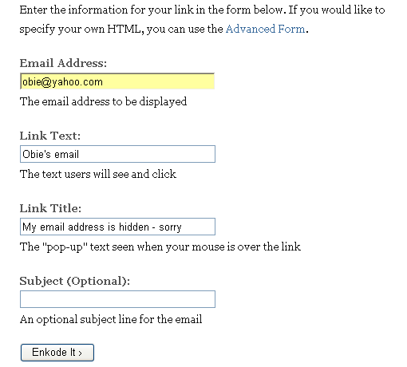
Although the email address is of the usual format, only the Link Text will show on a click and only the Link Title will show when the mouse goes over the link.
The encoder produces JavaScript as on the next slide.

Slide 22
<script type="text/javascript">
/* <![CDATA[ */
function hivelogic_enkoder(){var kode=
"kode=\"oked\\\"=kode\\\"\\\\'=()i'jn)oe.r(vsre)e'.t'l(siepo.=ddkke\\\\o;\\"+
"\\\\\\kd\\\"=o\\\\e\\\\\\\"\\\\\\\\\\\\\\\\)\\\\\\\\;\\\\\\\\\\\\\\\\\\\\"+
"\\\\\\\\\\\\\\\\\\\"\\\\\\\\\\\\\\\\a\\\\<>i/ml a'eisOe\\\\b>\\\\\\\\\\\\"+
"\\\\\\\\\\\\\\\\\\\\\\\\\\\\\\\\\\\"\\\\\\\\\\\\\\\\\\\\\\\\\\\\\\\\\\\\\\"+
"\\\\\\\\\\\\\\\\\\\\\\\\\\\\\\\\\\yr\\\\sr-on d ie dihsse dsarlda eiym\\\\"+
" M\\\\\\\\\\\\\\\\\\\\\\\\\\\\\\\\\\\\\\\\\\\\\\\"\\\\\\\\\\\\\\\\\\\\\\\\"+
"\\\\\\\\\\\\\\\\\\\\\\\\\\\\\\\\\\\\\\\\\\\\\\\\=l\\\\ie t\\\\t\\\\\\\\\\"+
"\\\\\\\\\\\\\\\\\\\\\\\\\\\\\"\\\\\\\\\\\\\\\\\\\\\\\\\\\\\\\\\\\\\\\\\\\\"+
"\\\\\\\\\\\\\\\\\\\\\\\\\\\\\\\\\\\\o\\\\.mocao@hiyoeobl:at\\\\im\\\\\\\\"+
"\\\\\\\\\\\\\\\\\\\\\\\\\\\\\\\\\\\\\\\"\\\\\\\\\\\\\\\\\\\\\\\\\\\\\\\\\\"+
"\\\\\\\\\\\\\\\\\\\\\\\\\\\\\\\\\\\\\\=e\\\\hfar\\\\ <\\\\\\\\\\\\\\\\\\\\"+
"\\\\\\\\\\\\\\\\\\\\\\\\\\\"\\\\\\\\(t\\\\re.inwmtcedu\\\\o\\\\\\\"\\\\\\"+
"\\\\\\\\\\k\\\\d;=ooeeksdl.tp'i)(r'v.reee)sj(i.(o'n\\\\')\\\\\\\\=d\\\"ke;"+
"o\\\"\\\\kode=kode.split('').reverse().join('');\\\"=x''f;roi(0=i;(<okedl."+
"netg-h)1i;=+)2x{=+okedc.ahAr(t+i)1k+do.ehcratAi(})okedx=(+<iokedl.netg?hok"+
"edc.ahAr(tokedl.netg-h)1':)';\";x='';for(i=0;i<(kode.length-1);i+=2){x+=ko"+
"de.charAt(i+1)+kode.charAt(i)}kode=x+(i<kode.length?kode.charAt(kode.lengt"+
"h-1):'');"
;var i,c,x;while(eval(kode));}hivelogic_enkoder();
/* ]]> */
</script>

Slide 23
All that is needed is to paste the JavaScript code block into the HTML source of the website you're creating in exactly the place where you'd like the address to appear.
The view in a web browser is as shown.
Realize that some people turn off JavaScript for security reasons so if you want to show the real address to those users, show a graphic.

Slide 24
Malware and Email
Operating System Vulnerabilities

Slide 25
A Disturbing Twist
You've probably heard that viruses and worms are only activated when you click on the attachment.
This is no longer true.
In March, 2004, multiple variants of the Bagle worm appeared that could infect a PC when a user just opened an email.
The Sasser worn was delivered the same way which exploited known Windows vulnerabilities by infecting PCs automatically when users clicked on email.
How do you counter these types of malware?
Be sure to install operating systems immediately after their release.

Slide 26
Phishing

Slide 27
Responses to Phishing Attacks
Gartner, Inc., Stamford, CT, www.gartner.com
is the largest information technology consulting firm that specializes in research and analysis.
Gartner offers more than 2000 management reports on every topic in the IT world and hosts the annual GartnerGroup Symposium/ITxpo in the U.S. and abroad.
Many of Gartner's reports are quite disturbing:
  The cost to U.S. banks and credit card Issuers was estimated at $1.2 billion in 2003 due to an erosion of consumer trust in online transactions because of phishing attacks.
http://www.gartner.com/press_releases/asset_71087_11.html

Slide 28
More Gartner Results
  Phishing attacks by hackers against online consumers have become so widespread that an estimated 57 million Americans likely have received these fraudulent e-mails.
  "Based on survey responses from 5,000 adult Internet users, Gartner analysts project that approximately 30 million adult Internet users believe they have definitely experienced a phishing attack, and another 27 million believe they have observed what looked like a phishing attack."
http://www.gartner.com/press_releases/asset_71087_11.html

Slide 29
And, Even More
A Gartner survey in April, 2004, showed a high rate of success for phishers.
Based on survey data, Gartner estimates that about 19 percent of those attacked, or nearly 11 million U.S. adult Internet users, have clicked on the link in a phishing attack e-mail.
Moreover, 3 percent of those attacked, or an estimated 1.78 million adults, report giving phishers their financial or personal information.
The data indicate that phishing attack victims are almost three times as prone to identity-theft related fraud as other online consumers.

Slide 30
Another Survey
MailFrontier (now Sonicwall), an antispam vendor, commissioned an independent survey in which 1000 adults were presented with email messages and asked to identify them as legitimate or fraudulent. Try their survey at http://www.sonicwall.com/phishing/
6.2% - The percentage of test takers who get 100% - answering all 10 questions
81% - The percentage of phishing e-mails that are identifies as "phish" by the test takers
52% - The percentage of legitimate e-mails that are identified as "legitimate" by the test takers

Slide 31
Before the test you are told:
  At the bottom of each "e-mail", on the status bar, there is the URL of the active link - the one being pointed to in the e-mail. You can decide if what is displayed is "real" or fake.
  For this test, assume that you are "John Doe" or "Jane Doe" - in other words that you received the e-mail in your inbox addressed to you.
DO NOT LOOK AT THE NEXT SLIDE IF YOU PLAN TO TAKE THE TEST.

Slide 32
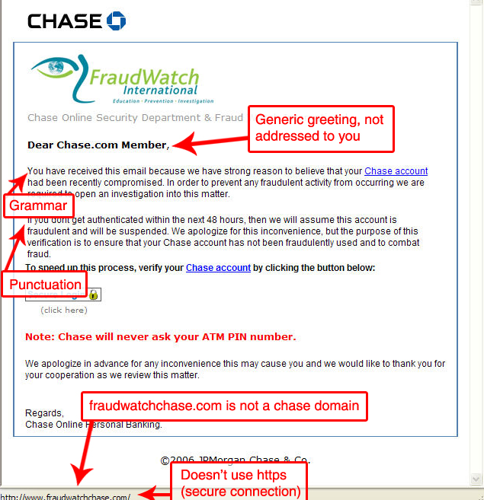
An example showing how the survey site shows you tips for detecting phishing.
Survey taker claimed this was legit, but it wasn't.

Slide 33
Phishing Facts on SonicWall's Website
6.1 Billion - Number of phishing e-mails sent world-wide each month
$1,200 - Average loss to each person sucessfully phished (Federal Trade Commission)
15,451 - Number of unique phishing attacks in January 2006 (Anti-Phishing Working Group)
7,484 - Number of phishing Web sites found in January 2006 (Anti-Phishing Working Group)
755,000 - The number of people who have taken the Phishing IQ Test worldwide

Slide 34
Routers As Firewalls

Slide 35
NAT
Network address translation (NAT, also known as network masquerading, native address translation or IP masquerading) is a technique of transporting network traffic through a router that involves re-writing the source and/or destination IP addresses and usually also the TCP/UDP port numbers of IP packets as they pass through.
Most systems using NAT do so in order to enable multiple hosts on a private network to access the Internet using a single public IP address.

Slide 36
Claims About Routers
Many home routers are touted as NAT firewalls.
How much security do you really have with a small home - small office (SOHO) router?
You do obtain some protection.
  Blaster, Sasser, and most of the protocol-level attacks on Windows systems could not reach systems on a network behind a NAT firewall.
  They work by scanning the internet for unprotected Windows systems and the router hid the IPs of the Windows systems.
But, if an attack is able to reach one computer, it can attack all as the router doesn't protect internal computers.

Slide 37
Network Firewalls
Network firewalls, which operate on a computer between the internet and an internal network,
  Guard an internal computer network (home, school, business intranet) against malicious access from the outside.
  May be configured to limit access to the outside from internal users.
  Examine the headers and potentially the content of network packets to check for validity.
These should not be confused with personal firewalls such as Symantec's Norton Internet Security or Window's Firewall which operate on the PC itself.

Slide 38
For example, a well-written network firewall will
  Recognize a Snarf or Fraggle attack , both of which use a form of address spoofing.
  Block access to TCP ports unless they are opened for an approved reason.
  See the attempt by a hijacker to communicate with the infected system.
  Block any attacks perpetrated by the infected system such as MyDoom which attempted to attack Microsoft and Google web sites.

Slide 39
Personal Firewalls
They protect both inbound and outbound traffic if configured properly.
Their main problem is they can be confusing to novices and are often not set up properly.
Many users know nothing about the firewall other than to reply to a popup asking if a program asking to access the internet should be allowed to do so.
Most users don't really know how to answer that question.

Slide 40
Real Firewall Routers
These are much more expensive (4-5 times low end routers) and many users hesitate to pay that much.
Moreover, the high end routers are much more difficult to administer.
High end routers can contain SPI (stateful packet inspection).
Low end routers claiming to contain SPI usually don't support it totally, but they are better than NAT only.

Slide 41
Home or Small Office Users
Network routers are usually too expensive or difficult to set up for a home (or even small office).
The general home user's best bet is to provide a router along with constantly updated client-side software protection.
Small office users should hire a computer scientist.

Slide 42
Port Scanners

Slide 43
For Good and For Evil
Port scanners can be used in several ways:
  As a tool by a system administrator to check for some port vulnerabilities on their network.
  As a tool by a home computer user to check for some port vulnerabilities on their own computer.
  By a hacker to hunt for networks and computers that can be attacked through their open ports.
Much malware such as Blaster prowls the nets looking for open ports to use to infect a system.
On the defense side, it is important to locate open ports that are not needed, and close them or, at least, protect them.

Slide 44
What is a Port?
A protocol is a set of rules and procedures governing communication between entities connected by a computer network.
Transmission Control Protocol / Internet Protocol. (TCP/IP) -- the communications protocol that underlies most of the internet and communications between computers in a network.
Computers that use TCP/IP obtain services from one another through ports.
The port is a number assigned to user sessions and server applications in an network.
The port number resides in the TCP or UDP header of a packet traveling over a network.

Slide 45
An Analogy
An IP addresses can be viewed as the street address of an apartment building.
Then the port number can be viewed as the number of a particular apartment within that building.
If a data packet is sent to an IP address without a port number on it, then the packet doesn't know which service it is for.

Slide 46
Definitions
The source port, which can be a random number, is assigned to the client and is used to keep track of user sessions.
The combination of port number and IP address is called a socket.
The destination port is used to route packets from a server to the appropriate network application.
The destination port numbers follow a general scheme (explained on the next slide).
On a return trip for the packet the two roles are reversed.

Slide 47
Specific Port Numbers
For example, port 80 is the standard port number for HTTP traffic, and port 80 packets are processed by a Web server.
Destination ports are typically well-known ports (0-1023) for common Internet applications such as HTTP, FTP and SMTP.
For example, port 21 is designated as the FTP port.
They can also be a registered port (1024-49151) that vendors use for proprietary applications.
The Internet Assigned Numbers Authority (IANA) registers ports 1024 to 49151 for the convenience of the Internet community.

Slide 48
For example, 1102 is registered to Adobe.
Port numbers from 49152 to 65535 are private ports, called dynamic ports.
The software that responds to a port number is said to be listening for its packets.
In Windows, this program is called a service, while in Unix, the program is called a daemon.
More accurately, the term should be looking for its packets, because the software is comparing numbers, not listening to numbers.
See http://iana.org/assignments/port-numbers
for a listing of all non-dynamic port designations.
(or post my List of TCP and UDP ports which is more readable.

Slide 49
Two Kinds of Ports: TCP and UDP
TCP ports are used by the Transmission Control Protocol which allows a server to conduct a session with another machine.
When a computer requests a Web page from a server, it sends a packet to the server requesting the use of TCP port 80.
When the server sees the request for port 80, it activates its web server program to create a packet of the page to return to the original requester.
Once the port is open for a particular computer, the interaction between them can continue as long as needed.
The two computers are said to be connected.

Slide 50
UDP Ports
UDP ports are used by the User Datagram Protocol, which lets machines send short message to each other.
Unlike TCP ports, UDP ports do not establish continuing sessions, but operate on a once only basis.
As we will see when we look at malware in detail, any program that listens on a particular port represents a potential liability if the malware activates by using that port .
In general, it is a good strategy to close as many ports as possible.

Slide 51
Back to Port Scanners
Now you can see why a program that checks a network or a computer for open ports can be useful.
From a protection standpoint, it useful to find open ports that are not needed and close them.
From an attack standpoint, it is useful to hunt for specific ports the malware will use by scanning for them.
(To see ports that malware has exploited in the past, see the Word file "PortNumbers-malware ports used" in the directory C:\Documents and Settings\ObieS\MyDocuments\Classes\ComputerSecurity\PortsExplained)

Slide 52
Netstat
netstat (network statistics) is a command-line tool that displays network connections (both incoming and outgoing), routing tables, and a number of network interface statistics. It is available on Unix, Unix-like, and Windows NT-based operating systems.

Slide 53
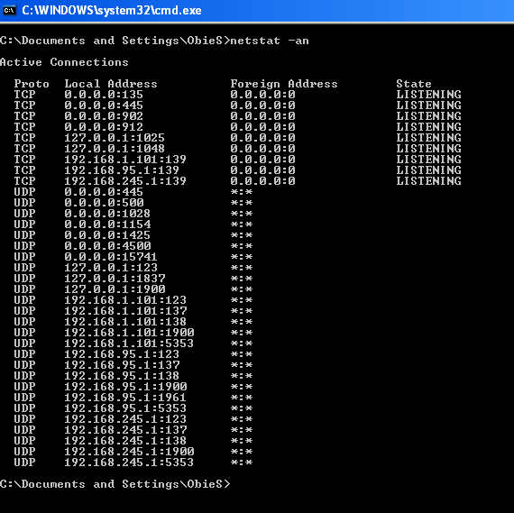

Slide 54
Attacking Your Own Network

Slide 55
Why and How Would You Attack Your Own Network?
You might be humbled by running a vulnerability scanner on your network, particularly if you think you have locked it down well.
A vulnerability scanner is a program that probes computers on a network for potential weakness.
Such tools have been around for years, but only recently have they matured into more comprehensive and user-friendly, if still complex products, with features like customized reporting, distributed threat assessment, and automatic correction of potential problems.

Slide 56
Reviews of Several Vulnerability Scanners
See http://www.pcmag.com/article2/0,1759,1400382,00.asp
A good free one is Nessus, available at http://www.nessus.org/download/
Caution: Running a vulnerability scanner on your own private network is something you should do.
BUT, realize that running it against someone else's network could put you into an illegal situation (which could be detected and lead to prosecution.)

Slide 57
