Slide 1
Blaster
Cory Shields
Brain Close

Slide 2
What Is It?
Worm that exploits Microsoft’s Remote Procedure Call (RPC) implementation.
RPC deals with message exchange over TCP/IP.
A buffer overflow problem.
A remote attacker could exploit this vulnerability to execute arbitrary code or cause a denial of service.
An exploit for this vulnerability is publicly available.
The worm has been observed to continuously scan random IP addresses and send data to vulnerable systems on the network.
Performs a distributed denial of service attack against windowsupdate.com.

Slide 3
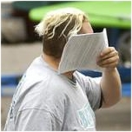
When Was the Malware Launched?
First version of Blaster called MSBlast or Lovsan was discovered on August 11, 2003.
Many variants appeared.
On August 13, 2003 Jeffrey Parson released the Blaster.B worm from his house near Minneapolis.
He was caught and sentenced to 18 months of jail time and 100 hours of community service.

Slide 4
Payload
First it transmits the payload over the designated RPC service listening on that port.
The payload is encapsulated within the MSBLAST.exe file.
The payload causes a command shell to be bound to port 4444 on the infected target. The port will only stay open for one connection.
Sends a command to a TFTP server thread on the local machine which sends another command that instructs the remote machine to download a copy of the MSBLAST.exe worm.

Slide 5
Mechanisms of Spread
Begins the infection at an address either based off the local machine’s IP address, or a completely random address.
Attempts to infect sequential IP addresses endlessly.
There is a 40% chance that it will begin at the first address of its class C size subnet, and 60% that the new IP will be random.
Once the address is determined, the worm attempts to probe blocks of 20 sequential IP addresses at a time for host with TCP port 135 open, (the RPC service) by sending a connection attempt to each one simultaneously.

Slide 6
Systems Vulnerable to Infection
Virus assumed 80% of the time that the target was Windows XP.
For the other 20%, the virus assumed that the machine was running Windows 2000.
The virus configured itself accordingly based upon which system it was infecting.
The choice of which OS was decided when the worm executable begins running.
If the target host is running the correct version of Windows, and if the RPC service is vulnerable to the buffer overflow then the payload is executed.

Slide 7
Damage to Networks
Denial of Service
Each infected host will begin to SYN flood windowsupdate.com (on port 80) starting on the 16th of the month in January through August, or any day in September through December.
This behavior is independent of the current, year, and can persist indefinitely as long as instances of the worm remain active in the wild.

Slide 8
Damage Done
In just 24 hours, "MSBlast" exploded onto some 120,000 computers around the world.
Estimated 1.2 million in damage when it spread in August 2003.

Slide 9
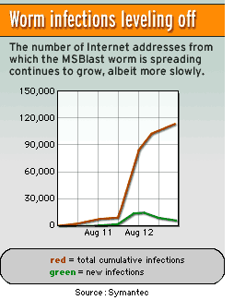
Damage Done

Slide 10
Preventative Measures
Physically disconnect the computer from the network (remove phone/network cable, wireless card)
enable Internet Connection Firewall (ICF).
Install the patch from Windows Update or MS03-026.

Slide 11
Recovery Methods
Kill the worm process using Task Manager. Known variants of this worm may show up as "msblast.exe", "teekids.exe", or "penis32.exe".
Delete any files named "msblast.exe", "teekids.exe", or "penis32.exe" on the computer.
Reboot your computer and reconnect to the network.
Install the patch from Windows Update or MS03-026

Slide 12
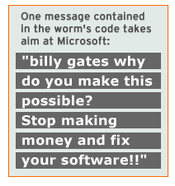
Interesting Facts
Strings found in the Blaster Code.
msblast.exe I just want to say LOVE YOU SAN!! billy gates why do you make this possible ? Stop making money and fix your software!! windowsupdate.com start %s tftp -i %s GET %s %d.%d.%d.%d %i.%i.%i.%i BILLY windows auto update SOFTWARE\Microsoft\Windows\CurrentVersion\Run

Slide 13
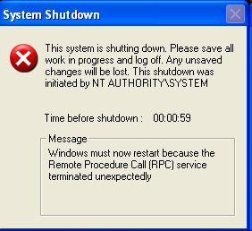
Interesting Facts
Screenshot of the error:

Slide 14
Sources
www.cert.org
www.Symantec.com
http://research.eeye.com
www.itvibe.com

