Slide 1
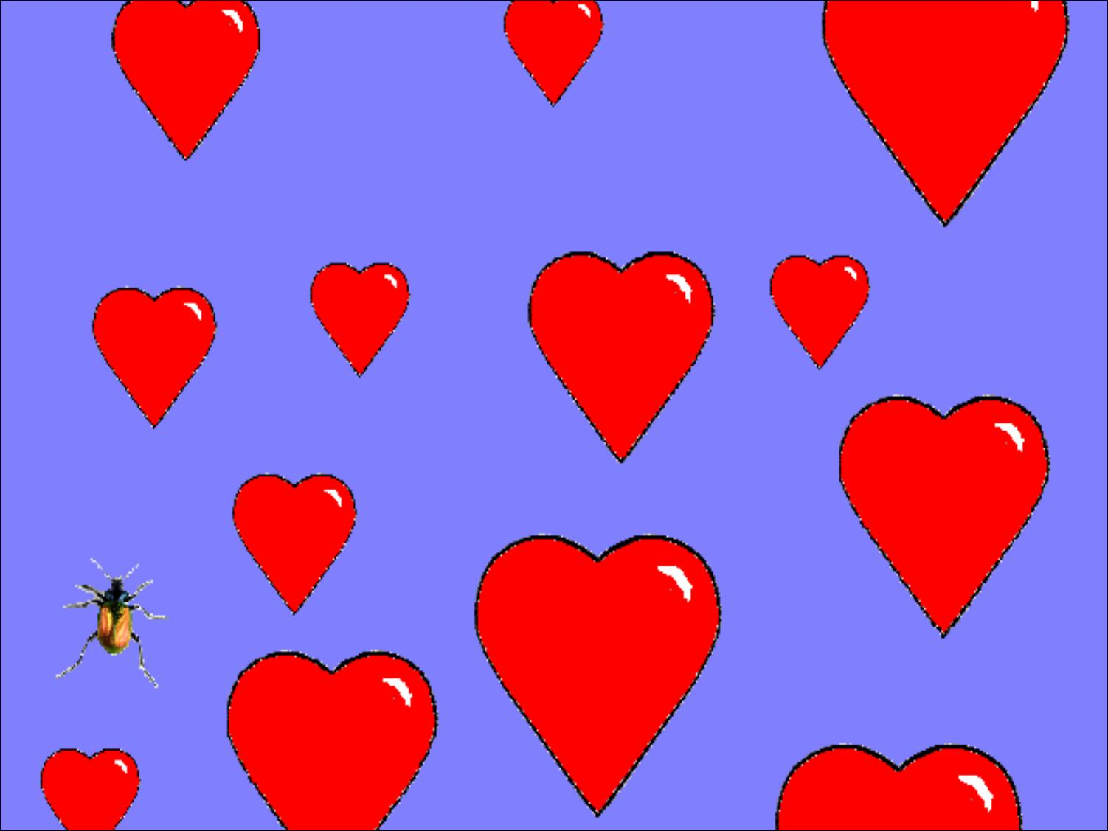
ILOVEYOU
Virus
By Tim Posta & Stefan Maurer

Slide 2
May 4, 2000
E-mails started showing up in the Philippines with the subject: ILOVEYOU
Attached was a file called: LOVE-LETTER-FOR-YOU.TXT.vbs
.vbs = visual basic script
Based on the Melissa virus
Created by a programmer in the Philippines, who was not charged as it was not a crime at the time.

Slide 3
Spreading and Paylaod
Opening the attachment caused the virus to send itself to everyone in the victim’s contact list.
Payload: copies itself over files with extensions:
  .jpeg
  .mp3
  .mp2
  .jpg
  .js
  .jse
  .css
  .wsh
  .sct
  .hta

Slide 4
Windows
Mostly hit Windows 98 and Windows 2000 Systems
Could also affect Windows 95 and Windows NT 4.0 if they were using Internet Explorer 5 browser.
Ran in MS-DOS, so other O/S were not at risk.

Slide 5
Estimated damage
Appx. 10% of computers connected to the internet infected
Between $5 billion and $8 billion in damage.

Slide 6
Why Love Bug Worked
Human curiosity
Received from contact so thought to be safe
HOW Love Bug Worked:
  Visual Basic Script
  Underlying macro code for Outlook

Slide 7
Prevention and Recovery
Prevention:
  Don’t open attachments
  Disable scripting languages
Recovery:
  None, files permanently destroyed
  Must restore from backup
  Majority of monetary damage came from time/resources needed to replace files

Slide 8
Works Cited
http://news.zdnet.com/2100-9595_22-107344.html
http://www.catalogs.com/info/travel-vacations/top-10-worst-computer-viruses.html
http://news.zdnet.com/2100-9595_22-107318.html?legacy=zdnn
http://www.theregister.co.uk/2005/05/11/love_bug_author/

