Slide 1
Background for Lab 5

Slide 2
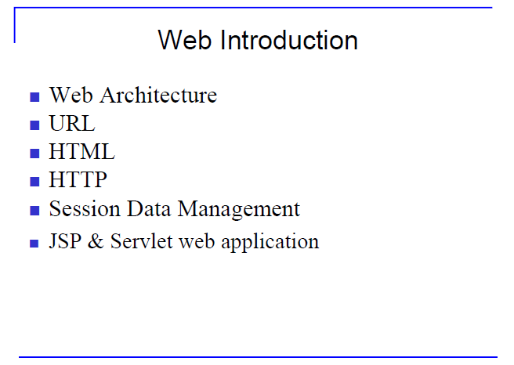

Slide 3
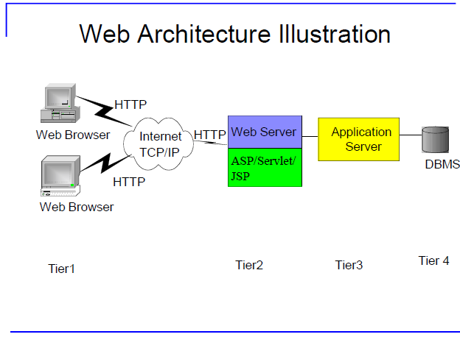

Slide 4
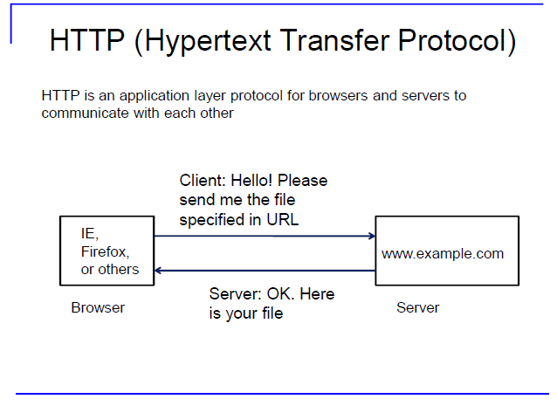

Slide 5
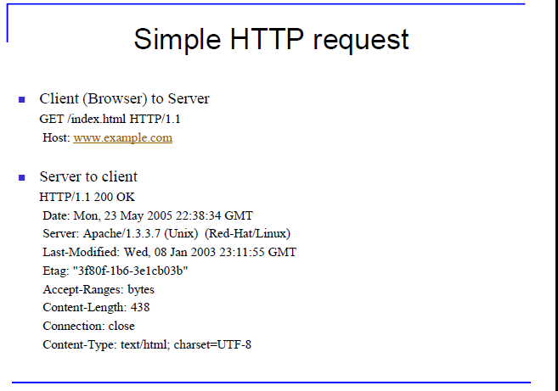

Slide 6
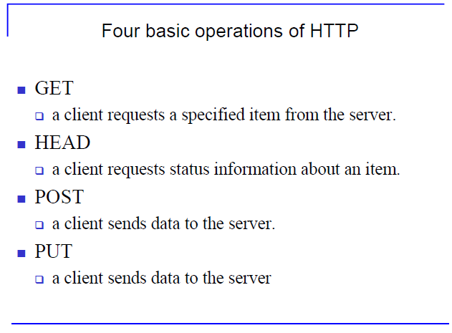

Slide 7
Post vs Put
The fundamental difference between the POST and PUT requests is reflected in the different meaning of the Request-URI. The URI in a POST request identifies the resource that will handle the enclosed entity.
That resource might be a data-accepting process, a gateway to some other protocol, or a separate entity that accepts annotations.
In contrast, the URI in a PUT request identifies the entity enclosed with the request -- the user agent knows what URI is intended and the server MUST NOT attempt to apply the request to some other resource.

Slide 8
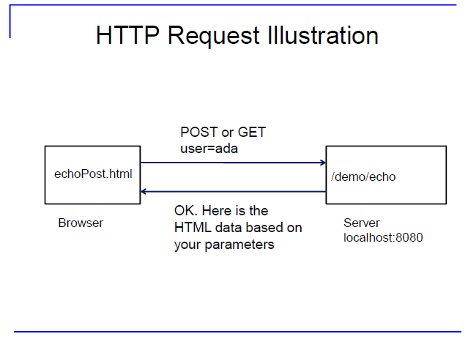

Slide 9
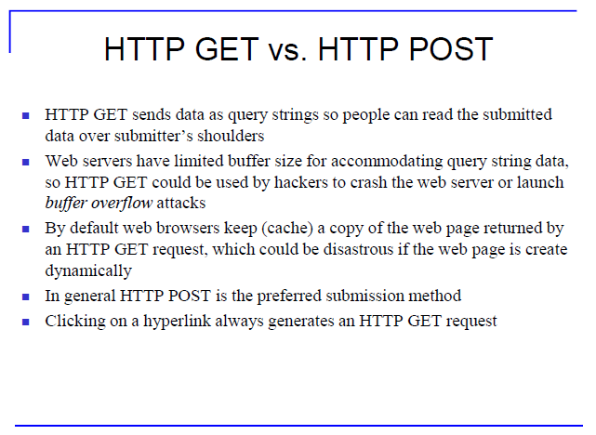

Slide 10
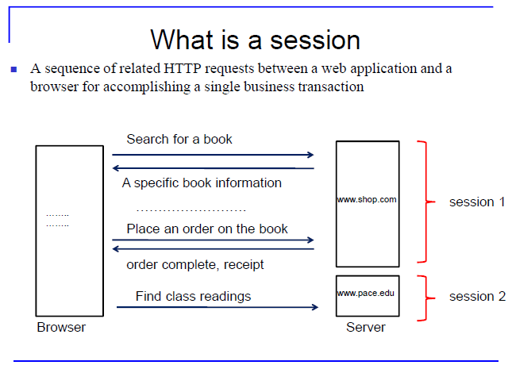

Slide 11
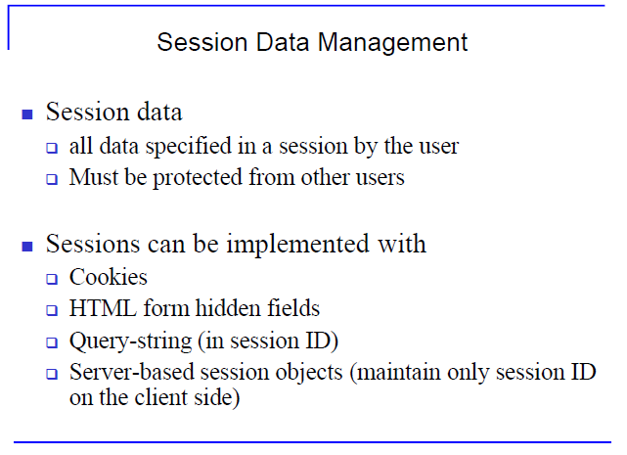

Slide 12
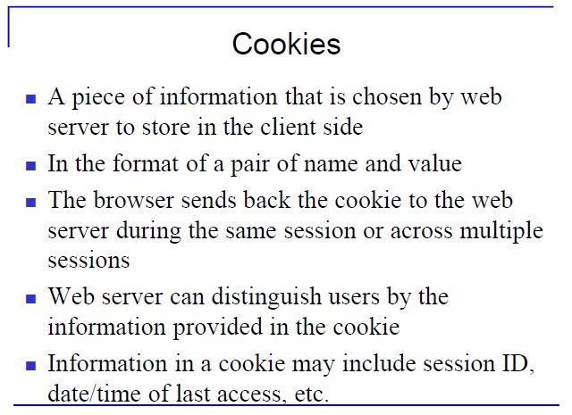

Slide 13
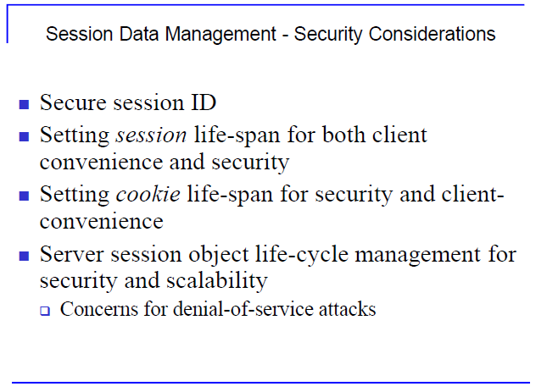

Slide 14
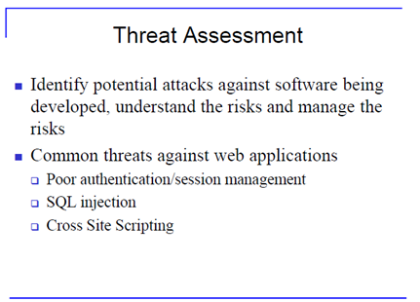

Slide 15
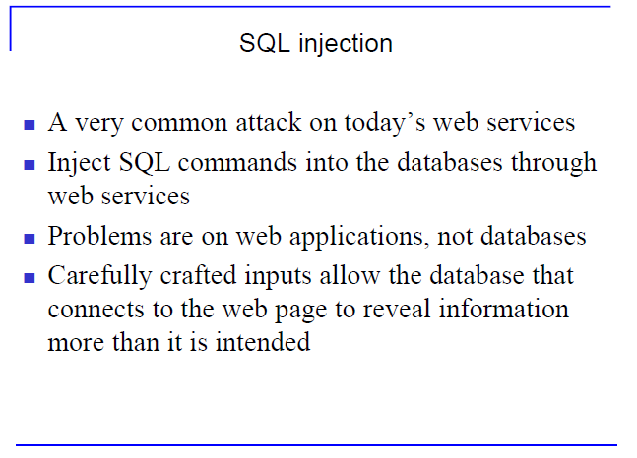

Slide 16
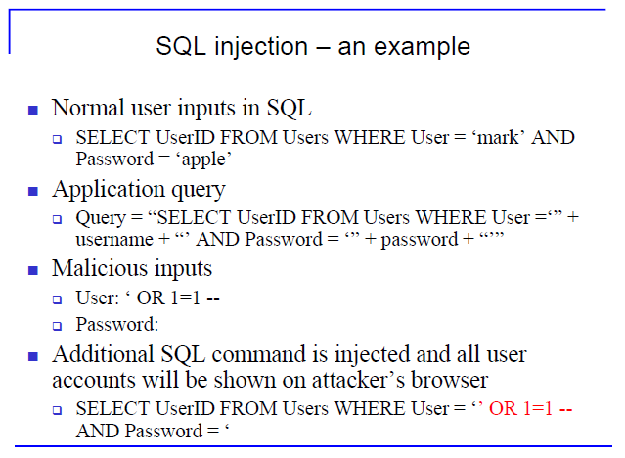

Slide 17
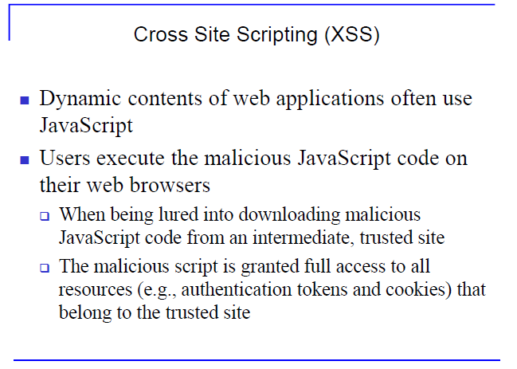

Slide 18
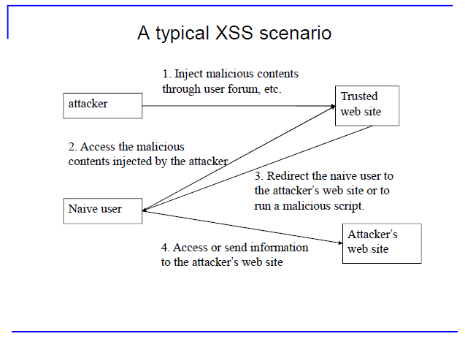

Slide 19
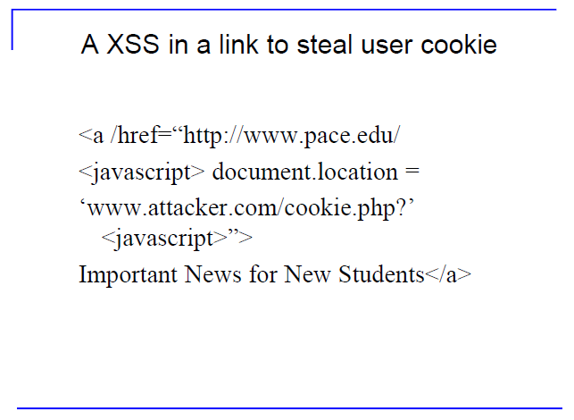

Slide 20
