Slide 1
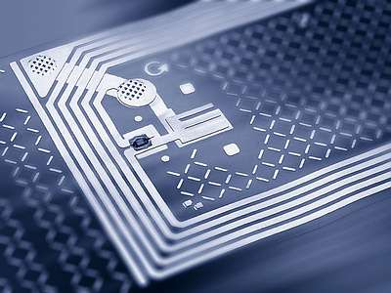
RFID Security
Materials from the FIRB SAT lecture slides by Massimo Rimondini included with permission.

Slide 2
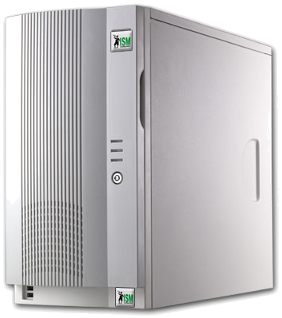
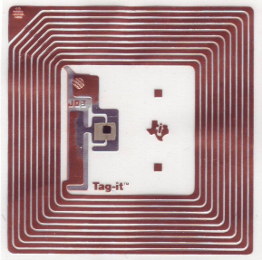
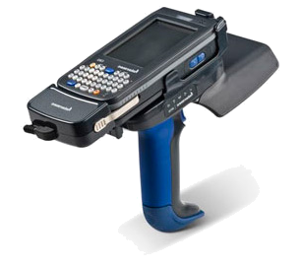
Architecture
communication interface & protocol
data format
middleware
0100101110100...
tag
Object Naming Service
reader

Slide 3
Who Uses?
Supply chain management
Benetton
Wal-Mart
Procter & Gamble
Gillette
U.S. Department of Defense
Tires
Michelin (truck tires)
Goodyear (racing tires)
Volkswagen

Slide 4
Why Used?
Unique identification and tracking of goods
Manufacturing
Supply chain
Inventory
Retail
Unique identification and tracking of people and animals
Access control & Authorization
Medical applications (drugs, blood banks, mother‑baby pairing, etc.)
Tracking of livestock, endangered species, and pets
Anti-theft systems
Toll systems
Passports
Sports event timing
Sam Polniak. The RFID Case Study Book: RFID Application Stories from Around the Globe. Abhisam Software.

Slide 5
Range
Some RFID systems will only work over a few inches or centimeters while others may work over 100 meters (300 feet) or more.
While choosing an RFID system with an RFID range of a hundred meters might seem attractive, the technology that enables this may not support some of other needs, such as minimizing costs by allowing the use of inexpensive passive tags.

Slide 6
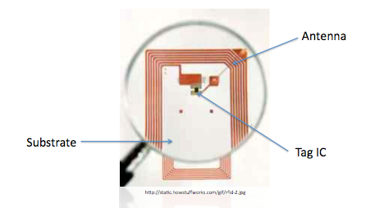
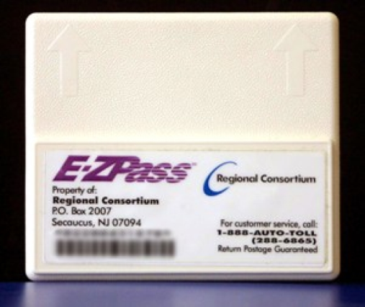
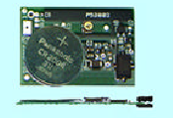
Types of Tags
Passive
Operational power scavenged
from reader radiated power
Semi-passive
Operational power provided by battery
Active
Operational power provided by battery - transmitter built into tag

Slide 7
Threats & Countermeasures
Eavesdropping
Passive monitoring of the air interface
Encryption, shielding, range reduction
Relaying
Man-in-the-middle (allows legitimate authentication)
Shielding, range reduction, distance bounding protocols
Unauthorized tag reading
Fake reader with extended range
Reader authentication, on-demand tag enabling, sensitive data in the backend, tag killing
Pawel Rotter. A Framework for Assessing RFID System Security and Privacy
Risks. IEEE Pervasive Computing, 7(2):70–77, June 2008.

Slide 8
Threats & Countermeasures
Cloning
Duplication of tag contents and functionality
Authentication, manufacturing-stage countermeasures against reverse engineering
Tracking
Rogue readers in doors or near legitimate ones
Authentication, range reduction, shielding tags, tag disabling, pseudonyms
Replaying
Repeated authentication sequences
Authentication [see eavesdropping]
Pawel Rotter. A Framework for Assessing RFID System Security and Privacy
Risks. IEEE Pervasive Computing, 7(2):70–77, June 2008.

Slide 9
Threats & Countermeasures
Tag content changes
Insertion or modification of data in the tag's memory
Lock, permalock, smarter malware-proof readers
Tag destruction
Burn in a microwave oven, slam with a hammer, etc.
...?
Blocking
Reader awaits response from several non-existent tags
Detection is possible
Jamming
Radio noise
Detection is possible
Pawel Rotter. A Framework for Assessing RFID System Security and Privacy
Risks. IEEE Pervasive Computing, 7(2):70–77, June 2008.

Slide 10
Threats
Breakdown of business processes
Handling of crucial and strategical information
Privacy violations
External risks
e.g., exposure to RF radiation, middleware hacking
Tom Karygiannis, Bernard Eydt, Greg Barber, Lynn Bunn, and Ted Phillips. Guidelines for securing radio frequency identiﬁcation (RFID) systems. Recommendations of the National Institute of Standards and Technology, NIST 800-98, 2007.

Slide 11
Denial of Service
Impair communication with valid tag
Jamming
oscillator+audio amplifier
Faraday cage
aluminium leaf
Fool the reader with counterfeit tags
Confuse an algorithm
Interposing metals
Detaching tag antennas
Physical destruction (of anti-shoplifting tags)

Slide 12
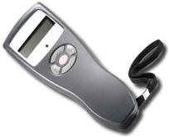
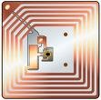
Challenge-Response Protocol
Challenge : nonce X
Response : Y = f (K,X)
Y’ = f (K,X)
RFID TAG
RFID reader
Function f is public
Secret key K is known only to the tag and reader
The reader sends challenge X and the tag responds with Y, computed from K and X
The reader computes Y’ = f(K,X) and verifies that Y=Y’

Slide 13
Unauthorized changes
Private memory on the tags
Readers can access it
Only the tag can write to it
Records changes to tag information
Akira Yamamoto, Shigeya Suzuki, Hisakazu Hada, Jin Mitsugi, Fumio Teraoka, and Osamu Nakamura. A Tamper Detection Method for RFID Tag Data. IEEE International Conference on RFID, pages 51–57, April 2008.

Slide 14
Prevent eavesdropping
In EPC tags can “mask” (XOR) responses with a random 16-bit value
Weak security
Combine RFID with optical memory
Optical communication is more secure
Optical memory may store access keys
Mikko Lehtonen, Thorsten Staake, Florian Michahelles, and Elgar Fleisch. Strengthening the Security of Machine Readable Documents by Combining RFID and Optical Memory Devices. In Ambient Intelligence Developments Conference – AmI.d, September 2006.

Slide 15
Prevent server impersonation
RFID memory is not tamper-proof
Too costly
Compromised tags can cause desynchronization with database
Countermeasures:
Digital signature
Not viable
Additional tag storing most recently used secret
Not viable
Tags authenticate the server

Slide 16
Backend vulnerabilities
Each component of an RFID systems may be vulnerable
Compromising a component reflects on others
Compromising tags may affect the backend!

Slide 17

Each component of a RFID system may be vulnerable Compromising a component reflects on others Compromising tags may affect the backend!
0100101110100...

Slide 18
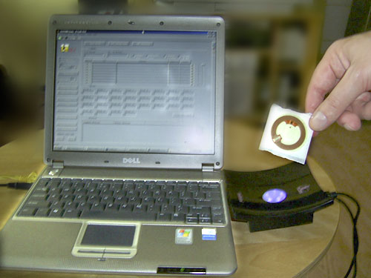
Malware
The world's First RFID chip infected with a virus
Melanie Rieback, Bruno Crispo, and Andrew Tanenbaum. Is your cat infected
with a computer virus? In Proc. IEEE PerCom 2006, 2006.

Slide 19
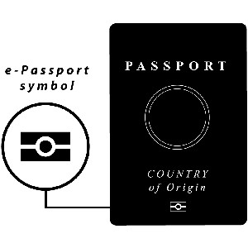
Security of existing applications
e-Passports
ICAO (International Civil Aviation Organization) requires:
compulsory authentication of passport data, signed by the issuer
(optionally) access control based on cryptographic keys
(optionally) public key authentication of the passport
Vulnerabilities still exist
Transferability (verifier becomes prover)
Reset attacks (same coin toss by resetting internal state of one party)
Carlo Blundo, Giuseppe Persiano, Ahmad-Reza Sadeghi, and Ivan Visconti. Resettable and Non-Transferable Chip Authentication for ePassports. In Conference on RFID Security, Budaperst, Hongria, July 2008.

Slide 20
Security of existing applications
Car ignition: Keeloq
Manufacturer has master secret
Cars have unique ID
MASTER ⊕ ID = car’s secret key
Finding 1 key leads to the master secret!!
~2 days on a cluster of 50 Dual-Cores
“Soon, cryptographers will all drive expensive cars” :-)
Sebastian Indesteege, Nathan Keller, Orr Dunkelman, Eli Biham, and Bart
Preneel. A practical attack on keeloq. In Proc. Eurocrypt 2008, 2008.

Slide 21
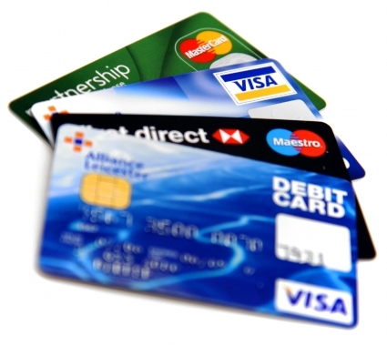
Security of existing applications
Credit cards
First-generation
Holder, number, expire date are transmitted in clear text
Thomas S. Heydt-Benjamin, Dan V. Bailey, Kevin Fu, Ari Juels, and Tom O’Hare. Vulnerabilities in First-Generation RFID-Enabled Credit Cards. Manuscript, October 2006.

Slide 22
Security of existing applications
Medical implants
Some defibrillators are vulnerable
175KHz ⇒ low range!
Daniel Halperin, Thomas S. Heydt-Benjamin, Benjamin Ransford, Shane S. Clark, Benessa Defend, Will Morgan, Kevin Fu, Tadayoshi Kohno, and William H. Maisel. Pacemakers and Implantable Cardiac Deﬁbrillators: Software Radio Attacks and Zero-Power Defenses. In Proceedings of the 29th Annual IEEE Symposium on Security and Privacy, May 2008.

Slide 23
Security of existing applications
MIFARE - trademark of a series of chips widely used in contactless smart cards and proximity cards
Widespread for contactless smart cards
ISO 14443 type A (HF, 13.56MHz)
~10cm operating distance
About 16KB memory, fragmented in sectors
Buggy pseudorandom generator
The 1st sector can be overwritten!
Each sector for which one block is known can be overwritten!
Based on active attack, requires eavesdropping response from legitimate tag
Secret keys still inaccessible

Slide 24
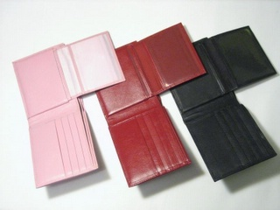
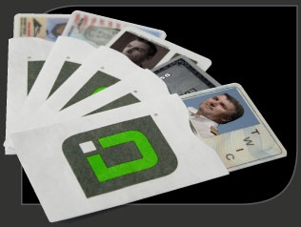
Skimmer
“Would you be comfortable wearing your name, your credit card number and your card expiration date on your T-shirt?”
Skim ~ quick eavesdrop
As cheap as $150 to build
Readily available computer & radio components
Solution: shield
http://www.difrwear.com/
http://www.idstronghold.com/
Thomas S. Heydt-Benjamin, Dan V. Bailey, Kevin Fu, Ari Juels, and Tom O’Hare. Vulnerabilities in First-Generation RFID-Enabled Credit Cards. Manuscript, October 2006.
Ilan Kirschenbaum and Avishai Wool. How to Build a Low-Cost, Extended-Range RFID Skimmer. Cryptology ePrint Archive, Report 2006/054, 2006.

